Slide 1

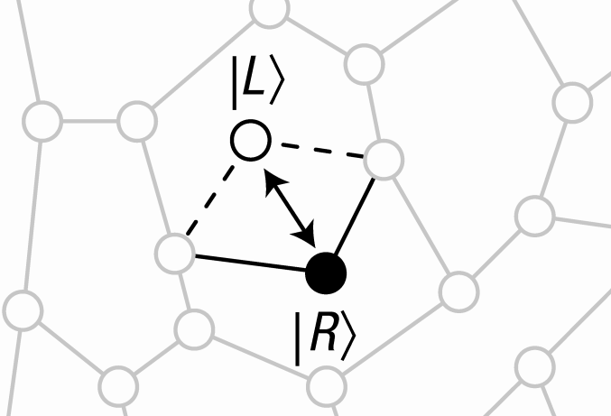
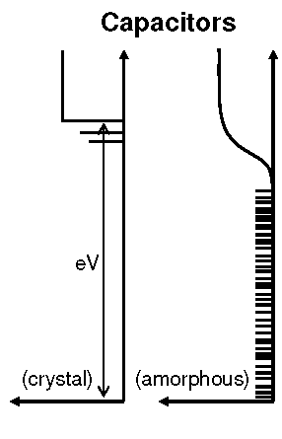
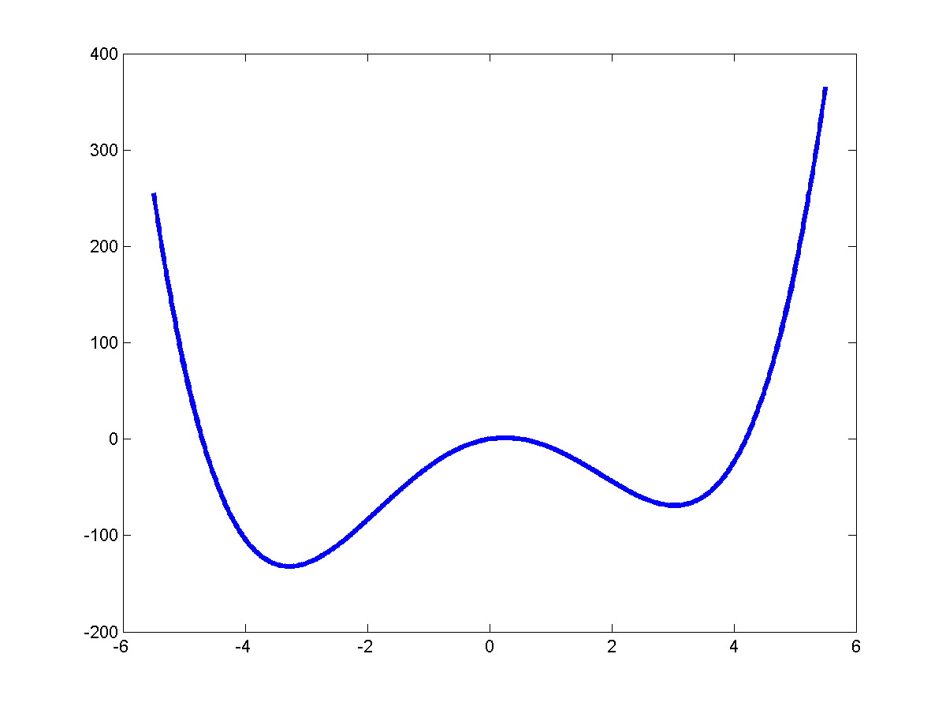
Energy Loss from Dielectric Two-Level State (TLS) Defects
Robert McDermott University of Wisconsin
high density of
defects in typical
amorphous dielectrics
general
double-well
potential for
TLS
tunneling Δ₀
eigenstates
DOS
asymmetry Δ
configurational states

Slide 2
Anomalous Properties of Glasses at Low-T
Pohl et al., RMP 74, 991 (2002)
Zeller & Pohl, PRB 4, 2029 (1971)

Slide 3
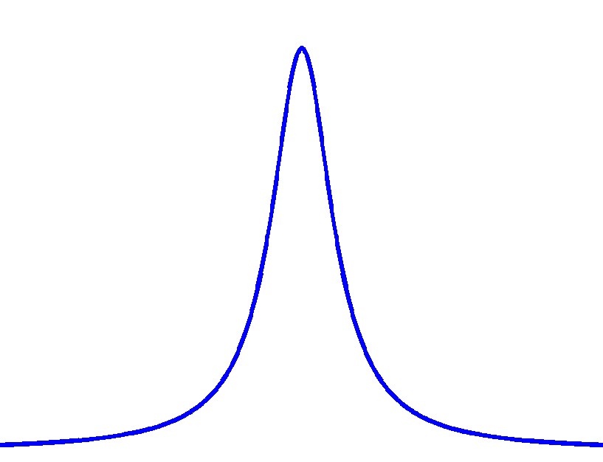
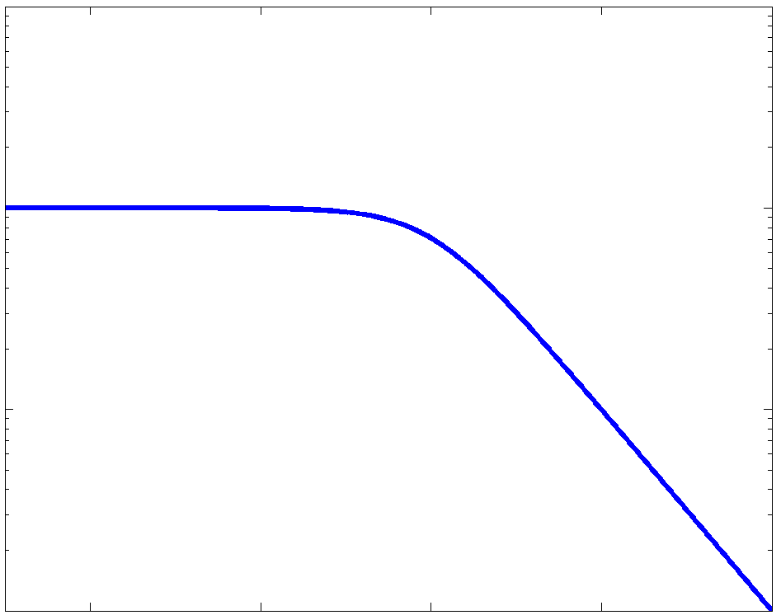
Nonlinear Dissipation from Two-Level States (TLS)
See Amorphous Solids: Low-Temperature Properties,
ed. W. A. Phillips (Springer, Berlin, 1981).
V
driving electric field
Rabi frequency
electric dipole moment ed
normalized lineshape function
transition rate
; constant density of defect states
tan δ
E

Slide 4
Dielectric Loss at Low Temperature
decreasing
microwave drive
approach:
systematic test of the
linear circuit
S₂₁
dielectric under study
Huge loss at low power and low temperature!

Slide 5
Loss of PECVD Grown Dielectrics
Martinis et al., PRL 95, 210503 (2005)
hypothesis: high loss in SiO₂
due to OH defects
tan δ
TLS DOS x (dipole moment)²
<V²>^{1/2} (Volts)

Slide 6
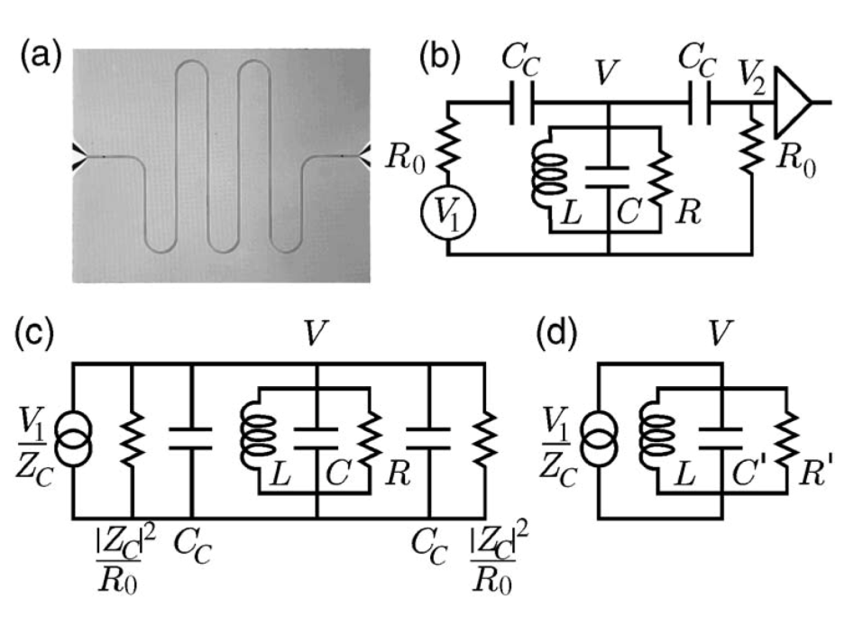
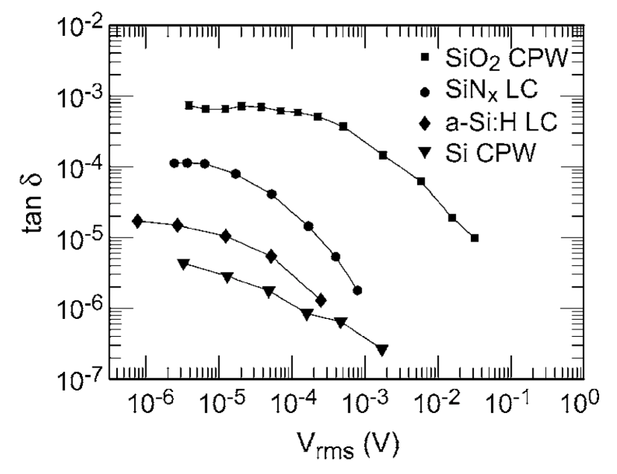
Candidate Qubit Dielectrics
O’Connell et al., APL 92, 112903 (08)
Search for improved qubit dielectrics continues
a-Si:H has ~ factor 10 lower loss than SiNx
(defects overconstrained from fourfold bond coordination?)
Even in qubits with “simple” single-layer fabrication, lossy native oxides will
limit T₁ times (2D transmon data compatible with surface loss)
Crystalline dielectrics should be much better

Slide 7
Scaling of Dielectric Loss with Device Dimension
total loss
participation ratio
Wenner et al., APL 99, 113513 (2011)

Slide 8
3D Transmon
Paik et al. PRL 107, 240501 (2011)
Embed qubit in BULK superconducting cavity:
lossy surface oxides make negligible contribution
Couple qubit to cavity via large (mm-scale)
dipole antenna – large vacuum Rabi splitting
despite reduced zero-point fields
Significant improvements in coherence
T₁ to ~ 50 μs, T₂ ~ 20 μs

Slide 9
Scaling of Dielectric Loss with Device Dimension
Dial et al., SST 29, 044001 (2016)
Chu et al., APL 109, 112601 (2016)

Slide 10
SWAP Spectroscopy
Measurement of qubit decay rate (1/T₁) as a function of frequency.
T₁ suppression due to incoherent
coupling to resonant TLS
g : TLS-qubit coupling
Γ : TLS decay rate
Barends et al., PRL 111, 080502 (2013)

Slide 11
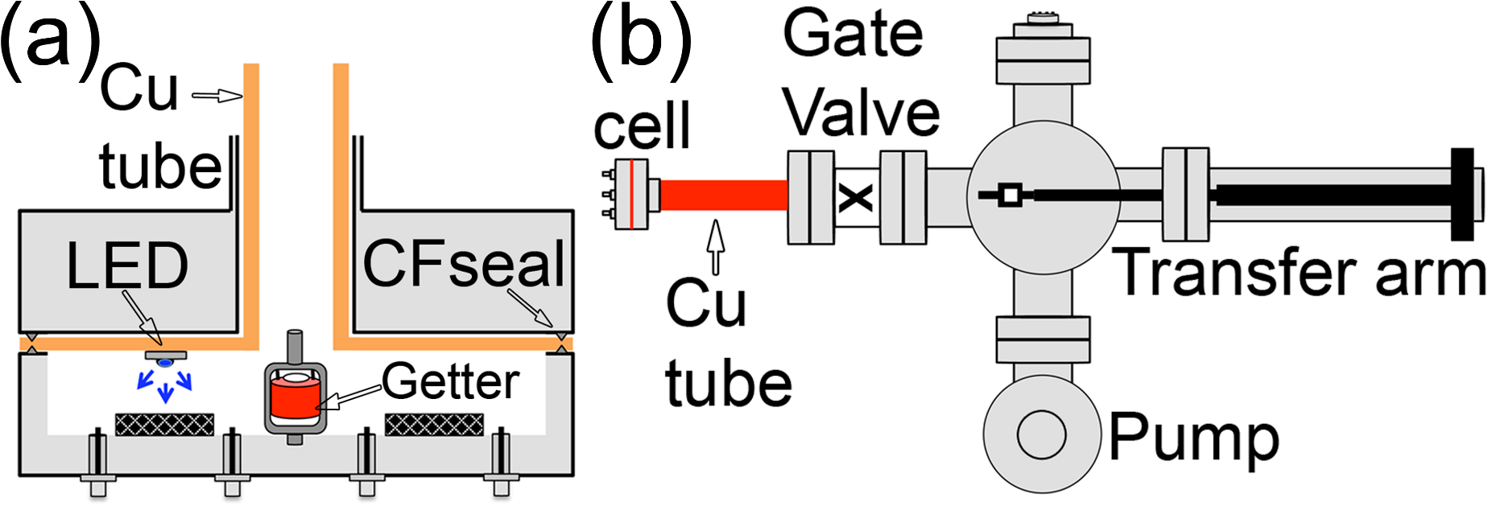
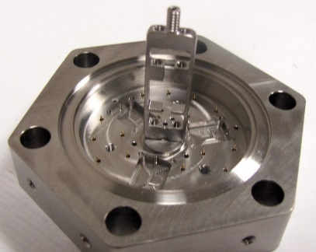
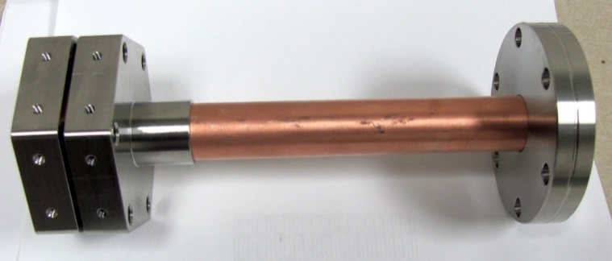
Surface Treatment to Suppress TLS Loss
See Kumar et al.,
Origin and Reduction of 1/f Flux Noise
PR Applied 6, 041001 (2016)

Slide 12
Swap Spectroscopy: Treated vs. Untreated Devices
Reference (Q0)
Reference (Q1)
Treated (A)
Treated (B)

Slide 13
Swap Spectroscopy: Treated vs. Untreated Devices
Measure T1 over a large range of frequencies
Defects manifest as a Lorentzian peak in the decay rate.
The “T₁ dropouts” contribute to the frequency crowding issue for frequency-tunable qubits
2 g²/Γ is the peak decay rate due to a resonant defect. The plot is the integral of all 2 g²/Γ > 0.05 MHz, across all measured samples, normalized to a GHz bandwidth.

Slide 14
Summary
Loss from dielectric TLS a dominant decoherence mechanism
Bigger is better (3D is best), but lossy surfaces still contribute
Interface quality is critical
Some evidence that adsorbates contribute to dielectric loss; possible
approaches to mitigate loss are under investigation

