Slide 1
Surface Resistance and Non Equilibrium - Summary
Martina Martinello and James Sauls
TTC Topical Workshop – Pushing Cavity Performance Limits
Nov 17, 2017

Slide 2
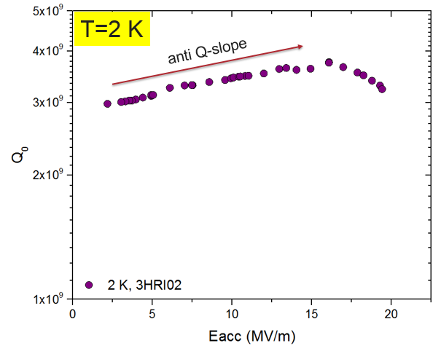
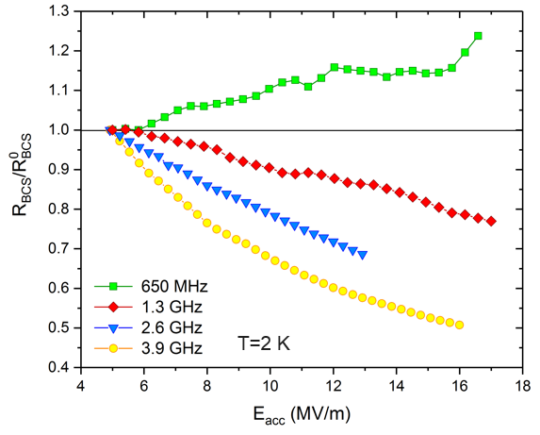
Key Points and Open Questions
Anti-Q-slope effect stimulated by presence of impurities and/or high frequencies
M. Martinello

Slide 3
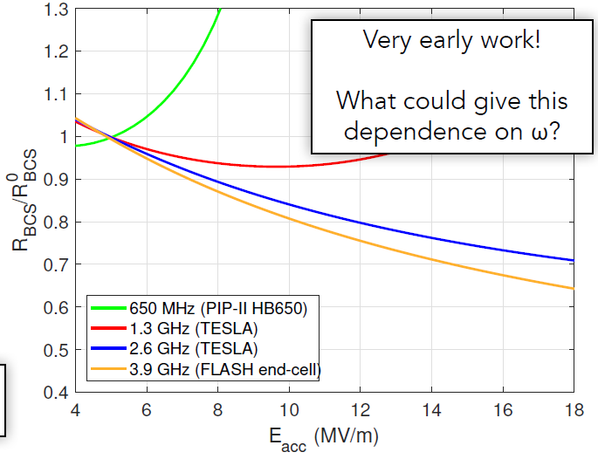
Key Points and Open Questions
Anti-Q-slope effect stimulated by presence of impurities and/or high frequencies
The current theory based on QPs overheating cannot explain this frequency dependence
M. Martinello
Adding a dependence of $ω^{−4}$ at the overheating parameter the trend of Rbcs can be in agreement but this does not have a physical meaning
J. Maniscalco

Slide 4
Key Points and Open Questions
Anti-Q-slope effect stimulated by presence of impurities and/or high frequencies
→ Non-equilibrium distribution of QPs can qualitative explain the results
Is the condition for non-equilibrium respected?
Can the presence of impurities modify the relaxation and recombination time of QPs? How could we measure it?
$ν>{1/τ}_{r}$, ${1/τ}_{ep}$

Slide 5
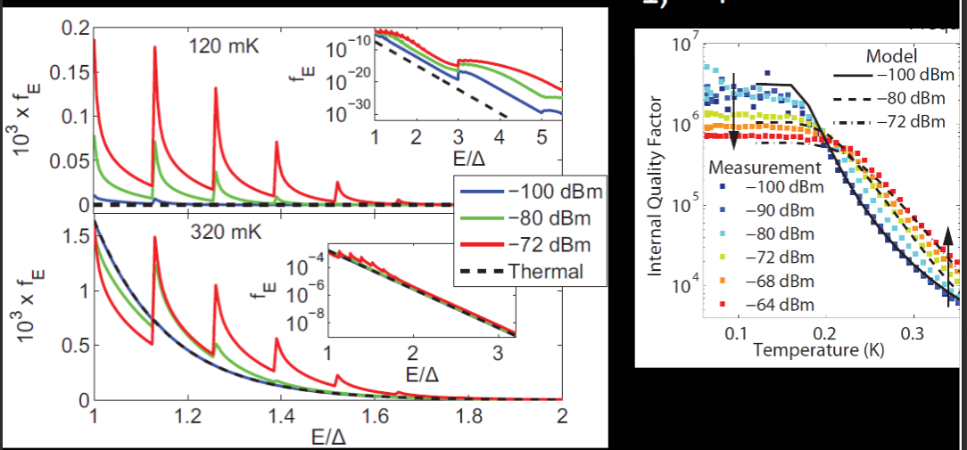
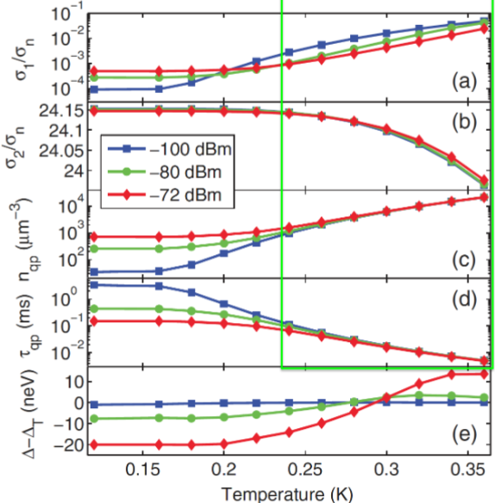
Key Points and Open Questions
Anti-Q-slope effect stimulated by presence of impurities and/or high frequencies
→ Non-equilibrium distribution of QPs can qualitative explain the results
$hν < kT$for SRF cavities, however it does not mean that non-equilibrium distribution of quasiparticles cannot drastically affect the photon absorption (surface resistance)
P. De Visser
No significant variation of $Δ$ still leads to a decreasing of the surface resistance with the field
Anti Q-slope

Slide 6
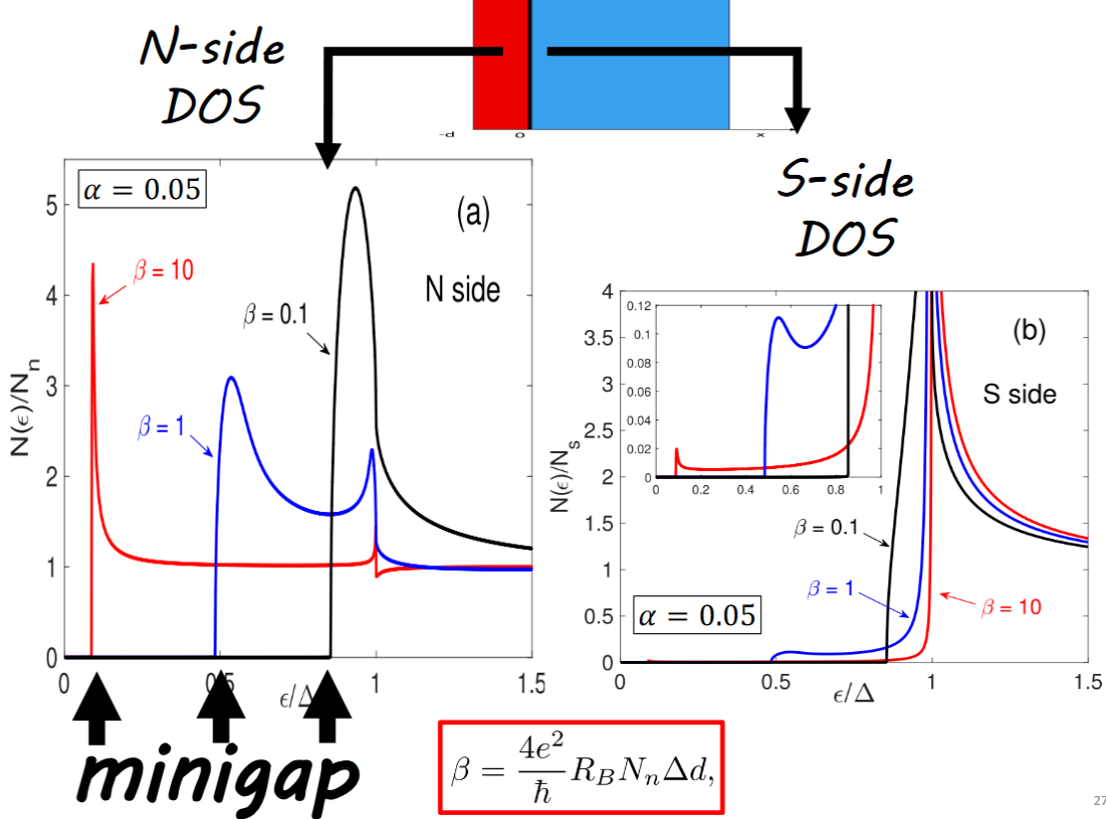
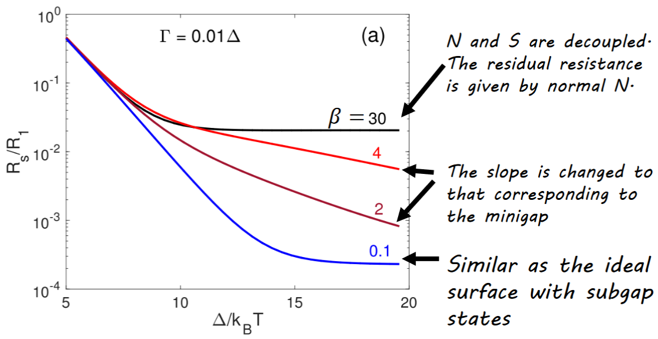
Key Points and Open Questions
The DOS of a superconductor with a non-ideal surface (oxide layer, impurities, etc…) is smeared out by the proximity effect, and some sub-gap states are generated. A mini-gap may be generated in the normal-conducting region
T. Kubo

Slide 7
Key Points and Open Questions
J. Zasadzinski
Only Andreev bound state measured in hot spot cut-out from an EP cavity
The DOS of a superconductor with a non-ideal surface (oxide layer, impurities, etc…) is smeared out by the proximity effect, and some sub-gap states are generated. A mini-gap may be generated in the normal-conducting region
T. Kubo

Slide 8
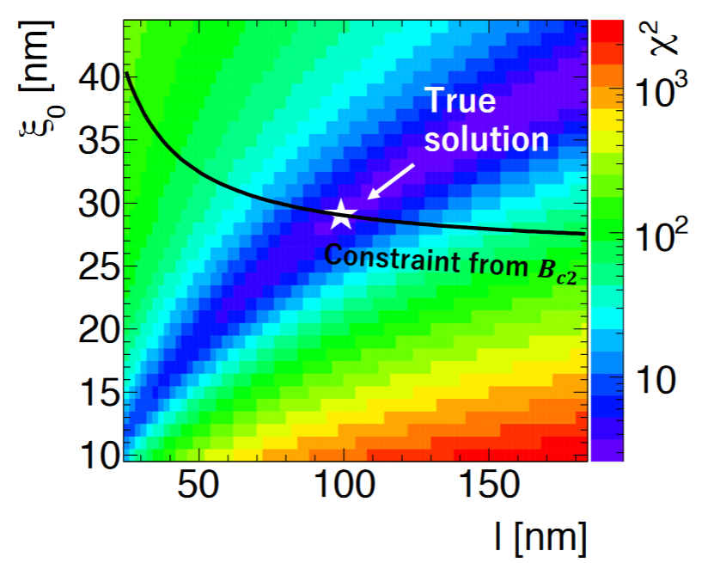
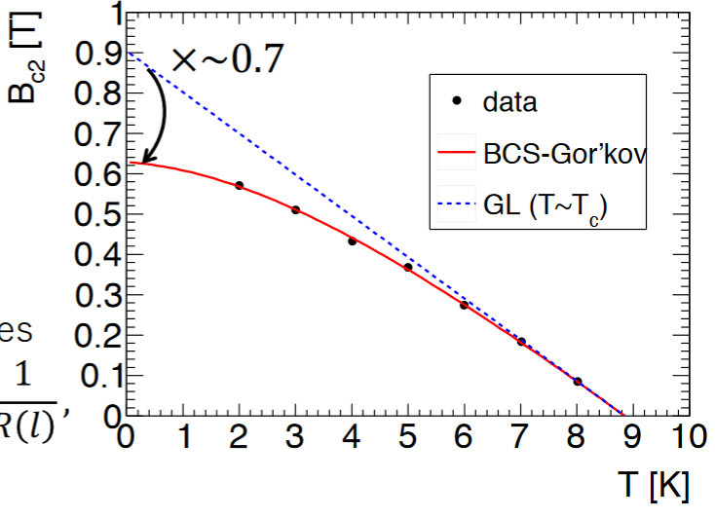
Key Points and Open Questions
Lowering the number of free parameters in the SRIMP fit can help to restrict the valley of solution that otherwise can be very large
A. Miyazaki

Slide 9
Key Points and Open Questions
Lowering the number of free parameters in the SRIMP fit can help to restrict the valley of solution that otherwise can be very large
A. Miyazaki
Is this techniques sensitive to the surface?

Slide 10
Back-Up Slides

Slide 11
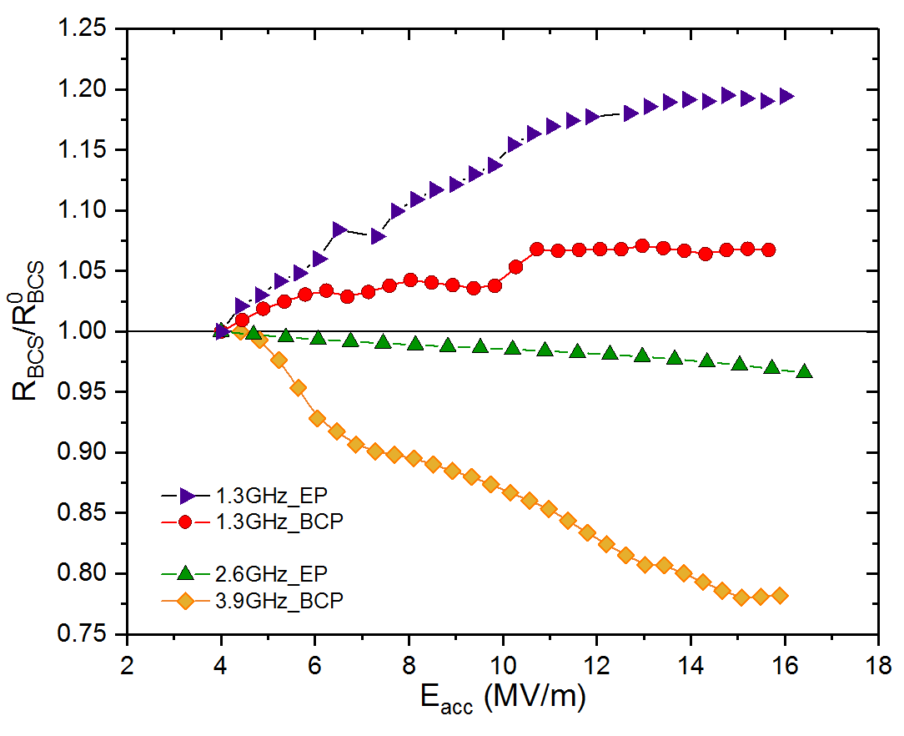
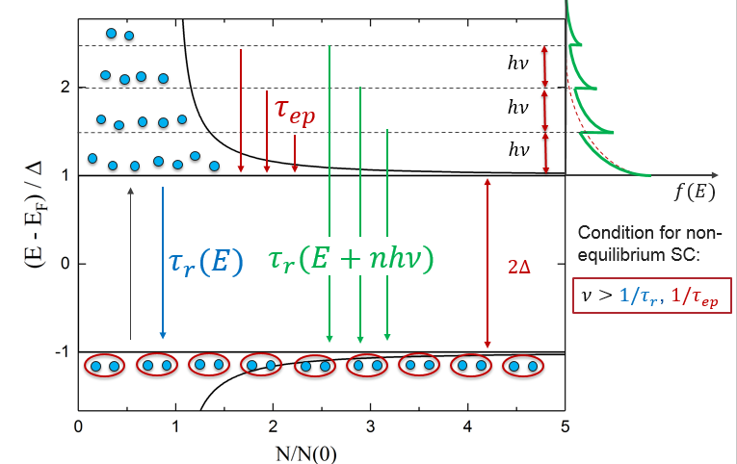
EP/BCP

