Slide 1
Working Group 3 Summary
Sam Posen
Takayuki Kubo

Slide 2
Gaining Insight into Trapped Flux
Flux Expulsion
How to prevent ambient flux from being trapped during cooldown?
Flux Losses
How much extra surface resistance per mG trapped?

Slide 3
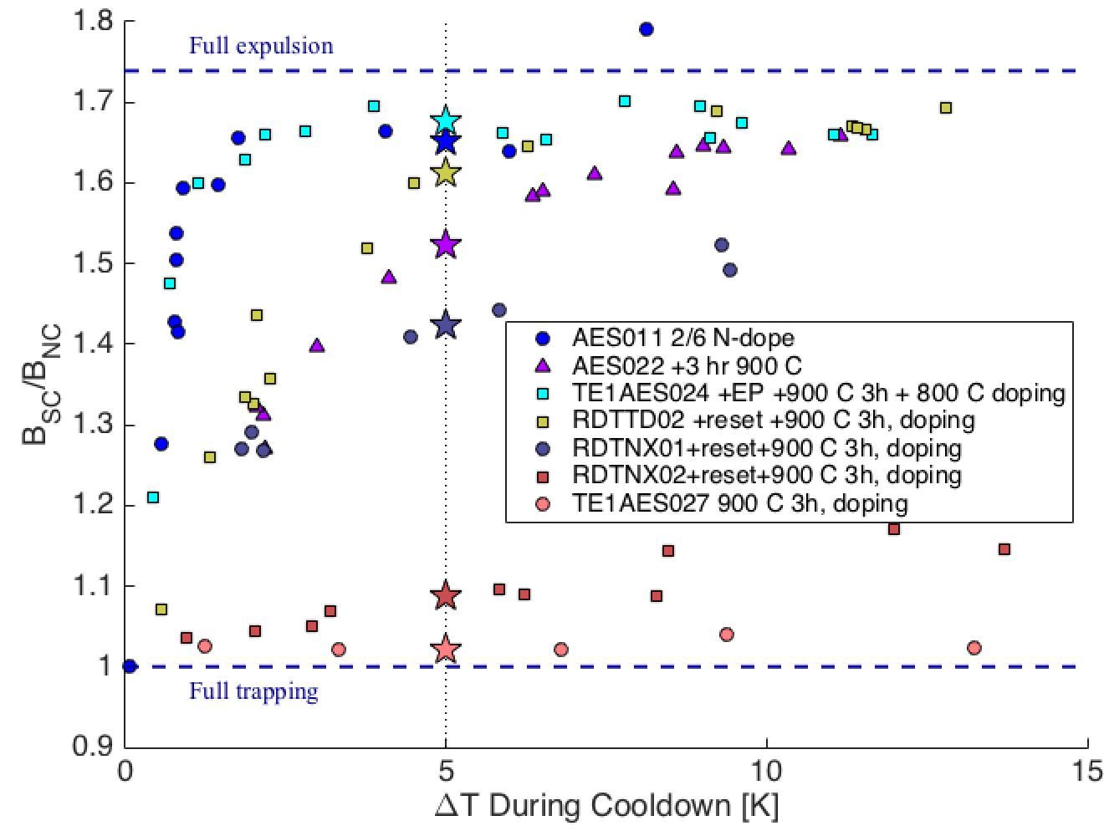
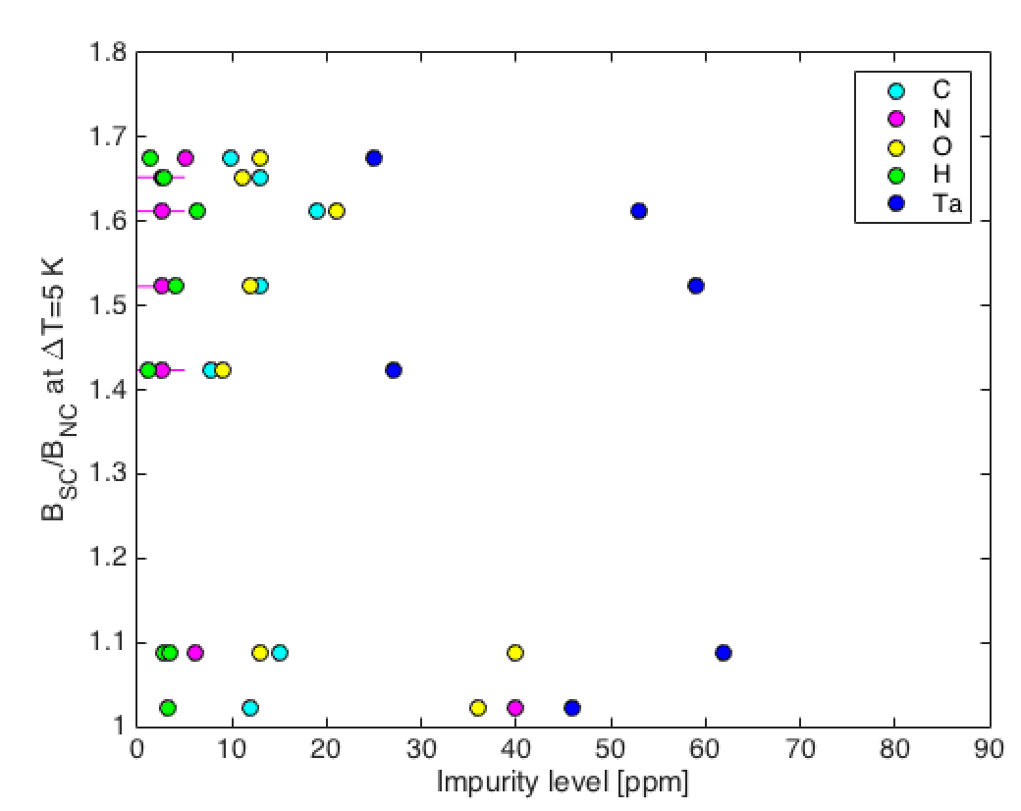
Flux Expulsion – Fine Grain
Key question: what is main source of flux pinning relevant during cooldown?
If impurities play a role, can we observe a trend between impurity content and flux expulsion behavior in materials?
Some preliminary indications from survey but quite difficult to measure impurities with ppm accuracy

Slide 4
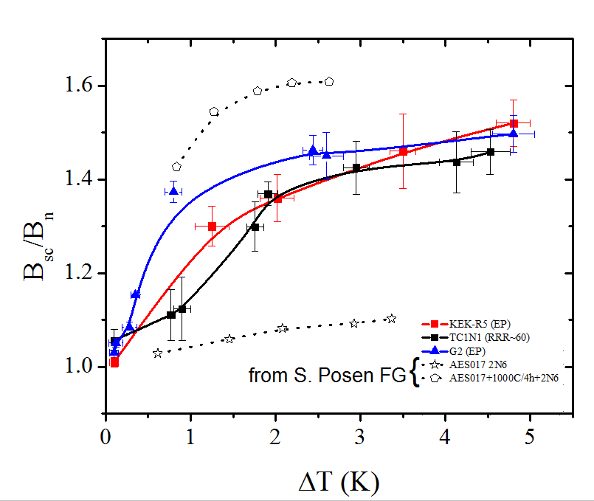
Flux Expulsion – Large Grain
LG cavities generally seem to show good expulsion, though not necessarily as strong as FG cavities with high temperature treatment
No observable effect of RRR variation in material
Sensitivity to flux seems in good agreement between LG and FG cavity measurement
P. Dhakal

Slide 5
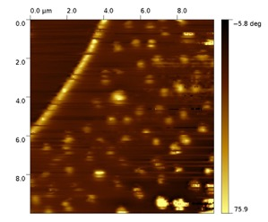
Direct Observations of Flux
Flux observed at grain boundaries from field cooling
Flux trapped at GBs of both EP’ed & BCP’ed Nb
GB vortex pinning does not vary with cooling cycle, compared to grains
Vortices in grain are disorder
BCP’ed
ZFC T = 6 K
FC T = 6 K
H = 58 mT
H = 0 mT
FC wt H = 5 mT, at 2K
GB // H_{ext}
H
1 mm
GB
EP’ed
ZFC T = 6.5 K
FC T = 6.5 K
H = 72 mT
H = 0 mT
Z. Sung
Notes:
What are the features that dominate flux pinning?

Slide 6
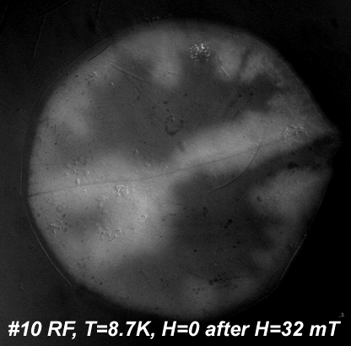
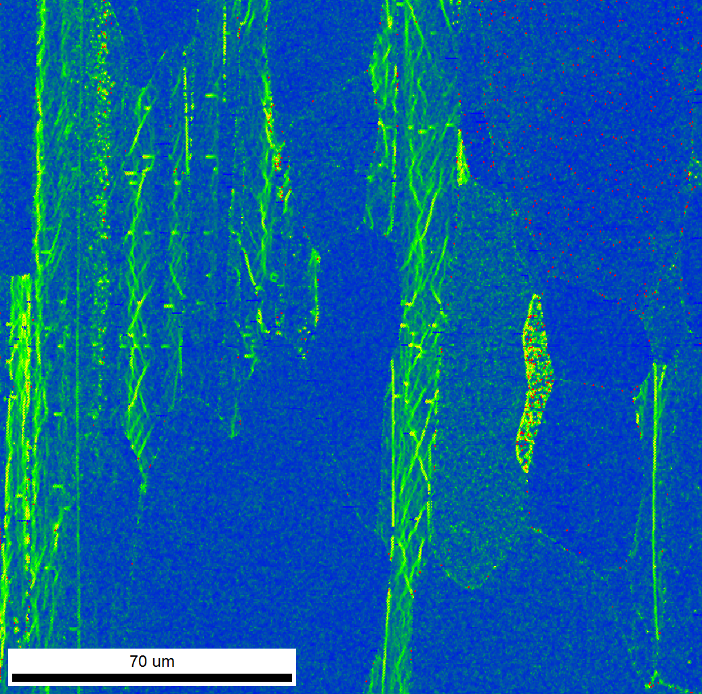
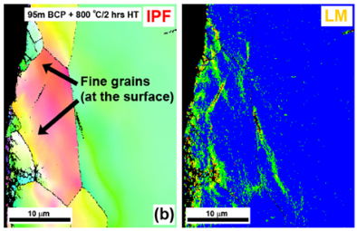
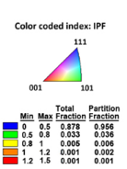
Microscopic Flux Studies
Applied field H points out of plane
MO image, overlaid on optical image
Trapped flux observed around GBs in MO – “Is contamination or normal precipitates at and around GB’s responsible for trapping behavior?”
EBSD shows show presence of dislocation networks and substructure in LCLS-II material – “Is incomplete recrystallization a symptom of residual interstitials?”
Flux trapped
GB
Flux trapped “fork”
~3mm
Z. Sung
Cross-sectional OIM of sheet id: T11007
Vendor B for LCLS-II
S. Balachandran
Notes:
Do you think there might be a connection between incomplete recrystallization and flux?

Slide 7
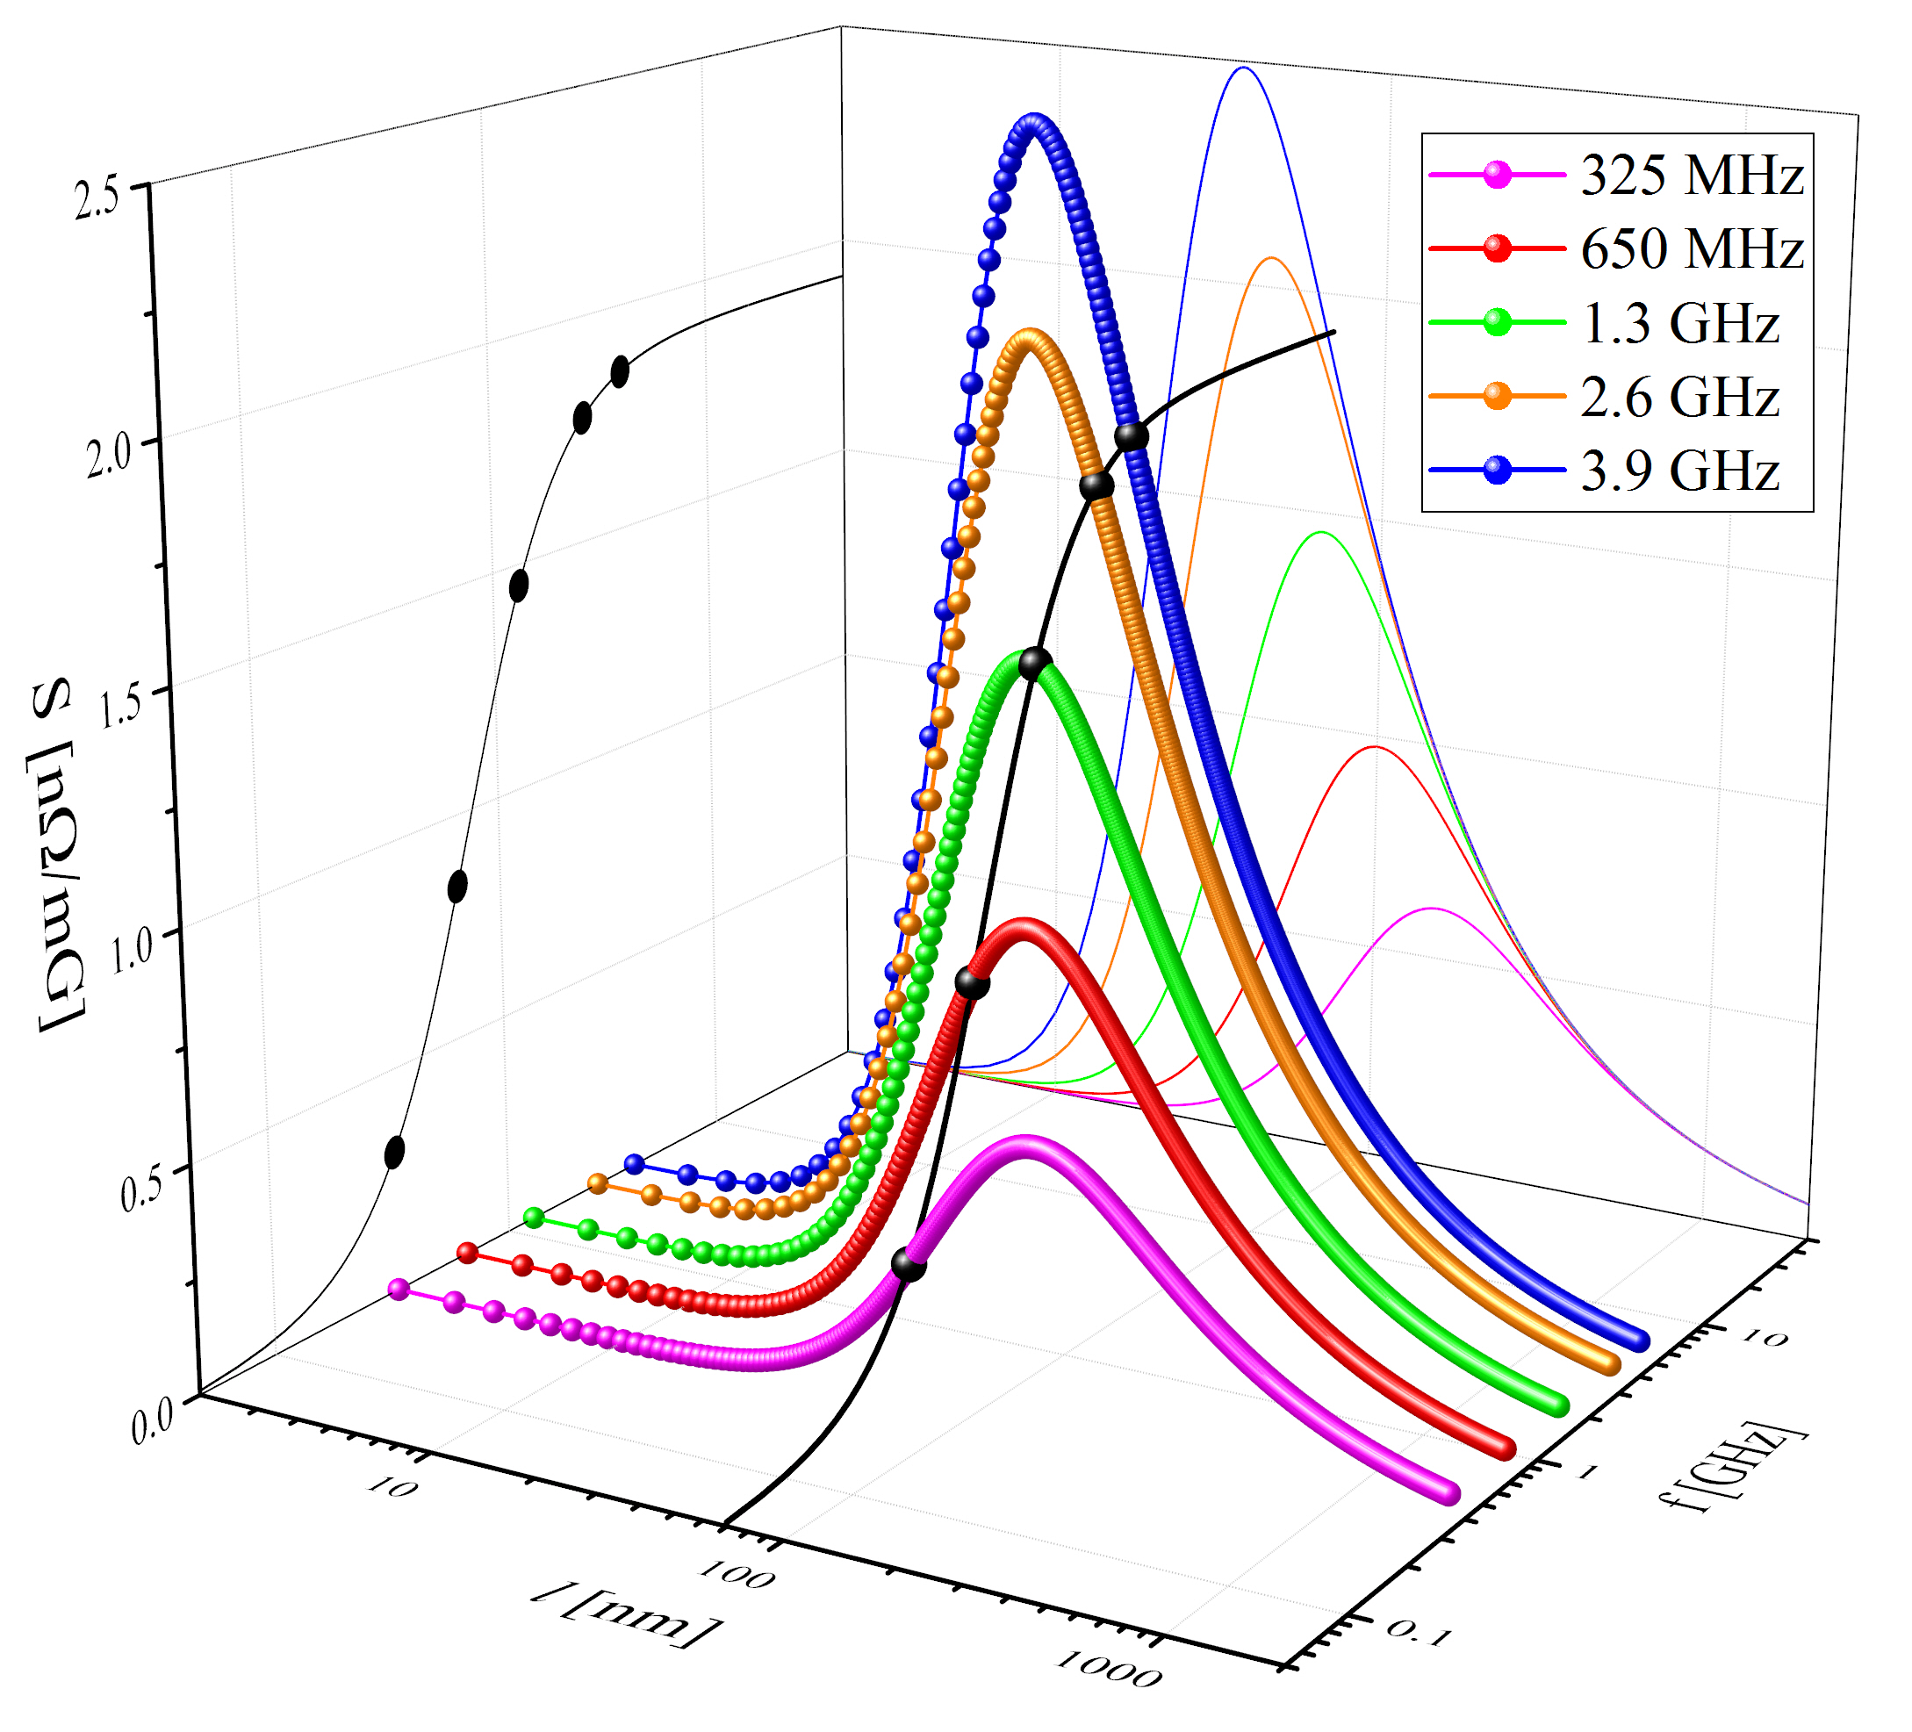
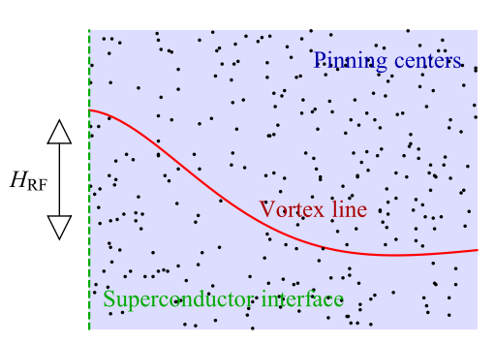
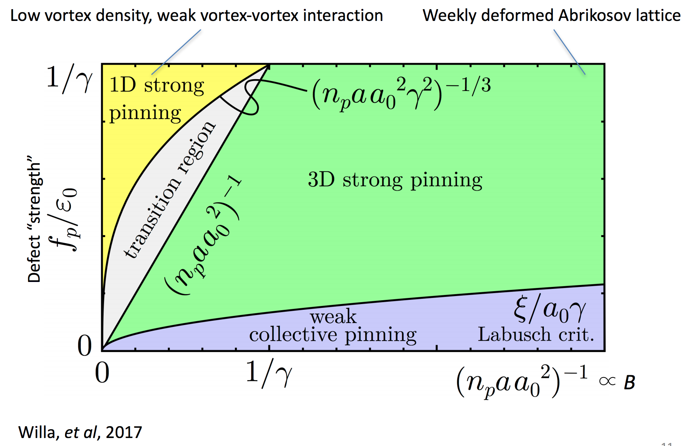
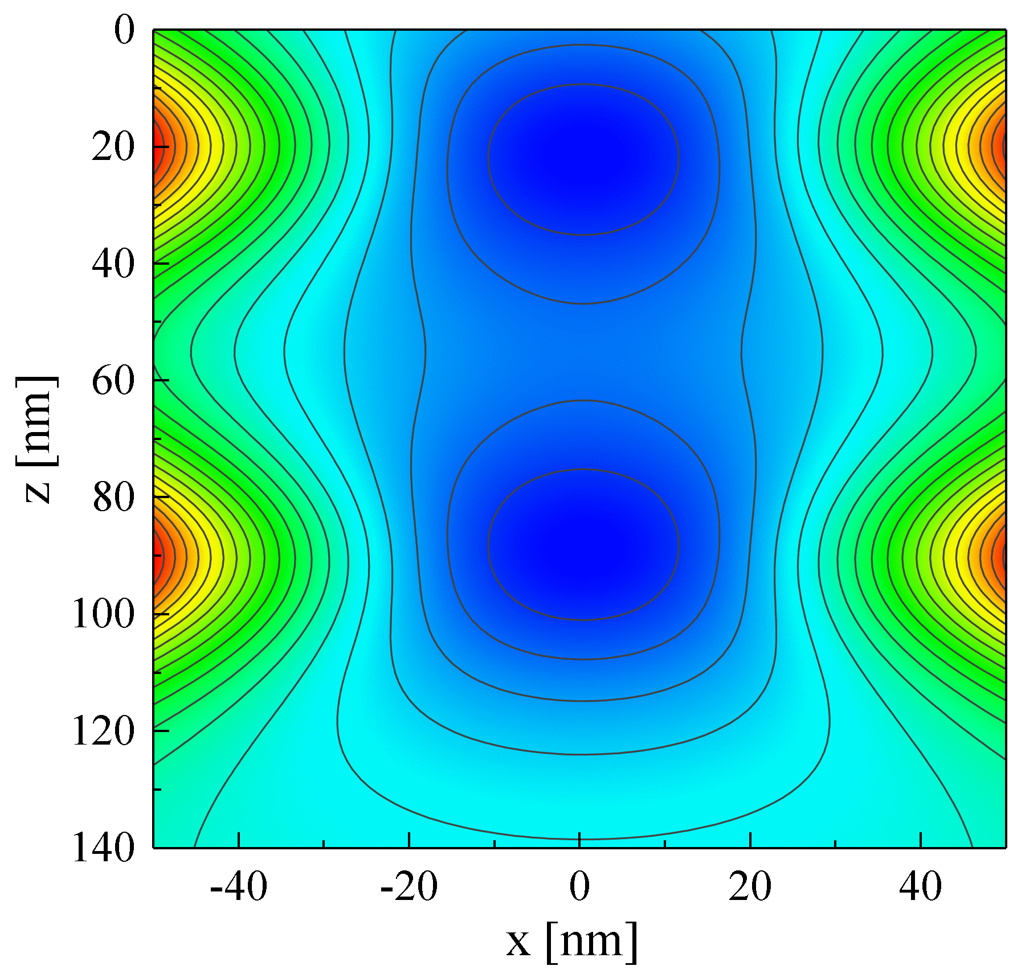
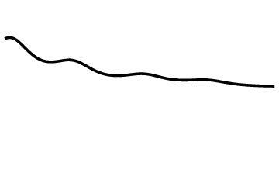
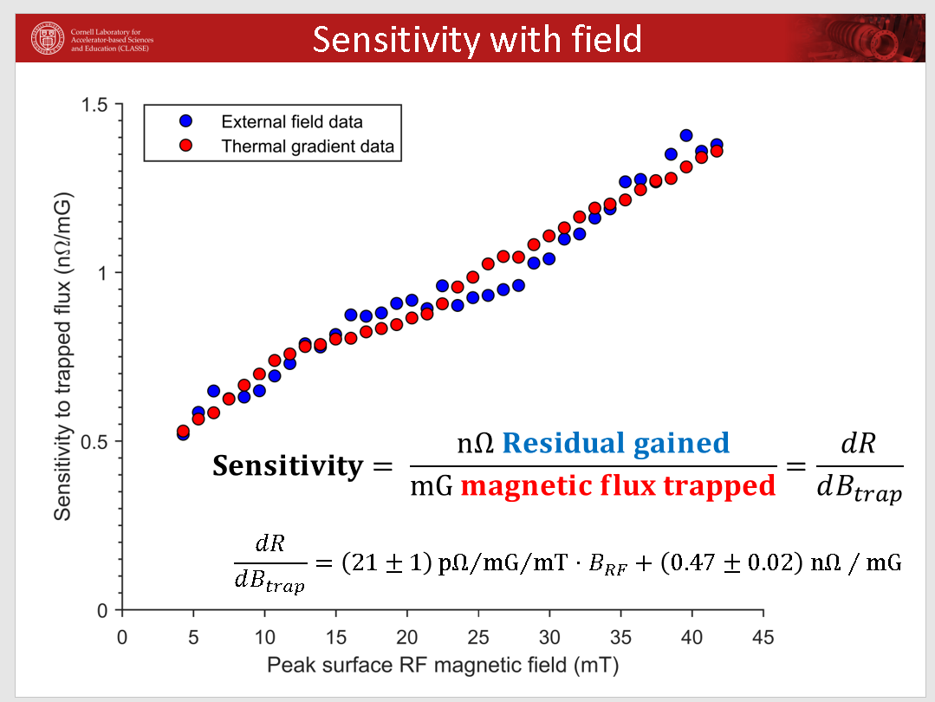
D. Liarte
I. Sadovski
Checchin model good agreement with frequency dependence
$$B_{RF}(t)$$
Liarte collective weak pinning model might explain observed linear field dependence of sensitivity
Porter
Miyazaki
Notes:
If you tried to fit the same data that the other person showed, would you get the same fit? What would be different?

Slide 8
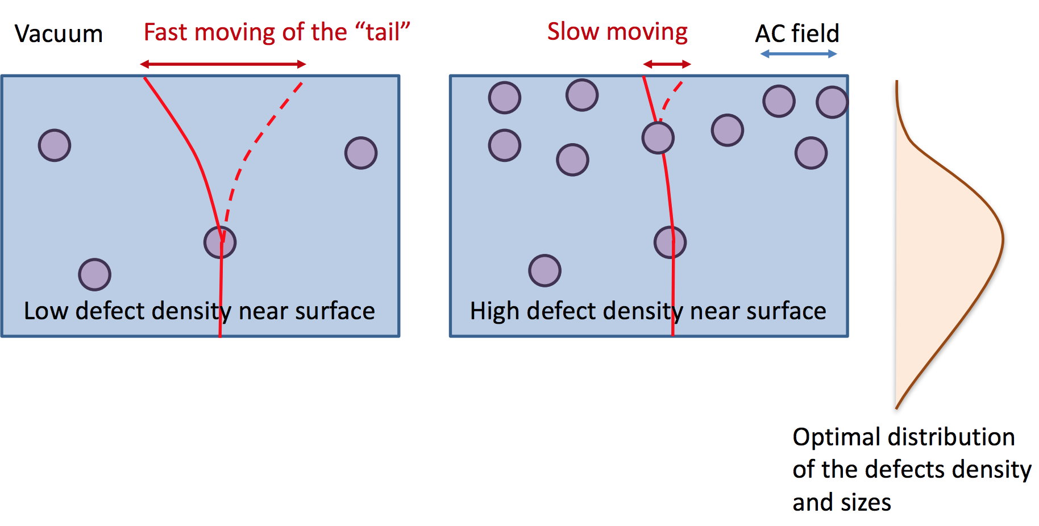
D. Liarte
I. Sadovski

Slide 9
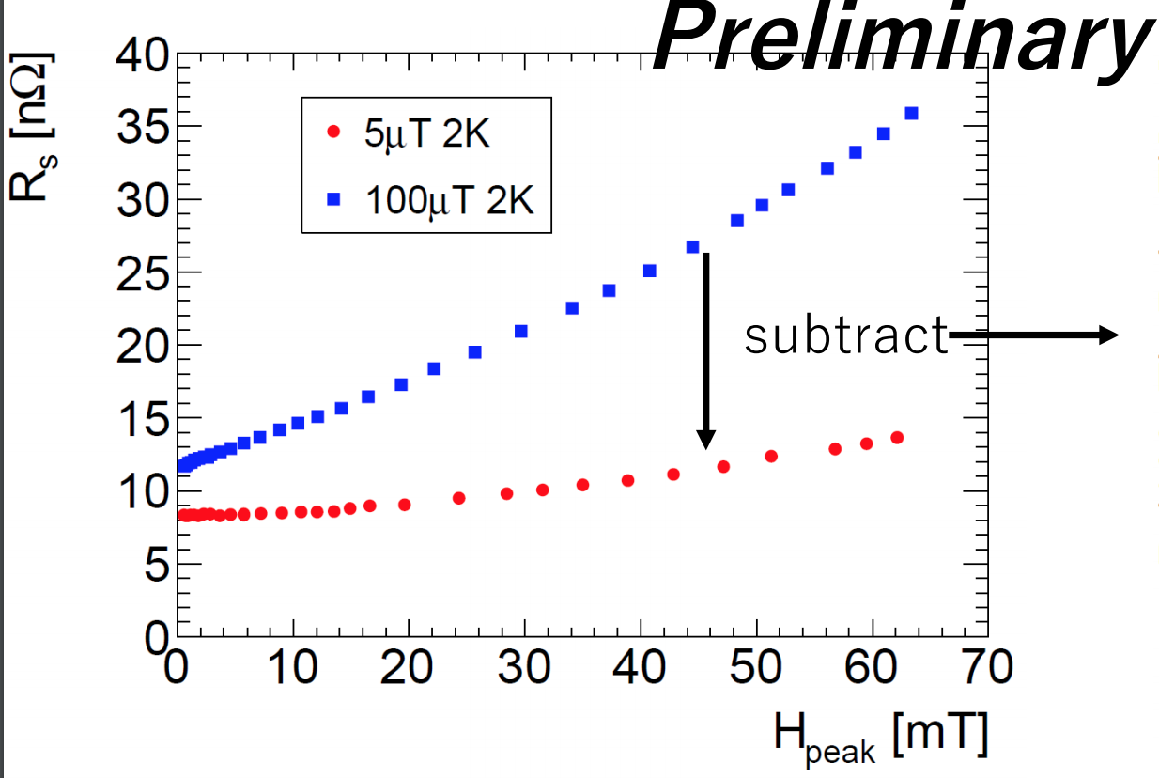
Flux Losses in Nb/Cu – A. Miyazaki
Can thermal boundary model explain Rres measurements when flux is trapped or when cavity is poorly thermally cycled? Can flux losses explain this?
Discussion of whether Q-slope is observed when cooling in small fields
Maybe some interplay?

Slide 10
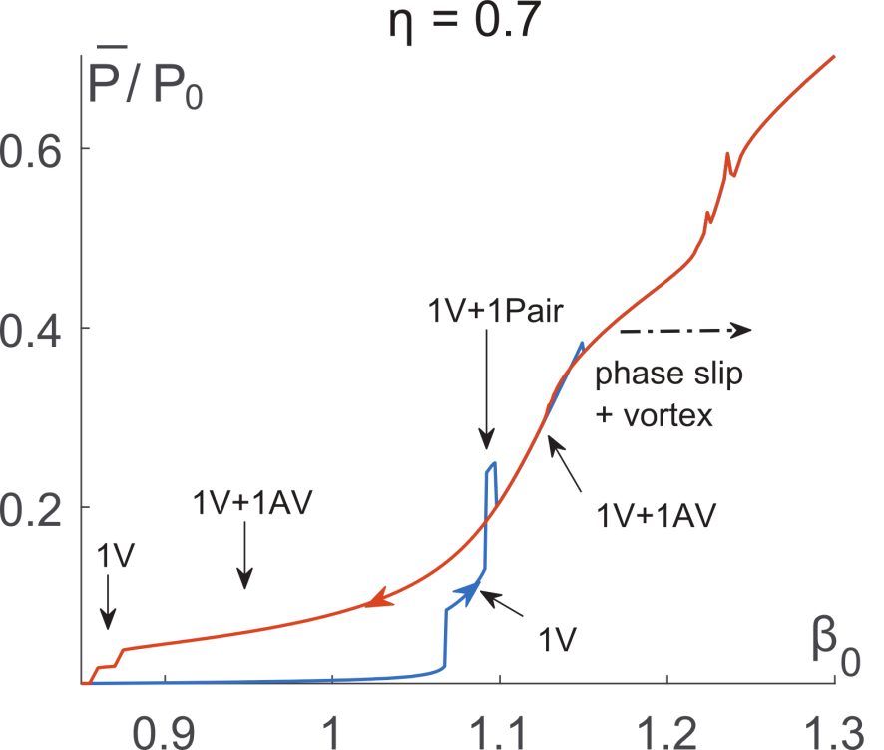
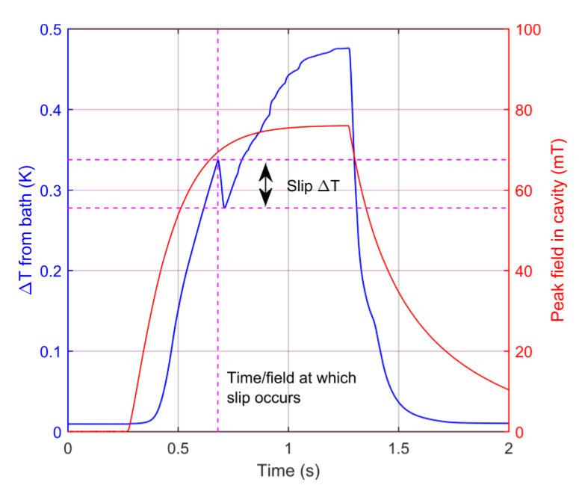
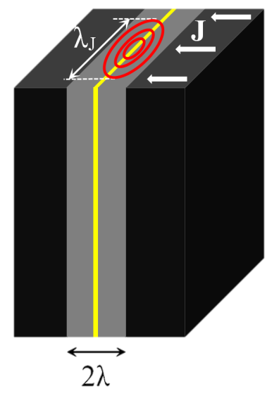
Nb3Sn – Flux and Other Results
Flux losses appear to be dominant source of residual resistance in Cornell Nb3Sn cavities
“temperature slip”, hysteresis, quench spot study
Porter

Slide 11
Nb3Sn – Flux and Other Results
Flux entry at grain boundary?
Wednesday Danillo discussed reliability
Porter
Liarte

