Slide 1
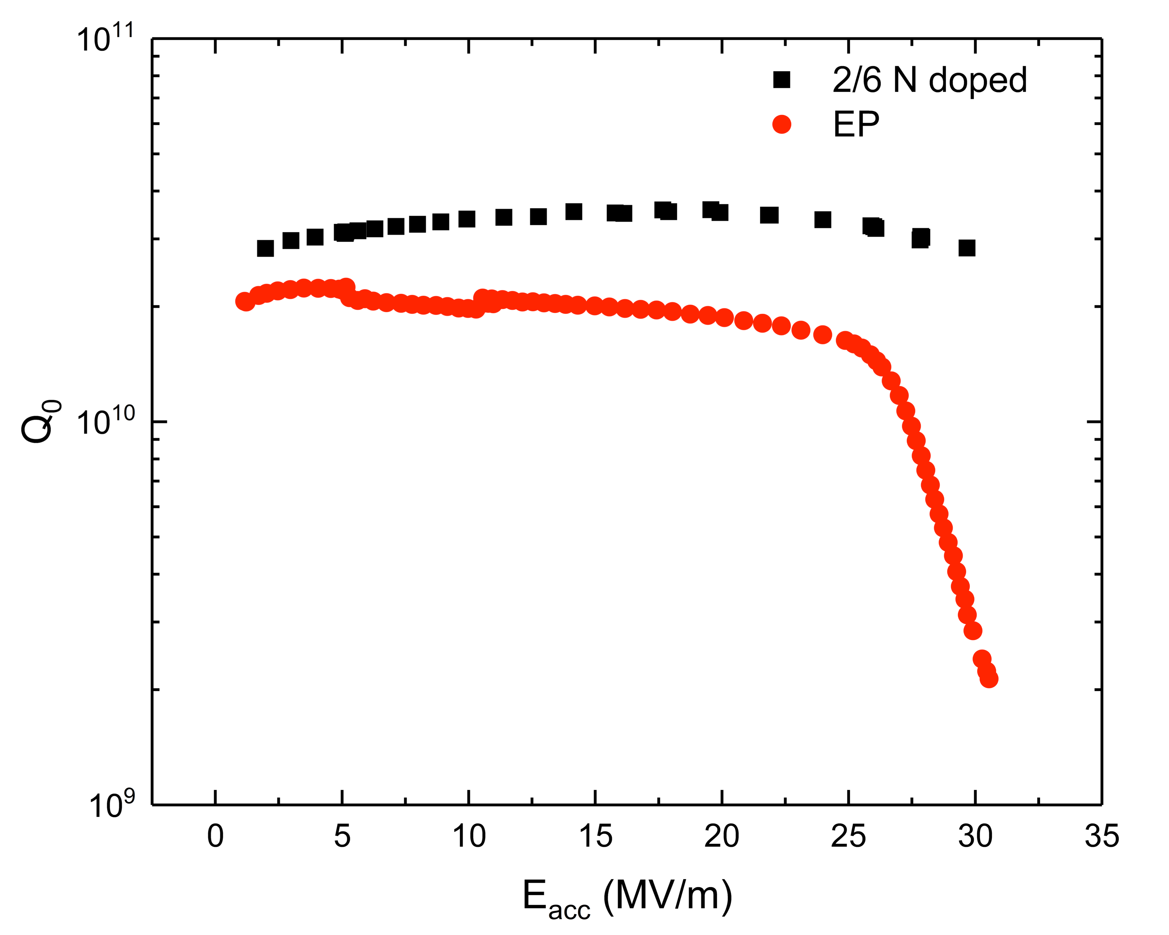
Summary WG2 – HFQS and Ultimate Gradients Limitations
Anna Grassellino
Deputy Head, Technical Division, Fermilab
TTC Topical Meeting, Fermilab
November 14th, 2017

Slide 2
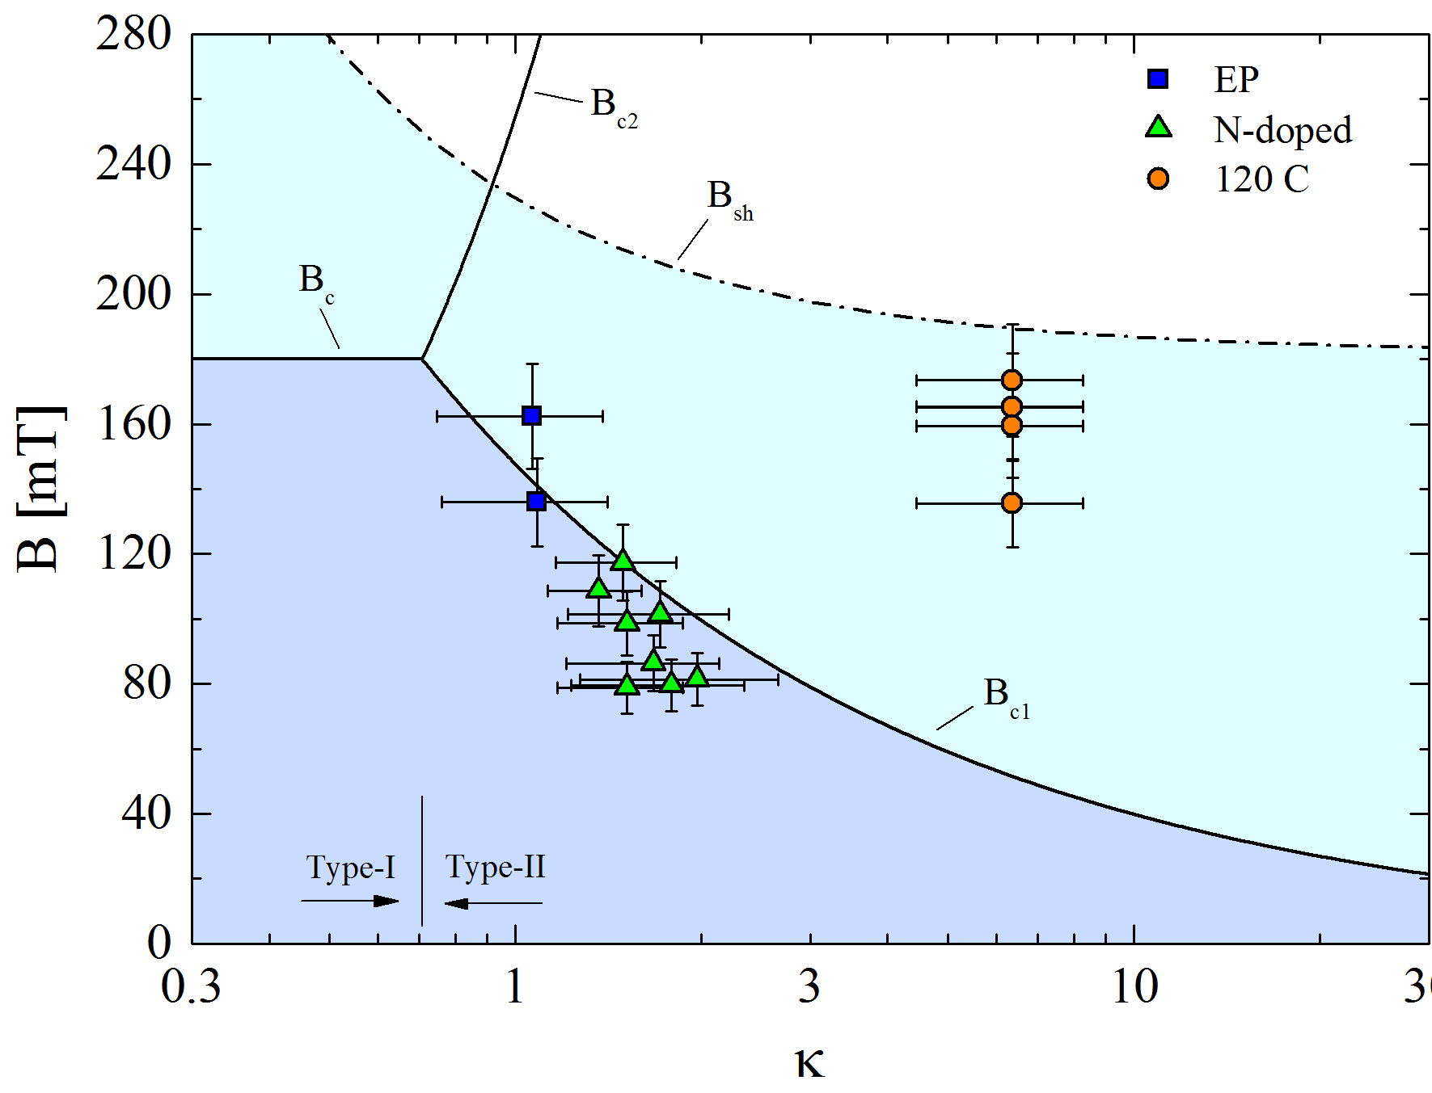
Introduction
In this session we discussed our understanding of gradients limitations
From EP surfaces, to baked, to doped, to infused, we can certainly conclude that doping with impurities or defects in the first nanometers from the surface seems to be key in determining the ultimate gradient reach of the cavity
Experimental data, ideas/predictions and theoretical calculations seem to converge on the fact that a surface in the dirty limit in the first nanometers, on clean Nb, is the key to produce higher gradients
But so what is the optimum point? What is the ideal impurity concentration profile, and what type of impurity/defect is best as dopant?
And what is the mechanism that allows to drive Nb to higher gradients? Vortex entry barriers? Vortex nucleation time considerations?
M. Checchin, Proceedings of IPAC 2016

Slide 3
Open Questions
Why is “large” grain (post-purified fine-grain or ingot) necessary for baking to work on BCP-treated Nb?
What is the source of the losses: normal-conducting hydrides or flux penetration or…?
Why would the m.f.p. after UHV baking be lower than after N-doping?
How do changes in the D.O.S by baking impact the HFQS? Do the metallic suboxide play any role?
Discrepancies on published data regarding Hydrogen depth profiles and Vacancies concentration before/after baking.

Slide 4
Therefore, the effect of 120C baking is doping with vacancies
Oxide
Oxide
~50 nm
Free interstitial hydrogen
Hydrogen is trapped by vacancies
120C baking
T= 300K
T= 300K
A. Romanenko, C. J. Edwardson, P. G. Coleman, P. J. Simpson, Appl. Phys. Lett. 102, 232601 (2013)

Slide 5
Anodization idea and experiment (discussion with J. Sauls)
Surface nano-roughness could cause HFQS due to premature exceeding of critical current density (or vortex entry)
The standard (or infusion) 120C bake may be introducing a poorly superconducting, almost dead layer, that effectively moves the supercurrents down and away from the surface, where they no longer see the problematic surface roughness
We have studied if anodizing could have an effect

Slide 6
Summarizing models vs experimental data, where we stand
 | Slope before baking (EP>BCP FG, FG EP=LG BCP) | Slope improvement after 120C baking | Slope cured by interstitial nitrogen, but not fully by 120C alone | Frequency Dependence | Anodization | HF rinse studies post bake | Rs decomposition (HFQS in residual) | Tmap HFQS pattern | HFQS reappear after 800C | SIMS, XPS and other surface characterization data
Magnetic Field Enhancement | Y | N | N | Y | ? | N | Y | Y | N | Y
Surface Nano-roughness + dead layer | Y | Y | Y | Y | ? | Y | Y | Y | Y | Y
Proximity Breakdown of Hydrides | Y | Y | ? | Y | Y | Y | Y | Y | Y | Y
Magnetic Flux depinning | N | Y | ? | N | Y | Y | Y | Y | Y | Y
Interface Tunnel Exchange | N | Y | ? | N | N | N | Y | N |  | N
Magnetic Field Dependence of Gap | N | N | ? | Y | Y | ? | N | Y | Y | ?
Thermal Feedback | N | N | N | N | Y | N | N | Y | N | Y
Oxygen pollution and diffusion model | Y | Y | ? | Y | ? | Y | Y | Y | N | N

Slide 7
HFQS -moving forward
Experimental evidence suggests that we can narrow down to two models:
  Proximity breakdown of nanohydrides (cured by pollution with vacancies, or nitrogen)
  Surface nano-roughness causing exceeding prematurely critical current density (cured by shifting currents away from surface via polluted poorly superconducting layer) or premature vortex entry (cured by increasing surface pinning)
Are we leaving some options out? How about the role of the oxide-Nb interface? Can it be that certain pollution of Nb is needed to grow a better quality oxide (eg no dangling bonds); SIMS and other experimental data not supporting difference in oxide
Then? Can we design next experiments to move towards elimination of HFQS from the root cause?

Slide 8
Surface characterization –SIMS- Y. Trenikhina

Slide 9
In-situ N-infusion experiment -1
      Sample: high purity single crystals from SPL, polished by SPL (Netherlands)
RT
Nb₂O₅
~4.7nm
NbO₂
NbO
Nb
800°C/2h
~4.2nm
NbO
Nb
~14nm
N-infusion
23 hrs
NbO_{x}N_{y}
NbO
~1nm
Nb
-by G. Dalla Lana

Slide 10
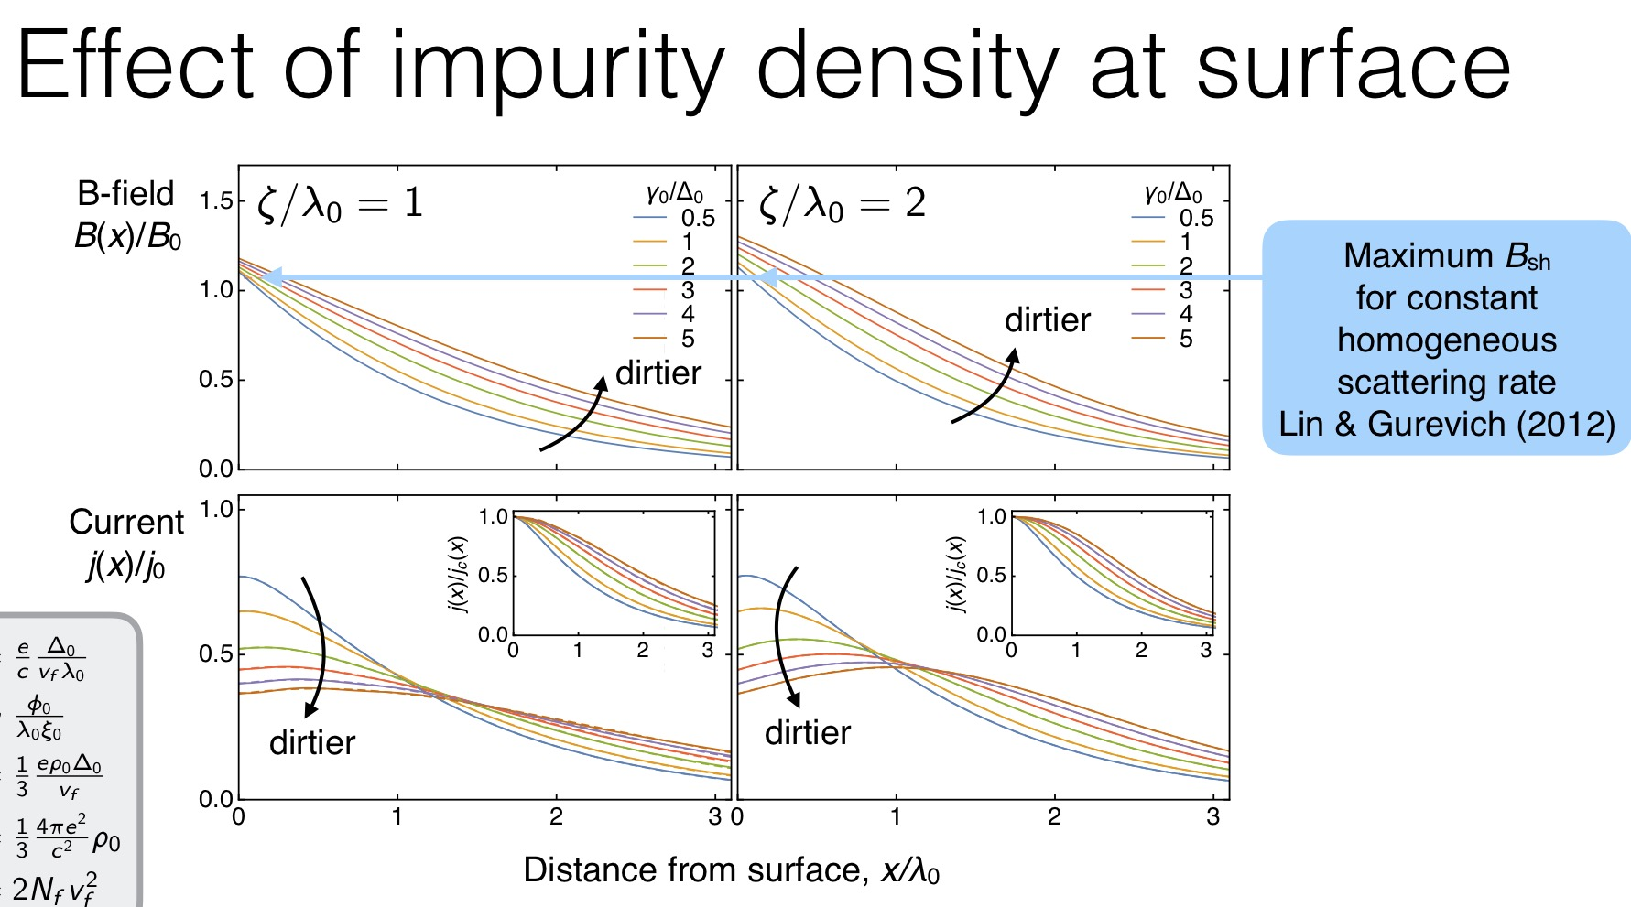
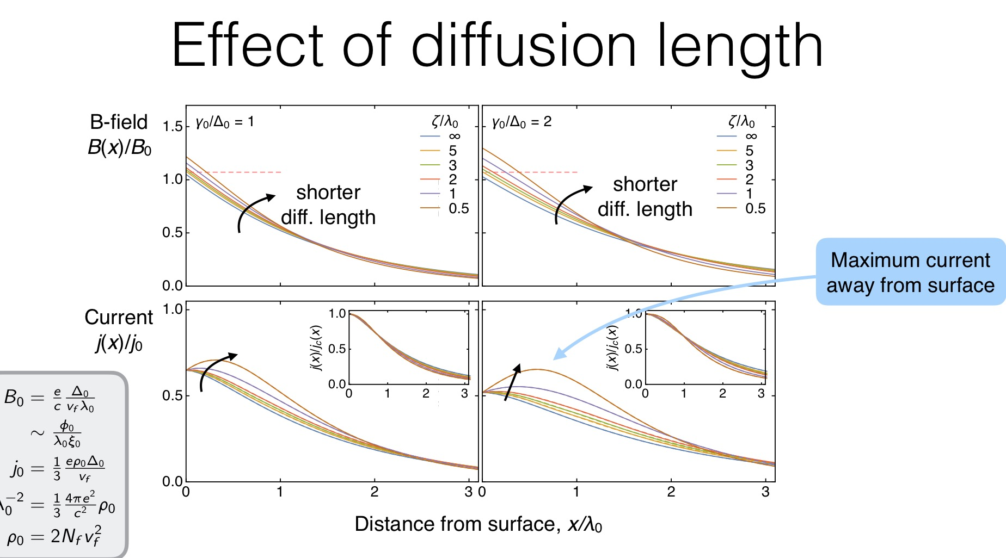

Slide 11
High-gradient R&D challenges and opportunities
Gurevich
Understanding the fundamental limits of SRF field gradients
Theory of superheating field at low temperatures and GHz frequencies. Manifestations of nonequilibrium effects in a dynamic superheating field.
Physics of vortices driven by strong RF currents
Experimental investigations of dynamic superheating field on small samples and test cavities under controlled conditions of RF and pulsed fields
Getting more out of Nb:
Impurity engineering and surface nanostructuring to optimize 100 nm dirty layer at the surface ( reverse the Q slope and increase H_{s} ). Nb may still bring surprises.
Deposition of N-infused Nb thin films and SIS multilayers on Nb cavities can capitalize on the Q(H) rise and reverse the reduction of breakdown fields. Can it be done on Nb₃Sn?
Beyond the bulk Nb
N-infused Nb-I-Nb ML on Nb (well-developed technology, quick progress appears likely):
Extend the Q(E_{acc}) rise up to 70 mV/m
Nb₃Sn SIS multilayers (more challenging than Nb, current-blocking grain boundaries, low thermal and electrical conductivity, local nonstoichiometry). Higher Q up to 120 mV/m
Pnictides – next level, but a potentially big payoff. Pushing the limit beyond 200 MV/m

Slide 12
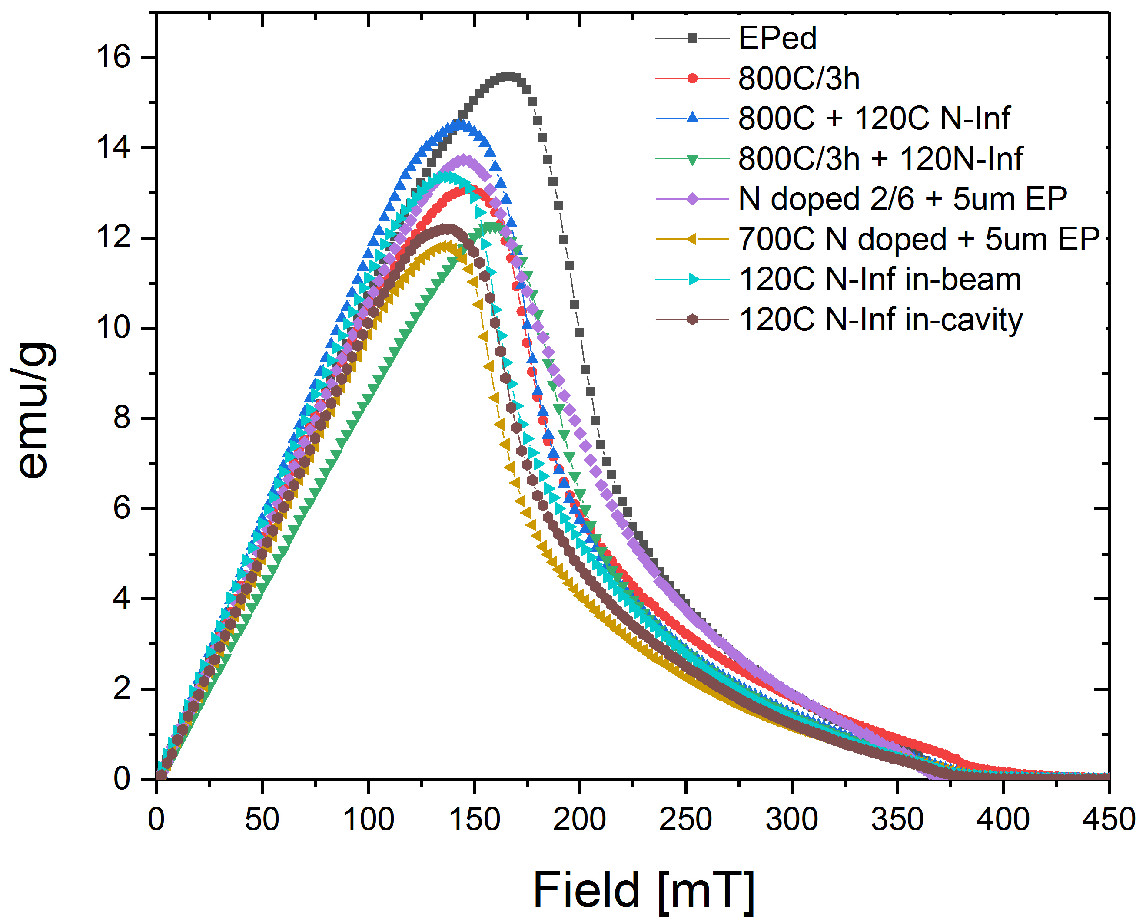
PPMS Magnetization Studies
DC Magnetization curve (m [H])
33 MV/m
45 MV/m
At 2 K
H_{p} & H_{c, peak} from the curve
Treatment | H_{p}, onset [mT]* | Hc, peak [mT]**
TD bulk EPed | 120 | 170
800C/3hrs | 100 | 150
800C + 120C N infusion | 110 | 145
800C/3h + 120C/48h N infusion | 115 | 160
N-doped 2/6, 800C/6h+N2/2m 25mT + 5um EP | 105 | 145
800C/3h+700C/10m+700C/2m N2 + 700C/6m HV | 105 | 135
Nb 120C Infusion, in beam tube | 105 | 140
Nb 120C Infusion, in cavity | 110 | 140
Even with the further help of pinning in DC,
Nb doesn’t seem to be able to go to > 30-35 MV/m without letting lots of flux in
* Onset of Flux Penetration (Hp), defined as the first deviation point from the linearity from H = 0 mT, at 2K.
** H_{c, peak}: the peak value after H_{p}, at 2K
Data by Z. Sung

Slide 13
So how are current cavities reaching Eacc = 45 MV/m then?

Slide 14
I suggest another key mechanism is at play
In addition to surface barrier (superheating) there is a “time barrier”
  There should be enough time for vortices to nucleate/dissipate
Vortex nucleation is governed by the characteristic time scale of order parameter changes, so-called τ_{Δ}
  If flux penetration/dissipation is happening or not depends on the relation between τ_{Δ} and RF period T_{rf}
    τ_{Δ} > T_{rf} => vortex-induced dissipation is delayed beyond Hsh
    τ_{Δ} < T_{rf} => Hc1 and superheating become more relevant – more DC-like
    τ_{Δ} >> T_{rf} => vortices don’t matter as they never form
τ_{Δ} ~ τ_{GL} << 1 ns is only relevant for gapless superconductors (which Nb is not) > was understood by e.g. Tinkham and Bezuglii in late 1980s
For gapped superconductors at low T: τ_{Δ} ∼ τ_{Ε} >∼ 1 ns for Nb

Slide 15
So which materials could be better for “time barrier”?
A15 are not good –too ”fast”

Slide 16
A thin layer of slow superconductor should help too!
Option 1
Option 2
“Slow” Nb
10-20 nm
V (or other slower SC)
Nb
Nb
Is it how 120C baking enables Hrf >> Hc1?
Explore techniques for lower Tc SC deposition

Slide 17
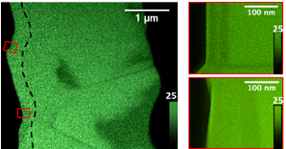
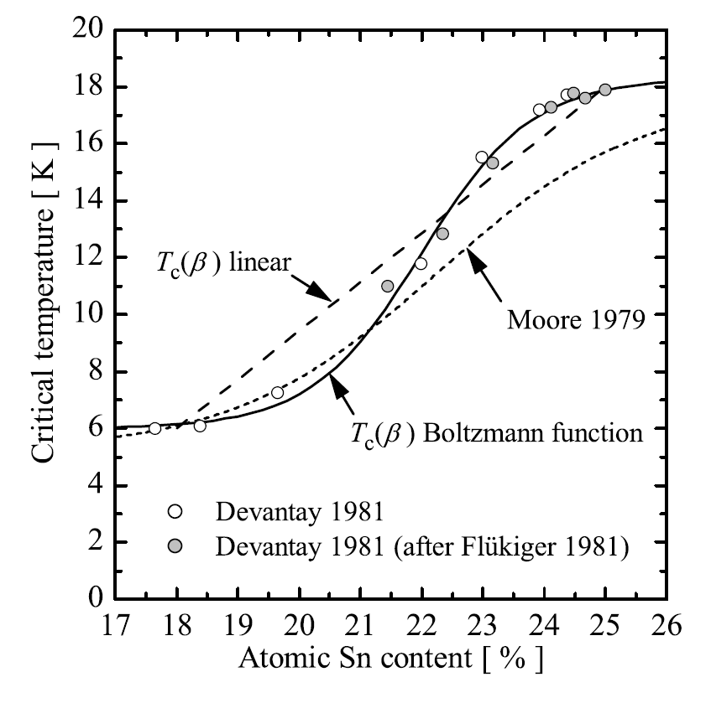
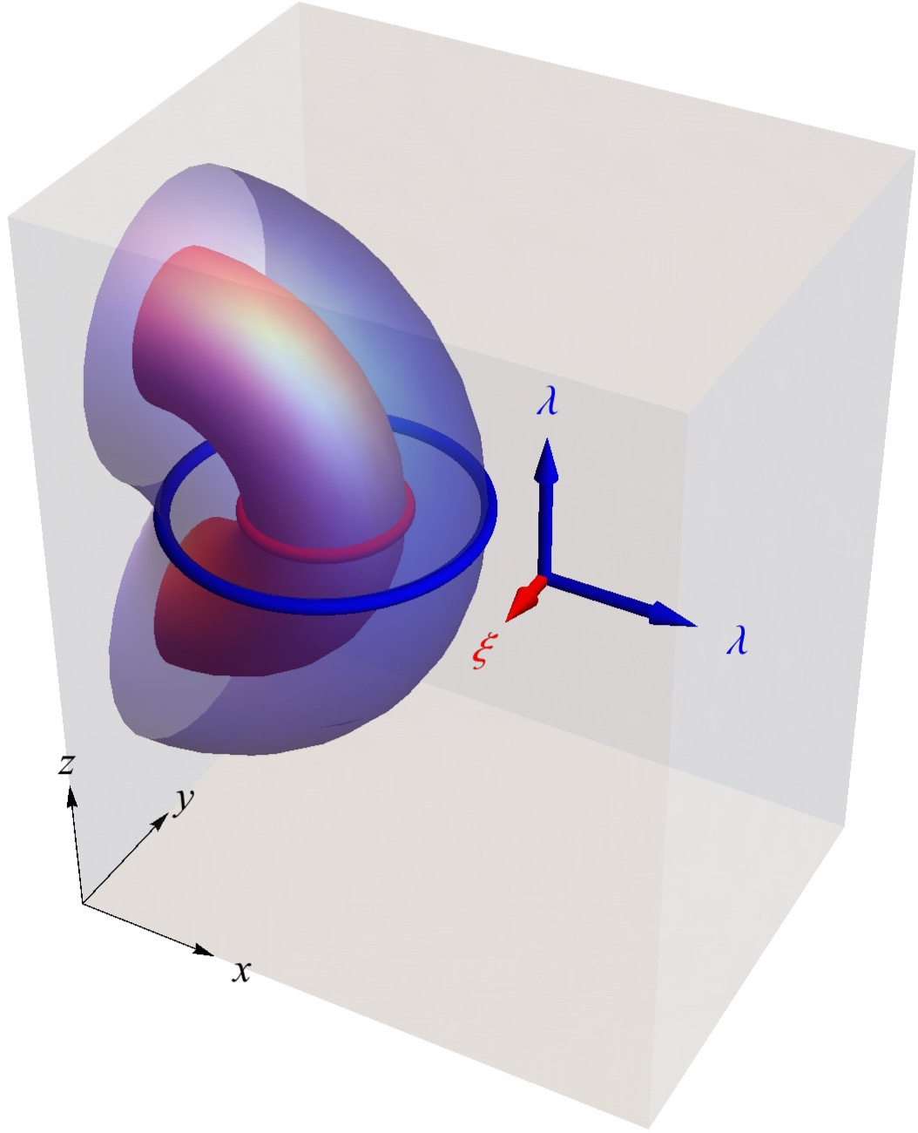
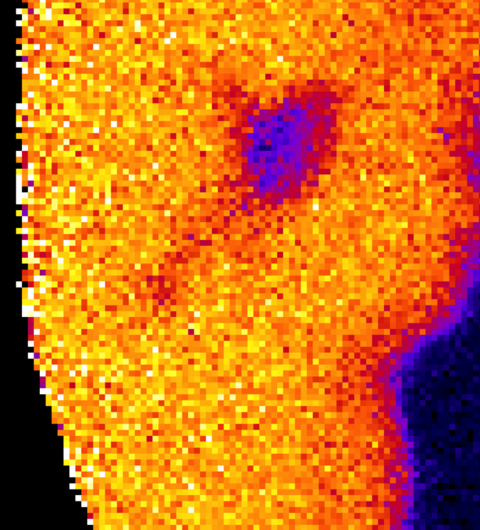
Sn depleted regions and Nb3Sn quenches
Liarte
Thomas Proslier
(Argonne)
A. Godecke: SUST 2006
Muller Group
(CBB)
Can the tin depleted regions (or something else) facilitate vortex nucleation?

