Slide 1
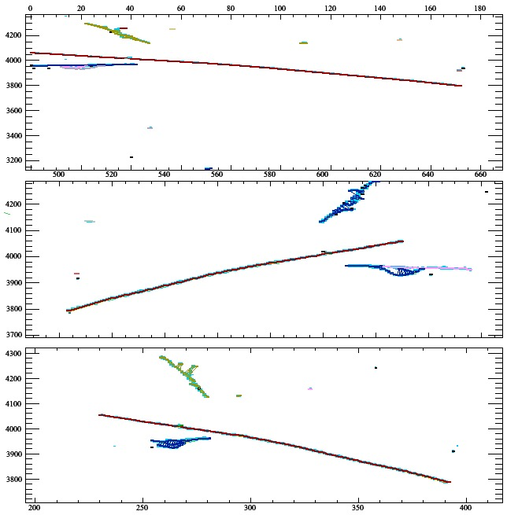
TrajCluster configured for ~MicroBooNE
Six 2D showers reconstructed (incompletely)
3D shower matching incomplete
Working on shower vertex finder algorithm
3D matched PFParticle
300 MeV p
900 MeV π⁺
Investigating problems reconstructing events with cosmic background

