Slide 1
DUNE FD-SP APA Alignment with Muons, RF pulsing
Tom Junk
Fermilab
Calibration Task Force Meeting
November 15, 2017

Slide 2
An Important Task To Get Started
Evaluate the capability of alignment of single-phase FD detector components using cosmic-ray muons using fully-simulated events.
There are many well-documented historical examples.
Motivation – we'd like to know where the weaknesses of this method and how to address them in other ways. Laser? Survey? Something else?
We'd also like to know how well we need to measure the detector component locations. Driven by multiple-scattering measurements of muon momenta. Fiducial volume calculation? Anything else need precise alignment?

Slide 3
Base Assumptions
First pass at alignment, assume:
  APA's are rigid objects with nominal shapes and sizes
  Muon tracks are locally straight, but scatter on larger distance scales
  APA's may have small (of order mm or maybe even cm, globally) position offsets, and small (mrad or smaller) angular offsets.
  CPA panels are similar – assume rigid panels but possibly misaligned by small amounts.
We expect to measure relative positions with cosmic rays much better than installation tolerances.

Slide 4
An Elaborate Example: CMS Muon Tracker
Alignment with Cosmic-Ray and Beam-Halo Muons
http://arxiv.org/abs/0911.4022
Essentially a sum of track-fit chisquareds as a function of alignment parameters
(offsets and angles). Add to that survey constraints which keep the fit from
wandering off in "loose" directions.
The total chisquared is quadratic in its parameters and minimizing it is a matrix inversion.
Another method in the paper uses non-Gaussian constraints and runs MINUIT.
Some hints at selecting well-formed track segments may be clues of things we have to
do too.
This example has only two displacements and two angles per rigid detector piece due to
the strip geometry. We'll probably do ours in 3D.

Slide 5
Simulated Sample
The production group finished a sample of 17800 MUSUN cosmic-ray muons in
a 10 kt FD module (20K requested, some jobs ran over time).
MUSUN + G4 + standard detsim + standard reco + mergeAna.
We need to store the AnaTrees too. The default electron lifetime is set to 3 ms.
Data sample name in SAM: MUSUN_Cosmic_DUNEFDSP_mcc9.1
Look at http://dune-data.fnal.gov for instructions on access. Look in the MCC9 page.
Mike Wallbank also has a private sample of (Vitaly says 1M muons) simulated
but no reconstruction has been run.
There's a very large sample of MUSUN cosmics in persistent dCache space, however with long
tracks in the detector filtered out, has been made for the NDK search.
Not useful for calibration unfortunately.

Slide 6
Alignment Tasks Broken Down
Decide whether to do the analysis in art or gallery.
Doing it in art will likely involve producing a special ntuple that can be experimented with
quickly, to try out new ideas. Possibly gallery too. Spacepoints may be the perfect data product
– minimal extra geometry information needed to interpret them.
Event selection
  Steep enough angles but not too step
  No showering of muons
  Muons must be straight enough to be useful.
  Muons must cross the gaps of interest
  Timing less important for APA gaps and angles, but aligning the CPA requires timing.
Construction of fit function
  Hit residuals
  survey or just the nominal positions for now
Fit method. MINUIT? Something else? (Markov Chain perhaps?)
Tests of reliability
  Uncertainties vs. spread in outcomes (are the uncertainties right?)
  What parameters or linear combinations of parameters are poorly constrained?
  How many cosmic rays are needed? How long will it take to collect them?

Slide 7
Muon Flux at the 4850' Level
See DocDB 5505 for an approximate calculation based on Vitaly Kudryavtsev, Martin Richardson, J. Klinger, and Karl Warburton LBNE DocDB 9673-v1, and the calibration concept study document, DUNE DocDB 4769-v2
Estimate 4 cosmic rays
per day per square
meter at the 4850'
level (DocDB 4769)

Slide 8
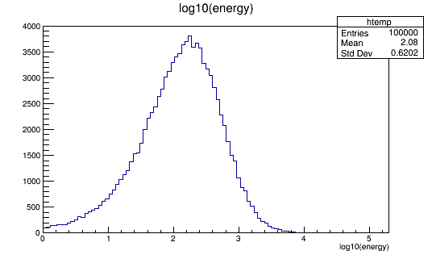
Fraction of Showering Muons
No-shower cut: Critical Energy (energy at which radiative effects are more important than ionization) is 485 GeV in LAr. log₁₀(485) = 2.7
Vitaly's plot was
in muons per GeV (linear)
on a log scale (!)
Estimate that 60% of muons
don't shower significantly.
MUSUN Generator-Level Run: prodMUSUN_DUNE10kt.fcl with 100000 events

Slide 9
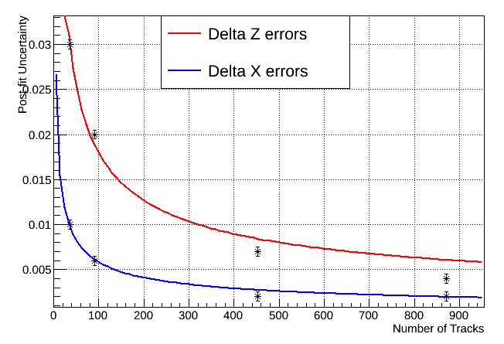
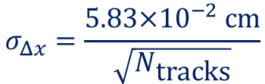
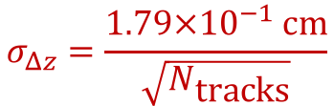
Vertical Gap Measurement Precision
From Mike Wallbank's work on
35-ton measurements.
Some gaps had more crossing
tracks than others and are thus
better measured.
Assumes: 𝛥x and 𝛥z are
constant along the length of the gap
Error bars
on these points
are arbitrary
$$σ_{Δz}=\frac{1.79×{10}^{−1} \text{cm}}{\sqrt{N_{\text{tracks}}}}$$
$$σ_{Δx}=\frac{5.83×{10}^{−2} cm}{\sqrt{N_{\text{tracks}}}}$$

Slide 10
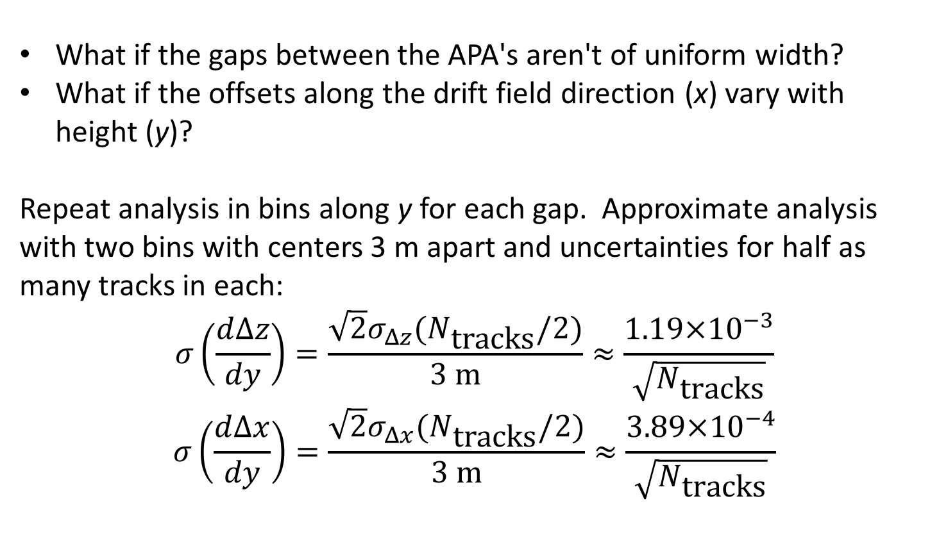
Measuring Angles
What if the gaps between the APA's aren't of uniform width?
What if the offsets along the drift field direction (x) vary with height (y)?
Repeat analysis in bins along y for each gap. Approximate analysis with two bins with centers 3 m apart and uncertainties for half as many tracks in each:
$$σ\left(\frac{d∆z}{dy}\right)=\frac{\sqrt{2}σ_{Δz}(N_{\text{tracks}}/2)}{3 \text{m}}≈\frac{1.19×{10}^{−3}}{\sqrt{N_{\text{tracks}}}}$$
$$σ\left(\frac{d∆x}{dy}\right)=\frac{\sqrt{2}σ_{Δx}(N_{\text{tracks}}/2)}{3 \text{m}}≈\frac{3.89×{10}^{−4}}{\sqrt{N_{\text{tracks}}}}$$

Slide 11
Local vs. Global Alignment
We measure gap offsets in x and z easily.
But muons only sample a small amount of x and z at a time – mostly travel in the y direction.
How to tell these kinds of distortions apart with cosmics? Cosmic rays sample local patches of (x,z)
and are best at seeing step discontinuities
x
z
APA's viewed from top – distortions exaggerated
A

Slide 12
Other Difficult Distortions
View from top
Bent APA's: Will a "flat" APA stay flat when cold?
Bending of APA's:
More difficult with cosmics than steps at the gaps
Does not violate alignment pin constraints (others do, but manufacturing
imperfections can result in systematic offsets)
Multiple scattering means that single tracks cannot be relied on to extract
bending information. A large ensemble of them might be able to tease
something out. But more z coverage per track helps.
Or just a slightly crumpled curtain:

Slide 13
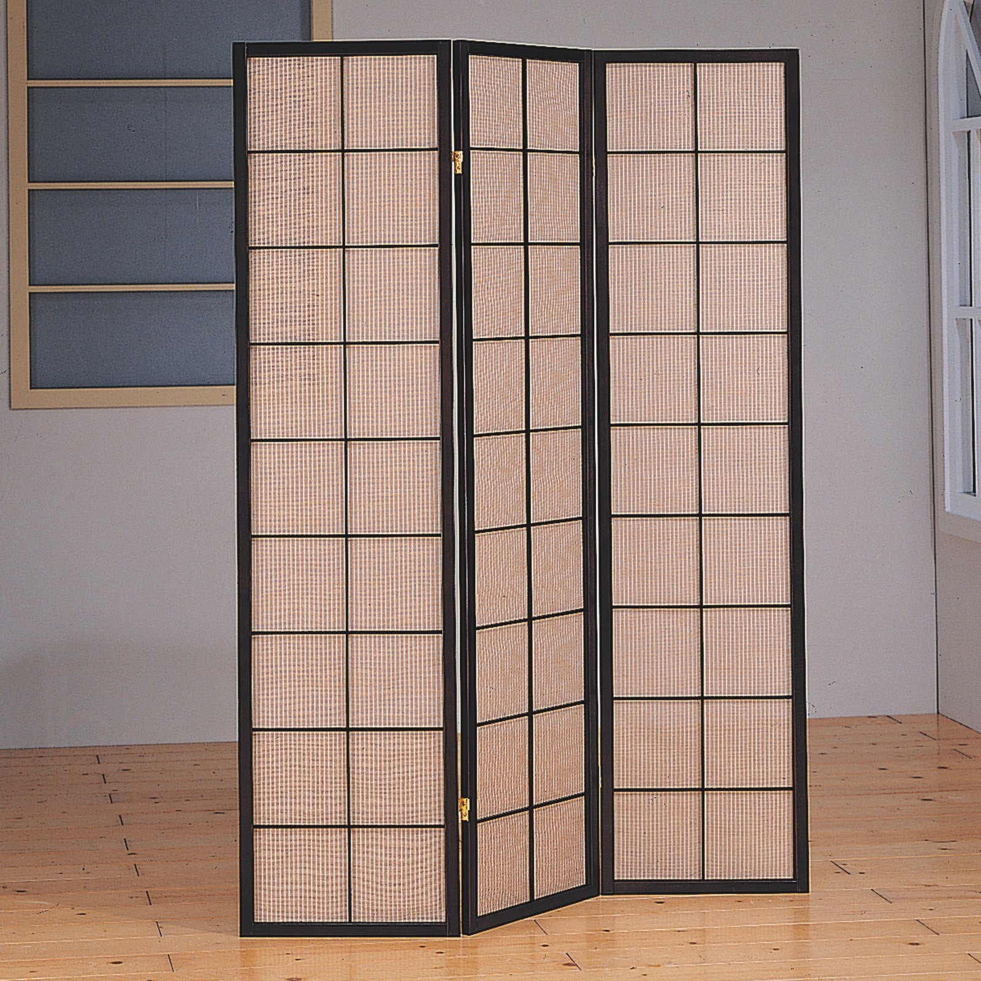
APA Alignment Pin and Slot
x
Hopefully constrain this sort
of distortion
z
  From the ProtoDUNE-SP TDR
Provides a One-Dimensional Position Constraint (X but not Y or Z, unless they are locking).
Provides a One-Dimensional Angular constraint if the slot is tight (roll in the above picture)
A series of pins provides an additional angular constraint (pitch)
On the figure above, roll and pitch are constrained but not yaw.
Manufacturing tolerances: With the pins engaged, wires can still be offset in ways
we can measure.
35-ton Prototype was assembled without Alignment pins and slots

Slide 14
Aligning the Cathode
ICARUS had troubles of the order of cm on cathode alignment (anecdotal). Impacted ability to measure muon momentum with multiple scattering
DUNE is a bit different – we observe tracks crossing the cathode. Distinguish drift velocity miscalibration from misalignment
Have not thought about this much yet. Cathode displacements distort the field too.
Can use the cathode panel frames as a test pattern for constraining space-charge effects in ProtoDUNE. Maybe harder to see in DUNE FD-SP

Slide 15
CPA Panel Geometry (ProtoDUNE-SP TDR)

Slide 16
Cathode Panel frames in ProtoDUNE-SP
Can we
"X-ray" the
frames with
tracks?
Look for gaps
in CPA-crossers
The reco
image will
tell us about
space charge
Martin Tzanov added
these to the ProtoDUNE-SP
Geometry! Thanks!!!

Slide 17
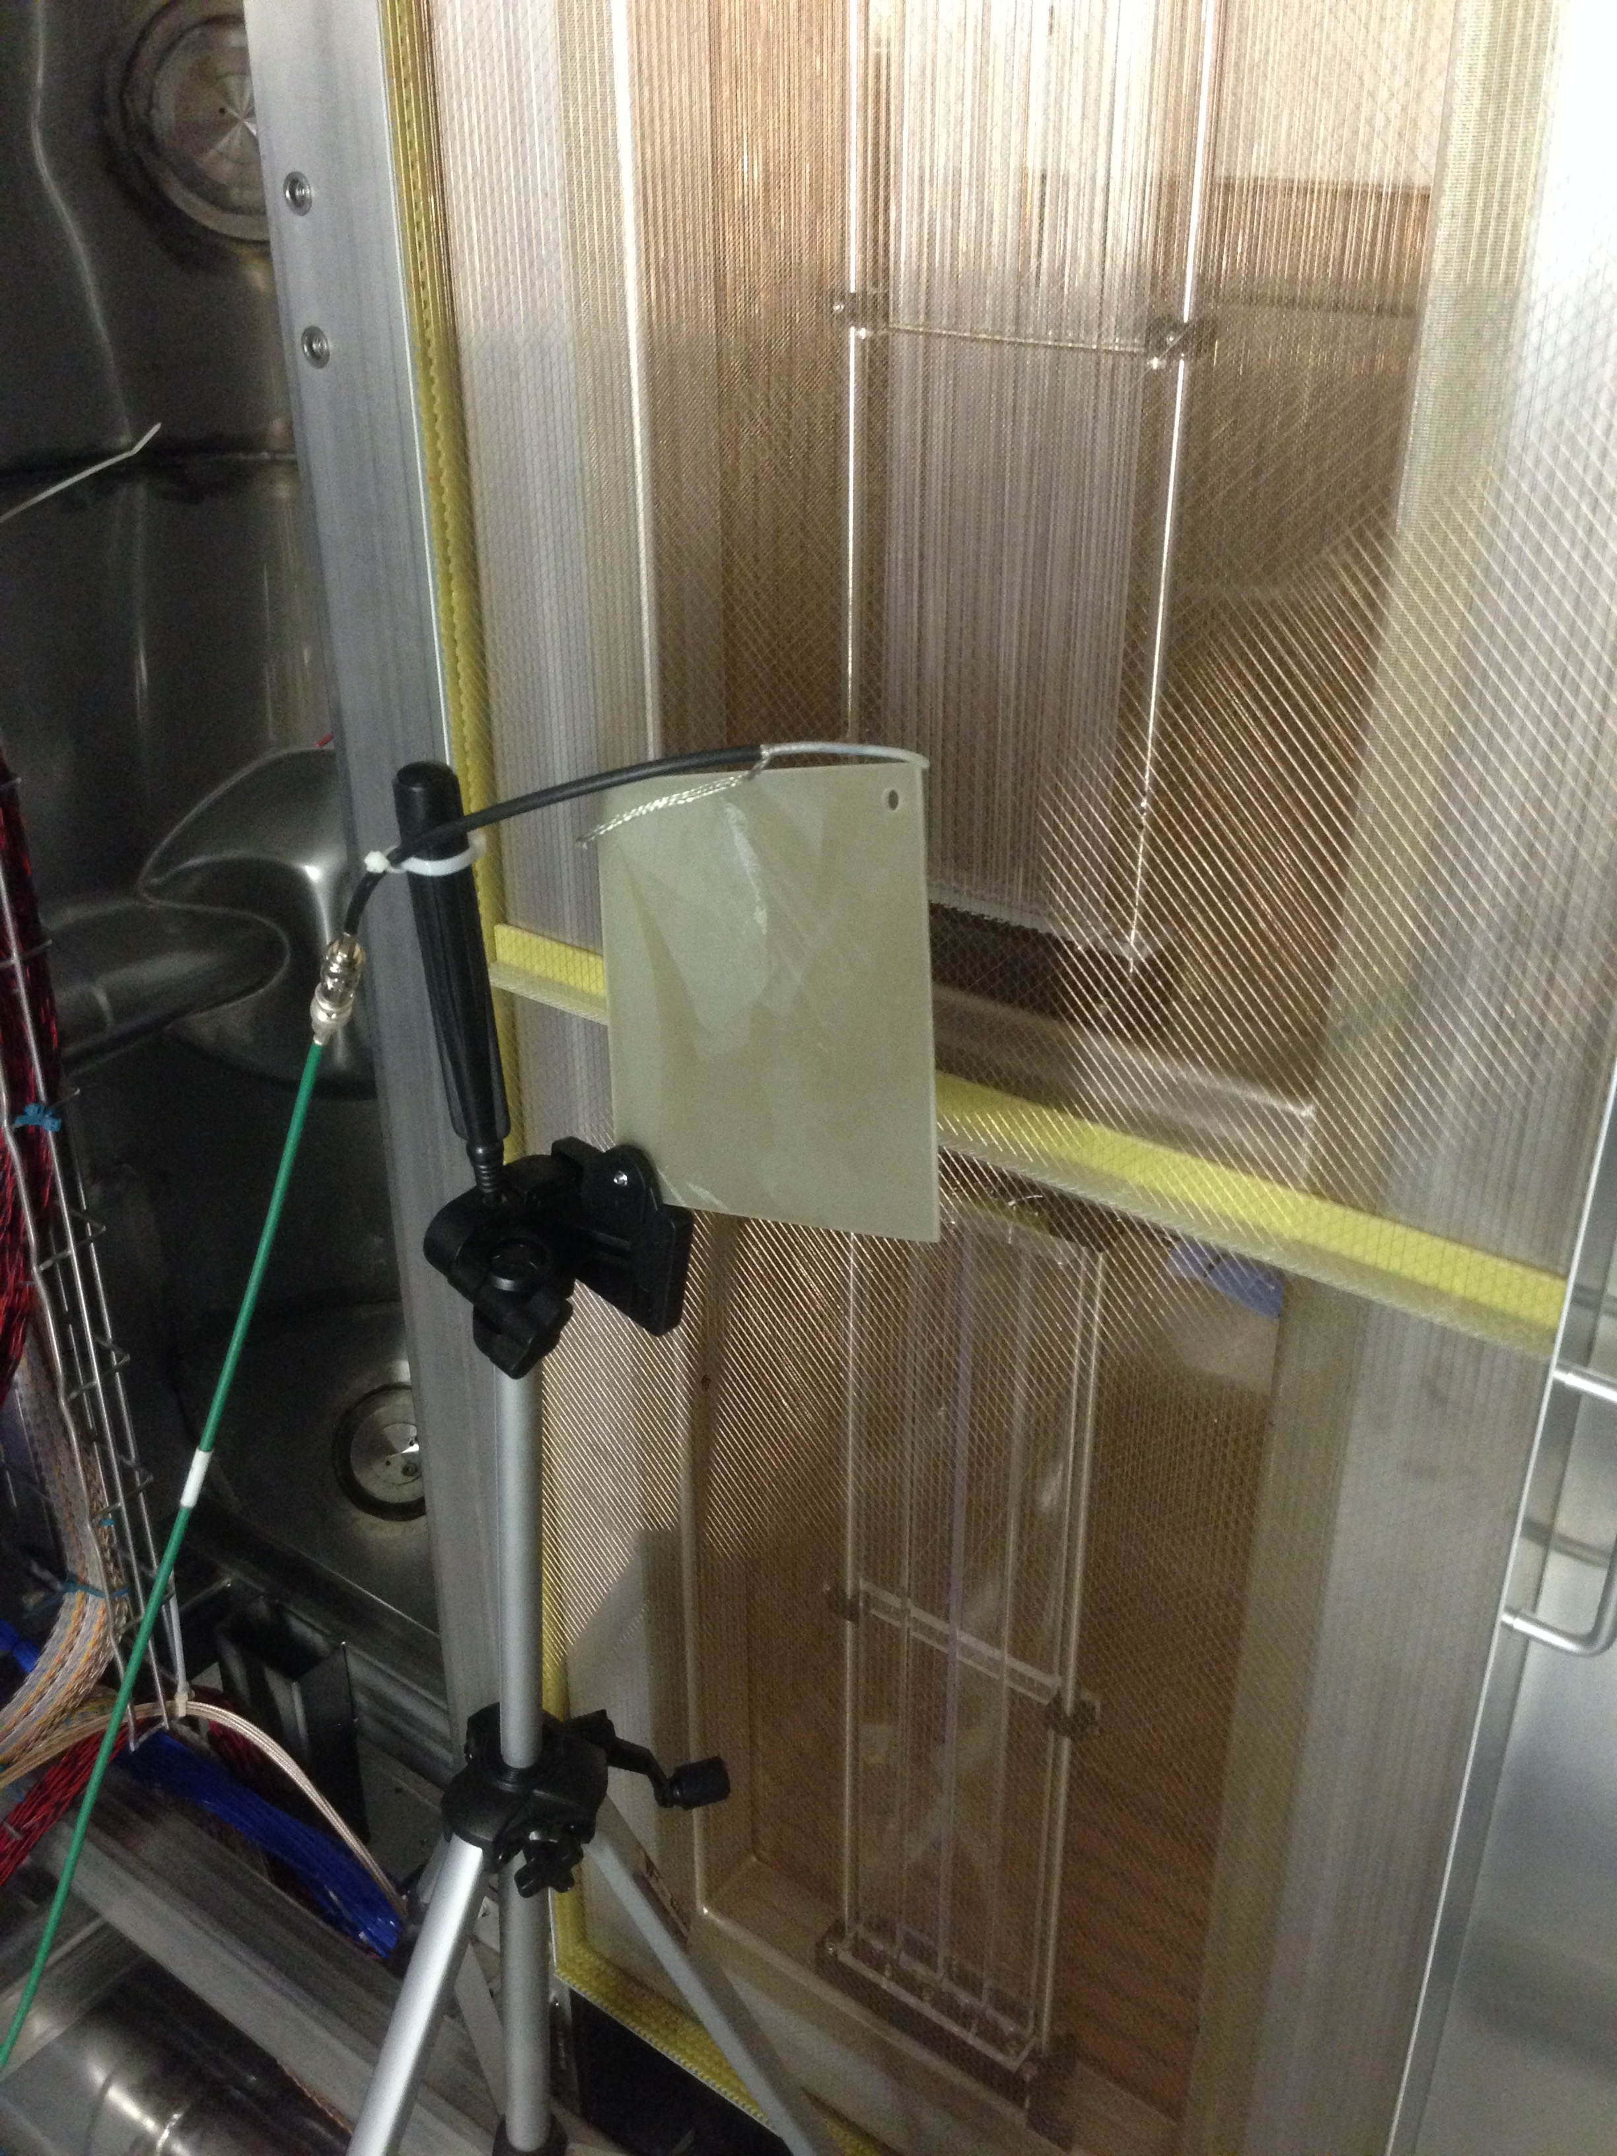
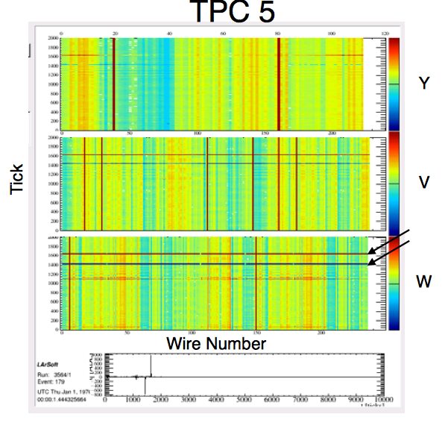
External Pulser to Test Connectivity, Geometry, and Response
External capacitive pulser “The Tickler” was very useful.
Designed and executed by Mark Convery and Michelle Stancari
Only way to check the channel mapping
It forced us to read in real data very early and address all those issues.
Data
plot
made by
T. Yang
http://indico.fnal.gov/event/10276/session/2/contribution/36/material/slides/0.pptx
See Sec. 4.1.4 of DUNE DocDB 1315-v4 for more details

Slide 18
A Possibly Crazy Idea:
Using Microwaves for Alignment
Install tuneable microwave transmitters on the CPA, as well as a grid of
receivers.
The frequency of a standing wave between the APA and the CPA tells us
the distance. You only need the refractive index of microwaves in air, Ar, and LAr
Higher frequencies: ~60 GHz samples Bragg interference with the APA wires, with
wavelength comparable to the wire spacing.
Can use Bragg scattering peaks to measure a combination of wire spacing and
APA angle
The problem is complicated by the angled wires, field cage, and modular APA's.
Enough information to solve the inverse problem of finding the APA locations and angles?

Slide 19
More Jobs to do with Muons
Calibrate the detector response to MIPs
Determine the electron lifetime – Bruce Baller has a nice module for this.
  This was very difficult on 35-ton due to noise
Measure the Drift Velocity
  How to determine this indepenently of the Anode-Cathode distance. May
  need accurate timing information from the photon detectors
High-energy cosmic-ray muons may be our most copious source of EM showers.
Can we use these profitably? Or are there too many systematics in predicting
what to expect?

Slide 20
Extra Slides

Slide 21
Estimating Rate of Muons Crossing Vertical Gaps: Angle
Want 20 collection-plane hits on either side of the gap. 10 cm in both APA's + 5 cm for the gap (wild guess) – need 25 cm in z for 6m in y. Need 2.4∘ at least, more is better.
From Vitaly's note: Average angle with respect to zenith: 26∘.
Assume 0.5 efficiency for having a steep enough angle. Most muons travel close to vertical.

Slide 22
Estimating Rate of Muons Crossing Vertical Gaps: Flux
Area of gap: 6m tall x 3.6 m in the drift direction.
Average incident angle: 26∘wrt vertical. Take tangent and divide by sqrt(2) for the xz projection.
Get ~7.4 square meters projected area on the top surface.
Divide by 2 again as muons passing near edges and corners of the gap are not useful.
Four muons/day per square meter on top surface → ~four muons per vertical gap per day.
Checked with MUSUN MC at generator level: 9 muons per gap per day

Slide 23
Need Tracks with + and - Angles
APA's seen from above, looking down a vertical gap
Need positive 𝛥x or positive 𝛥z
to fix this track (really a combination)
Need positive 𝛥x or negative 𝛥z
to fix this track (really a combination)

Slide 24
Estimated Rate of Muons
Passing Horizontal Gaps
Similar calculation – 2.5 m x 3.6 m in size (smaller), but angular requirements are less stringent. Can't be exactly vertical (otherwise saturate the collection-plane wires), but still useful for alignment. Nearly all muons pass a horizontal gap somewhere.
Five useful muons per day per horizontal gap
Checked with a MUSUN MC: 10/day horizontal gaps.
Numbers are approximate
20K Fully simulated and standard-reco MUSUN events in a single-phase FD module have been requested of the production group.
Production group still ironing out procedures.

Slide 25
Estimated Rate of APA-CPA Crossers
Use MUSUN sample to do this, and pick an APA in the middle of the detector
  Rate of muons with 20 GeV < E < 400 GeV crossing an APA and the portion of the CPA on one side in its own TPC: 1/day
  Rate of muons 20 GeV < E < 400 GeV crossing an APA and the portion of the CPA on one side in any TPC: 5/day
  More with any TPC because upper-story APA and lower-story CPA section is now possible. Also the track can cross into other neighboring volumes.

Slide 26
Physics Week To-Do List
To Do, or at least To Start
Run through gap alignment study with fully simulated hits. Verify zero offsets with
respect to MC geometry, get statistical uncertainties and correlations.
Identify "weak spots" in the 6n position+rotation space for alignment of detector
components
Specify requirements in alignment uncertainties
Run the lifetime module Bruce Baller wrote – it works for ProtoDUNE-SP.
Needs APA-CPA piercing cosmic rays.
Specify or validate requirements on electron lifetime, stability of electron
lifetime, and uncertainty on electron lifetime
See if the photon-detection system simulation works and can associate flashes with
cosmic rays. I think they all come at t=0 though.
MIP calibration with cosmic rays
Drift velocity calibration – how independent is this from the
anode-cathode distance?

