Slide 1
Investigation of radiation damage effect on advanced materials under different irradiation conditions
7th High Power Targetry Workshop, East Lansing (USA) 04.06.2018
C. Accettura^{1,2}, A. Bertarelli¹, F. Carra¹,A. Lechner¹,E. Skordis¹, S. Redaelli¹, M. Tomut³, M. Beghi², E. Besozzi², N. Simos⁴
¹CERN (Switzerland), ²Politecnico of Milan (Italy), ³GSI (Germany), ⁴BNL (USA)

Slide 2
Outline
Introduction
Beam-matter interaction
LHC and HL-LHC collimation system
Expected radiation damage on HL-LHC collimators
How to mimic this damage in other facilities
Irradiation tests on collimator materials
Proton irradiation at BNL
Ion irradiation at GSI
Future tests
Conclusions
Notes:
Explain quick summary

Slide 3
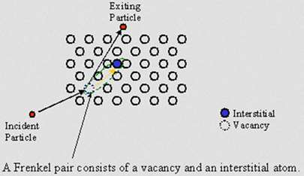
Beam-matter interaction
To investigate material behaviour under irradiation, it is important to consider the irradiation conditions
High energy density fast interaction→ dynamic thermo-mechanical response
Long-term irradiation→ radiation damage (microstructural changes induced by radiation) – main topic of this presentation
Atomic displacement caused by charge particle-nucleus interaction (DPA)
Gas production (H, He)
Consequences of long-term irradiation
Degradation of thermal and electrical conductivity
Radiation hardening
Swelling
Induced brittleness
Atomic displacement induced by an incident particle

Slide 4
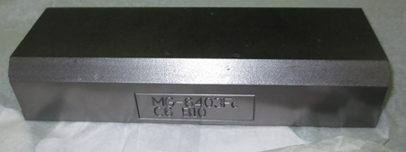
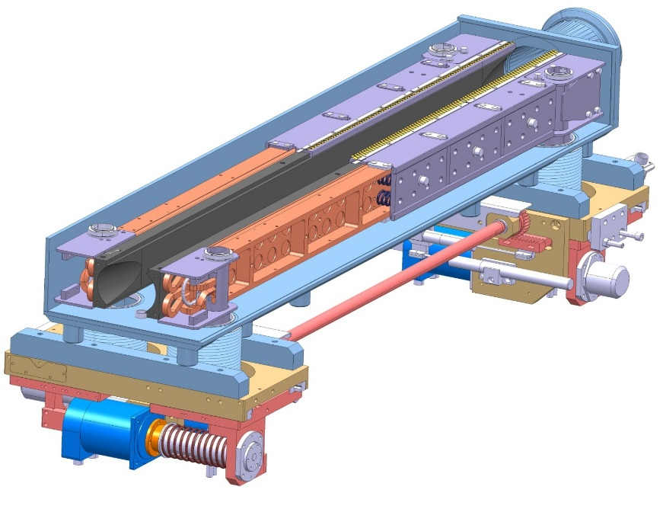
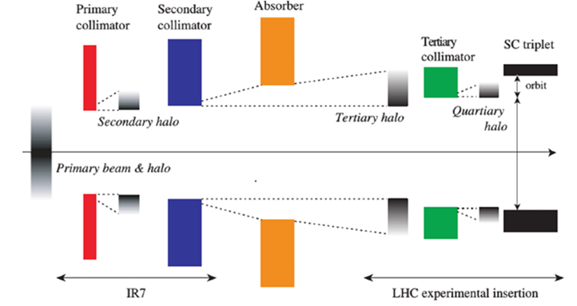
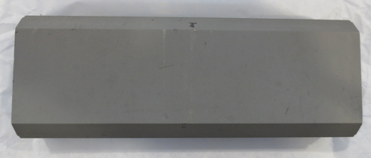
LHC collimation system
Focus on material for beam intercepting device of LHC, e.g. collimators
The energy stored in the beam is very high→ even a tiny fraction of it would induced quench in the superconductive magnet
Need of a protection system from unavoidable beam losses
LHC | 362 MJ
HL-LHC | 690 MJ
FCC | 8500 MJ
v = 390 km/h
120 t Australian road train
MoGr
CFC Jaw Block
~1.2 m
Particle Beam
Vacuum Vessel
Jaw Cooling system
Actuation system
MoGr with Mo coating
CuCD

Slide 5
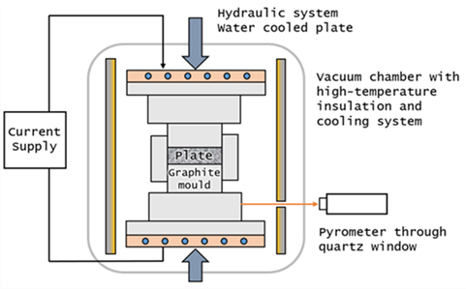
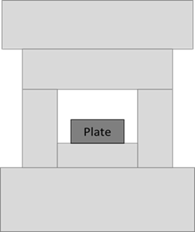
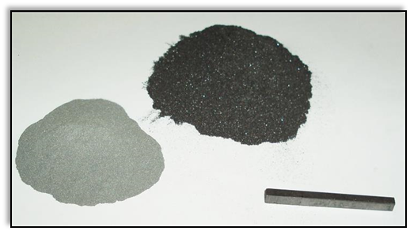
Molybdenum-carbide graphite
Collimators operate in an extreme environment: thermal shock (accidental beam impact), UHV, radiation, high geometrical stability→ C-based materials best compromise, but CFC and graphite have poor electrical conductivity for HL-LHC
A new composite material has been developed to enhance electrical conductivity and other properties→ MoGr baseline for collimators that will be installed in 2020 (LS2).
Powders compaction:
~90-95%vol graphite
~4.5%vol Mo
Ti doping
Sintering:
Mo-C reaction to form carbides
Enhancement of graphitization
Stress-relief treatment:
High temperature, pressure-less
 | In-plane | Perpendicular
Electrical conductivity [MS/m] | ~1 | ~0.08
Thermal Conductivity [W/(mK)] | 700 – 900 | ~50
CTE RT÷200 °C [10⁻⁶K⁻¹] | 1.7 - 2.7 | 8 - 12
Flexural Strength [MPa] | 60 – 80 | 10 - 12
Specific Heat [J/(gK)] | 0.6 - 0.65
Density [g/cm³] | 2.5 – 2.6
J. Guardia et al., Development and properties of high thermal conductivity molybdenum-carbide-Graphite composites, 2018

Slide 6
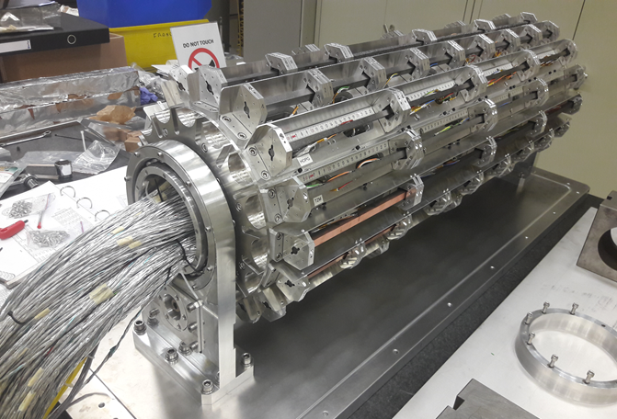
Thermo-mechanical response
Different successful experiences: HRTM14, HRTM23, HRTM36→ thermo-mechanical response of BID materials and benchmarking of numerical simulation
HRTM36: assessment of thermo-mechanical properties of 18 materials, including metallic coatings (Mo, Cu, TiN) on CFC, MoGr, Graphite
Few mm Scratches in impact area→ impact on electrical conductivity seems acceptable
Dynamic response function of thermo-physical properties→ important to correlate to radiation damage-induced degradation
HRTM36 rotating barrel
Impacted Cu and Mo coating on MoGr
A. Bertarelli et al., Dynamic testing and characterization of advanced materials in a new experiment at CERN HiRadMat facility, IPAC 2018

Slide 7
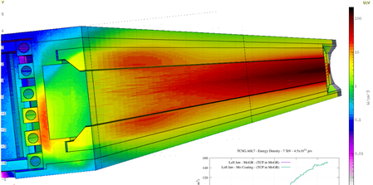
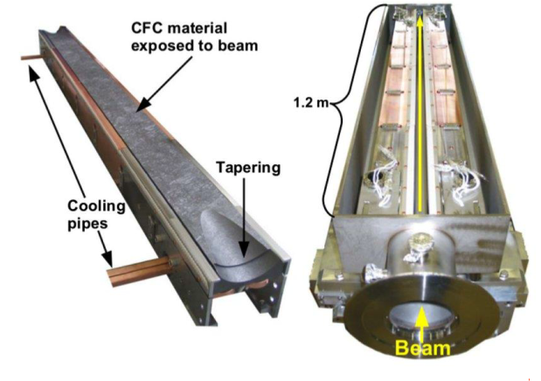
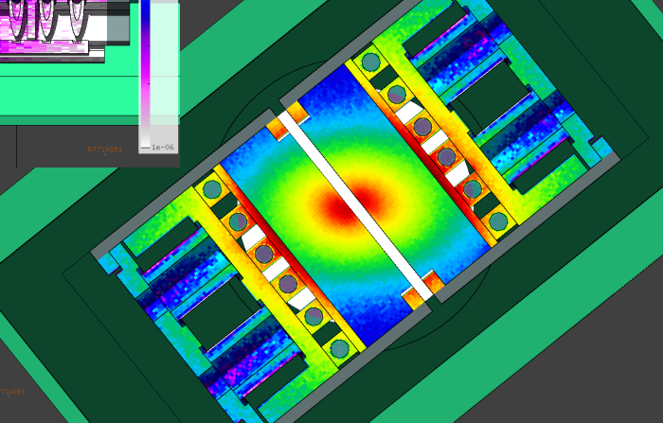
DPA for HL-LHC collimators
FLUKA simulations used to determine the expected DPA level after 12 years of HL-LHC (7 TeV protons)
Displacement Per Atom (DPA) in HL-LHC
(8x10¹⁶ protons lost in collimation system)
Material | Primary [DPA] | Secondary [DPA] | Mo coating [DPA]
MoGr | 0.3 | 4·10⁻⁴ | 1÷3·10⁻³
CFC | 0.12 | 1·10⁻⁴

Slide 8
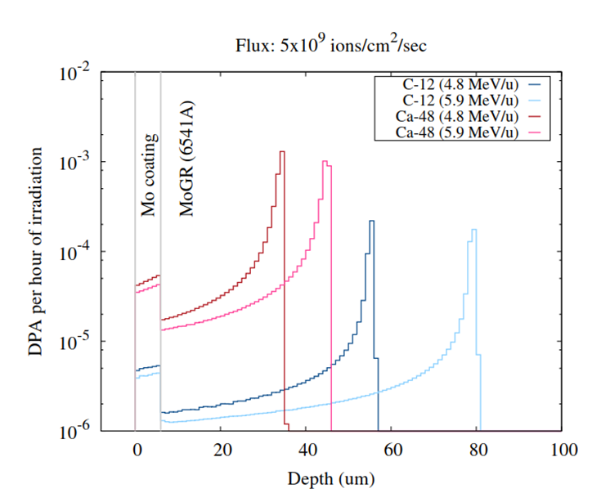
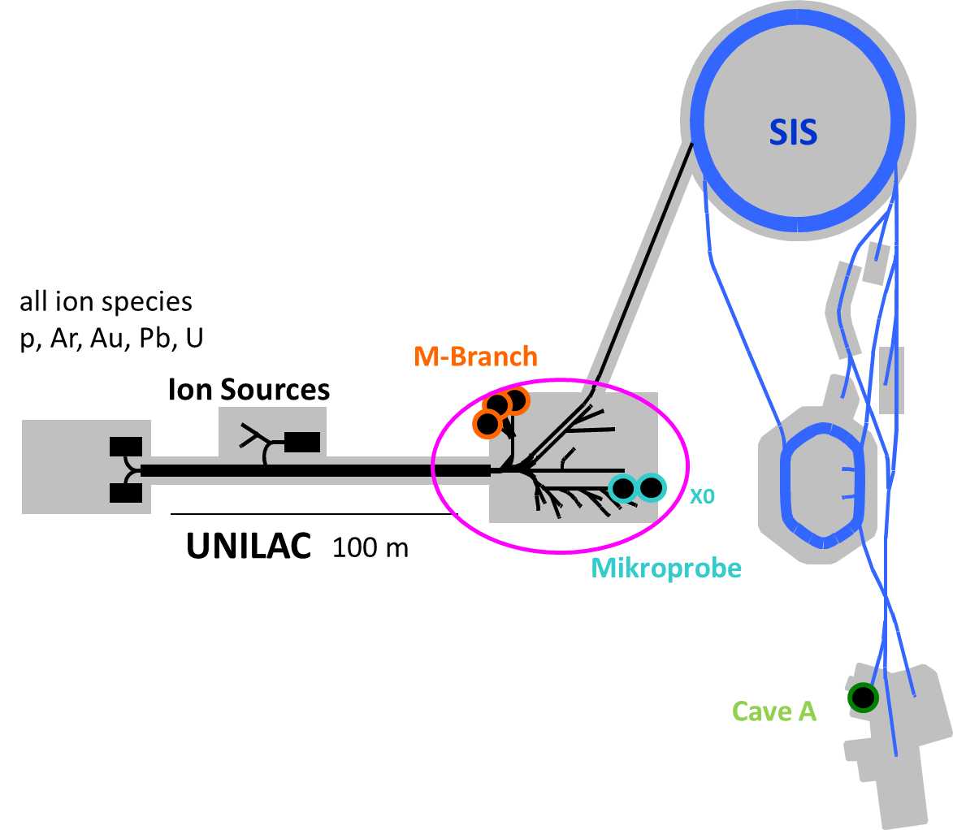
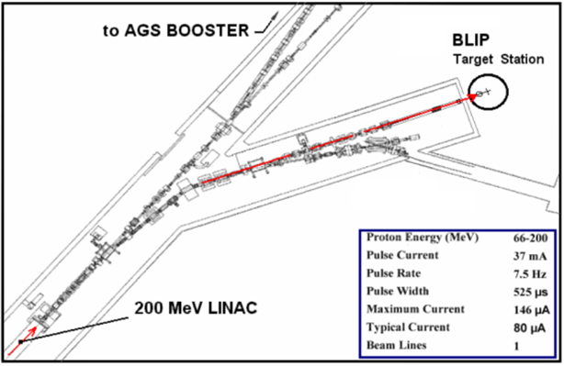
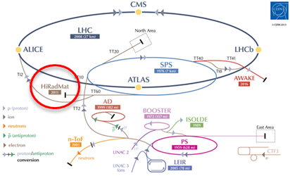
How to mimic 7 TeV protons?
GSI ion irradiation:
Goal: mimic radiation damage induced by 7 TeV protons in 12y and predict the properties degradation
Find a correlation (empirical and theoretical) between ion-induced and proton-induced radiation damage→ different facilities involved
Penetration | Superficial
Gas production | No
Activation | Zero-low ☺
Dose rate | High
EU project within HORIZON 2020
WP17.4 Simulation of irradiation effects and mitigation methods (A. Lechner, CERN-EN/STI)
Radiation damage investigation
Thermo-mechanical response
Max 200 MeV protons
~5 MeV/u ions
440 GeV protons
BNL beamlines
GSI beamlines
CERN- HRMT beamlines
Notes:
Dose rate conservative

Slide 9
MoGr irradiation
BNL (p⁺, n)
GSI (²³⁸U, ²⁰⁹Bi, ¹⁹⁷Au, ¹⁵²Sm, Ca, C ions)
BNL (p⁺, n)
mid 2013
Feb. 2014
July 2014
mid 2015
2016
3th generation
MG 1110-E
(3.7 g/cm³)
NOT fully molten
20%v Mo
40%v C-fibers (long+short)
4th generation
MG 3110-P
(2.67 g/cm³)
Fully molten
20%v Mo
40%v C-fibers (long+short)
5th generation
MG 5200-S
(2.65 g/cm³)
Fully molten
7.2%v Mo
46.4%v C-fibers (long+short)
2 annealing cycles:
1150°C
1300°C
6th generation
MG 6400-U
(2.63 g/cm³)
Fully molten
4.5%v Mo
NO C-fibers
Annealing 1800˚C
MG 6530-Aa
(2.5 g/cm³)
Fully molten
4.5%v Mo
5%v C-fibers (long only)
Annealing 1900°C
MG 6541-Aa
(2.5 g/cm³)
Fully molten
4.5%v Mo
0. %v Ti
5%v C-fibers (short only)
Annealing 1900°C
7th generation
MG 6403-Aa
(g/cm³)
Fully molten
4.5%v Mo
%v Ti
NO C-fibers
E. Quaranta, EuCARD-2 WP11 Annual meeting, CERN 2017

Slide 10
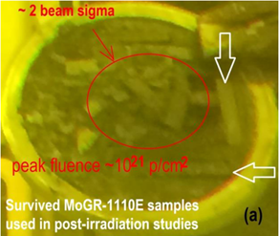
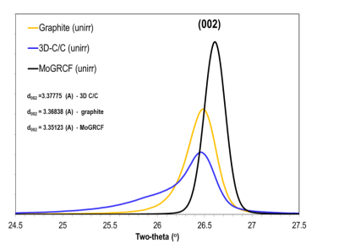
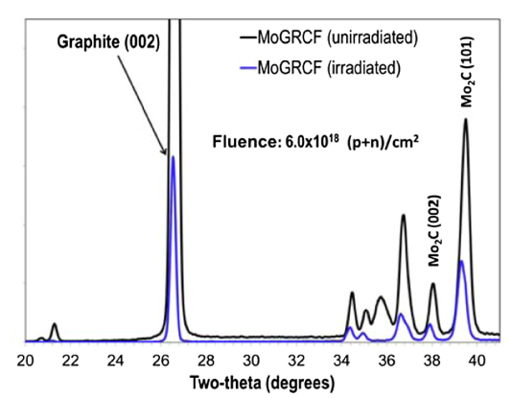
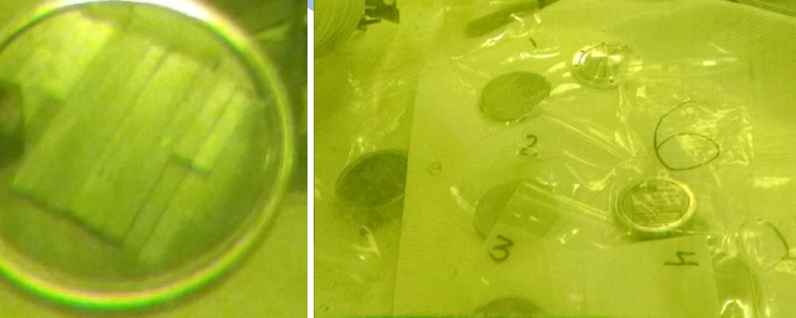
Proton irradiation at BNL
BLIP 2014:
MG1110E
1x10²¹ p/cm² 200MeV
6x10¹⁸ p+n/cm² 118 MeV
Serious structural degradation, already at 6x10¹⁸ p/cm²
Premature failure related to release of internal stresses and/or irradiation-induced transformation of the phase, not to poor graphitization (see XRD below)
0.3 DPA
Introduction of Ti to stabilize phase
Internal stresses release with pressure-less thermal treatment
MG-1110E exposed to max. fluence of 1x10²¹ p/cm²
N. Simos et al. Radiation damage and thermal shock response of carbon-fiber-reinforced materials to intense high-energy proton beam, 2016
BLIP 2016:
MG6530Aa, MG6403Fc, MG6403Ga
2x10²⁰ p/cm² 200MeV
No macroscopic damage after first visual inspection → proof of similar damage threshold of other C/C composites

Slide 11
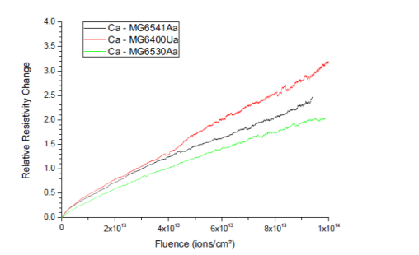
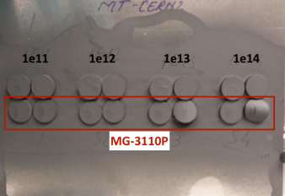
Ion irradiation at GSI
MoGr grades:
- MG3110P No post-sintering treatment
- MG6400 PS treatment, no Ti, no fibers
- MG6530 PS treatment, no Ti, long fibers
- MG6541 PS treatment, Ti, short fibers
C, Ca, Bi, Au, U
4.8 MeV/u-5.9 MeV/u
1x10¹¹-5x10¹³ ions/cm²
MG3110P irradiated with ²⁰⁸Bi at 4.8MeV/u
Electrical resistivity increase for different MoGr grades
Residual stresses accumulated during sintering lead to deformation starting from ~1x10¹³ ions/cm²
High temperature post-sintering treatment useful to increase fluence threshold for deformation
Grades with C-fibers suffer less electrical conductivity degradation
High temperature post-sintering treatment useful to increase fluence threshold for deformation (to be further investigated)
Notes:
The beneficial effect of post-sintering high temperature treatment is confirmed by the test at GSI

Slide 12
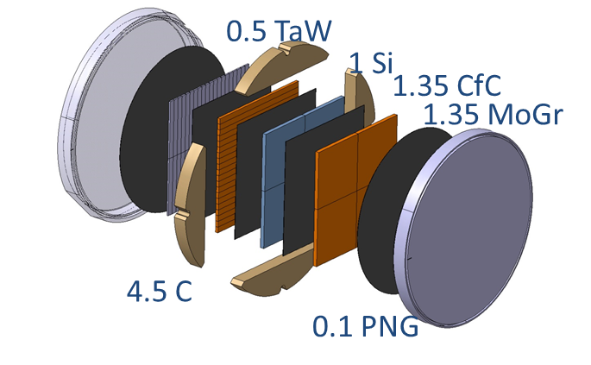
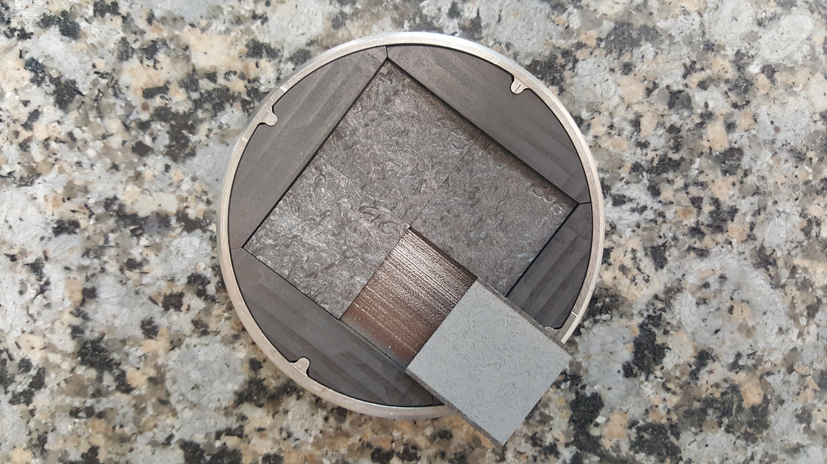
Future tests
New and ‘old’ grades of BID materials (also coated!) under test to reach DPA level ~HL-LHC:
With high-energy proton at BLIP (CFC, MoGr)→ done (In the framework of raDIATE collaboration)
With light ions at GSI (CFC,MoGr,Graphite)→ August 2018
Mo thin coating deposited on the bulk material (secondary collimators)→ investigation of thin film properties degradation:
Adhesion
Impedance
CTE
Thermal conductivity
Courtesy of M. Calviani, CERN EN-STI

Slide 13
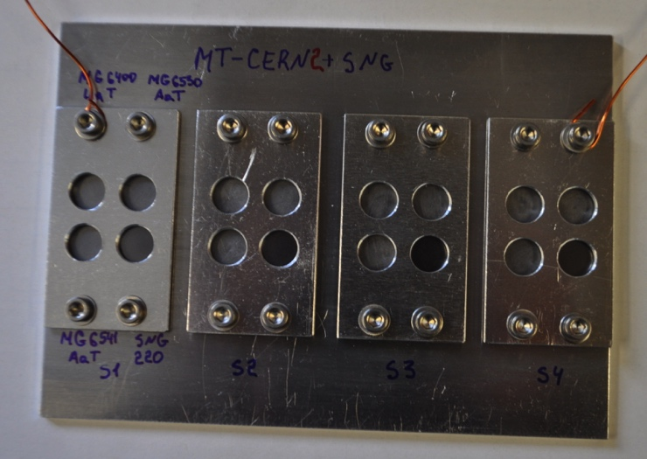
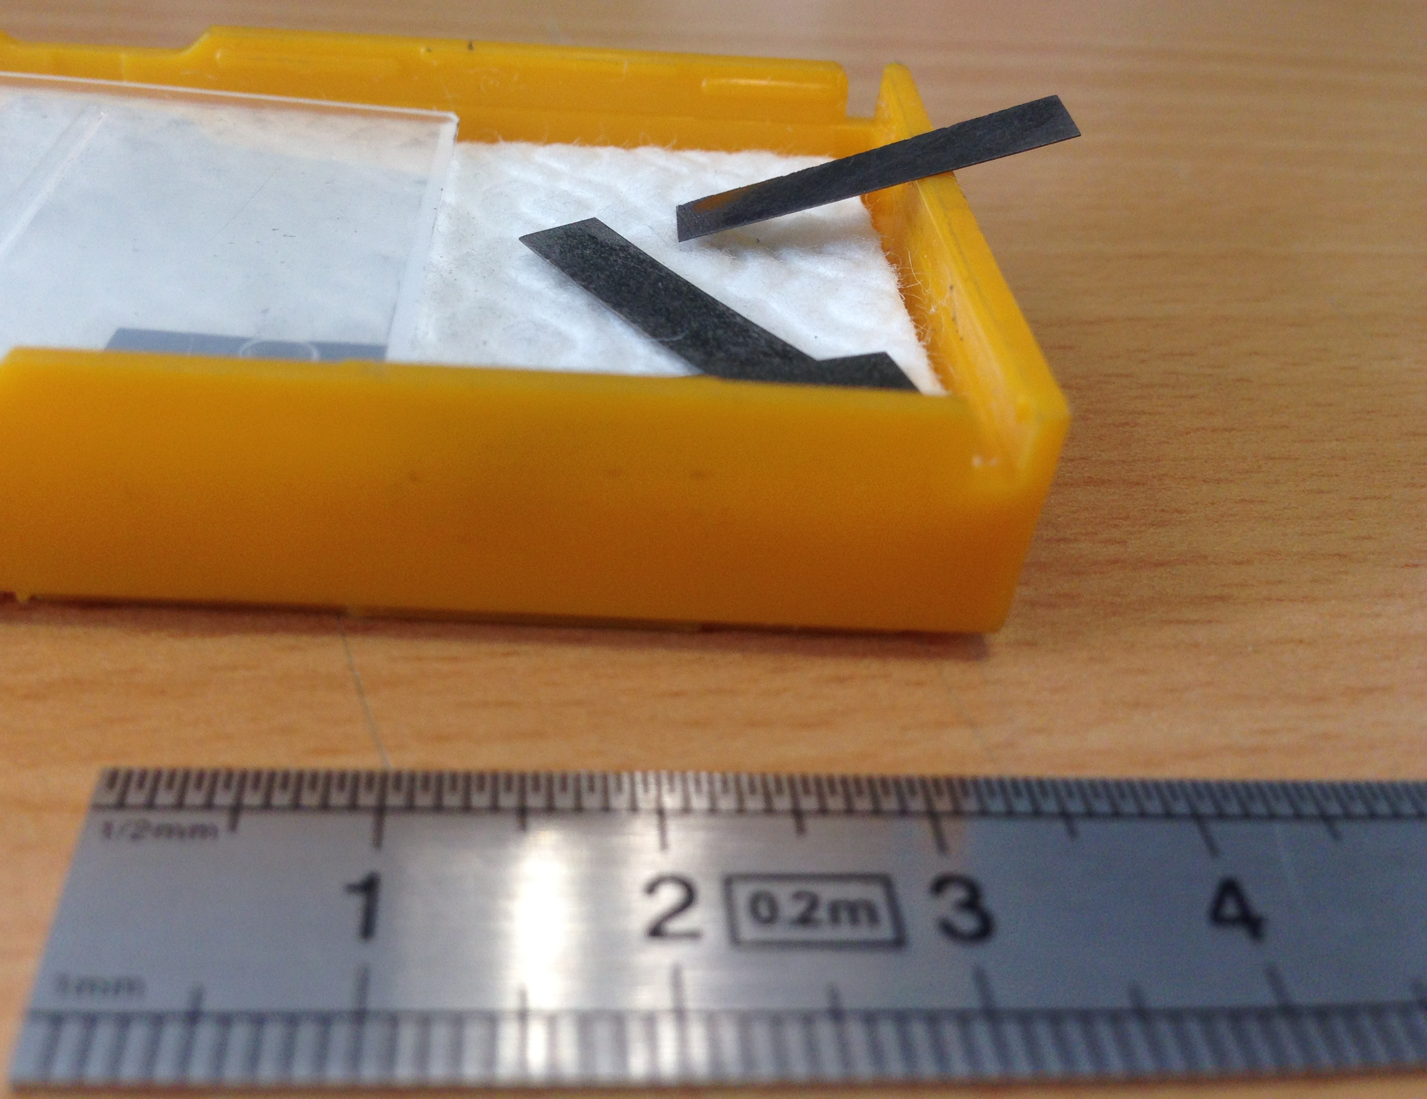
Next GSI irradiation campaign
48Ca, 4.8MeV/u
Φ=5·10⁹ ion/(s·cm²)
f=10Hz, t_{d}=5 ms
4 different fluences and different samples
To overcome thin penetration layer: 150μm thick sample for electrical conductivity measurements!
~4·10¹⁴ ions/cm²
DPA level in the coating similar to HL-LHC after 60h of irradiation
Sample dimensions: D=10mm, t=1mm
Sample dimensions:
20x2.5x0.1mm
 | DPA/hour | DPA collimator
Mo coating | ~5·10⁻⁵ | 1÷3·10⁻³
MoGr | ~1·10⁻³ | 0.3 (primary)

Slide 14
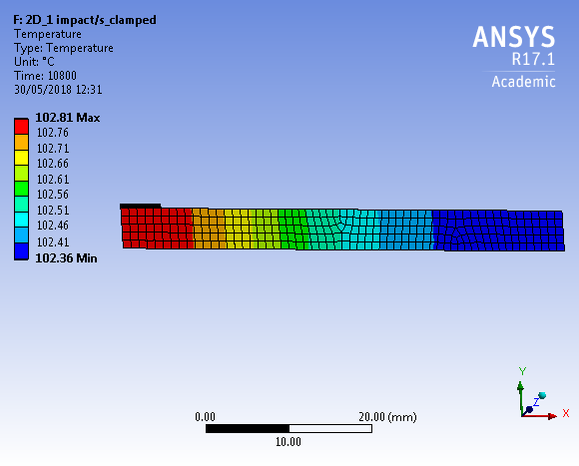
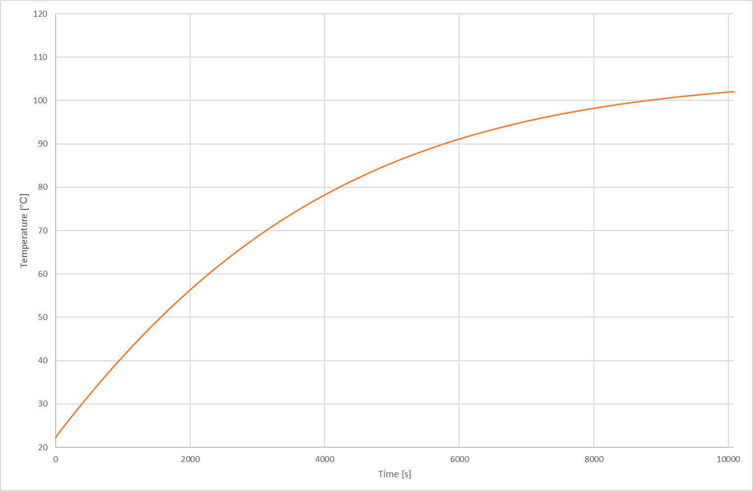
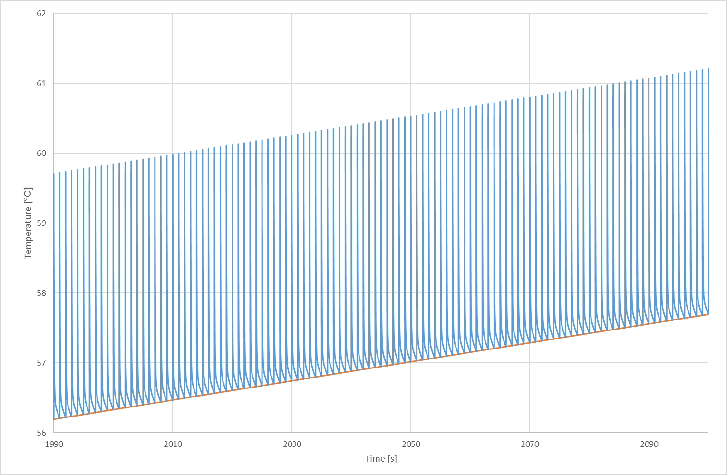
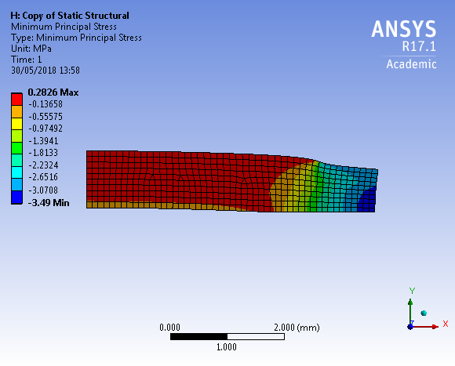
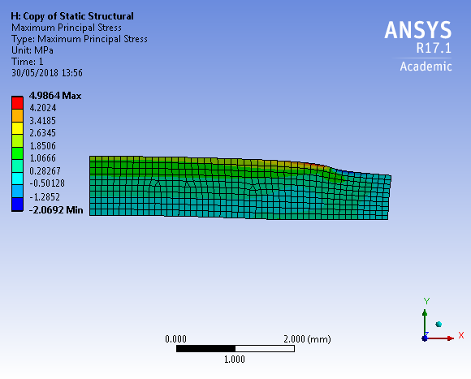
Next GSI irradiation campaign
Thermo-mechanical simulation of 1mm thick disks (2D, axysymmetric)
3h
ΔT~4°C
Transient thermal analysis
Tmax~100°C
Maximum stresses (mainly due to clamping) far from material limits
Structural analysis

Slide 15
Conclusions
Radiation damage to graphitic-based materials for HL-LHC Collimators (MoGr, CFC) could be assessed through irradiation tests campaigns under different conditions:
200 MeV protons at BNL
~ 4.8 MeV/u ions at GSI
Several improvements in MoGr were implemented/validated thanks to these campaigns
High temperature pressure-less thermal treatment to relieve internal stresses
Ti-addition to stabilize Mo carbide phases
C-fibers to help counteract electrical resistivity degradation
Ion irradiation at GSI has some drawbacks (no gas production, different dose rate), but it allows to:
Reach high dpa in short time
Perform analysis on not-activated sample
New experiment planned at GSI testing collimator materials also with metallic coating
Evaluation of radiation-induced degradation of thermo-physical, electrical and micro-mechanical properties:
thermal diffusivity, electrical conductivity, CTE, elastic properties, etc..
Future PIE of thin film metallic coatings irradiated at BNL, fundamental for HL-LHC secondary collimators

Slide 16
Thank you for the attention!

Slide 17
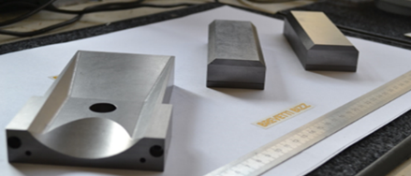
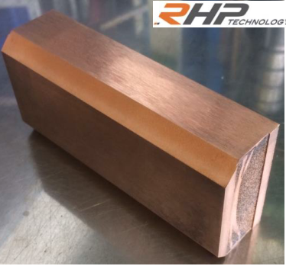
Collimator materials
BID material properties:
High electrical conductivity
High thermal conductivity
Low CTE
High ultimate strength
UHV compatibility
Radiation resistance
STRATEGY for new BID:
Graphite/diamond (low density, good thermal properties,..)+ metals (good mechanical properties)

Slide 18
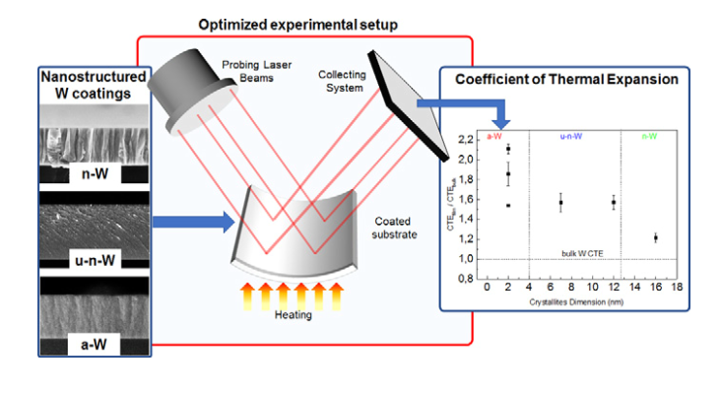
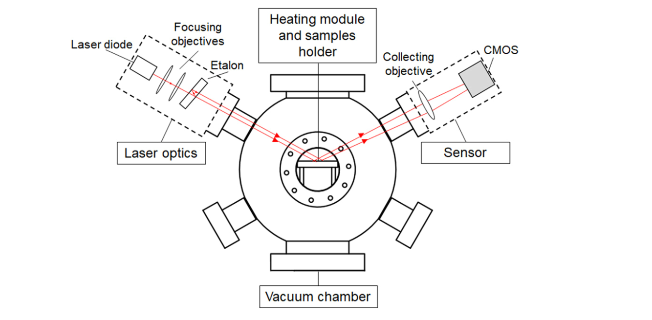
Coating CTE- Substrate Curvature
Mismatch between bulk and film CTE→ bending of the sample
$$σ_{f}\left(T\right)=\frac{E_{S}}{1−ν_{S}}·\frac{t_{f}}{t_{s}^{2}}\text{·}\frac{1}{6}\left(\frac{1}{R\left(T\right)}−\frac{1}{R0}\right)$$
$$σ_{f}\left(T\right)=σ_{thermal}=\frac{E_{f}}{1−ν_{f}}(CTEf−CTEs)∆T$$
$$CTEf=CTEs+\frac{dσ_{f}}{dT}\frac{1−ν_{f}}{Ef}$$
Hp: T-independent E
- Optical system drives a 2D pattern of parallel laser beams
- CMOS sensor detects reflected beams
- Beam position function of the substrate-coating curvature

Slide 19
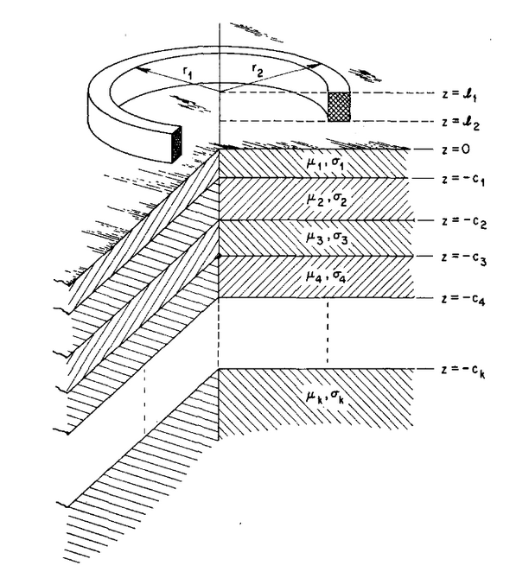
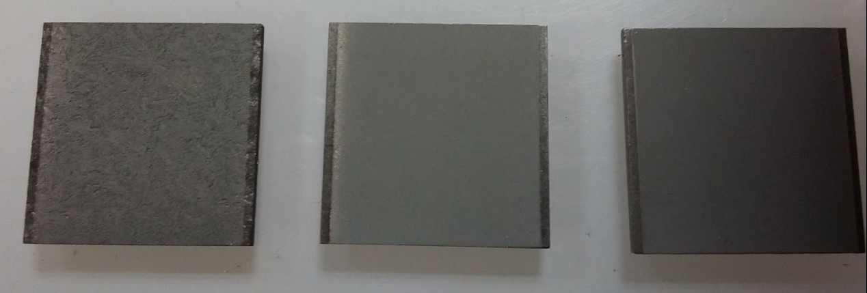
Impedance measurements
Our standard method (long coil + IW2D simulations) is not suitable for small samples
Implemented analytical formulas to compute input impedance of a coil, theory known since 50y [1]
Extended to multi-layer in [2]
Allows any permittivity/permeability/conductivity below coil self resonance (neglects parasitic capacitance between wires and wire-substrate)
Successful measurements on BLIP spare samples.
Slide courtesy of N. Biancacci (CERN, BE/ABP)

Slide 20
Microscopic investigation
Focused ion beam: qualitative idea of adhesion, bulk-coating interface

Slide 21
Thermo-mechanical simulations
Input parameters
E_{impact}= E_{ion}·N·Φ·f $\frac{J}{impact·cm2}$
W_{impact}= $\frac{\text{E}\text{impact}}{td}$ $\frac{W}{impact·cm2}$
Φ=10¹⁰ ion/(s·cm²)
E_{ion}=4.8 MeV/u
N=48 u/ion
f=5Hz
t_{d}=3.5 ms
Φ=5·10⁹ ion/(s·cm²)
E_{ion}=4.8 MeV/u
N=48 u/ion
f=10Hz
t_{d}=5 ms
W_{impact}= $21$ $\frac{W}{impact·cm2}$
W_{impact}= $5.3$ $\frac{W}{impact·cm2}$

