Slide 1
Research of Materials in Target Environment at European Spallation Source
Yong Joong LEE
on behalf of
Monika Hartl, Jemila Habainy, Matteo Ferrari,
and Srinivasan Iyengar
www.europeanspallationsource.se
1 June, 2018

Slide 2
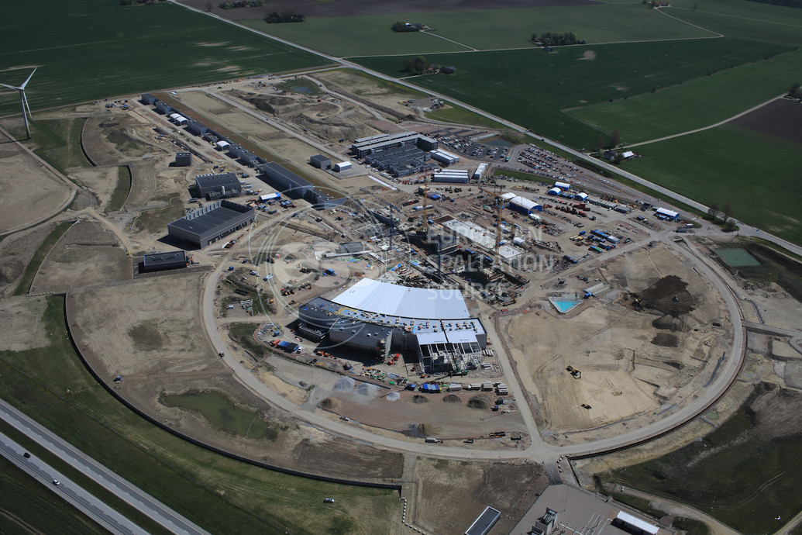
ESS on May 18, 2018 (45% Completion)

Slide 3
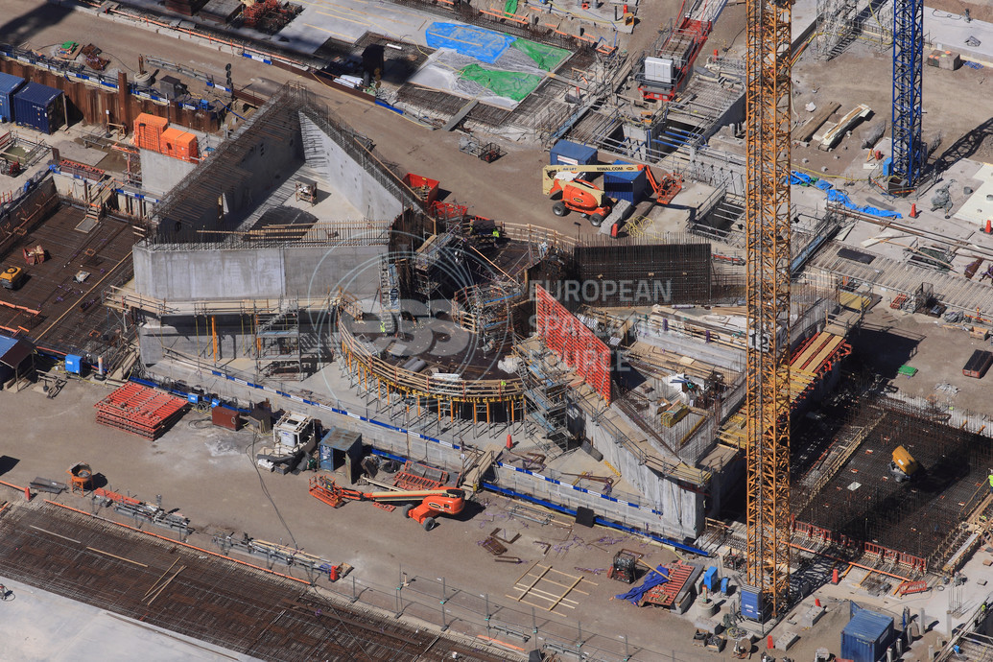
ESS Target Station on May 18, 2018

Slide 4
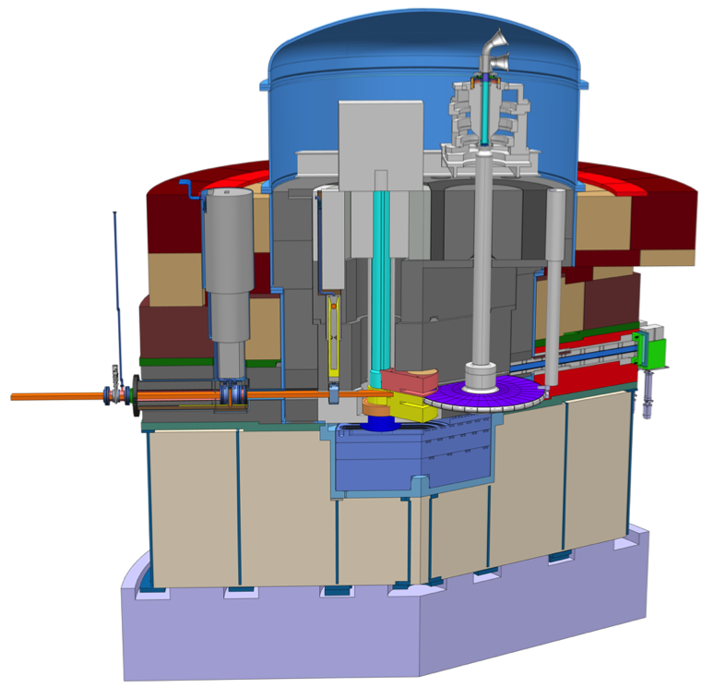
ESS Target Environment
Proton Beam
Instrumentation Plug (PBIP)
Proton Beam
Window (PBW)
Proton beam:
2 GeV/5 MW
Moderator-Reflector
Plug (MR Plug)
Target Wheel

Slide 5
Materials Research in Target Environment
Degradation of functional and structural materials in target environment poses challenges to operational reliability and costs.
The materials research at ESS is dedicated to
  Selection of materials which endures intense radiation field in target environment
  Determination of component lifetime, which are subject to radiation damage
  Realization of the visions of materials R&D at ESS
  Contributions to the high power target community with the knowledge acquired

Slide 6









Materials Research in Target Environment
Materials Research
Spallation Materials
PBW Materials
Polymers and Lubricants
Moderator Materials
Irradiation Module
Beam Imaging Materials
RaDIATE

Slide 7
Spallation Material Research
Spallation Materials
Tungsten tensile and fatigue properties
Tungsten oxidation
STIP-V tungsten PIE
Heavy ion irradiation program
Erosion and oxide aerosol release
Tungsten release factors
Purpose: Identification of reliable operational conditions of tungsten

Slide 8
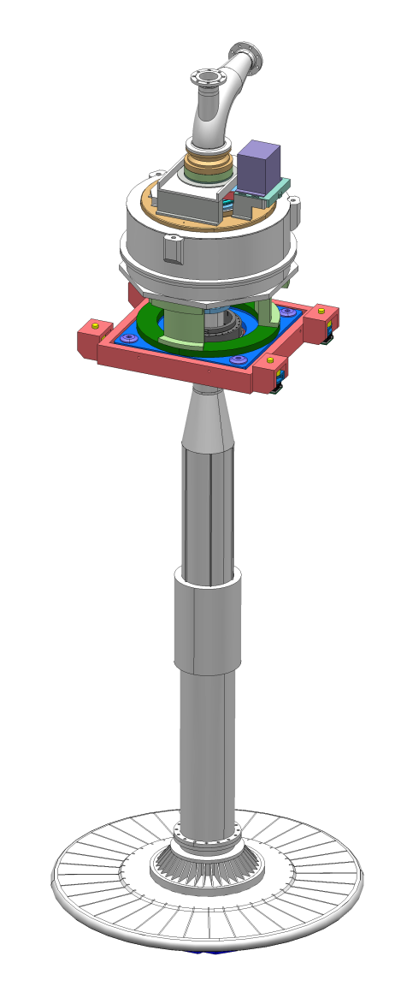
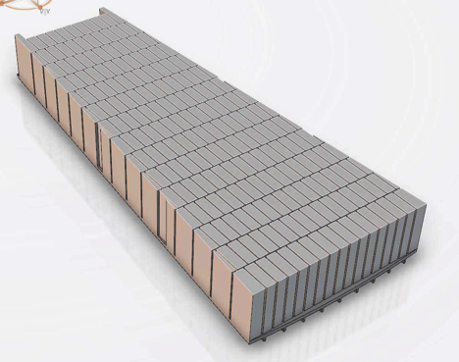
Spallation Material: Operational Environment
Parameter | Unit | Value
Beam energy | GeV | 2.0
Pulse length | ms | 2.86
Repetition Rate | Hz | 14
Raster deflection, horizontal | mm | 60.0
Raster deflection, vertical | mm | 20.0
Beamlet RMS, horizontal | mm | 13.5
Beamlet RMS, vertical | mm | 5.05
Peak current density | mA/cm² | 1.16

Slide 9
Spallation Material: tensile and fatigue properties
Vendors | Raw material | Fatigue Limit [MPa] | Fracture
Vendor A | Hot rolled | 125 | Transgranular
Vendor B | Hot rolled | 312 | Transgranular
 | Hot forged | 185 | Intergranular
Vendor C | Hot rolled | 371 | Transgranular
 | HIPed | 185 | Intergranular

Slide 10
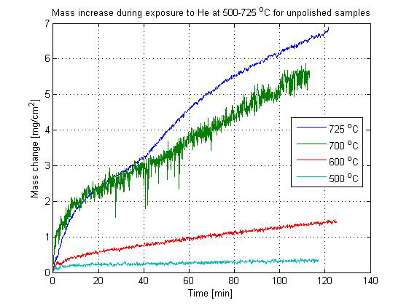
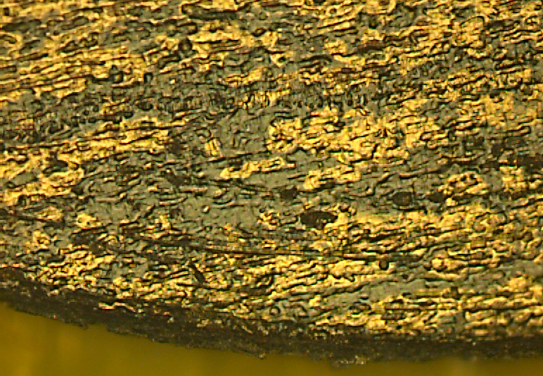
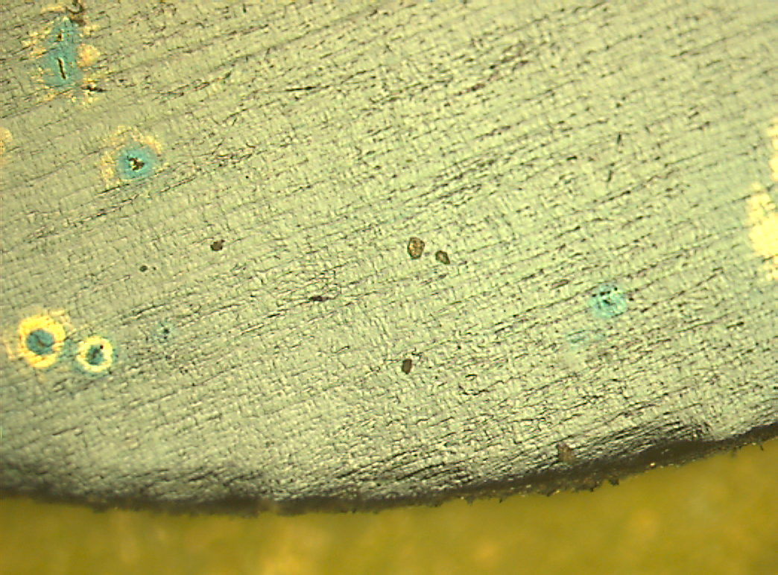
Spallation Material: Oxidation
Oxidation observed in He atmosphere with a small partial pressure of oxygen above 500°C [J. Habainy et al. IWSMT-12, 2014]
Reactive vaporization of the hydrated oxide layer is observed in steam above 700°C [G. Greene, C. Frinfrock, Exp. Therm. Fluid Sci. 25 (2001)]

Slide 11
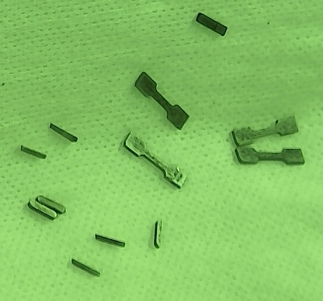
Spallation Material: STIP-V Tungsten PIE
STIP-V (Target 7): Two 60 x 8 x 1 mm³ tungsten bars
  Irradiation period: 2007-2008 for total 9.83 Ah p-charge
  Irradiation condition: 5-28 dpa at 100-800 C
Post Irradiation Examination
  Bend tests
    6 low dose and 16 high dose bars
  Tensile tests
    4 high dose specimen
  Hardness tests
    Irradiation hardening as a function of dose
  SEM & TEM microscopy
    Fracture mode and microstructural changes at different doses and temperatures
  Thermal diffusivity with Laser Flash Apparatus
    2 low dose, 3 high dose discs
11:30 TUE
Thermal Diffusivity of Tungsten
Jemila Habainy

Slide 12
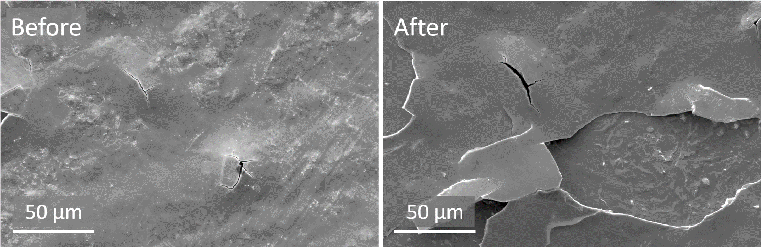
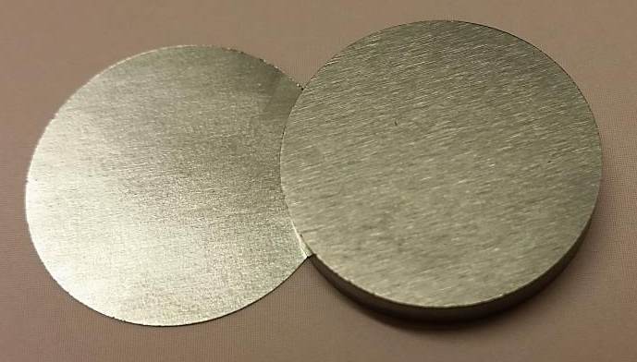
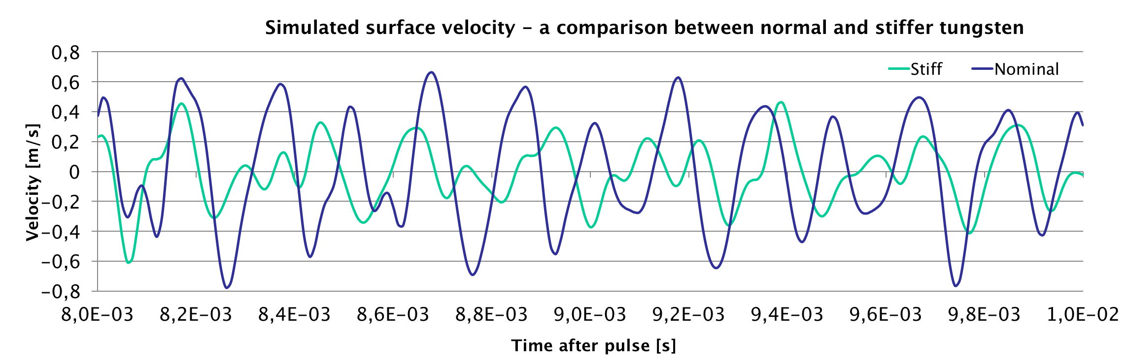
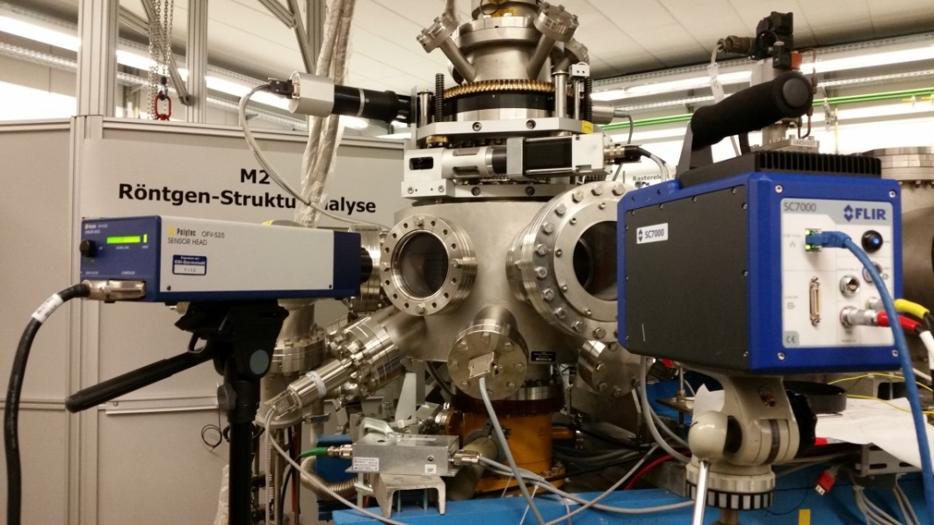
Spallation Materials: M3-beamline of GSI UNILAC
U-beam on tungsten coins
  Beam energy: 4.8 MeV/u
  Ion flux: Max. 7.5e9 ions/cm²/pulse
  Pulse length: 150 us
  Repetition rate: 1 Hz
Comparable thermal and stress amplitudes
  74 C (ESS) vs 82 C (GSI)
  56 MPa (ESS) vs 125 MPa (GSI)
Post Irradiation Examination:
  Hardness tests
  Stability of oxide layer
  Dynamic response
  Thermal diffusivity

Slide 13
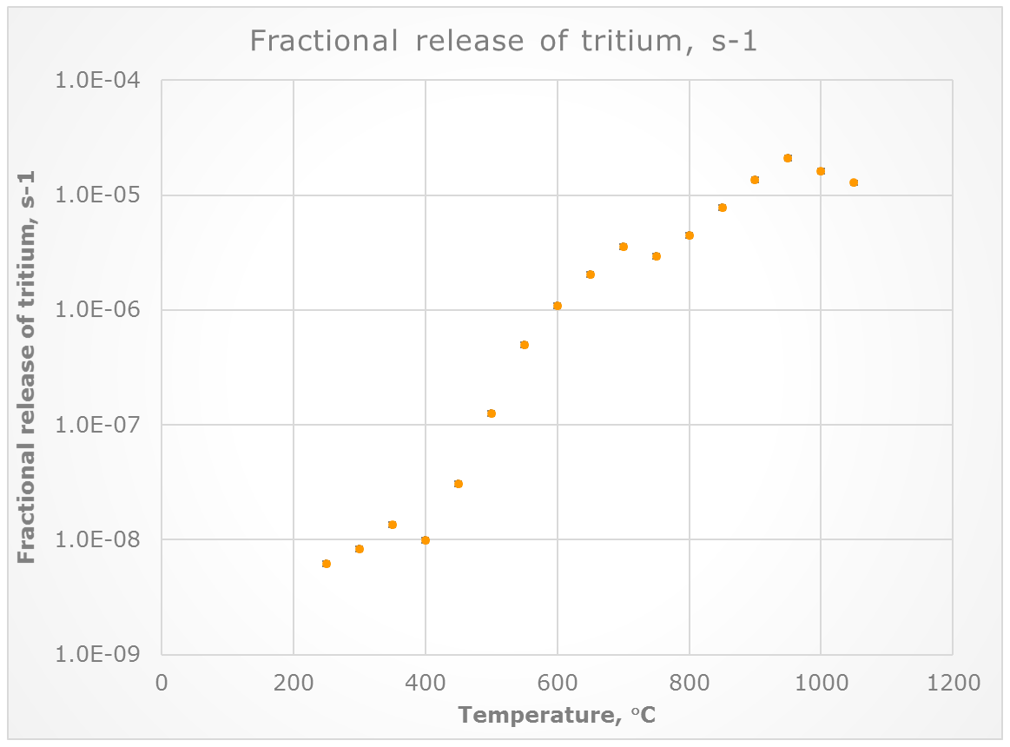
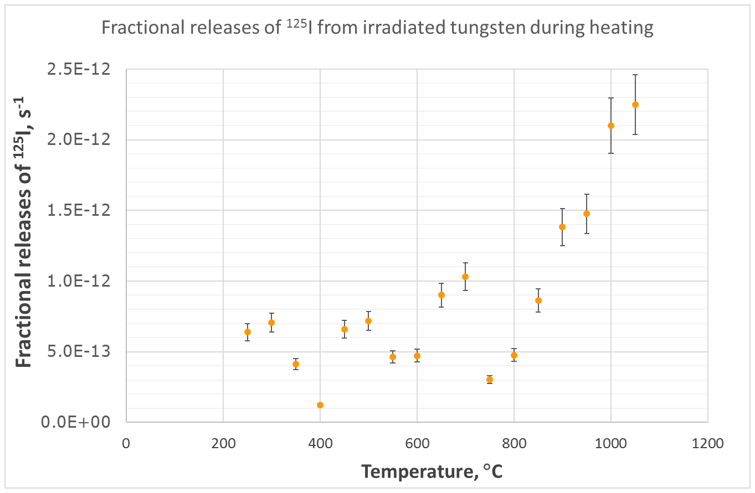
Spallation Material: Release Fraction
Motivation: Measurements of the temperature-dependent release factors of important radionuclides is necessary for the estimation of the radiation dose to workers and public, during off-normal events
Xiaolin Hou, Mikael Jensen, Sven P. Nielsen, Günter Muhrer

Slide 14
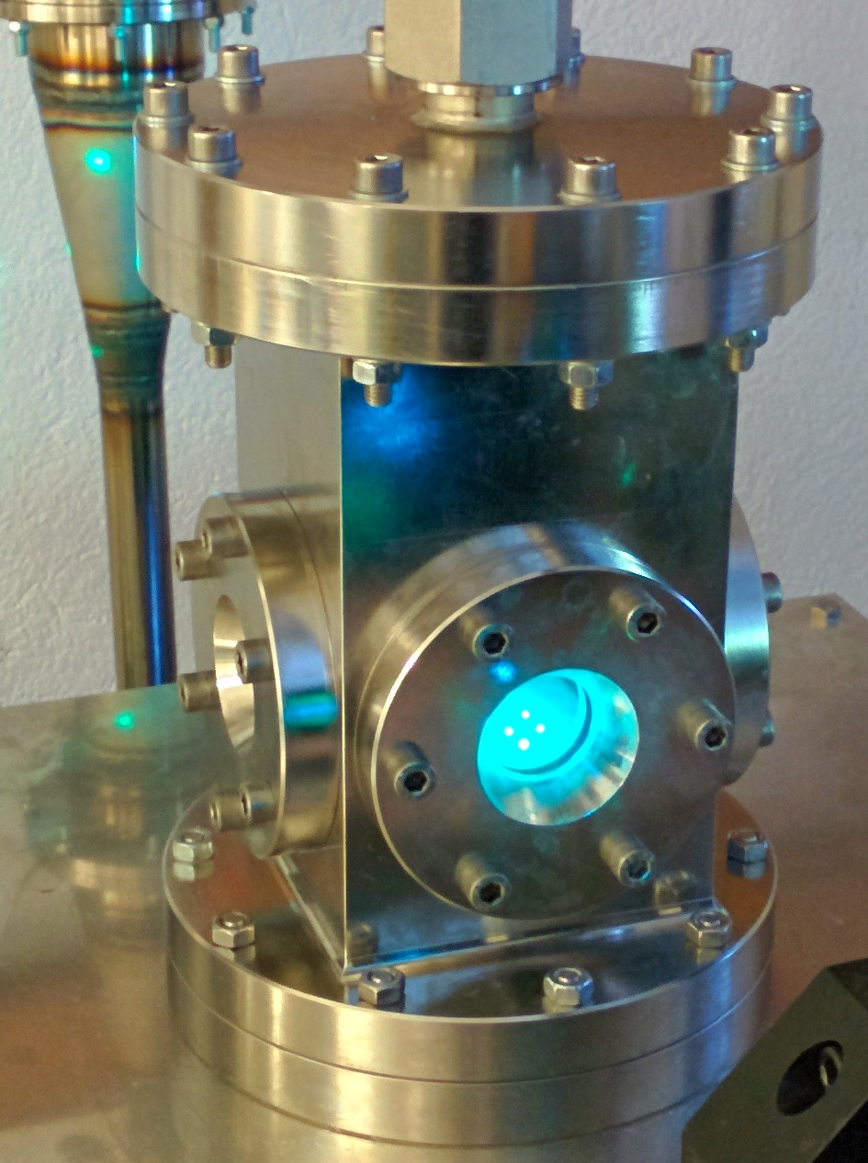
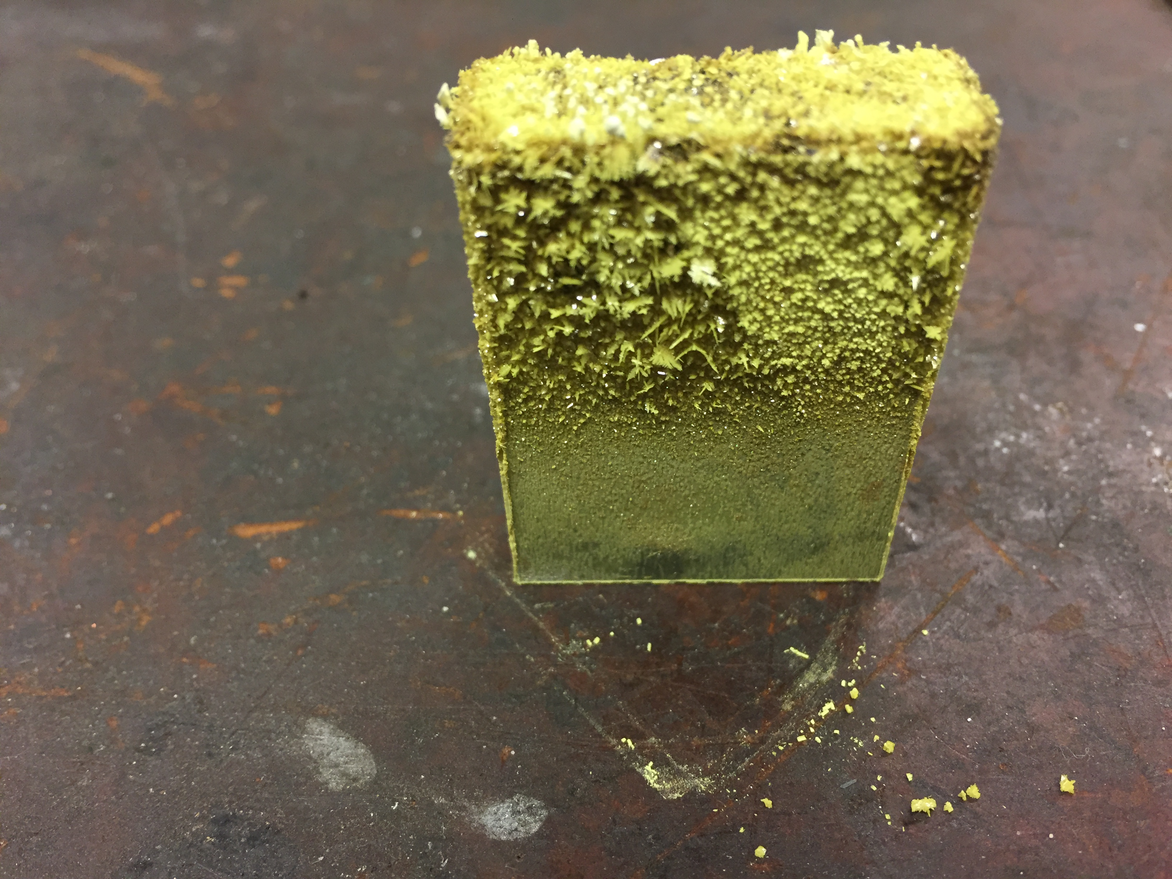
Spallation Material: Erosion and oxide aerosol release
13:20 MON
Tungsten Oxidation Aerosol Transport Experiments
Dr. Per Nilsson

Slide 15



Proton Beam Window Materials Research
Purpose: Exploration of the feasibility of a longer PBW lifetime under proton dose
PBW Materials
BLIP Irradiation Campaign
Mechanical Characterization of Luminescent Coating
STIP-VII Specimens PIE (Plan)
RaDIATE

Slide 16
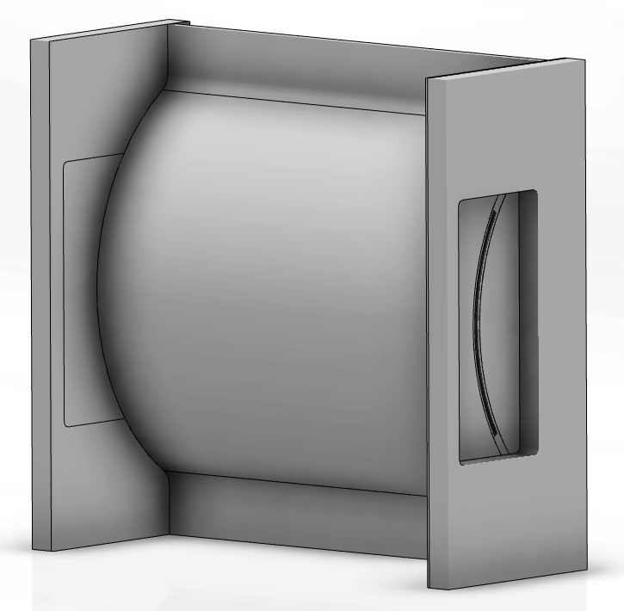
PBW Material: Operational Environment
Parameter | Unit | Value
Material | Al6061-T6
Raster deflection, horizontal | mm | 47.4
Raster deflection, vertical | mm | 15.8
Beamlet RMS, horizontal | mm | 10.67
Beamlet RMS, vertical | mm | 3.99
Peak current density | mA/cm² | 1.66

Slide 17
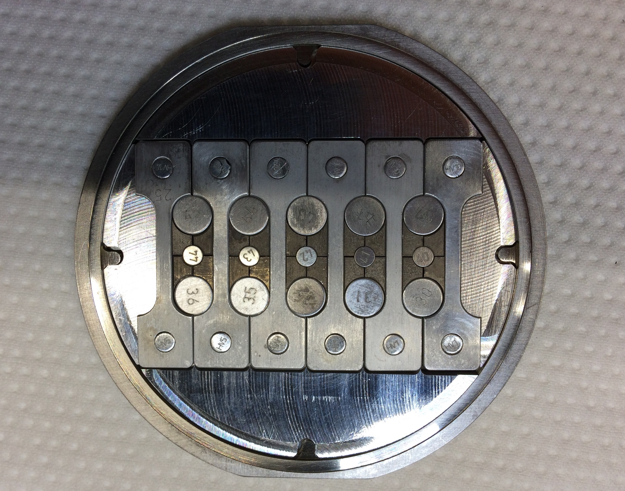
PBW Material: BLIP Irradiation Campaign
Purpose: Characterization of helium bubble distribution in Al6061-T6 and Al5754-O
Beam Parameters
  Energy: 181 MeV
  Current: 165 uA
  Rastered Beam Profile
    6.67 Hz
    Sigmax = xx, sigmay = yy
    4 x outer (r = 1.2 cm) xxx us
    1 x inner (r = x.x cm)
RaDIATE

Slide 18
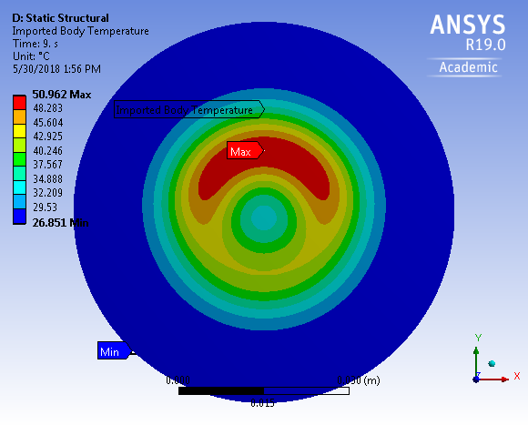
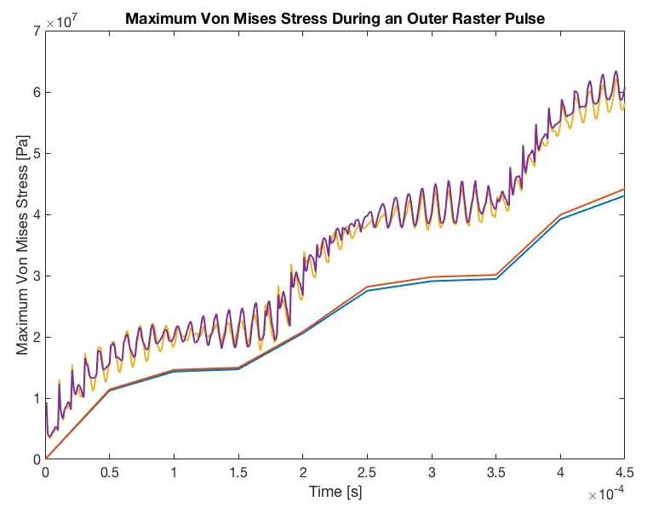
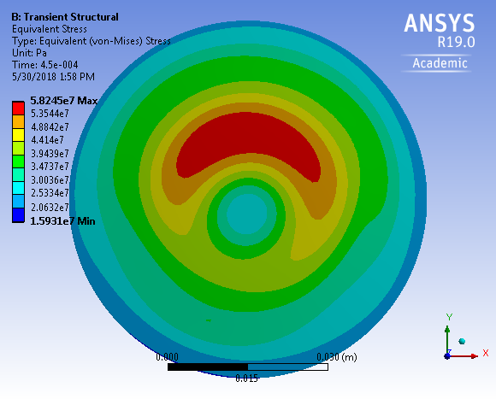
PBW Material: Raster Dynamics
Coupled thermal and structural analysis for a single outer raster is made
The dynamic effect on thermal stress is about 20 MPa (10% of tensile stress for 304L SS)

Slide 19
PBW Material: STIP-VII PIE (Plan)
STIP-VII LT type tensile specimens
  Ti-6Al-4V
  Al6061-T6
Required post irradiation examinations:
  Hardness tests
  Tensile tests
  Positron annihilation spectroscopy
  SEM
  TEM
  LFA
  3D atom probe tomography.

Slide 20

PBW Material: Mechanical Characterization of Luminescent Coating
Purpose: Identification of the additional risk of window failure due to luminescent coating
Tests planned:
  Bend test
  Bend fatigue test
  Tensile test
  Interface characterisation:
    SEM & EDS
    Micro/Nano-indentation
    Coating uniformity: LDV
    Porosity
    Residual stress

Slide 21
Polymers and Lubricants
Purpose: Compilation of radiation resistance data of polymers in mixed neutron and gamma dose
Polymers and Lubricants
LENA Irradiation Campaign
PIE of Polymers
PIE of Lubricants

Slide 22
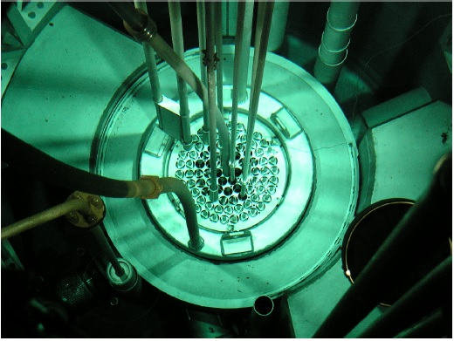
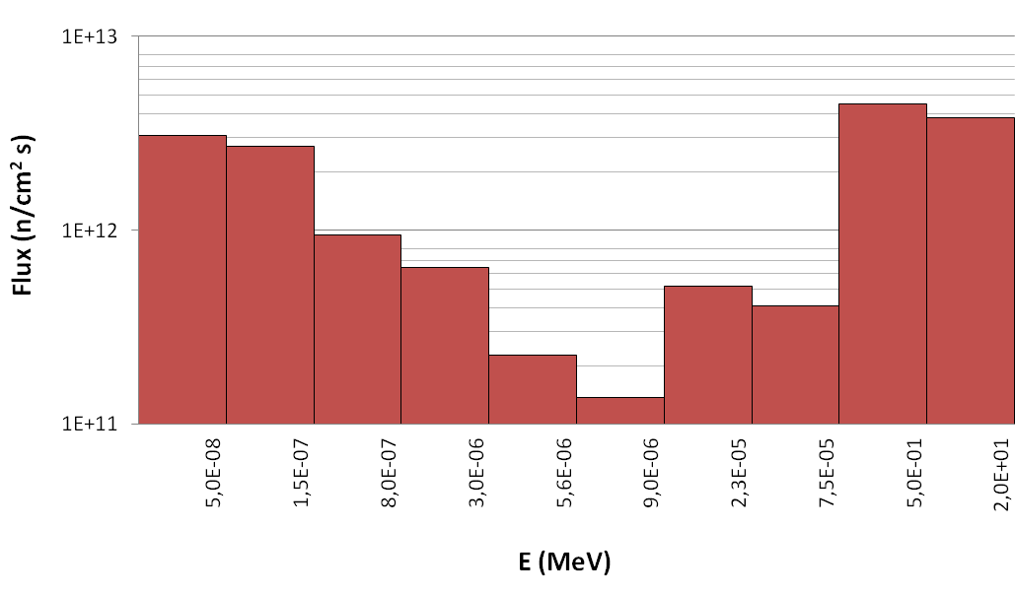
Polymers and Lubricants: LENA Irradiation Campaign
TRIGA MARK-II Nuclear Research Reactor in Pavia
  250 kW maximum power
  Central thimble with a diameter of 3.8 cm houses the test specimens
  Total maximum neutron flux: 1.72e13 neutron/cm²/s
    Thermal (E < 0.8 eV): 6.75e12 neutron/cm²/s
    Fast (E > 0.5 MeV): 3.80e12 neutron/cm²/s
  Maximum irradiation temperature: 60 C

Slide 23
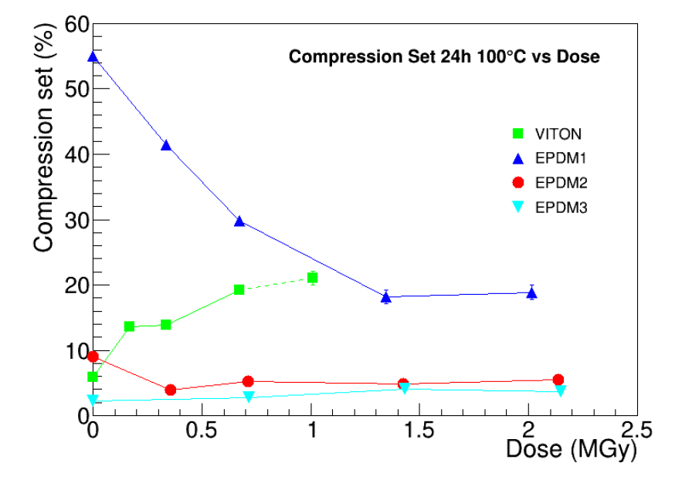
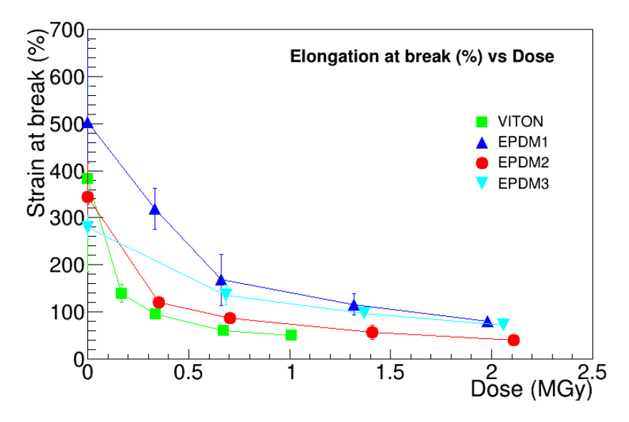
Polymers and Lubricants: PIE of Elastomers

Slide 24
Polymers and Lubricants: PIE of Lubricants

Slide 25
Moderator Materials
Purpose: Characterization of moderator-reflector materials in view of neutronic performance
Moderator Materials
Characterization of ortho-para catalyzers
Characterization of different grades of beryllium
Nanodiamond (Plan)

Slide 26
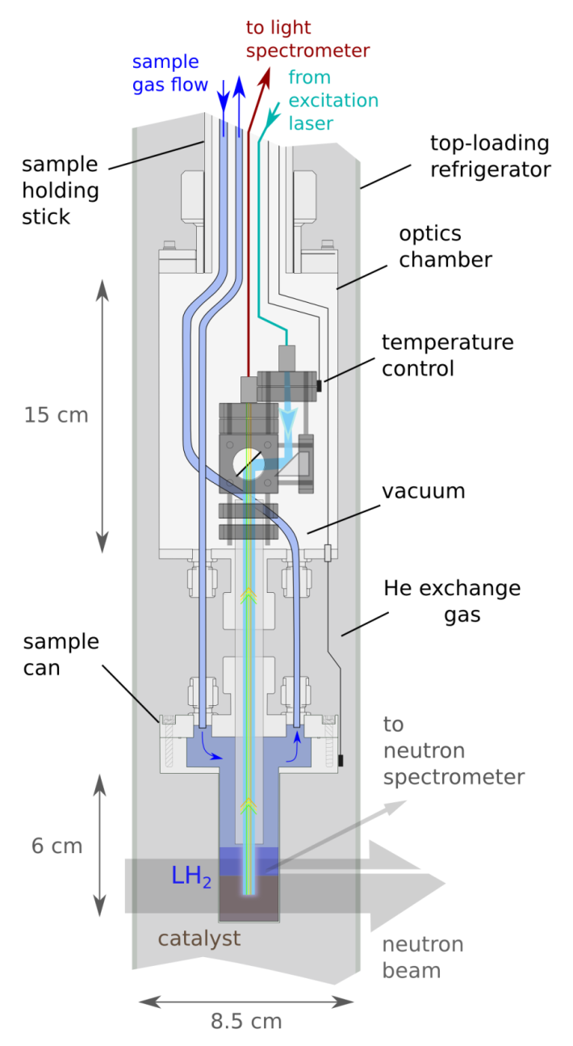
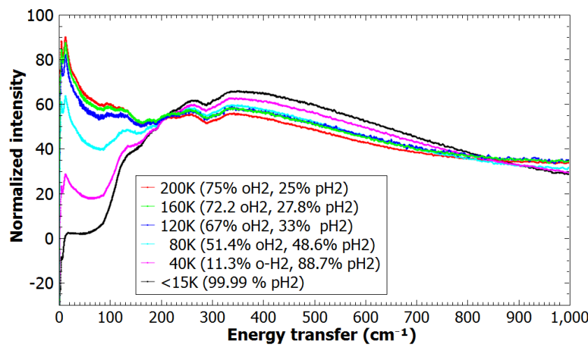
Moderator Materials: Ortho-Para Catalyzers
R.C. Gillis et al., Rev. Sci. Inst, 2018
M. Hartl et al, PCCP 2016

Slide 27
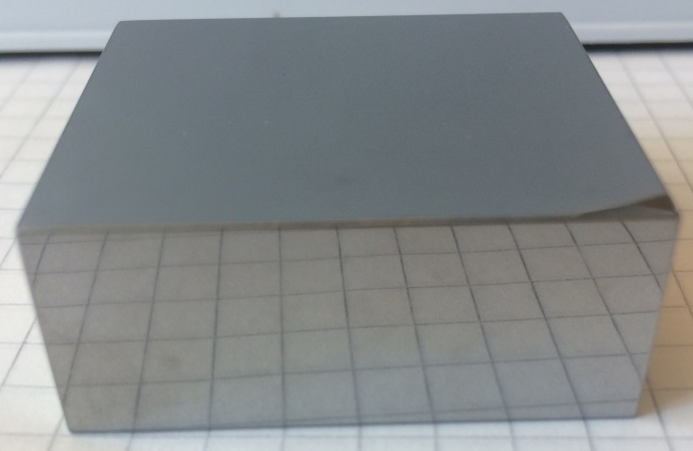
Moderator Materials: Beryllium of different grades
Beryllium Selection Criteria
  Isotropic texture
  Small grain size
  High purity
Research on the correlation between neutron scattering x-section and different beryllium is launched
G. Muhrer et al., NIMA, 2007

Slide 28
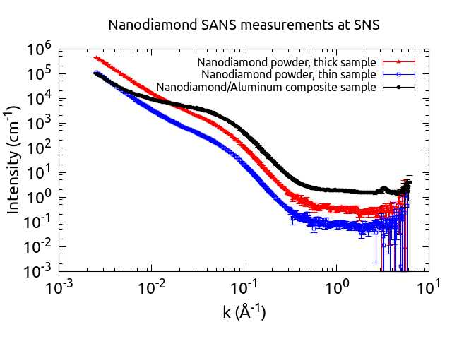
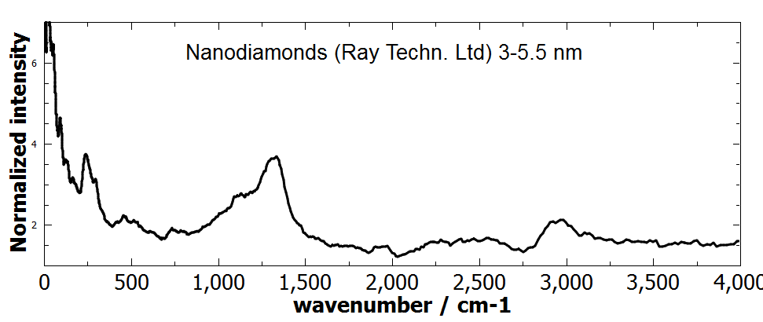
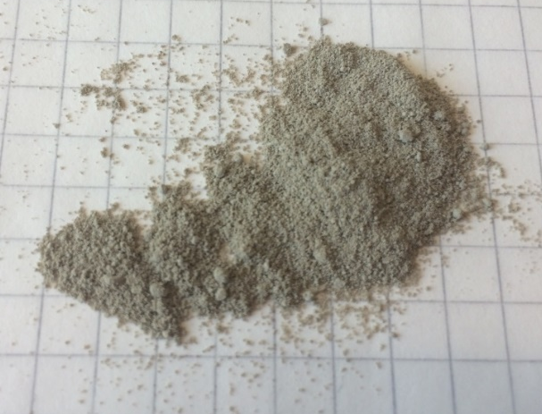
Moderator Materials: Nanodiamond
Nanodiamonds
  Useful for cold neutron reflection
  2 sources:
    Aldrich, < 10nm (TEM), 200-450 m²/g (BET)
    Ray Techn. Ltd, 3-5.5 nm, hydrophobic
  Issues:
    Surface contamination
  Goal:
    Develop scattering kernel
    Determine usefulness for application
K. Grammer et al., (SNS)
Aldrich, <10 nm
F-H-F
stretch?
C-H
stretch

Slide 29
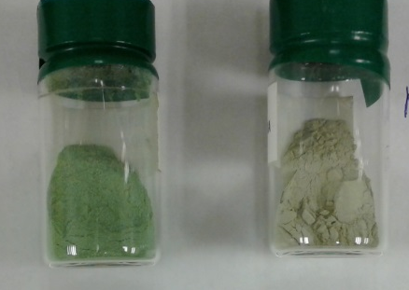
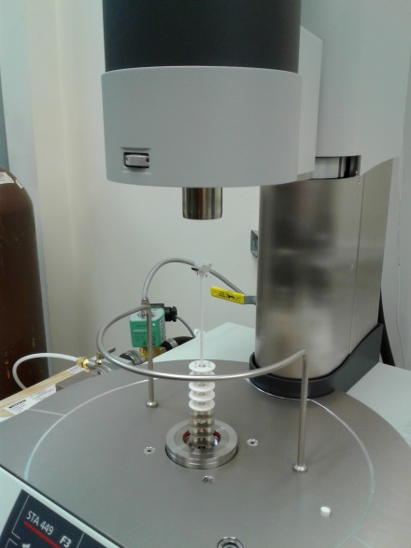
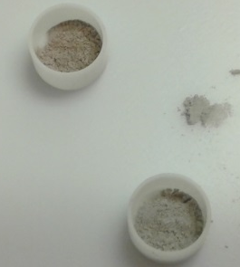
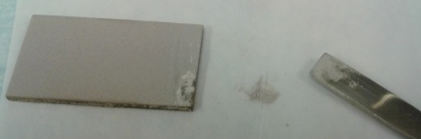



Beam Imaging Materials
Luminescence screen:
  Cr-doped alumina (SNS/ESS)
  Structural changes upon irradiation (XRD), stability of various phases
  Impact of pre-cursor on structure
  Thermal stability of alumina (DSC/TG)
Future: development of more radiation-resistant materials:
  Y₂WO₆ and others….
Original
batch of
pre-cursor
New batch of
pre-cursor

Slide 30
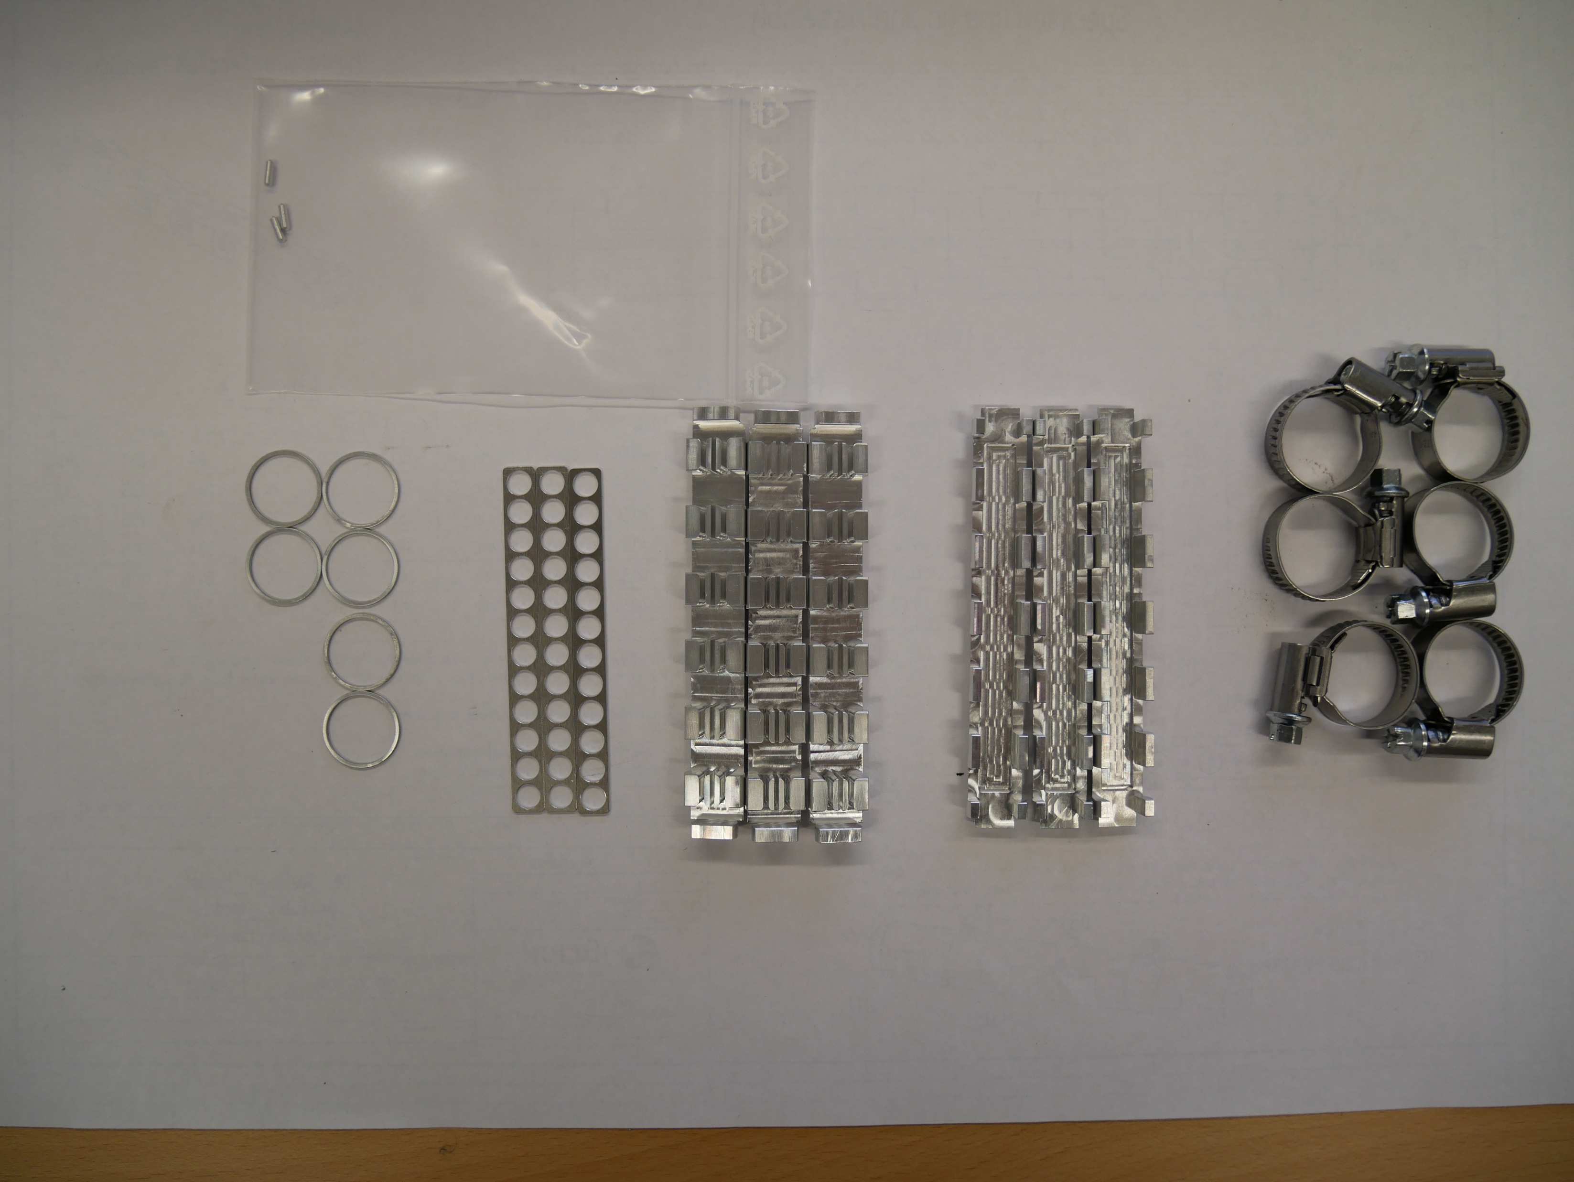
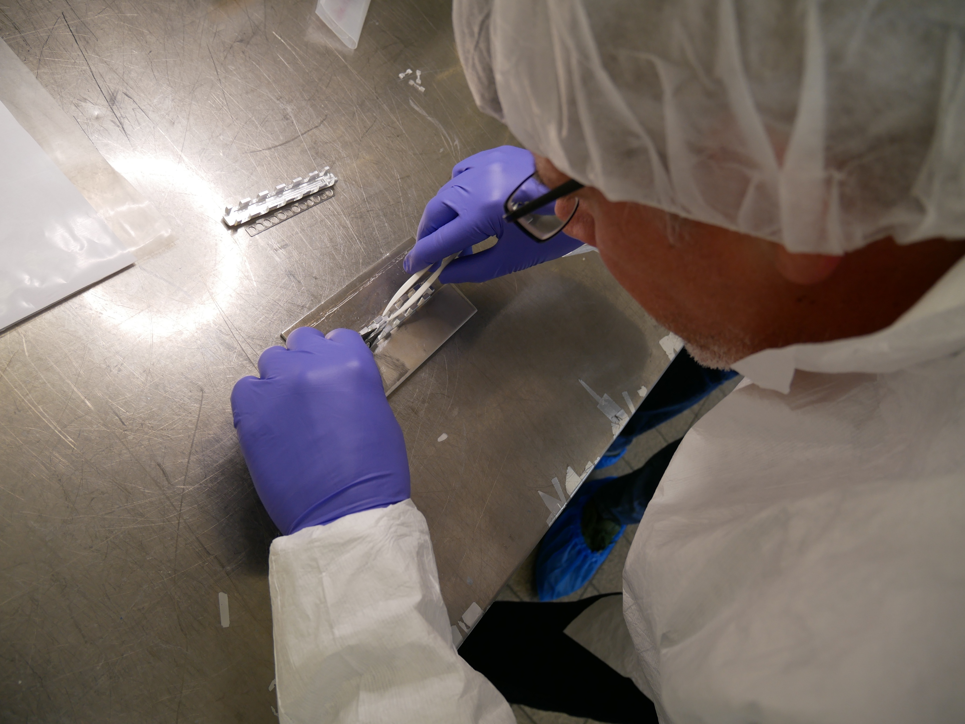
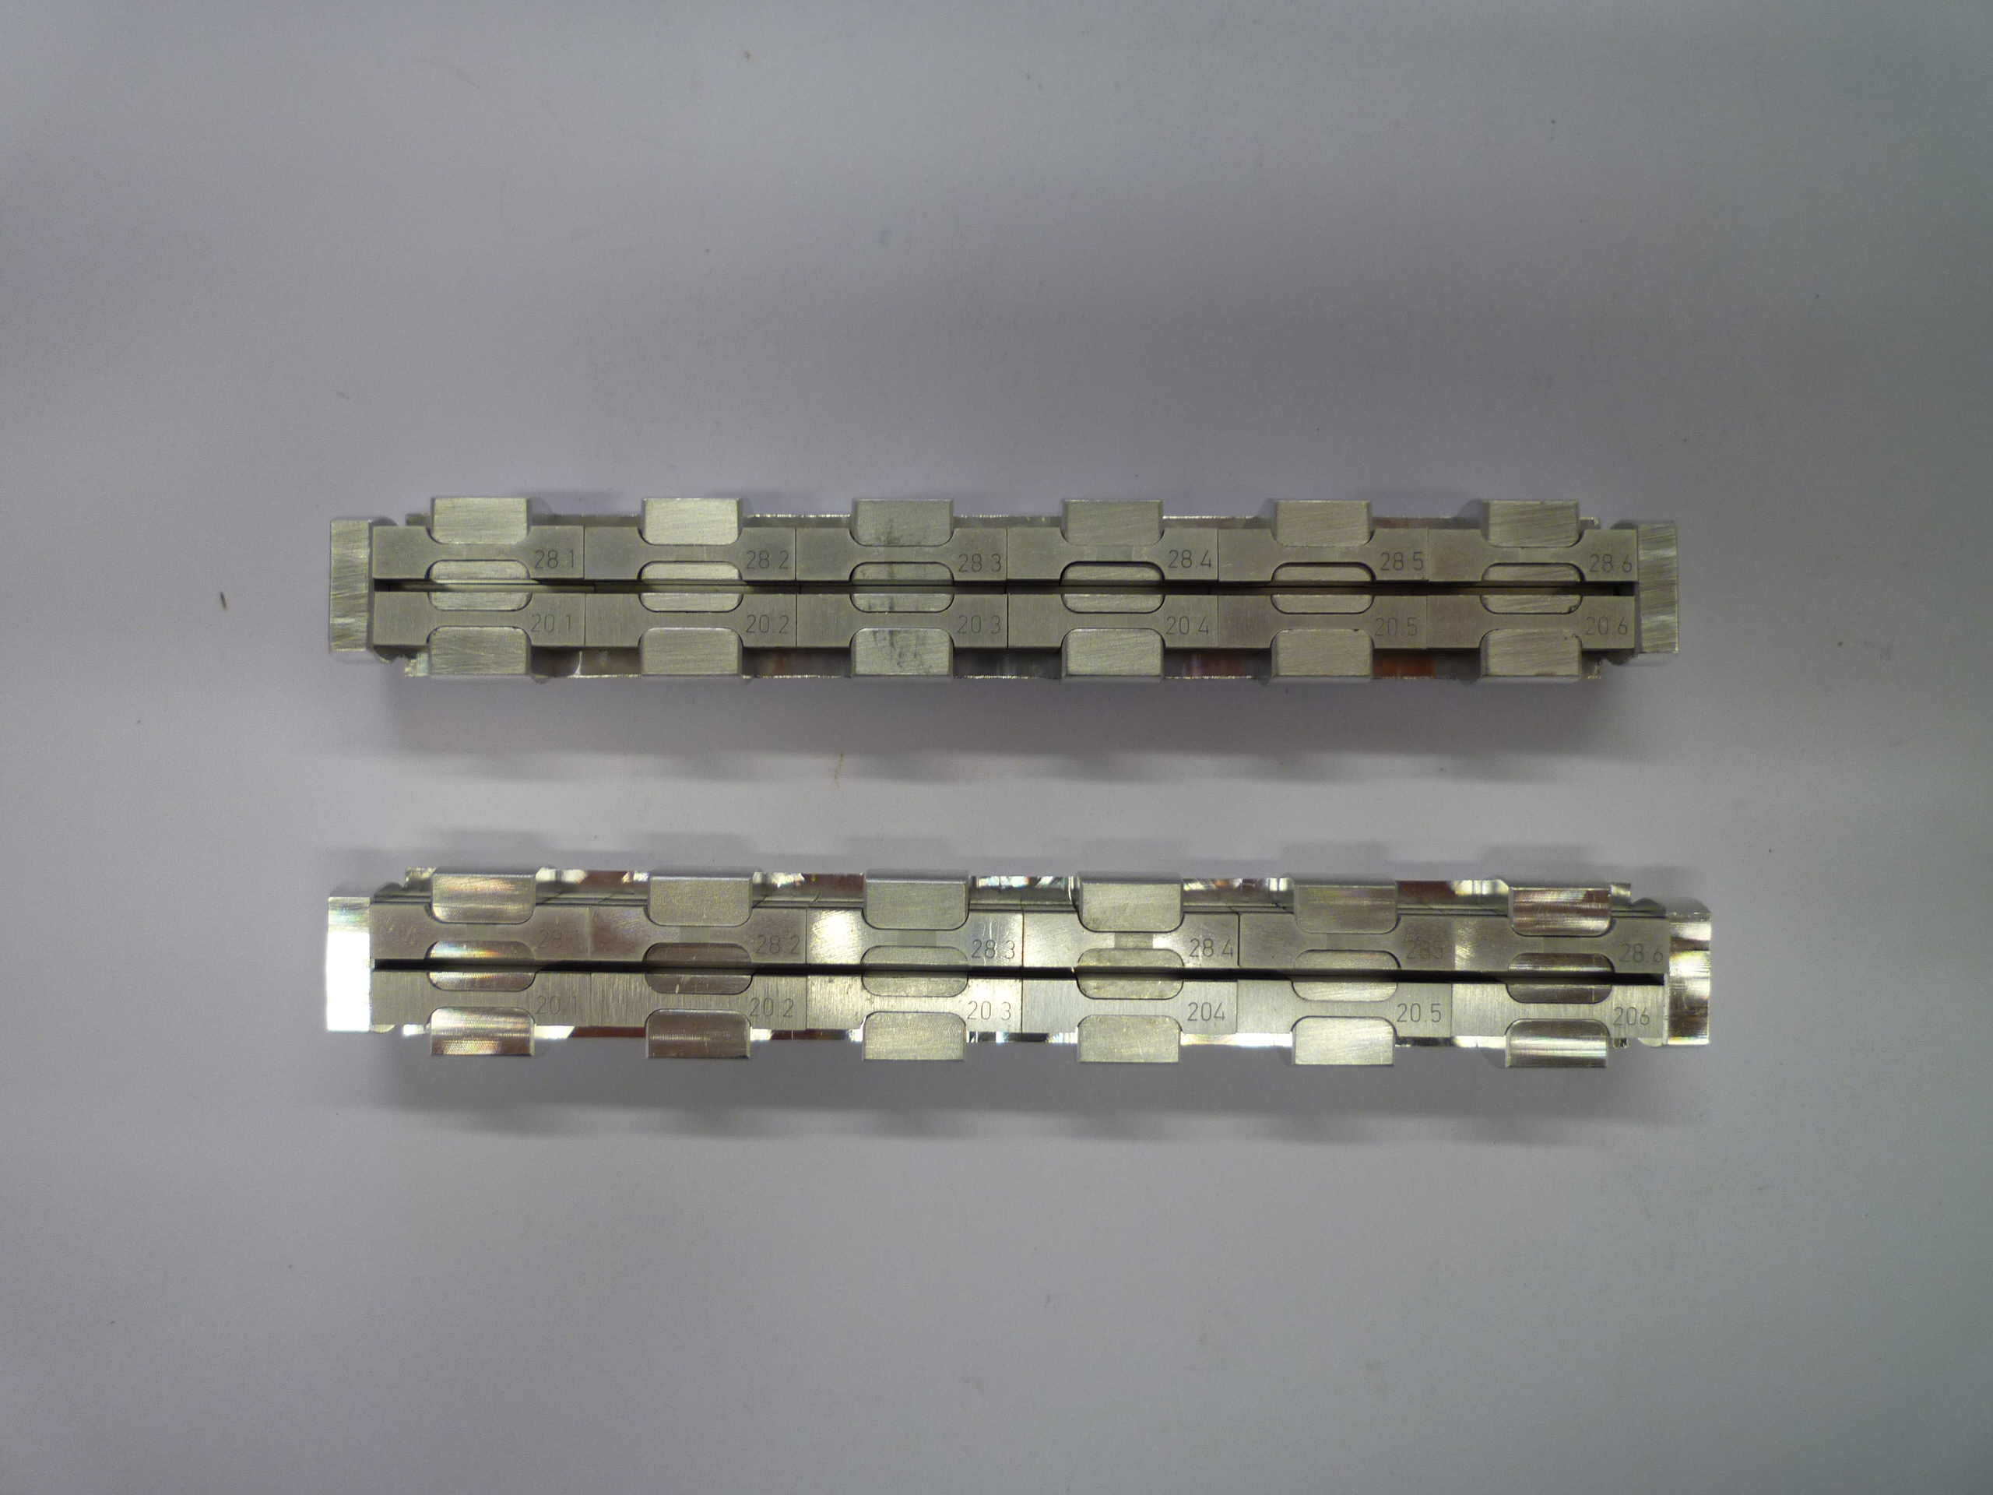
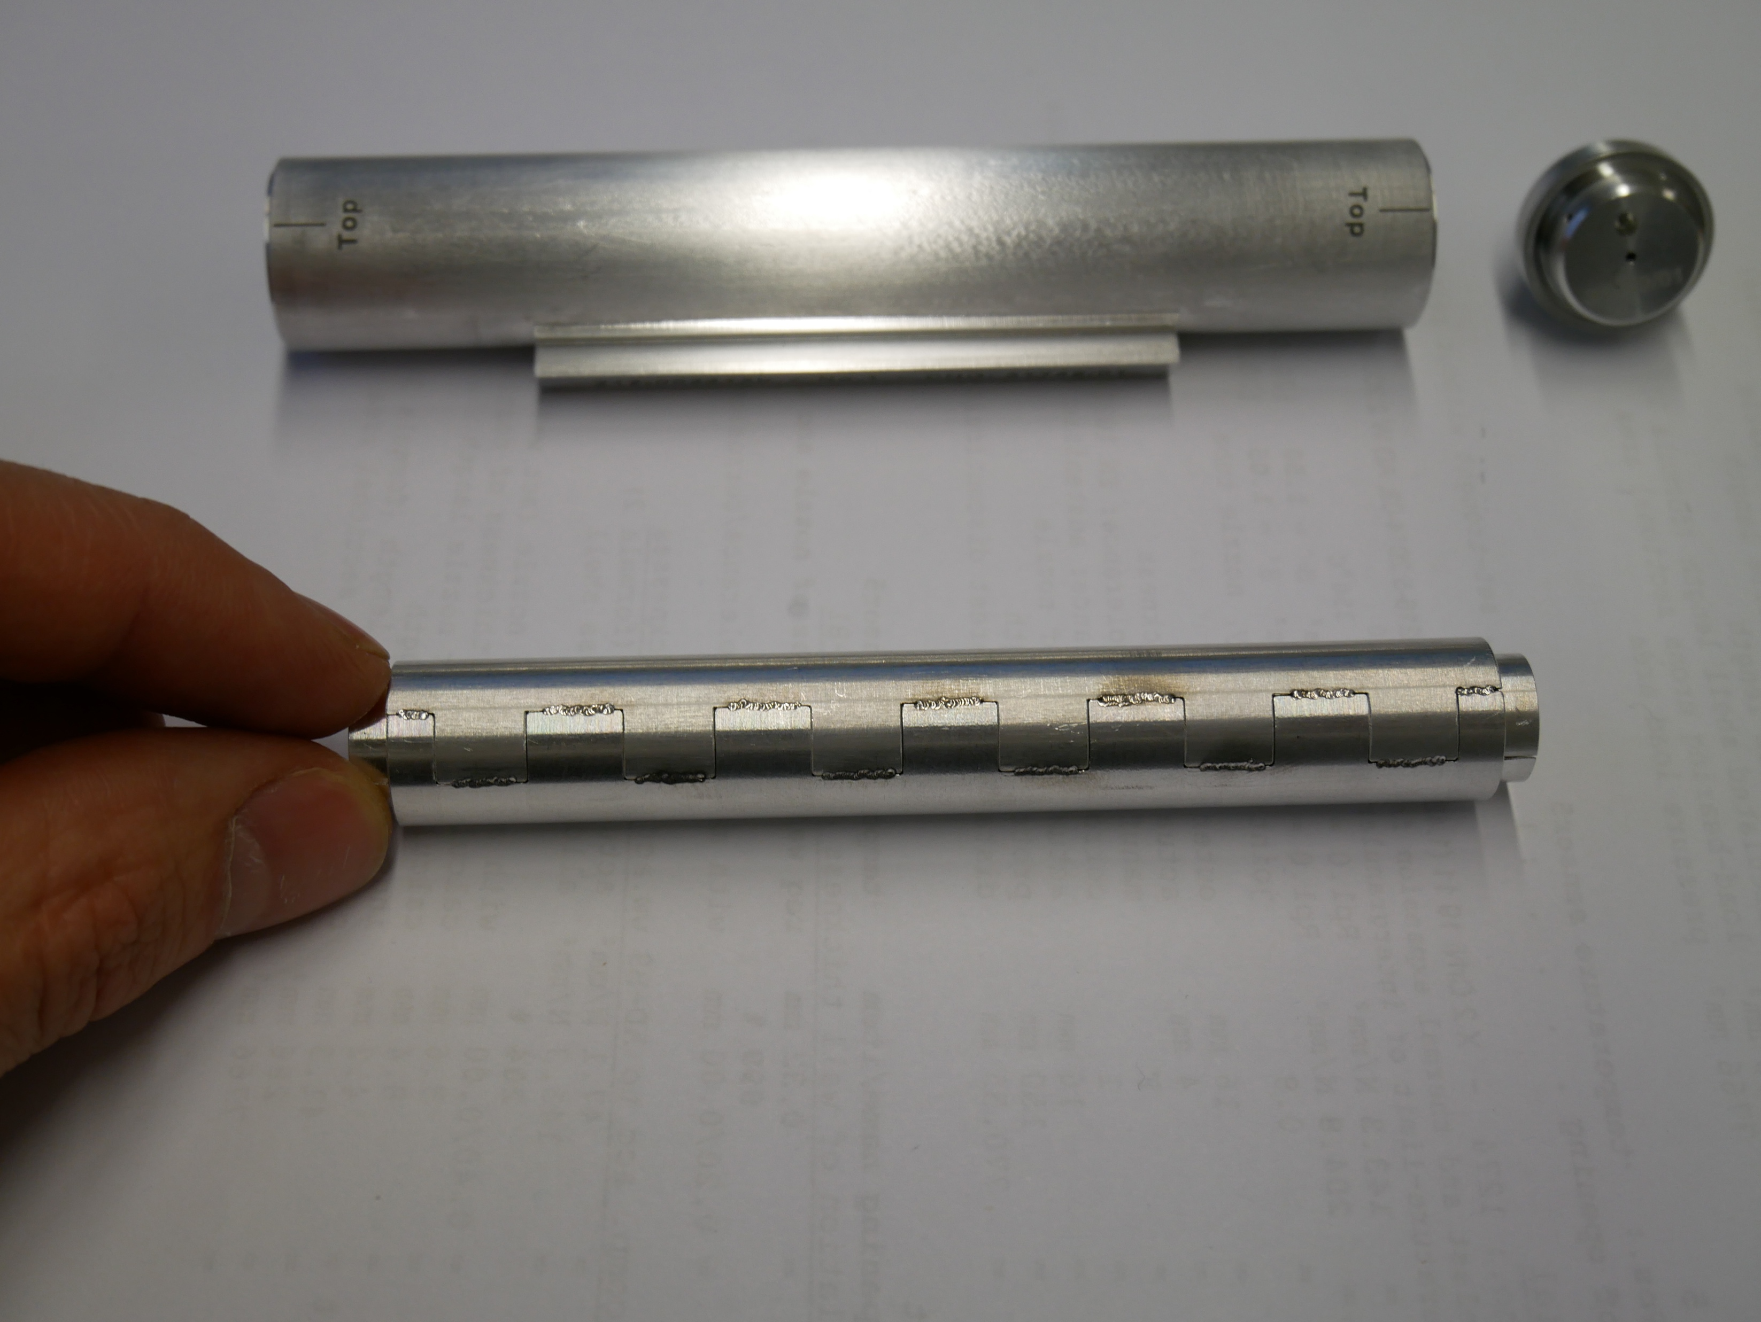
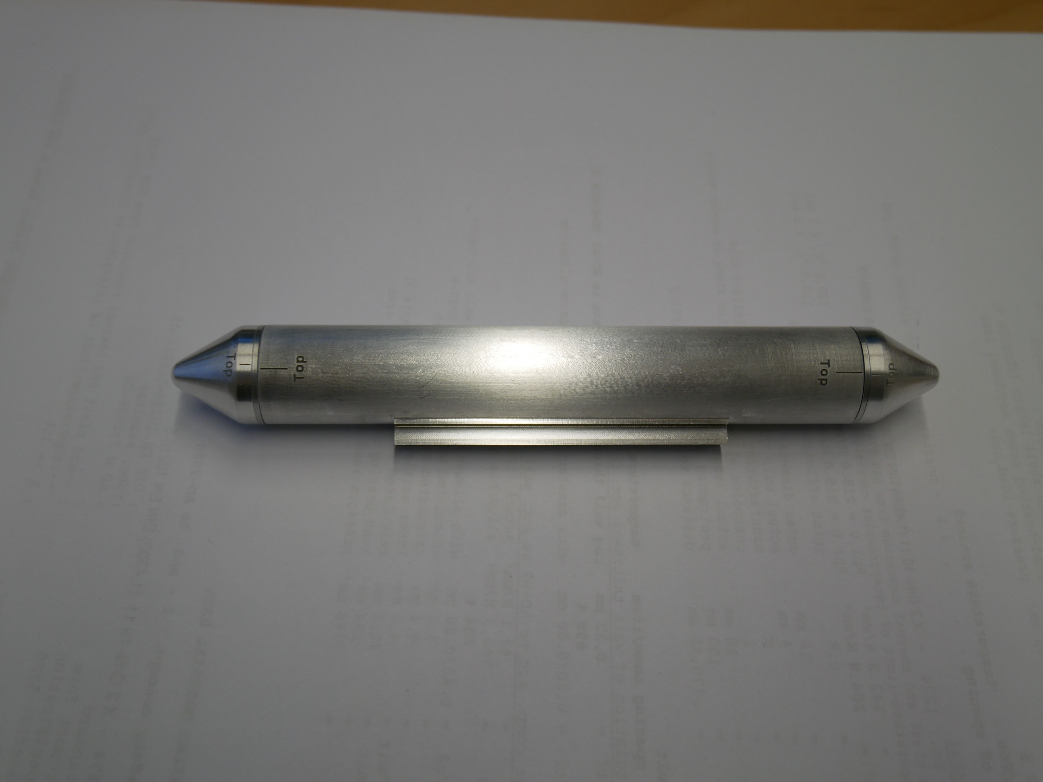
Irradiation Module

Slide 31
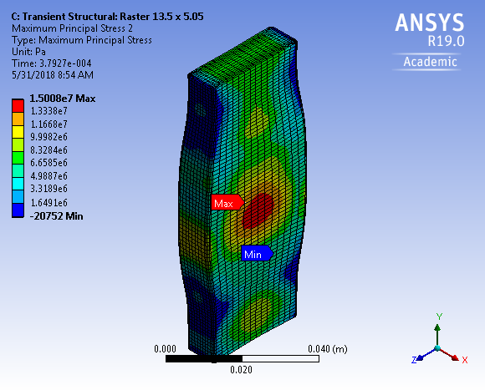
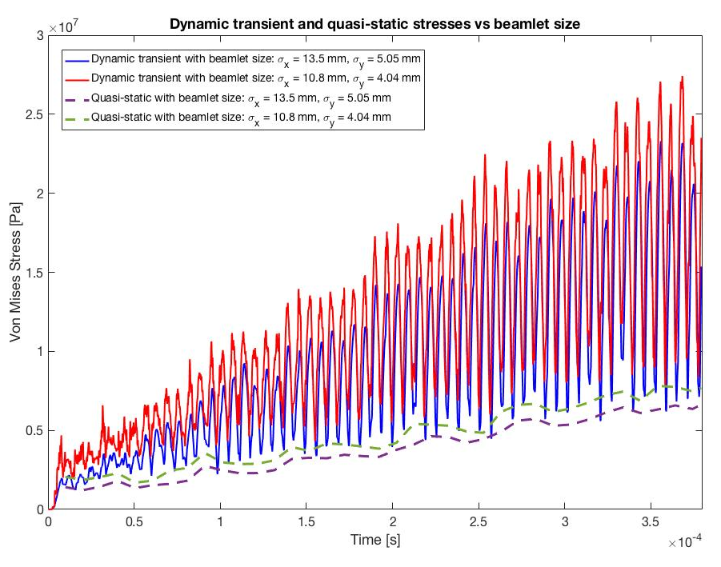
Miscellaneous Analytical Activities
Tritium permeation
Nitric acid problem
Cold welding
Impact of beam ramp up on BIDs
FLUKA simulations
Multiphysics simulations
Etc.

Slide 32
Concluding Remarks
Research of Materials in Target Environment Provides Support for Target Project
External Materials Research Collaborations are essential for the Acquirement of Materials Knowledge
Radiation Damage Driven Lifetime Limits of Main Functional Systems are explored for Enhanced Overall System Reliability and Operational Cost Saving
Visions of Materials R&D at ESS are under work.
Any good ideas on collaboration for the benefit of high power target community will be highly appreciated!

Slide 33
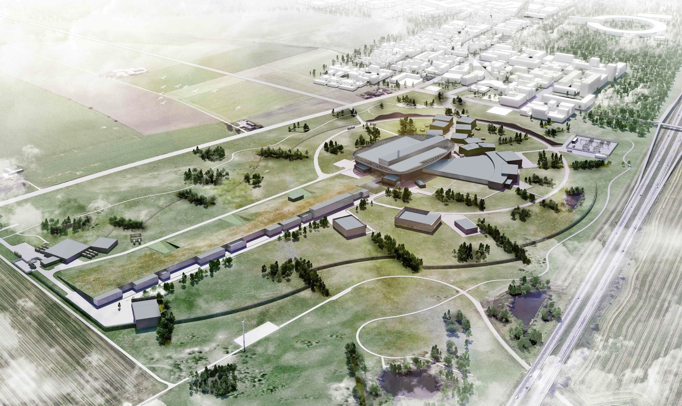
Thank you for your attention!

