Slide 1
Strain Reduction on the SNS Target Using Gas Injection
Wim Blokland, RAD/BST
Yun Liu, RAD/BST
Drew Winder, NTD/ISD
Notes:
Abstract: SNS has successfully deployed and demonstrated mercury target Gas Injection Initial Implementation (GI3). Gas injection is expected to increase the performance and durability of target mercury vessels in two ways: (1) by reducing the dynamic stress resulting from the beam energy deposition, and (2) reducing cavitation erosion of the vessel inner wall. The system is operating safely and stably, and initial measurements with GI3 enabled have demonstrated location-dependent peak strain reductions of 10-60% on the mercury vessel. The effect of gas injection on cavitation damage erosion can only be assessed after T18 is sampled and measured in the spring of 2018. This seminar presents the details of the measurements on target T18 made with fiberoptic strain sensors, including some single-mode radiation resistant sensors developed at ORNL.

Slide 2
Target Lifetime
Target reliability is a key part of SNS reliability and thus user experience
Target modules are expensive to build and dispose of
We want reliable targets that last as long as possible
Gas bubbles can act as shock absorbers to lessen the pressure wave, which reduces stress and influences cavitation behavior

Slide 3
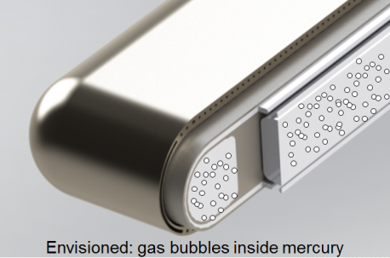
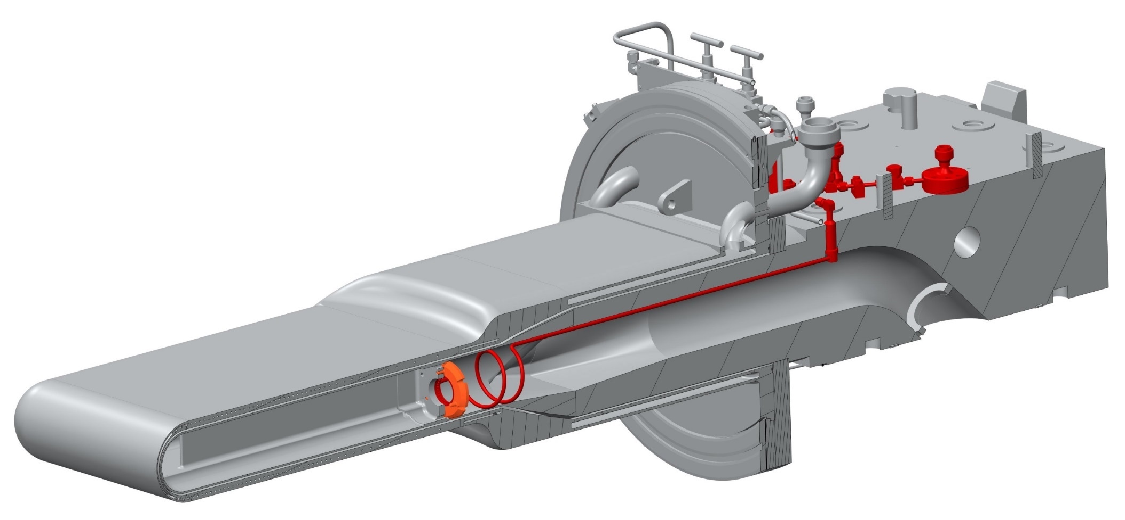
Gas Injection System
Gas is injected in the target into the main mercury supply channels
Sixty 8-micron orifices control the flow
Mercury turbulence shreds the gas to tiny bubbles
Sensors must fit in interstitial space
Mercury
Mercury+Gas

Slide 4
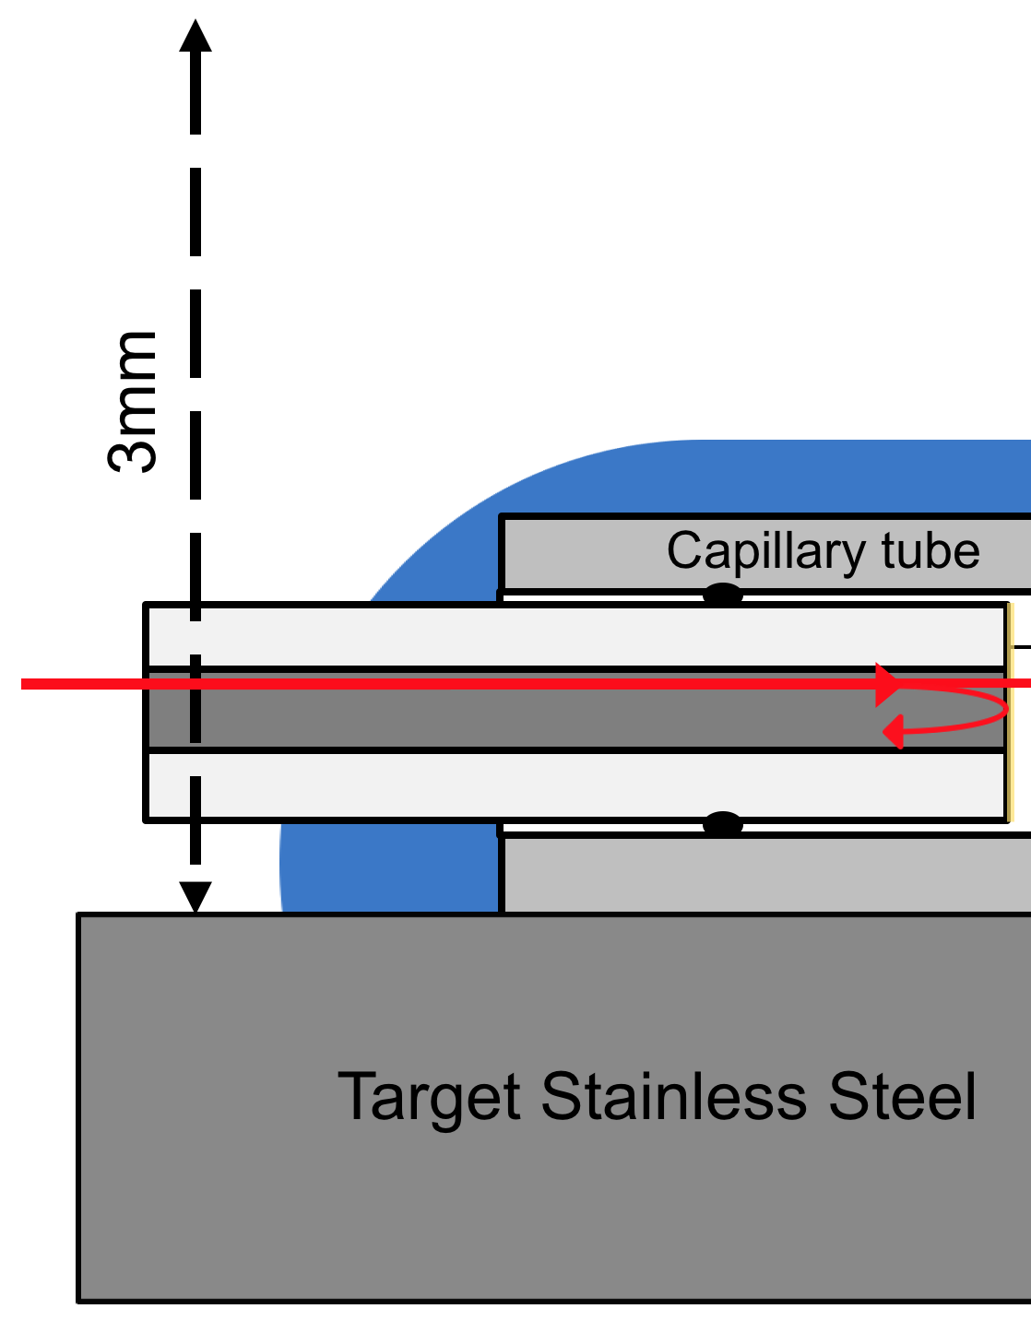
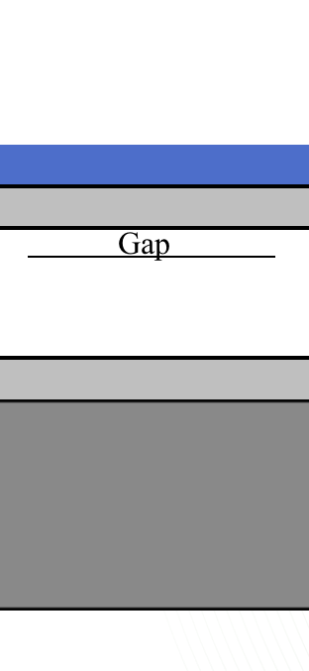
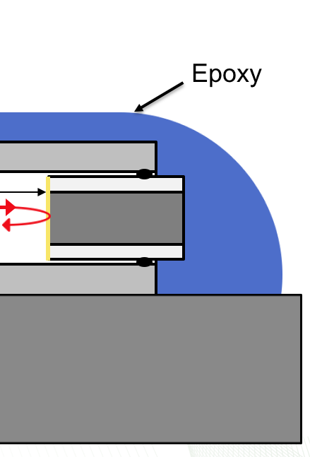
Fiber Optic Strain Gauges
Sensors must be mounted in the ~3mm thick interstitial space between shroud and mercury vessel
Sensors cannot interfere with the leak detection equipment
High bandwidth to measure fast pulse response
Radiation dose of 10⁴ to 10⁷ R before beam
and 10⁸ to 10⁹ R/hr in operation

Slide 5
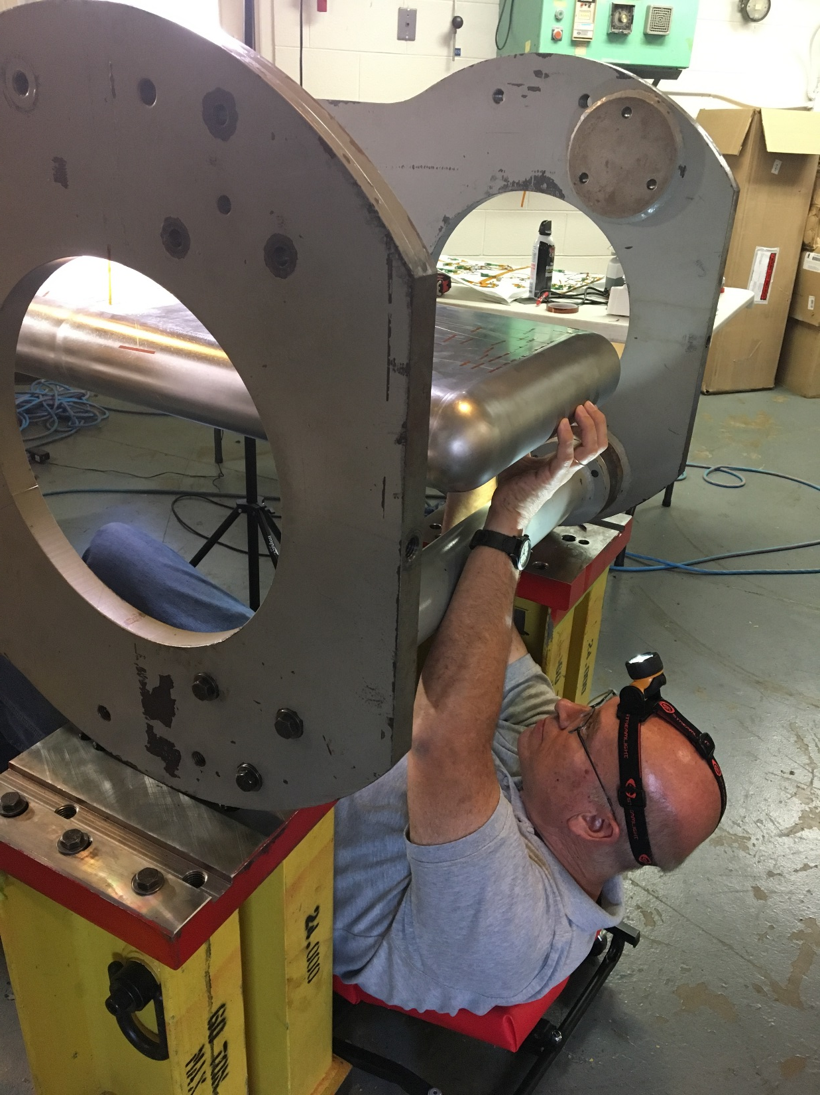
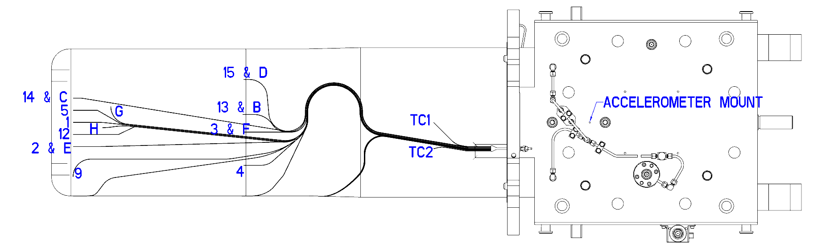
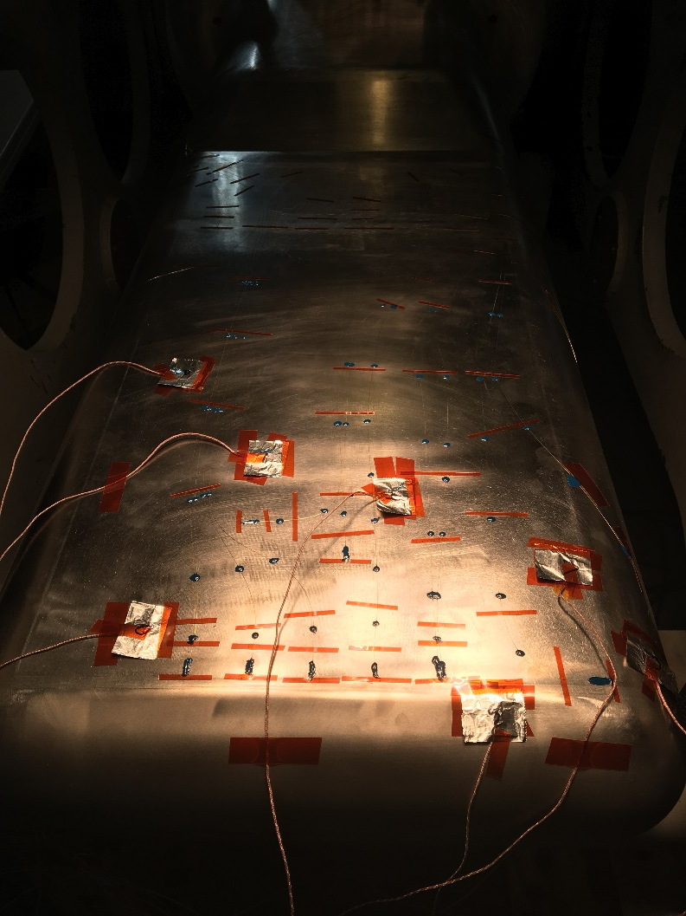
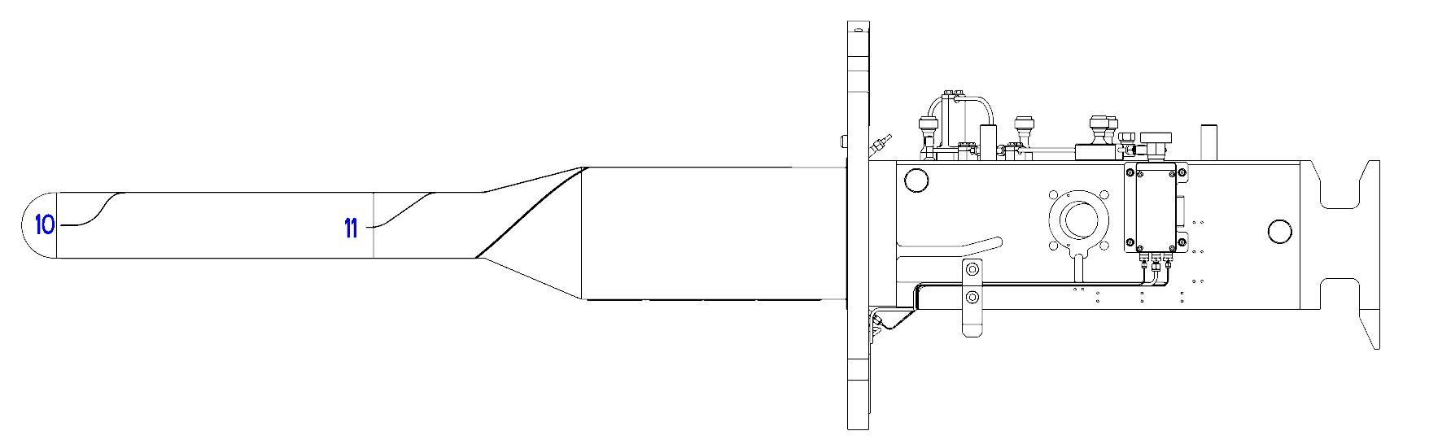
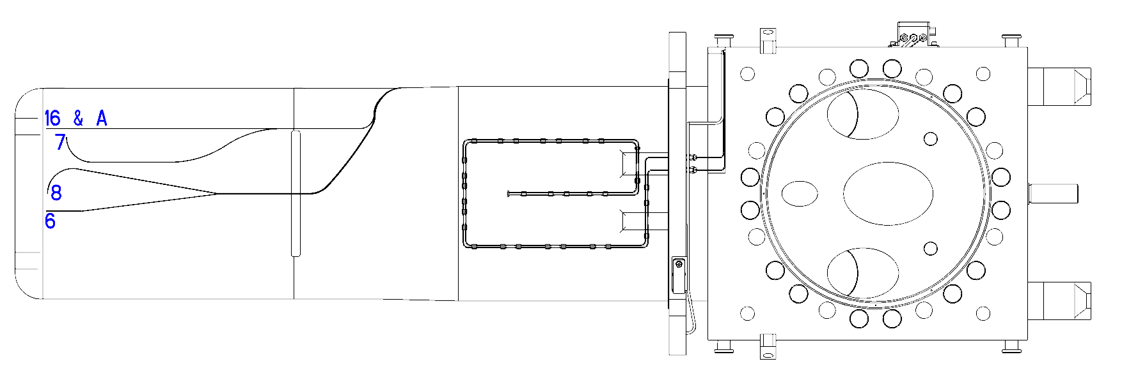
Sensor Installation
Bob Sangrey
  2 thermocouples
  16 commercial MM strain gauges
  8 custom SM strain gauges

Slide 6
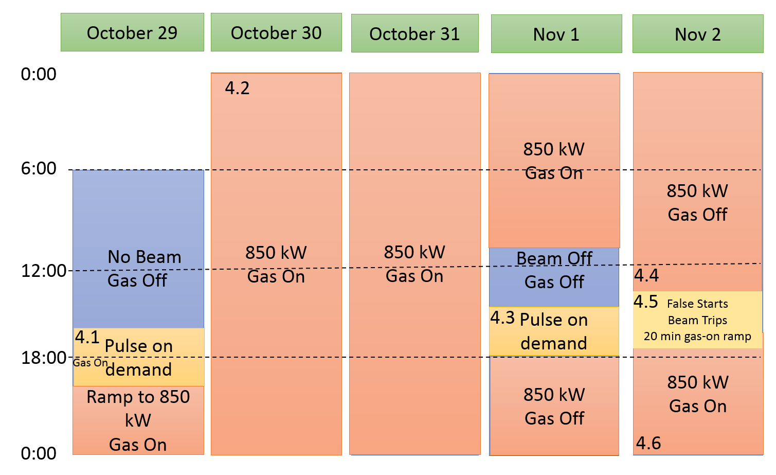
Studies
Pulse on demand:
  First all without gas then with gas injection as it takes hours for the gas to leave the mercury
  Single pulses at different energies (charge)
  Multi-pulse burst for 5 seconds at 600 kW
Gas injection ramp-up while running at 850 kW
Additional studies during production

Slide 7
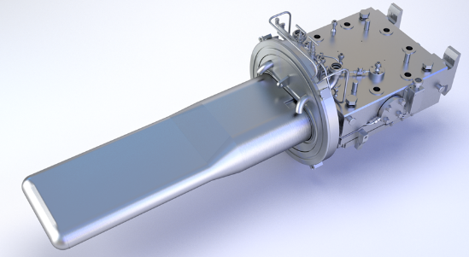
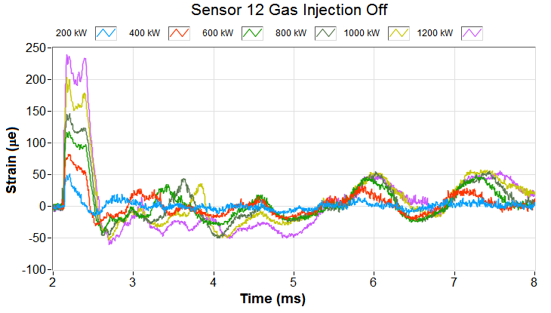
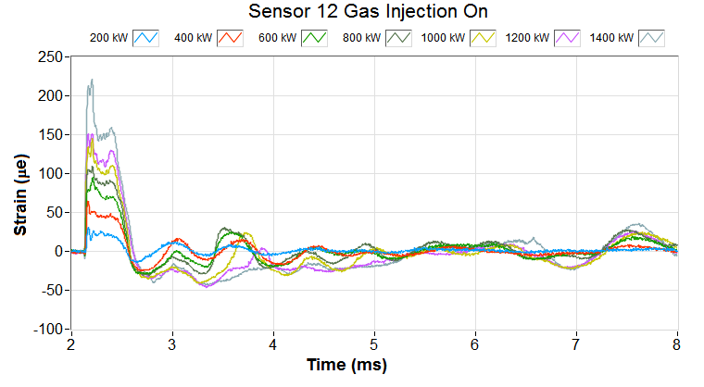

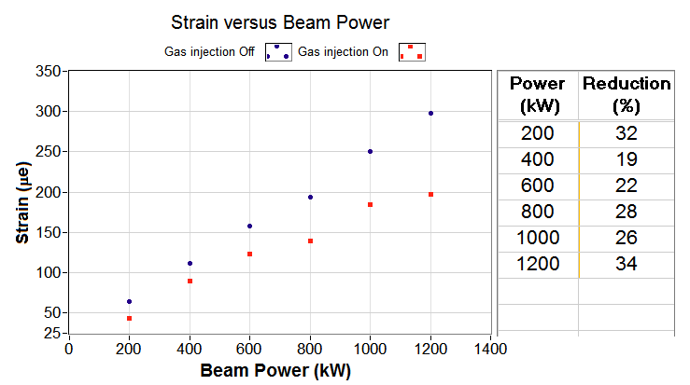
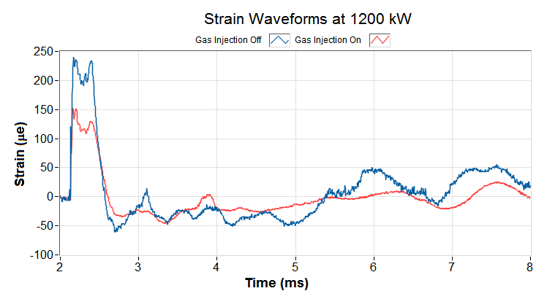
Pulse on Demand: Front Middle
Sensor 12
Gas off
Gas on

Slide 8
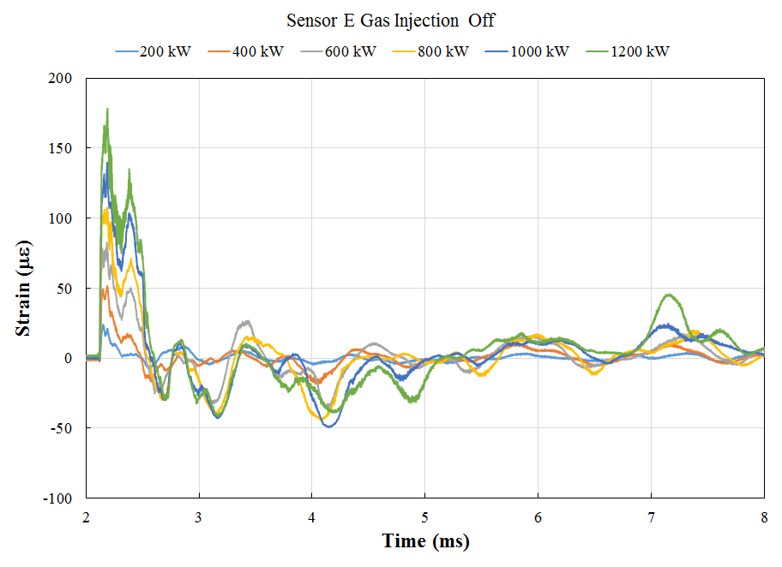
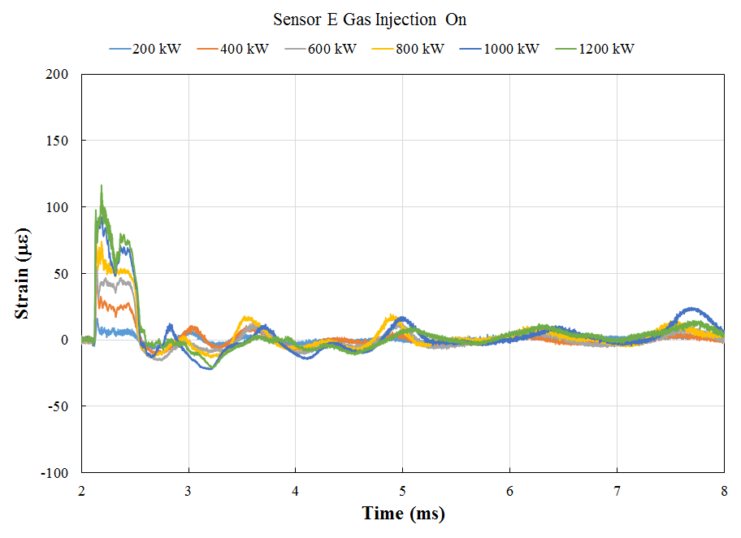
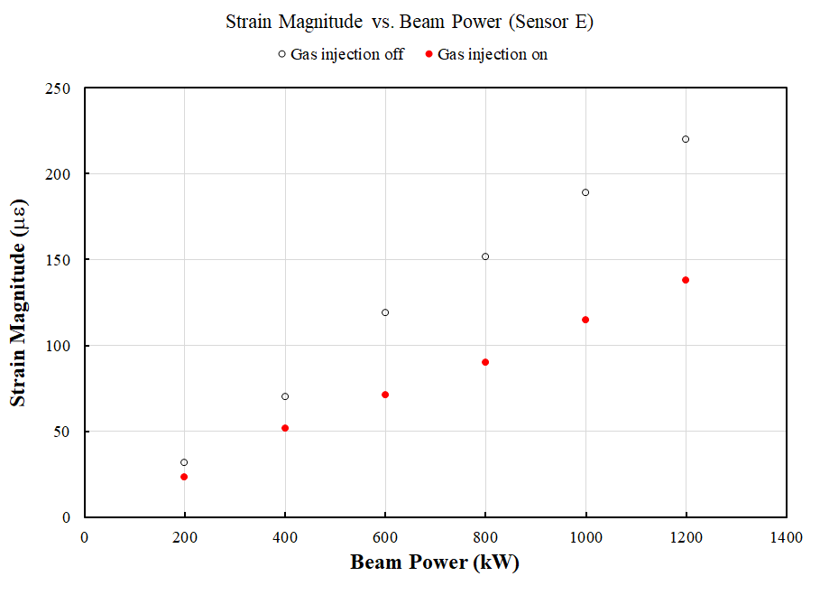
Pulse on Demand: Front Middle Side
Sensor E
Gas Off
Gas On
Gas Off Gas On
Beam Power (kW) | Strain Magnitude (με) |  | Strain Reduction (%)
 | Gas injection off | Gas injection on
200 | 31.73 | 23.06 | 27.3
400 | 70.06 | 51.50 | 26.5
600 | 118.76 | 70.95 | 40.3
800 | 151.79 | 90.09 | 40.6
1000 | 189.04 | 114.75 | 39.3
1200 | 219.97 | 137.64 | 37.4

Slide 9
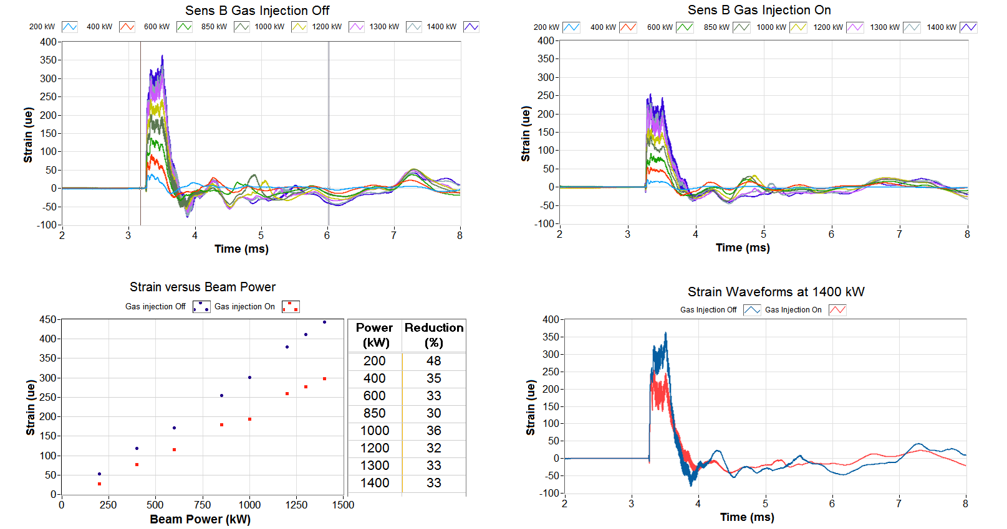
Pulse on Demand: Front Middle of target T19
Sensor B
T19
Second target with gas injection
Sensor B

Slide 10
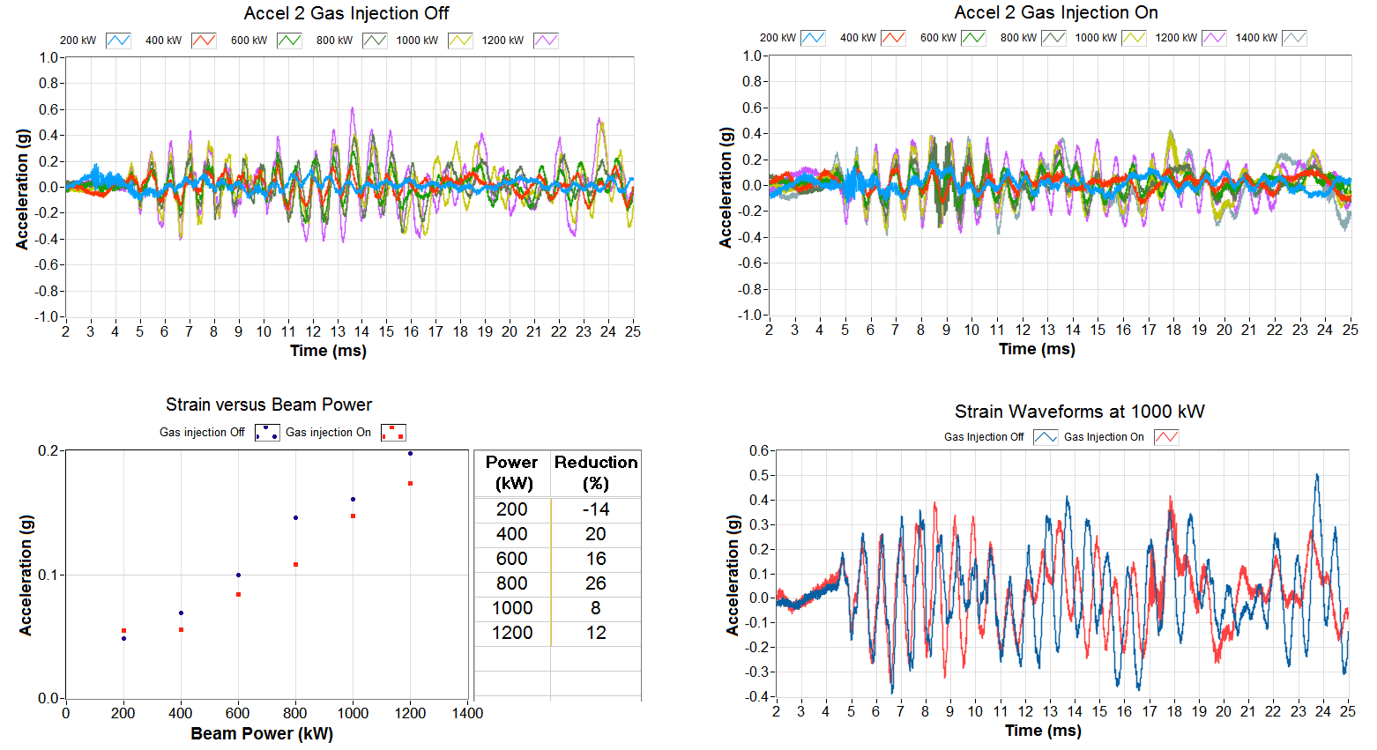
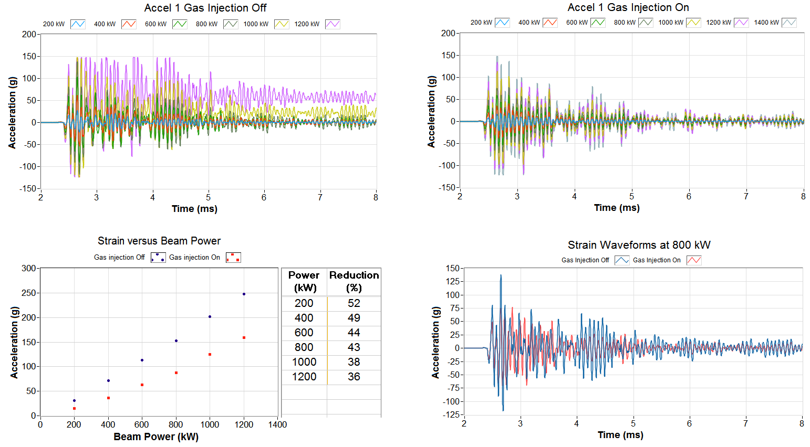
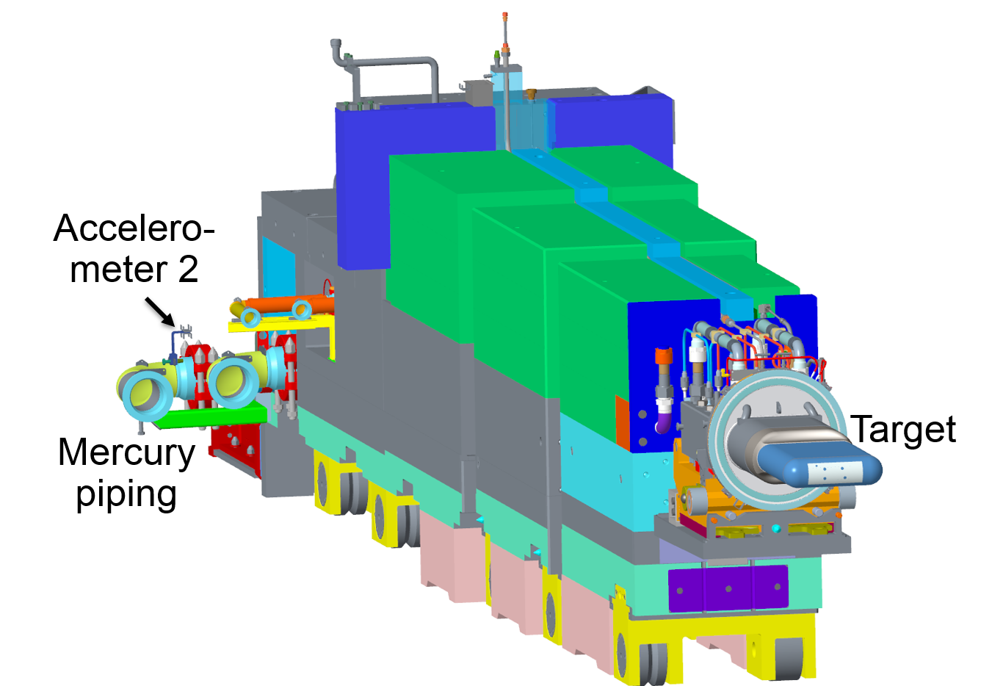

Pulse on Demand: Accelerometer
The accelerometer on the target manifold sees a significant reduction while the accelerometer on the piping sees a smaller reduction (noise)
Gas off
Gas on

Slide 11
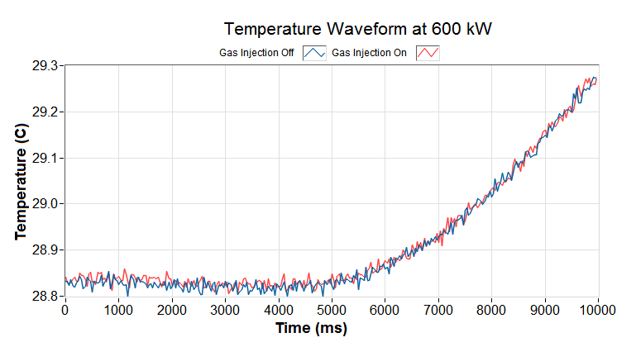
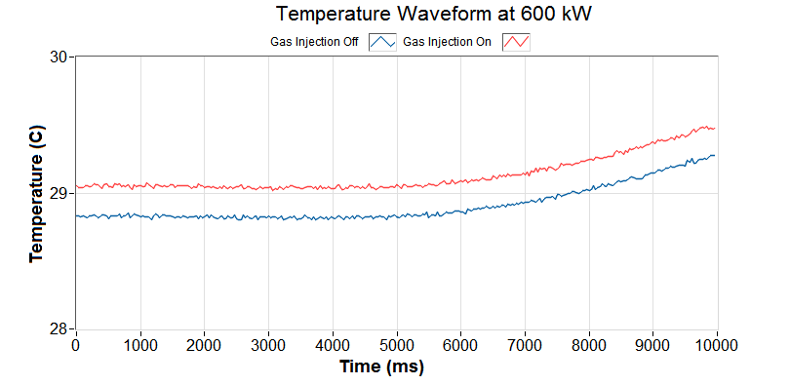
Pulse on demand: Multi-pulse burst TC1 temperature
TC1 & TC2
TC2 is near the mercury inlet and doesn’t see any change during this time scale
Thermocouples are too far back for a fast response but the sensor has conductive materials and we can not risk the leak detector
  In the future we will use a fiber based temperature sensor
Heat response is the same for gas injection off and on

Slide 12
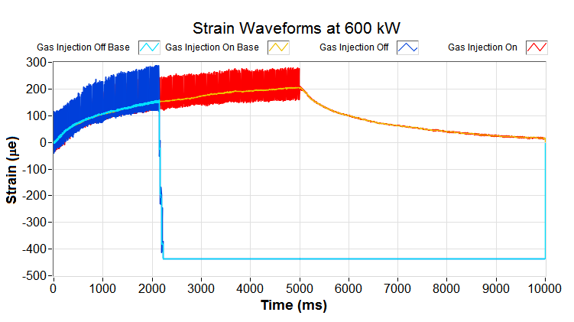
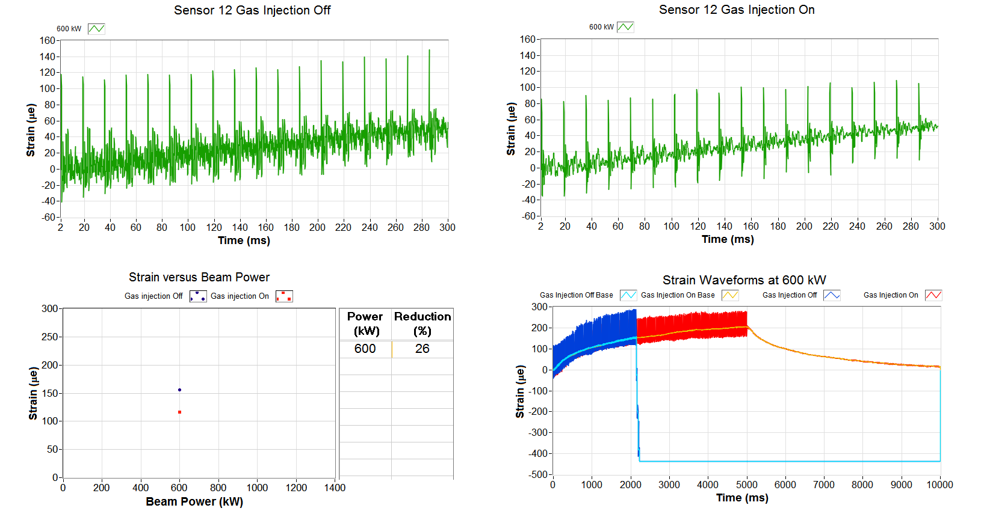
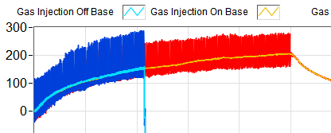
Pulse on demand: Pulse Train
Sensor 12
5 second burst at 600 kW:
slow strain build up (heating)
Individual pulse impacts
Strain due to beam impact
This shows that the sensor response in both gas off and gas on cases is the same!
Strain due to temperature

Slide 13
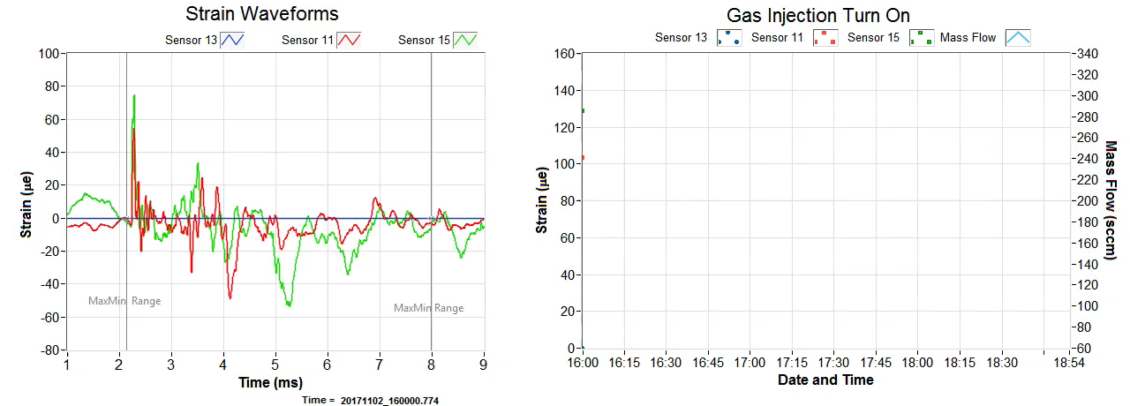
Gas Injection Ramp-Up: Back
Sensor 15
Sensor 13
Ramping the gas injection up during 850 kW beam.
Sensor 11
Strain measured during the gas injection ramp up

Slide 14
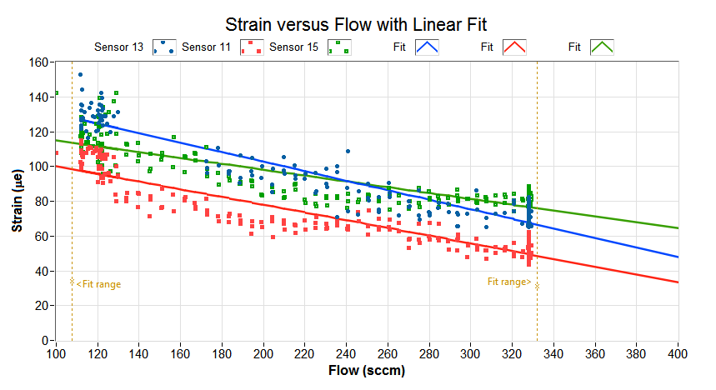
Gas Injection Ramp-Up
Sensor 15
Sensor 13
Correlation between gas and strain
Sensor 11
More gas means more reduction in strain

Slide 15
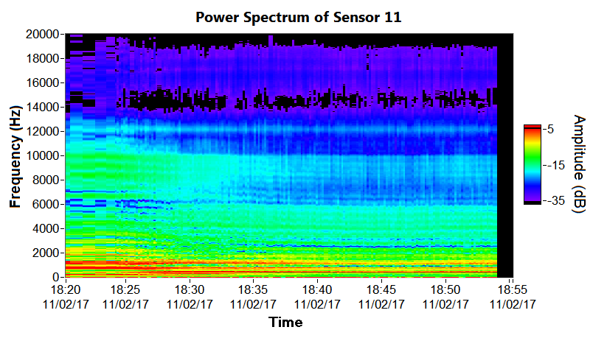
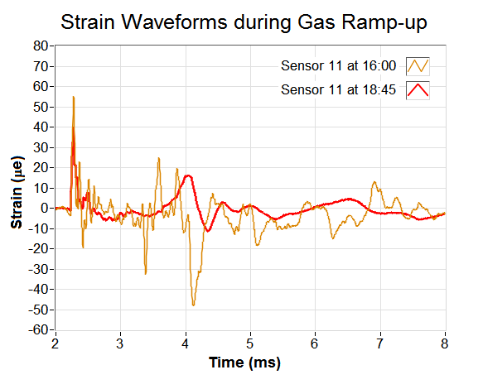
Gas Injection Ramp-Up: Side
Sensor 11
Frequency spectrum changes as gas injection ramps up

Slide 16

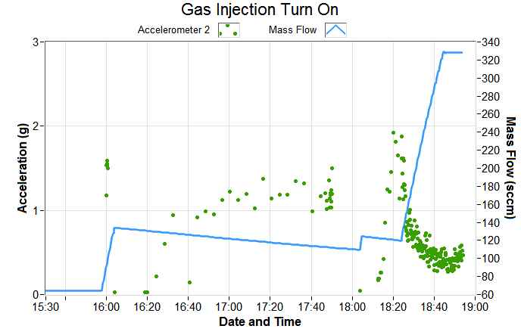
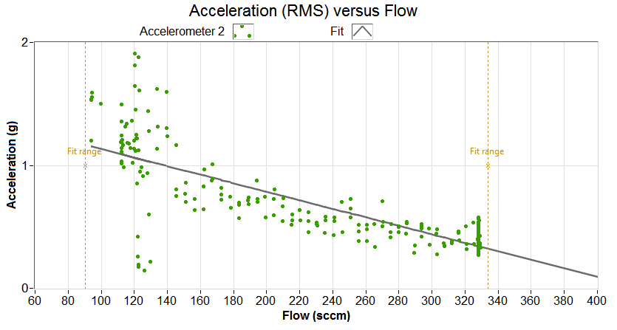
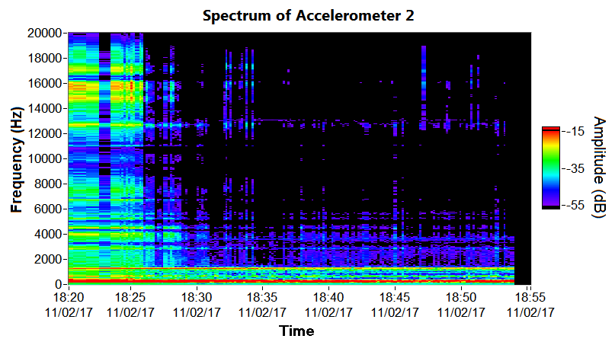
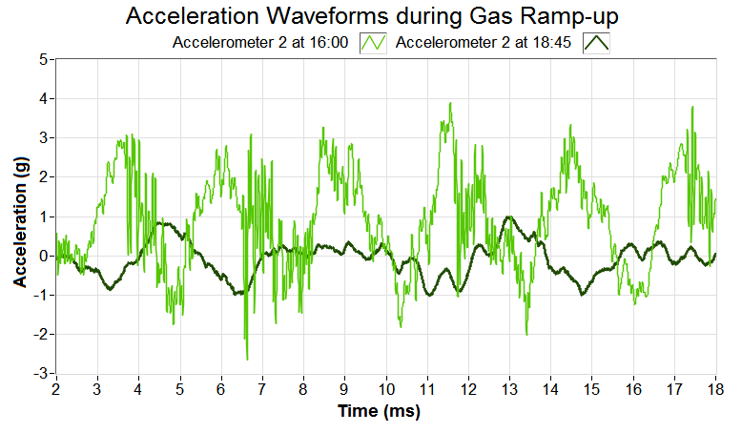
Gas Injection Ramp-Up: Accelerator return line
More gas means more reduction in acceleration on mercury return line

Slide 17
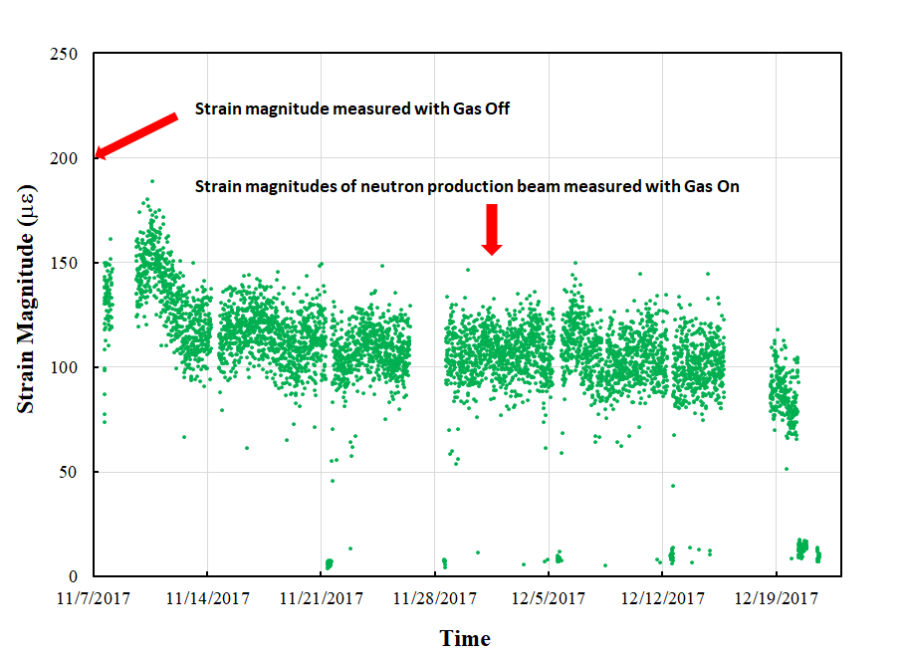
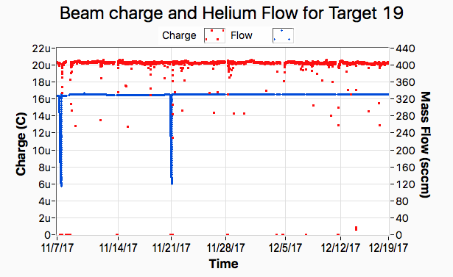
Strain measurement of 1.2 MW production beam
Conditions

Slide 18
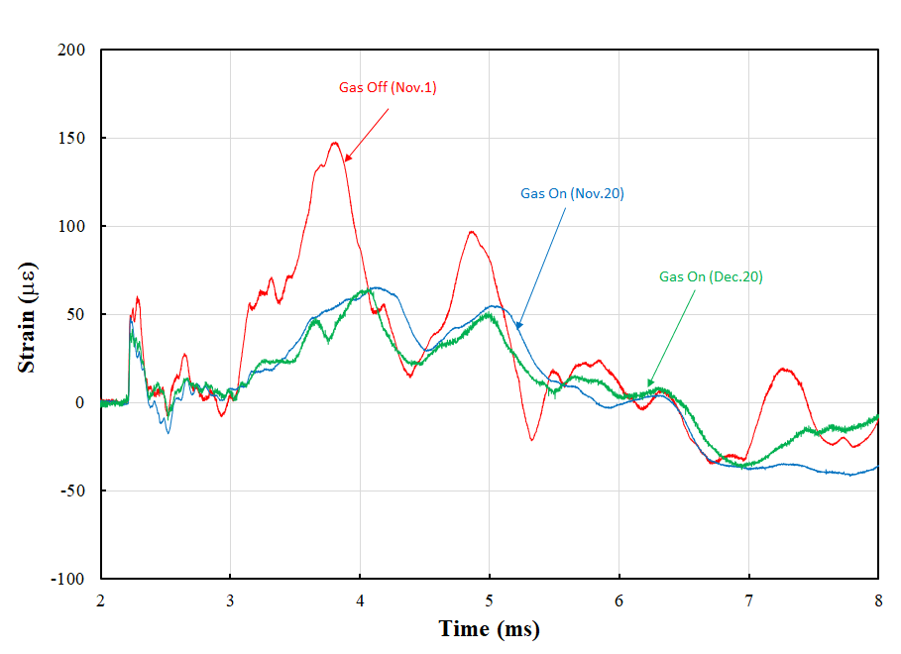
Strain profiles of 1.2 MW production beam

Slide 19
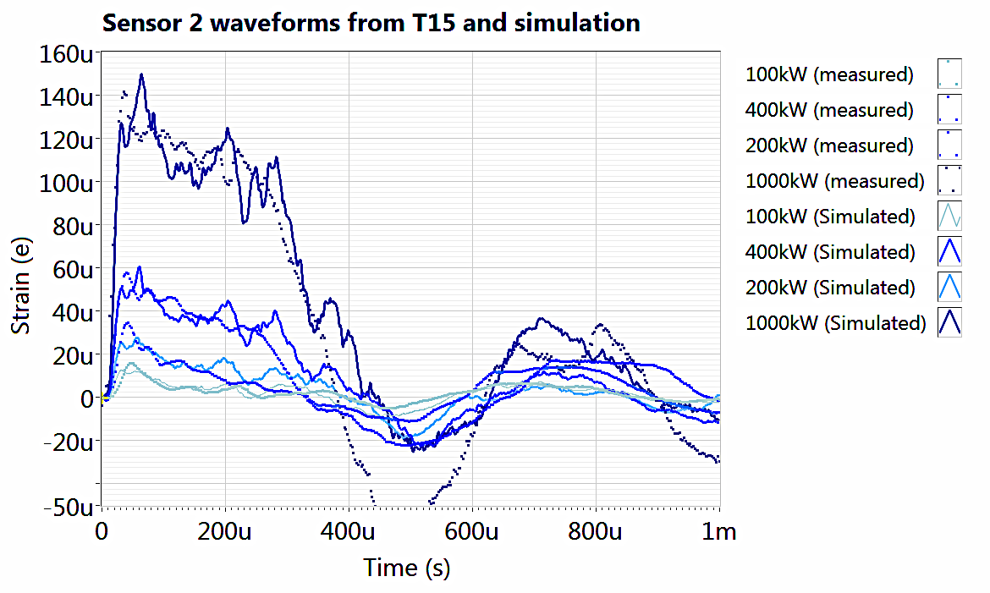

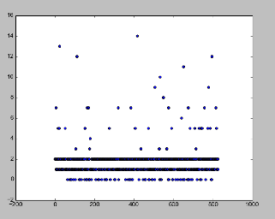
What we want to do with the data over time
We have many GB of data to
  look for:
    Target structure changes
    Sensor attachment failures
    Sensor degradation
  help improve target modeling
We used cluster analysis on T18 during the ugly data Machine Learning contest
  Not much happened during T18
  Subtle target changes might be lost in long waveforms
  → looking at preprocessing: e.g. ARMA modeling on T14 MM Data
1000 kW
Simulation:
Measured : ▪
400 kW
200 kW
100 kW
Simulated and measured strain (T15 sensor 2, up front)
Cluster Distribution
Recording Index
T18 Clustering Result

Slide 20
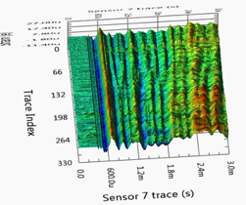
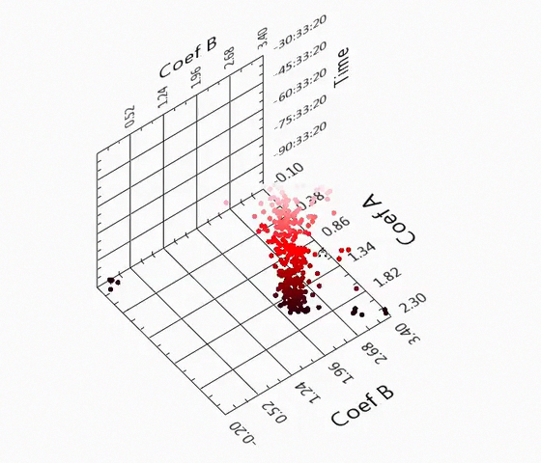
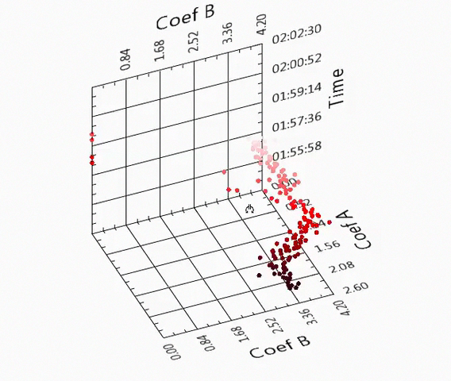
What we want to do with the data over time
Example to reduce data and capture relevant information
  ARMA model coefficients over time T14
Event
T14 Data
(~4 weeks)
from MM
sensors
Before event
During event

Slide 21
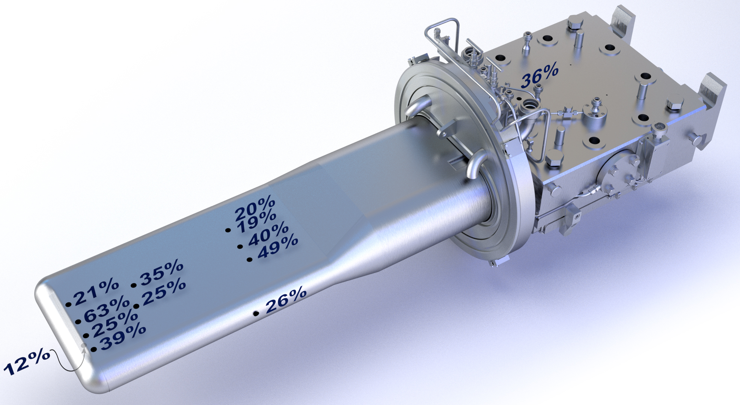
So what did we learn?
Strain is reduced and more gas can reduce even more
Temperature of the target not affected
Strange things happen to our
sensors
(see Y. Liu talk on Thursday)
We can use machine learning to detect changes
T18 Results

