Slide 1
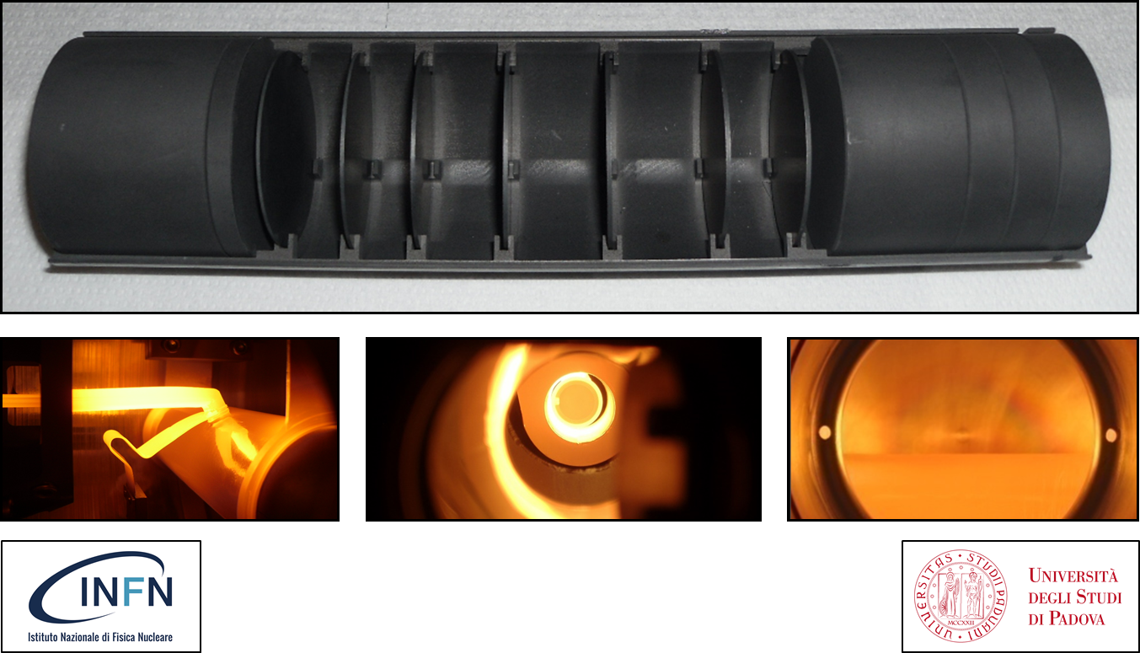
Design of High Temperature ISOL Targets
Mattia Manzolaro
on behalf of the SPES target group
(A. Andrighetto, S. Corradetti, M. Ballan, A. Monetti, G. Meneghetti, D. Scarpa, M. Rossignoli, F. D’Agostini, F. Borgna)
Mattia Manzolaro

Slide 2
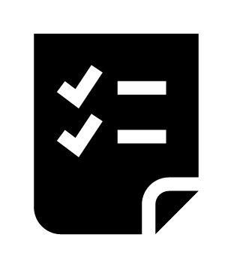
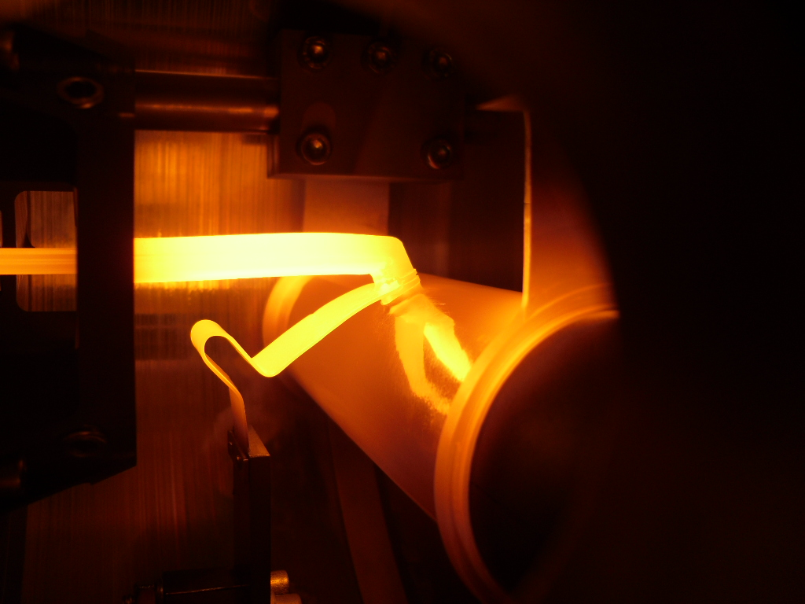
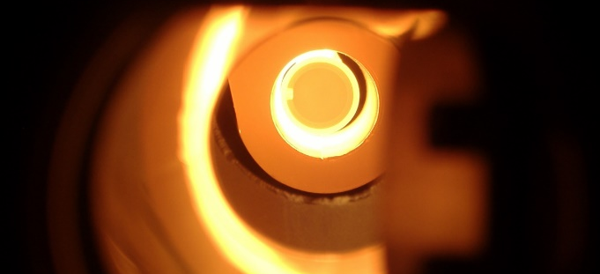
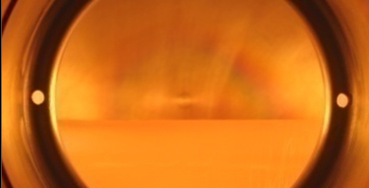
SUMMARY
1- Introduction
2- The SPES target
3- Numerical models
4- On-line tests
5- Target material characterization @ HT
6- ISOL targets @ other facilities
7- Conclusions and future developments
Mattia Manzolaro slide 2/46

Slide 3
SUMMARY
1- Introduction
2- The SPES target
3- Numerical models
4- On-line tests
5- Target material characterization @ HT
6- ISOL targets @ other facilities
7- Conclusions and future developments
Mattia Manzolaro slide 3/46

Slide 4
1- Introduction: the ISOL (Isotope Separation On Line) technique
primary beam driver
production target
high temperature
diffusion
effusion
P
transfer line
high temperature
radiative heat transfer
ion source
+
+
+
+
+
charge breeder (1+ → n+)
& post accelerator
mass separator
Mattia Manzolaro slide 4/46

Slide 5
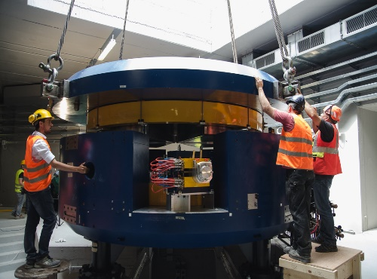
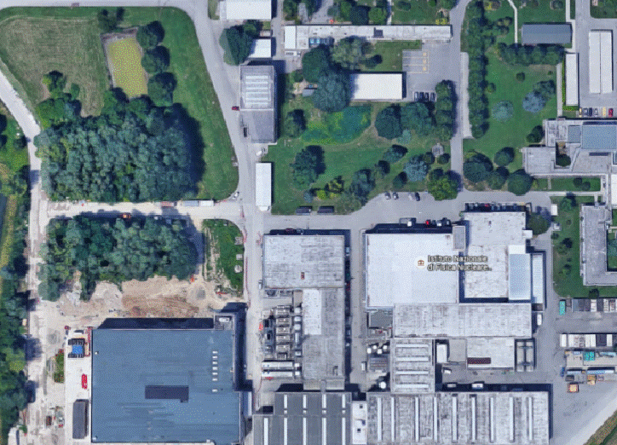
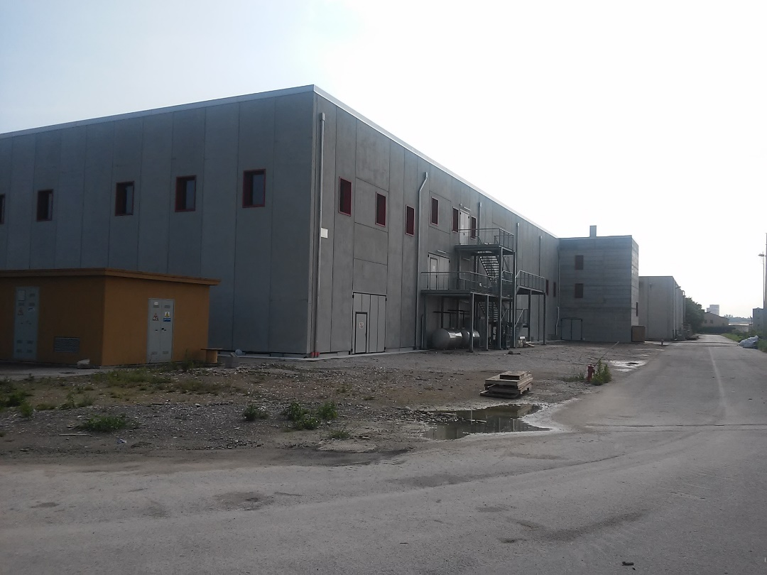
1- Introduction: the SPES facility @ LNL
SPES is: 1) A second generation ISOL RIB Facility (for neutron-rich radioactive ion beams)
2) An interdisciplinary Application Facility (for p,n applications)
New infrastructure for:
Cyclotron
ISOL RIB Facility
Application Facility
Mattia Manzolaro slide 5/46

Slide 6
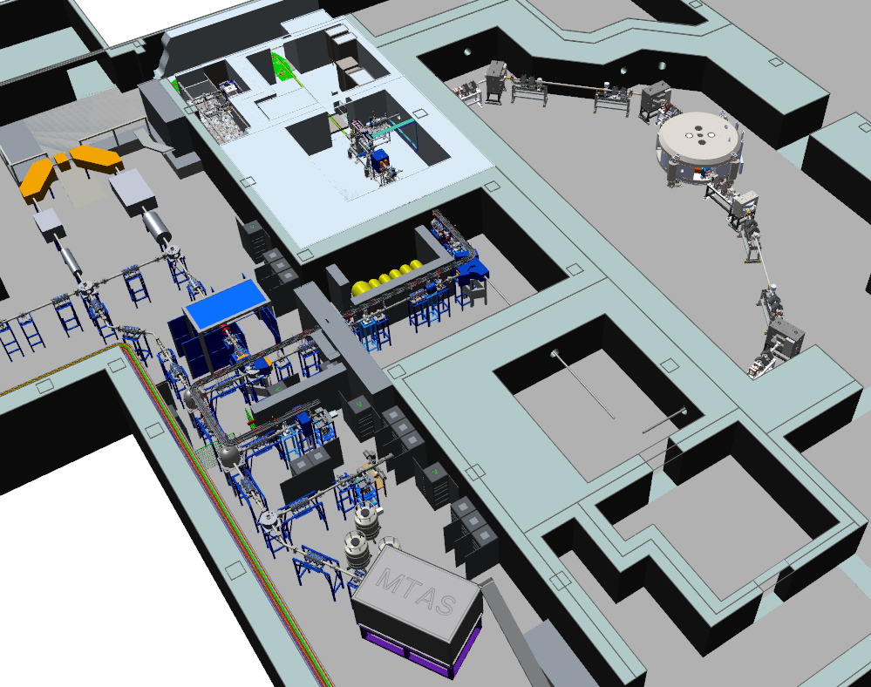
1- Introduction: the ISOL RIB (Radioactive Ion Beam) facility
ISOL hall
40 MeV 200 µA primary proton beam
1⁺ RIB @ LE
to MRMS/HRMS
and n⁺ RIB @ HE
Mattia Manzolaro slide 6/46

Slide 7
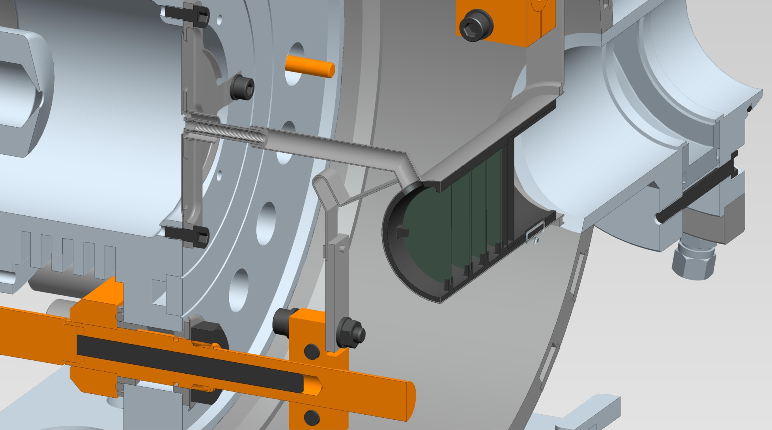
1- Introduction: the RIB bunker and the TIS (Target – Ion Source) system
surface
ion source
proton
beam
transfer line
1+
extraction electrode
SPES
production target
I_{T} = 700 A
I_{IS} = 200 A
Mattia Manzolaro slide 7/46

Slide 8
SUMMARY
1- Introduction
2- The SPES target
3- Numerical models
4- On-line tests
5- Target material characterization @ HT
6- ISOL targets @ other facilities
7- Conclusions and future developments
Mattia Manzolaro slide 8/46

Slide 9
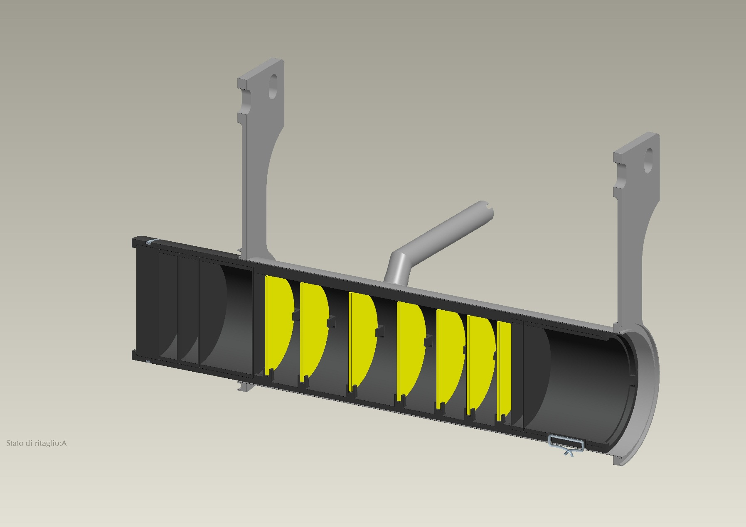
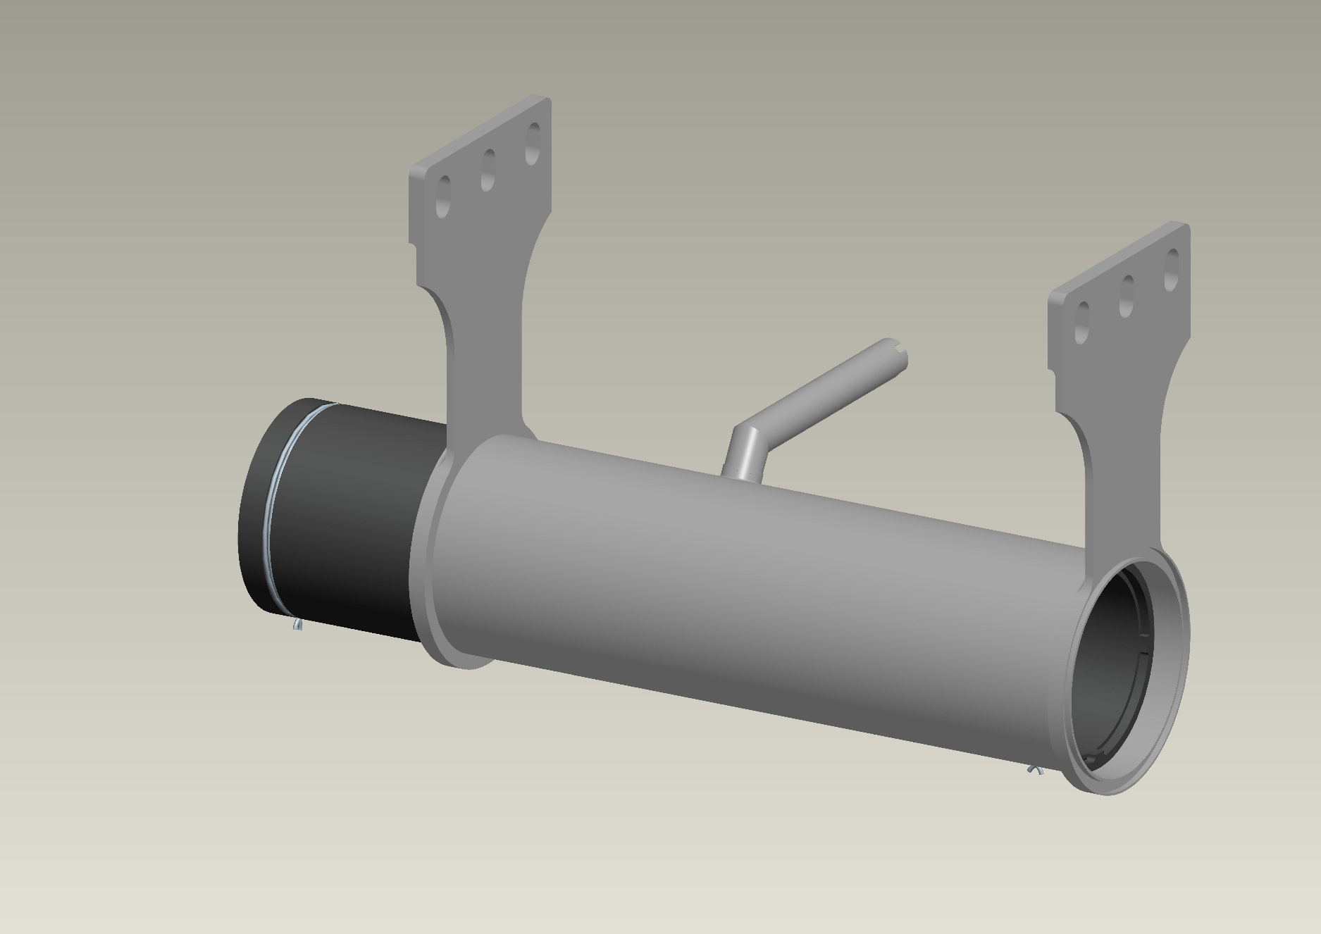
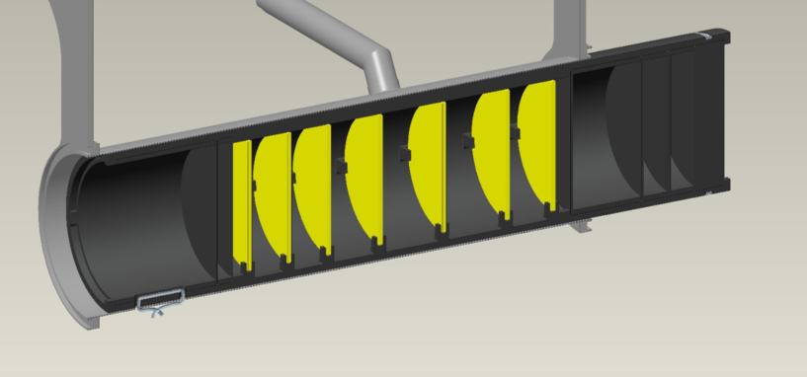
2- The SPES target: general architecture and main characteristics
the whole target system must be operated at extremely high temperature (2000°C and more)
p energy: 40 MeV
p intensity: 200 µA
40 MeV, 200 µA
proton beam
box (C)
heater (Ta)
window (C)
disc (UCx)
dumper (C)
Mattia Manzolaro slide 9/46

Slide 10
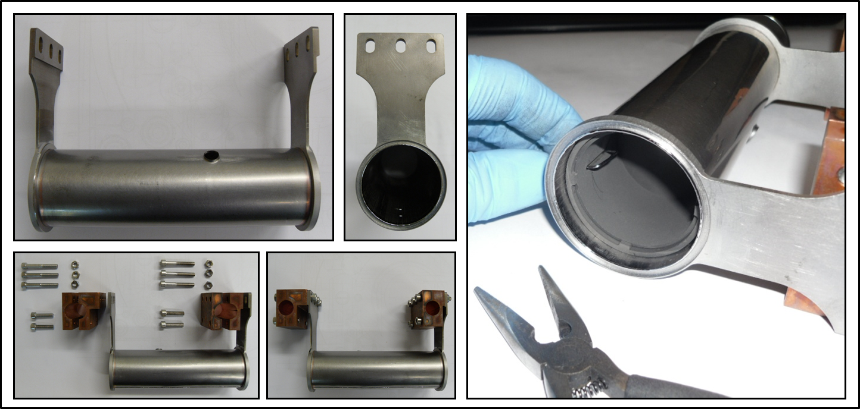
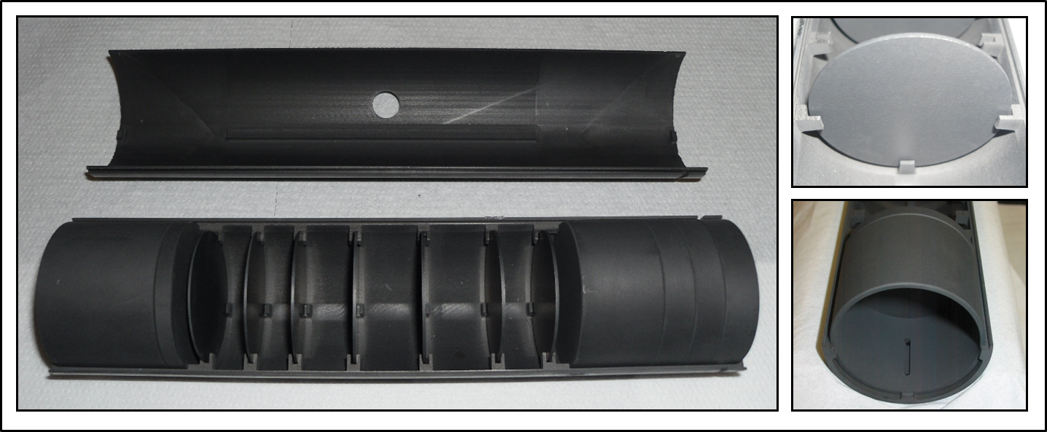
2- The SPES target: general architecture and main characteristics
Mattia Manzolaro slide 10/46

Slide 11
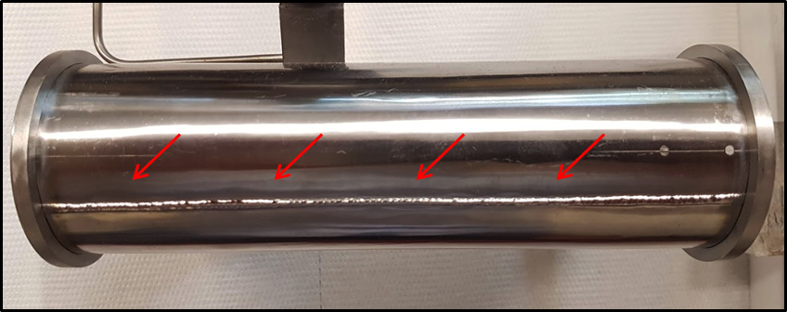
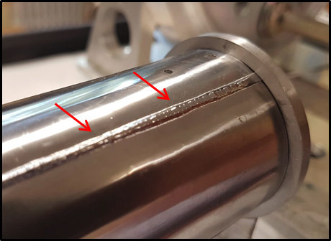
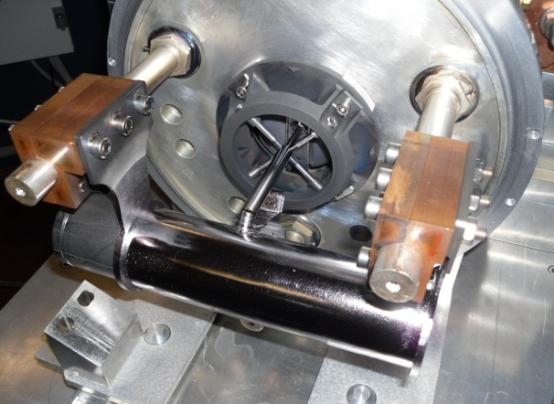
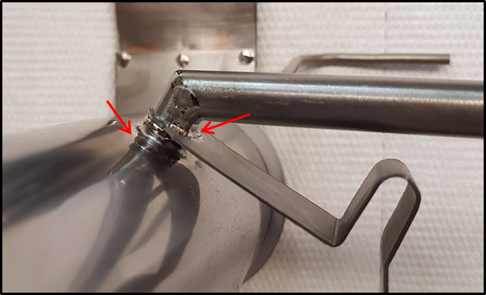
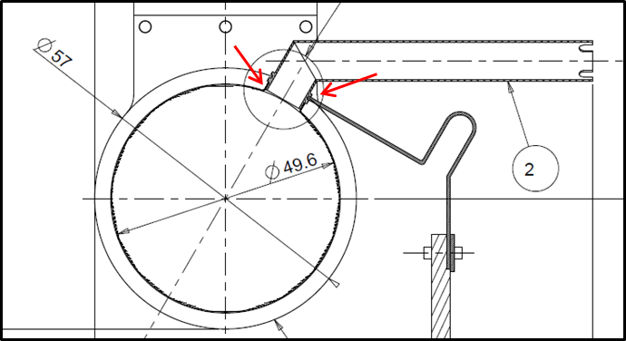
2- The SPES target: general architecture and main characteristics
Ta sheet (tk = 0.2 mm) rolled and welded for the main body of the heating system (Ø_{e} = 50 mm)
welding of thin Ta components for the high temperature target transfer line
Mattia Manzolaro slide 11/46

Slide 12
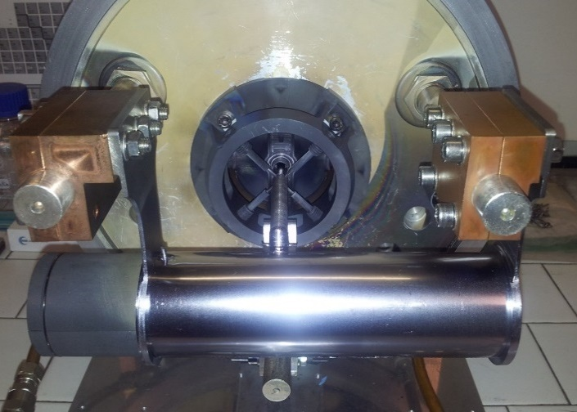
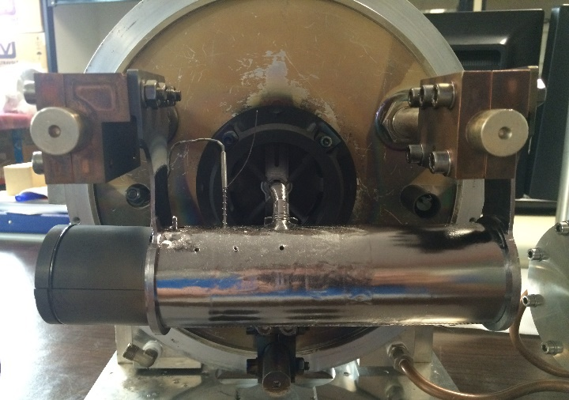

2- The SPES target: general architecture and main characteristics
Endurance tests at high temperature with Joule heating thermal load → 10 kW
(primary proton beam thermal load → 8 kW)
before testing
after testing
400 testing hours at ≈ 2000 °C → 200 hours at maximum power (10 kW)
80 heating-cooling cycles → 10 with current ramps of 1 s from 0 A to 1300 A (!)
TIS UNIT STILL OPERATIVE !
Mattia Manzolaro
Mattia Manzolaro slide 12/46

Slide 13
SUMMARY
1- Introduction
2- The SPES target
3- Numerical models
4- On-line tests
5- Target material characterization @ HT
6- ISOL targets @ other facilities
7- Conclusions and future developments
Mattia Manzolaro slide 13/46

Slide 14
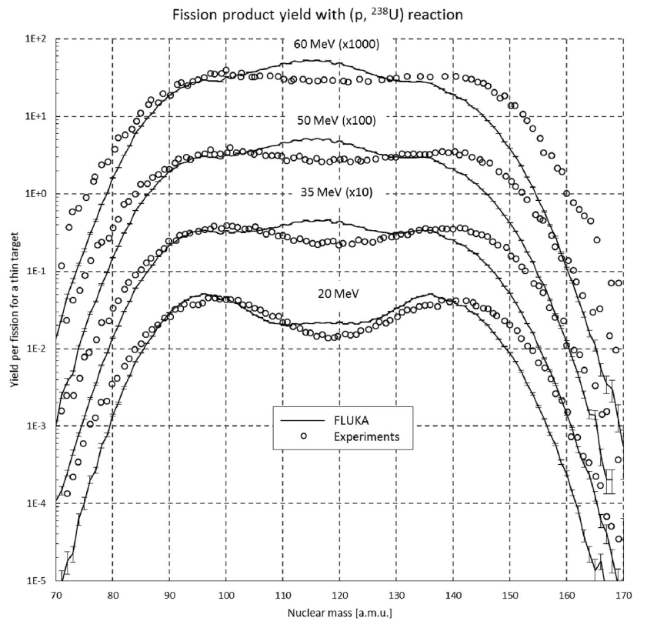
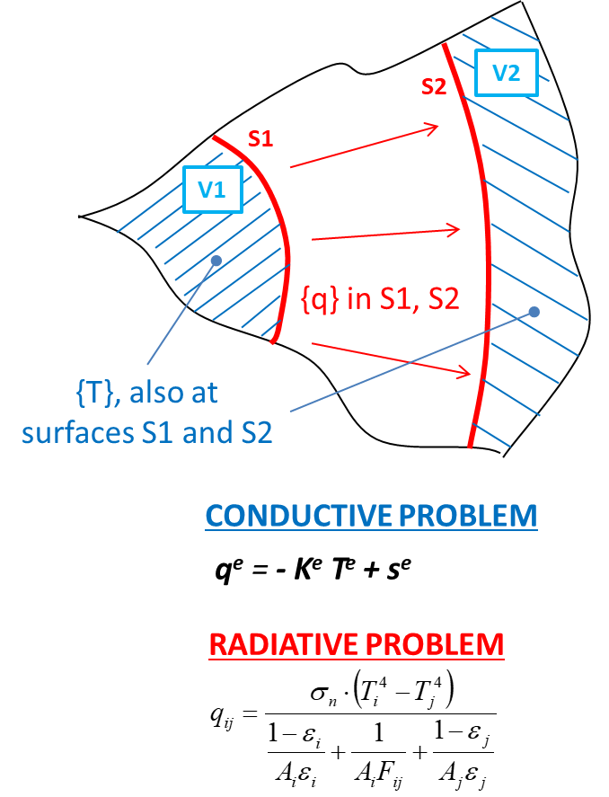
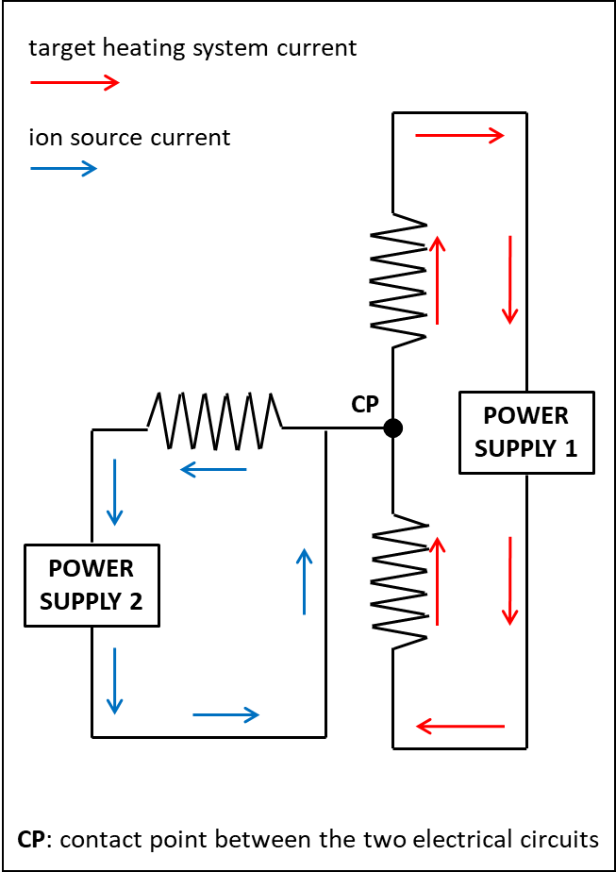
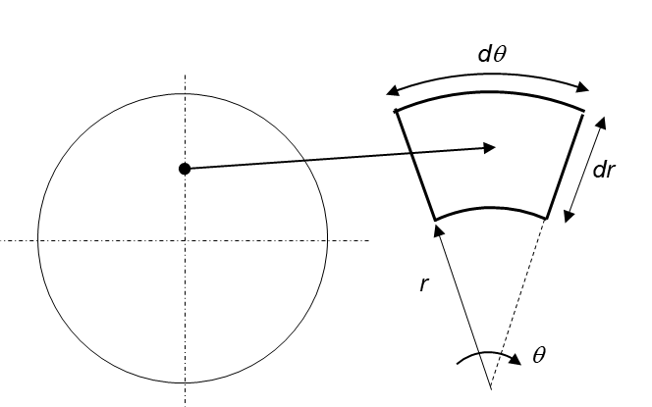
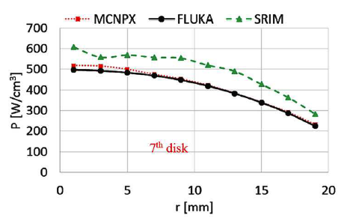
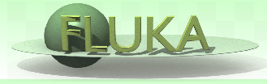
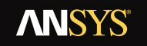
3- Numerical models: a multiphysics approach
thermal analysis
- thermal conduction
- thermal radiation
particle-matter interaction
electrical conduction
structural analysis
particle physics MonteCarlo simulations (FLUKA)
coupled-field Finite Element simulations (ANSYS)
p
q
I
σ
Mattia Manzolaro slide 14/46

Slide 15
3- Numerical models: a multiphysics approach
electrical-thermal Finite Element model
thermal analysis
- thermal conduction
- thermal radiation
particle-matter interaction
electrical conduction
structural analysis
TWO-WAY coupling
Joule heating (x,y,z) – ρ (T)
temperature distribution (x,y,z)
ONE-WAY coupling
ONE-WAY coupling
power density (x,y,z)
temperature distribution (x,y,z)
Mattia Manzolaro slide 15/46

Slide 16
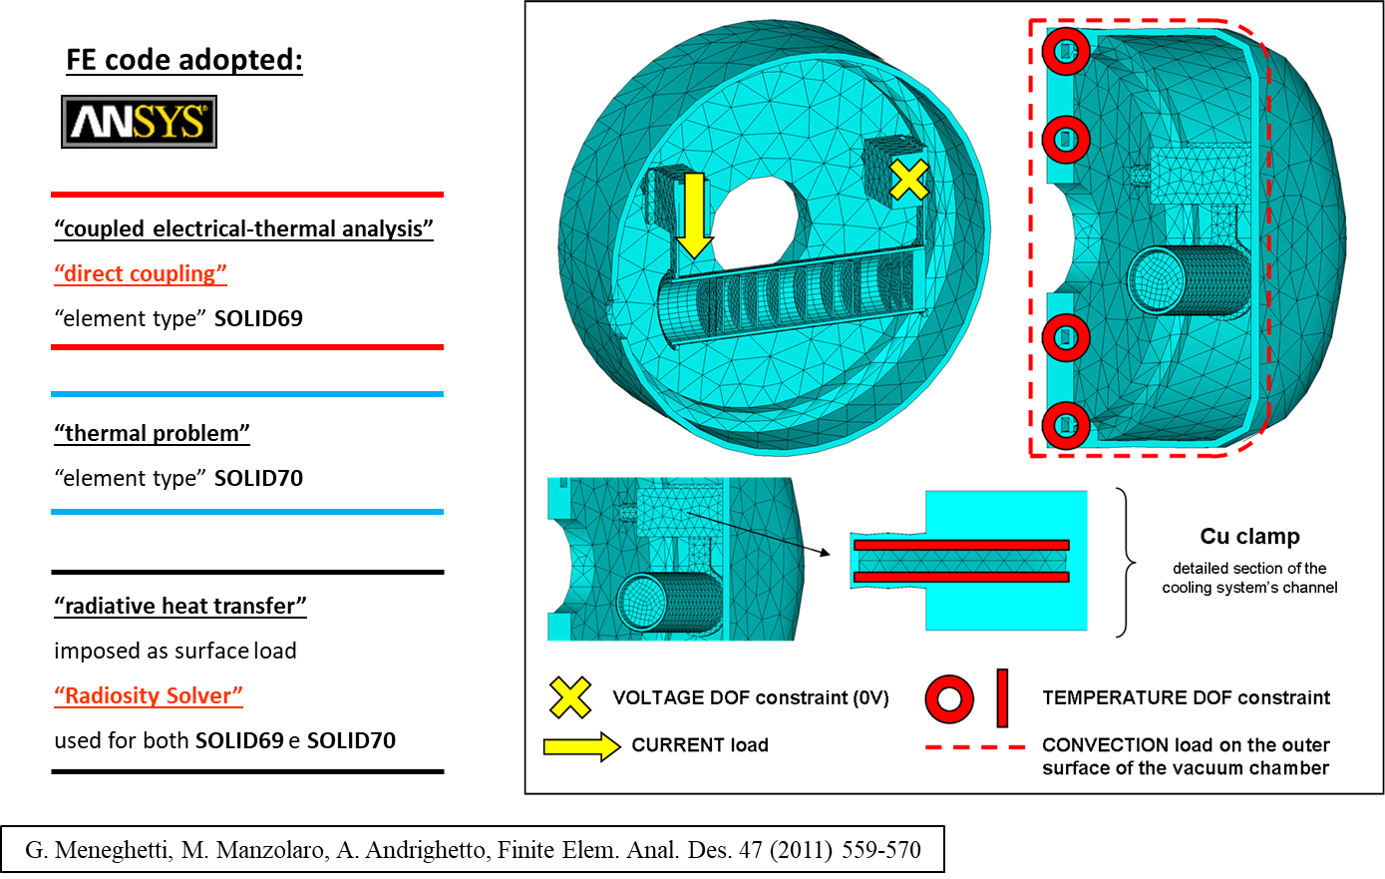
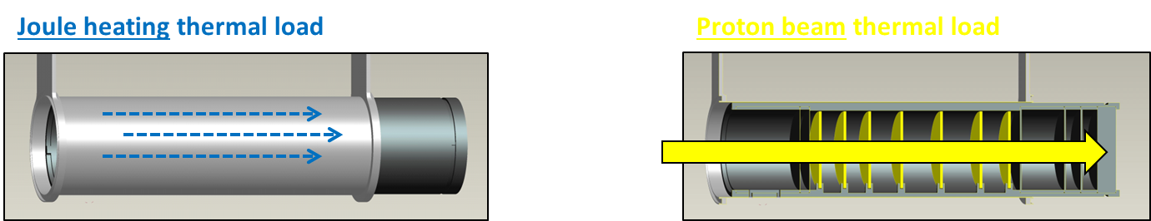
3- Numerical models: the electrical-thermal Finite Element model
directly implemented (electrical-thermal model)
power density tables import
Mattia Manzolaro slide 16/46

Slide 17
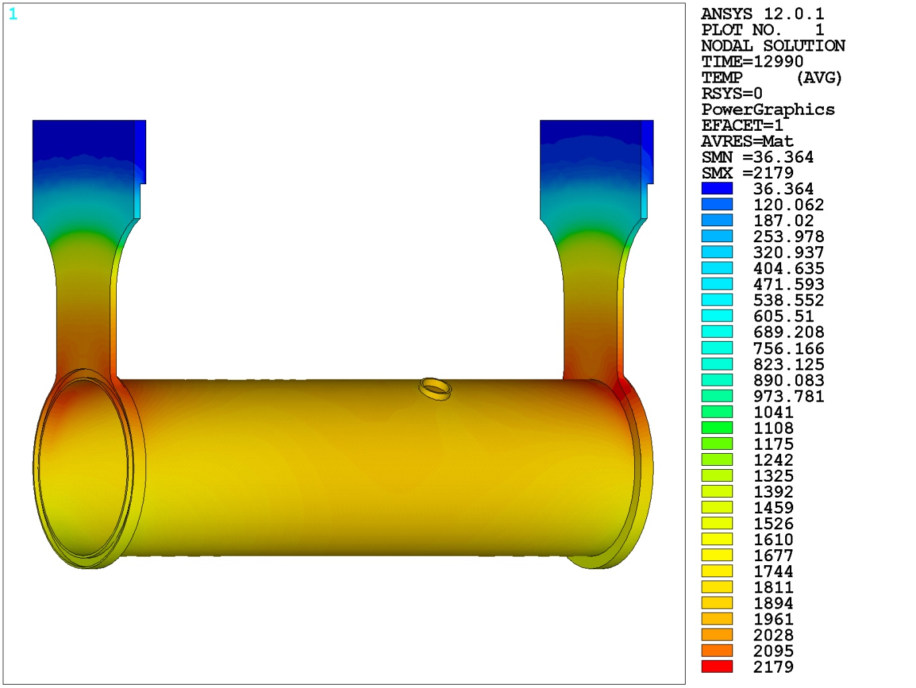
3- Numerical models: the electrical-thermal Finite Element model
Joule heating thermal load (1300 A) to heat the target during the conditioning phase
> point P1: Ta tube reference temperature
> point P2: C window reference temperature
P1
P2
Mattia Manzolaro slide 17/46

Slide 18
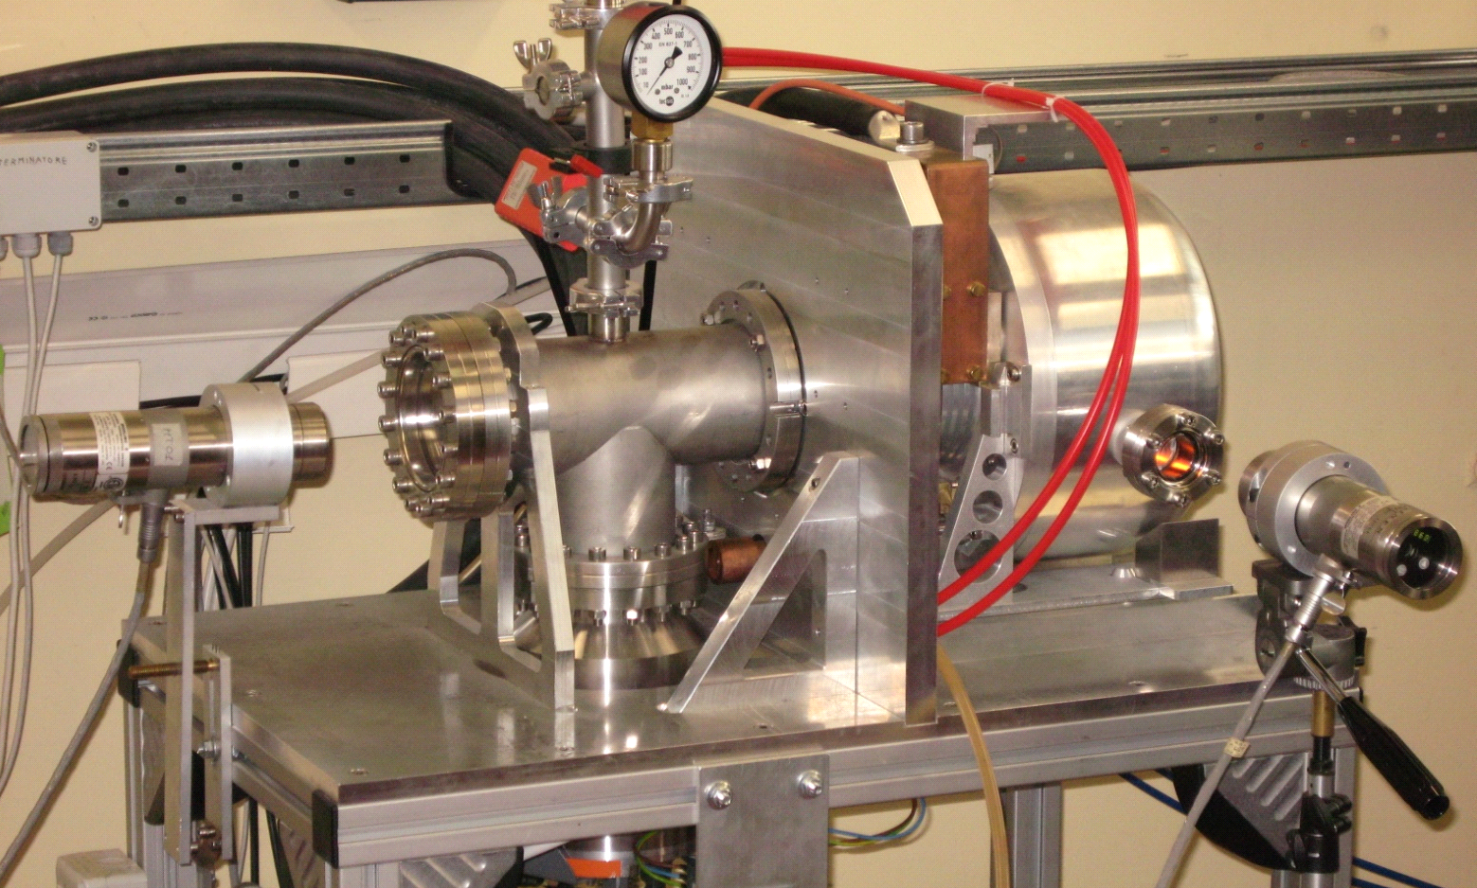
3- Numerical models: the electrical-thermal Finite Element model
Joule heating thermal load (1300 A) to heat the target during the conditioning phase
2
1
7
8
5
6
3
4
1.
Target vacuum chamber
5.
HT pyrometer
2.
Power supply connection
6.
LT pyrometer
3.
Vacuum turbomolecular pump
7.
Kodial viewport (Ta tube)
4.
Cooling water line
8.
Kodial viewport (graphite window)
Mattia Manzolaro slide 18/46

Slide 19
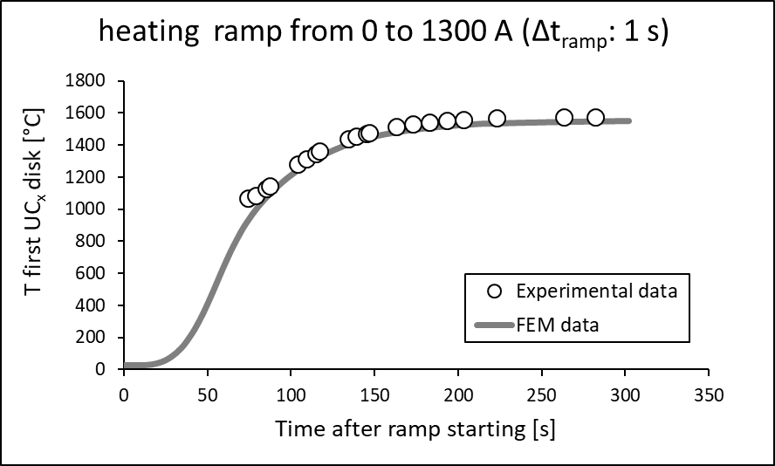
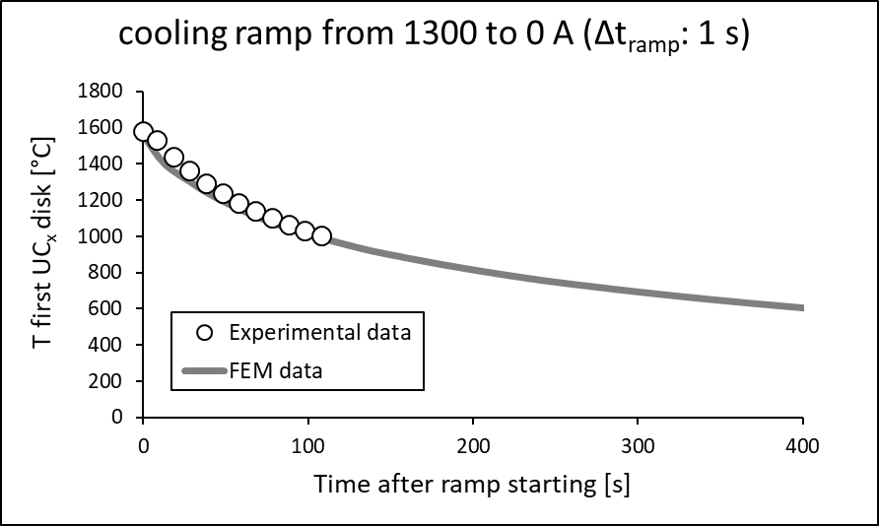
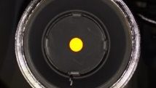
3- Numerical models: the electrical-thermal Finite Element model
Joule heating thermal load (1300 A) to heat the target during the conditioning phase
Reference: M. Ballan et al., Nucl. Instrum. Methods Phys. Res., Sect. B 376, 28-32 (2016)
Mattia Manzolaro slide 19/46

Slide 20
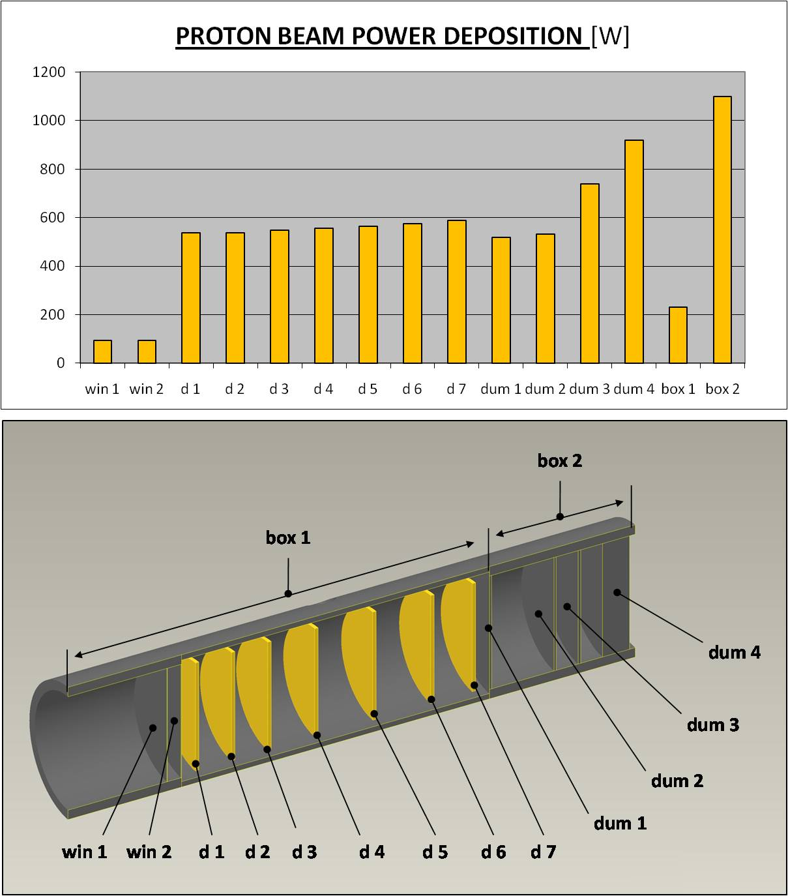
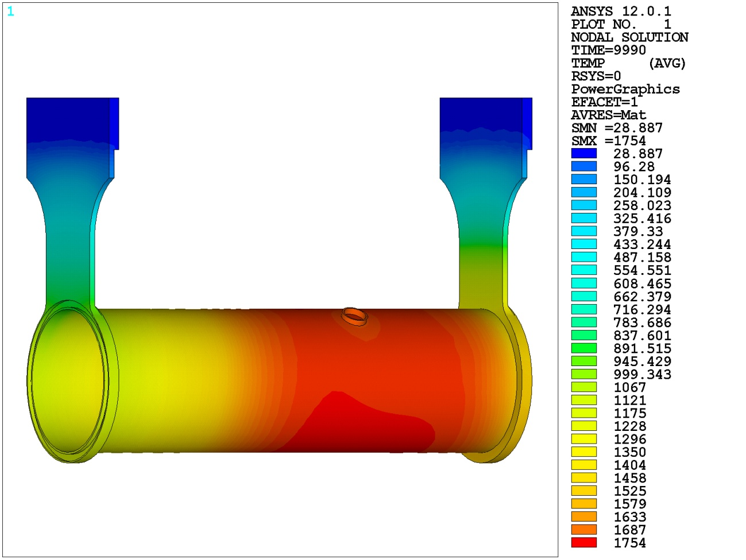
3- Numerical models: the electrical-thermal Finite Element model
Proton beam thermal load: 40 MeV, 0.2 mA (≈ 8 kW) (power density input for the Finite Element model calculated by means of particle physics MonteCarlo codes)
TEMPERATURE DISTRIBUTION [°C]
Mattia Manzolaro slide 20/46

Slide 21
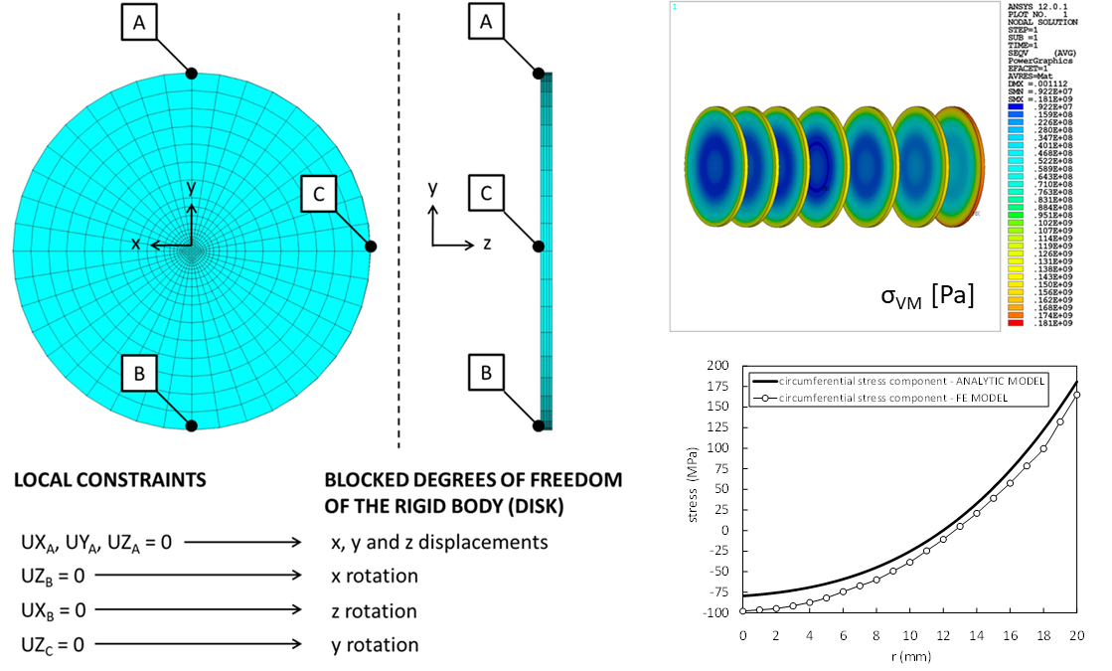
3- Numerical models: the electrical-thermal Finite Element model
Proton beam thermal load: 40 MeV, 0.2 mA (≈ 8 kW) (power density input for the Finite Element model calculated by means of particle physics MonteCarlo codes)
THERMAL STRESS STATE [Pa]
(induced by temperature gradients)
Mattia Manzolaro slide 21/46

Slide 22
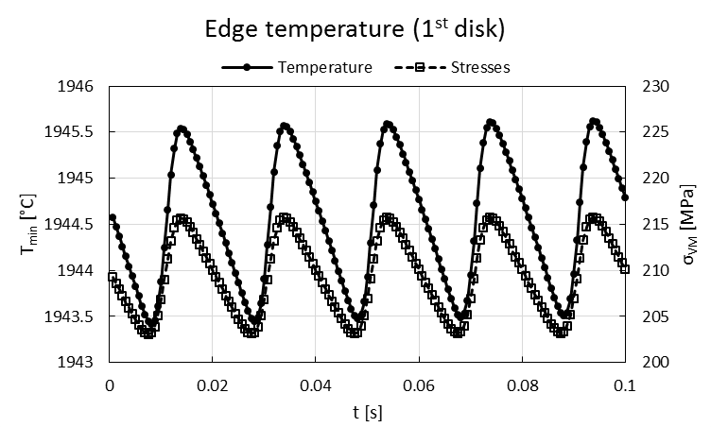
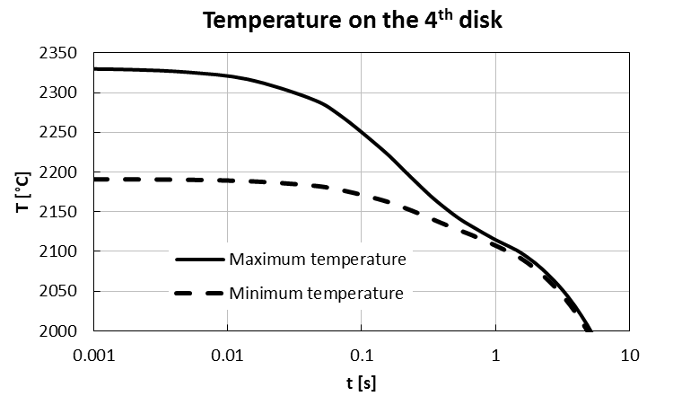
3- Numerical models: the electrical-thermal Finite Element model
Proton beam thermal load: 40 MeV, 0.2 mA (≈ 8 kW) (power density input for the Finite Element model calculated by means of particle physics MonteCarlo codes)
Effect of the wobbling (50 Hz)
Request for an higher wobbling frequency
ΔT_{MAX} ≈ 2.5°C
σ_{VM_MAX} = 198 MPa
Δσ = 14 MPa
Proton beam onto the disk
Stop of the proton beam
After 1 s, ΔT_{MAX} ≈ 350°C
Warning on the sudden increase of the proton beam power!
Proton beam onto the disk
Reference: A. Monetti et al., “The RIB production target for the SPES project”, Eur. Phys. J. A 51, 128 (2015)
Mattia Manzolaro slide 22/46

Slide 23
SUMMARY
1- Introduction
2- The SPES target
3- Numerical models
4- On-line tests
5- Target material characterization @ HT
6- ISOL targets @ other facilities
7- Conclusions and future developments
Mattia Manzolaro slide 23/46

Slide 24
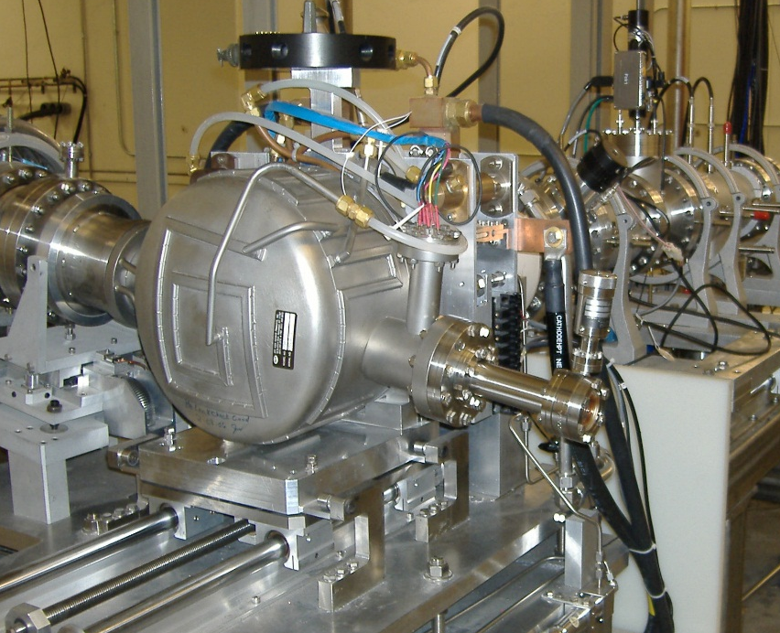
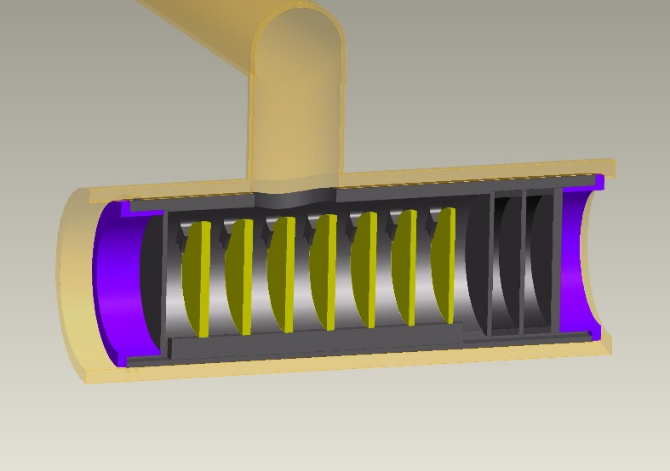

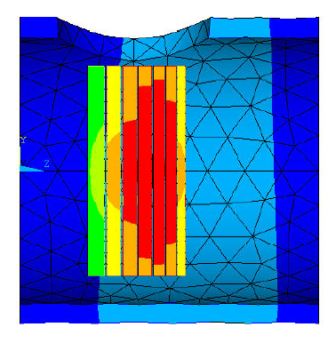
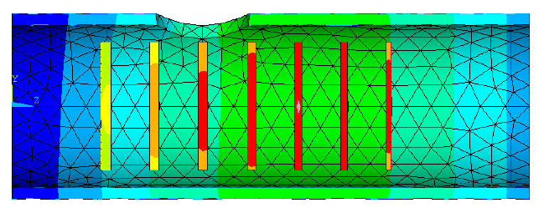
4- On-line tests: scaled SiC target prototype tested @ ORNL
Scaled (d = 13 mm) SiC SPES Target Prototype
tested @ ORNL (2007)
Total Deposited Power / Total Disks Surface = constant
SPES target architecture
tested successfully with a
42 MeV, 12 µA proton beam
Conventional Target Architecture
T_{MAX} ≈ 2200 °C - 40 MeV, 6 µA proton beam
SPES Target Architecture
T_{MAX} ≈ 2200 °C - 40 MeV, 18 µA proton beam
Mattia Manzolaro slide 24/46

Slide 25
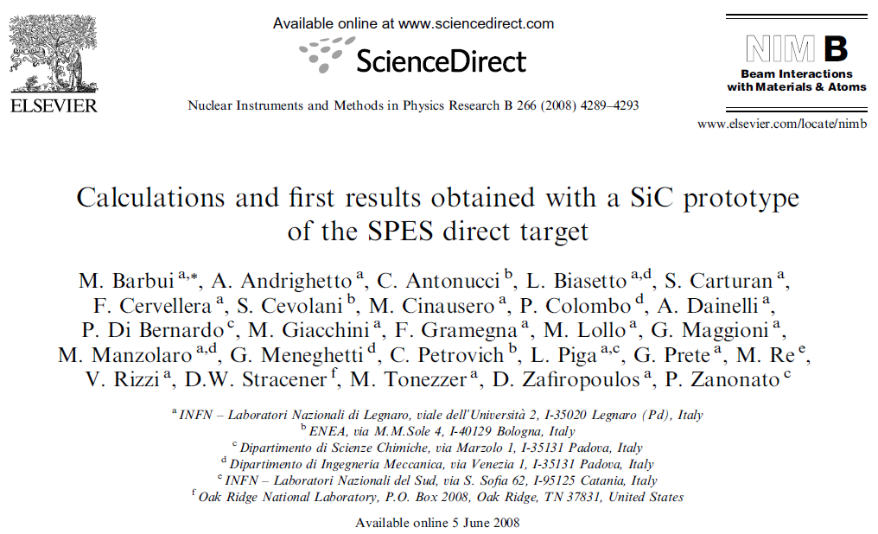
4- On-line tests: scaled SiC target prototype tested @ ORNL
Mechanical Design by Michele Lollo
Mattia Manzolaro slide 25/46

Slide 26
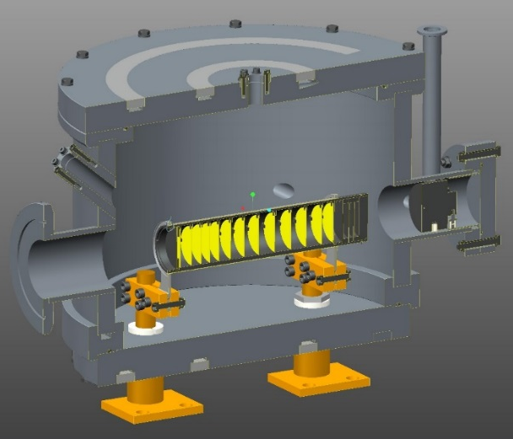
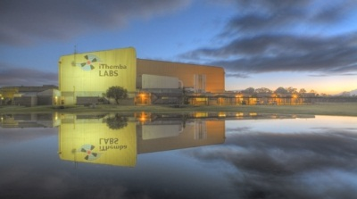
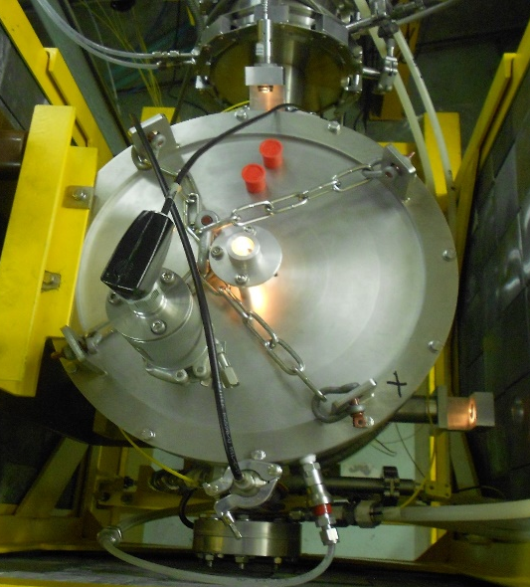
4- On-line tests: SiC target prototype tested @ iThemba LABS
high power tests @ iThemba LABS (A. Monetti)
Full scale SPES target successfully tested
- 66 MeV, 60 µA proton beam (40 MeV, 200 µA @ SPES)
- SiC disks (UCx disks @ SPES) → acceptable activation levels
- 13 disks (7 disks @ SPES)
Reference: A. Monetti et al., “On-line test using multi-foil SiC target at iThemba LABS”, Eur. Phys. J. A 52, 168 (2016)
Mattia Manzolaro slide 26/46

Slide 27
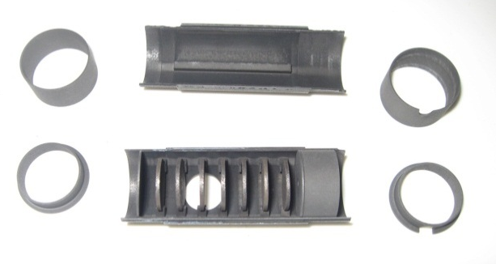






4- On-line tests: scaled UCx target prototype tested @ ORNL
On-line testing of the SPES target material and architecture @ ORNL
40 MeV, 50 nA proton beam on a UCx target
 | 2010 | 2011
Density (g/cm³) | 4.25 | 2.59
Diameter (mm) | 12.50 | 13.07
Thickness (g/cm²) | 0.41 | 0.41
Calculated porosity (%) | 58 | 75
2010 Test
Standard UC_{X}
2011 Test
Low density UC_{X}
Mattia Manzolaro slide 27/46

Slide 28

4- On-line tests: scaled UCx target prototype tested @ ORNL
On-line testing of the SPES target material and architecture @ ORNL
40 MeV, 50 nA proton beam on a UCx target
- 2 target prototypes tested at 3 different temperature levels (2000°C, 1800°C and 1600°C)
- approximately 80 isotopes (20 elements) collected
Mattia Manzolaro slide 28/46

Slide 29



4- On-line tests: scaled UCx target prototype tested @ ORNL
Special Thanks to Dr. Daniel Stracener (ORNL)
Mattia Manzolaro slide 29/46

Slide 30




4- On-line tests: commissioning plan @ SPES
the next two steps of the commissioning phase
2020: 40 MeV, 20 µA
40 MeV, 20 µA, 10¹² f/s
40 MeV, 200 µA, 10¹³ f/s
SiC target
UCx target
UCx target
the full-scale SPES target for high intensity RIBs
Nominal parameters
- Target material: UCx (SiC as an alternative)
- Proton beam energy: 40 MeV
- Proton beam intensity: 200 µA
- Proton beam sigma: 7 mm
- Wobbling radius : 11 mm
First SPES RIB (²⁶Al)
to high proton beam intensities
(increase by a factor of 10)
first n-rich fission isotopes
Mattia Manzolaro slide 30/46

Slide 31
SUMMARY
1- Introduction
2- The SPES target
3- Numerical models
4- On-line tests
5- Target material characterization @ HT
6- ISOL targets @ other facilities
7- Conclusions and future developments
Mattia Manzolaro slide 31/46

Slide 32

5- Target material characterization @ HT
homemade materials for the target disks (strong R&D activity required)
Mattia Manzolaro slide 32/46

Slide 33




5- Target material characterization @ HT
homemade materials for the target disks (strong R&D activity required)
main requirements for ISOL target materials @ high temperatures
- open porosity and reduced grain size (diffusion & effusion)
- low vapor pressure (low gas load in the ion source and long term stability at high temperature)
- high emissivity
- high thermal conductivity
- good mechanical properties
total isotope yield deeply affected by open porosity (diffusion/effusion processes)
Courtesy of Stefano Corradetti
Mattia Manzolaro slide 33/46

Slide 34

5- Target material characterization @ HT
Emissivity ε (th. radiation) and thermal conductivity λ (th. conduction) control the target temperature field
Temperature gradients generate stress states and a good tensile/compressive strength σ_{TS} is required
Mattia Manzolaro slide 34/46

Slide 35





5- Target material characterization @ HT
Emissivity ε meas. method
L. Biasetto, M. Manzolaro, A. Andrighetto, Eur. Phys. J. A 38 (2008) 167-171
Thermal conductivity λ meas. method
M. Manzolaro, S. Corradetti, A. Andrighetto, L. Ferrari, Rev. Sci. Instrum. 84, (2013) 054902
Mattia Manzolaro slide 35/46

Slide 36




5- Target material characterization @ HT
Emissivity measurements for different Uranium Carbides
- Direct emissivity measurements on heated UC_{x} discs using a dual frequency pyrometer
- UC_{x} samples of different composition and synthesis routes produced in different laboratories participating to ActiLab
Thermal Conductivity estimations for the SPES Uranium Carbide
- Creation of thermal gradients on UC_{x} disks → thermal conductivity obtained by inverse analysis using Ansys®
- Activity performed in the context of ActiLab Work
Package in ENSAR (7th Framework Program)
Mattia Manzolaro slide 36/46

Slide 37





5- Target material characterization @ HT
A new method to estimate the Tensile Strength @ HT (Silicon Carbide)
SiC disk (Hexoloy SA) – Matteo Sturaro master’s thesis, University of Padova
Supervisors: G. Meneghetti, A. Andrighetto, M. Manzolaro, M. Ballan
average stress level during operation with primary beam
Mattia Manzolaro slide 37/46

Slide 38
SUMMARY
1- Introduction
2- The SPES target
3- Numerical models
4- On-line tests
5- Target material characterization @ HT
6- ISOL targets @ other facilities
7- Conclusions and future developments
Mattia Manzolaro slide 38/46

Slide 39

6- ISOL targets @ other facilities
courtesy of Dr. W. Hwang (RISP)
Mattia Manzolaro slide 39/46

Slide 40

6- ISOL targets @ other facilities
courtesy of Dr. João Pedro Ramos (ISOLDE-CERN)
ID35-A first integrated CERN-ISOLDE spallation source operated at 2000°C with GW instantaneous beam power for isotope production-Dr. RAMOS, J.p.
Mattia Manzolaro slide 40/46

Slide 41

6- ISOL targets @ other facilities
courtesy of Dr. João Pedro Ramos (ISOLDE-CERN)
ID35-A first integrated CERN-ISOLDE spallation source operated at 2000°C with GW instantaneous beam power for isotope production-Dr. RAMOS, J.p.
Mattia Manzolaro slide 41/46

Slide 42

6- ISOL targets @ other facilities
courtesy of Dr. Alexander Gottberg (TRIUMF)
ABSTRACT 71: A. Gottberg – TRIUMF High-Power Targets – Novel Concepts and Operational Experience
Mattia Manzolaro slide 42/46

Slide 43

6- ISOL targets @ other facilities
courtesy of Ferran Boix Pamies (ISOLDE-CERN)
ID60-The LIEBE high-power target: Offline commissioning results-Mr. BOIX PAMIES, Ferran
Mattia Manzolaro slide 43/46

Slide 44
SUMMARY
1- Introduction
2- The SPES target
3- Numerical models
4- On-line tests
5- Target material characterization @ HT
6- ISOL targets @ other facilities
7- Conclusions and future developments
Mattia Manzolaro slide 44/46

Slide 45
7- Conclusions and future developments
Numerical models and simulation activities are fundamental for the design of High Temperature ISOL Targets
The goal is to design a target system that can be used for the highest RIB production (and so for the highest primary beam intensity) without exceeding the material limiting temperature
Validation of numerical models by means of dedicated experimental tests (both off-line and on-line) is extremely important
Numerical models and simulation activities can be extremely useful for Safety and Machine Protection Systems
The aforementioned multiphysics approach could be improved introducing CFD (water cooling, …) and diffusion/effusion analysis (GEANT4 custom routines)
ABSTRACT 71 (poster session): M. Ballan - Targets for the SPES project and its applications: material selection and release simulations
Mattia Manzolaro slide 45/46

Slide 46

MANY THANKS FOR YOUR ATTENTION!
Acknowlegments: Prof. G. Meneghetti and Prof. P. Colombo (UNIPD-DII), Prof. L. Biasetto (UNIPD-DTG), Dr. D.W. Stracener (ORNL), the ENSAR-ActiLab collaboration (2010-2014, CERN, PSI, IPNO, GANIL)
Mattia Manzolaro slide 46/46

