Slide 1
Vulnerability Scanning
Automated Patching Efforts
  Jonathan Homer
  NLIT 2008 Conference

Slide 2
Eating The Elephant
Data Collection – paying attention to what’s important
Data Analysis – Build a process and stick to it

Slide 3

Roadmap
Where we’re going:
Preemptive Remediation
Improved Reconciliation
Department Crosscutting
Where we’re at:
Regular Scans
Automated Notification and Follow-up
Advanced Metrics and Reporting
Where we came from:
Sporadic Scanning
Large teams to fix vulnerabilities
“Fire drills”

Slide 4
Our Environment
Self Managed
Decentralized Management
MSC self applied w/ reporting tools
Root Access
  (LUA user required for daily tasks)
Individual responsible for
patching and security
Wider range of:
  Operating Systems
  Applications
  Hardware and Devices
Allows for exemptions with
proper approval
IT Managed
Strict MSC enforcement
Strict LUA enforcement
Strict Password Enforcement
Automated Patching
“Maintenance Free”
Small Deviation Threshold

Slide 5
Purpose of Vuln Management
To detect and remediate
vulnerabilities on a network
Detection Methods
Remediation Methods
Retina
LANGuard
Nessus
Core Impact
Foundstone
NeXpose
Vulnerability Scanners
Logical Comparison with data feed service(s)
Log Files or Intrusion Detection
iDefense
DeepSight
IntelliShield
Automated Patching
Manual Patching
False Positive
Accepted Risk

Slide 6
Our Assignment
To provide the necessary information
(and motivation) to the person responsible for resolving the issue

Slide 7
Drivers and Requirements
NIST 800.40
  “The PVG is responsible for monitoring security sources for vulnerability announcements, patch and non-patch remediations, and threats that correspond to the software within the organizational software inventory. A variety of sources should be monitored to ensure that the PVG is aware of all newly discovered vulnerabilities.”
  Timely patching of security issues is generally recognized as critical to maintaining the operational availability, confidentiality, and integrity of information technology (IT) systems.
PCSP
  CMG-45: Develop a uniform patch management and flaw remediation process
  CMG-55: Implement non-critical patches within 30 days
  CMG-60: Install all critical patches within 30 days
INL: Follow-up to “Get-To-Green” Patching Effort

Slide 8
Process Flow
Scanning and Reconciliation
Closure and Reporting
Notification and Remediation

Slide 9
Scanning/Detection
Scan Engines
Single or Multiple Scanners
Credentialed vs. Non-Credentialed Scans
Scanning Schedule
Agent vs Network Scans
Data Feeds
Relationship between affected technologies and current logical inventory
Incident Response
Integrate process with response team
Scanning and Reconciliation

Slide 10
Reconciliation
Combining multiple detections on the same device
Relating a detected vulnerability to a logical device
Relating a logical device to an end user and/or administrator
EXAMPLE:
Retina
Scan
Engine
DNS
Records
CMDB
Scanning and Reconciliation
Vuln Mgmt
System
Vuln Data
Asset Mgmt
Config Mgmt
Vuln Management
Nessus
Scan
Engine
DNS
Records
CMDB

Slide 11
Notification
To be effective, must reach the person who has the ability to apply necessary changes.
No escalation = No patching
You can’t be too clear
Cooperation and understanding are key
Customers need specific, step-by-step instructions and a place to go for help
Full time administrators need digests
Notification and Remediation

Slide 12
Closure
Sometimes applying the patch is not enough
Admins will think they fixed it everytime
Everyone makes mistakes
“I” am always the exception
Some patches are more stubborn than others
Collaboration and communication is the key
Closure and Reporting

Slide 13
Closure cont.
Use logic to determine patch resolution
(see “Avoiding Pitfalls Section”)
Don’t punish those devices taken off the network
Record the progress along the way
(it’s all about metrics)
Have a process for vulnerabilities which are
“re-detected”
Closure and Reporting

Slide 14
Reporting
Weekly reports to Management
Management Questions:
#1 – What does it look like this week?
#2 – Where are the specific offenders?
(be able to drill-down)
Live Data is essential to patching personnel
  Views by Machine, by Vuln, by Date
  Identify trends/patterns to avoid tunnel vision
  Not tracking historical data will bite you in the end
Closure and Reporting

Slide 15
Application @ INL
Phase 1 – Microsoft Access Database
  Single Vuln Scan Engine
  Very Rough Notification System
  90 – 180 Days
Phase 2 – Custom Application
  Utilized Single Vuln Scan Engine
  Followed same basic process as Access DB
  1 Year Development (System went online at 6 months)
Phase 2.9 – Custom App w/ Multiple Engines
Phase 3 – COTS Solution + Custom Application
  COTS runs our IT admin groups
  Custom App runs End User Notifications

Slide 16
PatchMan (Custom App)
Scan Engines (Multiple)
Digest by machine
Process flow determined by management state
Each vuln state determined by comparison with previous scans
(see “Avoiding Pitfalls section)
Notification system with integrated escalation
Analyze per vuln per machine basis

Slide 17
Metrics
Management
Vulnerabilities on Network (by severity)
Vulnerabilities being reviewed for impact
Historical Trending
Average Vulnerabilities per System
Time to Remediation
Ground Support
Customer Interaction
Newly discovered vulnerabilities
Acknowledged Risks
Devices vulnerability free
Devices with one or fewer vulnerabilities
Failed Patching

Slide 18
Avoiding Pitfalls
Non-Standard Configurations
Tip: Align with existing Configuration Management System
Number of Exceptions/False Positives is proportional to deviation from standard configuration
Use caution when relating vulns by CVE – OS must be taken into consideration
Consider excluding, segregating, or processing differently those machines which fall outside a pre-defined scope

Slide 19
Avoiding Pitfalls
Non-Cooperative Users
Most Important: Get Management Buy-in
Communicate clearly
Be strict on exceptions – clear definitions
Sell the positive – educate the user on the benefits

Slide 20
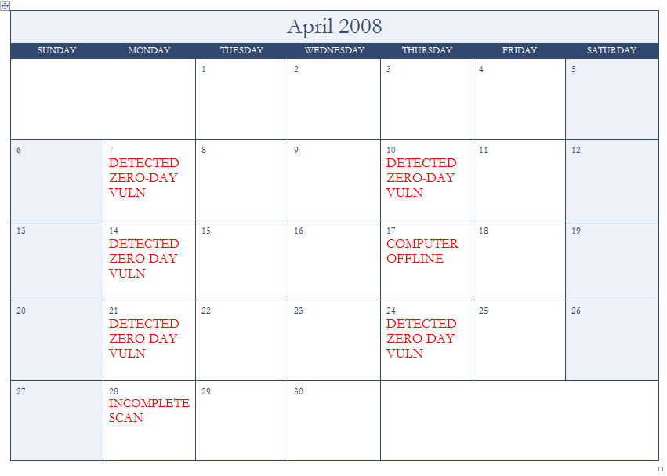
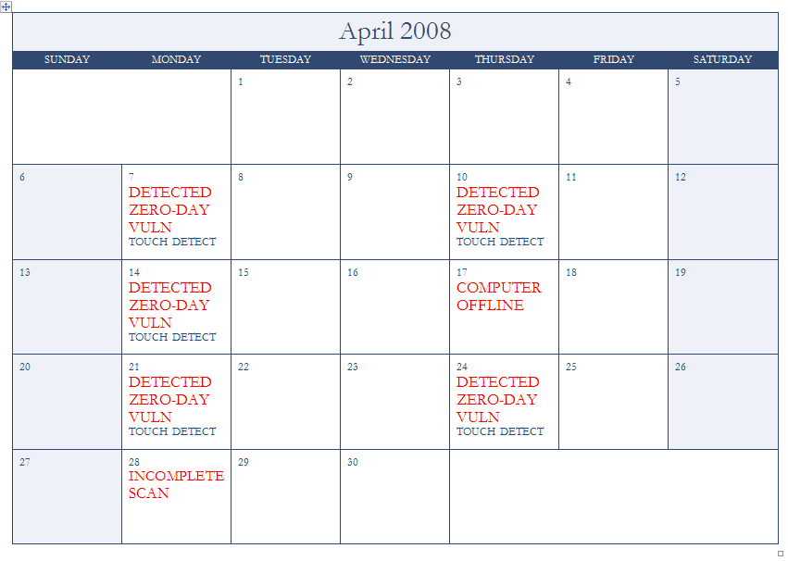
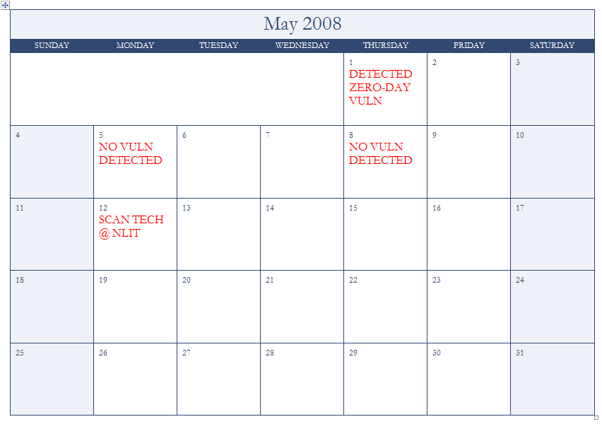
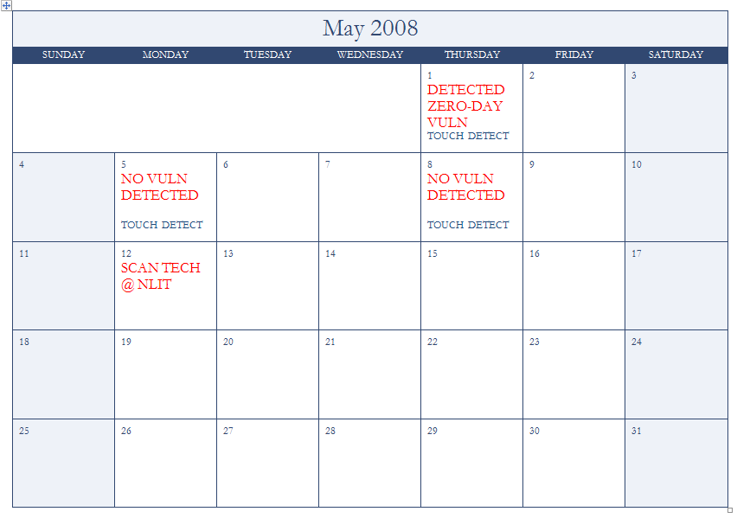
Avoiding Pitfalls
“Clean” Scan
Situation: Most scan engines return a result on finding a vulnerability, and return [NULL] on a ‘clean’ detection. How can you programmatically detect when a vulnerability goes away?
Create a Touch Vulnerability
Must be unique per scan engine
Small margin for error
Essential to clear communication

Slide 21
Avoiding Pitfalls
User Self Scans
Great option where feasible
Must perform the same scan as the automated scan
May or may not integrate with vuln tracking system
Recommendation: have the results emailed to the user rather than waiting at a page

Slide 22
Questions?

Slide 23
Contact Info
Jonathan Homer
Desktop Management
(208) 526-9660
jonathan.homer@inl.gov

