Slide 1
Change Control for SAP at ORNL
Terry Scoggins
SAP Infrastructure Task Lead
NLIT 2008

Slide 2
30,000 foot IT strategy
Enforcing Network Compliance – Stafford
Update on Network Enhancements – Piercy
Who’s Your System Administrator - Willoughby
Advanced Windows Operating System Imaging and Deployment – DeGuira
Lessons Learned in Implementing SCCM – Cunningham
Change Management/Control in the SAP Environment – Scoggins
Central Helpdesk Standardization and Consolidation – Causby/Beane
Consolidate IT Staff
Cyber Security Revitalization
IT Governance & Standards
Enhancing Communications through Unifying – Depp
IT University – Overby
Sharepoint as ORNL Portal - Begovich
Application Transformation
2006
2007
2008
While maintaining a consistent or reduced cost profile

Slide 3
History of SAP at ORNL
In 1997, we began a consolidation of our major business and HR systems on SAP
Phase 1 of this project was completed in 1998
We are still migrating business functionality to SAP as we standardize our business IT infrastructure on SAP and Microsoft technologies
Over 50 business applications have been migrated to SAP including all major Accounting, HR, Procurement, and Project Systems applications

Slide 4
Modules Implemented
MM - Materials Management
  Web catalog front-end
  Web Subcontracting front-end
SD - Sales and Distribution
WFO Billing
FI - Financial Accounting
  GL - General Ledger
  AP - Accounts Payable
  AR - Accounts Receivable
CO – Cost Allocation/Distribution
AM - Asset Management
PS - Project Systems
Work Breakdown Structures
Basic Cost and Budget Reports
Workflow
Industry Solution-Aerospace & Def
WFO Billing
HR - Human Resources
Organizational Management
Training and Event Mgmt
  Payroll
  Benefits
  EEO
SD
Sales &
Distribution
FI
Financial
Accounting
MM
Materials
Mgmt.
CO
Controlling
PP
Production
Planning
SAP
R/3
AM
Fixed Assets
Mgmt.
QM
Quality
Management
Client / Server
ABAP/4
PS
Project
System
PM
Plant Maintenance
WF
Workflow
HR
Human
Resources
IS
Industry
Solutions

Slide 5
Non-Integrated Legacy Systems Replaced
50+ systems were replaced by the SAP implementation
Major Systems replaced included:
Cost Accounting System (Dunn & Bradstreet)
Accounts Payable
Accounts Receivable (Dunn & Bradstreet)
Materials Management System
Requisition Approval System
Accelerated Vendor Inventory & Delivery System
Task Based Management System
Training Management System
Compensation
Payroll (Cyborg)
Benefits (Cyborg)
HR support systems

Slide 6
ORNL SAP Business Functions
Procurement
Accounts Receivable/MARS
Badge Assignment
Compensation
Cost Reporting
DOE FTE Reporting
General Ledger
Internal Auditing
Materials Management
Organization Management
Personnel Access
Project Systems
Purchase Card
Tax Reporting
Travel Settlements
Workflow
Accounts Payable
Acquire Commodities Easily (ACE)
Benefits
Controlling Web Reports
Cyber Security
EEO Reporting
Human Resources Web
Labor Distribution
Materials Management Web Apps
Overhead Distribution
Personnel Records
Smart Services
Telecommunications
Treasury Services
Work for Others
Training
Accounts Receivable
Asset Accounting
Building Management
Cost Feeders
DOE Commitment Reporting
Human Resources Workflow
Labor Relations
Materials Management Workflow
Payroll
Portal Access Check
Property Accountability
Space Management
Variance Distribution
Project Systems/MARS/STARS

Slide 7
Consolidation Leads to Increased Need for Change Control
Consolidation reduced the number of separate systems for which change control and maintenance was needed
However, with so many critical business functions consolidated into one integrated system, change control became even more important

Slide 8
Change Control For SAP
We achieve change control in our SAP system by using a combination of the following methods:
Separation of development, QA, and Production SAP instances
Control of change transports between SAP instances using SAP security features
Locking manual changes in the QA and Production SAP instances
Administrative control of changes and transports as defined in the “ORNL Software Change Management Plan”
Restriction, logging, and review of privileged account activity

Slide 9
ORNL SAP Landscape
We use a standard SAP 3-tier landscape consisting of separate development, QA, and Production environments
Changes are moved thru the landscape via change requests using the SAP Transport Management System (TMS)
Programs, Program Modifications, Configuration Changes, etc
Development
QA
Production

Slide 10
Change Request Transport Process
Development tools locked in QA and Production. Changes made via Transport System
Programs created or changed in development and assigned to an SAP change request
After reviewing test results and documentation, Functional Support Manager
Transports change to Production
Change is released for QA by developer and approved for transport to QA by Task Lead
After functional testing, Task Lead releases to Functional Manager for Prod. approval
Development
QA
Production

Slide 11
SAP Change Management Plan
Provides guidance for the implementation of all software changes (programming and configuration) to SAP
Defines change categories that are used to determine levels of approval
Defines roles and responsibilities for personnel involved in approving and implementing changes
Defines minimum documentation and approval requirements for each change category
Defines an “Internal Order” as the key component for each software change task. The Internal Order contains a description of the change, key personnel, type of change, priority, and status
Ensures at least two staff members involved in all changes going to production

Slide 12
Internal Order Features
Customized use of existing SAP Order Management application. Internal Orders stored and managed within SAP
Contains information on type of change, key personnel, priority, and status of each change
Contains status management functionality that represents phases of the development cycle (i.e., development, testing, technically complete, complete, etc.).
Contains documentation for the tasks as defined by the Change Management Plan. A graded approach is used for establishing minimum documentation requirements based on the type of change.
Internal order is forced into the process by an ORNL customization of the transport process that will not allow a change request to move to QA without an internal order.

Slide 13
Software Change Categories
Production Support
Software modifications supporting normal business operations. These changes do not alter basic system functionality. Examples include updates to data tables (i.e., payroll tax tables, travel per diem rates, etc.) that are made by support staff due to the complex, non-routine, or sensitive nature of the change.
System Fix
Software modifications correcting a problem that exists in the production environment. Fixes do not add new functionality.
System Enhancement
Software modifications changing functionality in the production environment
Infrastructure Support
Modifications to hardware, operating systems, DBMS, or Basis/Security changes supporting software systems
Major Upgrade/Addition
Implementation of a new version of existing software (i.e., replacing SAP version 4.6C with ECC version 5.0), a major new area of functionality (i.e., SAP Business Warehouse, Supplier Relationship Management, etc.), and SAP Support Packages
Data Requests
This category does not represent a change to software. However, it is included in the change management plan in order to document prioritization and approval of requests for data. This category applies to requests for information by individuals that do not “own” the information and requests from “owners” requiring > four hours of staff support.

Slide 14
Roles in the Change Management Process
Management System Owner/Functional Owner Roles
CIO
Management System Owner
Functional Support Manager
Functional Lead
Project Management Roles
IT Project Manager
Technical Support Roles
IT Task Lead
System Administration Staff
Developer Staff
Security Staff

Slide 15
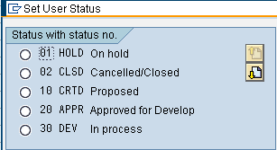


Progression of Internal Order “User Status” Codes

Slide 16
Example of Software Change Request Form
Instructions: Complete each section or mark Not Applicable (N/A)
GENERAL INFORMATION:
  Date Internal Order Created: 2/1/2008
  Internal Order Number: MBBS0022
  Task Name: Change timeout parameter on SAP servers
  System: SAP
  Business or Functional Area: Basis (System Administration)
Change Category (select one):
( ) Enhancement ( ) Production Support ( ) Fix
( ) Data Request ( x ) Infrastructure Support ( ) Major Upgrade/Addition
JUSTIFICATION:
  Task Requested by: Jane Doe
  Reason for Change Request: Audit finding that auto logoff time was set too long
Emergency Transport Justification: N/A
FUNCTIONAL SPECIFICATIONS (Narrative with attachments as necessary):
  (Documentation goes here)
SECURITY SPECIFICATIONS:
  Transaction Code: N/A
  Roles(s): N/A
  Other Issues: Segregation of Duties Review, etc. N/A
WORKFLOW ISSUES: N/A
INTEGRATION ISSUES: N/A
SUMMARY OF TEST RESULTS (Narrative with attachments as necessary):
(test results go here)
REFERENCES TO RELATED TRAINING DOCUMENTS (Scripts, Job Aids, etc.) N/A

Slide 17
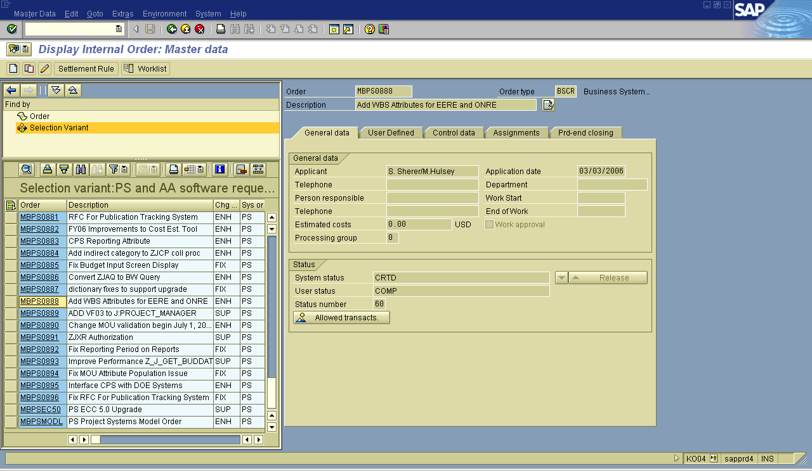
SAP transaction KO04 (Order Manager) used to create/update Internal Orders

Slide 18
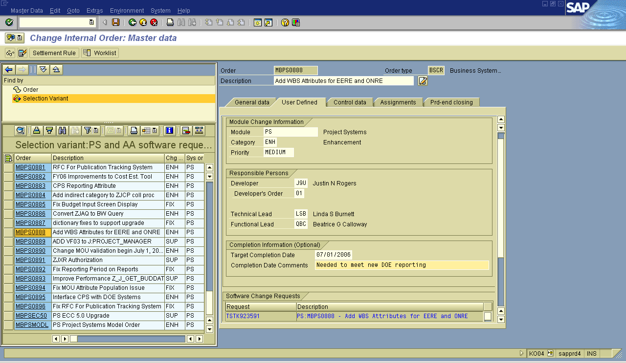
User defined fields configured to track additional information

Slide 19
Change Request Transport Process with Internal Order
-Change approved
-Personnel assigned
-Internal Order Created
-Status set to “APPR”
-Status Set to “DEV” when
work begins
-Status set to “Test”
-Functional testing begins
-Test results attached to IO
-Status set to “TECO” when
testing complete
-Change sent to FSM for
transport into PRD
-FSM reviews Internal Order
and documentation
-If documentation is
complete, change imported
into production.
-Status set to “COMP”
After reviewing test results and documentation, Functional Support Manager
Transports change to Production
Programs created or changed in development and assigned to an SAP change request
Change is released for QA by developer and approved for transport to QA by Task Lead
Internal Order required
After functional testing,Task Lead releases to Functional Manager for Prod. approval
Development
QA
Production

Slide 20
Can privileged accounts circumvent the change control process?
The SAP Governance, Risk, and Compliance module is used to control privileged accounts
  Privileged accounts were reviewed and changed to display-only in production
  Special login accounts are available if elevated privileges are needed.
  All transactions for these sessions are logged and sent to appropriate personnel for review immediately after the session.

Slide 21
Summary
Benefits of this process:
Separation of duties.
Ensures at least 2 people involved with all changes
Ensures required documentation and testing
Ensures communication among affected groups
Provides good reporting and audit trail

Slide 22
Questions?

