Slide 1

Sandia Labs Vista Deployment
NLIT 2008
May 2008
Roman Selever
Technology Development Group
Sandia is a multiprogram laboratory operated by Sandia Corporation, a Lockheed Martin Company,
for the United States Department of Energy’s National Nuclear Security Administration
under contract DE-AC04-94AL85000.

Slide 2
Many Changes Coming
FDCC
User Rights
Office 2007
Windows Vista

Slide 3
At the Core
Vista Automated Recovery
Drivers
Network Scripts
Additional Common Applications
Office 2007
Symantec Endpoint Protection
Windows Vista
Vista Image

Slide 4
Issues With Drivers
Vista Automated Recovery
Manufacturers had been slow to get out stable drivers when Vista was released, though that has improved greatly over the past year and a half
Many OEMs appear to have cut off older machines, generally more than 2 models back, not providing Vista drivers for these older systems or not doing a great deal of testing with the ones they have.
Will need to rely on Windows Update to supplement our driver set and provide drivers for older machines or devices
The older you go, the more likely that you won’t find Vista drivers from OEMs or on Windows Update.
If no drivers exist, XP drivers will in some cases work but stability or OEM support would be in question.
Drivers
Network Scripts
Additional Common Applications
Symantec Endpoint Protection
Office 2007
Windows Vista
Vista Image

Slide 5
User Recovery Options
Vista Automated Recovery
Allows for the user to easily run an automated startup repair tool if the system fails to boot (WinRE Details)
Puts additional repair tools at the disposal of technicians while on the phone with the user. (memory diagnostics, system restore, command prompt)
Based on Windows PE
Allows for the addition of custom tools or scripts
Possibility to do system backups/restores

Slide 6
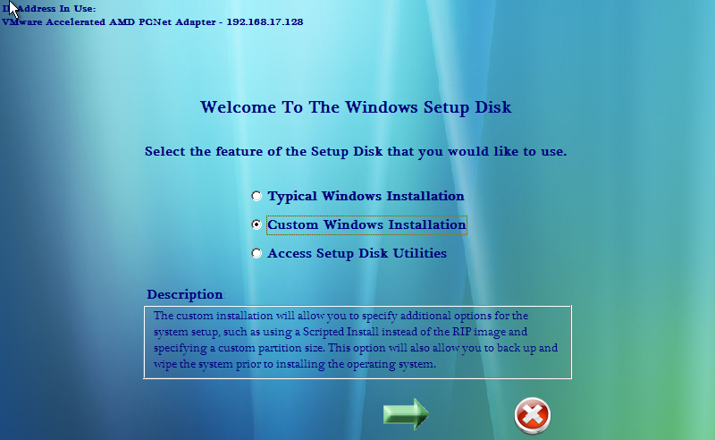
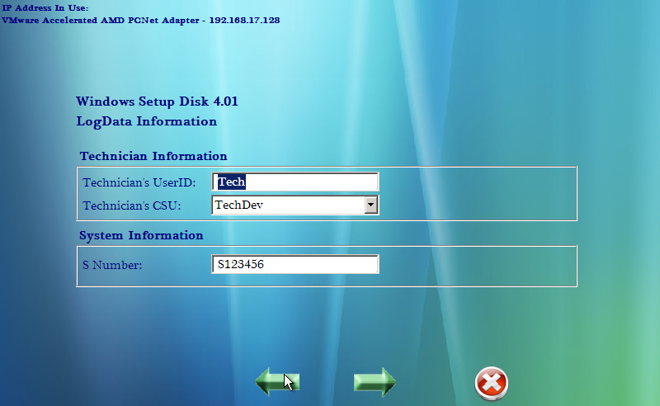
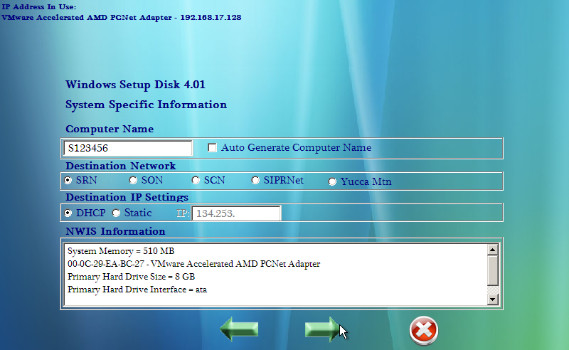
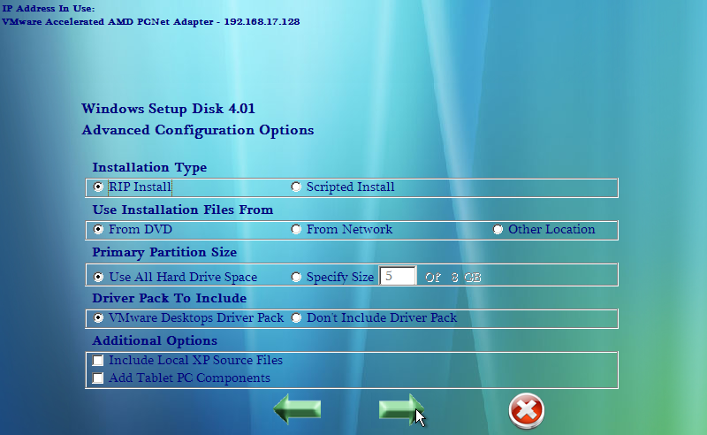
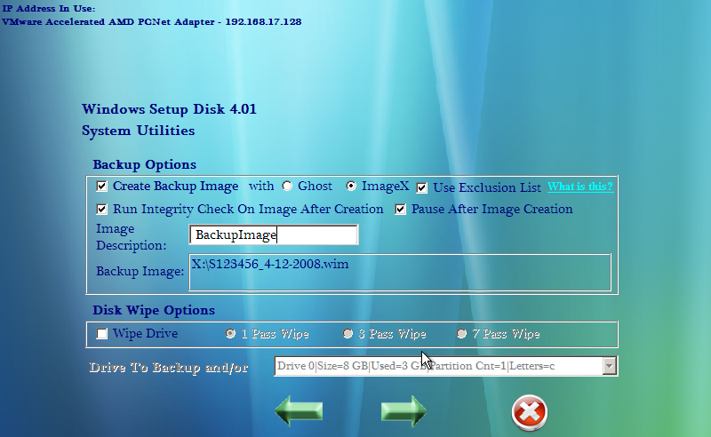
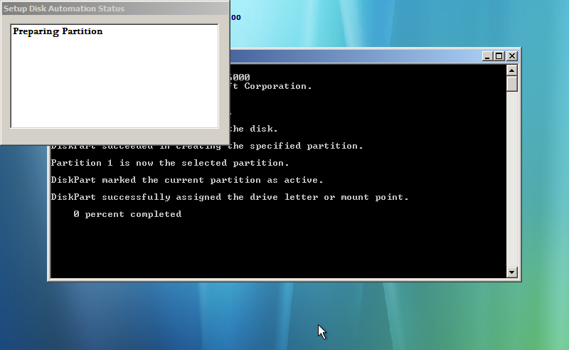
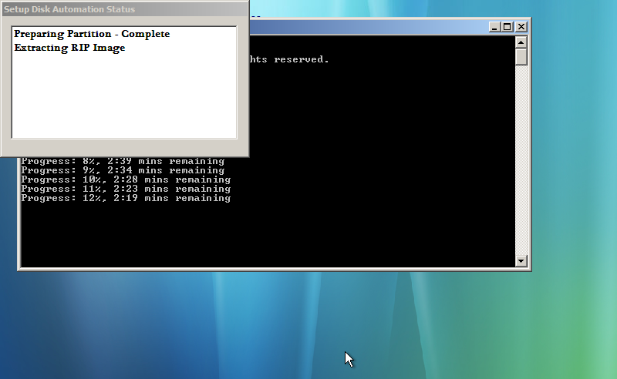
Deployment Options
Windows Setup disk
In Use For Several Years
Allows For Fast Consistent Builds
Allows For Tracking And Version Control
Flexibility To Do Builds For Various Networks
Allows Some Advanced Options
Ability To Do Backups And Wipes
Similar To Lite Touch Installation

Slide 7
Zero Touch Installations
Looking at how to integrate current processes with those documented in Windows Deployment.
Looking at changes to SCCM and how to integrate with ZTI process.
Working on a ZTI build process that will be SCCM initiated and will move the entire process to the evening.
Have an application that customers or techs can run that will evaluate their machines for application and hardware incompatibilities and schedule the Vista Migration.
Initially allow techs to schedule the rebuilds, but eventually make available for customers to schedule their own rebuilds.

Slide 8
The Overall Process
Customer/Tech runs program to evaluate and schedule Vista Migration
SCCM initiates process on all scheduled machines
USMT used to capture profile files and settings
Information such as applications installed and system name saved
Boot files reconfigured and system rebooted into Windows PE
Backup image created of existing machine
Hard drive partition recreated and formatted

Slide 9
The Overall Process
Hard drive partition recreated and formatted
Image, drivers and additional needed files copied to hard drive
Vista setup process runs
WSUS triggered to install additional patches and missing drivers
New build pushed to domain
USMT restores profile files and settings from previous build
Any available previous applications reinstalled

Slide 10
Additional Requirements
Training
  Paramount to the success of this project
  Users need to be prepared for the changes in software and security settings to minimize the impact to productivity
  Training department currently evaluating the changes and preparing in class and online training
  Looking at ways we can take advantage of the help system and the Windows Welcome Center
Application Compatibility
  Client currently being deployed
  Provides important data on software and hardware in our environment and which ones may cause issues with Vista
  Database will be used by the program that evaluates and schedules deployments to determine issues
  Application testing project currently underway

Slide 11
Questions
?
Additional Information
The Federal Desktop Core Configuration (FDCC)
Stan Hall
Columbus E-F
Mon 5/12/2008 3:30 PM
FDCC/Vista/Office 2007 Rollout BOF
Stan Hall/Roman Selever
Columbus E-F
Mon 5/12/2008 4:15 PM

