Slide 1
System Center Configuration Manager at ORNL National Laboratories Information Technology Summit 2008
Carlos Cunningham
Information Technology Services Division
Desktop Management

Slide 2
System Center Configuration Manager at ORNL
Session Agenda
ORNL Background
System Management Server 2003 features
Deploying System Center Configuration Manager (SCCM)
Prerequisites, Considerations and Migration Paths
Discuss ORNL Site Configuration
How ORNL is using System Center Configuration Manager
Patching
Microsoft and Non-Microsoft Products
Hardware and Software Inventory
Software Metering
Software Distribution
Helpdesk, Remote Control
Future Plans for SCCM
Lessons Learned

Slide 3
System Center Configuration Manager at ORNL
My Background
Worked at Oak Ridge National Laboratory for 13 years
Current responsibilities
Desktop Management
Manage Active Directory
Manage System Center Configuration Manager

Slide 4
System Center Configuration Manager at ORNL
ORNL Environment
Approximately 8000 Windows Systems
Currently supported Windows Operating Systems
Windows XP SP2, Vista (including SP1), Server 2003 SP2 & 2008
XP SP2 and Vista both 32 and 64 bit ~7500
Server 2003 SP2 and 2008 both 32 and 64 bit ~500
Windows 2000 - EOL September 30th 2008
Non supported Windows Operating Systems
Windows 9x
Windows NT 4.0 Server and Workstation

Slide 5
System Center Configuration Manager at ORNL
System Management Server 2003
System Management Server features
Patch Management
Software Update Inventory Tool
Hardware and Software Inventory
Software Deployment
Desired Configuration Management
O/S Deployment
Remote Control
Notes:
Ask how many users are currently running SMS 2003?
Why did we originally install/chose SMS?

Slide 6
System Center Configuration Manager at ORNL
Reason for Migrating to SCCM
Better automation of Patch Management
Windows Update Server integration
Wake On Lan support
Improved control of Software Deployments
Maintenance Windows
Improved security
Native Mode, communication over https
Support for Internet Clients
Site must be in Native Mode
Desired Configuration Manager
Validate client configuration
Software Metering
Metering Properties
Support for mobile devices
PDA, requires Windows Mobile 6.0
Notes:
Why upgrade to SCCM?
Improved integration with Windows Update Server
Maintenance Windows for improved control of system reboots and software distribution
Desired Configuration Management (DCM) is a feature in System Center Configuration Manager. With DCM, utilize Microsoft and third party best practice configuration knowledge to improve configuration definition and maintenance. Find the software you need to define configurations for your Microsoft and third party applications with Configuration Manager 2007.
Auto Logon Disabled
Guest Account Disabled
Virus software installed and enabled
Non NTFS file systems

Slide 7
System Center Configuration Manager at ORNL
Migration Path
In place Upgrade
Questions to ask?
Keep existing data
Generally easier and requires less planning
Does not require the purchase of new hardware
Does not require site boundary changes between sites
Does not require clients to be reassigned to new site
All feature packs with the exception of ITMU must be uninstalled
Side by Side Upgrade (ORNL)
Clean Installation
Site had been upgraded multiple times
Windows 2000 to 2003
SMS 2.0 to 2003
Notes:
Site Upgrade
1) You can keep Client historical data by making the existing 2003 site a child site to the newly installed SCCM site.

Slide 8
System Center Configuration Manager at ORNL
Site Server Requirements
Resource | Minimum Required | Recommended < 50k clients | Recommended 50K+ clients
CPU | Pentium 4 | 2 x 3GHz | 4 x 2.66GHz (Dual Core)
Memory | 512 MB | 4 GB | 16 GB
Network | 10 mb/s | 100 mb/s | 100/1000 mb/s
Disk | 5 GB | 3 MB per client | 3 MB per client
Site system operating system requirements:
Windows Server 2003 SP1 or SP2
Windows Server 2003 R2
Windows Server 2008 (SCCM SP1 required)
All site system roles supported with Configuration Manager 2007 SP1
Notes:
Windows Server 2008 (only for NPS/SHV)
All site system roles supported with Configuration Manager 2007 SP1
ORNL site server
Dell Power Edge 2950
Windows 2003 SP2 X64
Ram: 16GB ram, Configured 13GB for SQL
Processors: Dual 3GB processors
Disk configuration: 3 Mirrors, one for the OS, one for database and one for transaction logs.

Slide 9
System Center Configuration Manager at ORNL
Site Considerations
Site Considerations / Requirements
All Site Systems must be in Active Directory
Schema can be upgraded while running SMS 2003
Must manually upgrade schema, extending the schema is not part of the SCCM setup. Run SMSSetup\Bin\I386\Extadsch.exe.
Check C:\Extadsch.log for success.
Give the Site Server right to the System container in Active Directory to publish site data. “Same as in SMS 2003”
Site Boundaries, not recommend to use “Default First Site Name”
Should install site in “Mixed Mode” although Native is the default.
Upgrade the Site Server before upgrading clients
Always select custom setup
Notes:
Site Considerations
All Site Systems:
Schema:
Give the Site Server:
Active Directory Permissions on System Container, recommended is Full access to System container and all objects. SCCM data will be published to the “System Management Container”.
Ensure the 2003 site system information has been removed for AD, and if applicable, Wins and DNS
Site Boundaries:
1) Not recommended to use the Default First Site Name as an AD site boundary. Boundaries should be unique and most site will have “default first site name”.
2) Be sure you don’t have the same site boundaries assigned to both sites. Migrate the site boundaries over to the newly installed site only after removing them from the pre-existing SMS 2003 site.
Should install site in “Mixed Mode”:
Should install in Mixed Mode. Site should be fully functional before switching to Native mode. SCCM allows site to be switch back to mixed mode from native mode if required.
Upgrade Site Server:
Upgrade Site first then clients. SCCM can support 2003 clients but SMS 2003 can not support SCCM clients.

Slide 10
System Center Configuration Manager at ORNL
Site Server Requirements “Prerequisite Checker”
Prerequisites are verified during install by the “Prerequisite Checker”
Window 2003 SP1, SP2
Internet Information Services (IIS) 6.0
Required for a number of site systems
Windows Install 3.1
Active Directory
Microsoft .Net Framework Version 2.0
MMC 3.0
Access to specific required client components
Site server must have internet access to download components or files can be downloaded before installation “/download”
No pending reboot
Database Requirements
SQL 2005 SP2
Windows Authentication mode
Notes:
Database must be on SQL 2005 SP2 and using windows authentication

Slide 11
System Center Configuration Manager at ORNL
Site Server Requirements “Prerequisite Checker”
The Configuration Manager Prerequisite Checker will also check for:
Administrative rights on site systems
Sysadmin rights to SQL Server instance
WSUS requirement
Minimum of the WSUS administrator console
Or entire WSUS Server installation
Active Directory schema extensions
8.3 file name support
Notes:
Recommend Extending Schema prior to installing SCCM. Extended the schema in a SMS 2003 site will not cause any issues.

Slide 12
System Center Configuration Manager at ORNL
Migration – Site Modes
Mixed Mode (Always install mixed mode) (ORNL)
No PKI infrastructure
Remote client supported over VPN
Communication over http
Required support for Windows 2000 clients
Native Mode (Default on new installs)
Requires PKI infrastructure
Required to support internet clients “VPN not required”
More secure, communications over https
Supports Windows XP, Vista, Server 2003 and 2008
No support for Windows 2000
Notes:
Always install in Mixed Mode even if you plan to migrate to Native.
Installing in mixed mode allows you to validate you site and client configuration is working correctly before introducing additional issues with certificates.
Native Mode:
What certificate are needed? PKI, signing certificate, web certificate, client auth. certificate. Protects client to server communication, must use ipsec to protect server to server communication.

Slide 13
System Center Configuration Manager at ORNL
Client Migration
Client Considerations
Side by Side
Client must not attempt to contact the 2003 site Server
Ensure the 2003 site systems are not published in Active Directory, Wins or DNS
Client deployment
Leverage SMS 2003 to deploy new SCCM client
Leverage SMS 2003 to force clients to rediscover site (ORNL)
Enable discovery on new SCCM site and use client push
In place
Client deployment
Enable discovery on SCCM site and use client push
Fallback Status Point - Recommended
Allows monitoring of client deployment
Notes:
Client Considerations
1) Remove all legacy client in you hierarchy
2) ORNL – Deployed SMS package to force SMS 2003 clients to rediscover site. This allowed the SMS 2003 client to be resigned to the new SCCM site.
3) Do not upgrade the clients before upgrading the site. SCCM can support 2003 clients but SMS 2003 can not support SCCM clients.

Slide 14
System Center Configuration Manager at ORNL
SCCM Site Roles
SMS 2003 Equivalent Role
SQL Server
SQL Server
New Role
Distribution Point
Primary Site Server
Server Locator Point
System Health Validator
Reporting Point
Fallback Status Point
Management Point
Software Update Point
PXE Service Point
Branch DP
State Migration Point
Notes:
Most site system roles remain the same:
Site server (primary and secondary)
Site database server
Management point
Server locator point
Reporting point
Distribution point
The only roles that were removed are:
Client access point
Sender component server
New Site System Roles
1) Operating system deployment roles
State migration point
PXE service point
2) Software updates management roles
Software update point (WSUS 3.0 server SP1)
3) Network access protection roles
System health validator
4) Client deployment and distress roles
Fallback status point
5) Software distribution roles
Branch distribution point
Also supports OSD and SUM
6) SMS Provider can now be on a 3rd computer
SMS 2003 required it on the site server or the site database server

Slide 15
System Center Configuration Manager at ORNL
ORNL Environment
Site Server
Distribution Points
Management / Reporting Points (VM)
Software Update Point
Fallback Status Point (VM)
Notes:
Server Configuration “How ORNL configured Site Roles”
Site Server and SQL database on the same server
Management Points “NLB”, Two VMs running on a clustered Microsoft Virtual Server
Reporting Point, installed on MP’s
Fallback Point, VM running on a single node of a clustered Microsoft Virtual Server
Distribution Points, Two physical boxes, bits enabled
Software Update Point, two physical boxes, bits enabled

Slide 16
System Center Configuration Manager at ORNL
How ORNL Using SCCM
Patch Management
Microsoft Products
Windows 2000, XP, Vista, Server 2003 and 2008
All Office Applications
Virtual PC and Server
System Center Virtual Server Machine Manager
Non-Microsoft Products, “including removal of vulnerable version”
Sap GUI
HP Quick Launch
Java
Adobe Acrobat Reader
QuickTime
Adobe Flash Player
Notes:
Talk about patching process

Slide 17
System Center Configuration Manager at ORNL
Hardware and Software Inventory
Hardware Inventory
“ORNL” Cyber Security Report (CSR)
Encryption, Registered Device
Operating System deployments
Verify hardware requirements
Targeted Deployments
Based on system and model
Forecasting system replacement
Security compliance (Cyber)
Software Inventory
“ORNL” Cyber Security Report (Cyber)
Encryption
Operating System deployments
Asset Intelligence 1.1
Not enabled by default on a clean install
Prohibited software identification
Application identification for patching purposes

Slide 18
System Center Configuration Manager at ORNL
Software Deployments
Replace current software deployment mechanism (SPUDS)
Current mechanism – File server
Application updates (Adobe, QuickTime, Java…)
Targeted software distribution
Reporting

Slide 19
System Center Configuration Manager at ORNL
Leveraging SCCM Remote Control
Helpdesk
Single console for management of workstations
Ease of use for level 1 technicians to remotely troubleshoot and assist clients
Lower instances of desk side visits for problem resolution
Server Support
Console access to all managed servers from a single window

Slide 20
System Center Configuration Manager at ORNL
Desired Configuration Manager
Compliance Validation
Validating settings
Checking Installed Applications and services such as Forefront Antivirus
Registry Keys
Presents of file or if a file is missing
Notes:
Desired Configuration Management (DCM) is a feature in System Center Configuration Manager. With DCM, utilize Microsoft and third party best practice configuration knowledge to improve configuration definition and maintenance. Find the software you need to define configurations for your Microsoft and third party applications with Configuration Manager 2007.
Auto Logon Disabled
Guest Account Disabled
Virus software installed and enabled
Non NTFS file systems

Slide 21
System Center Configuration Manager at ORNL
Lessons Learned
Site System Deployment Tips
Ensure you have a Fallback status point (FSP) in your hierarchy
Then you can generate client deployment reports
Don’t place distribution points on remote site systems with unreliable or high-latency links
SMB is used to replicate content to distribution points
Use branch distribution points to handle poor network connectivity
Use BITS to download content
Separate site systems for easier troubleshooting
Software update point
Management point
Reporting point
Fallback status point

Slide 22
System Center Configuration Manager at ORNL
Lessons Learned
Firewall settings
Remote tools
Remote control 2701 UDP and TCP
Remote control(data) 2702 UPD and TCP
Remote Assistance 3389 RDP
Rcagent.exe “Vista” Not documented
Windows Server Update Service 3.0
Synchronization problems with WSUS 3.0 fixed with SP1
SCCM Admin Console
SCCM Admin Console can not be on the same system that is used to manage SMS 2003.
Site Boundary ?
Should not overlay between 2003 site and SCCM site

Slide 23
System Center Configuration Manager at ORNL
Future Plans for SCCM
Convert site to Native Mode
To support internet clients
Network Access Protection
Operating System Deployments
Light Touch Deployment
Not fully automated
Requires some user interaction
Zero Touch Deployment
SCCM required
No user interaction
Fully automated

Slide 24
Questions

Slide 25
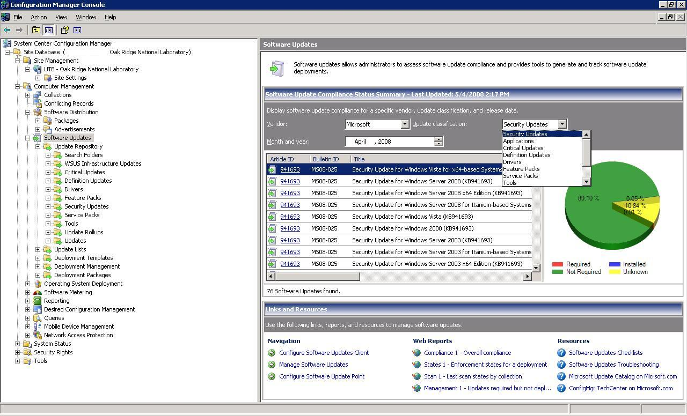
System Center Configuration Manager at ORNL
Software Updates
Back

Slide 26
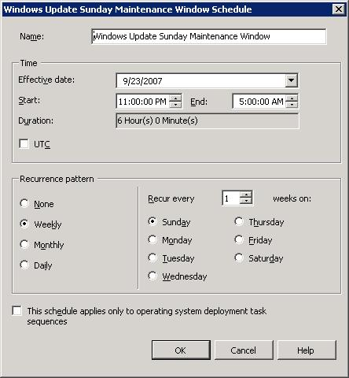
System Center Configuration Manager at ORNL
Maintenance Windows
Back

Slide 27
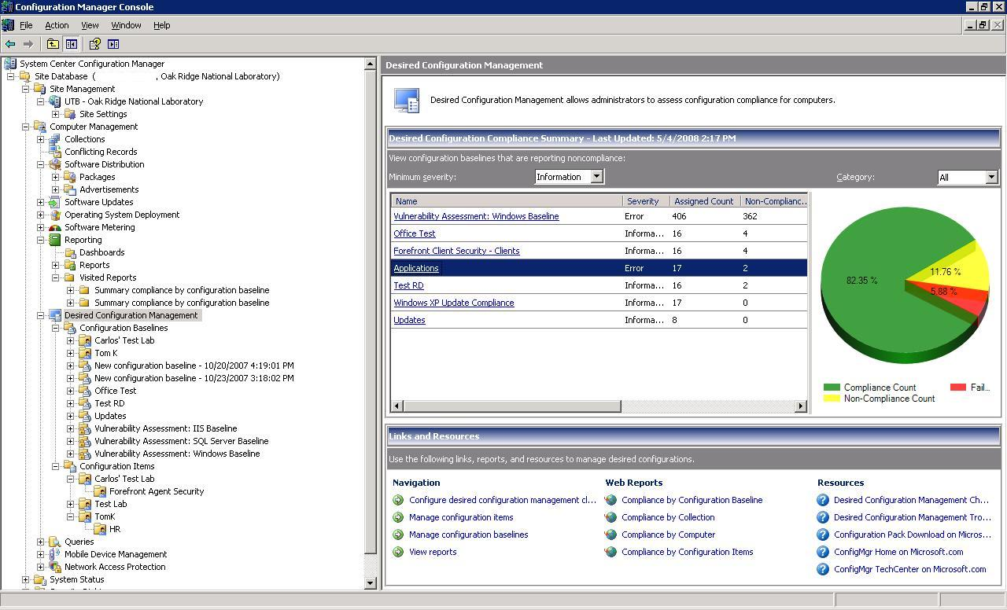
System Center Configuration Manager at ORNL
Desired Configuration Manager
Back

Slide 28
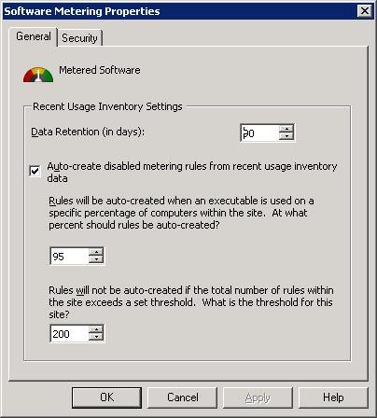
System Center Configuration Manager at ORNL
Software Metering
Back

