Slide 1
A Brief Overview
Shelly Bird
Architect
Microsoft Public Sector Services

Slide 2
Agenda
History
Deliverables
Configuration Details
Testing and Troubleshooting

Slide 3
History
Federal Desktop Core Configuration (FDCC)

Slide 4
















Microsoft Services Contribution
Services Offering for security conscious customers provided to over forty military and civilian agencies:
Notes:
United States Army, Internal Revenue Service, Department of Interior, Department of Justice, United States Department of Agriculture, California National Guard, Defense Intelligence , United States Marine Corps Agency, and Drug Enforcement Agency, UNICEF, US Army, US Coast Guard, National Aeronautics and Space Agency (NASA), USAID, Patents and Trademarks Office

Slide 5
Implementation Oriented
Standard Settings Review – introduce and solidify security and configuration decisions
Image Build Session – apply those decisions in an Agency standard baseline
Application Compatibility – educate on tools and methods to solve issues
Typically delivered
in six to eight weeks

Slide 6
Steady Building of Consensus
Feb 2008
Civilian Standard Desktop
Standard
Mar 2007
OMB Memo
Q1 2007
DoD
consensus
on Vista
settings
Q4 2006
Microsoft Security Guide for Vista
Q4 2006
USAF
Major
Commands’
consensus
Vista, IE7, and Office 2007
settings
Mid-2006
NIST
SCAP
Feb 2005
USAF
Major
Commands’
consensus
XP, IE6, and
Office 2003
settings
Nov 2004
NSA, DISA,
NIST, CIS,
& Microsoft
Consensus
on XP
Q1 2004
Microsoft Security Guide for XP
2003
IRS
2001-3
2004
2005
2006
2007
2008
Std Config Work at Civilian and Military Agencies

Slide 7
FDCC Benefits
Clear target for government developers
Revised on a quarterly basis
Standardize security and configuration
  Cut costs
  Simplify deployments
  Focus audits
Drive vendor development decisions
Improve security

Slide 8
Deliverables
Federal Desktop Core Configuration (FDCC)

Slide 9
Two Virtual PC Files
FDCC Q3 2007 XP = includes IE7 Settings, XP Security Settings, Additional Settings, Additional XP-Specific Settings
FDCC Q3 2007 Vista = includes IE7, XP Security Settings, Additional Settings, Additional Vista-Specific Settings

Slide 10
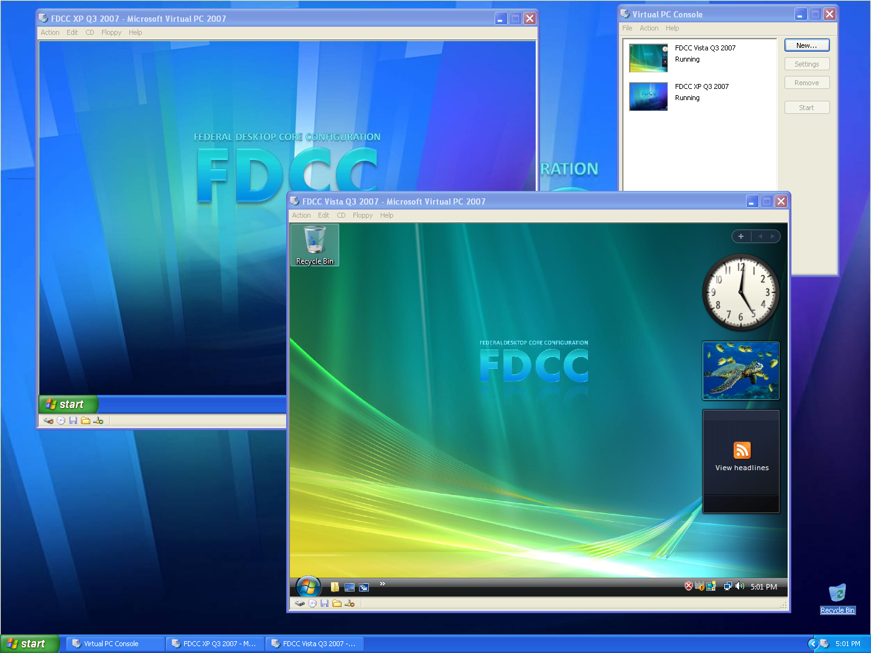
VPCs

Slide 11
Deliverable: Group Policy Objects
Both operating systems
  FDCC Q3 2007 Account Policy
  FDCC Q3 2007 Additional Settings
  FDCC Q3 2007 IE7 Settings
Windows XP SP2
  FDCC Q3 2007 XP Firewall Settings
  FDCC Q3 2007 XP Security Settings
  FDCC Q3 2007 XP-Specific Additional Settings
Windows Vista
  FDCC Q3 2007 Vista Firewall Settings
  FDCC Q3 2007 Vista Security Settings
  FDCC Q3 2007 Vista-Specific Additional Settings

Slide 12
Deliverable: SCAP Content
Windows XP SCAP content covers:
  FDCC Q3 2007 Account Policy
  FDCC Q3 2007 Additional Settings
  FDCC Q3 2007 XP Security Settings
  FDCC Q3 2007 XP-Specific Additional Settings
  Windows XP Firewall SCAP content
      FDCC Q3 2007 XP Firewall Settings
  Windows Vista Firewall SCAP content
      FDCC Q3 2007 Vista Firewall Settings
Windows Vista SCAP content covers:
  FDCC Q3 2007 Account Policy
  FDCC Q3 2007 Additional Settings
  FDCC Q3 2007 Vista Security Settings
  FDCC Q3 2007 Vista-Specific Additional Settings
IE7 SCAP content
  FDCC Q3 2007 IE7 Settings (use on both XP and Vista)

Slide 13
Deliverable: Documentation
Settings: a master database generates a spreadsheet:
  Group Policy Path
  Setting Name
  Setting for XP
  Setting for Vista
  Group Policy File Name
  Registry Key related to the group policy setting
  SCAP CCE numbers for testing
Frequently Asked Questions
  Guidance on how to load VPCs and GPOs
  Address common questions about FDCC
Where SCAP content gives false negatives

Slide 14
Configuration Details
Federal Desktop Core Configuration (FDCC)

Slide 15
Key Takeaways
Typical user must run as User
  Not Power User, Not Administrator
Firewall (inbound) On
  Local Admins cannot edit firewall settings
File and Print Sharing Off
IE7 Protected Mode On (Vista only)
Password Length set to 12 characters
“Challenge” Settings
  FIPS 140-2 turned On
  Driver Signing turned On (XP only)

Slide 16
What May Cause Concern
Java in IE7 settings Disabled
ActiveX Controls cannot be loaded by Normal Users
  But Vista has ActiveX Install Service
Notes:
Trying to avoid accusations that Microsoft encryption is being favored

Slide 17
LGPO Tool
Local Group Policy Object tool
Takes FDCC GPOs provided by NIST, applies them to local group policy
Allows use of a Delta file (your variances)
See the latest webcast by Aaron Margosis to get full details on usage
Get the tool from Microsoft FDCC Blog

Slide 18
Testing and Troubleshooting
Federal Desktop Core Configuration (FDCC)

Slide 19
Two Testing Tracks
Accountability: how to pass the audits
  Security Content Automation Protocol (SCAP)
  Some variances permitted, but must provide:
    Reason for the variance
    Get Healthy date
Compatibility: prove applications and drivers work

Slide 20
Accountability
Testing and Troubleshooting

Slide 21

SCAP: Checks and Balances
SCAP Data
Security
Scanner
A
Security
Scanner
B
Security
Scanner
A
Security
Scanner
B
Baseline
Baseline

Slide 22
Notes on SCAP in the Field
Final step: confirm settings haven’t changed
Security auditors will use the same SCAP data to confirm compliance repeatedly
Eventually: requirement for regular enterprise wide scan and reports
Since this is a manufacturer independent baseline file, expect growing support
Microsoft has the Desired Configuration Monitoring (DCM) which runs on top of Systems Center Configuration Manager (SCCM), and an SCAP converter tool

Slide 23
Application Compatibility Troubleshooting
Testing and Troubleshooting

Slide 24
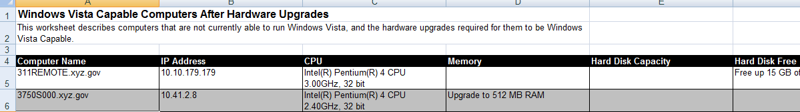
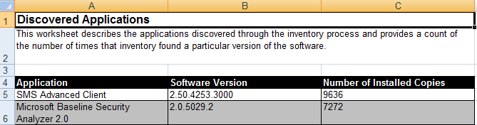
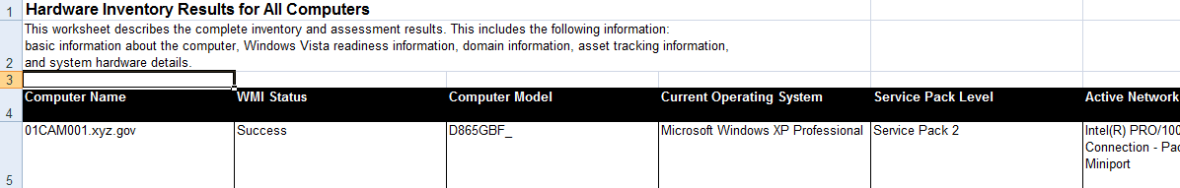
Microsoft Assessment and Planning (MAP)Tool
Originally the Windows Vista Hardware Assessment tool
  WMI queries, no agent required on systems

Slide 25
Application Compatibility Toolkit
Pick machines that are representative of what applications a department likes to run
  Load ACT Collection Package
    Example: \\w70ffxkms\act5ffx\Collect.exe
      Run once logged in as Administrator or via package delivered by software distribution system
Result: repository information on what applications and/or hardware will work well with Vista, Internet Explorer 7 and XP SP2
Good internal tool for tracking application compatibility results

Slide 26
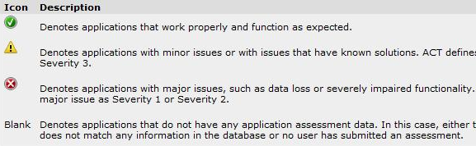
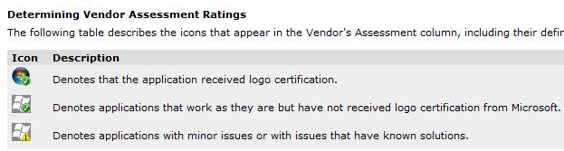
ACT Repository Assessment
Red Light, Green Light, Yellow Light
Vendor Assessment

Slide 27
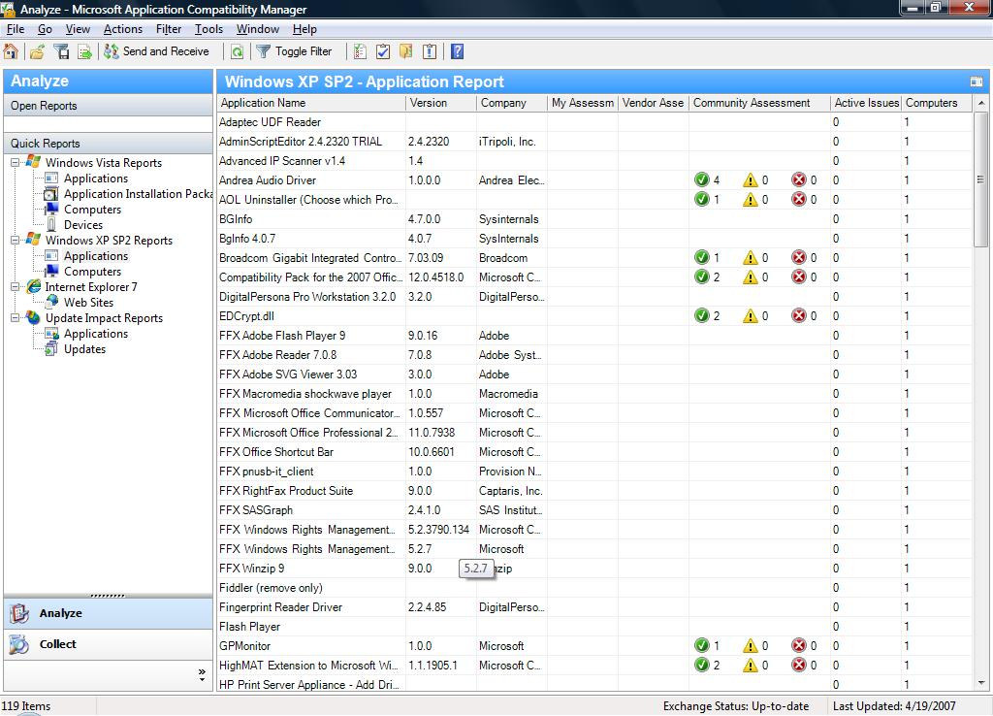
Example Application Data

Slide 28
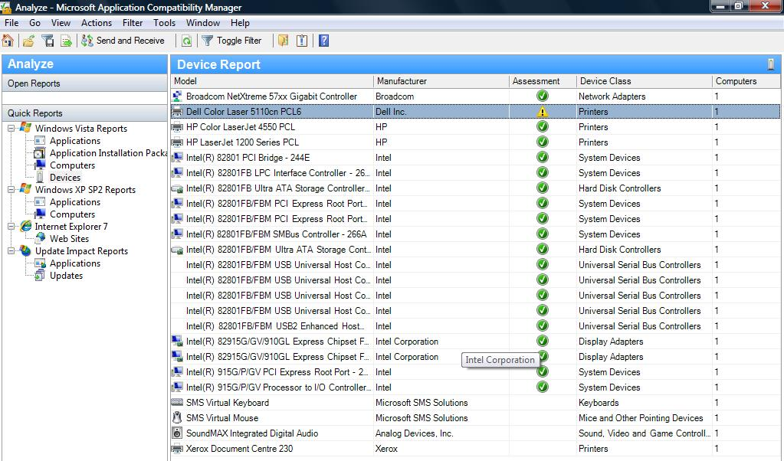
Example Device Data

Slide 29
Flow of App Compat Tests

Slide 30
Prepare for FDCC
Federal Desktop Core Configuration (FDCC)

Slide 31
Lay the Groundwork
Users log on as Normal User--therefore:
  Management systems (examples: SMS, Tivoli, Altiris, Remote Desktop capabilities) will be critical to success
  Must have mature help desks/remote support
  Developers must code so software runs as User
  Log in as User now to flag problem applications
Capture data about hardware and software
  SMS Queries, Tivoli queries, etc.
  Application Compatibility Toolkit (ACT)
  Microsoft Assessment and Planning tool (MAP)
Gather information on firewall exceptions
Run a Standard Settings Review

Slide 32
Build the Standard
Leverage Microsoft Deployment Toolkit
  Dynamic injection of drivers if you work with MDT or SCCM (Windows Image or WIM)
  Can capture at the end with any imaging tool
Use the latest drivers
Adjust NIST GPOs to your SSR decisions
  Variances can be put into a separate GPO
Get the standard out there as soon as possible, be ready to adjust

Slide 33
Run Limited Pilots in Production
Set user expectations
Raise level of confidence in new build
PR value: “socialize” new standard image
Work with regional and departmental support staff
  Basics of application compatibility fixes
  Group Policy basics
  Firewall management: exceptions
Gather issues into central repository (ACT)
Escalate deployment blockers to Microsoft

Slide 34
FDCC in Progress
Governance board inside the CIO Council for final decisions
  Need to establish the feedback loop
Program Office that will host quarterly builds (a Center of Excellence)
  Assist agencies with implementation
Update to the FDCC settings is imminent

Slide 35
FDCC Feedback Channels
NIST FDCC web site: http://csrc.nist.gov/fdcc
  Send e-mail to fdcc@nist.gov
Microsoft FDCC site: http://www.microsoft.com/industry/government/solutions/FDCC/get_info.mspx
Microsoft blog: http://blogs.technet.com/fdcc/
FDCC Education/Status LiveMeetings (webcasts) run on a bi-weekly basis
Microsoft Program Manager: Ken Page kepage@microsoft.com
Microsoft Account Manager: TS Mallick
tmallick@microsoft.com

