Slide 1
Using SharePoint as the ORNL Portal
Connie Begovich
Oak Ridge National Laboratory

Slide 2
30,000 foot IT strategy
Enforcing Network Compliance – Stafford
Update on Network Enhancements – Piercy
Who’s Your System Administrator - Willoughby
Advanced Windows Operating System Imaging and Deployment – DeGuira
Lessons Learned in Implementing SCCM – Cunningham
Change Management/Control in the SAP Environment – Scoggins
Central Helpdesk Standardization and Consolidation – Causby/Beane
Consolidate IT Staff
Cyber Security Revitalization
IT Governance & Standards
Enhancing Communications through Unifying – Depp
IT University – Overby
Sharepoint as ORNL Portal - Begovich
Application Transformation
2006
2007
2008
While maintaining a consistent or reduced cost profile

Slide 3
Defender
Other O/S
Windows XP
(PointSec)
Windows Vista
(BitLocker)
Macintosh
OSX, Leopard
We have rebuilt our technical foundation.
Office 2003 Clients
Office 2007 Clients
Office 2008
Microsoft Forefront
Third-Party Solutions
Office SharePoint Portal
Exchange Server 2007
Exchange Server 2003
Custom Web Parts
Office SharePoint Server 2007
Portal
My site
Search
Workflow
Business Data Catalog
Excel Services
Form Services
AgilePoint
BPMN
Line of Business
Apps.
System Center Configuration Manager
Virtual Earth
Visual Studio Team Foundation Server
Visual Studio 2008
Live Meeting 2007
Web Service
Orientation
Office Communication Server 2007
VoIP
SQL Server 2005
SQL Server Reporting Services
SQL Server Information Services
SQL Server Analytical Services
SAP
Red: Deployed in last 12 months

Slide 4
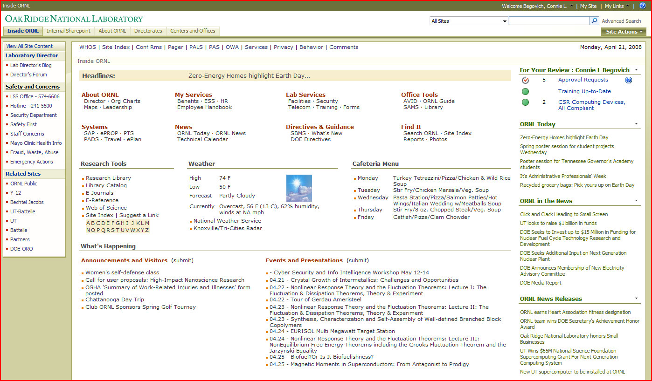

Slide 5
Deployment of SharePoint
Set up organization sites and enable non-IT staff to be responsible for their sites
Develop SharePoint web parts to consolidate information and reduce emails
Provide useful searches
Integrate Line of Business (LOB) applications into SharePoint
Deploy reports and data views in a standard way

Slide 6
For Each Topic
Describe what and why
Show example(s)
Discuss technical details

Slide 7
Organization Sites
For information that is mostly static
  Let the data owner maintain
    More likely to keep up-to-date
    Usually more cost-effective and timely
  Have IT staff available for setup and help
    May provide initial design
    Set up authorization/workflow
    Train the data owners
    Help when necessary

Slide 8
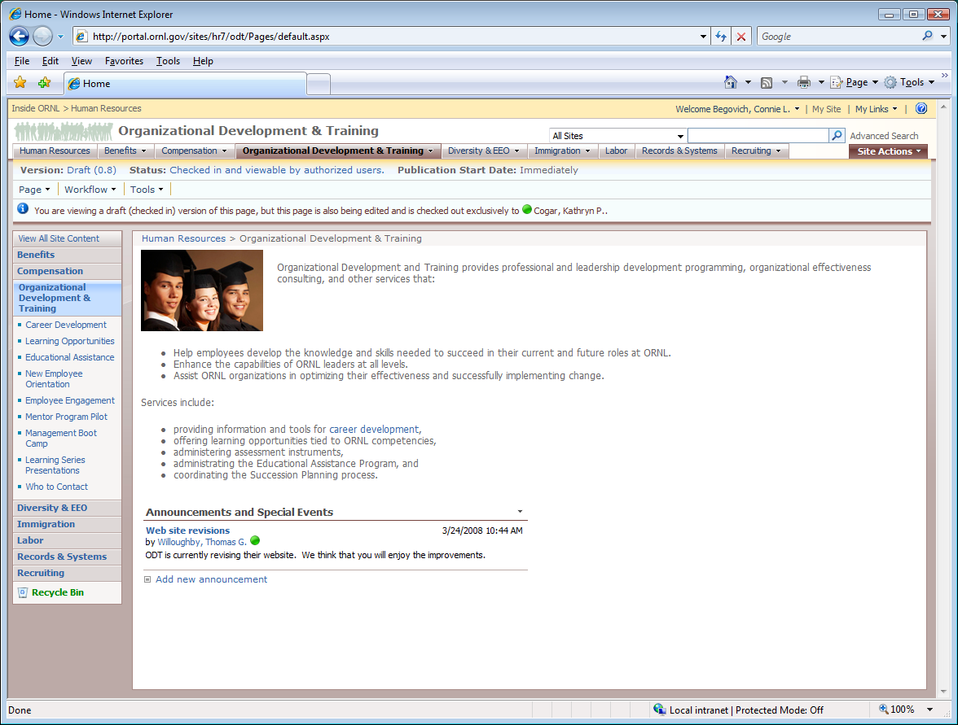
Notes:
IT Staff Setting up navigation, workflow, announcements

Slide 9
Organization Sites
Use SharePoint’s features for communication
  Blogging
  Team Sites
  Shared Document Libraries
  Task Lists

Slide 10
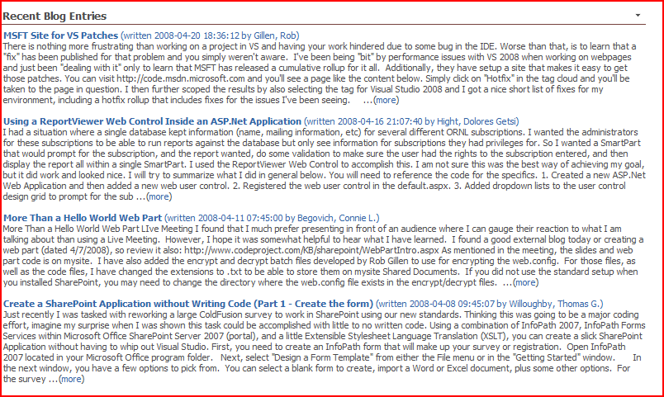
Blogging

Slide 11
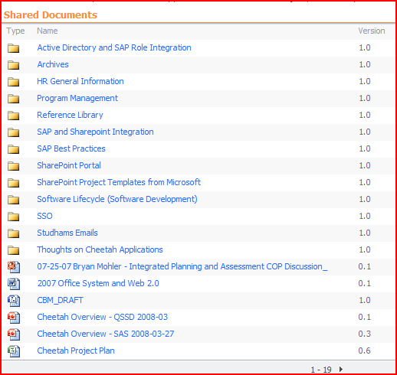
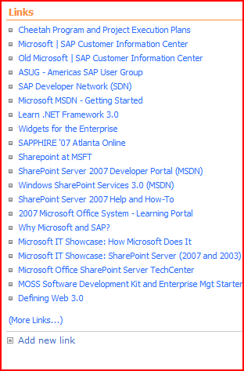
Team Site with Shared Documents/Links

Slide 12
Technical Details
IT Staff creating layouts and migrating information to the new web sites while working closely with data owners for new Development and Training
SharePoint standard web parts being used (e.g., Announcements, then using a roll-up web part to combine into one HR site Announcement) and for blogs/links etc
Training through IT University (see Tina Overby’s talk on Wednesday)
SharePoint groups set up to handle authorization for input, review, and approval of new content or changes (e.g., SP Custodians and Content Managers)

Slide 13
SharePoint Web Parts/Feature
Develop SharePoint web parts to consolidate and deploy information needed by staff
  Items for your review
    Requests
    Training
    Computer Security
  Commonly used actions on drop down menu
  Key Performance Indicators (KPIs)

Slide 14
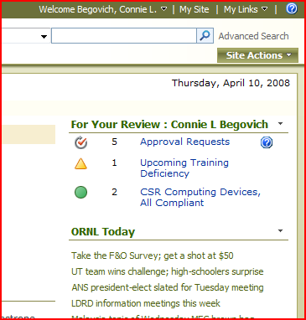
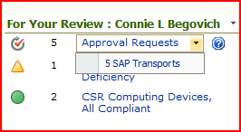
For Your Review
Approval Requests Examples
  Travel Expense Approvals
  Purchase Requisitions, etc
Required Training
  Security Training
Computing Devices
  In Compliance
  Been Used Recently

Slide 15
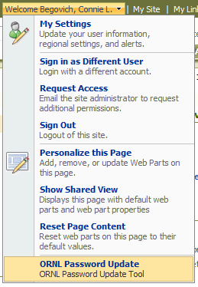
ORNL Password Update

Slide 16
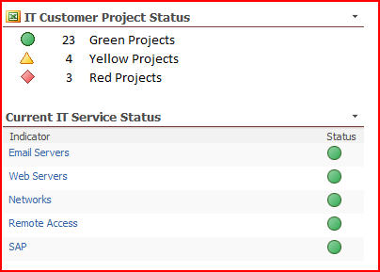
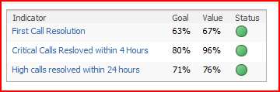
Key Performance Indicators

Slide 17
Technical Details
Coding on .NET side and web services on the Line of Business side
Defining structure on both sides for exchange of information
Using Single Sign On between systems (and logon as user or as system account)

Slide 18
Meaningful Searches
Search for information on the portal
  MySite SharePoint technology used
  Standard SharePoint searching
  Adding additional searching using Business Data Catalog

Slide 19

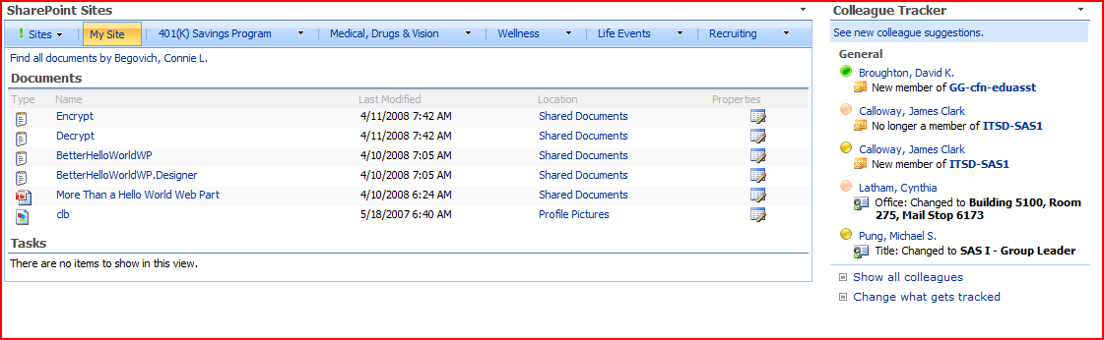
MySite in SharePoint

Slide 20
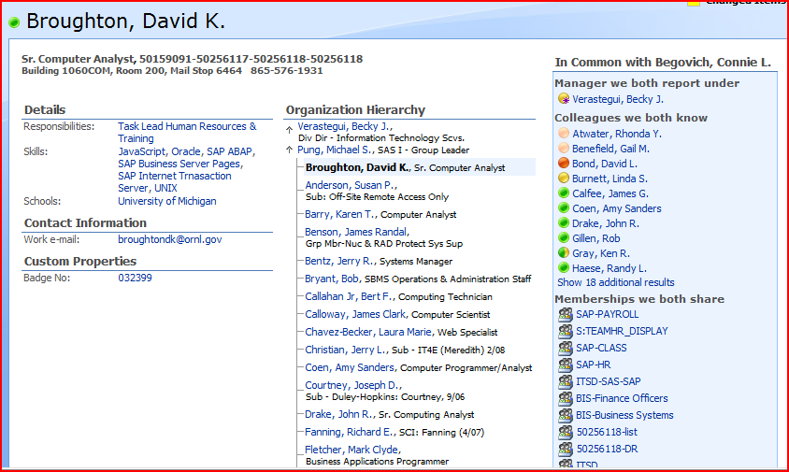
Information on Colleague

Slide 21
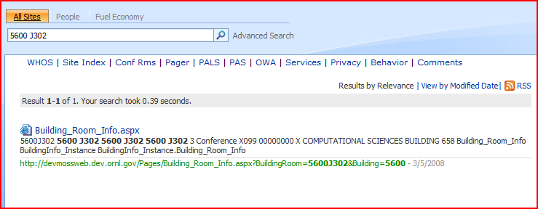
Conference Room Search

Slide 22
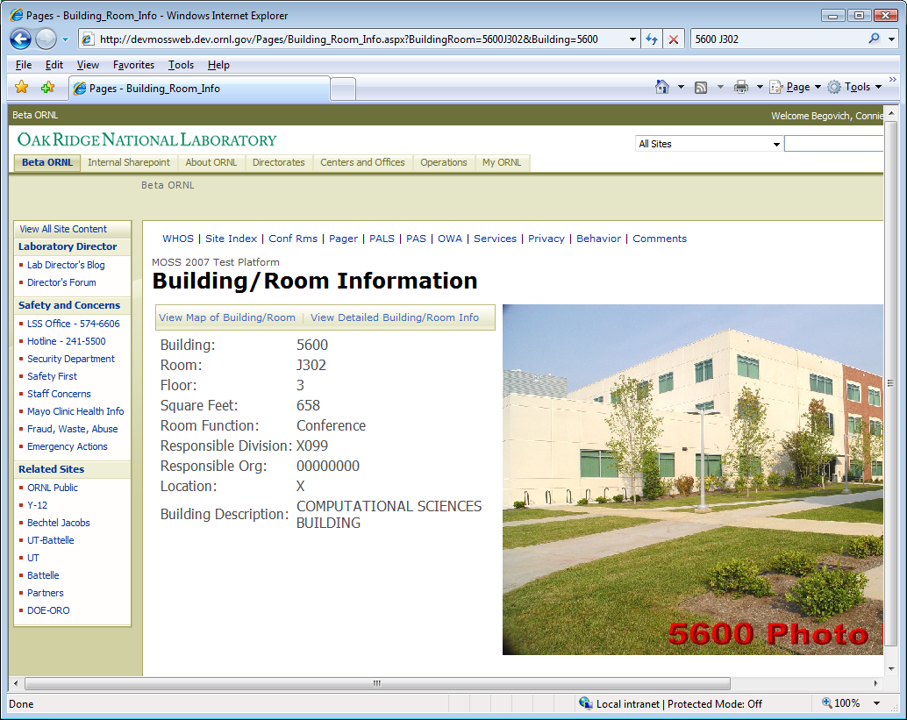
Conference Room Search (cont)

Slide 23
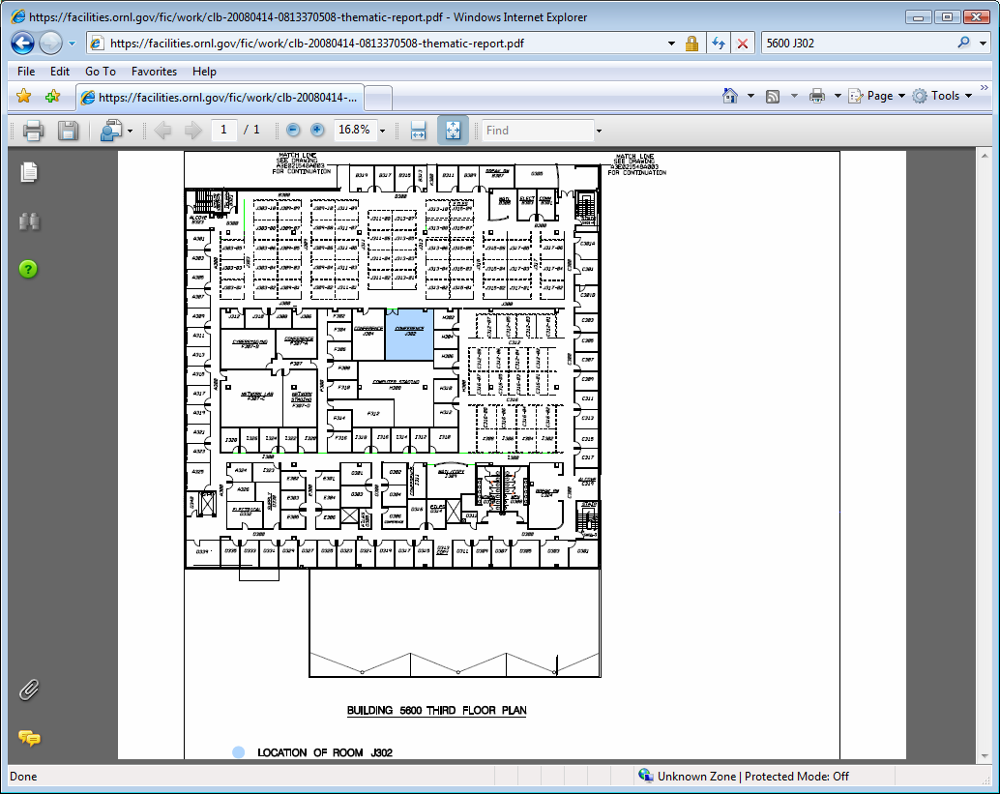
Conference Room Search (cont)

Slide 24
Meaningful Searches
Use MySite Capabilities
Use Standard SharePoint search
  Provides overall site searching
  Includes advanced searches
Use SharePoint Business Data Catalog (BDC)
  Processes Line of Business data in searches
  Also can use standard web parts for BDC
Add external Knowledge Management to SharePoint searches
  Not yet investigated

Slide 25
Integrate Web Applications into SharePoint for Consistency
Increasing
Amount of
Development
Use links to existing web applications
Bring existing web application inside a SharePoint page with a little programming
Use web services from Line of Business system to present a SharePoint-like user interface
Write the entire web application using SQL*Server and .NET programming

Slide 26
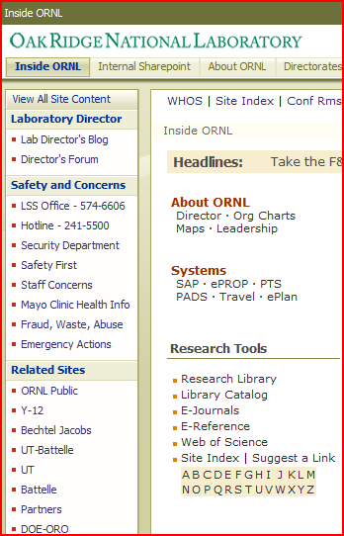
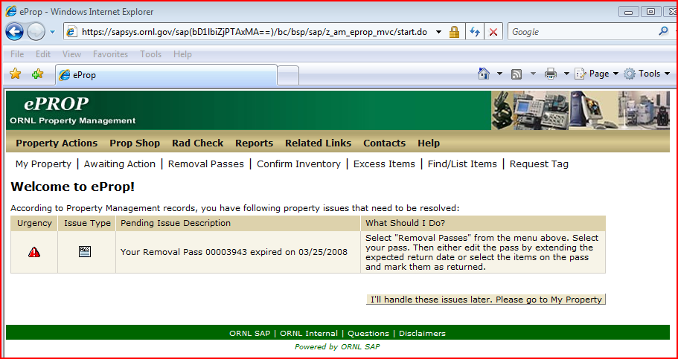
Link to Existing Web Applications

Slide 27
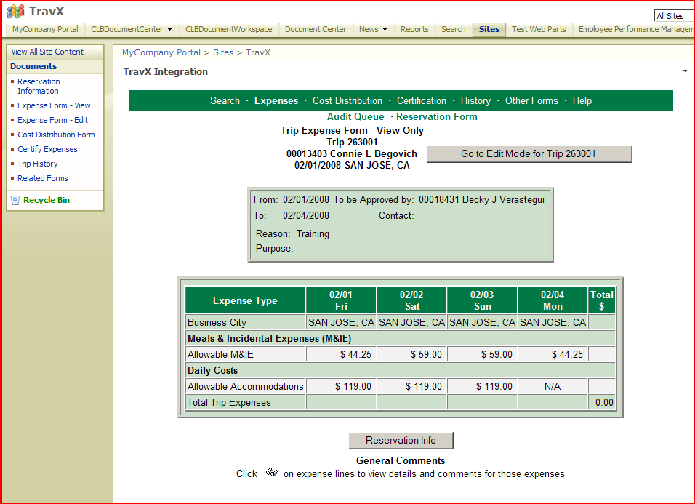
Use Web Application with Left-Side Navigation

Slide 28
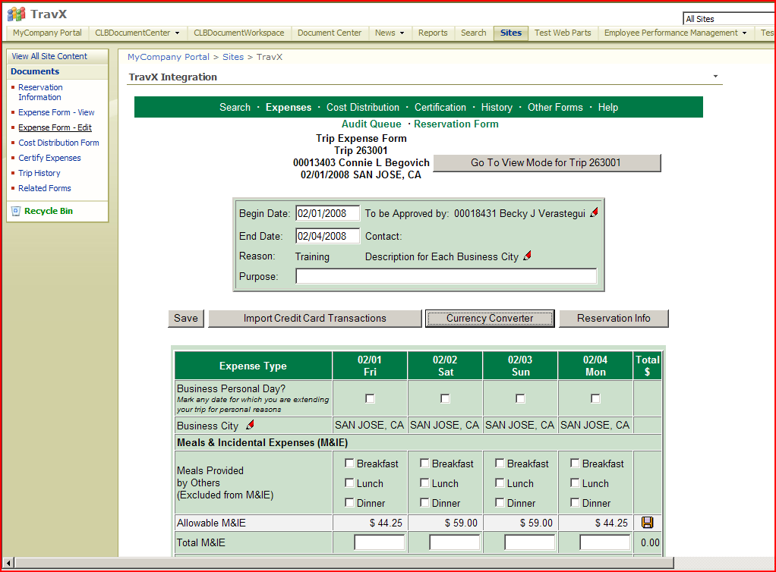
Use Web Application with Left-Side Navigation

Slide 29
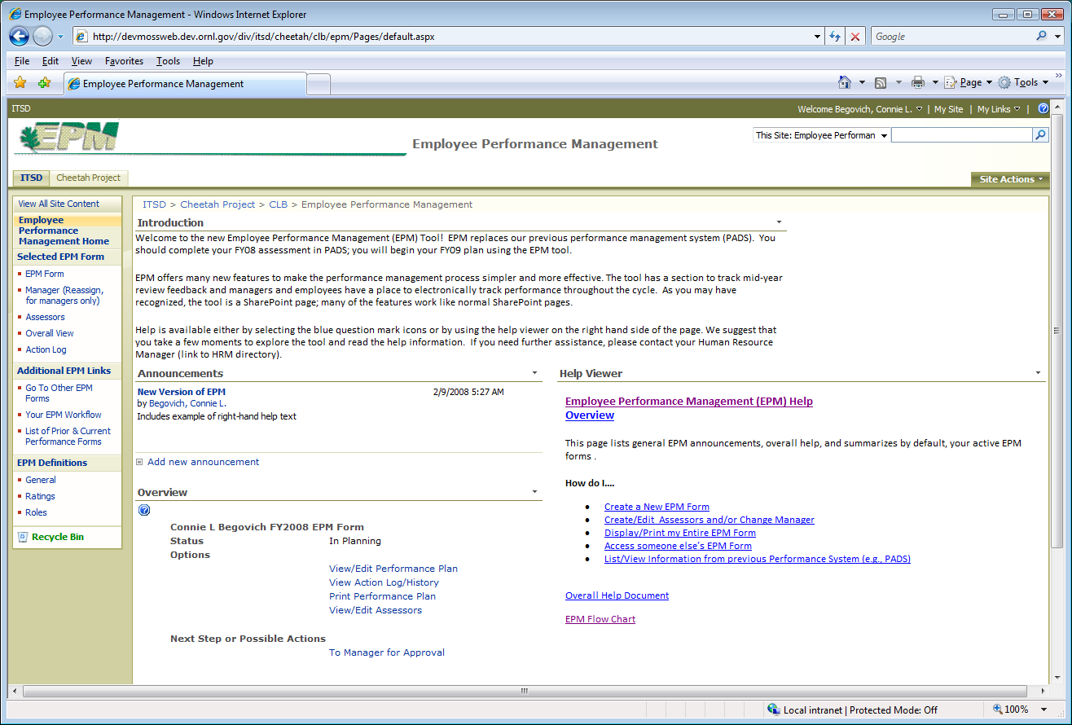
Keep Data and Business Rules on LOB System and Display UI in SharePoint

Slide 30
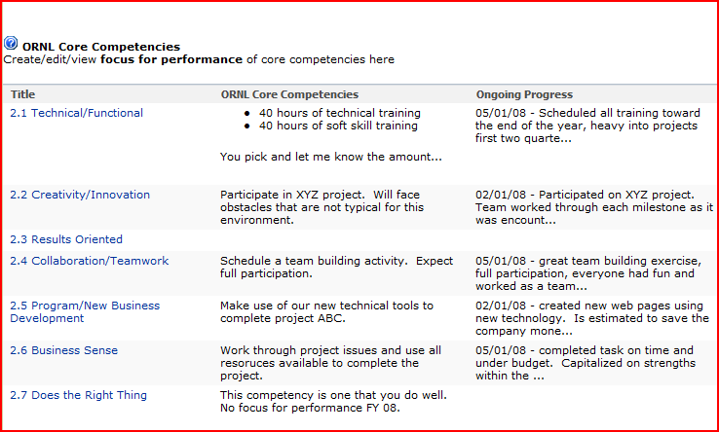
Use SharePoint-Like Interface (e.g., Lists)

Slide 31
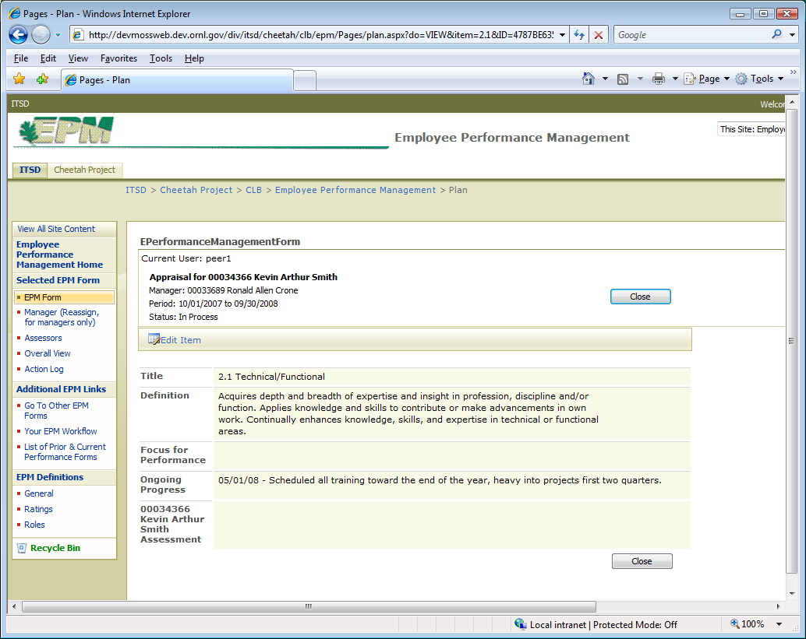
Use SharePoint-Like Interface (continued)

Slide 32
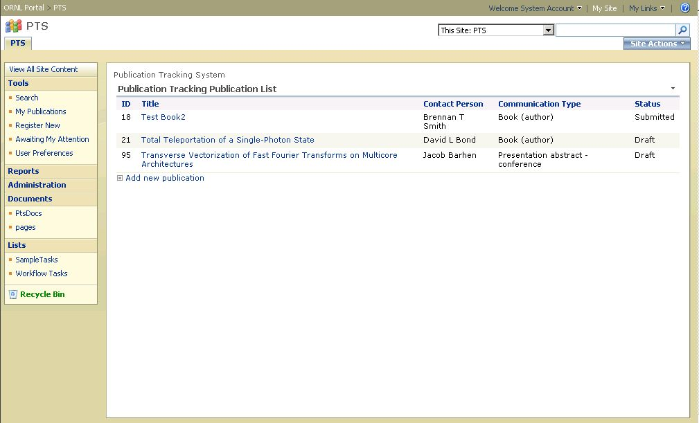
Develop Web Applications Entirely in SharePoint and SQL*Server

Slide 33
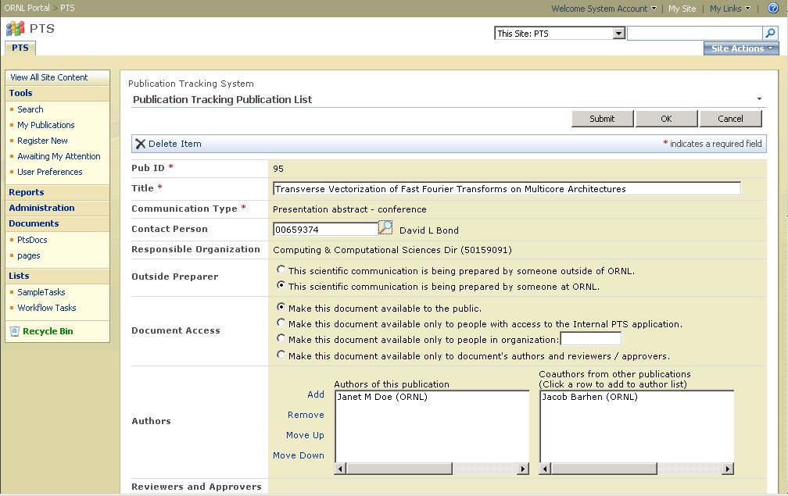
Develop Web Applications Entirely in SharePoint and SQL*Server (cont)

Slide 34
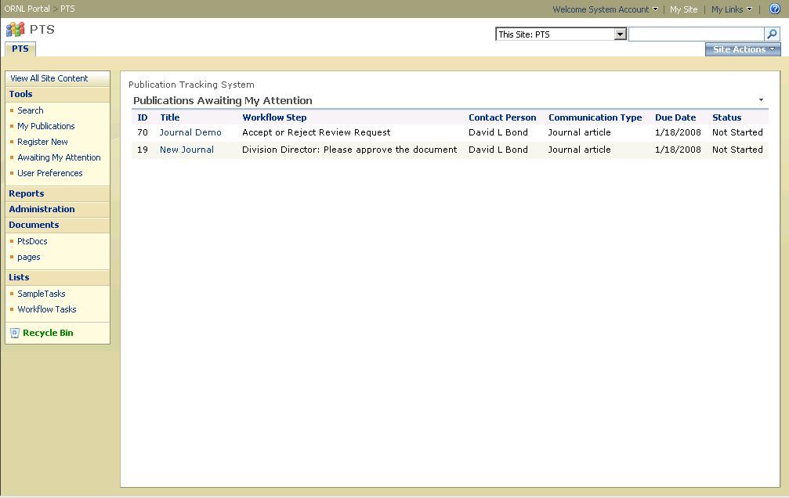
Develop Web Applications Entirely in SharePoint and SQL*Server (cont)

Slide 35
Comparison of Web Application Deployment
Methodology | Advantages | Disadvantages
Link to Existing Web Apps | No programming required | No consistent look and feel or navigation
Existing Web Applications Inside | Some Programming, but not a re-write; consistent navigation | May not be consistent look and feel; problems with scrolling/style
Use Web Services and Surface User Interface | Separation of User Interface from Business Rules and Data; Consistent Look and Feel plus Navigation | Requires more programming and understanding of both business system and UI
Write Entire Web Application in .NET Framework | Consistent Look and Feel plus Navigation | Requires more programming and may require duplication of data if using information in business system

Slide 36
Technical Challenges
Developing in new environment
  IT University
  Live Meetings
Understanding interoperability between two basic environments of Business (SAP) System and Microsoft SharePoint
Using consistent Roles
  Keeping SAP roles as source
  Extracting SAP Roles to Active Directory Roles
  Using Active Directory Roles in SharePoint

Slide 37
Deploy Reports and Data Views in Standard Way
Data on Several Platforms
  Line of Business BI System (SAP BI)
  Oracle (Source data and Extracts)
  SQL*Server (.NET web application data)
Combine to deliver data with SharePoint consistent interface
  Standard Reports: SQL Server Reporting Services (SSRS)
  Excel Services

Slide 38
Line of Business Data
Use data extractors to form BI cubes
For defined reports:
  Use data interface to build reports from these cubes
  Deploy in SharePoint
For ad hoc queries
  Use SAP ad hoc query tools if data all available
  Extract SAP data and combine with external data and use SQL Server query tools

Slide 39
Data External to Line of Business System
Move all system data to SQL Server
Use SQL Server Analysis Services (SSAS)
Defined Reports
  SSRS
  Excel Services
Ad Hoc Queries
  SSAS/SSRS
  Excel Services

Slide 40
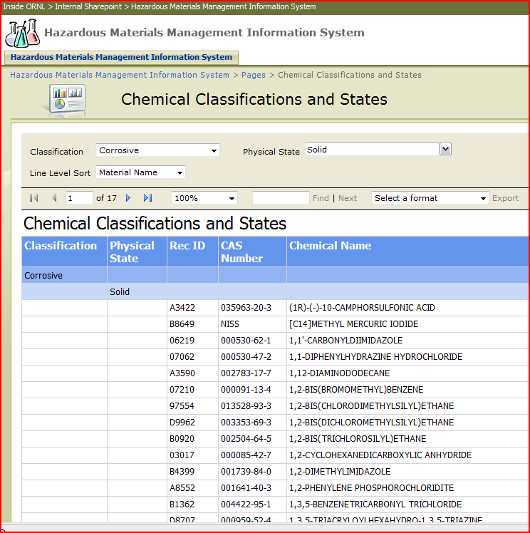
Example SSRS Report

Slide 41
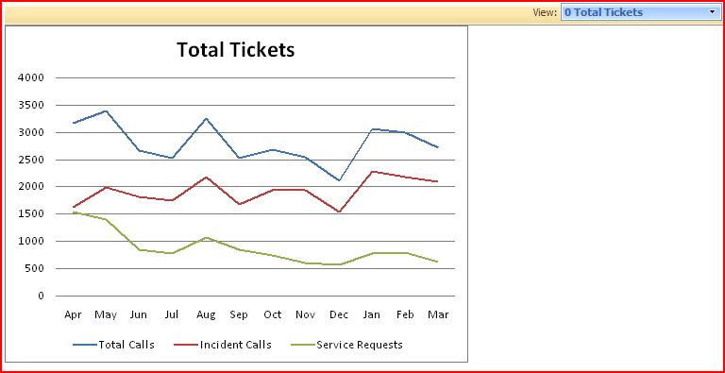
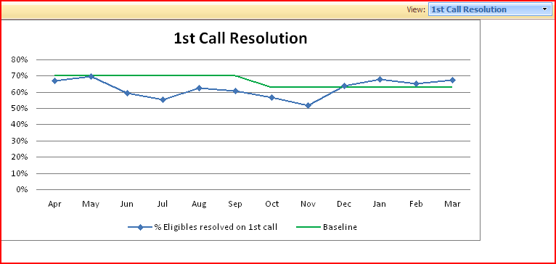
Example Excel Services Reports

Slide 42
Summary
Goal: Consistent User Interface and Easier Maintenance
Status:
  Starting deployment of different pieces and parts
  Training users and developers
  Working with Microsoft/SAP to understand and help direct interoperability

Slide 43
Questions?
Contact Information:
  Connie Begovich
  begovichcl@ornl.gov

