Slide 1
Enhancing Communication through Unifying Services
Dennis Depp
Task Lead IT Projects

Slide 2
30,000 foot IT strategy
Enforcing Network Compliance – Stafford
Update on Network Enhancements – Piercy
Who’s Your System Administrator - Willoughby
Advanced Windows Operating System Imaging and Deployment – DeGuira
Lessons Learned in Implementing SCCM – Cunningham
Change Management/Control in the SAP Environment – Scoggins
Central Helpdesk Standardization and Consolidation – Causby/Beane
Consolidate IT Staff
Cyber Security Revitalization
IT Governance & Standards
Enhancing Communications through Unifying – Depp
IT University – Overby
Sharepoint as ORNL Portal - Begovich
Application Transformation
2006
2007
2008
While maintaining a consistent or reduced cost profile

Slide 3
Defender
Other O/S
Windows XP
(PointSec)
Windows Vista
(BitLocker)
Macintosh
OSX, Leopard
We have rebuilt our technical foundation.
Office 2003 Clients
Office 2007 Clients
Office 2008
Microsoft Forefront
Third-Party Solutions
Office SharePoint Portal
Exchange Server 2007
Exchange Server 2003
Custom Web Parts
Office SharePoint Server 2007
Portal
My site
Search
Workflow
Business Data Catalog
Excel Services
Form Services
AgilePoint
BPMN
Line of Business
Apps.
System Center Configuration Manager
Virtual Earth
Visual Studio Team Foundation Server
Visual Studio 2008
Live Meeting 2007
Web Service
Orientation
Office Communication Server 2007
VoIP
SQL Server 2005
SQL Server Reporting Services
SQL Server Information Services
SQL Server Analytical Services
SAP
Red: Deployed in last 12 months

Slide 4
Defender
Other O/S
Windows XP
(PointSec)
Windows Vista
(BitLocker)
Macintosh
OSX, Leopard
We have rebuilt our technical foundation.
Office 2003 Clients
Office 2007 Clients
Office 2008
Microsoft Forefront
Third-Party Solutions
Office SharePoint Portal
Exchange Server 2007
Exchange Server 2003
Custom Web Parts
Office SharePoint Server 2007
Portal
My site
Search
Workflow
Business Data Catalog
Excel Services
Form Services
AgilePoint
BPMN
Line of Business
Apps.
System Center Configuration Manager
Virtual Earth
Visual Studio Team Foundation Server
Visual Studio 2008
Live Meeting 2007
Web Service
Orientation
Office Communication Server 2007
VoIP
SQL Server 2005
SQL Server Reporting Services
SQL Server Information Services
SQL Server Analytical Services
SAP
Red: Deployed in last 12 months

Slide 5
What is Unified Communication and Why should we care?
Is it Voice/Data convergence?
Is it voice mail in our inbox?
Is it presence?
Is it vDenny?

Slide 6
Maslow’s Hierarchy of Needs
Self-Actualization
Esteem
Love
Safety
Physiological

Slide 7
Gurdeep’s Hierarchy of Needs for Unified Communication
Self-Actualization
Dynamic
Rationalized
Standard
Basic
Moving the Business forward
Mobility, Unified Messaging
Voice and Data Convergence
Cheap Dial tone/Calendar, Contacts
Dial tone/Basic Email

Slide 8
Three Plans
Plan A – Integrate LCS with Phone System
Plan B – Implement Unified Messaging
Plan B’ – Implement VoIP with Office Communication Server

Slide 9
Plan 1 – Integrate LCS with 5ESS
June 2006 started implementing LCS 2005. Goal was to integrate with existing phone system, Lucent 5ESS.
Close gap with Microsoft’s consumer offering
Vendors plan was to sell us new IP capable PBX system. Cost $1-2M
Federate with other entities running LCS

Slide 10
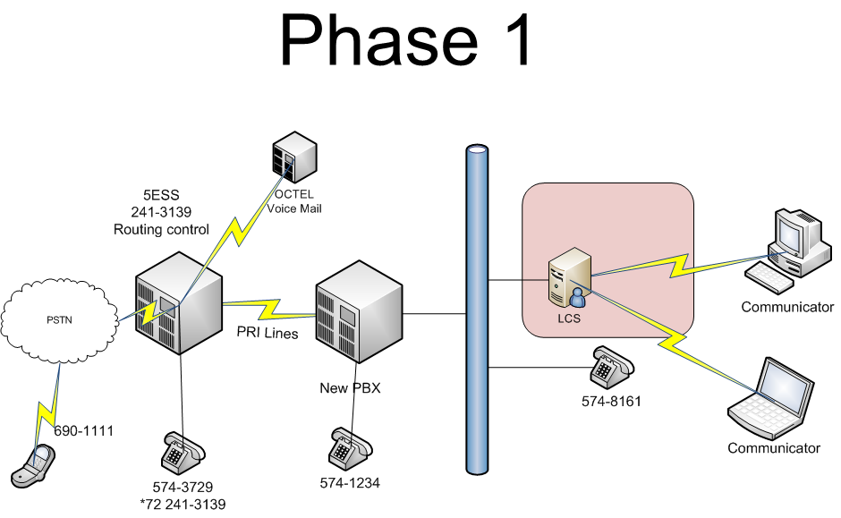

Slide 11
Plan B – Implement Exchange Unified Messaging
Microsoft required utilizing a Unified Messaging certified partner
Chose MethodIQ and Audio Codes hardware (SIP Gateway)
Initial hardware ordered did not have serial connections
Switched to Dialogic and purchased integrated SIP Gateway and OCS Mediation Server

Slide 12
Plan B – cont
Required additional hardware for 5ESS to send calling number to SIP gateway
MethodIQ sold to AVDS and no longer does Microsoft ☹
Working with new vendor

Slide 13
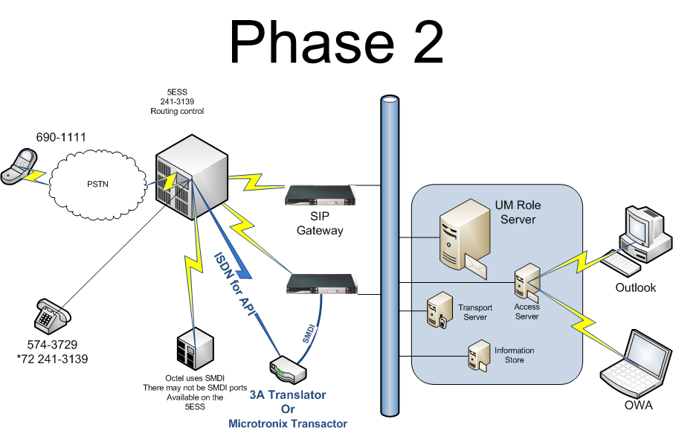

Slide 14
Plan B’– OCS as Phone System
August 2007 upgraded LCS to OCS
Utilize SIP Gateway from Phase 2
Initial very limited ( 3 phone numbers)
Existing voice mail not compatible with OCS
Federation with external entities

Slide 15
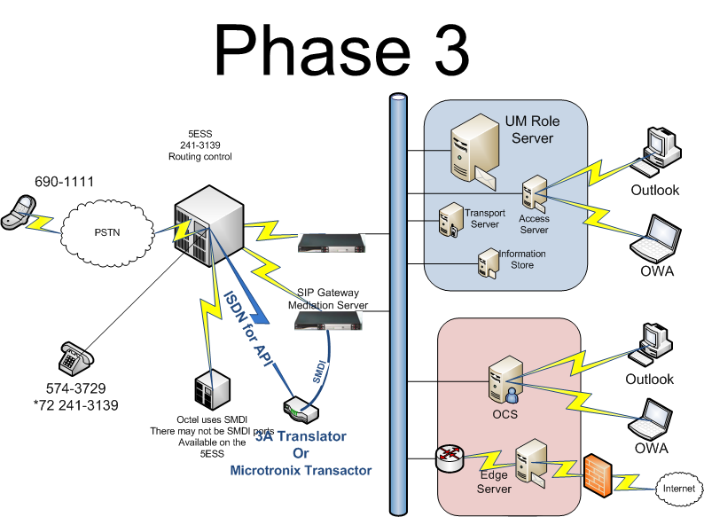

Slide 16
Benefits
All communications are available in one place
The computer becomes the communication hub
Enhanced presence based on your relationship

Slide 17
Current Status
Setting up Unified Messaging for current Exchange 2007 users
Implementing additional users on OCS
Capacity planning for expansion

