Slide 1







Software for Large-Scale and
Near-Term Quantum Computing
Fred Chong
Seymour Goodman Professor
Department of Computer Science
University of Chicago
Senior Scientist, Argonne National Laboratory
With Margaret Martonosi, Diana Franklin, Peter Shor, Eddie Farhi, Aram Harrow, Ken Brown, Ali Javadi Abhari, Adam Holmes, Yongshan Ding, Yunong Shi, Ryan Wu, Pranav Gokhal, Lunkai Zhang, Ash Wiseth
(UChicago, Princeton, MIT, GATech)

Slide 2
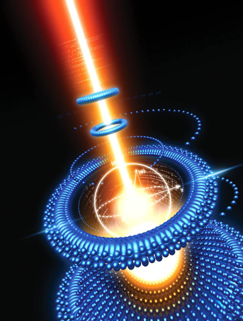
Outline
QC requires the solution of many unique compiler, verification and simulation problems
Lessons Learned
  Managing compiler resources for deep optimization
  Dynamic code generation for arbitrary rotations
  Managing congestion in surface code computations
Ongoing research
  Validation of quantum programs
  Optimizing for 100-1000 qubits
(CACM 2010)

Slide 3

Lession 1:
Managing Compiler resources

Slide 4

Deep Optimization
QC similar to circuit synthesis for ASICs
Program inputs known at compile time
  Enables compiler optimizations
    Constant propagation
    Loop unrolling
Scarce resources
  Every qubit and gate is important

Slide 5
Execution Model
Scaffold
QASM
Classical
Processor
Quantum
Co-processor

Slide 6
Tool Flow
Compilation
Program Checks
Logical Backend
Fault-Tolerant Redundancies
Physical Backend
Scaffold Quantum Program
LLVM Intermediate Representation
Logical Schedule
Physical Schedule
Modified Clang Parser
Conversion to Reversible Circuit
Classical Control Resolution
Decomposing to Standard Gates
Resource Estimation
Module Inlinining and Flattening
No-Cloning Verification
Logical QASM Generation
LPFS Scheduler
Qubit Redundancy
Fault-Tolerant Gate Conversion
Zero States for ECC
Magic States for T Gates
EPR states for Teleportation
Physical QASM Generation
Physical Scheduler
Communication Optimizer
LLVM Infrastructure
Architectural Simulator
https://github.com/epiqc/ScaffCC

Slide 7
Algorithms in Scaffold
Algorithm | Lines of Code
Boolean Formula | 479
Linear Systems | 1741
Binary Welded Tree | 608
Class Number | 226
Triangle Finding | 1231
Shortest Vector Problem | 539
Ground State Estimation | 554
Shor’s Algorithm | 1055
Grover’s Algorithm (invert SHA-1) | 388
Ising Model | 113

Slide 8
Effect of Remodularization
Based on resource analysis, flatten modules with size less than a threshold
Limited by memory on compilation machine

Slide 9
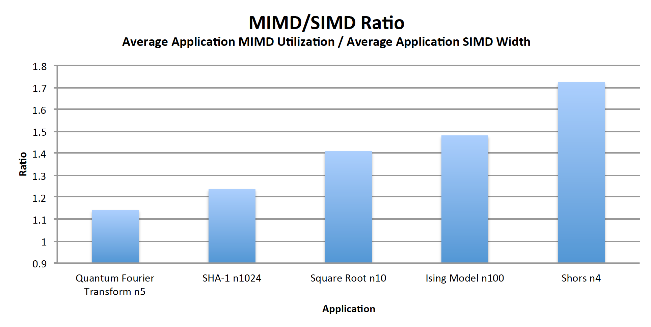
SIMD vs MIMD
Is MIMD control complexity worthwhile?

Slide 10
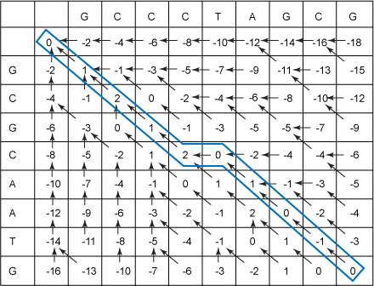
Sequence Alignment for SIMD

Slide 11
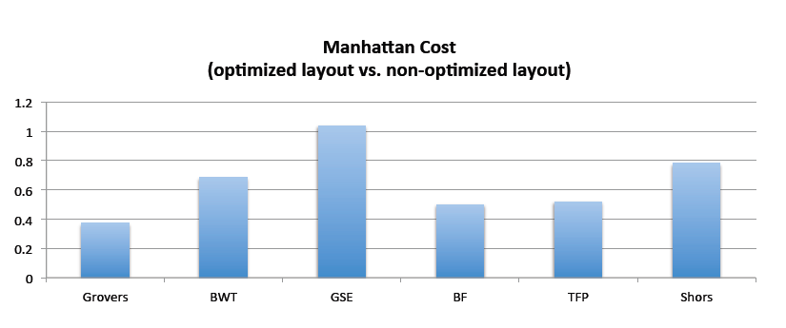
Mapping Qubits
Modified heuristic graph partitioner
  based on Metis [Karypis and Kumar, 1995]

Slide 12
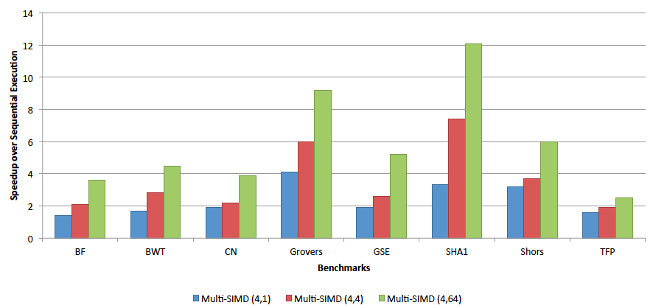
Logical Speedup Estimates

Slide 13
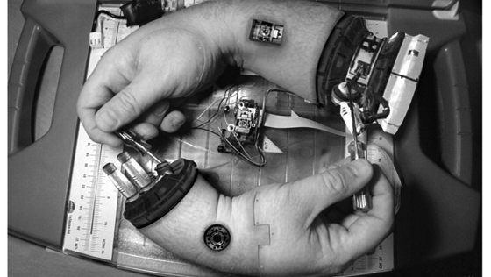
Lesson 2:
Dynamic code generation

Slide 14
Quantum Code Generation for Arbitrary Rotations
Arbitrary rotations are important, difficult to compile for, and expensive to execute
Unique sequence for every distinct rotation
Sometimes need dynamic code generation
  Rotation angles determined at runtime
  Classical-quantum co-processing
  Large code size
[Kudrow et al, ISCA 2013]

Slide 15
Dynamic Code Generation
Scaffold
QASM
Classical
Processor
Static
Compilation
Dynamic
Compilation
Quantum
Co-processor

Slide 16
Rotation Decomposition
H gate
T gate
X gate
H gate
T† gate
...
Notes:
Main point
Decomposing a rotation is the process of determining the sequence of supported gates that best mimic it
Transition
Recalling our execution model, this is what the process looks like in Scaffold/QASM
Talking points
-T dagger, etc.
-Trying to come as close to the desired output state as possible

Slide 17
Precomputed Library
Example: binary construction
Generate library:
Concatenate appropriate sequences
to approximate desired angle:
T, H, T, Z, T, Z, H, ...
Notes:
Main point
As a basic example we consider a binary construction and walk through the how an arbitrary angle is constructed from our library
Transition
While the Binary Construction is simplest, we can generalize this technique
Talking points
-First we generate a library of gates, each a different rotation angle
-We can apply the rotations in succession to construct the angle we want
-Incremental rotations around the Bloch Sphere

Slide 18
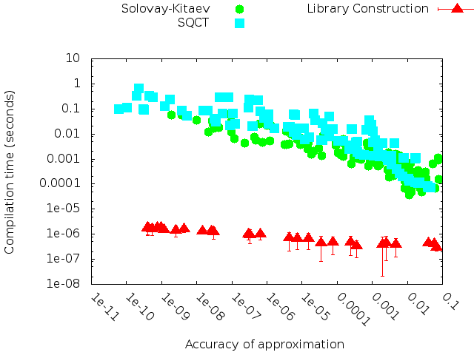
Results – Compilation Time
Notes:
Main point
When we compare the compilation time with the precision of the compilation, we find that the LC method is significantly faster than the other two for the same precision
Transition
We can add the quantum processor “stall cycle” times to give us a point of reference
Talking points
-Precision along horizontal axis
-Compilation time along vertical axis
-”Good” is down and to the left
-Fault tolerant gate times to indicate fitness for dynamic compilation

Slide 19
Results – Compilation Time
Ion Trap
Neutral Atom
Superconductor
Photons
Notes:
Main point
When we compare the compilation time with the precision of the compilation, we find that the LC method is significantly faster than the other two for the same precision
Transition
The precision of the compilation is determined by the target application, consider Linear Systems
Talking points
-The quantum stall cycles indicate to what extent dynamic compilation would hold up program execution

Slide 20
Dynamic Compilation Summary
Up to 100,000X speedup for dynamic compilation with 5X increase in sequence length (T-gate depth)

Slide 21
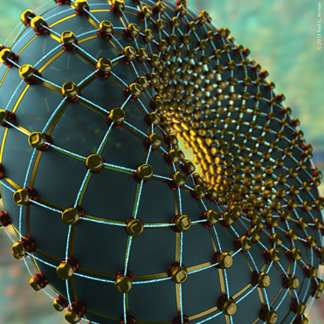
Lesson 3: managing
Communication for Surface codes
[Javadi-abhari et al micro17]

Slide 22
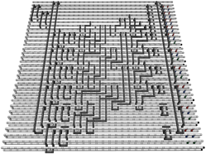
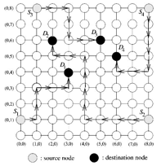
Surface Codes
Sensitive to braid crossings
  Serializes communication
  Qubit mapping for locality is important
Network routing heuristics for scalable scheduling

Slide 23
Data Placement Reduces Crossings
more parallel

Slide 24
Space Overhead of Error Correction

Slide 25
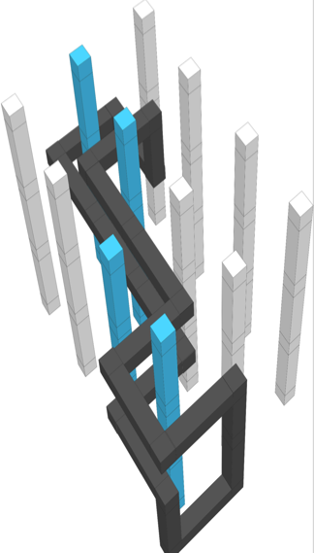
Time Overhead of Error Correction
Plaquette-Based: 2-step communication
Hole-Based: 1-step communication
- Qubits slowly move close to each other to interact.
+ EPRs are decoupled from data: can be prefetched.
+ Braids move fast: n hops per cycle.
+ Braids move fast: n hops per cycle.
- Braids can’t be pre-fetched.
Step 1:
Distribute EPR Pair
Communication Source
Prepare
EPR Pair
Teleport Channel
Established
Step 2:
Teleport
Communication Destination

Slide 26
Characterizing Space-Time Cost (& Optimization)
Summary characteristics of different error corrections:
Mapping & scheduling is key to optimizing performance:
1) Plaquette-Based: Scheduling EPR pairs to avoid traffic
2) Hole-Based: Scheduling braids to avoid collisions
Quantum Applications
& Libraries
Error Correction Type | Communication Method | Space (Qubits) | Time (Latency) | Pre-fetchable?
Plaquette-Based | Teleportations | Low | High | Yes
Hole-Based | Braids | High | Low | No
Compilation & Logical Resource Estimation
Intermediary Format
Mapping Optimization:
Reduce Total Moves
Mapping & scheduling is key to optimizing performance:
1) Plaquette-Based: Scheduling EPR pairs to avoid traffic
2) Hole-Based: Scheduling braids to avoid collisions
Rules:
1) Qubits are stationary, only braids move (initial mapping important)
2) Braids cannot cross (scheduling important)
3) Braids must respect data dependencies (scheduling important)
Error Correction
Network Optimization:
Reduce Congestion
qubits
time

Slide 27
Optimized Initial Qubit Mapping
Qubit-Interaction Graph
Notes:
NP complete to minimize number of moves

Slide 28
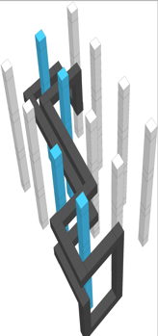
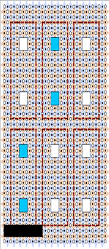
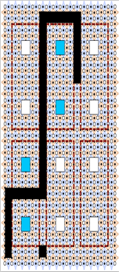
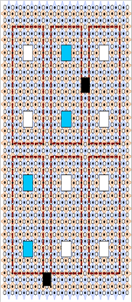
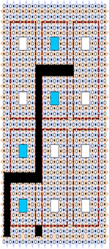
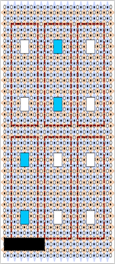
Braid Scheduling using Network Routing
Map problem to network routing.
Differences:
1) braid travels n hops per cycle
2) routers cannot buffer braids
3) braids physically occupy one channel: no virtual channels.

Slide 29
Braiding Heuristics for Optimality & Scalability
Heuristics for optimization:
1) Prioritize most critical braids.
2) Prioritize short braids for highest criticality.
3) Prioritize long braids for lower criticalities.
Operation Dependency Graph
1
2
3
4
q3
H
X
X
X
T†
S
X
5
C
C
C
6
C
T†
X
q2
C
7
C
q1
H
Z
T
S
X
H
8
9
10
11
GSE (serial) SQ (serial) SHA-1 (parallel) IM (parallel)
12

Slide 30
Application Dictates Code Favorability
Error Correction Type | Communication Method | Space (Qubits) | Time (Latency) | Pre-fetchable?
Plaquette-Based | Teleportations | Low | High | Yes
Hole-Based | Braids | High | Low | No
Cross-over point:
The computation size at which hole-based has better (lower) space x time, compared to plaquette-based.
Cross-over point occurs much later for parallel apps:
Plaquette-based code stays better for longer. Due to ability to schedule EPR pre-distribution around congestion.
Tools are needed for these insights:
Previous work had falsely assumed
hole-based to be better by default.
cross-over point
Plaquette-Based Favorable
Hole-Based Favorable
Grover App.
(serial)
Normalized Resource Usage
Hole- Relative to Plaquette-Based Baseline
cross-over point
Ising Model App.
(parallel)
Computation Size
Notes:
Main result of thesis. Complex problem because qubit and time cost are intertwined.

Slide 31
Sweeping the Design Space
Goal:
Anticipate and guide
future developments
Input:
Application/device characteristic
Output:
Most efficient error correction type
Hole-Based Favorable
Plaquette-Based Favorable

Slide 32
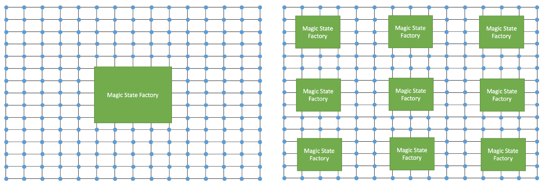
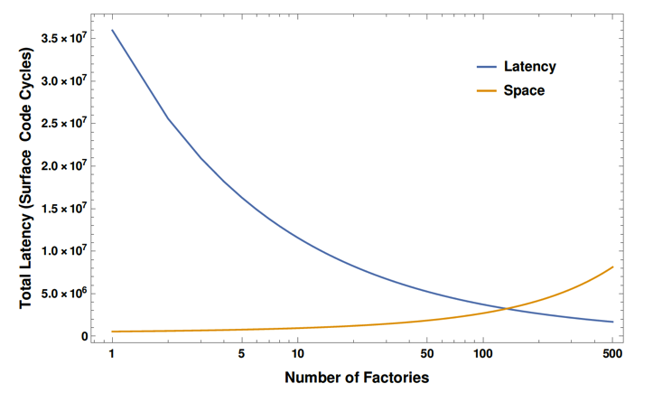
Magic State Factories

Slide 33


future work 1:
Program Correctness

Slide 34
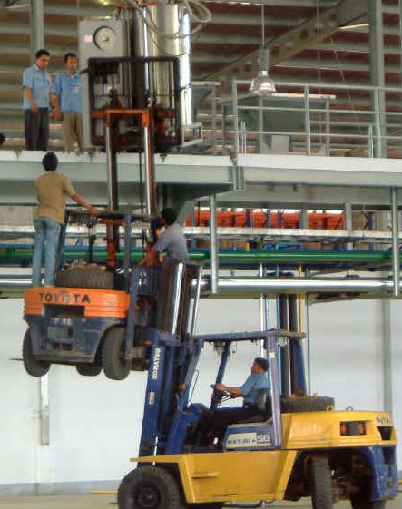
How do I know if my QC program is correct?
Need: Specification language for QC algorithms
Check implementation against the specification
  Simulation for small problem sizes (~50 qubits)
  Symbolic execution for larger problems
  Type systems
  Model checking
  Certified compilation passes
Program synthesis
Compiler checks general quantum properties
  No-cloning, entanglement, uncomputation
Checks based on programmer assertions where possible
Heuristic bug-finding systems (facebook infer)
Can we check useful properties in polynomial time for programs with quantum supremacy?

Slide 35
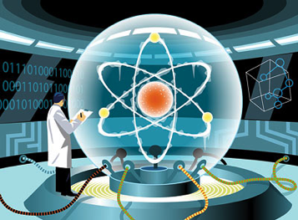
Future work 2:
Enabling a practical-Scale quantum Computer (EPIQC)

Slide 36




















“Practical” Quantum Computing
Algorithms and Software for a 100- to 1000-qubit quantum computer
Fill the gap between theory and experiment
External
Advisory
Board
Industry
Partners
Algorithms and Applications
Harrow
Farhi
Shor
Umesh
Vazirani
(Berkeley)
Technology-Aware Programming Environment
Chong
Brown
Verification, Modeling and Simulation
David
DiVincenzo
(U. Aachen)
Reppy
Schuster
Franklin
Martonosi
Harlow
Education and Outreach

Slide 37
The Algorithms to Machines Gap
Grovers Algorithm (Database search)
#Qubits Needed
Shor’s Factoring Alg. (Crypto)
#Qubits
Gap!
#Qubits Buildable
Year

Slide 38
The Algorithms to Machines Gap
Grovers Algorithm (Database search)
#Qubits Needed
Shor’s Factoring Alg. (Crypto)
Quantum Sim, Q Chem, QAOA
#Qubits
Gap!
#Qubits Buildable
Year

Slide 39
The Algorithms to Machines Gap
Grovers Algorithm (Database search)
#Qubits Needed
Shor’s Factoring Alg. (Crypto)
Quantum Sim, Q Chem, QAOA
#Qubits
Our work
Gap!
#Qubits Buildable
Year

Slide 40
Closing the Gap: Cross-Layer Optimization, Interdisciplinary Research
Grovers Algorithm (Database search)
Algorithms
Shor’s Factoring Alg. (Crypto)
Prog Lang
Quantum Sim, Q Chem, QAOA
Compiler
Our work
Architecture
Gap!
Modeling
Devices
Year

Slide 41
Closing the Gap: Cross-Layer Optimization, Interdisciplinary Research
10X
Grovers Algorithm (Database search)
Algorithms
Device-Tailored QAOA
Shor’s Factoring Alg. (Crypto)
Prog Lang
Quantum Sim, Q Chem, QAOA
Compiler
Our work
Architecture
Gap!
Modeling
Devices
Year

Slide 42
Closing the Gap:
Prioritizing ECC on Critical Paths
10X
Grovers Algorithm (Database search)
Algorithms
Device-Tailored QAOA
Shor’s Factoring Alg. (Crypto)
Prog Lang
10X
Quantum Sim, Q Chem, QAOA
Crit Path ECC
Compiler
Our work
Architecture
Gap!
Modeling
Devices
Year

Slide 43
Closing the Gap:
Targeting Multi-Qubit Gates
10X
10X
Grovers Algorithm (Database search)
Algorithms
Device-Tailored QAOA
Multi-Qubit Gates
Shor’s Factoring Alg. (Crypto)
Prog Lang
10X
Quantum Sim, Q Chem, QAOA
Crit Path ECC
Compiler
Our work
Architecture
Gap!
Modeling
Devices
Year

Slide 44
Closing the Gap:
Debugging & Verification
10X
10X
Grovers Algorithm (Database search)
Debugging, Verification
Algorithms
Device-Tailored QAOA
Multi-Qubit Gates
Shor’s Factoring Alg. (Crypto)
Prog Lang
10X
Quantum Sim, Q Chem, QAOA
Crit Path ECC
Compiler
Our work
Architecture
Gap!
Modeling
Devices
Correct System behavior:
Priceless!
Year

Slide 45

Closing the Gap: Example 1
QAOA for Modular Superconductors
QAOA algorithm optimized for superconducting modules
Algorithms
10X
Prog Lang
Farhi
Shor
Language that captures Hamiltonians and controls time evolution
Compiler
Chong
Architecture
Modeling of performance to determine module size
Modeling
Devices
Franklin
Define available Hamiltonians for
superconducting modules
Schuster
Notes:
Our vision is to close this gap with co-design of algorithms, software and hardware. Traditionally, there has been little information flow between algorithms and physical experiments. We will address this with a vertically-integrated software stack that will expose key machine-specific features and enable adaptation and optimization to bring practical algorithms to realistic machines.
Near-term demonstration of practical algorithms will be a key motivator for future QC research and industry

Slide 46

Closing the Gap: Example 2
Variational Eigensolver for Quantum Chemistry
Optimal sampling from chemistry energies
Algorithms
10-50X
Prog Lang
Harrow
Adapt of probabilistic language to stochastic quantum algorithm
Compiler
Reppy
Architecture
ECC along critical path for relevant measurements
Modeling
Martonosi
Devices
Model physical errors
Brown
Notes:
Our vision is to close this gap with co-design of algorithms, software and hardware. Traditionally, there has been little information flow between algorithms and physical experiments. We will address this with a vertically-integrated software stack that will expose key machine-specific features and enable adaptation and optimization to bring practical algorithms to realistic machines.
Near-term demonstration of practical algorithms will be a key motivator for future QC research and industry

Slide 47
Closing the Gap: Example 3
Adapting Algorithms to Multi-Qubit Gates
Algorithm development with multi-qubit gates in mind
Algorithms
10X
Prog Lang
Shor
Produce candidate multi-qubit operations
Compiler
Architecture
Chong
Optimized for operation versus noise compensation tradeoff
Modeling
Devices
Franklin
Specification of native gate set for trapped ions
Brown
Notes:
We don’t have time to give a lot of detail today on our entire research agenda, but let me just give you two examples to give you a flavor of what needs to be done.
The first is an example of low-hanging fruit that comes from connecting algorithms to physical machines.

Slide 48

Closing the Gap: Example 4
Debugging with Assertion Checking
Insert Quantum Assertions into Algorithms
Algorithms
Priceless!
Prog Lang
Harrow
Characterization of quantum programming
bugs
Compiler
Architecture
Chong
Simulation techniques
for assertion checking
Modeling
Devices
Martonosi
Noise models to simulate
Schuster
Notes:
We don’t have time to give a lot of detail today on our entire research agenda, but let me just give you two examples to give you a flavor of what needs to be done.
The first is an example of low-hanging fruit that comes from connecting algorithms to physical machines.

Slide 49
Impact
Develop co-designed algorithms, SW, and HW to close the gap between algorithms and devices by 100-1000X, accelerating QC by 10-20 years.
Grovers Algorithm (Database search)
Co-Design
Algorithms
Shor’s Factoring Alg. (Crypto)
Prog Lang
Quantum Sim, Q Chem, QAOA
Result: Crossover by 2023!
Compiler
Architecture
Gap!
Modeling
Devices
Year

Slide 50
Discussion
Gap?
Short-term SW
Long-term SW
100
1000
10000
100000
qubits
https://github.com/epiqc/ScaffCC
http://people.cs.uchicago.edu/~ftchong

