Slide 1
NuMI Shutdown Activities – Week 9
Marty Murphy
AD 09:00 Scheduling Meeting
8 September 2017

Slide 2
Week-9 Jobs
Prepared dead target MET-01 for move to C0
Completed As-found on Horn-2
Terminated wires for target pile
Fitters installing HX on multistack chiller (three weeks).
Saturday 06:00 – Move MET-01 to C0 for intermediate term storage. Specific details at end of presentation…

Slide 3
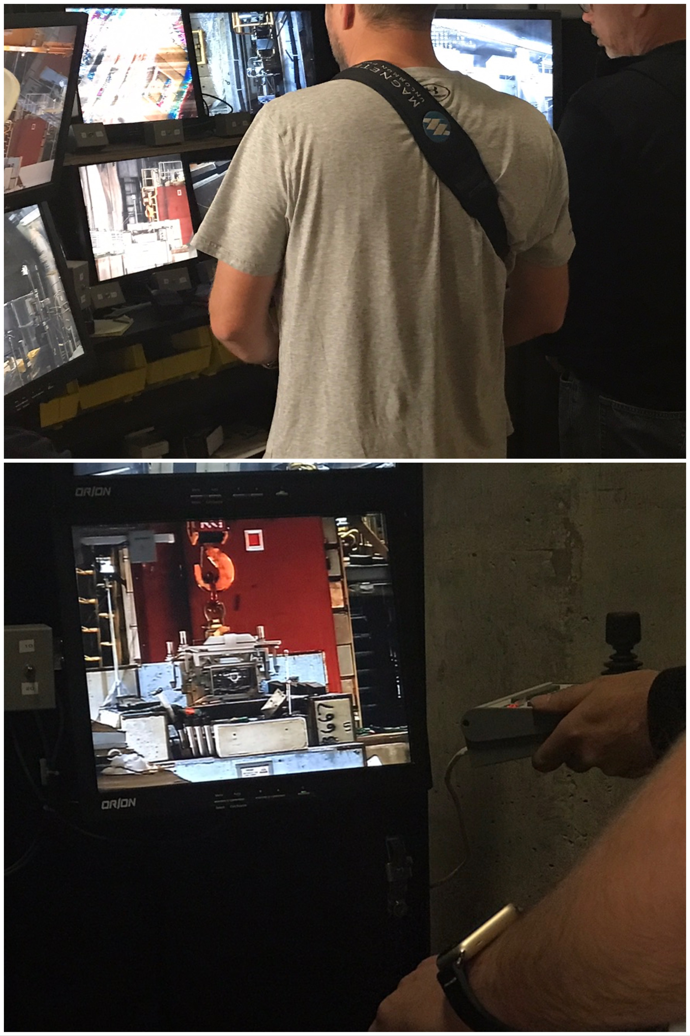
Remote Handling
Operation

Slide 4
Week-10 Jobs:
Week-10
  MI-65:
    Complete installation of heat exchanger for Multistack Chiller system. (3 week job)
  Target Hall:
    Fix thermocouples atop Target module in work cell.
    Complete termination of newly installed wires.
    Continue Horn-1 RAW leak hunt

Slide 5
To-do List:
Install Multistack chiller heat exchanger (3-weeks)
Target thermocouple repair (2 days)
Get PBTC & Hydrogen Peroxide systems operational
Replace TH chiller coil (fitters; 2-3 days)
PM of multistack chiller (Prism techs; one week)
Continue construction of C0 storage facility
pH test of Decay Pipe under drains
Clean drains in Pre-target; TH; & Decay Pipe (two weeks)
Continue Horn-1 leak hunt.
Goal is to close up TH by middle of Week-11 (Sept. 20)

Slide 6
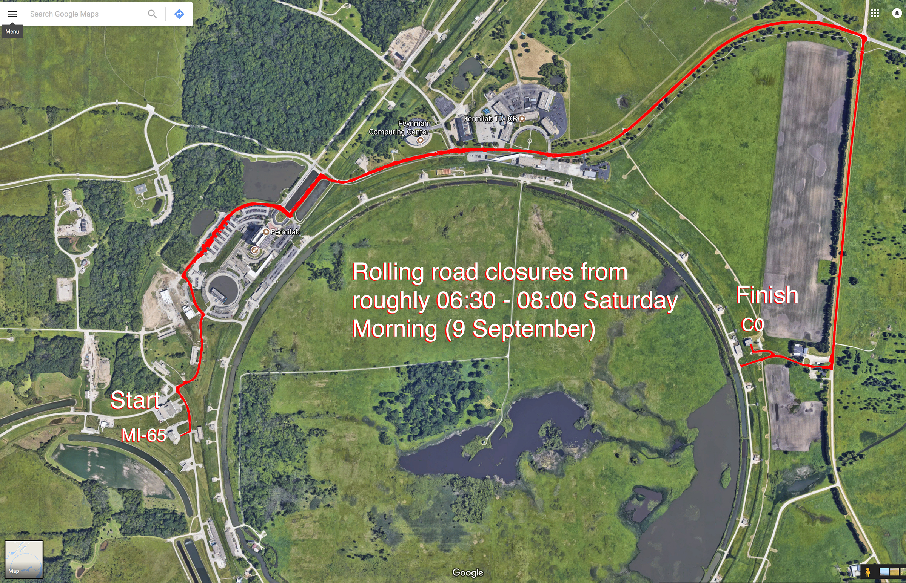
MET-01 Route

