Slide 1
Delivery Ring Update
Jerry Annala
Muon Campus Shutdown Status - week 9
8 September 2017

Slide 2
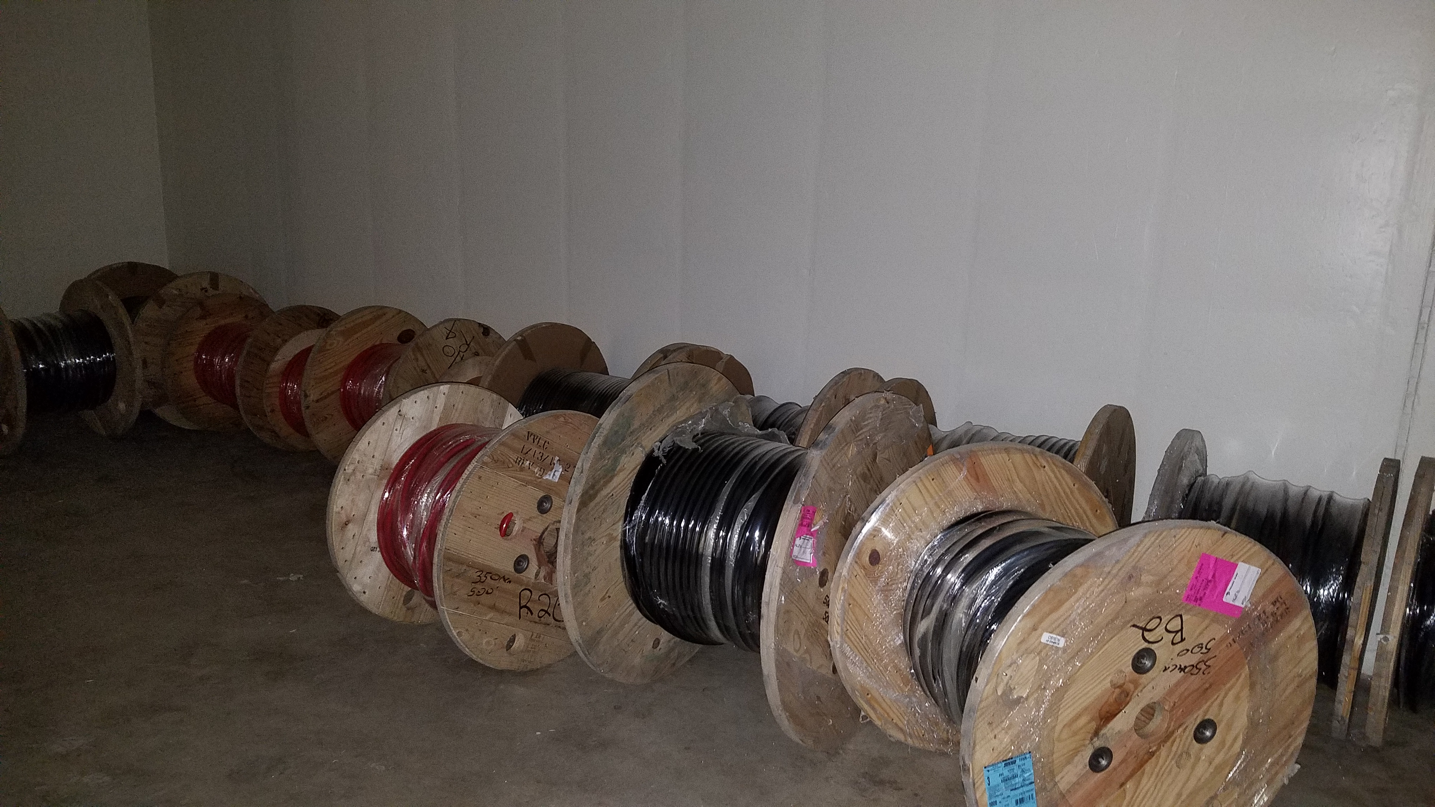
Major shutdown efforts
Install the M4 line
Magnets installed past the temp shield wall (100%)
Cables are being installed (40%)
Water connections will follow cable installation (0%)

Slide 3
Install new pulsed septa magnets
First Magnet is at NWA
Magnet has been pumping since 8/10/17
Vacuum pressure at 1.3e-6 torr
Ion pumps are holding on their own
Organizing all of the installation work so that actual vacuum installation time is as short as possible.

Slide 4
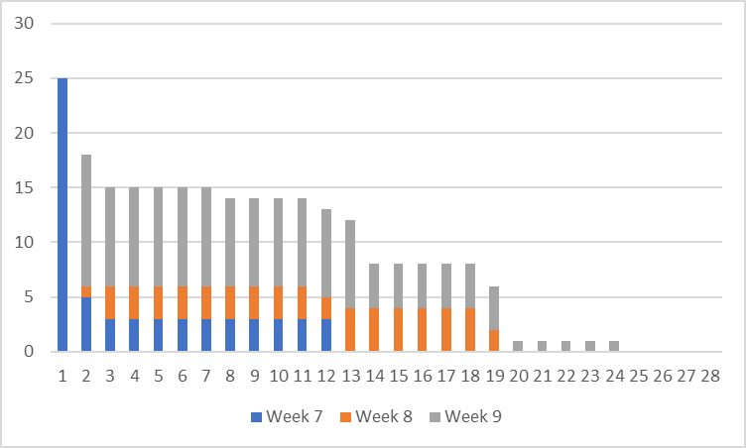
Repair of PWCs and Ion Chambers

Slide 5
Additional jobs (unchanged)
Installation of 3 extra correction elements
Stands being machined
Cables have been pulled
Search for aperture restrictions
Have inspected the M2 and M3 lines
Will still inspect the M4 and M5 lines

Slide 6
Schedule
Electricians continue pulling M4 line cable
Have resumed AP-0 pulse testing
Begin installation of injection Septum magnet on next week
Production line repair of PWCs and Ion Chambers is underway.

