Slide 1
Proton Source Week 9
Joe Compton
9am Meeting
9/8/2017

Slide 2
RIL/Linac
RIL
Source A left off due to the holiday and power outage
Testing the gas valve pulser
Previous pulser chassis was reason for poor regulation
Still looking into the cause of the poor regulation
New chassis regulating well
Linac
LRF2 Marx power testing in dummy load this week
Looking good
P1 Marx installation in LRF5 continues
LE maintenance continues
L1, L2, & L3 power outage today for maintenance

Slide 3
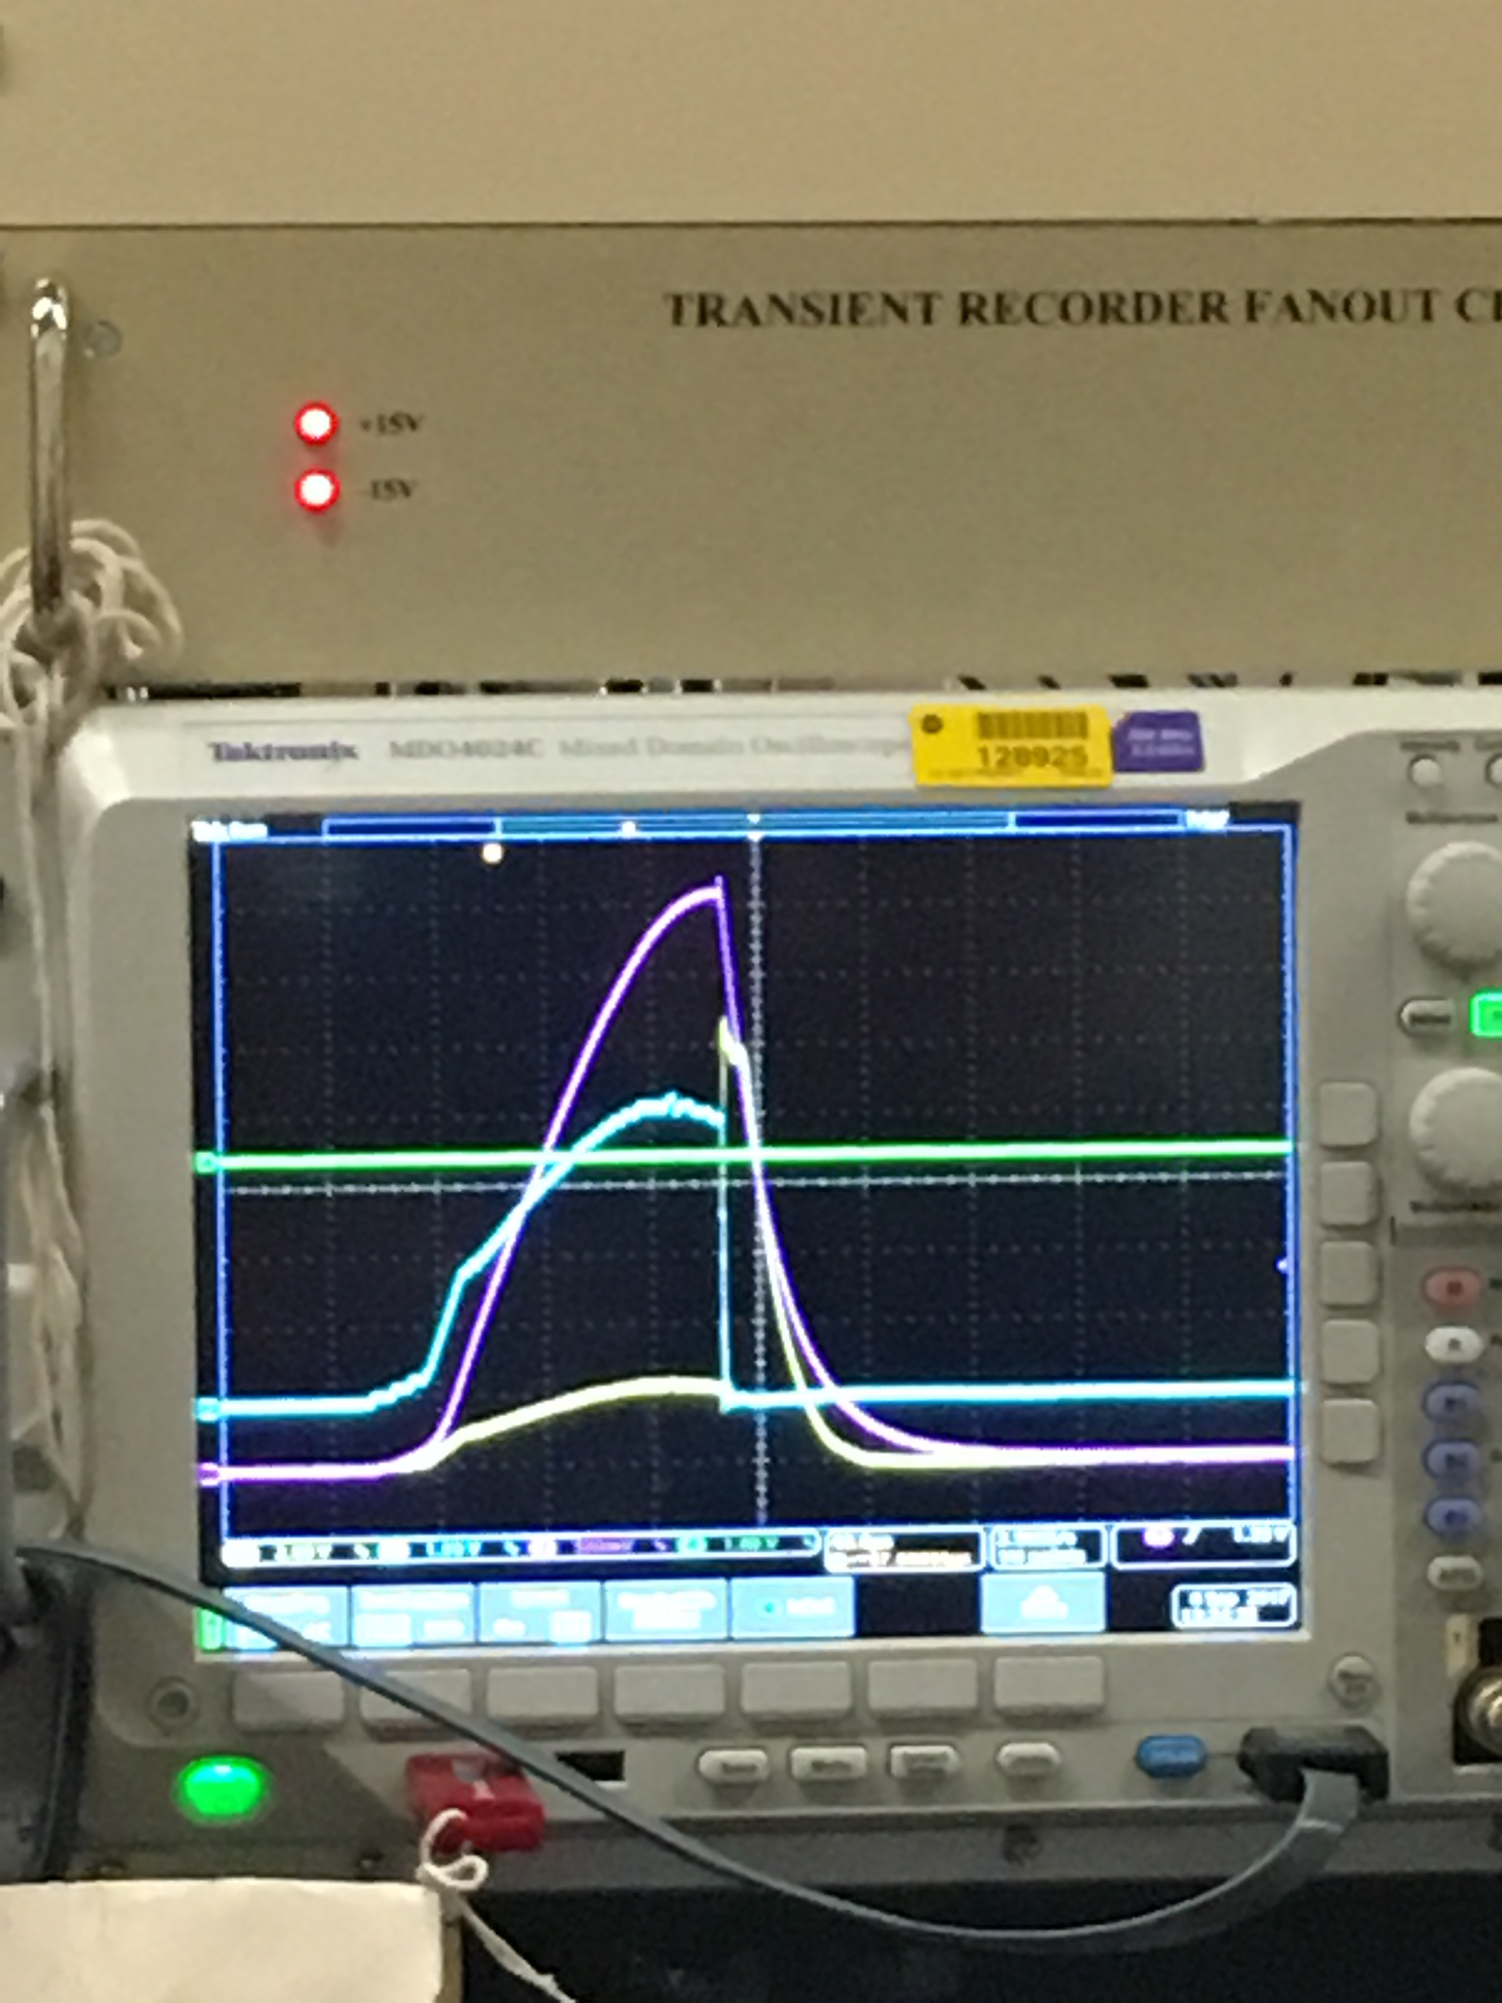
LRF2
Low Power
Spark Testing

Slide 4
Booster
BRF22 installation continues
BRF22 PS room prep continues
Shielding tests for CHG0 continues
General RF maintenance continues
Corrector maintenance
IP PS maintenance
In planning stage for mode damper resistor install
Sump pump maintenance
Eye bolts installed
Floats adjusted
Preparing for short outage on Monday
General maintenance

