Slide 1
2017 Main Injector/Recycler Shutdown
D. Morris
0900 Meeting
September 8, 2017

Slide 2
Tunnel Work
MI/RR-52 section
Recycler 52 Lamberston aperture upgrade
New beam pipe and flange have been installed
Alignment assisting in getting pipe deviations removed

Slide 3
Tunnel Work
MI-Instrumentation/RF section
Located vacuum leak inside RF #7
Leak check of instrumentation/damper region
Final leak check complete but…
I:IP601 failed and has been replaced
Needs leak checking after stand fabrication

Slide 4
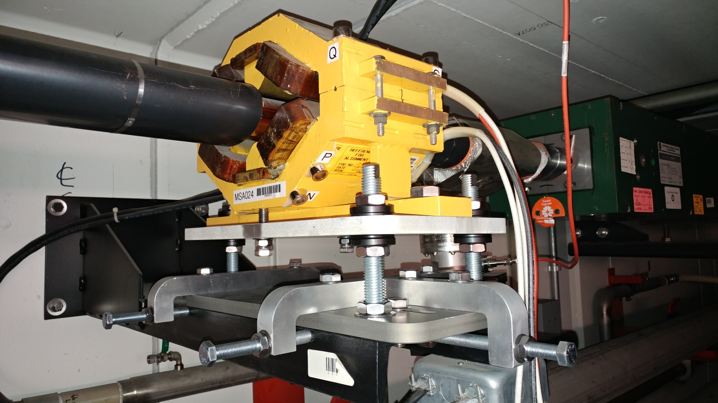
Tunnel Work
Installation of modified Recycler sextupole stands complete
Need aligning
Crew is removing more transfer line magnets

Slide 5
MI-8 Line Vacuum Work
Crew is working on ion pump replacement in MI-8GeV line
826 through 846 roughing down
One failed pump has been replaced
New leak located near collimators
Leak check complete for 846 - 852

Slide 6
Miscellaneous
MI-52 tunnel sump discharge line repair nearing completion
MI pond from MI-10 to MI-60 has been lowered for MI-62 sprayer repairs which are nearing completion
Water group is fixing leaks on the compressed air system
Installing two new compressors
Multiple LCW valve leaks to address

Slide 7
MI-52

Slide 8
MI-62

Slide 9
Going Forward
Jobs still on the schedule:
MI RF cavity #4 (~Sept.15th)
MI e-beam scanner (?)
R40 abort lamberston (MLAW) installation
RR abort toroid replacement
RR 104 HIPM MCP
R-103 pinger kicker
SEY sample change
Investigate MI vacuum at MI-301
Tunnel cleaning

