Slide 1
protoDUNE APA production in the UK
Justin Evans
University of Manchester
11th September 2017

Slide 2
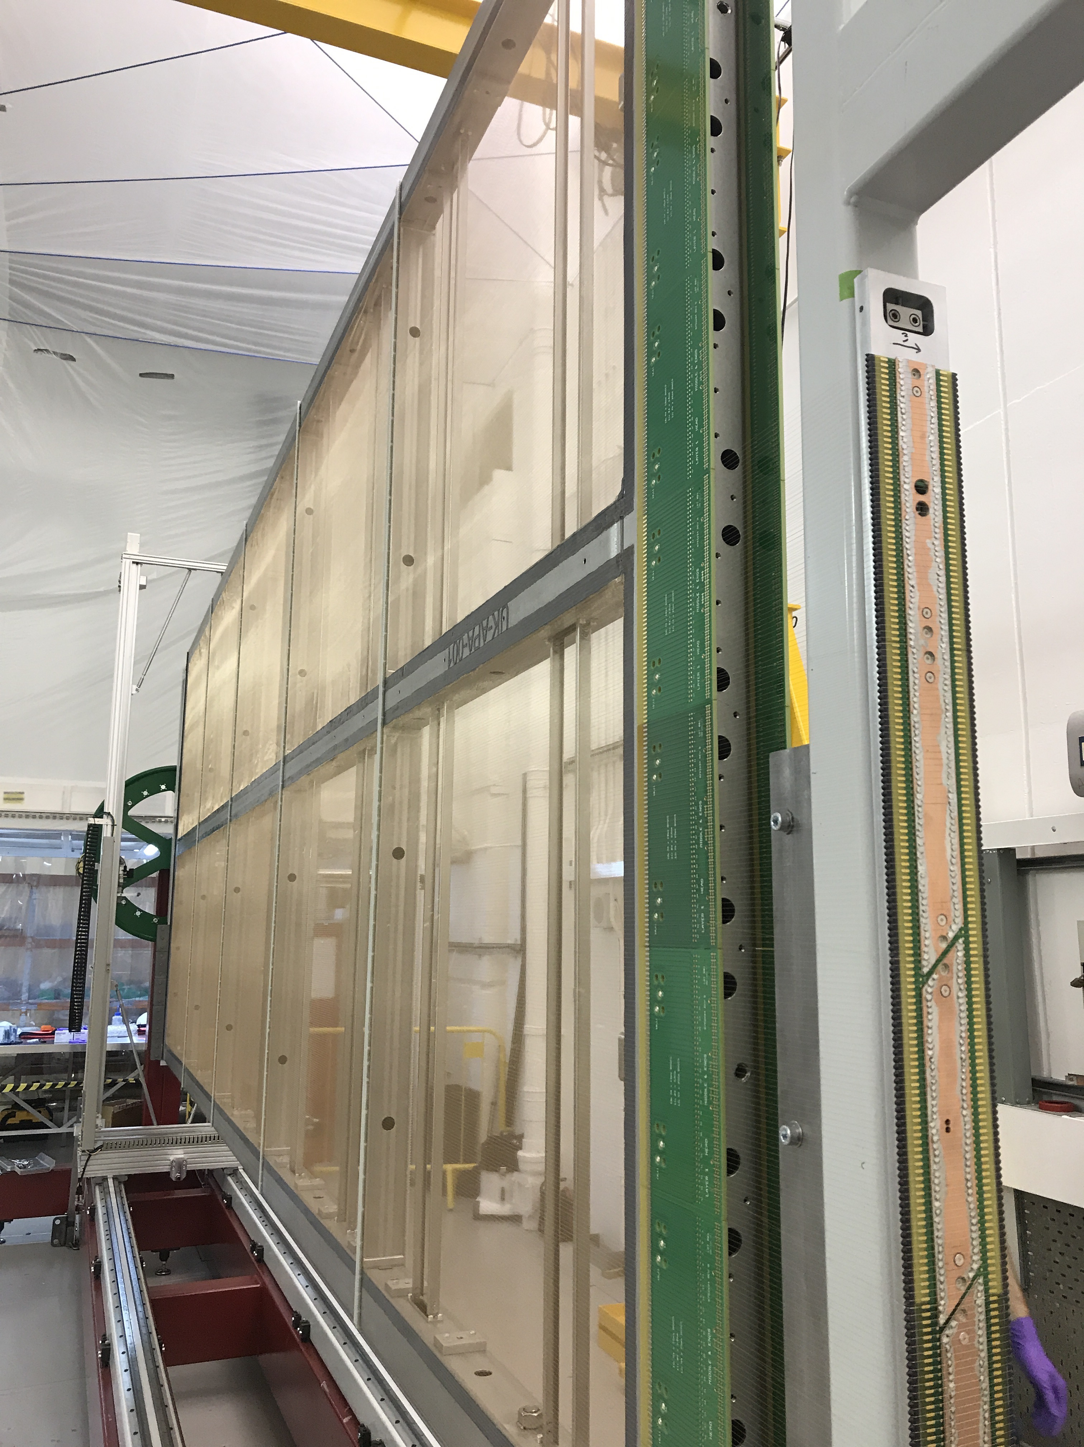
protoDUNE in the UK
We are making three protoDUNE APAs in the UK
Using a copy of the system designed by the PSL engineers
Working at the Daresbury laboratory
In close proximity to Manchester and Liverpool (30 min drive)
1 hour to Lancaster
90 minutes to Sheffield
This is important
Allows technical and academic staff from multiple universities to have day-to-day involvement in the project

Slide 3
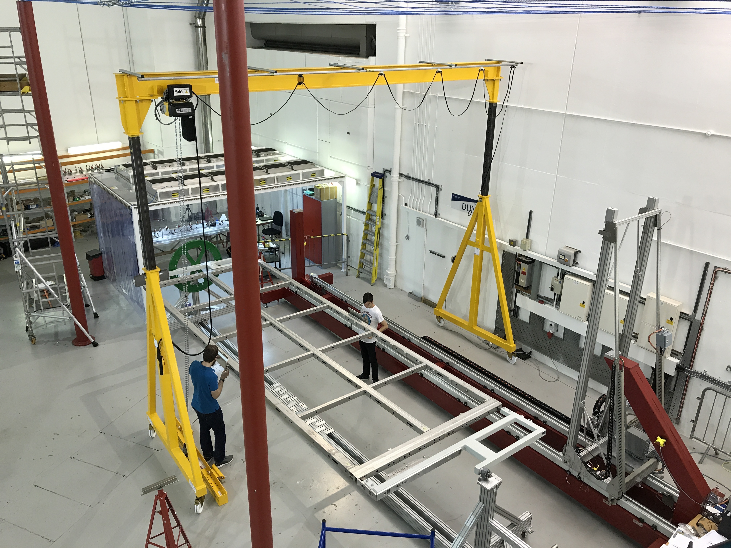
Working space
Winding
machine
Process cart
Production happening inside a class 100,000 clean tent; similar setup to PSL
The room is covered by a crane, rated to 6 tonnes
Clean tent has a separate internal crane

Slide 4
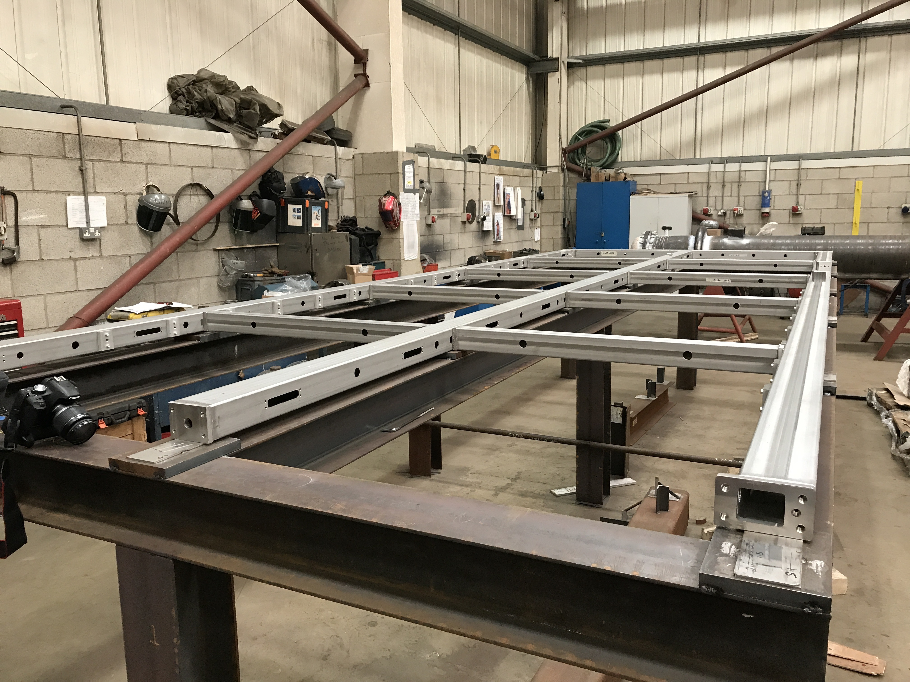
APA frames
Steel from Atlantic Steel (same supplier as PSL)
Steel selection process required to ensure tolerances
Portobello (engineering company near Sheffield) produce the frames
protoDUNE frame production has gone very smoothly
Currently £30k per frame

Slide 5
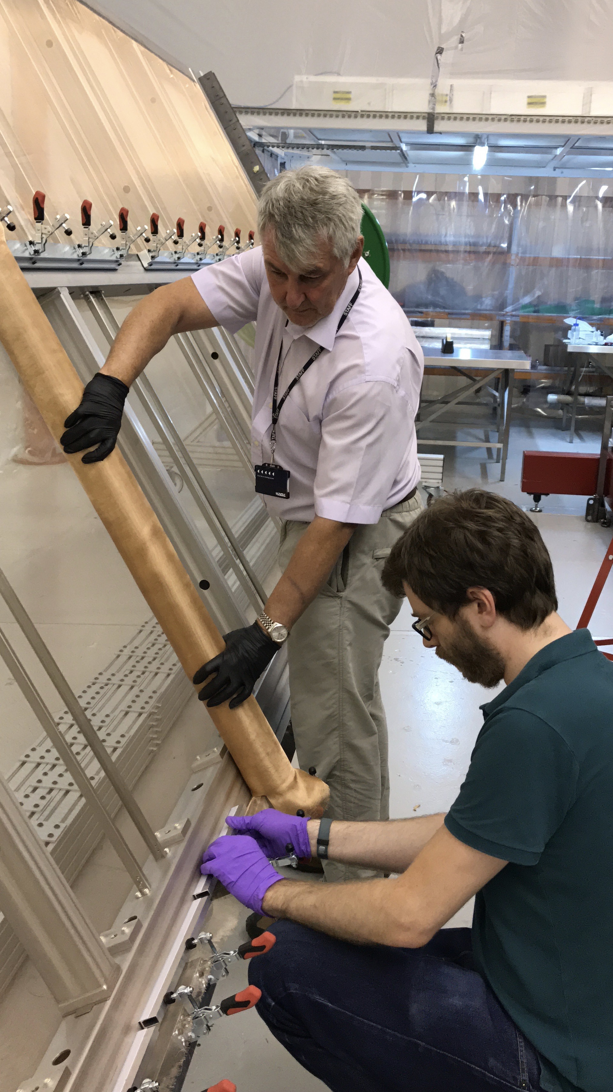
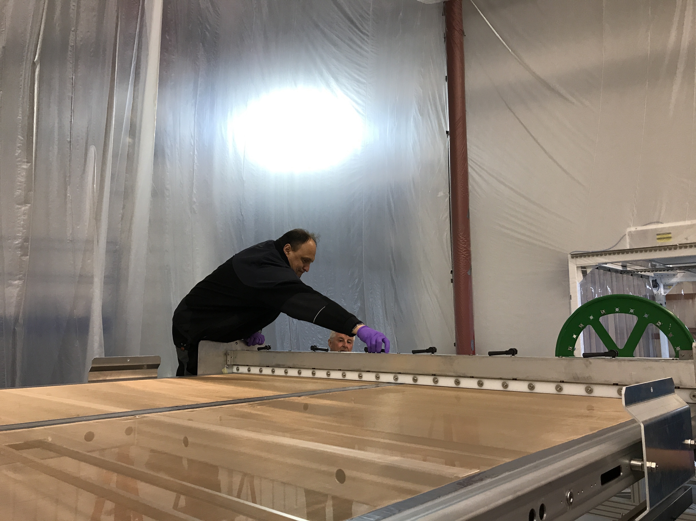
Production process
Mesh application
Install photon detectors
Quick
Apply mesh and combs
~2 weeks: 8 hours of epoxy drying each time, limited parallelisation
Install PCBs for wiring onto
1 day: epoxy must dry
Comb installation

Slide 6
Wiring
Wind a half-layer at a time
Takes 2-4 days depending on the layer
Or longer if the machine plays up

Slide 7
The winding machine
PSL have designed a very nice piece of machinery
For mass production, reliability is important
Machine can get confused and stop mid-job; easy to fix but needs expert supervision
Motors can seize up
Wire can snap and tangle around the clutch
Other suggested improvements
Clutch that provides tension needs 20 minutes to warm up before winding
Redesign to wire a whole layer at once
Automation software is currently expert level: not trivial to push out to a number of sites with beginner operators

Slide 8
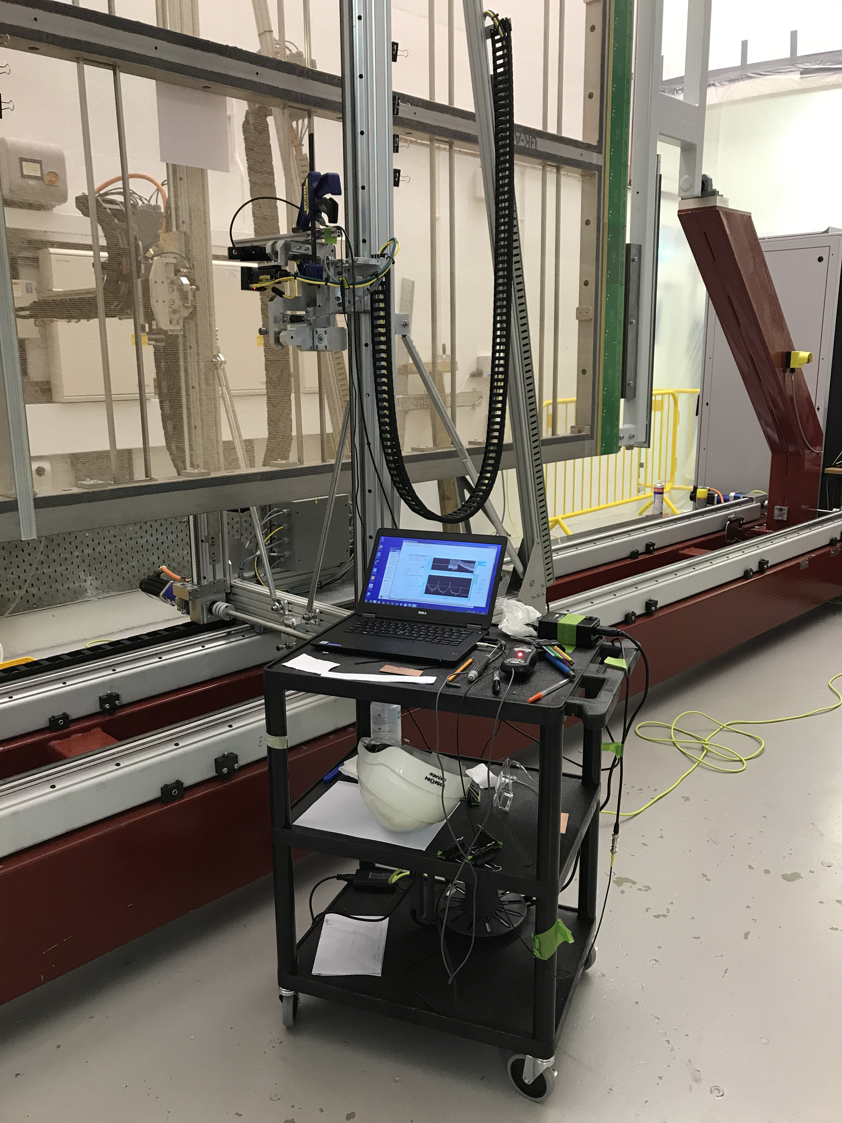
Tension testing
This takes a long time
Upwards of 3-4 hours to test one side of half a layer
Current procedure
Test every wire on both sides of a half layer (most of a day)
Solder and cut all wires (2-3 hours)
Test every wire on both sides again (most of a day)
We’re being super-cautious for our first layer, so could cut the first test down to every 10 wires or so
But this is still an integrated 2 weeks of tension testing for every APA
On top of that, there are a few hours of electrical tests per layer

Slide 9
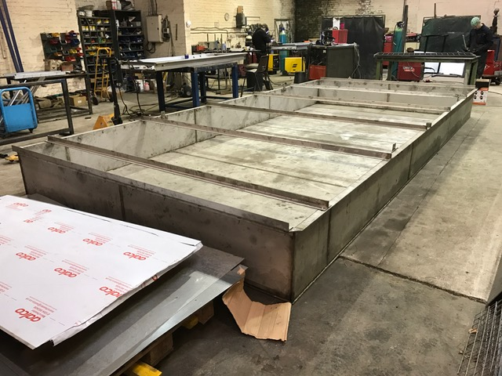
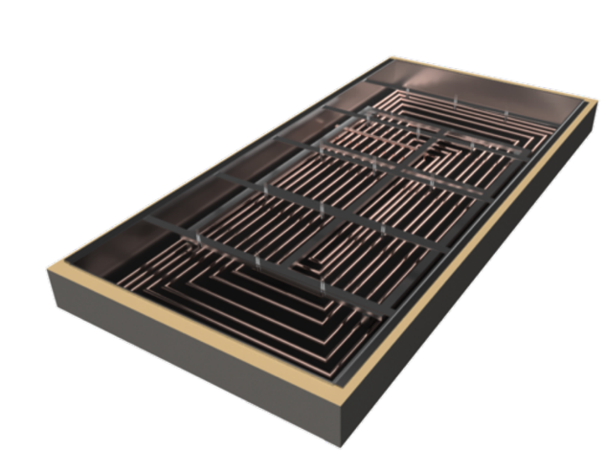
Cold testing
Lancaster-built cryo-box that can cool SBND and protoDUNE frames down to ~100 K in gaseous nitrogen
Goal is cool-down rate of 50 K / hour
Equipped with sixteen cameras and lighting
Not clear if we will use this on the protoDUNE frames
Time, risk, not clear what we will learn
We will by trying this out as part of our SBND production process

Slide 10
Production process summary
Currently taking around 3 months to wire an APA
For mass production, each site needs to push out an APA every 2-3 weeks
We’re looking at extending working hours to speed this up
Working overtime on some weekends
Moving to 12-hour days (an early crew and a late crew)
Current production procedure is quite manpower heavy
For most of the time, you need two people working together
Wiring happens half a layer at a time
APA must be moved twice between each layer: at these times you need three people
Many days of tension and electrical tests per APA
We have a very nice machine from PSL to start us off
A lot of work is needed to turn this into a mass production method

