Slide 1
APA Consortium Meeting
Stefan Söldner-Rembold
September 11, 2017

Slide 2
Technical Lead
Technical Lead will play an important role in managing technical aspects of the Consortium and in the project management.
Appointment in consultation with institutional representatives and DUNE management.
Alberto Marchionni has agreed to become the APA TL.
Alberto will move from the Beams Division and will be full-time on the APA Consortium. He brings considerable experience in detector design and construction.

Slide 3
Deliverables – Consortium Structure
Design APAs for the DUNE SP detector
Frames, wires, mesh, combs, support structure, boards
Validation of TPC design and QA/QC criteria using MC and ProtoDUNE data
Tooling, automatization, industrialization
Winder, tension measurements, electrical and cryo testing, shipping
Production planning, system engineering
Integration and Installation
QA/QC planning, Integration and Installation, SURF
Calibration
TPC Calibration system, specification, design, fabrication, installation
Simulation and Software
TPC simulation, electric field, drift properties, signal shapes
Implementation of real detector conditions
Calibration software, monitoring
Editing of Technical Proposal/TDR

Slide 4
Consortium Stucture
Please comment on this organisational structure; this will form the basis for forming working groups.
Please also nominate candidates for convenerships within the Consortium – including self-nominations.
We have recently received the input to the institutional commitments from Eric – will contact institution reps individually over the next weeks to discuss their possible contributions.
We hope to have conveners in place by the end of next week.

Slide 5
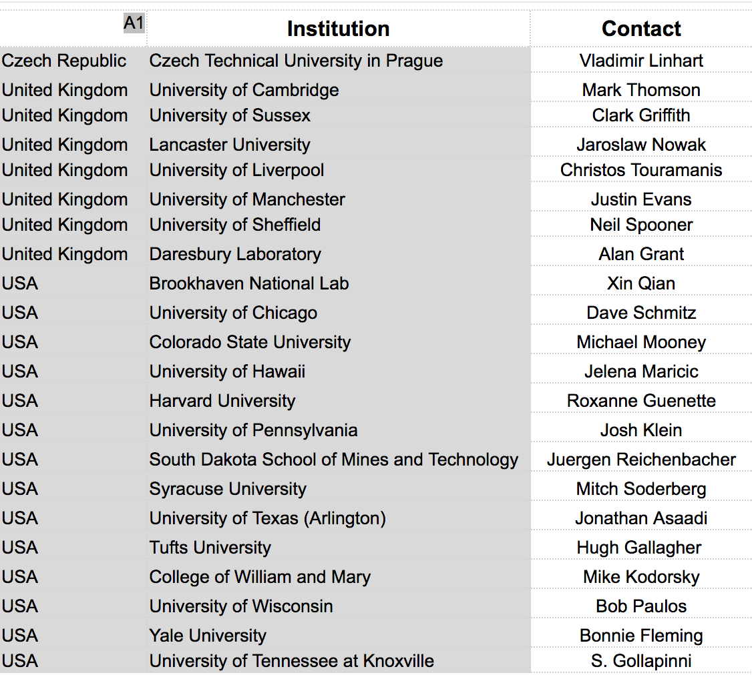
Consortium Membership
In addition, we welcome
MSU (Kendall Mahn) as
our first new APA
Consortium Member.

Slide 6
Organisational Matters
Two email lists:
DUNE-FD-APA-CNSRT-REP APA IB Representatives
DUNE-FD-APA-CNSRT General Consortium email list
Subscription to DUNE-FD-APA-CNSRT is open to all DUNE Collaborators (not only from Consortium member institutions).
Subscribe by sending a message “subscribe DUNE-FD-APA-CNSRT Jane User” to listserv.fnal.gov (or contact me).
Meeting time agreed on by Doodle poll:
Mondays, 10-11:30 am FNAL time.
Might change structure to alternating bi-weekly with sub-group meetings in the future.
Consortium agenda server:
https://indico.fnal.gov/categoryDisplay.py?categId=674

Slide 7
Milestones
2 November 2017, RRB Meeting
Need a first version of the Work Breakdown Structure (WBS) and an assignment of institutional responsibilities.
Summer 2018
Technical Proposals
Preliminary cost estimates
Updated matrices of institutional responsibilities
Draft schedules for 2020 and beyond
Description of proposed system (can include some alternatives
Spring 2019
Technical Design Report
Finalized version of Technical Proposal
Baseline design with requisite studies to show that proposed subsystem meets DUNE requirements.

Slide 8
Challenges
These time scales are very ambitious; will need to carefully manage the resources within the Consortium to achieve our goals.
In addition, we have to reach out within DUNE (and beyond) to involve more people.
In parallel, many members of the Consortium are involved in ProtoDUNE and the SBN programme; these exist separately but we need close collaboration.
Identify overlaps and interfaces with other consortia.
There will be potential conflicts between ambitious time scale and potential detector changes/improvements – important to manage properly.

Slide 9
Re-inventing the wheel
We are not starting from a “tabula rasa”.
Example: Far Detector Task Force Final Report (DocDB 3384)
Will have presentations on these studies over the coming months.

Slide 10
Today’s Agenda:

