Slide 1
2017 Main Injector/Recycler Shutdown
D. Morris
0900 Meeting
September 15, 2017

Slide 2
Tunnel Work
MI/RR-52 section
Recycler 52 Lamberston aperture upgrade
New flange and beam pipe is installed, welded and aligned
Roughing down for leak check today

Slide 3
Tunnel Work
MI-Instrumentation/RF section
- 601 final leak check complete
- 606 area RF cavity leaks patched
Final leak check today
- 605 area leak check underway.

Slide 4
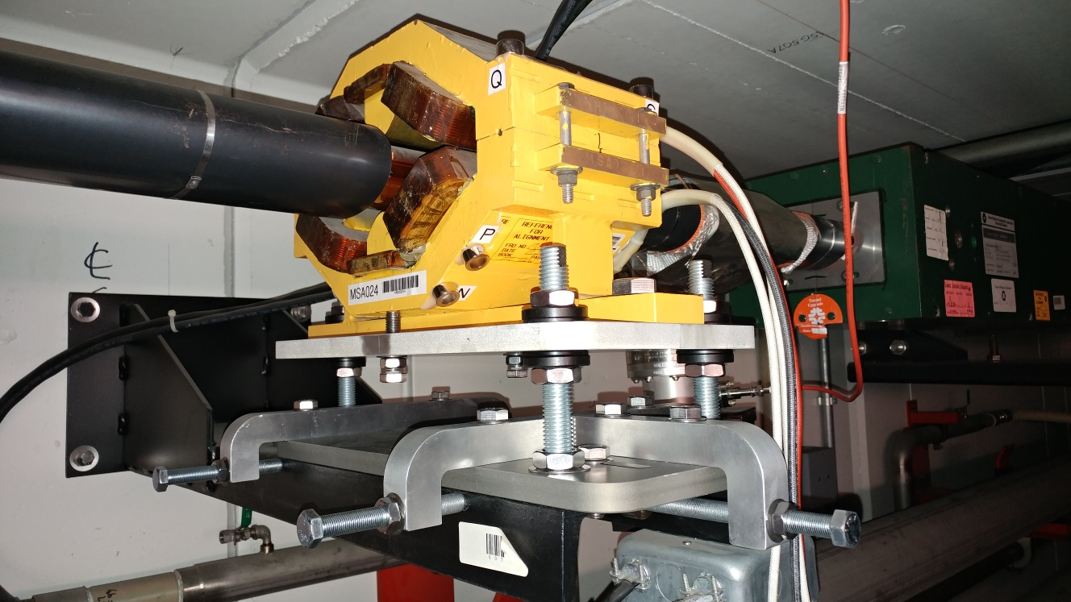
Tunnel Work
Installation of modified Recycler sextupole stands complete
Alignment in progress

Slide 5
MI-8 Line Vacuum Work
Vacuum work is complete
One issue with a potential cable fault at 835

Slide 6
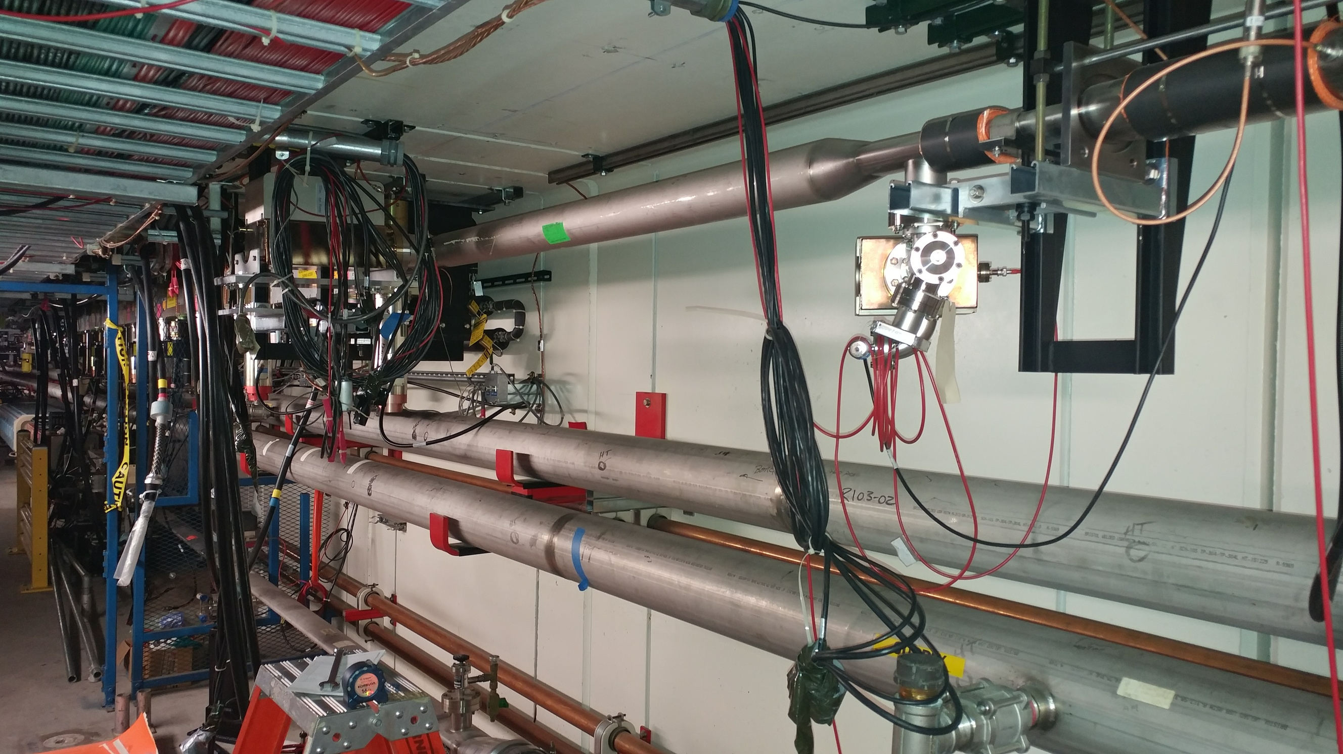
RR-10
Crews are starting work to install a new Recycler pinger

Slide 7
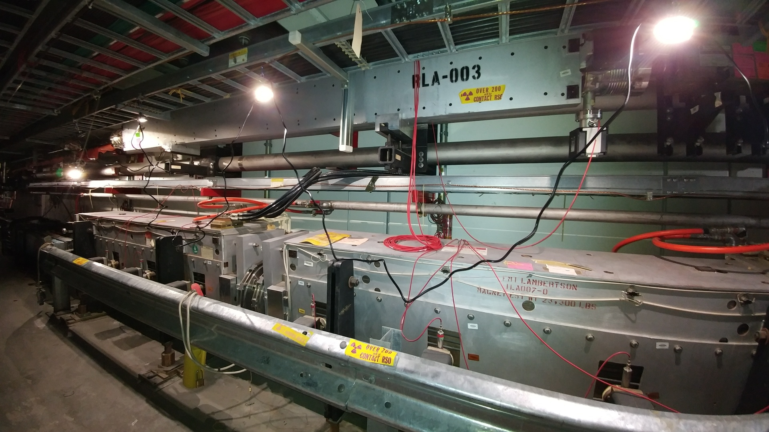
RR-40/Abort

Slide 8
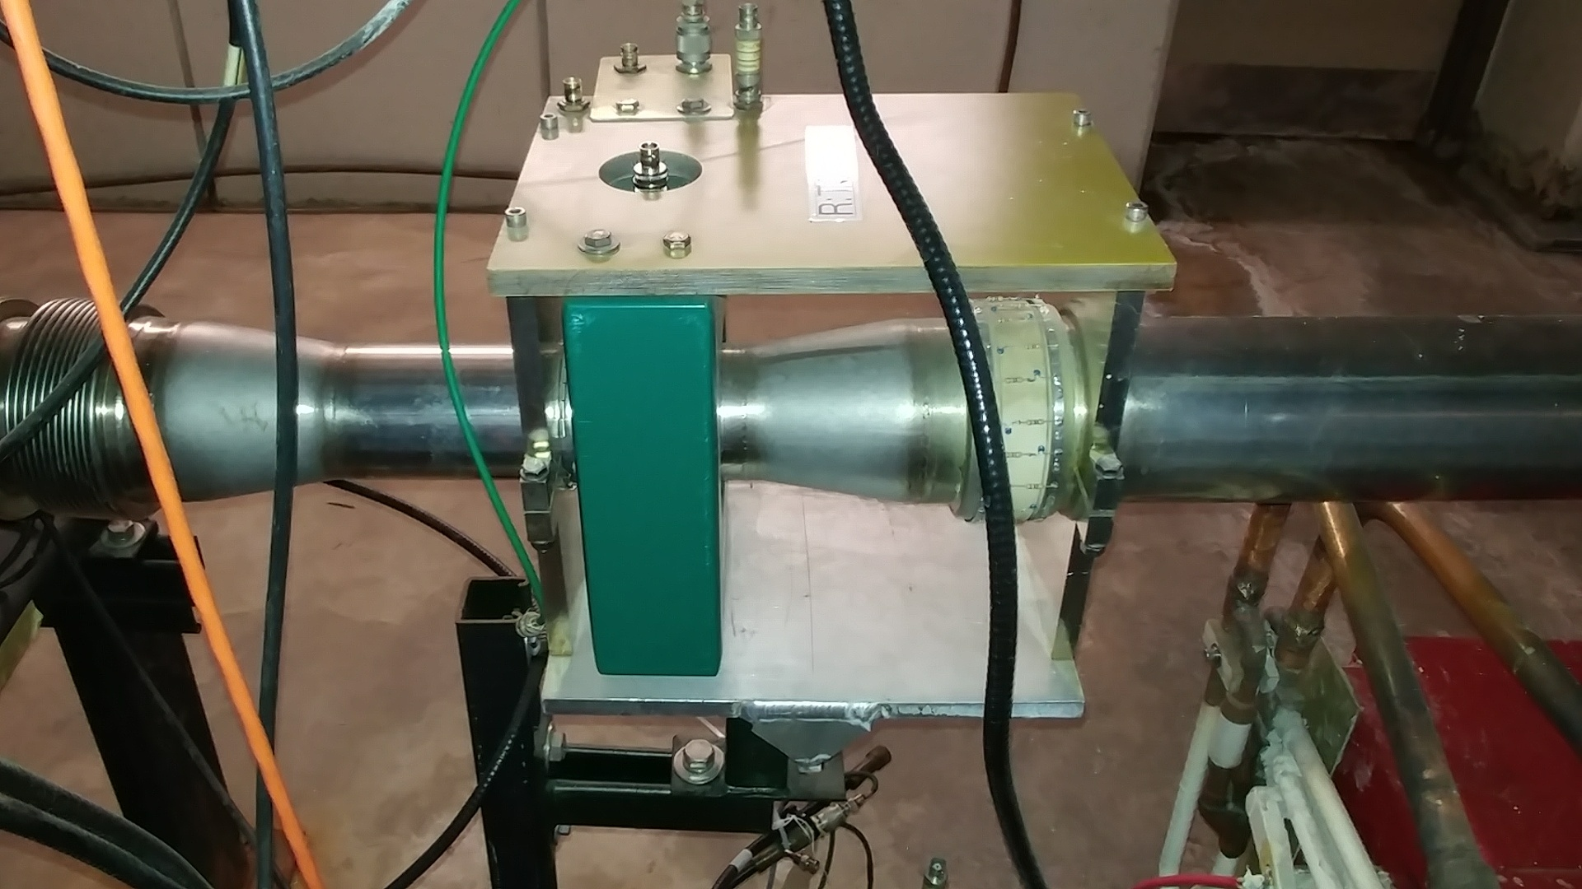
RR-40/Abort

Slide 9
Miscellaneous
MI-52 tunnel sump discharge line repair nearing completion
- After it’s operational we need to pull hose from tunnel
Water group is performing LCW pump vibration measurements, balancing and maintenance

Slide 10
Going Forward
Jobs still on the schedule:
MI RF cavity #4 (Expected to start next week)
MI e-beam scanner (?)
R40 abort lamberston (MLAW) installation (Purging Monday)
RR abort toroid replacement (Purging Monday)
RR 104 HIPM MCP (Next week)
SEY sample change (Next week)
Investigate MI vacuum at MI-30
Tunnel cleaning

