Slide 1
Eric McHugh
9/15/2017

Slide 2
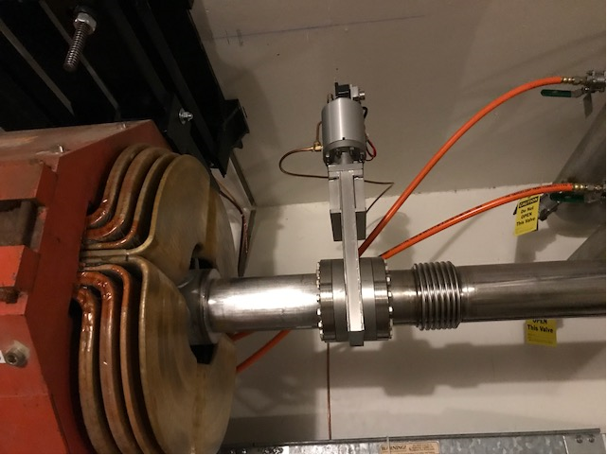
M5 configuration control event
This vacuum valve (and others) were configured prior to the shutdown to compensate for leaking PWCs.
The configuration was electronically “kludged” open for operations
Vacuum personnel were working in the area and to prevent operation of the valve remotely, they disconnected the signal cable

Slide 3
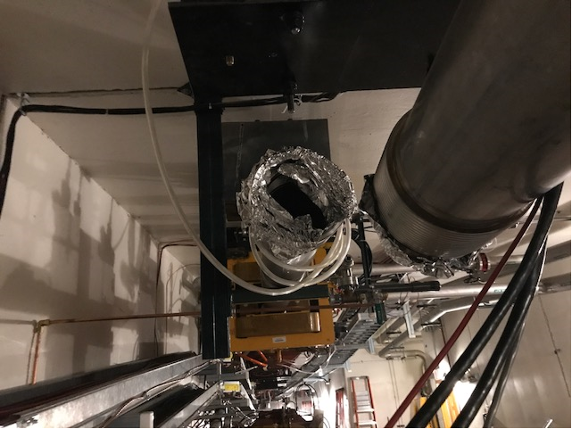
M5 configuration control event
Another group was working in the area disconnecting signal cable and other connections, preparing for electrician work.
When the work was complete, the signal cables were reconnected.
Technician connected the cable to the vacuum valve.
Vacuum valve opened due to the “kludge”

Slide 4
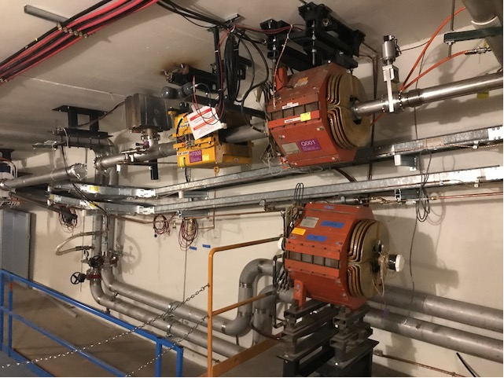
M5 configuration control event
Technician was standing on a step stool at the time of the event, loud sound “like a jet engine”
Investigation ongoing
Initial findings: configuration control issue – the valve controls were configured such that they would not operate as expected, the valve control cable was disconnected to maintain control. No configuration control tags

Slide 5
2017 Shutdown Pocket Dosimeter Reports – Week 9
WEEK 9:
421 person-mrem
55 people reported some dose, with average dose of 7.65 mrem
SHUTDOWN SO FAR:
2,891 person-mrem
130 people reported some dose, with average dose of 22.24 mrem

