Slide 1
Dual Phase Field Cage Trial Installation Proposal
NH1 Integration Meeting
Sept. 15, 2017
Jaehoon Yu for
A. Chatterjee, G. Brown & UTA Team
A. Gendotti, S. Murphy, C. Cantini & ETH Team
F. Pietropaolo & CERN Team

Slide 2
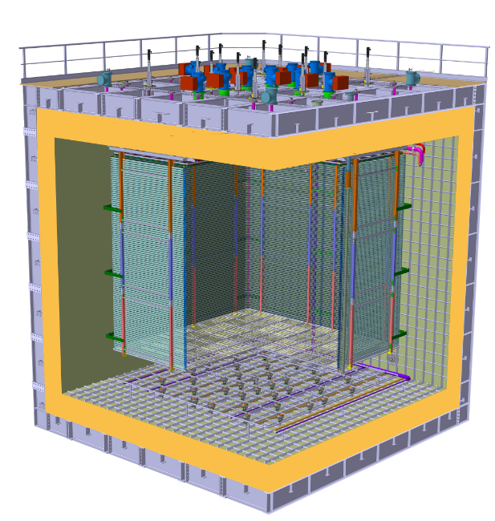
Field Cage in protoDUNE DP
Field Cage and cathode hangs off of the ceiling
Essential to have light yet sturdy structure
Based on modular concept as SP
Charge Readout Planes
6 m
Field Cage (common structural elements with SP)
Cathode
6 m

Slide 3
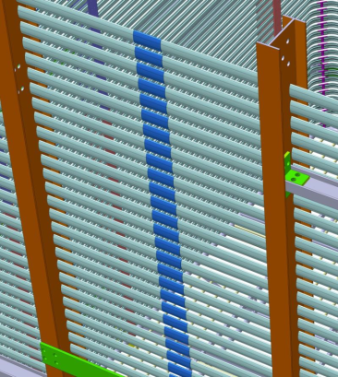
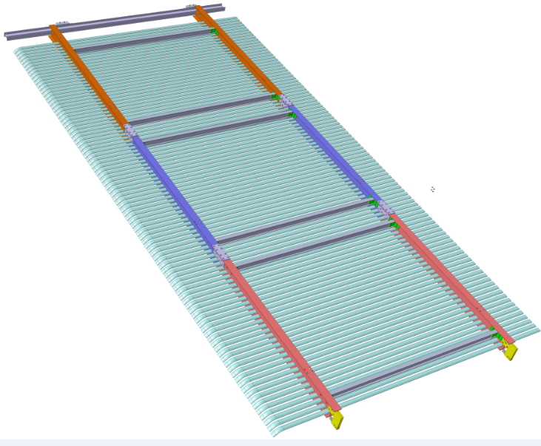
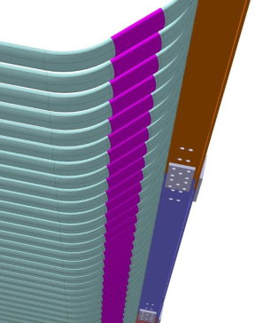
Field Cage Design
Shares common basic structural elements w/ ProtoDUNE-SP
Consists of 8 vertical modules of 6310 x 3010 m² (2 modules per detector face)
Each module is assembled out of 3 distinct sub-modules with 33, 33, and 32 profiles each held by a frame with two 6” and two 3” horizontal FRP I-beams
98 electrically continuous rings in 60mm pitch using straight aluminum clips
11 profiles with one end bent at 45 degrees are electrically connected by 2 divider boards
Inter-module connections made with FRP plates connected with FRP threaded rods
Sub-module 1
33 profiles
Sub-module 2
33 profiles
Sub-module 3
32 profiles + cathode
Continuity at center and borders w/ Al clips

Slide 4
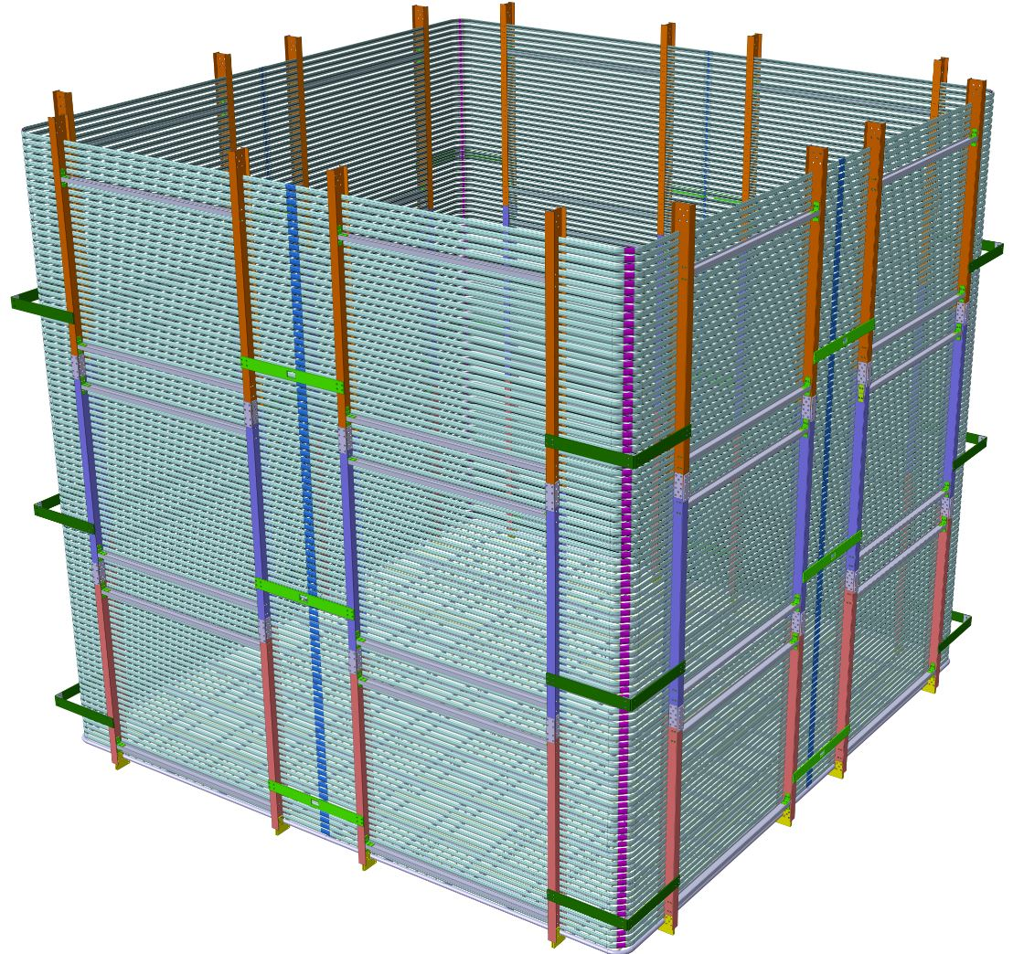
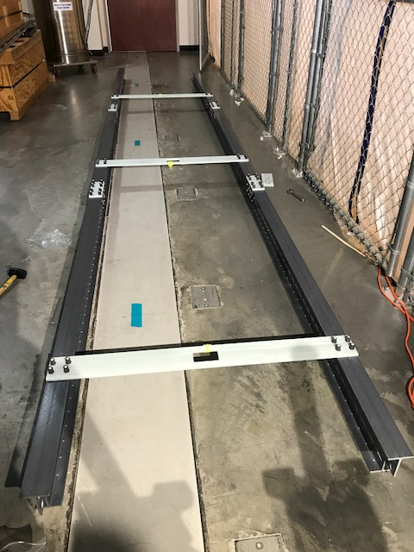
DP-FC Trial Installation Proposal
Assemble and install 3/8 of the DP-FC and test the installation procedure
One full side with two 6mx3m modules
Plus one 90 degree corner formed with an additional 6mx3m module
Connect all field shaping rings with the connecting clips and secure them with the slip nuts and screws
Connect one complete row of HVDB from top to bottom
Allow virtually all combinations of installation scenarios

Slide 5
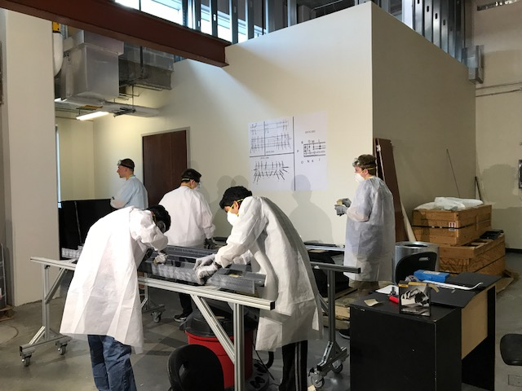
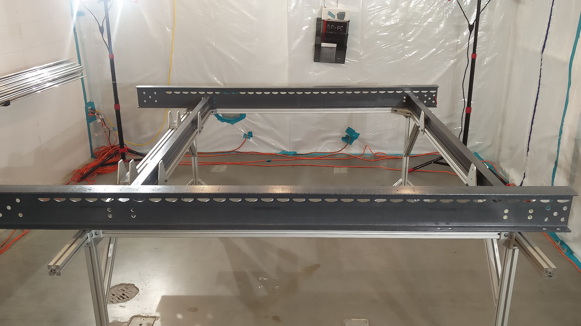
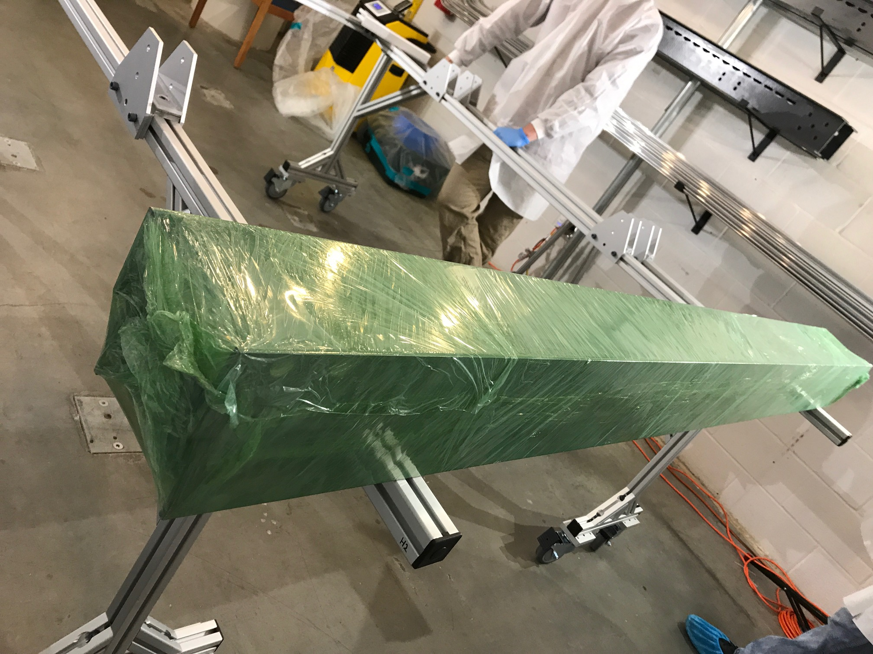
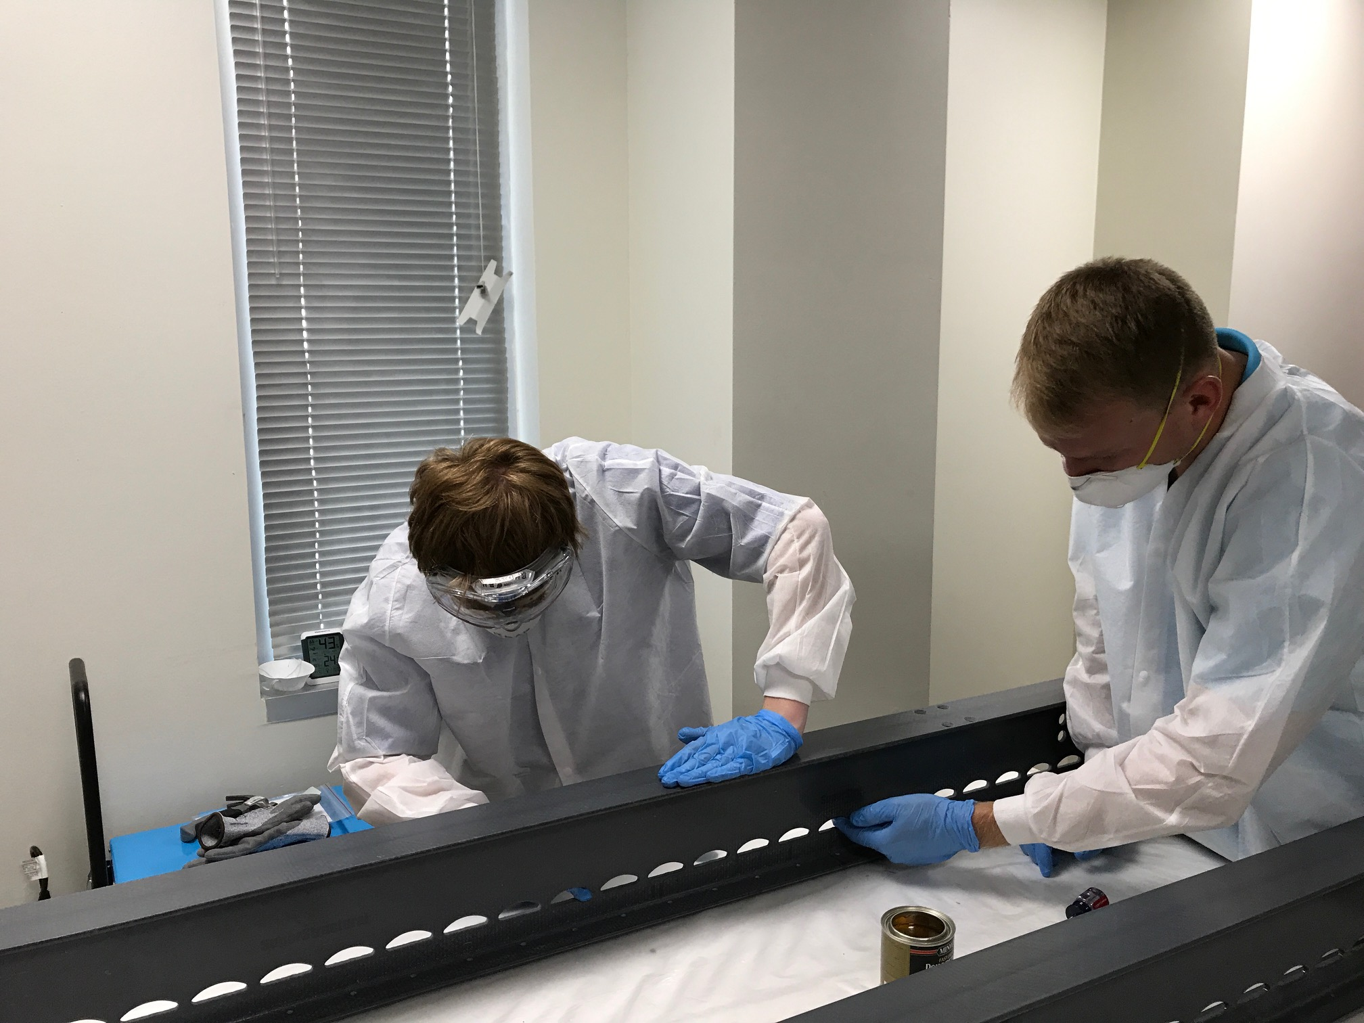
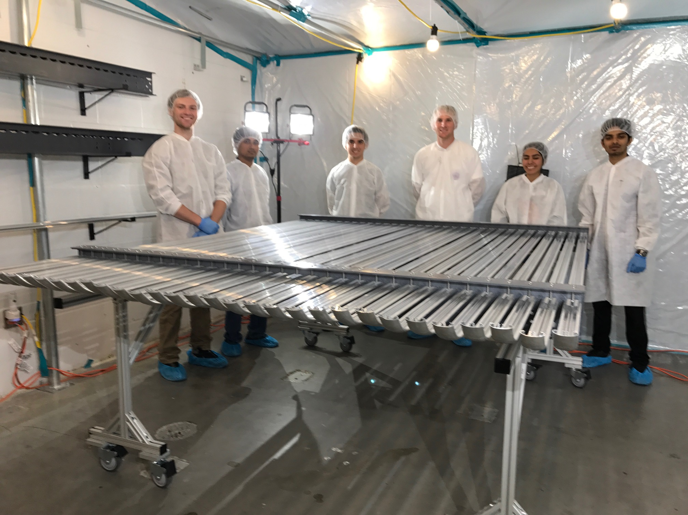
DP-FC Parts QA/QC process
Measure all critical dimensions compared to the drawings
Debur, defiber, sand, clean with simple green and varnish
Pre-assemble with the sample profiles at UTA to check the fit
Disassemble and package all parts except for the Al profiles

Slide 6
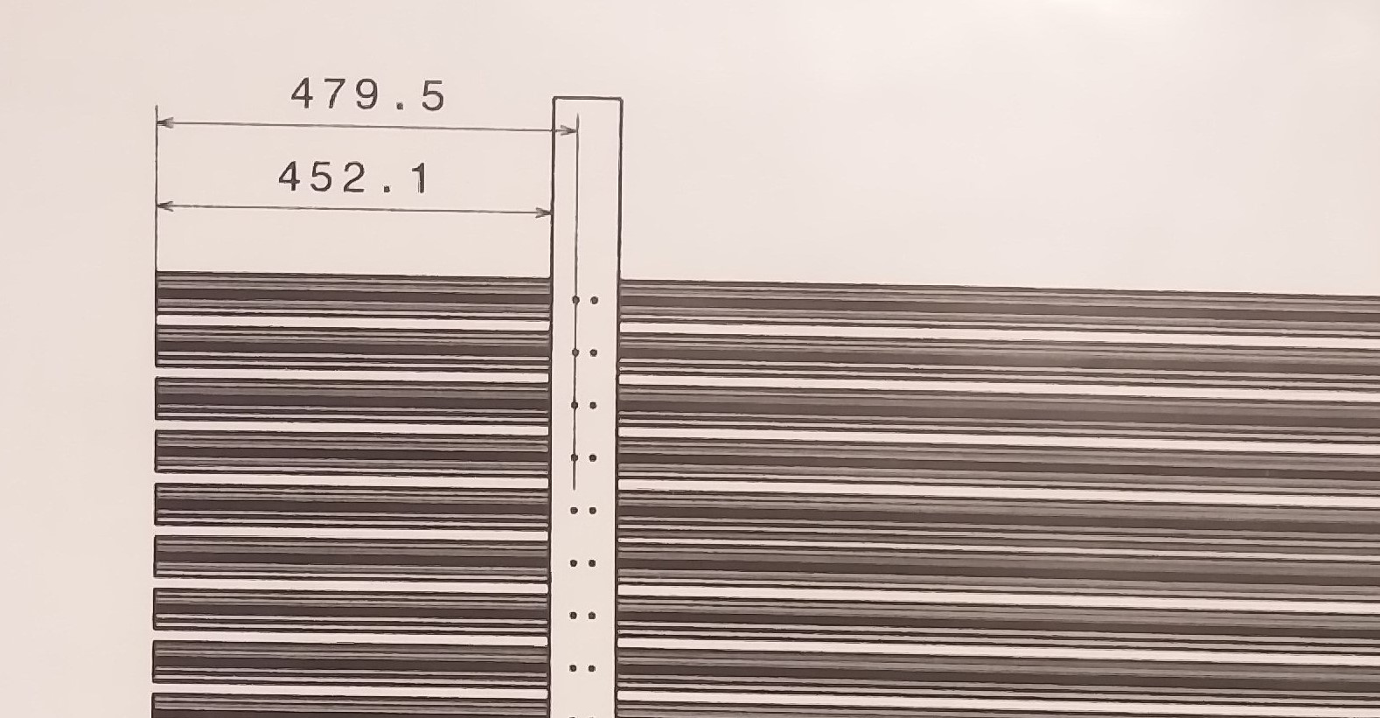
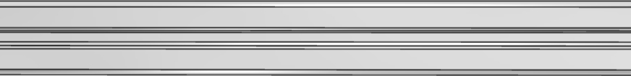
Assembly Table w/ Profile Alignment
stopper
stopper
452.1 mm
Al-Profiles will touch this frame
stopper
stopper

Slide 7
Current Status of DP-FC Part Prep
Part Number |  | Measured/ Inspected | Cleaned & Varnished
6” I-beams | DP-FC-002 | 18 (out of 18) | 7 (out of 18)
 | DP-FC-003 | 11 (out of 18) | 9 (out of 18)
 | DP-FC-004 | 18 (out of 18) | 9 (out of 18)
3” I-beam | DP-FC-008 | 46 (out of 54) | 8 (out of 54)

Slide 8
Sub-Module Delivery Schedule
Sept. 15: Complete FRP critical dimension measurements
Sept. 25: Complete FRP deburring, defibering, cleaning and varnishing
Oct. 4: Complete preassembly and packaging of the first 15 sub-modules
Week of Oct. 9: Ship the first 15 (5 of each kind) sub-modules
Oct. 20: Complete preassembly and packaging of the remaining 12 sub-modules, including the 3 spare
Oct. 27: Ship the remaining 12 sub-modules + precision assembly table

Slide 9
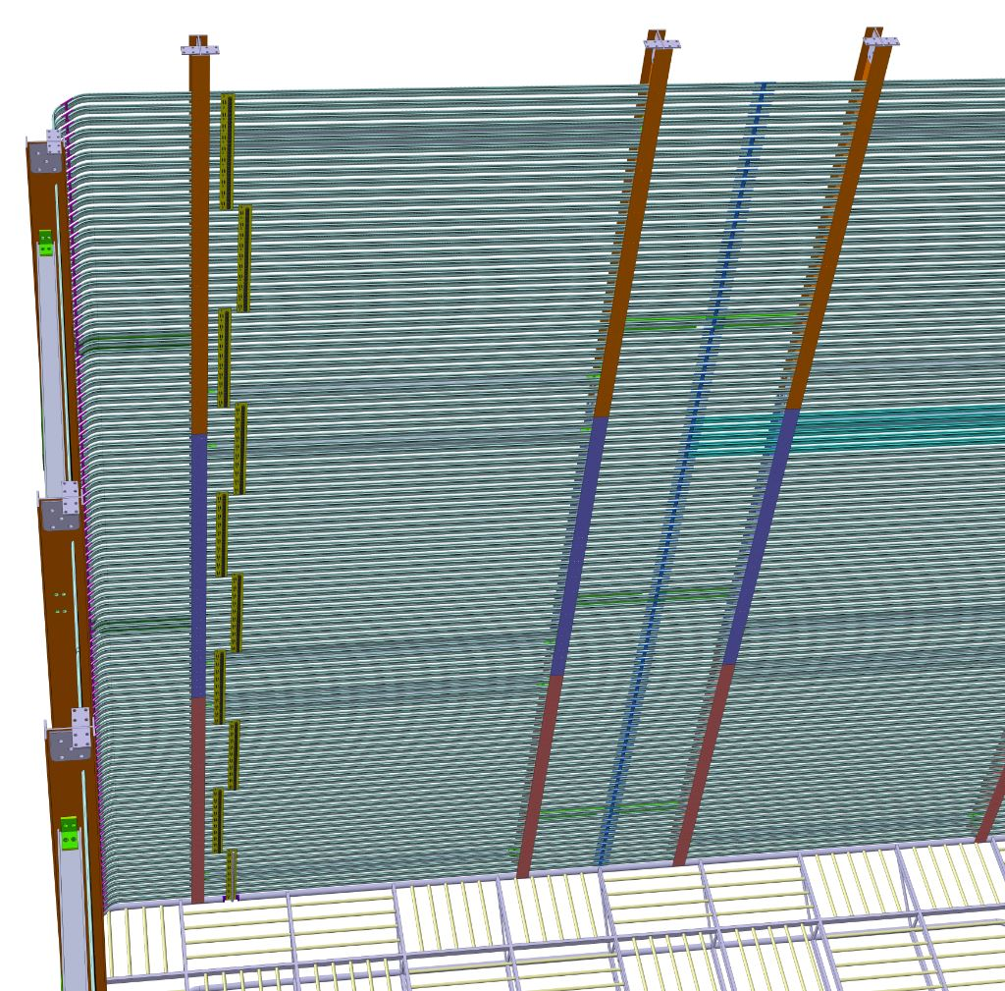
HV Divider Board Mounting to DC
Two parallel columns of 10 boards, totaling 20 boards
The total potential from the extraction grid to cathode: 294kV to 588kV
Two 2GΩ resisters each stage for each board, providing 0.5GΩ effective resistance per stage
Current through the entire circuit: 6μΑ – 12 μA (100 times the expected current from cosmic rays)
A. Gendotti

Slide 10
HVDB Preparation
Total number of boards needed: 18 long (11 profile) + 2 short (8 profile)
  Preparing 35 – 29 long and 6 short including spare
2GΩ resisters
  Total Needed: 29*20+6*16 = 676
  Total in hand: 1066 (530 qualified with 1% criteria, enough for what is needed but no spares)
    Additional order of 500 resisters placed
Varistors (1.8kV clamping voltage each)
  Total needed: 29*40+6*32=1352
  Total in hand: 1800 (expect 1440 to pass the criteria – 200mA at 1.75kV)
Anticipated completion date for testing & selection: 25/9

Slide 11
HVDB Schedule
Sept. 25: Complete testing and selection of the first batch of resisters and varistors and ship to the vendor
Sept. 28: Board delivered to the vendor
Oct. 9: First set of 18 long +2 short stuffed board delivered to UTA
Oct. 23: Complete warm and cold testing and qualification of the stuffed boards
Oct. 30: Ship 18 long + 2 short boards to CERN
Week of Oct. 30 – Week of Nov. 13: receive the remaining 11 long + 4 short stuffed boards
Week of Nov. 13: Ship the remaining 11+4 to CERN
11
Notes:
9/15/17
11
11

Slide 12
DP-FC Module Installation Sequence
Place all eight SS I-beam of the Hanging system in the nominal position on the temporary floor in the cryostat and mark the position → Bring out the five that are not needed
Connect the SS I-beam to the corresponding winches and lift it up ~2.5m
Assemble submodule inside the CRB and attach the steel reinforcement bar in its horizontal position
Connect the steel reinforcement bar to the I-beam rail, roate 90 deg fir lifting and transporting the sub-module through the TCO
Insert and secure the sub-module onto the wheeled support trolley while it is suspending from the transport I-beam crane
Position the sub-module under the hanging SS top frame bar
Remove the sub-module top reinforcement
Connect the sub-module to the SS top frame bar and lift it uo ~2.5m for the next sub-Module
Repeat procedure 3 – 8 for the other two sub-modules
12
Notes:
9/15/17
12
12

Slide 13
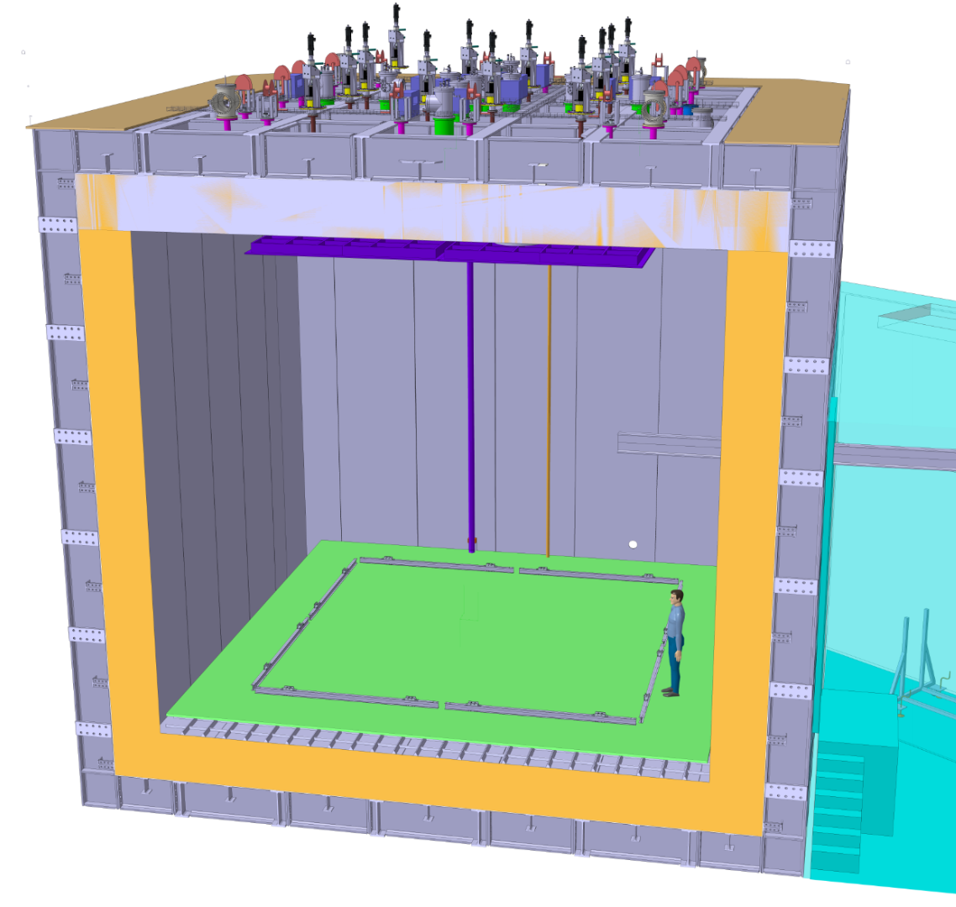
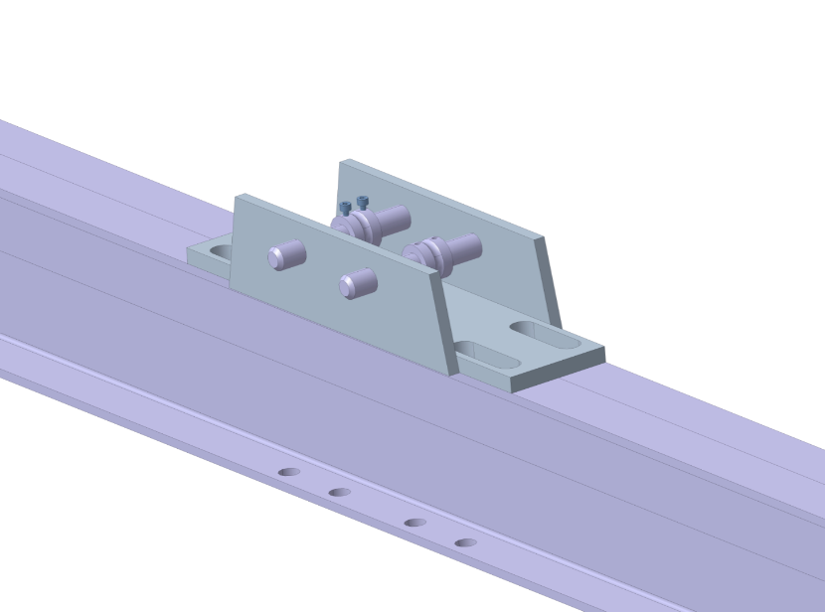
1) SS I-Beam for Hanging System
Accordingly to the position of the CRP
→ Mark the position of the field cage on the construction floor
Position the SS I-Beam (hanging system) in the right position
Lower the hanging SS wire and connect to the I-Beam → Connection point centered at the wire
32

Slide 14
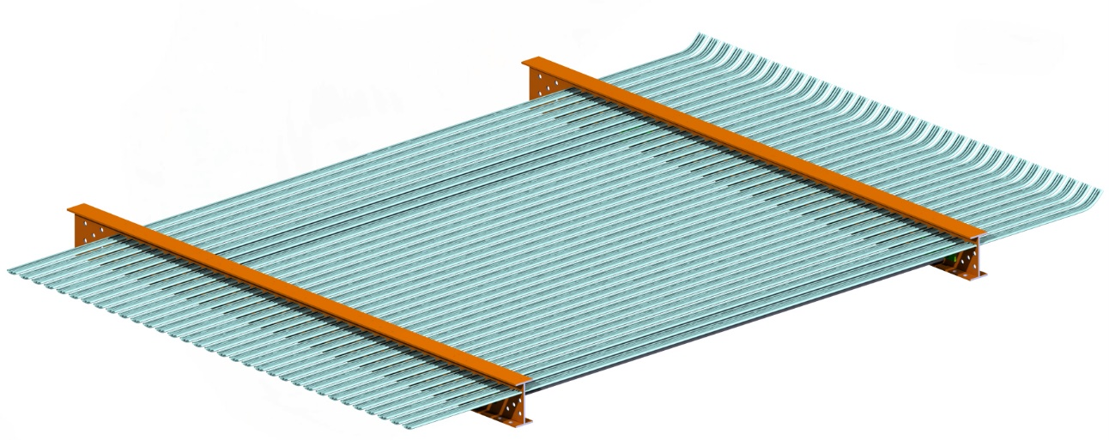
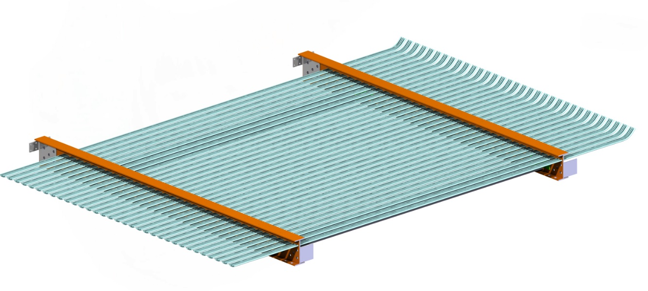
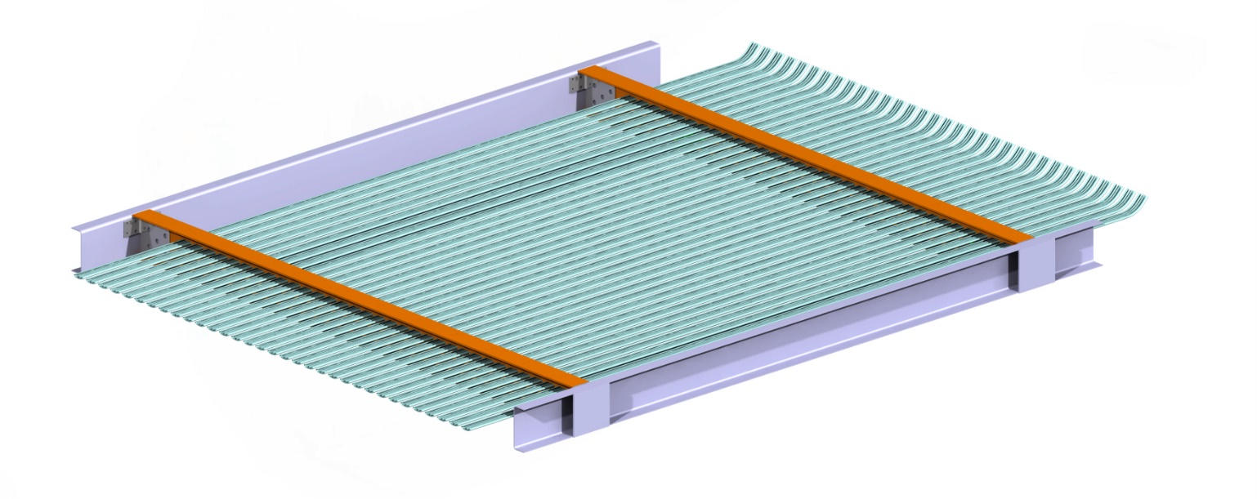
3.Assembled on the wheeled Table
4.Attach L-Profile Top and Bottom
4. Reinforcement U-Profile Top and Bottom

Slide 15
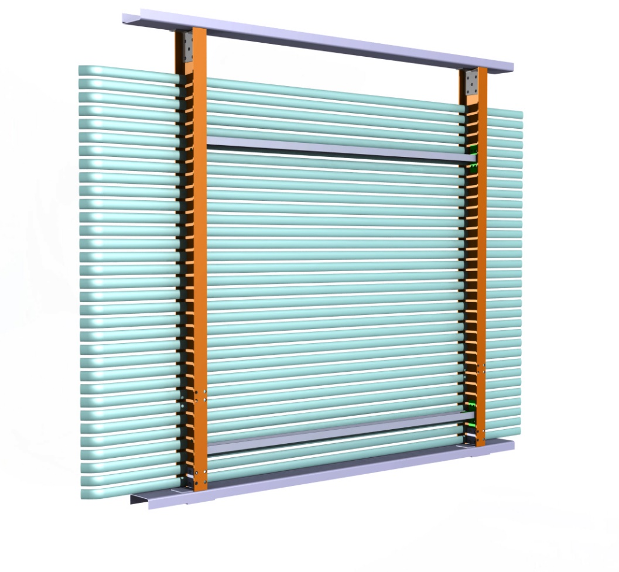
5) Sub-module transport through the TCO
I-Beam Rail

Slide 16
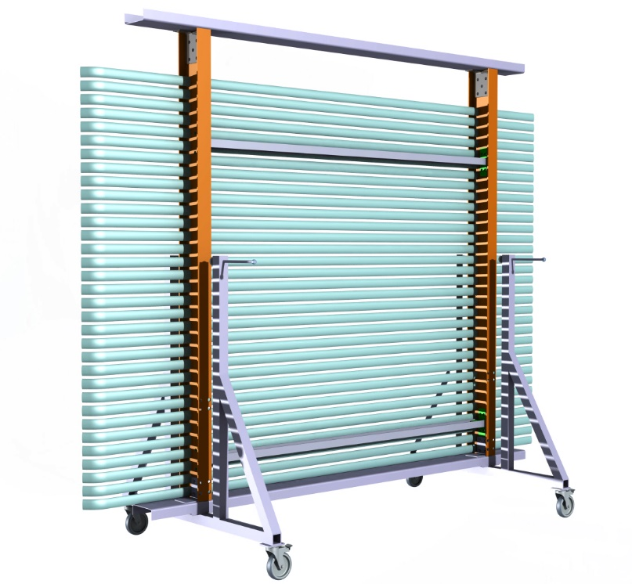
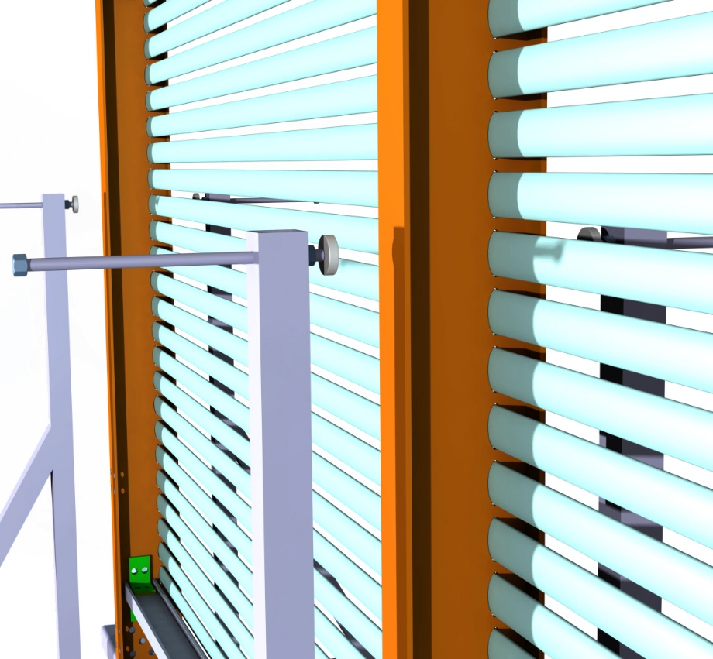
6) Wheeled trolley support
Teflon Plate for vertical stability and and vertical alignement

Slide 17
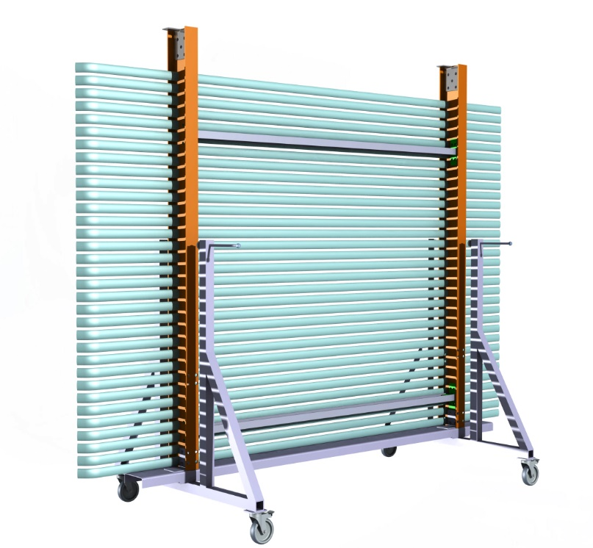

Slide 18
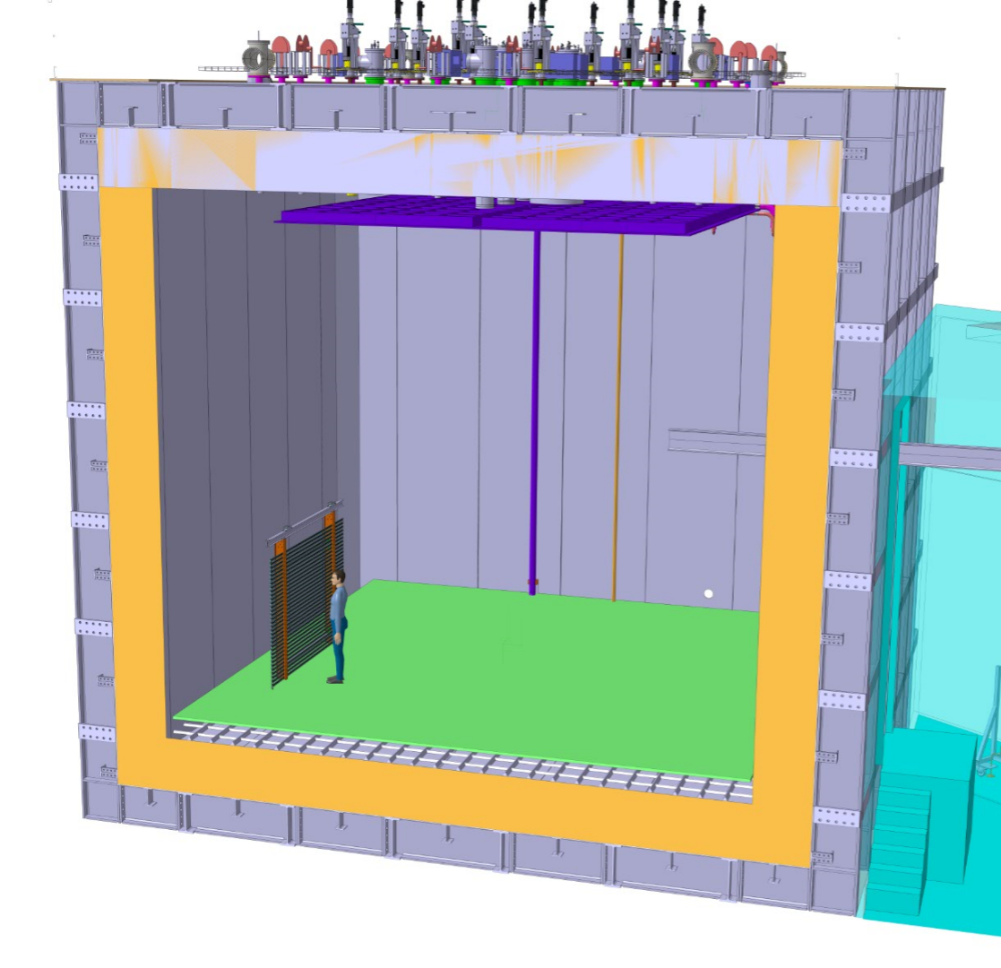

8) Connection to the SS bar of the hanging system
Lift the SS I-Beam ~2.5 m
Bring in first sub modules and connecto to hanging system
Already install the PCB boards of the HV divider (if it’s needed in module)
Sub module Installation:
2 Person on Top Lifting
3 Person inside the Cryostat
33

Slide 19
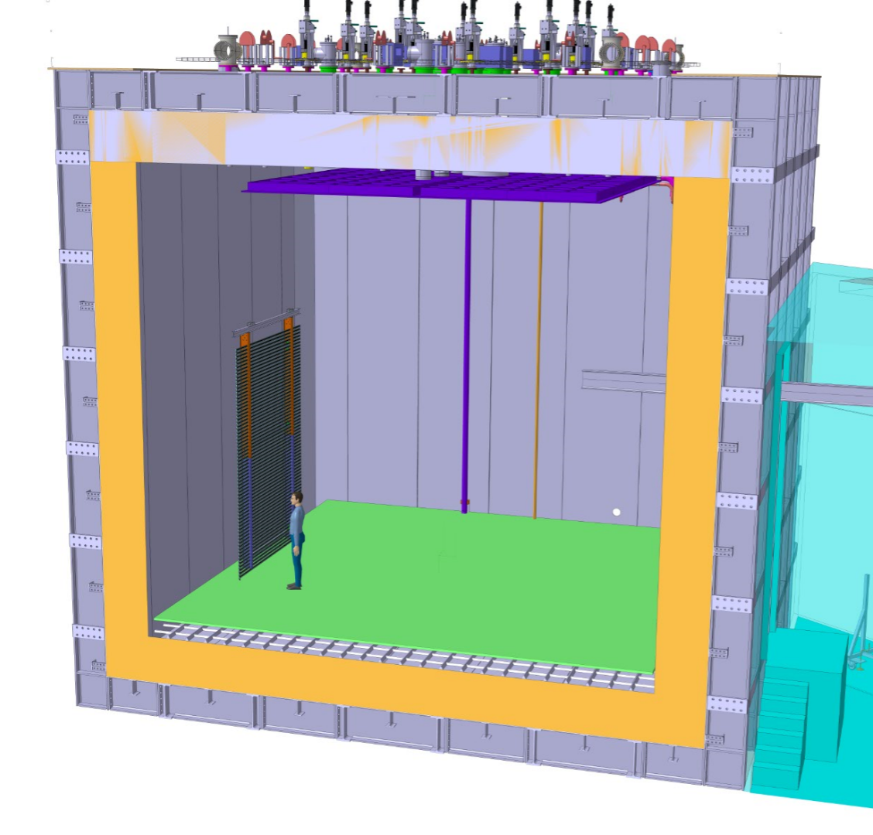
2nd Sub Module
Same for 2nd sub module
Lift for another 2.5m
34

Slide 20
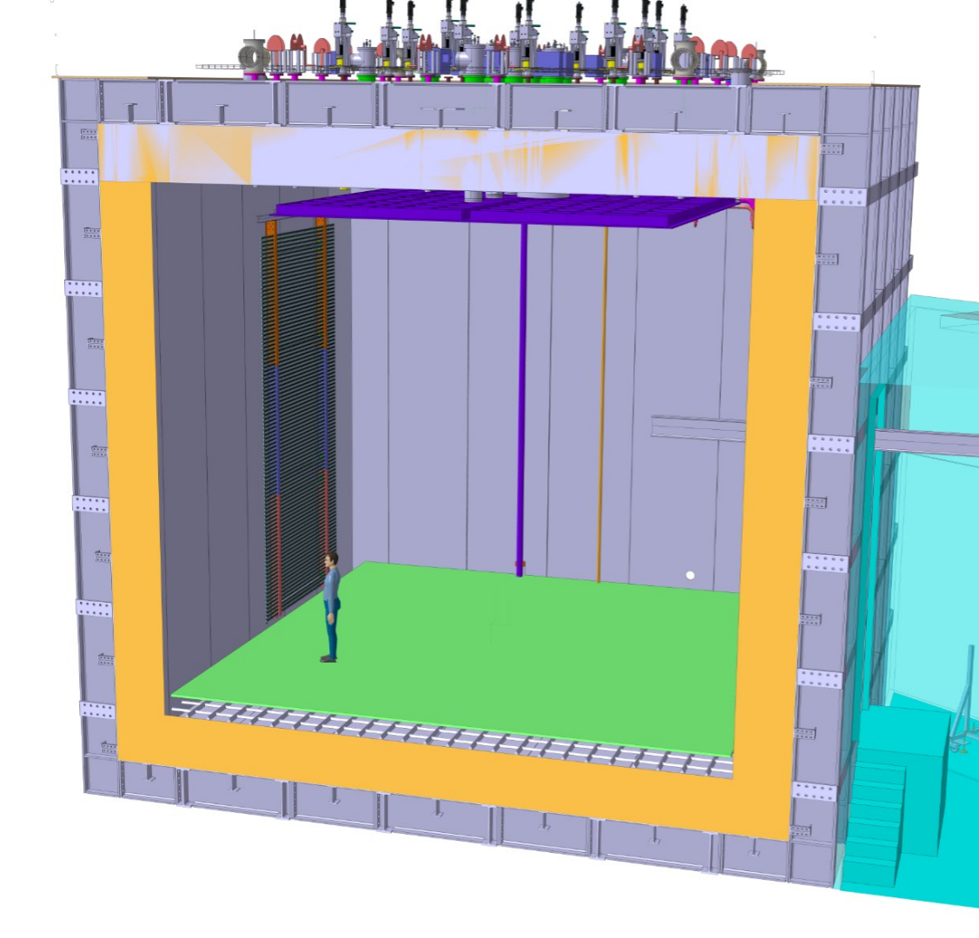
3rd Submodule
3nd sub module
Lift the entire module at his nominal position
35

Slide 21
Material Prep Matrix for Trial Installation
21
Notes:
9/15/17
21
21

Slide 22
Proposed Schedule
20/11 – 8/12: Maximum two people from UTA out to prepare and to help CERN technicians to learn sub-module assembly
30/11 – 22/12: Jae Yu coming to CERN as early as Nov. 30 and to stay through CERN shut down on Dec. 22, having one full week of overlap with the UTA people
Goal: Install 3/8 of the DP-FC – two modules on a straight section and one connected module with a 90 degree turn to explore all possible combinations of installation scenario
To the extent possible, leave the three modules of 6mx3m installed for expedited installation in 2018
22
Notes:
9/15/17
22
22

Slide 23
Summary
Proposed trial installation of three full 6mx3m DP-FC modules allow exploration of all combinations of installation scenarios
All DP-FC parts to be delivered to CERN by mid-Nov.
Up to 2 UTA people will be at CERN for 3 weeks from Nov. 20 to help prepare for this installation
Yu to join them for 1 week overlap and stay through CERN shut down for the completion of the task
Need all administrative documentations must be in place well ahead of Mid-Nov.
All training arrangements must be made to minimize time spent for these necessary preparations
All equipment needed for the task must be prepared ahead
23
Notes:
9/15/17
23
23

