Slide 1
Recent Observations

Slide 2
GW170817
Suggested by Albert
2017-08-17 12:41:04.450 (UTC)
NGC4993 (Az225.5, Alt8.3)
Dish pointed to (210, 50), no accurate record!
Fengquan was adjusting the noise source
Noise source signal too strong, system saturated?
No cylinder data
Observe NGC4993 since Sept. 3rd.
17 days later.

Slide 3
Solar X-ray Flux by GOES
Solar bursts from Active Region AR2673

Slide 4
Solar X-ray Flux by GOES
Solar bursts from Active Region AR2673

Slide 5
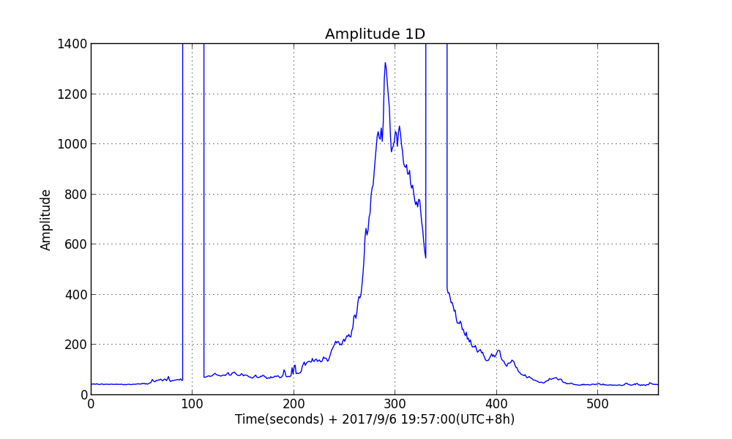
X9.3 Solar Burst by AR2673 2017/9/6 20:02 (Beijing)
Cross 7-17
Notes:
Solar burst of level X9.3 in active region AR2673 on 2017/9/6 20:02 (Beijing).
Cross-correlation 7-17.
Amplitude vs Time with all frequencies accumulated.

Slide 6
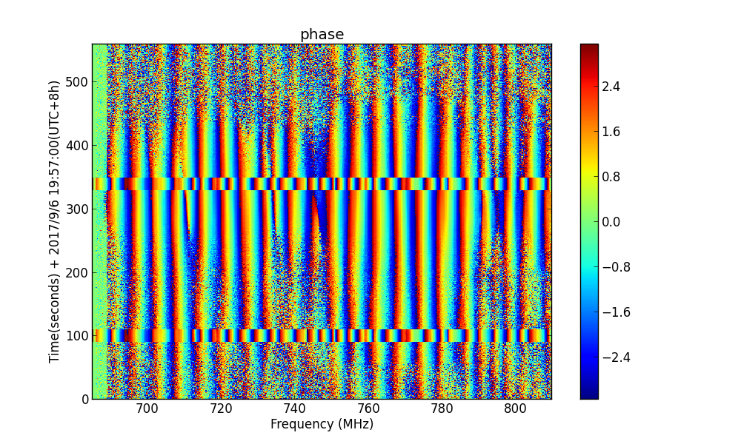
X9.3 Solar Burst by AR2673 2017/9/6 20:02 (Beijing)
Cross 7-17
Notes:
Solar burst of level X9.3 in active region AR2673 on 2017/9/6 20:02 (Beijing).
Cross-correlation 7-17.
2D phase.

Slide 7
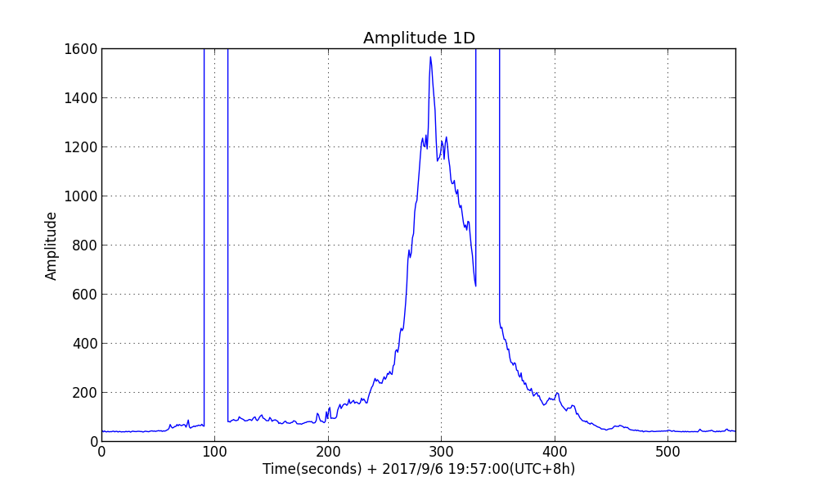
X9.3 Solar Burst by AR2673 2017/9/6 20:02 (Beijing)
Cross 3-11
Notes:
Solar burst of level X9.3 in active region AR2673 on 2017/9/6 20:02 (Beijing).
Cross-correlation 3-11.
Amplitude vs Time with all frequencies accumulated.

Slide 8
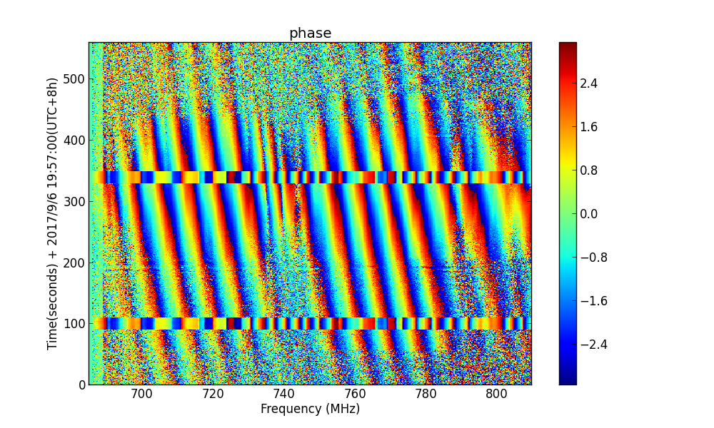
X9.3 Solar Burst by AR2673 2017/9/6 20:02 (Beijing)
Cross 3-11
Notes:
Solar burst of level X9.3 in active region AR2673 on 2017/9/6 20:02 (Beijing).
Cross-correlation 3-11.
2D phase.

Slide 9
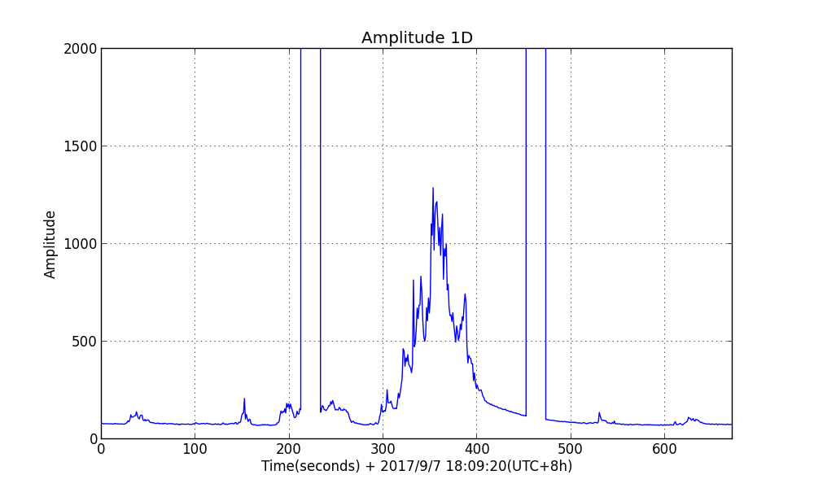
M7.3 Solar Burst by AR2673 2017/9/7 18:15 (Beijing)
Cross 7-17
Notes:
Solar burst of level M7.3 in active region AR2673 on 2017/9/7 18:15 (Beijing).
Cross-correlation 7-17.
Amplitude vs Time with all frequencies accumulated.

Slide 10
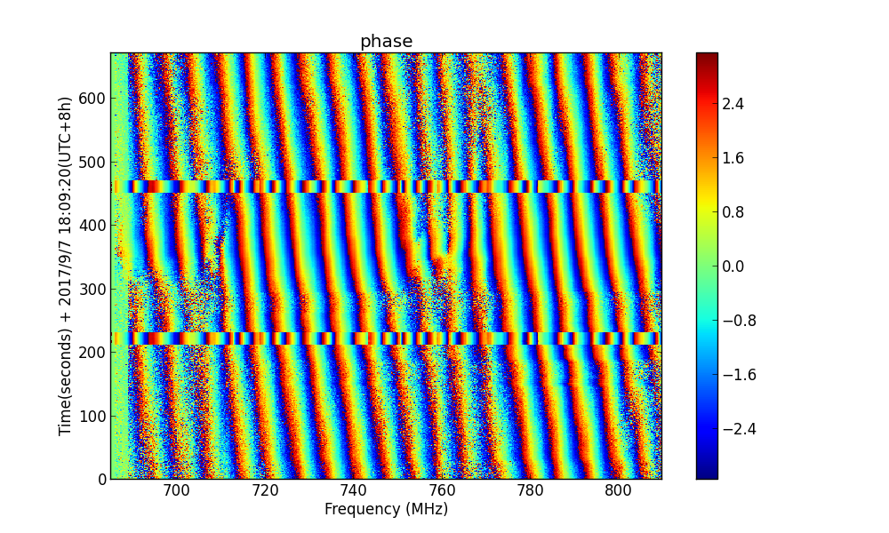
M7.3 Solar Burst by AR2673 2017/9/7 18:15 (Beijing)
Cross 7-17
Notes:
Solar burst of level M7.3 in active region AR2673 on 2017/9/7 18:15 (Beijing).
Cross-correlation 3-11.
2D phase.

Slide 11
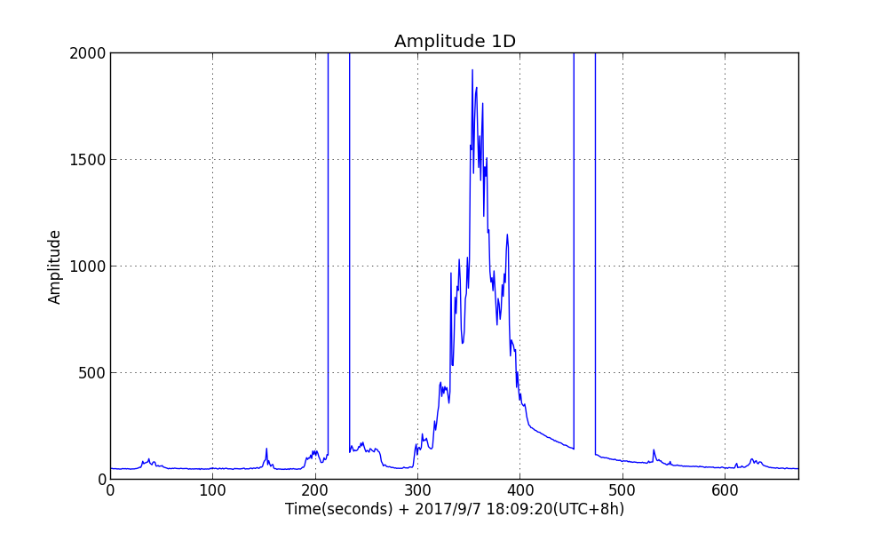
M7.3 Solar Burst by AR2673 2017/9/7 18:15 (Beijing)
Cross 3-11
Notes:
Solar burst of level M7.3 in active region AR2673 on 2017/9/7 18:15 (Beijing).
Cross-correlation 3-11.
Amplitude vs Time with all frequencies accumulated.

Slide 12
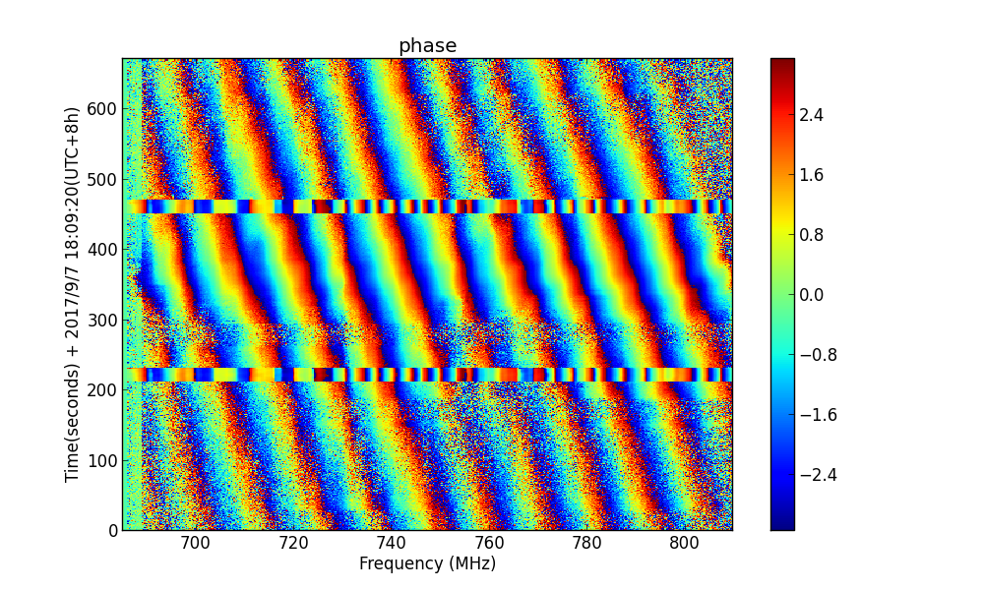
M7.3 Solar Burst by AR2673 2017/9/7 18:15 (Beijing)
Cross 3-11
Notes:
Solar burst of level M7.3 in active region AR2673 on 2017/9/7 18:15 (Beijing).
Cross-correlation 3-11.
2D phase.

Slide 13
X-ray Flux by GOES
M8.1 burst at 2017/9/8 07:49 UTC was not seen???

