Slide 1
PIP-II Project Manager’s Report
Steve Holmes
PIP-II Project Management Group
20 September 2017

Slide 2
Outline
Goals
Financials
ES&H/NEPA
Technical/R&D
India Collaboration
Project Management
CD-1 Status

Slide 3
Project Goals
Milestone | Planned | Actual or Forecast
CD-0 | Q1 FY2016 | November 12, 2015 (A)
CD-1 | FY2017 | Q2FY2018
CD-2/3a | FY2019 | FY2019
CD-3 | FY2020 | FY2020
CD-4 | FY2026 | FY2026
CD-1 profile as receive from OHEP on July 17
For the Director’s Review we will use the technically limited profile coming from P6
We need agreement with OHEP on the profile to use for the DOE Review by the end of the Director’s Review

Slide 4
Goals for FY17 (unchanged since July PMG)
Goal is to achieve CD-1 in ~January 2018
RLS
ICR
Documentation
Financial Goals – on track
Live within the provided budget: $21.03M (includes FY16 carryover)
Cross the FY17/18 border with ~$2.0M unobligated (carryover)
ES&H Goals – on track
Be prepared to initiate Environmental Assessment on 10/1/17
R&D Goals – on track
Release CDR
Complete PIP2IT MEBT
Keep HWR and SSR1 on track for CY2018/19 delivery
India Collaboration Goals - delayed
Meet 2017 deliverable milestones
Establish confidence between the partners
Management Goals -delayed
Complete all CD-1 documentation and successfully navigate required reviews
Fill missing positions on organization chart

Slide 5
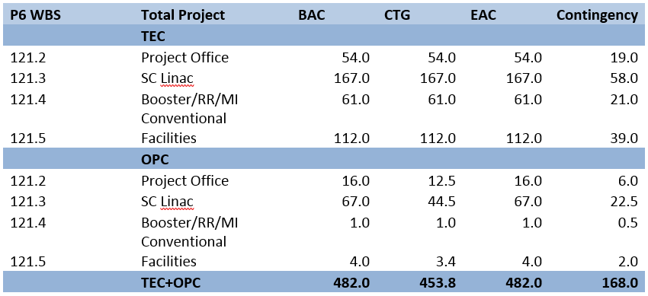
Financials (inception through 7-31-17)
Spending since CD-0
OPC/Project Office, ConvFac, and SC Linac are only areas of activity to date
5.9% complete

Slide 6
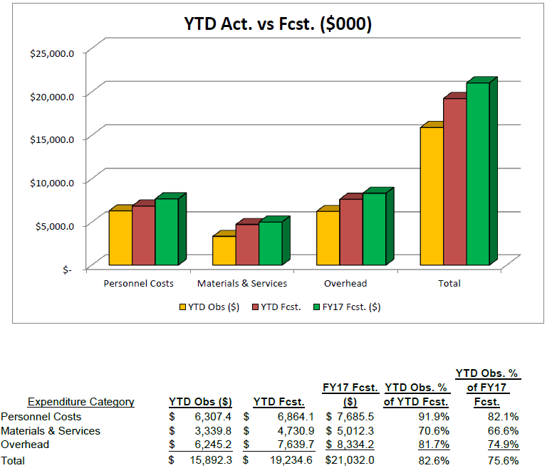
FY17 Financials (through 8-31-17)
RIPs: $760K

Slide 7
FY17 Financials
Current (Sep 10) forecast is ~$3.6M underrun
2.6 FTE/$900K SWF
This estimate has held steady for last several months
$1.4M M&S
Activity slowed noticeably as engineers starting working on BOEs and RLS over last two months
Underrun is delayed procurements, not things coming in under budget
So we will be spending this money in FY18
$1.3M OHD
Expect to cross the FY17-18 boundary with ~$1.0M RIPs

Slide 8
FY18 Financials
FY18 could lie anywhere in the range $14-24M
We have provided DOE with a plan for $20M
63.0 FTE (compare 50.3 in FY17)
$4.3M M&S (compare $4.7M in FY17)
($431K) Management Reserve
Major procurement on next slide

Slide 9
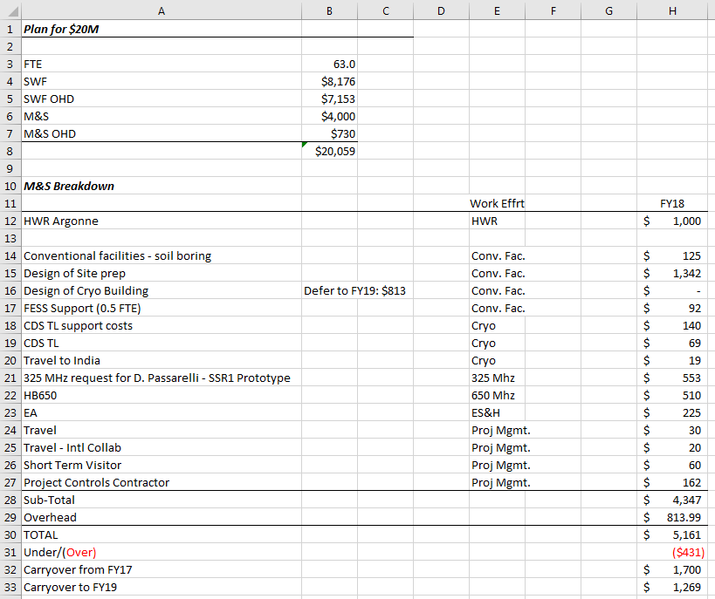
FY18 Financials

Slide 10
ES&H/NEPA
Wetlands Jurisdictional Determination
In process with USACE
If accepted, the wetlands located in the PIP-II footprint would be designated non-jurisdictional
If denied, a new wetlands permit application would be submitted in FY2018 to allow USACE the 1 year review period in order to meet a PIP-II start work date of late FY2019/early FY2020.
Environmental Assessment
Purchase Requisition/Scope of Work is in the system
RFP released Sep 19

Slide 11
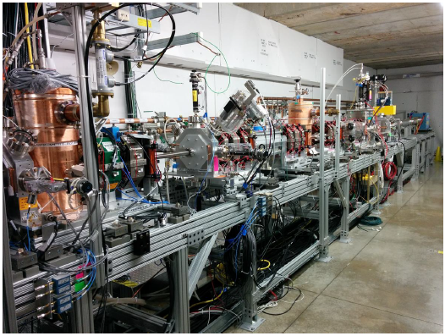
Technical/R&D Status
PIP2IT
2017 goal to complete MEBT and commission with beam
5 mA × 1 ms × 20 Hz to dump
Measure kickers’ effects on the beam
Completed installation of
MEBT in early August
Beam to end of MEBT
Considering designating
200 Ω kicker as baseline
FY17 goals met

Slide 12
Technical/SRF R&D Status
SSR1
Dressed cavities have been showing FE in full power tests (at STC)
This is delaying the SSR1 schedule
Reprocessing/retesting of cavities
S112 qualified w/ unity (low power) coupler; retesting with high power coupler
S113 failed to overcome MP barrier at 9 MV/m
HB650
Goal is to qualify and dress four cavities in FY17
Two cavities are qualified
One ready for retest; other being prepared for retest
Awaiting access to VTS
RRCAT prototype cavity fabricated; should go to processing (@RRCAT) this week
Couplers
New RFQ coupler design has been completed and reviewed
Procurement initiated
HB650 couplers contract award imminent
Best value procurement with pre-qualified vendors

Slide 13
Project Management/CD-1 Strategy
We have concluded it is not possible to keep the TPC/UCR <$700M, and that keeping the TPC/UCR <$750M requires removal of the Recycler/Main Injector scope
Risks of retaining or removing Recycler & Main Injector from scope:
On project: TPC/UCR will exceed $750M. CD-1 will have to go to undersecretary who is either acting or new on the job. Risk is that it will take a while to get approval
Off project: Recycler/Main Injector scope is required to meet Mission Need Statement (1.2 MW). Risk is that the money required for RR/MI will not materialize
Where we stand as of Friday: Point Estimate = $638M
Recycler/Main Injector out of scope
Based on technically limited schedule – funding profile unconstrained
$33M actual cost to date + $605M estimate to complete
Includes 23.1% estimate uncertainty
10% risk uncertainty
May still be some adjustments to this number (either direction)
Upper cost range derived from this:
$729M @ 15% maturity premium
$759M @ 20%
$789M @ 25%
It appears unlikely we can keep the UCR < $750M beyond the Director’s Review
Any draw out in the schedule adds about $15M/year
For example, to align with funding profile provided by OHEP
Unlikely DOE will accept 15% multiplier to get from point estimate to UCR
Each % increase adds ~$6M to UCR
Once we break $750M there is no rationale for keeping Recycler/Main Injector off project
Adds about $30M to UCR

Slide 14
Project Management/CD-1 Strategy
Review Timeline
Director’s Review October 10-12
DOE IPR Dec 12-14 (backup Nov 28-30)
DOE/ICR Dec 4-7 (site visit)
ESAAB (CD-1) January/February 2018
Director’s Review Timeline:
RLS complete for cavities/cryomodules: Wednesday, Sep 20
RLS complete for everything else Friday, Sep 22
BOEs complete/aligned with RLS (P6) Monday, Sep 25
Rehearsals Sep 25-29
Talks posted Oct 3

Slide 15
RLS Status
Close to be checked against BOE data
Partially resource loaded
High level plan to be integrated in P6
Advanced integration
To be completed
CLOSED - BOE=P6
Advanced integr.
CLOSED → 43 BOEs

Slide 16
Project Management/CD-1 Documentation Status
CDR - Done
Assumptions Document - Done
PIP-II FRS - Done
Alternatives Analysis Report - Done
Alternatives Determination letter - Done
Lab MOU/interface document – in process
Preliminary Hazard Analysis Report – Done
Quality Assurance Plan – in process
PSVAR – Done
ISM – Done
NEPA Strategy – Done
Risk Management Plan – Done
PMP – Draft (not required by DOE413.3)
Procurement Management Plan - Draft (not required by DOE413.3)
PPEP – Done? (DOE document)
Acquisition Strategy – Done? (DOE document)

Slide 17
India Collaboration
Joint R&D Project Document
Addendum II: Documentation of Fermilab engineering deliverables.
DAE responded with 12 pages of comments to my July 5 proposal.
Addendum I: Modification to DAE deliverable dates to reflect delays in R&D program to FY2020
DAE to make Addendum I consistent with Addendum II
HTS-2 cryostats P.O. has now been issued by RRCAT
Visitors
Authorization to restart the long- and short-term visitors programs has been give to the Technical Coordinators
They have proposed six assignment they would like filled in the next cohort
We are discussing and will propose some modification
Shooting for arrival in early 2018
Exports
Procurement of MOSFETs for SSR1 RF sources is becoming critical
Identified potential distributor willing to sell with BARC as end user
Discussion with SC (Mike Salamon) on modification to DOC entities list
He will discuss possibility with DOC
SSR1 cavities
Leonardo Ristori and Paolo Berrutti visit rescheduled to first week in November:
Witnessing of SSR1 He vessel welding
Review of SSR2 cavity design
We have advised DAE that we need these cavities on the Fermilab site by December 31, 2017 in order to incorporate into the prototype SSR1 cryomodule
IIFC Meeting
Moving meeting to Fermilab, immediately after the DOE Review, expected in December

Slide 18
Summary
Moving toward CD-1, with a newly-modified plan
Acceleration by ~2 months has been challenging
Director’s Review now Oct 10-12
Recycler/Main Injector off-project for this review
Schedule is technically limited – not matched to DOE profile
Believe we are heading for >$750M (major system) by time of DOE review
India collaboration is taking a lot of attention
But have not had much time on this lately
(Although weekly teleconference is continuing)

