Slide 1
Summer Shutdown Status
9/18/17
Cons Gattuso

Slide 2
Proton Source Shutdown Work list
RIL 100% complete
Source maintenance
Einzel Lens maintenance
RFQ maintenance
General maintience
Linac
Marx modulator project ~65% complete
Fabrication and Testing underway
Planning to installed 2 modulator in 2017
Duration ~6-7 Weeks for the removal of old and installation of new
LE tasks (performed by Linac techs) ~90% complete
Modulator/driver maintenance
Inductrol maintenance
Water skid maintenance
HE tasks (performed by Linac techs) ~90% complete
CS & PFN maintenance
PFN cap bank maintenance
QPS PM
Water skid maintenance
Heat exchanger maintenance
Booster
BRF21 and BR22 installation
~6-8 weeks ~95% complete
IPM Installation ~90% complete
Controls Rack installation
Tunnel component installation
General Maintenance ~85% complete
Power supplies
Cooling Systems
Vacuum

Slide 3
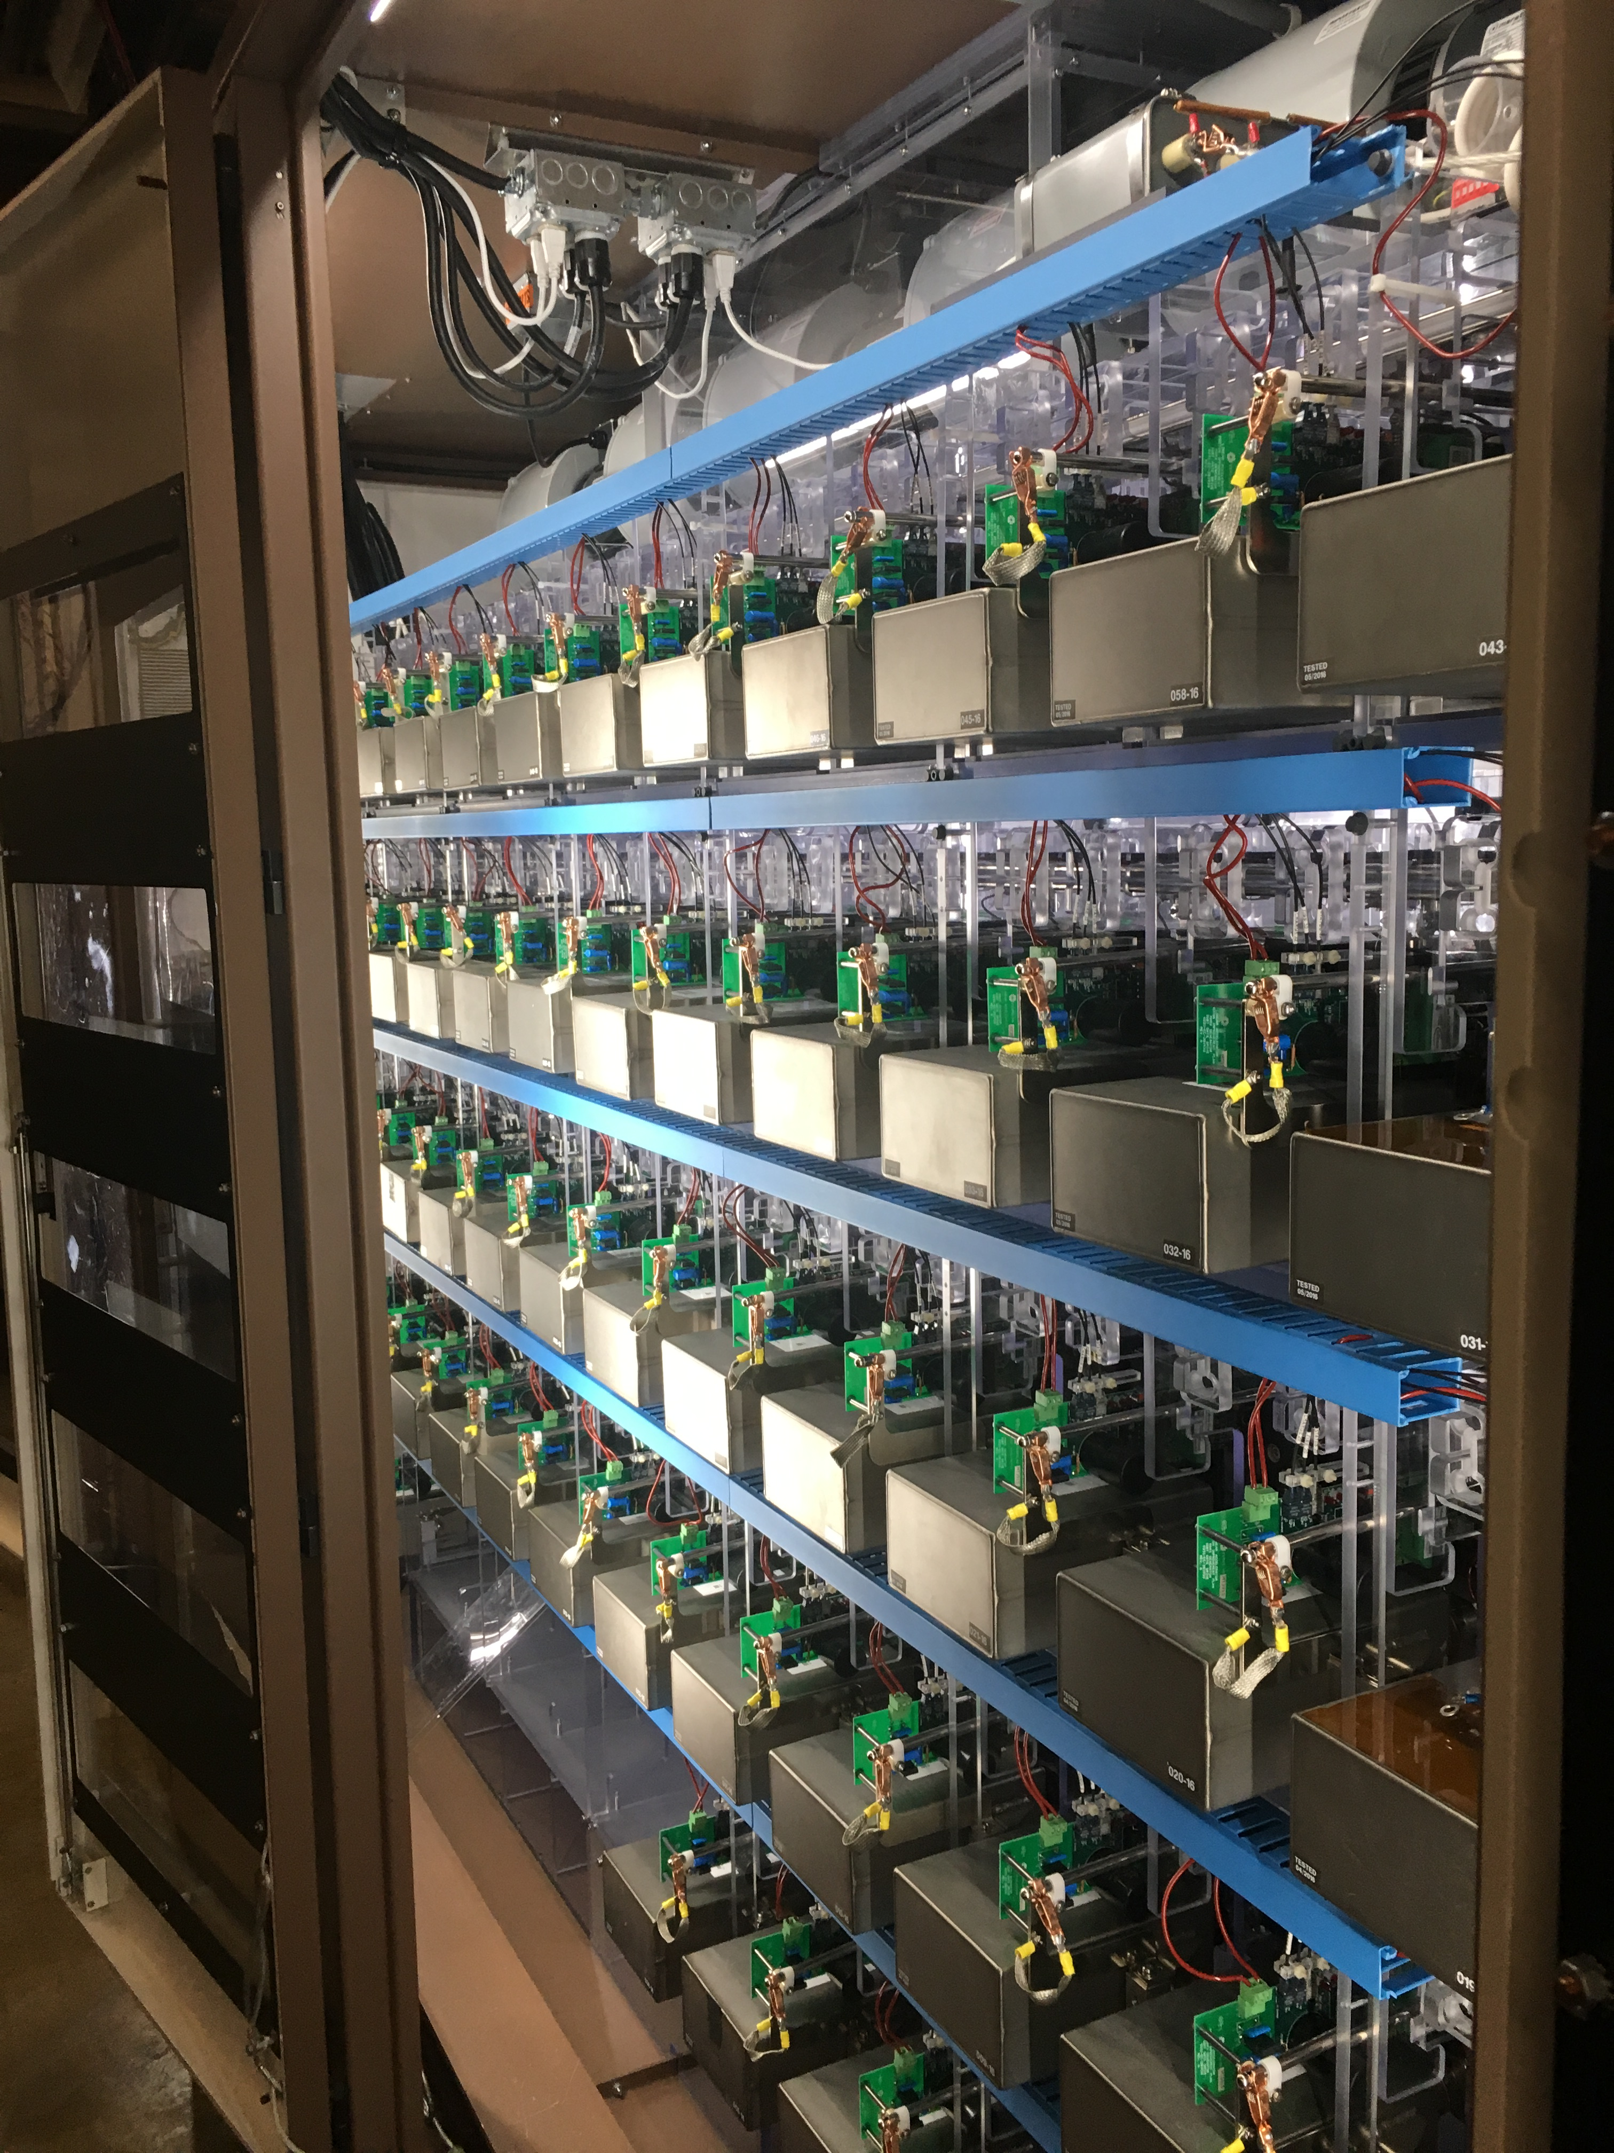
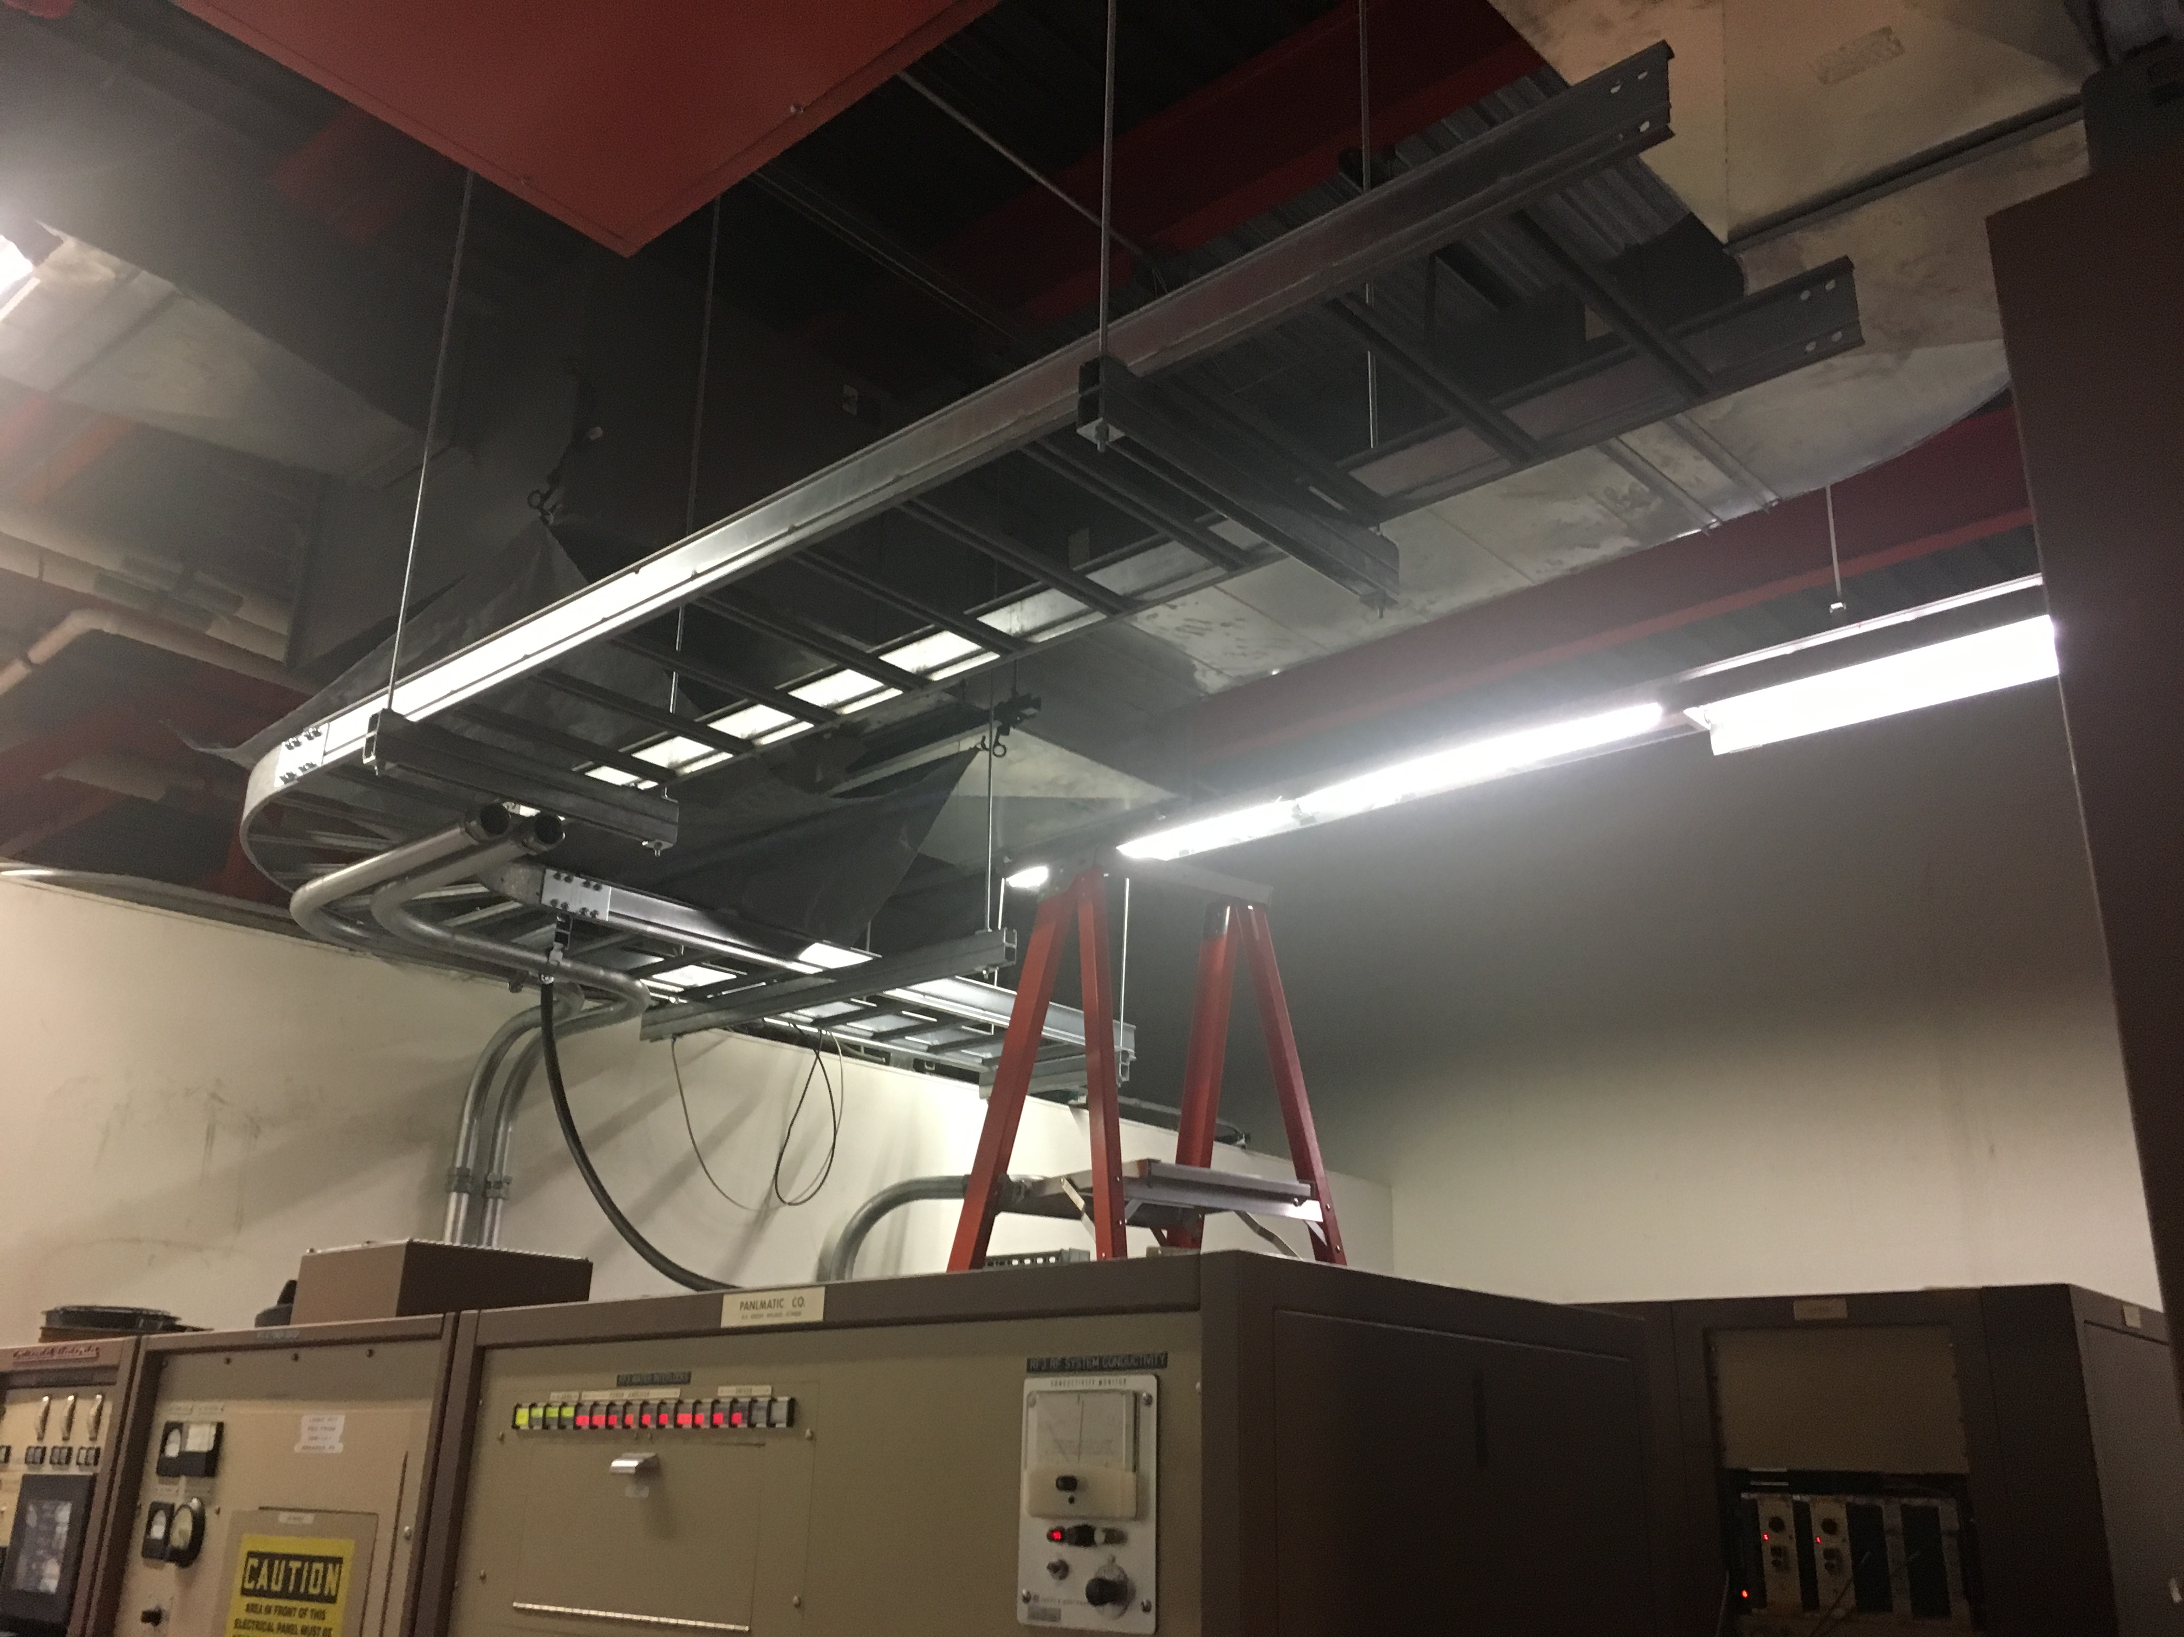
LRF2/LRF3
LRF3
LRF2

Slide 4
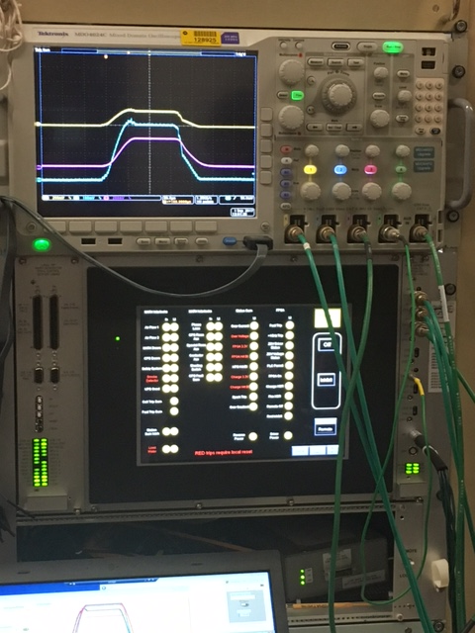
LRF2 Marx Modulator Commissioning

Slide 5
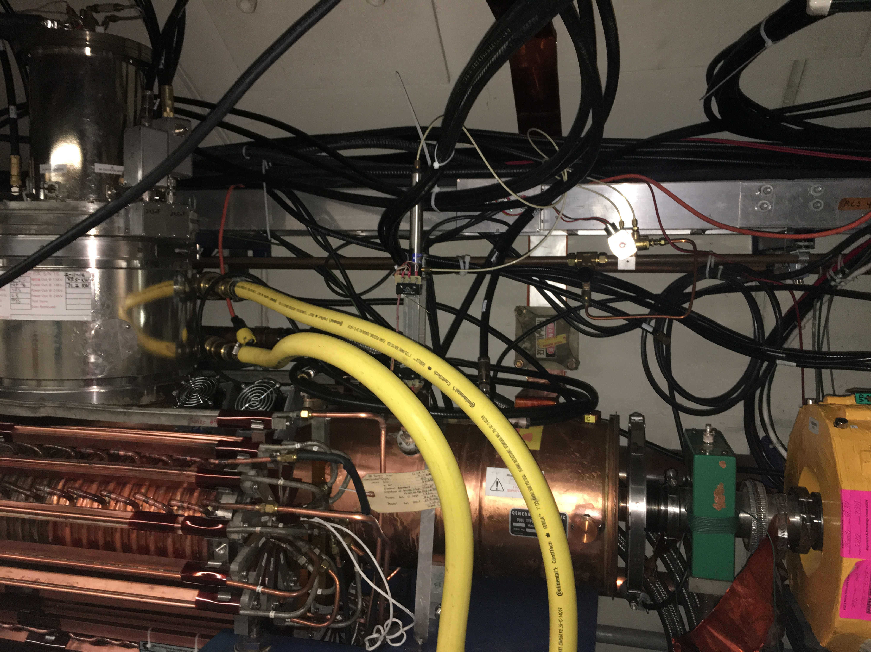
BRF22

Slide 6
Main Injector/Recycler
MI
Replace MI RF station 4 ~15% Done
~1.5-2 weeks
Ion pump maintience ~90% Done
~1-2 Weeks
8 Gev line
Ion pump replacement ~100% Done
~1-2 weeks
Vacuum leak check~100% Done
~1-2 Weeks
Multi wire replacement (2)
~1 Week -Cancelled
General maintience for MI/RR ~70% Done
~2-3 weeks
Tunnel and service building
Replace the beam pipe in Q504 -95% Done
Vacuum leak on BPM feed through
Switching Flourinert in the MI-10 and 60 kicker systems 100% Done
Replacing FC-77 to FC-40
RR
TSP upgrade from 106-229 -~100% done
10-11 weeks
Aperture improvement at the RR 402 and 520 locations
~3 weeks at the 402 – ~5%Done
~1.5 weeks at the 520 ~75% Done
Recycler Abort lamberstons replacement
~3 weeks at the 402
Recycler Sextupole stand change out ~100% Done
~3 weeks
New Pinger installation in the 10 region ~5% Done
Rebuilding and putting back into operations RRRF Anode power supply ~50% Done

Slide 7
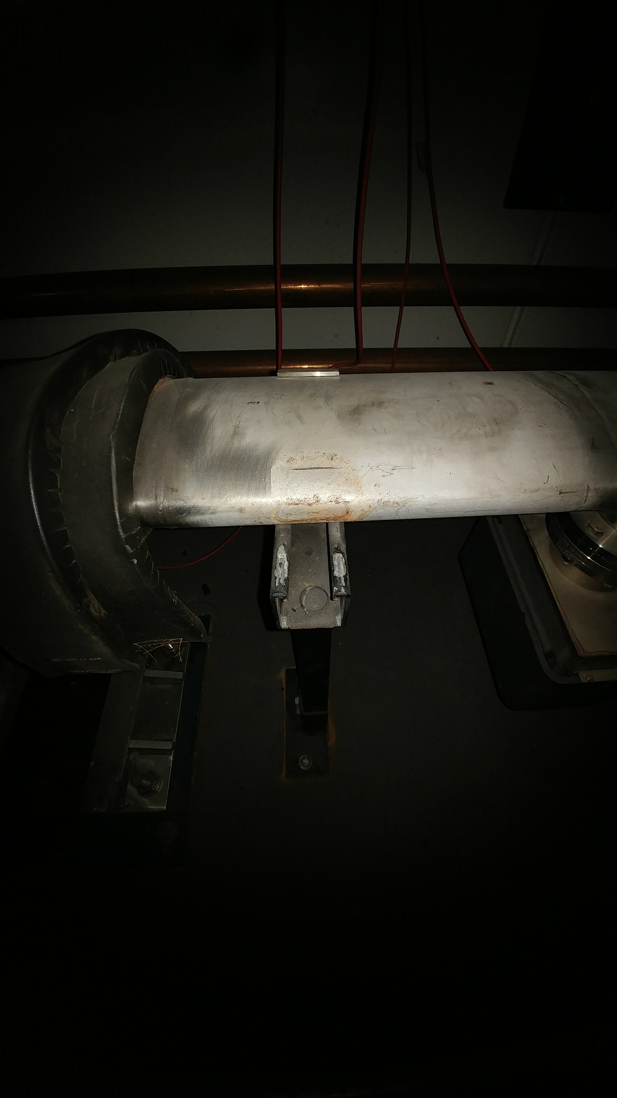
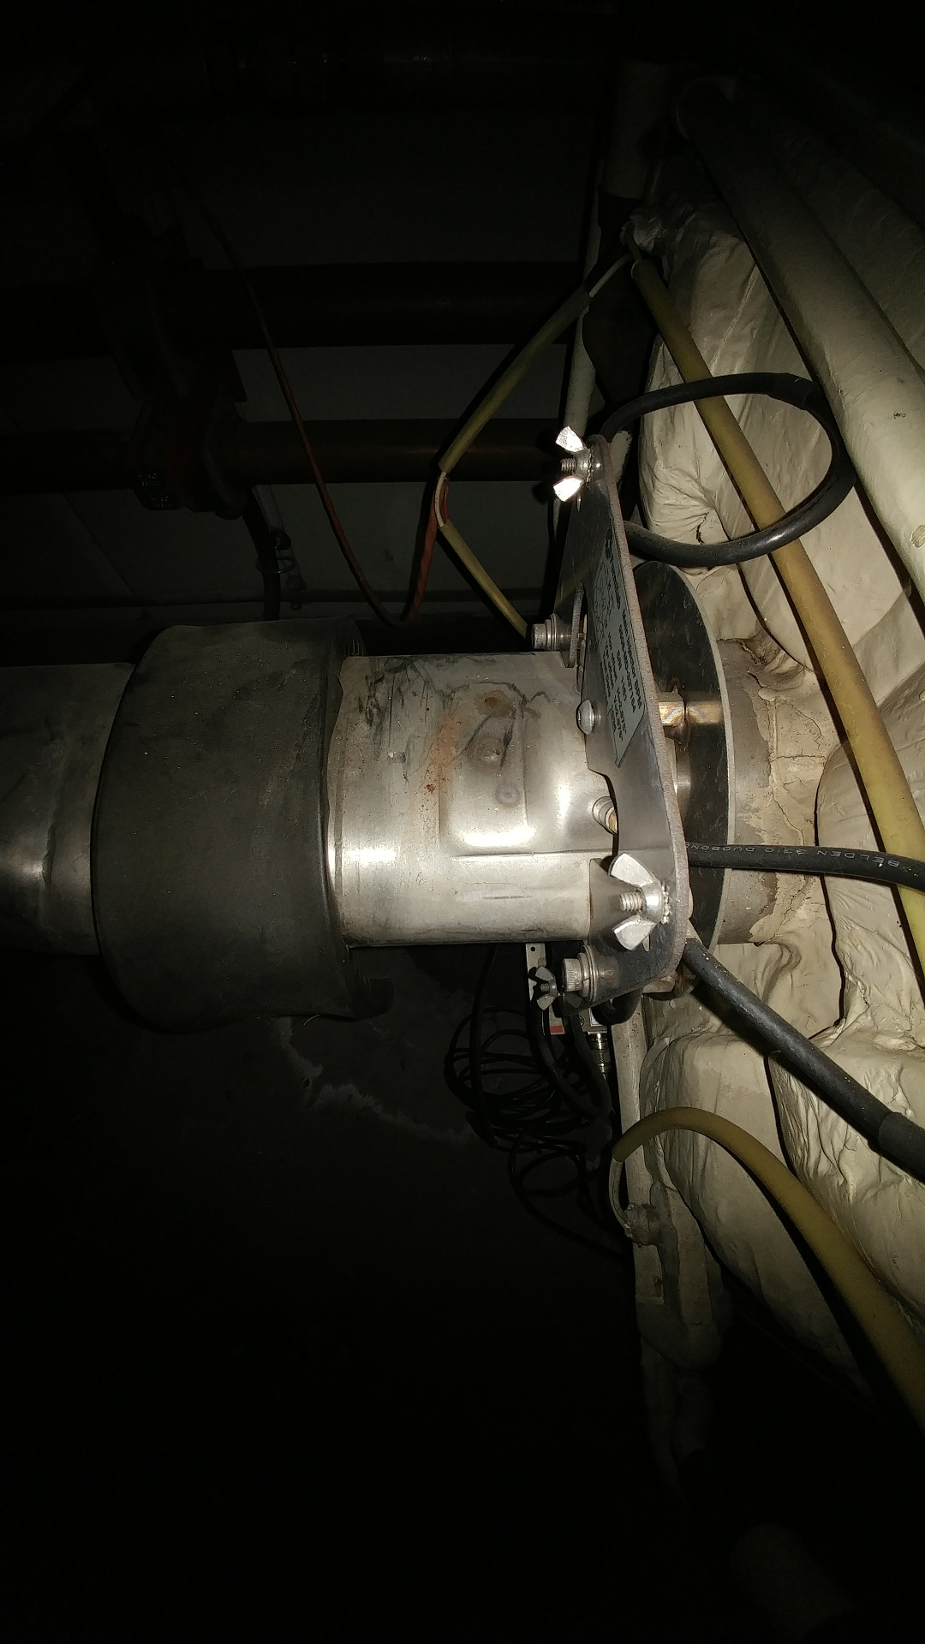
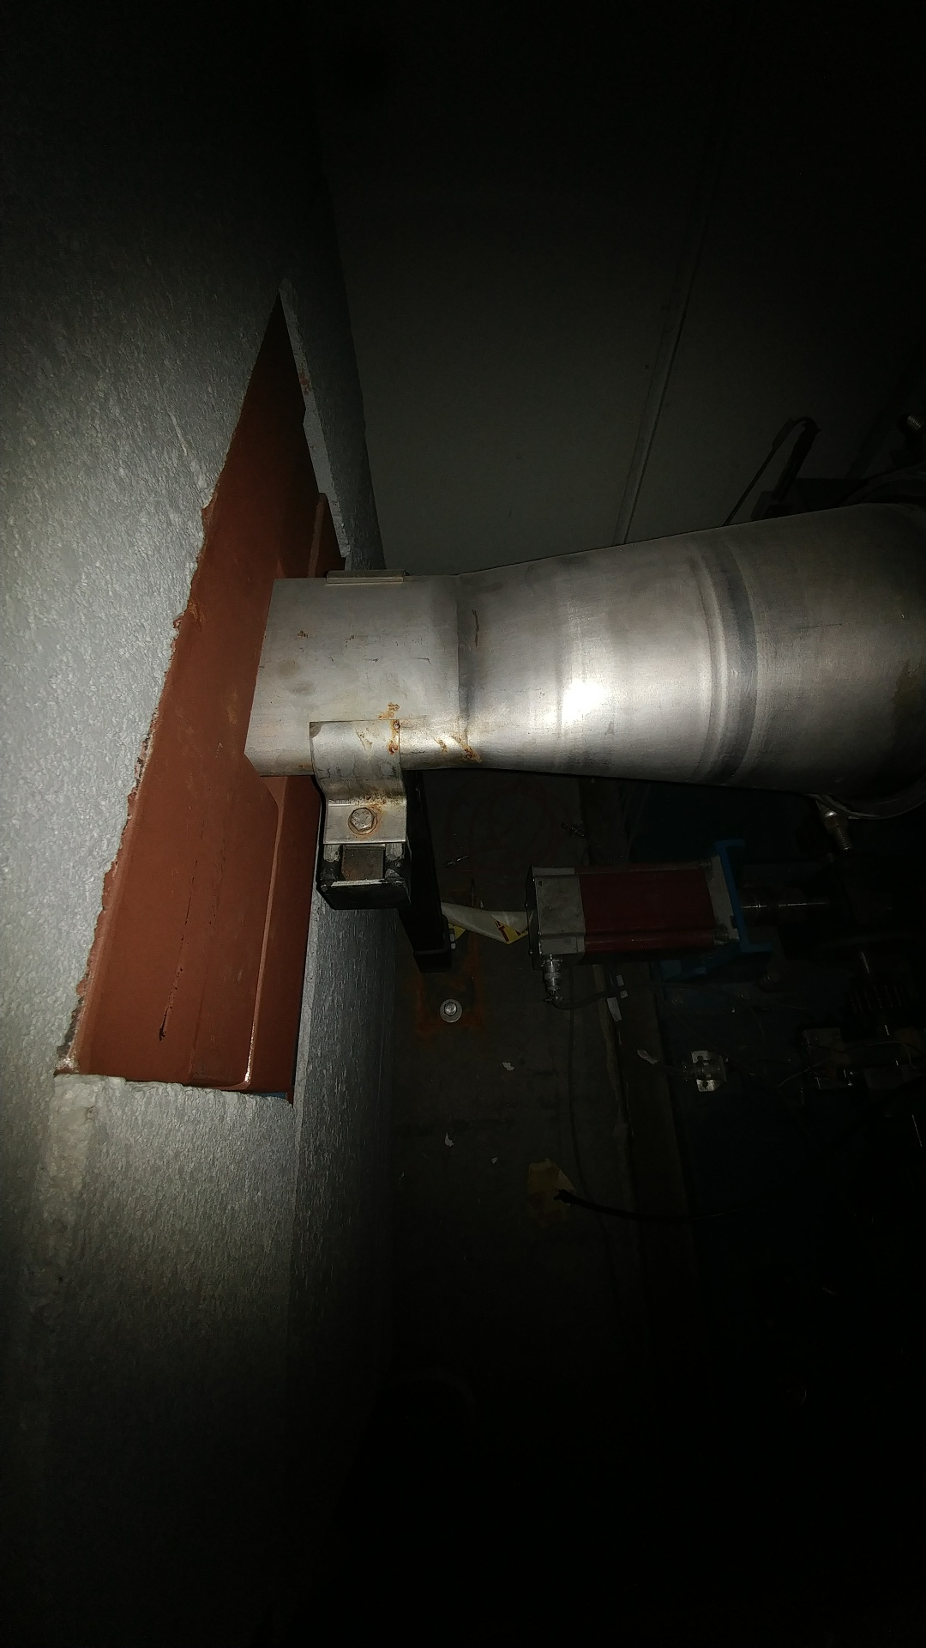
And Another Thing
MI 301/301 are vacuum issues

Slide 8
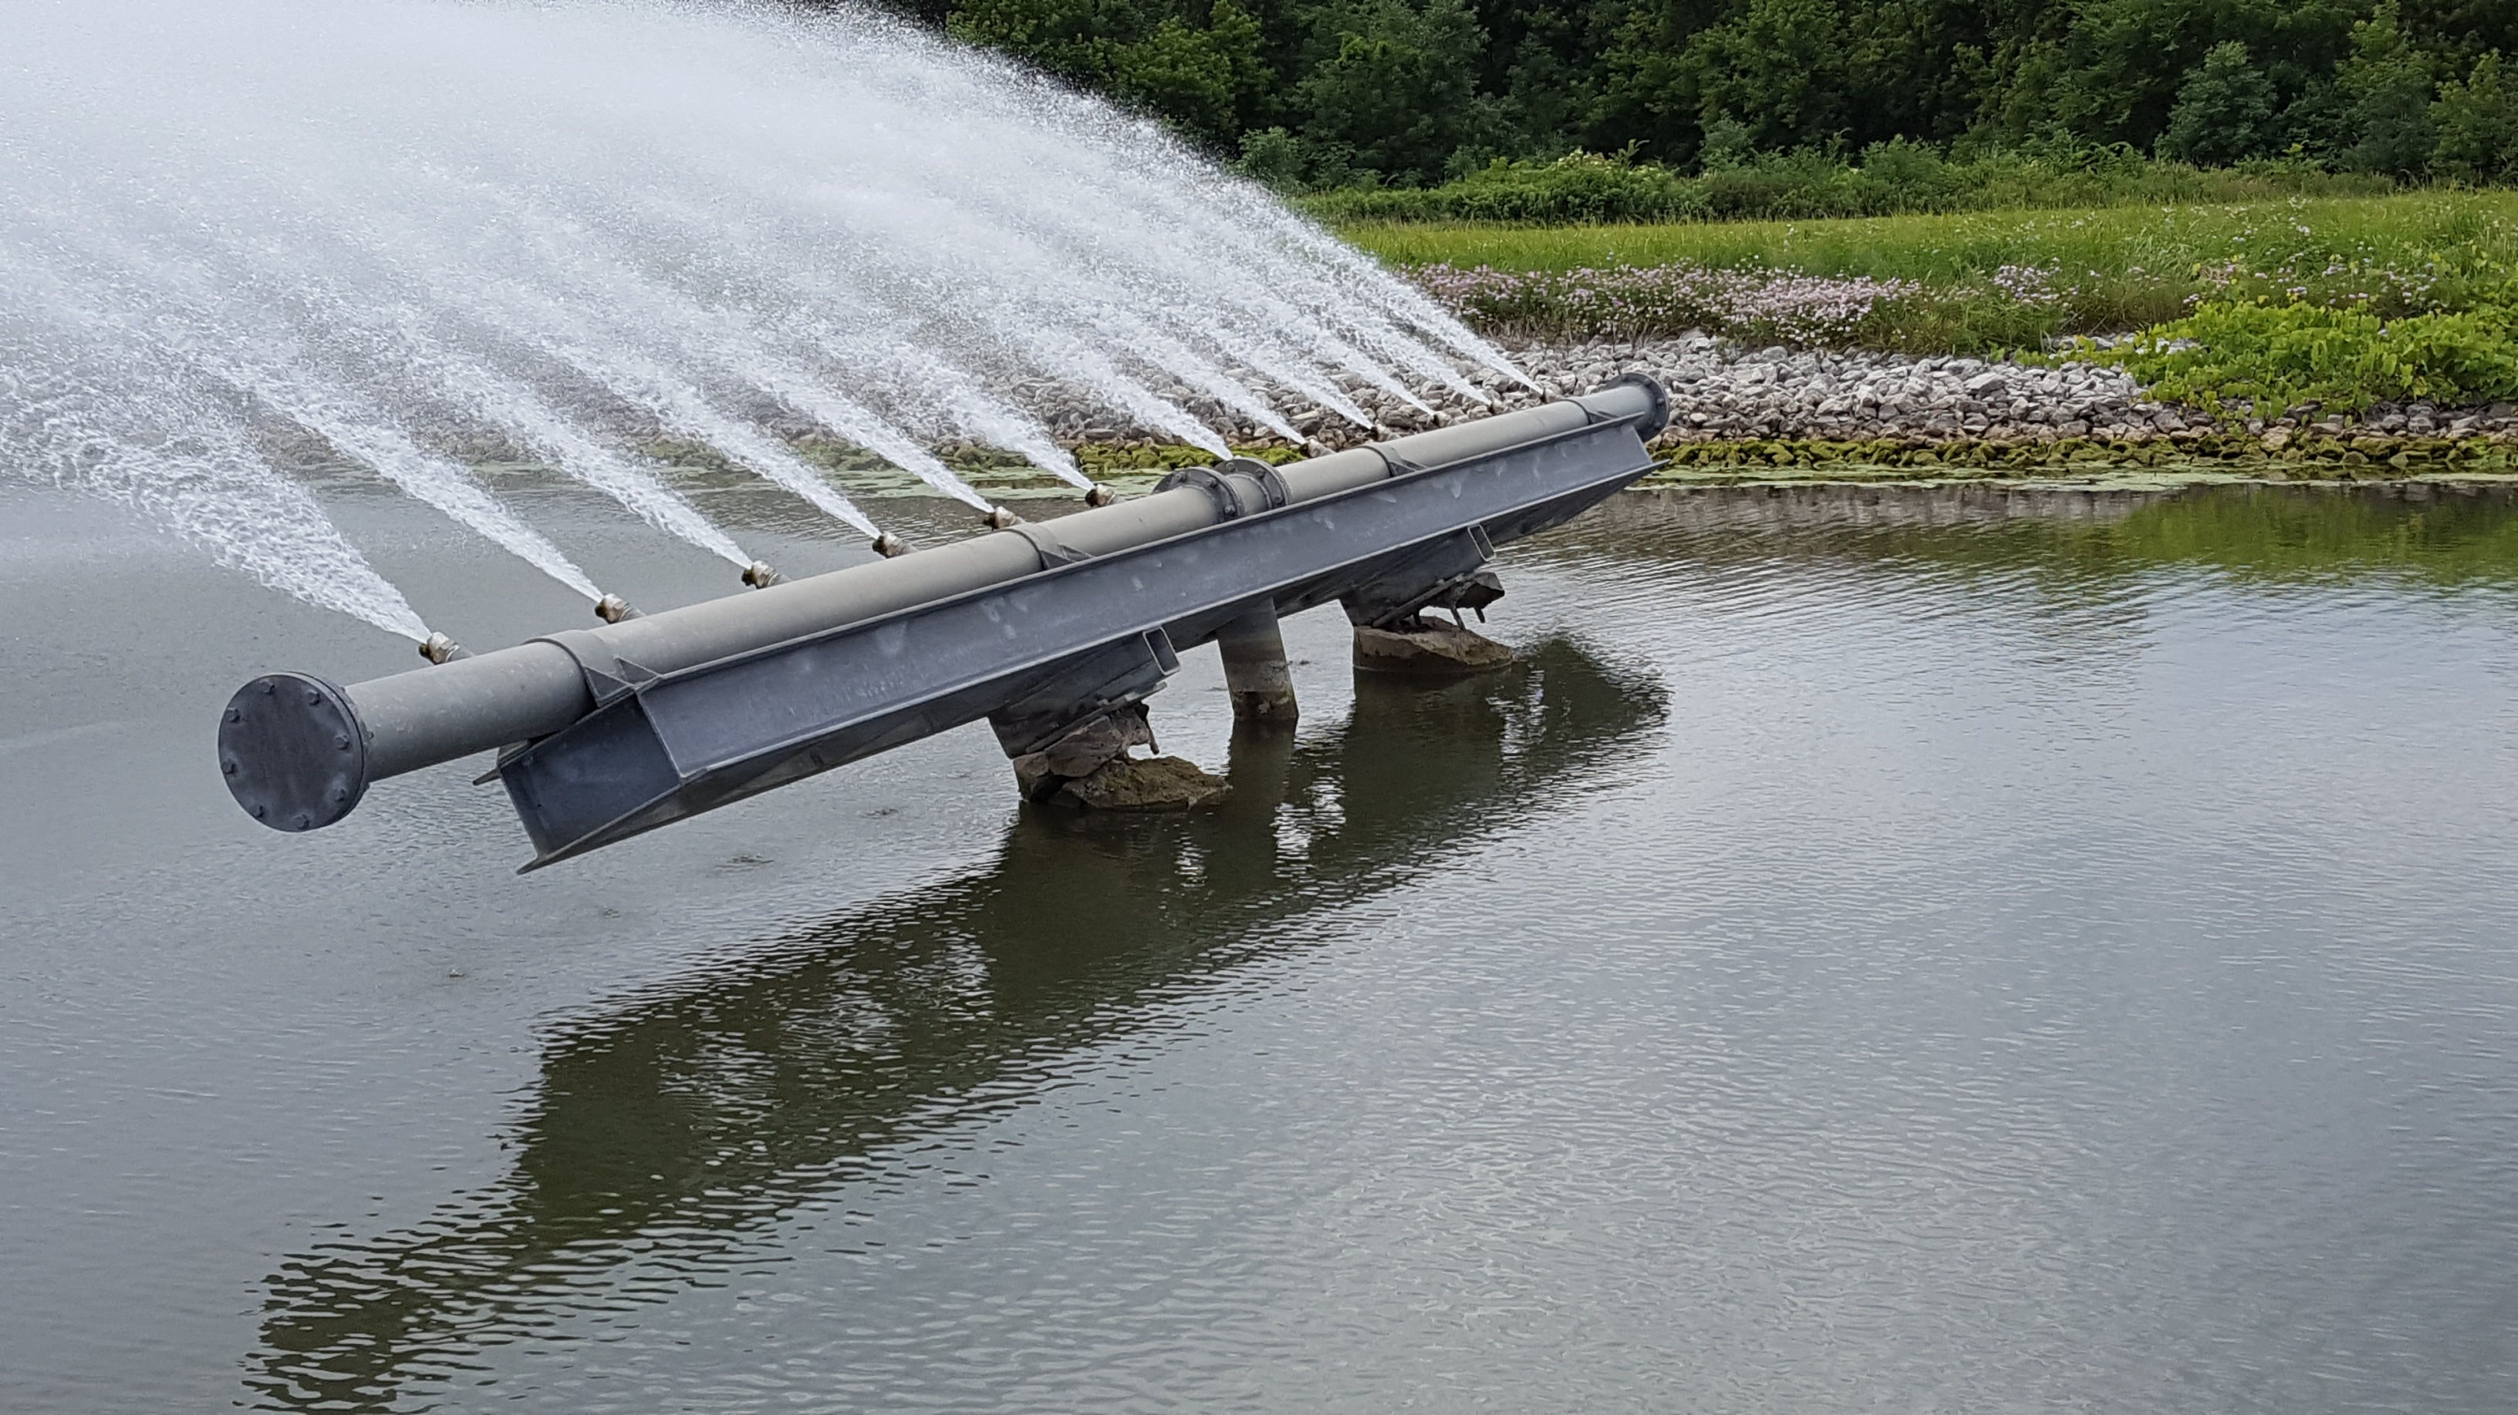
External Beam line
P3 rough vacuum 100% Done
F3 House IP to Turbo Station upgrade (~2 weeks)
Run 4" vacuum pipe from service buildings down stairwells to tunnel
Install Roots blower stations in service buildings, one per house.
Switch controls over to Tevatron CIA crates, rename parameters
Remove and cap ion pumps.
Cable mitigation in the Meson and Neutrino Muon areas: (~6-7 weeks)
Separating the Booster 95 LCW system from Switchyard (~3-4 weeks)
Switchyard would be its own separate stand alone system. Feed from the F-Sector old MR system.
MI65 Sprayer repair ~100% Done
Drain pond down by 4-5 feet
Remove Sprayer
Repair/reinforce concrete pillars
BNB ~5% Done
Relocation of the of the
DI bottles (~2 weeks)
~99% Done
~95% Done

Slide 9
MI-62 Sprayer repair

Slide 10
Installing the MI-62 sprayer

Slide 11
External Beam line (continued)
NuMI (~10-12 weeks)
Target removal for beam scan of the horns ~100% Done
Upgrades
Heat exchanger installation on Multi stack chiller (tritium mitigations) ~100% Done
General maintience
Dehumidifiers
Replace Filter and water in the Absorber and Decay pipe cooling system
Drain tile cleaning
Ext.
Water system repair
Repaired cracked nipple on LCW supply manifold in Pre-Target enclosure near Q115.
Repaired cracked weld on Decay Pipe RAW system in Absorber Hall.
~95% Done
100% Done

Slide 12
Muon Campus Work
Mu2e work
M4 line installation ( first half to absorber)
Stand and magnet 95% complete
Cable pulls installation (7-9 weeks) 80% complete
In support of g-2
Delivery ring straight section 30% complete
Injection septa (1-2 weeks)
Removal and reinstallation of ring for the M4 line installation ~ 2 days
Rotate Q207 and Q210 BPMs ~ 2-3 days
Relocation of ELAM ~2-3 days
Abort line
Extraction septa (1-2 weeks)
Magnet replacement/repair Internal water leaks 100% complete
V742 ~ 1 week
Instrumentation Repair 10% complete
PWC and IC’s ~ 10-12 weeks
Beam Pipe Aperture Inspection 60% complete

Slide 13
2017 Shutdown Pocket Dosimeter Reports – Week 9
WEEK 9:
421 person-mrem
55 people reported some dose, with average dose of 7.65 mrem
SHUTDOWN SO FAR:
2,891 person-mrem
130 people reported some dose, with average dose of 22.24 mrem

Slide 15
What Next??
Switching over from Shutdown Mode to a Start-up Mode
Getting Major System back on-line
Pond Systems
Starting this the week Sept. 25th
LCW systems
MI/Booster/Switchyard
Starting this the end of week of the Sept. 25th or beginning of week Oct. 2nd
Tunnel Cleaning
Linac/Booster Done
Starting this the week September 25th
External Beam line enclosure/ 8 Gev line
Starting this the week Oct. 2nd
MI/RR, Muon Campus Enclosures
Tunnel Enclosure Switch back to operational cores
Safety System Tests

Slide 16
Shutdown Duration Drivers
Linac Marx Modulator installation
Station 2 upgrade commissioning underway
Station 3 tested in the Station 5 has commenced
Muon Campus Work in general
Additional crews will be added
Re-structing the workflow

