Slide 1
Cooldown Circuit Flow Induced Microphonics
J Kaluzny, J Holzbauer, B Hansen
LCLS-II Cryomodule Assembly QA/QC Workshop
19 September 2017

Slide 2
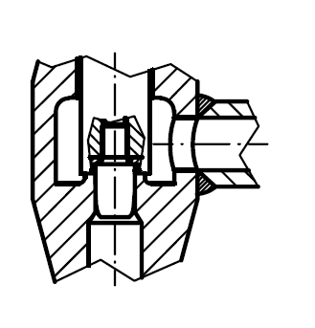
Cooldown valve leak
Temperatures on cooldown heater outlet were consistently cold
~1 g/s was seen with flow meters with CM valves “closed”
~1 g/s corresponds to the valve being ~15% or ~2mm open
Not just the sealing surface
Something preventing CD valve from closing
Debris in line
Bottom valve wiper interfering with weld

Slide 3
F1.3-04 2K Supply Shutoff (8/29/2017)
In a further attempt to study cooldown valve leakage, a manual valve upstream of the CM was closed, positively isolating 2K flow to the cryomodule.
As the line pumped down, the microphonics returned to expected (~CM3) levels, and returned when the valve was reopened.

Slide 4
F1.3-04 Cooldown Valve Stem Swap (8/30/2017)
The cooldown valve stem was swapped in an attempt to correct what was causing the leakage. (No visible cause on pulled stem and sealing surface)
After ~12 hours of soaking, microphonics levels were captured briefly and mesured to be similar to CM3 performance.
No fully thermalized data was captured.

Slide 5
Cooldown valve leak mitigation
Lowest wiper (installed by Fermilab that may interfere with weld) will not be installed
All lines on incoming upper cold mass are cleaned by pulling rags through them
Final stems for valves will now be installed at WS5
Rate of rise leak check will be done at WS5
Pull vacuum on the line B, G, H and cavity circuit
Close valves
Backfill line A
Monitor vacuum level in the line B, G, H and cavity circuit

