Slide 1
JLab LCLS-II CM Magnetic Hygiene
Gary Cheng
19-September-2017

Slide 2
Magnetic Hygiene Control Tools
Magnetometers
At JLab, we have been using a few types of 3-axis magnetometers for parts magnetic field survey:
Honeywell HMR2300 – VV demag field mapping, UCM items survey, CS components survey
Coliy G93 – Used on UCM and cavity field survey before device broke
Metrolab THM7025 – use as a backup device
AlphaLab VGM – primarily used on dressed cavity field survey
Demagnetizers
A portable SPI Demagnetizer 98-269-4 - UCM parts degauss
DSC425-120 surface type demagnetizer – UCM parts degauss
A MPS solenoidal demagnetizer – used to degauss dressed cavities
124-turn Helmholtz coil demagnetizer – mainly used on dressed cavities
Highlighted items are recommended by Fermi.

Slide 3
Magnetic Hygiene Control Travelers/Procedures
Fermi shared with JLab the kit lists, in which items require magnetic hygiene check are marked. JLab travelers/procedures are consistent with Fermi kit lists on magnetic hygiene components.
Dressed cavity incoming inspection traveler’s magnetic hygiene step is adapted from a corresponding Fermi procedure with Doc. No. 464344
L2PRD-CM-DMAG-UCM traveler covers upper cold mass items demagnetization procedure and criteria
L2PRD-CM-DMAG-VV addresses vacuum vessels demagnetization. It refers to an OSP that is developed basing on Fermi relevant procedures.
L2PRD-CM-DMAG-CM is not finalized yet, waiting for Fermi to finalize the CM demag flowchart.

Slide 4
Vacuum Vessel Demagnetization
All vacuum vessels are demagnetized before use to confirm that its magnetization can be mitigated to a comfortable level, ~ 50 mG central field in an ~ 500 mG earth magnetic field is desirable.
JLab pCM VV showed higher than 50 mG central field post demagnetization.
So far, the production VVs showed lower than, or approximately, 50 mG central field after degaussing. Vendor conducts 500 °C heat treatment on the production VVs. That may have helped with mitigation of the remanent field in the carbon steel material.

Slide 5
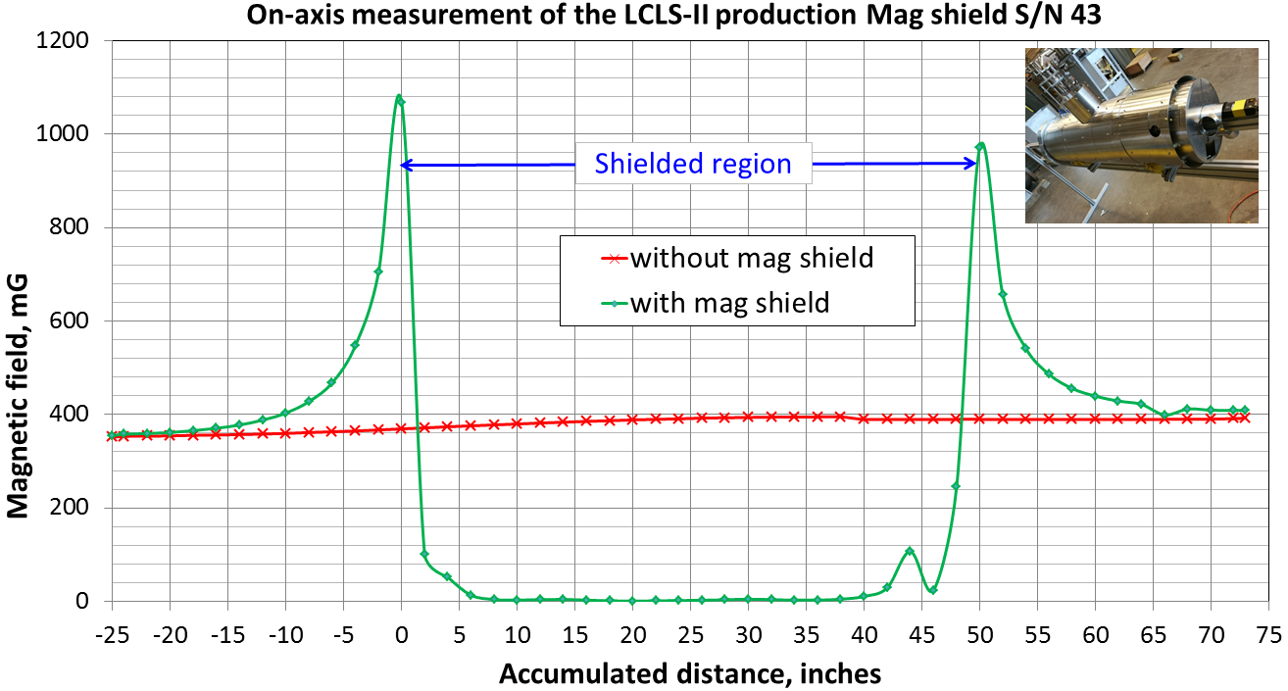
Magnetic Shield Field Mapping
Every 1 out of 8 magnetic shields for a CM is picked to conduct on-axis field mapping. This is a QC step to make sure the annealing of mumetal is done properly and shield performance is satisfactory.
Typically, the on-axis field is measured to be < 5 mG in an ambient of approximately 400 mG.

Slide 6
J1.3-01 pCM Magnetic Hygiene
JLab pCM’s 13 fluxgates, especially the 8x on-cell fluxgates, were monitored at multiple CM assembly steps and continuously during the CM testing.
JLab pCM has been demagnetized multiple times at JLab:
11/30/2016 – in front of CMTF, room temperature, before moving to CMTF 1st time
04/07/2017 – in front of CMTF, room temperature, after shipping test and before first retest, 65A demag twice
06/23/2017 – in CMTF, pCM cooled down, before Qo measurements, 65A demag twice

Slide 7
J1.3-01 pCM Fluxgate Reading vs. Qo
Cavities 1, 4, 5 and 8 has a pair of FGs mounted per cavity:
Cavities 2, 3, 6 and 7 do not have FGs mounted:
* Readings on 6/24/2017, cavities temperatures in range of 10-20K, before transitioning
** Data cited from E. Daly/M. Drury/J Fischer/R. Legg/T. Reilly "pCM Retest" dated 11-July-2017
Cavity 5 that has > 10 mG surface magnetic field has a Qo that is at the low end among all 8 cavities.
Note there are only 4/72 = 5.5% cells have FGs mounted.

Slide 8
J1.3-2 and -3 Magnetic Hygiene
CM2 was demagnetized once on 7/13/2017 when it was in the CMTF but not cooled down yet. An 65A standard degauss run was conducted. The program ran unusually for 3 hours due to a suspected laptop power cable issue.
CM3 was also demagnetized just once on 8/29/2017 when it was in the CMTF but not cooled down yet. We ran a 65A standard degauss.
The 5x fluxgates mounted on magnetic shields are monitored before and after:

Slide 9
Production Cryomodule Magnetic Hygiene Rules
The criterion on single-axis fluxgate reading is recently (8/29/2017) set to be < 2.5 mG. JLab CM2 has its cavity 1 fluxgate reading above the criterion.
Fermi is finalizing a flowchart that would provide guidance on what to do when there are > 2.5 mG readings on production CMs post initial demagnetization.

Slide 10
Other Remarks
Jlab magnetic hygiene team experienced confusions on magnetometer readings.
The Coliy G93 magnetometers are not durable. And the vendor is not cooperative at all.
Not all cavity Ti-SS joints can be fully demagnetized with currently available tools.
JLab pCM fluxgates were monitored at JLab and Fermi. Peak reading at Fermi is much lower than that read at JLab before shipping.
Demag flowchart/decision tree needs to be finalized.

Slide 11
THE END
Questions? Suggestions?
Thank you!

Slide 12
BACK UP SLIDES – Permeability vs. Applied Field

Slide 13
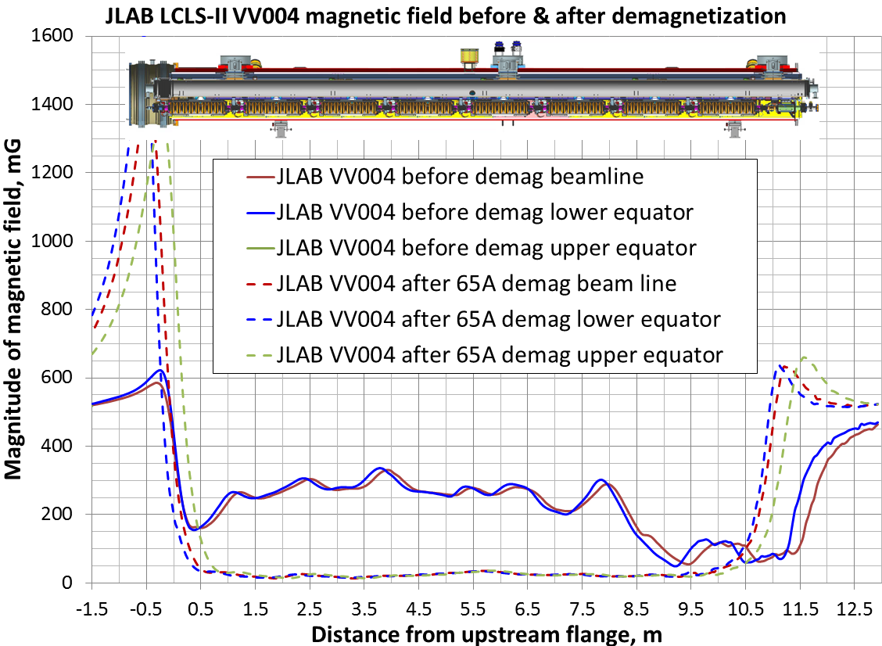
BACK UP SLIDES – Vacuum Vessel Before/After Demag

Slide 14
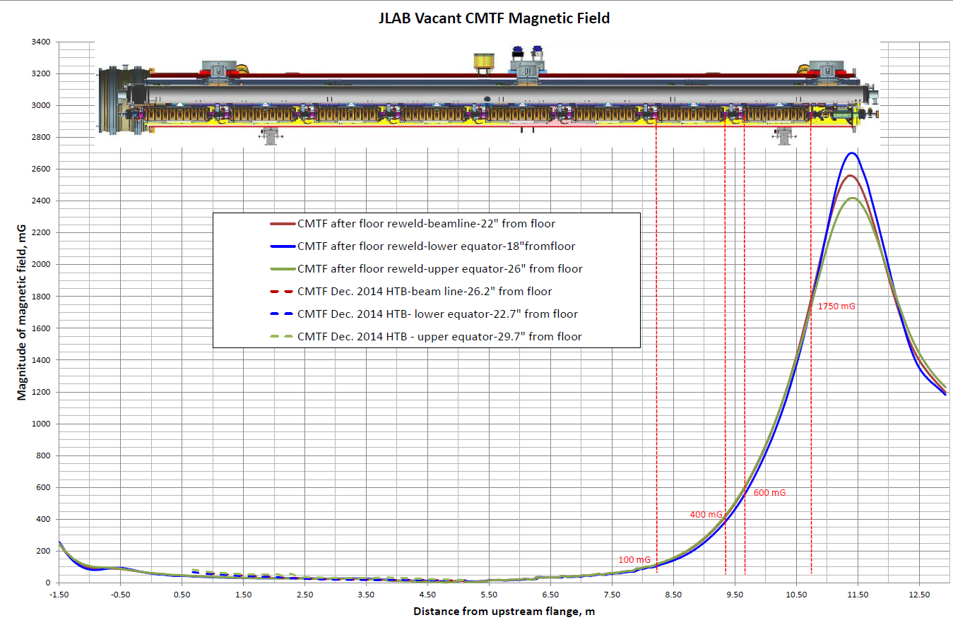
BACK UP SLIDES – Field in CMTF w/o a CM

