Slide 1
CM02, CM03 HOM Q_ext Tuning Status
Ari Palczewski, Anna Solopova, Bob Legg

Slide 2
Outline
Introduction
CM02
CM03
Results from Investigations
Ideas
Plans

Slide 3
Introduction – Results of CM02 acceptance testing
Cavity | Serial # | QxtFPC | Qprobe | QHOMA | QHOMB | Emax CM / VTA | Emaxop | FE Onset CM / VTA | Limit CM
1 | L2_014 | 4.14E+07 | 3.46E+11 | 1.03E+11 | 1.76E+12 | 20.5 / 24.0 | 20.0 | N/A / N/A | Quench
2 | L2_009 | 3.94E+07 | 2.86E+11 | 4.81E+11 | 1.03E+11 | 15.4 / 17.1 | 15.0 | N/A / N/A | Quench
3 | L2_001 | 4.25E+07 | 3.50E+11 | 1.34E+11 | 2.96E+11 | 20.5 / 24.0 | 20.0 | N/A / N/A | Quench
4 | L2_010 | 4.17E+07 | 3.80E+11 | 4.67E+11 | 8.25E+10 | 8.0 / 24.0 | 4.5 | 3.7 / N/A | Quench
5 | L2_002 | 3.99e+07 | 3.70E+11 | 7.16E+10 | 2.35E+11 | 19.7 / 24.0 | 19.0 | N/A / N/A | Quench
6 | L2_005 | 4.07E+07 | 3.99E+11 | 6.23E+11 | 2.06E+11 | 16.9 / 16.4 | 16.4 | N/A / N/A | Quench
7 | L2_004 | 3.91E+07 | 3.36E+11 | 6.86E+11 | 2.34E+11 | 19.4 / 21.0 | 18.9 | N/A / N/A | Quench
8 | L2_012 | 3.96E+07 | 3.03E+11 | 2.19E+13 | 5.05E+11 | 17.9 / 23.0 | 17.1 | N/A / N/A | End Group Quench
Performance Requirements (LCLSII-4.5-PP-0670-R1, rev’d 10-2016)
QHOMA – 6 below spec; QHOMB – 6 below spec

Slide 4
Introduction – Preliminary results of CM03 acceptance testing
* Admin - pulsed
** Measured at 10 MV/m
*** Needs further verification
**** Might increase with further vacuum processing

Slide 5
Results from Investigations
Collected data using FNAL software
Cross-checked measurements with 2 different setups
FNAL (Timergali) recalculated notch frequency from our data:
Cavity 1 HOM A tuned same as cavity 8, but results are better
Cavity 1 frequency was lower, 1299.95MHz vs 1300.000MHz
Cavity 1 and 7 HOM B Qext are close, but notch is different by 0.4MHz.
Cavity 3 HOM A severely mistuned – good Q, cavity 5 HOM B severely mistuned – bad Q.
Cavity | HOM A notch | HOM A Qext | HOM B notch | HOM B Qext | Limit | Spike
1 | 1296.6 | 4.12E+12 | 1296.5 | 3.21E+11 | Admin | N/A
2 | 1297.2 | 4.80E+10 | 1296.8 | 9.74E+10 | End group | None
3 | 1298.9 | 4.50E+11 | 1297.0 | 4.04E+11 | Quench | N/A
4 | 1297.2 | 9.10E+10 | 1296.9 | 8.54E+10 | Fwd power | N/A
5 | 1297.0 | 4.20E+10 | 1298.7 | 1.70E+10 | CARM | N/A
6 | 1296.5 | 4.00E+12 | 1297.8 | 1.56E+11 | End group | Cplr side
7 | 1296.9 | 7.70E+10 | 1296.9 | 3.50E+11 | End group | Cplr side
8 | 1296.6 | 3.70E+10 | 1296.9 | 1.80E+11 | End group | Cplr side
Notes:
HOM A on 1 and 8 – same f, different Q
HOM B on 1 and 7 – close Q, different f
Cav 3 HOM A severely mistuned – good Q.
Cav 5 HOM B severely mistuned – bad Q.

Slide 6
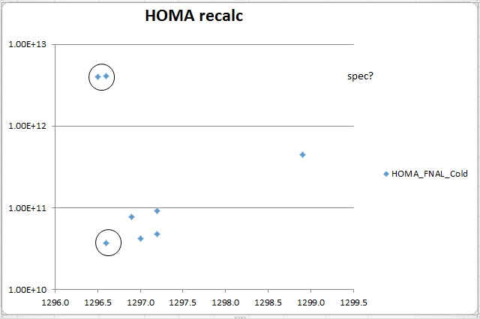
CM03 HOM A data

Slide 7
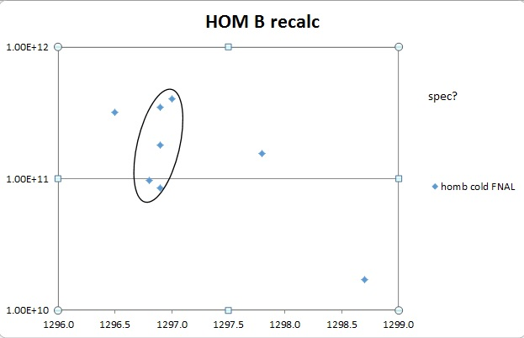
HOM B data

Slide 8
Ideas
Tune A and B to different specs?
Experiments to be done in VTA
Tuning procedure is consistent in VTA and CMTF – results are not
Cavities are in the same state – tuning should be the same
VTA cooldown performed “vacuum to vacuum”, Qext didn’t change.
VTA and CMTF notch position must be different – how?
We now suspect clamps, cables or other interference changing Qext
Notes:
FNAL atm\atm 1296.5
JLAB atm\vac 1297.0

Slide 9
Schedule
CM03 – in the cave, planning to take out later this week
Evaluate HOMs and retune as needed
Cooldown in the first week of October
CM02 – stored for now.
Data is collected, not analyzed
Retune HOMs after all issues have been resolved and procedures verified.

Slide 10
Plans
Continuing with verification of procedures
Formalize documented internal procedure
Compare with FNAL procedures by Timergali
Measure CM03 HOMs to see if the notch is shifted
Re-tune CM03 HOM with Timergali’s help
Compile lessons learned into report
Cooldown CM03 first week of October for re-test
Re-tune CM04 and CM02

Slide 11
HOM Evaluation Plan (began in August)
CM02:
1. Pull U tubes
2. Remove WG
3. Re-establish insulating vacuum
4. Measure HOM's, Vac to Vac
5. Break insulating vacuum.
6. Measure HOM's, Vac to Atm
7. Open module and check HOM heat Stationing.
8. Re-verify HOM measurement Vac to Atm
9. Analyze data and retune as needed
CM03:
1. Open ports.
2. Check HOM heat stationing
3. Measure HOM's Vac to Atm
4. Tune HOMA and/or B, if needed
5. Close up VV. Complete BB installation.
6. Move CM03 into cave.
7. Pump down insulating vacuum space
8. Measure HOM's Vac to Vac
9. U-tube party
10. Tune couplers Cold (Mircea)
11. Check HOM spectrum cold
12. Connect WGs and HOM cables
13. Test
14. Verify tuning procedure (Timergali at Jlab)
15. Verify data analysis
16. Retune HOMs

