Slide 1
Vent of J1.3-06
Ed Daly / M. Drury / J. Fischer / R. Legg / T. Reilly
15-September-2017

Slide 2
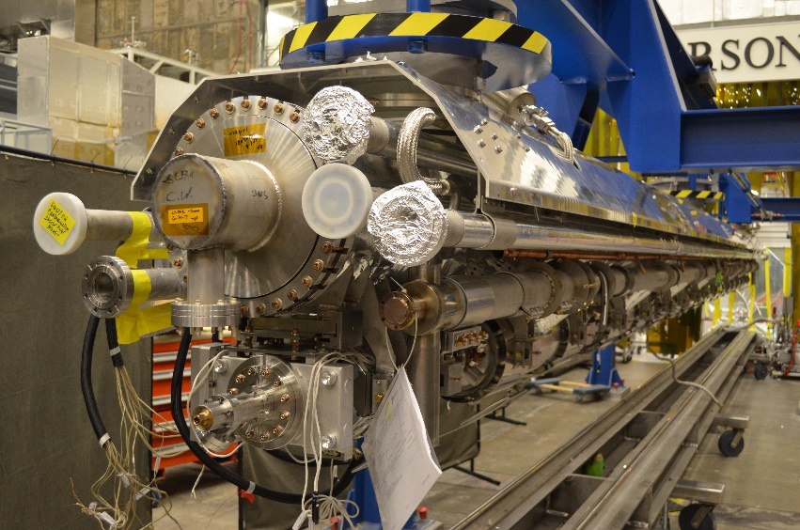
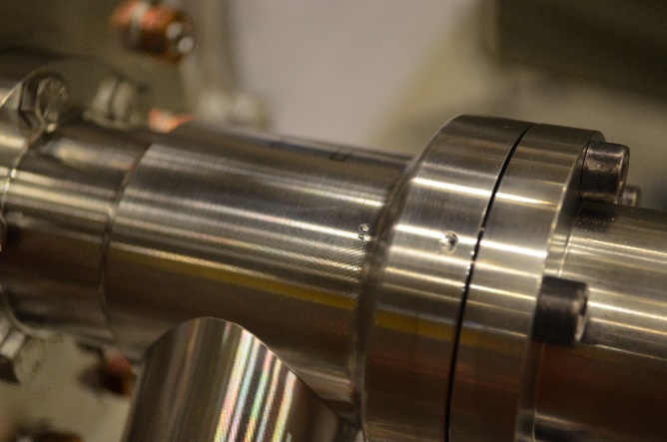
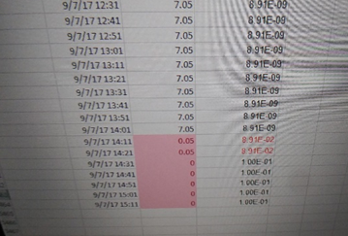
J1.3-06 Status
J1.3-6
Accidentally vented during preparation for leak check of 2 phase circuit
GHRP cap slipped and impacted right angle valve
String fast bled up to just under 100 torr.
J1.3-06
Cavity and couplers will require reprocessing

Slide 3
Disassembly Procedure
Disassemble from cavity 1 end of string
Cut south GHRP tee to 2 phase weld
Engage lollipop tooling to 4 upstream cavities and gate valve, Lock lollipops including the turn buckles, verify
Install cold coupler supports and anti-roll brackets
Install the 2 phase pipe support tooling
Remove the bearing block assy’s, invar clamps, GHRP 2 phase pipe clamps, and gate valve support.
Verify all items tying the UCM and Cavity string have been removed.
Disconnect the beamline bellows between cavities 4 & 5
Rotate Line H (1/4”lines) out of the way to provide clearance, tie up.
Slide the 4 cavities south to clear the previously disconnected beam line bellows flange edge.
Raise the UCM, watch for interferences. Guide the siphon tubes while lifting.
Once the UCM is high enough, transport the assembly to WS2
Remove the Magnetic shields (re-assemble for storage!!) and MLI
Install the anti-roll A-frames
Cut the remaining 2 phase helium vessel tees and remove the 2 phase interconnecting pipes.
Roll out from under the UCM.
Disassemble coupler from cavity
Remove probe from cavity
Reinstall PICs; cap cavity
Return cavity to storage

Slide 4
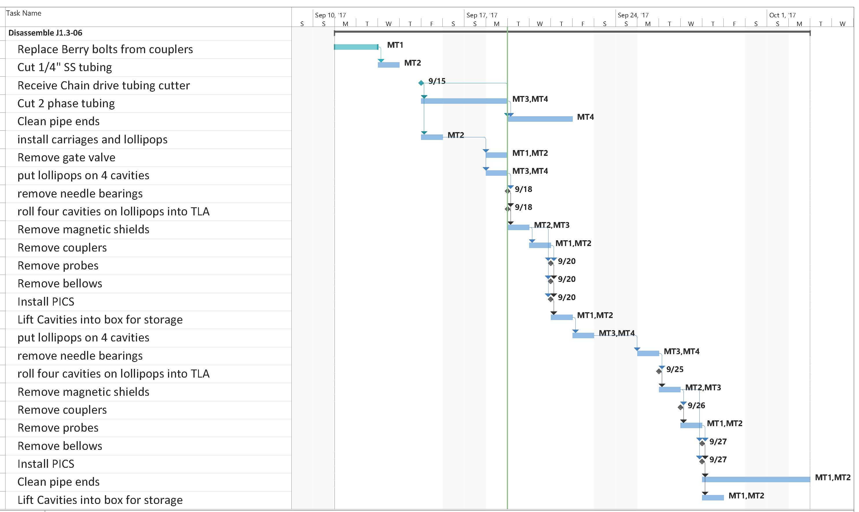
Schedule for Disassembly

Slide 5
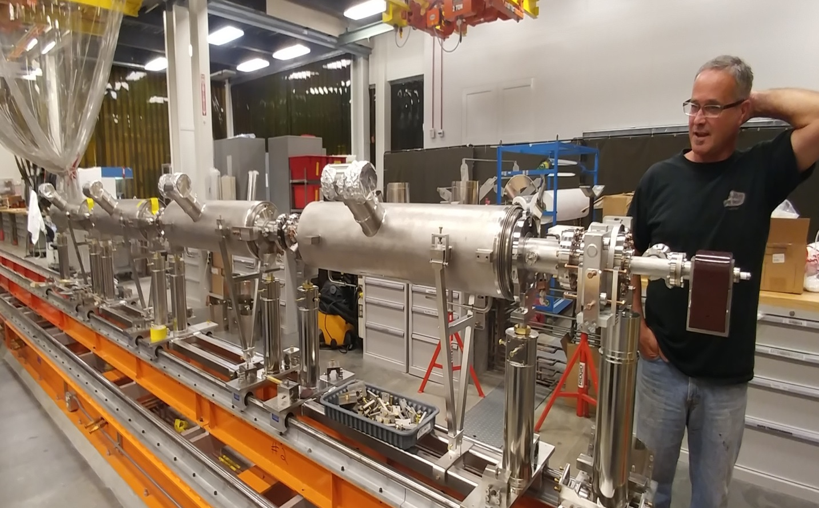
Disassembly of Cold Mass
First four cavities have been removed and will be disassembled this week for storage and re-processing

Slide 6
Reprocessing of Parts
HPR only; No chemistry
Send couplers back to RI for cleaning/requalification
Bellows will go through the full inspection traveler
Requalify cavities in VTA when time allows.
Parts will be integrated into new strings
“J1.3-06” name will be retired from Travelers

Slide 7
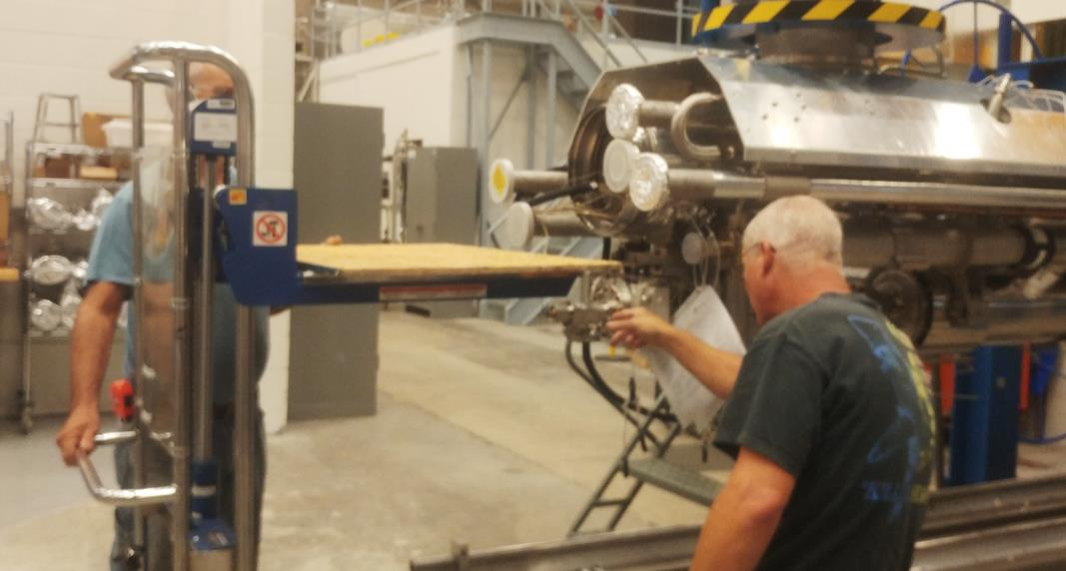
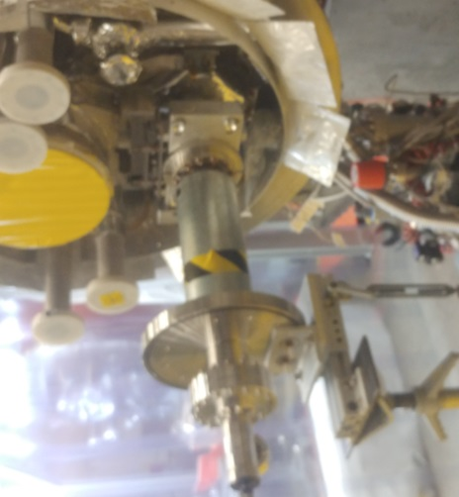
J1.3-06 Lessons Learned
New assembly procedure and tooling for GHRP cap installation at WS3 and WS5.
Portable lift used to both lift GHRP cap and protect the Right Angle Valve; Safer for both employees and equipment.
Looking into a plug with o-ring to replace GHRP cap for vacuum leak checks. Lighter, safer.
J1.3-06
Metal bellows covers put in place to prevent accidental venting during prep for testing.

