Slide 1
FNAL QA/QC Summary
LCLS-II QA/QC Workshop
Jamie Blowers
19-Sep-2017

Slide 2
Outline
Incoming Inspection summary data
Traveler summary data
Discrepancy Report summary data
Traveler/work status reports
Recent example of feedback loop
All of the above detail data

Slide 3
Incoming Inspection – By the Numbers
2174 “Routings” received
817 Inspections completed
299 Quality Control Reports (QCRs) generated
  May indicate something out of tolerance
  Often used to convey data (e.g. CMM) to SOTR for review and disposition
QCR Disposition | Count
Use as is | 225
Return to Vendor | 24
Scrap | 1
Other (combo) | 36

Slide 4
Incoming Inspection – Receipts, Inspections, QCRs

Slide 5
Travelers – By the Numbers
2300 travelers issued
SpecificationNo | MaxOfRevisionID | Title | CountOfSerialNo
464170 | 6 | LCLS-II 1.3 GHz Nine Cell Dressed and Undressed Cavity 2K VTS Testing (RFCG) | 173
464249 | 2 | RF Cable Batch – Incoming Quality Control Traveler | 155
464240 | 5 | Preparation and Installation of a Cavity in the Vertical Test Stand (VTS) | 150
464026 | 5 | LCLS-II Incoming Acceptance and Receiving for Cold End Couplers on the CPC Stand (RFCG) | 147
464305 | 5 | LCLS-II 1.3 GHz Dressed Cavity Incoming Inspection Traveler (RFCG) | 116
464224 | 3 | LCLS-II 1.3 GHz Dressed Cavity RF Incoming Inspection Traveler (RFCG) | 115
464282 | 2 | LCLS-II 1.3 GHz Dressed Cavity Incoming Inspection Leak Check Traveler (RFCG) | 103
333873 | 5 | Multi Cell Cavity - RF Measurement Traveler | 95
464281 | 2 | LCLS-II Beam Position Monitor (BPM) Inspection Traveler (RFCG) | 79
464319 | 2 | LCLS-II 1.3 GHz Magnetic Shielding Incoming Inspection Traveler (RFCG) | 72
464176 | 9 | LCLS-II Cold End Coupler Assembly Traveler - WS0 (RFCG) | 68
464349 | 3 | LCLS-II 1.3 GHz Copper Plated Beamline Components - Leak Check and Visual Inspection Traveler (RFCG) | 68
464325 | 2 | LCLS-II 3.9 GHz HOM Antenna Feedthrough Inspection Traveler (RFCH) | 56
464189 | 4 | LCLS-II Vertical Test (VTS) Preparation of 1.3GHz Dressed Cavities | 51
464314 | 2 | LCLS-II 1.3 GHz Dressed Cavity Incoming Inspection CMM Traveler (RFCG) | 50
464029 | 3 | Vertical Test Preparation of Elliptical Superconducting Radio Frequency Cavities | 48
464285 | 6 | Cryo-Module - RF Measurement Traveler | 44
333978 | 4 | SRF Cavity Optical Inspection Traveler | 42
333989 | 4 | SCRF Undressed Cavity Post-Electropolish Processing | 36
333988 | 3 | SCRF Undressed Cavity Electropolish | 35
333995 | 3 | Centrifugal Barrel Polishing of Nb SRF Cavities Traveler | 34
333987 | 3 | SCRF Undressed Cavity Electropolish Preparation | 33
333878 | 6 | Multi-Cell Cavity - Leak Check Traveler | 28
464324 | 2 | LCLS-II 3.9 GHz Field Probe Feedthrough Inspection Traveler (RFCH) | 28
333897 | 7 | Multi-Cell Coordinate Measuring Machine (CMM) Measurement Traveler | 23
333876 | 6 | Multi-Cell Cavity Visual Inspection Traveler | 23
464263 | 4 | LCLS-II Splittable Quadrupole Magnet Measurements at MTF (SPQA) | 22

Slide 6
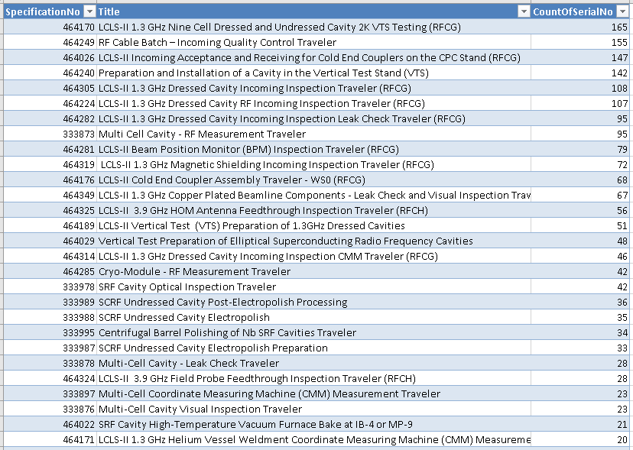
Count of Travelers Issued
Total issued: 2300
(all others)

Slide 7
Travelers Issued by Month

Slide 8
Discrepancy Reports – By the Numbers
349 Discrepancy Reports issued
5M | # of DRs
Method | 117
Measurement | 100
Material | 76
(To be dispositioned) | 53
Machine | 2
Manpower | 1
Cryomodule | CountOfDRNo
RFCG001 | 43
RFCG002 | 48
RFCG003 | 14
RFCG004 | 18
RFCG005 | 14
RFCG006 | 8
A review of the “Material” DRs shows there were none which were the result of a “failed” incoming inspection

Slide 9
DR Counts by Cryomodule and 5M

Slide 10
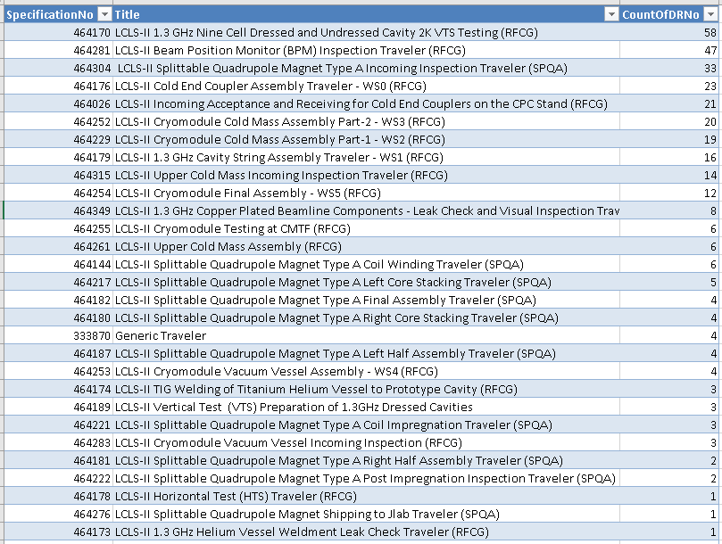
Count of DRs per Traveler
Total generated: 349
(all others)

Slide 11
DRs Issued by Month

Slide 12
Traveler/Work Status
Magnets: https://vector-offsite.fnal.gov/Tools/Reports/Include/TravelerStatus.asp?SeriesList=560&SpecificationList=1646,1605,1705,1618&ViewType=1&SortList=1
String Assembly: https://vector-offsite.fnal.gov/Tools/Reports/Include/TravelerStatus.asp?SeriesList=557&SpecificationList=1521&ViewType=1&SortList=1
Coldmass Assembly: https://vector-offsite.fnal.gov/Tools/Reports/Include/TravelerStatus.asp?SeriesList=557&SpecificationList=1571,1594&ViewType=1&SortList=1
Cryomodule Assembly: https://vector-offsite.fnal.gov/Tools/Reports/Include/TravelerStatus.asp?SeriesList=557&SpecificationList=1595,1596,1597,1598&ViewType=1&SortList=1

Slide 13
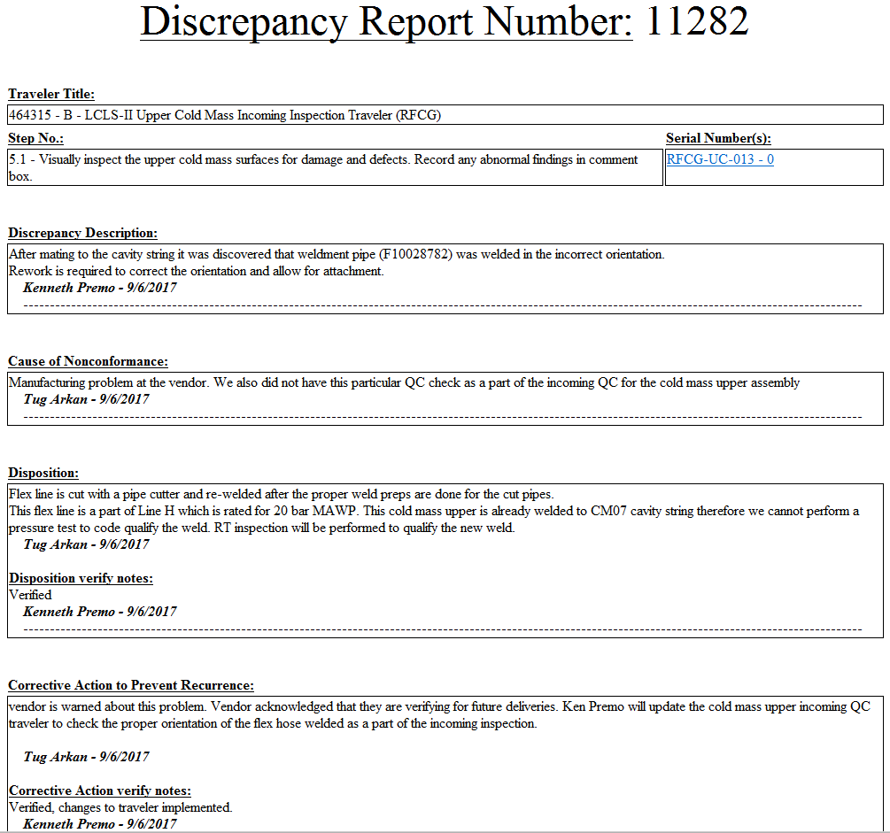
Recent Example of Feedback Loop
DR 11282:
Connection welded on incorrectly by supplier, discovered after coldmass was connected to string.

Slide 14
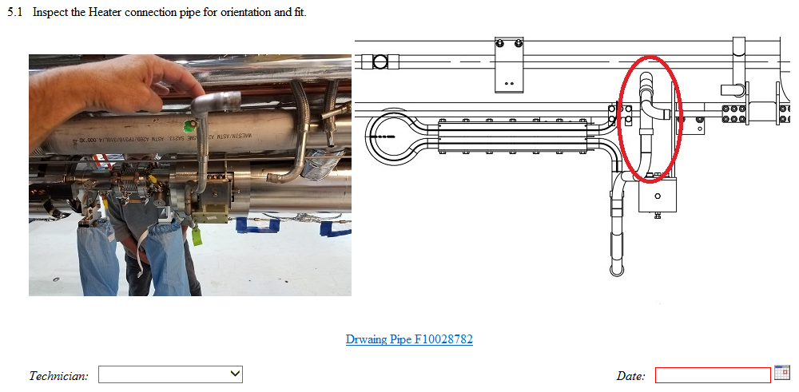
Feedback Loop
Incoming Inspection Traveler 464315 was modified to include verifying this connection:

Slide 15
Detail Data
Detail data are available in many formats
  Vector reports
  Spreadsheet “dumps” from Vector
  Queries linked to spreadsheets
A spreadsheet with a growing number of queries

