Slide 1
Vacuum Vessel Weld Repair of Leak in Tuner Access Port
Chuck Grimm
May 23, 2017

Slide 2
Vacuum Vessel Weld Repair of Leak in Tuner Access Port
Outline:
Description of leak
Magnitude
Location of leak
Tuner access port
Weld joint configuration
Inner fillet weld
Procedure for repair
Defined

Slide 3
Vacuum Vessel Weld Repair of Leak in Tuner Access Port
Description of leak:
During the final helium leak check of the pCM at WS5 a leak was found on the vacuum vessel Tuner Access Port with the magnitude of ~3E-4 Torr-l/s, this value is not completely understood due to a larger leak found on the E1/L1 flange.
This leak was verified at CMTF during setup and testing of the pCM and reported by Curtis Baffes on the CMTS Elog and also Traveler 464225 “LCLS-II Cryomodule Testing at CMTF” Step 4.10.5

Slide 4
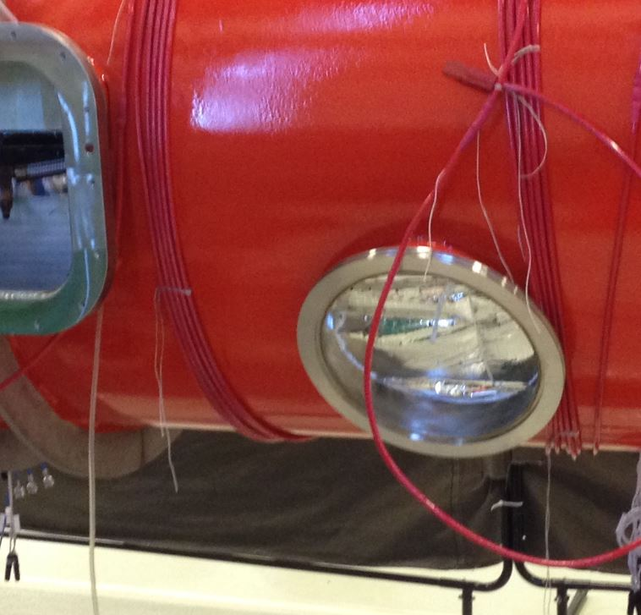
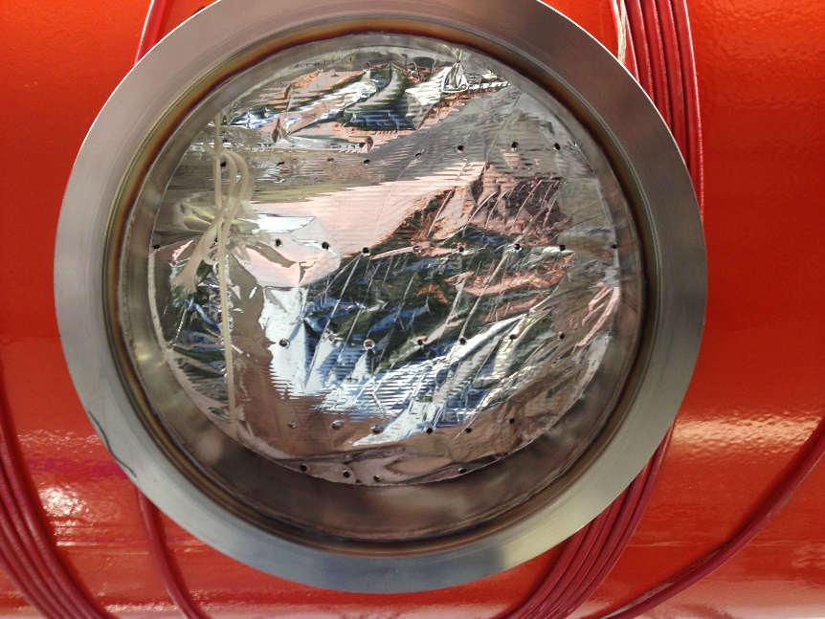
Vacuum Vessel Weld Repair of Leak in Tuner Access Port
Location of leak:
The leak is determined to be around the tuner access port for cavity #5 at the point where the tube stub is welded into the hole of the vacuum vessel
This leak was verified in ICB at WS5 and also at CMTF
Leaking weld on the inside
of the tuner access port

Slide 5
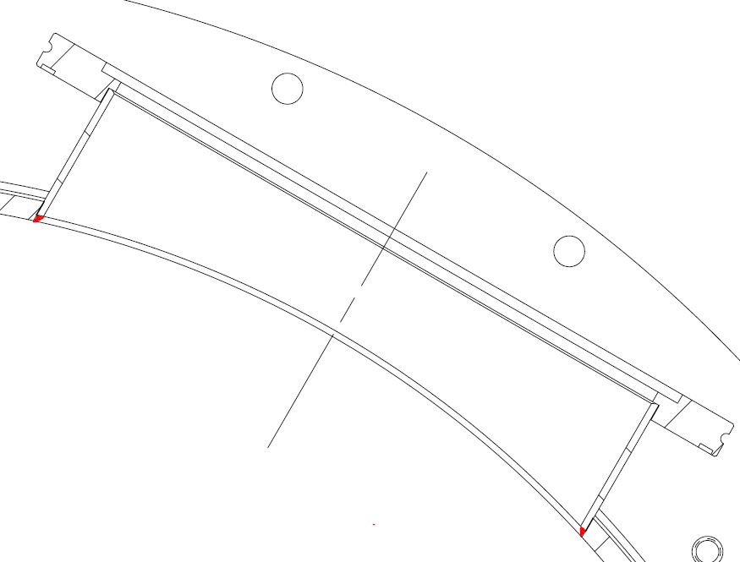
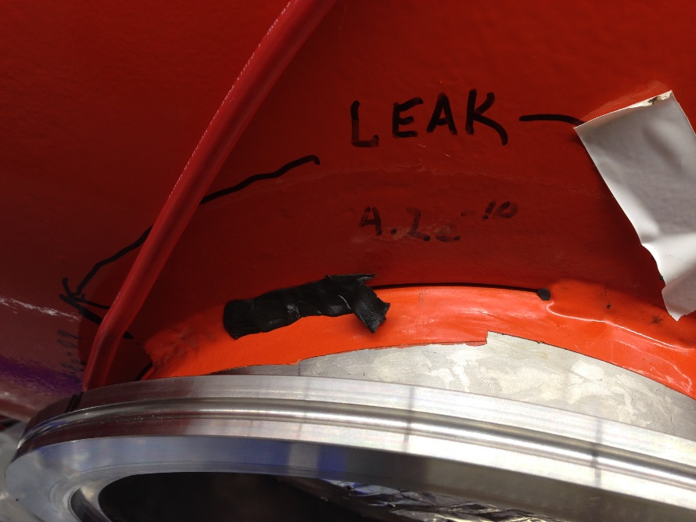
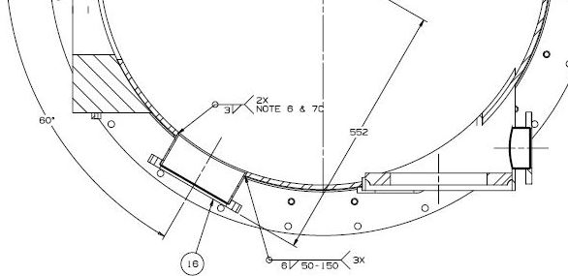
Vacuum Vessel Weld Repair of Leak in Tuner Access Port
Inside Fillet Weld
Shown in red
Weld joint configuration:
Inside full circumferential fillet weld
Exterior intermittent welds

Slide 6
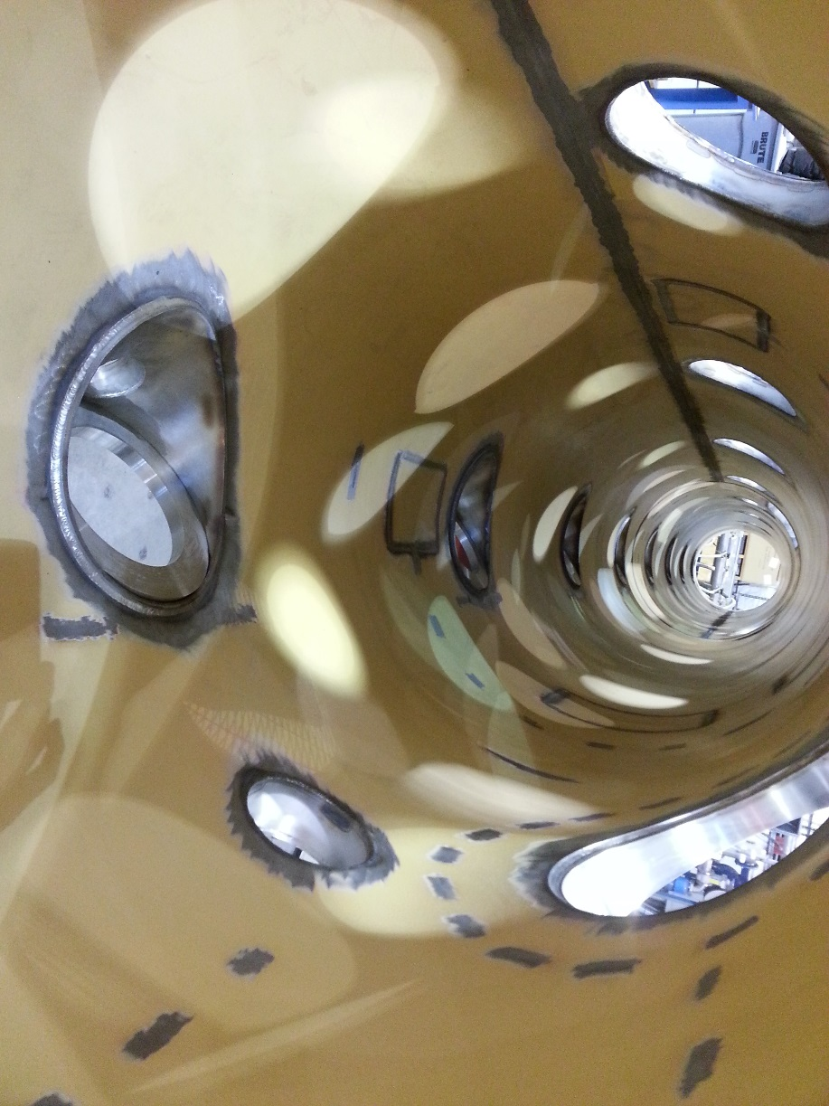
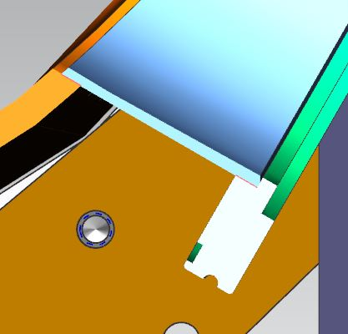
Vacuum Vessel Weld Repair of Leak in Tuner Port
Weld joint configuration:
Inside full circumferential fillet weld
Exterior intermittent welds
Location of leaking weld on the inside
of the tuner access port

Slide 7
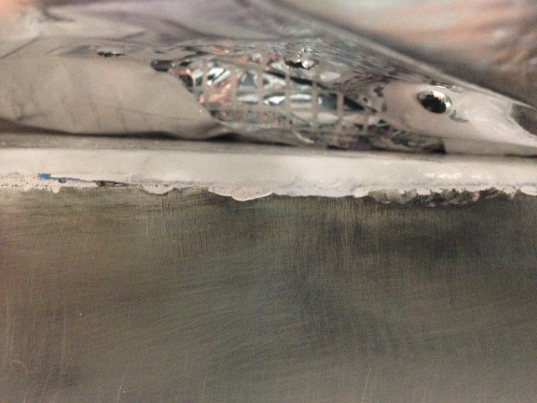
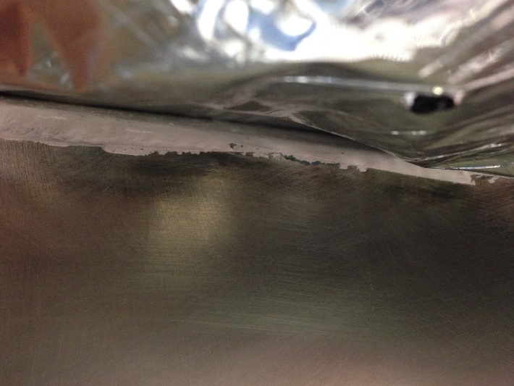
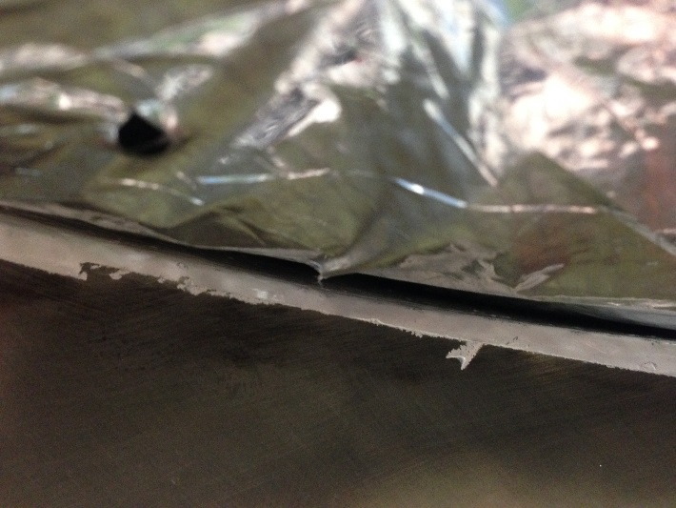
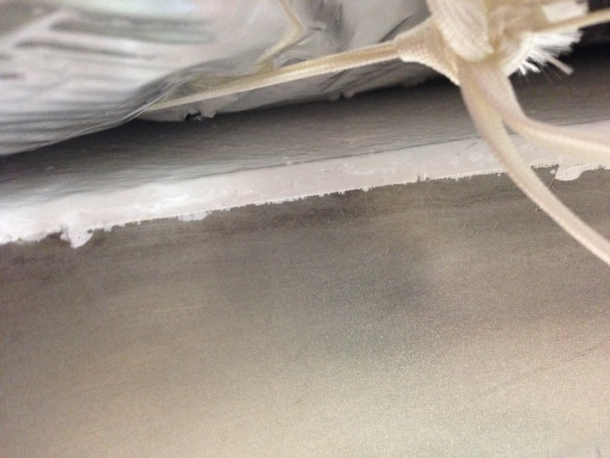
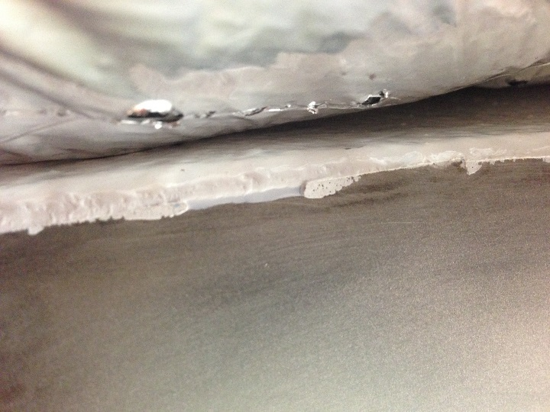
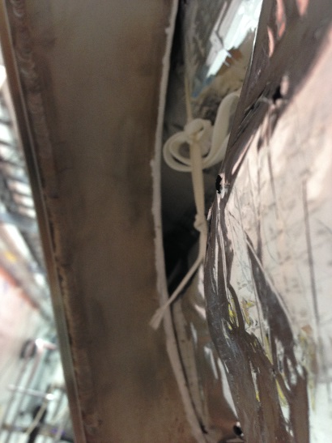
Vacuum Vessel Weld Repair of Leak in Tuner Port
Weld joint configuration:

Slide 8
Vacuum Vessel Weld Repair of Leak in Tuner Access Port
Options for repair:
Perform a “wash” over the inside fillet weld to close leak

Slide 9
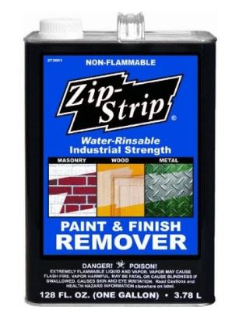
Vacuum Vessel Weld Repair of Leak in Tuner Access Port
Perform a “wash” over the inside fillet weld to close leak
Push back MLI and add spacers to keep it off the vessel surface
Tape plastic sheet around inner surface of the vessel
Grind paint from weld and around weld area
Option: “Zip Strip” paint remover to help remove paint in weld pours
Remove plastic and clean area of repair
Add torch guard blanket inside vessel to protect MLI from heat
Remove/move compensation coil wires away from weld area
Attach welding ground strap to Access Port flange
Slowly wash over existing weld
Remove torch guard blanket
Leak check

Slide 10
Vacuum Vessel Weld Repair of Leak in Tuner Access Port
Thank You!

