Slide 1
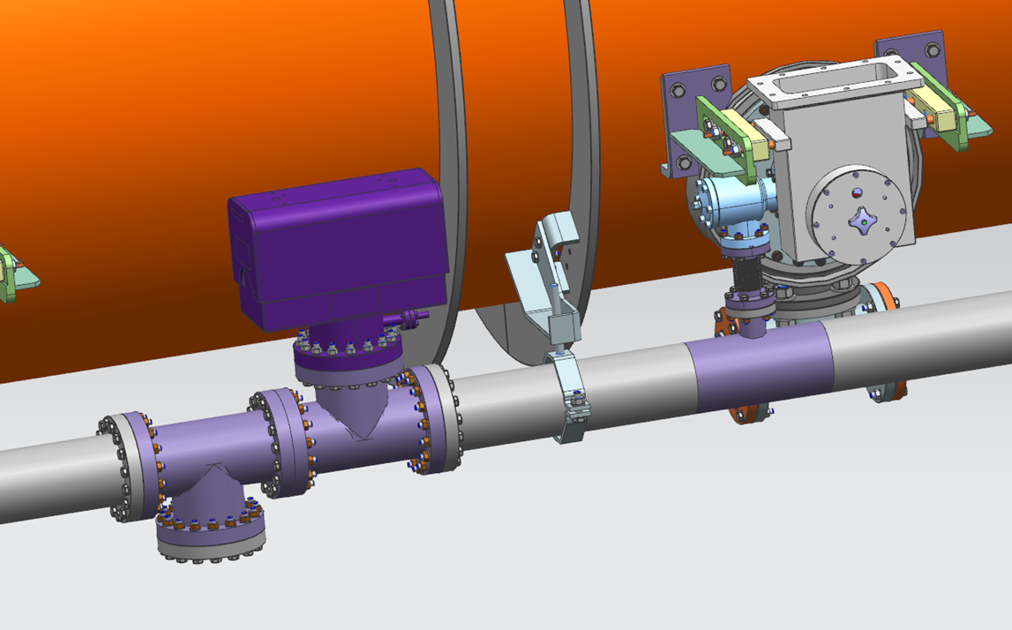
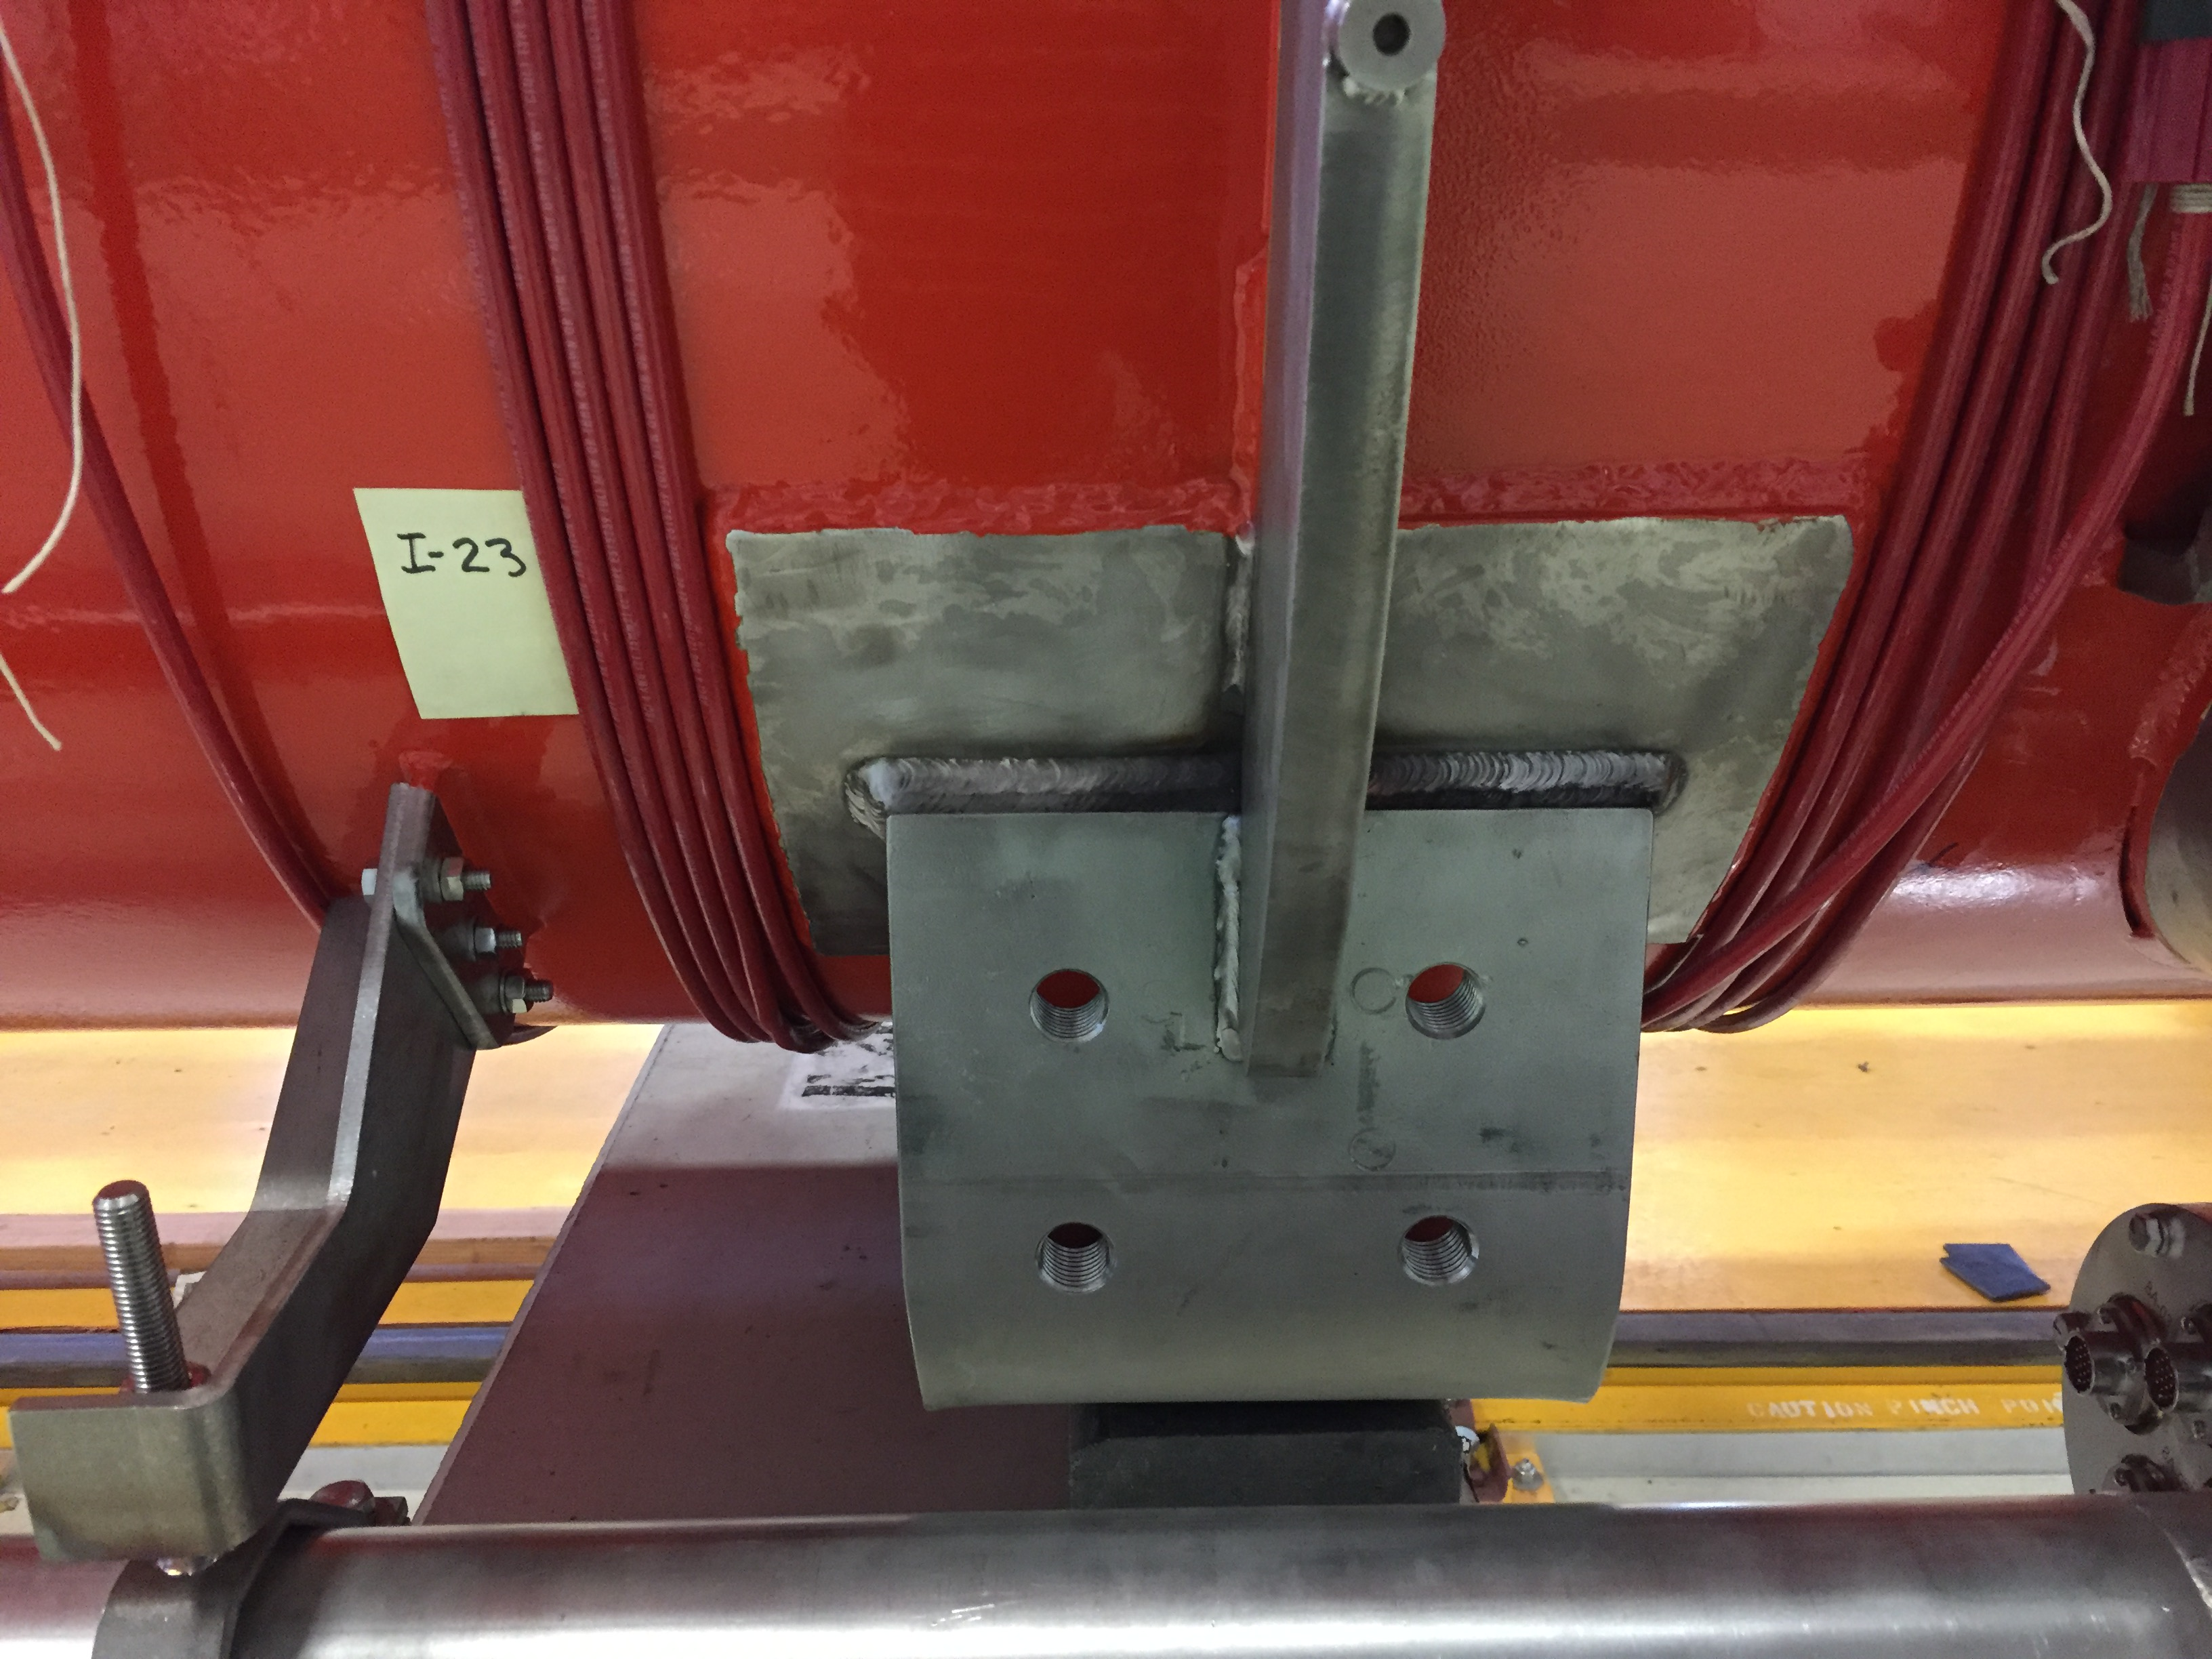
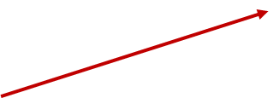
F1.3-1 aka pCM
Repair vacuum vessel leak w/ removing cold mass
Reverse plumbing of the cryogenic valves with new gas guard valves
Upstream end gate valve support frame (flex configuration) and long tuner arms for Cav#1
Additional ion pump support bracket
Seismic brackets holes for the vessel feet (completed)

Slide 2
F1.3-2
Reverse plumbing of the cryogenic valves with new gas guard valves
Upstream end gate valve support frame (flex configuration) and long tuner arms for Cav#1

Slide 3
F1.3-3
Pinpoint locate beamline leak
Decision point
Reverse plumbing of the cryogenic valves with new gas guard valves
Upstream end gate valve support frame (flex configuration) and long tuner arms for Cav#1

Slide 4
F1.3-4
Reverse plumbing of the cryogenic valves with new gas guard valves

