Slide 1
JLAB QA/QC for Cryomodule
LCLS-II QA/QC Workshop
Anne McEwen / Valerie Bookwalter
19-Sep-2017

Slide 2
Outline & Introduction
Introduction
  JLAB has an overall Quality Management System managed by EHS&Q
  SRF Quality overall is reviewed monthly with SRF Management
      Status reports & summaries are available to SRF Staff
QA Tools : How are we working to the “Plan”
  LCLS-II uses the same Quality Tools & Quality Management System
  Travelers in Pansophy are used to collect & organize our Data
  NCRs & D3s are recorded & tracked in Pansophy
QC Results /Pareto on Parts & Assembly
  Pareto of types of quality issues that we are finding
  “significant” NCRs are reported Monthly as required by SLAC
  We measure and track many measures including
    Travelers – open/closed
    NCRs & D3s , number open and number closed
  Through Data Mining Many reports are available to assist the Managers , Engineers & technicians to manage the large quantity of data

Slide 3
Quality Tools
How are we working to the “Plan” for LCLS-II Cryomodule
LCLS-II QA/QC Workshop
Valerie Bookwalter
19-Sep-2017

Slide 4
QA Tools in SRF
Where we keep our data
Pansophy (RECV, INSP, ASSY, TEST)
Docushare
LCLS-II folder on the M Drive (vendor data)
One Drive (Shared Vendor documentation for cavities)

Slide 5
How we use Pansophy
Travelers
(Data In)
Inspection, Processing and Assembly Data for Cavities & Cryomodules and associated parts
Use and Management
Supports Quality Management (NCRs & D3 Reports)
Data Mining Queries – example Cavity Performance
Reports
(Data Out)
Real-Time Status reports - Dashboards
Docushare links to Procedures & Documents
Production & Project Manager Status reports
Quality & Traveler Status , level of completion,
Reports, tables & graphs, export to PDF/Excel

Slide 6
Pansophy in use since 2002

Slide 7
NCRs & D3s by Year

Slide 8
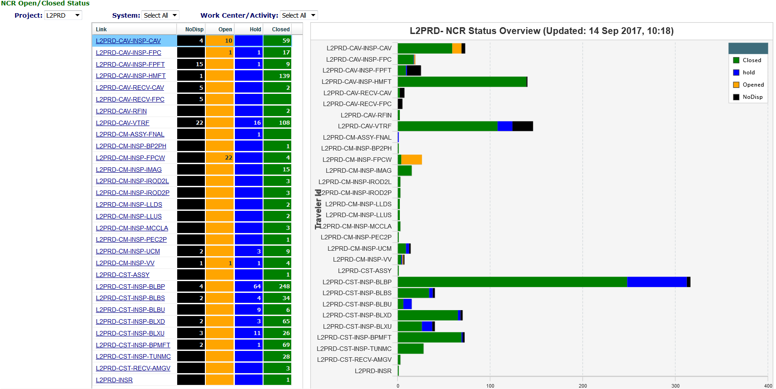
NCR Project View
Drill-down links to Traveler status Query
Visual Status of NCRs (open/close, numbers)
  Listing of NCRs by Traveler ID
Helps Prioritize Traveler/Components with the most issues

Slide 9
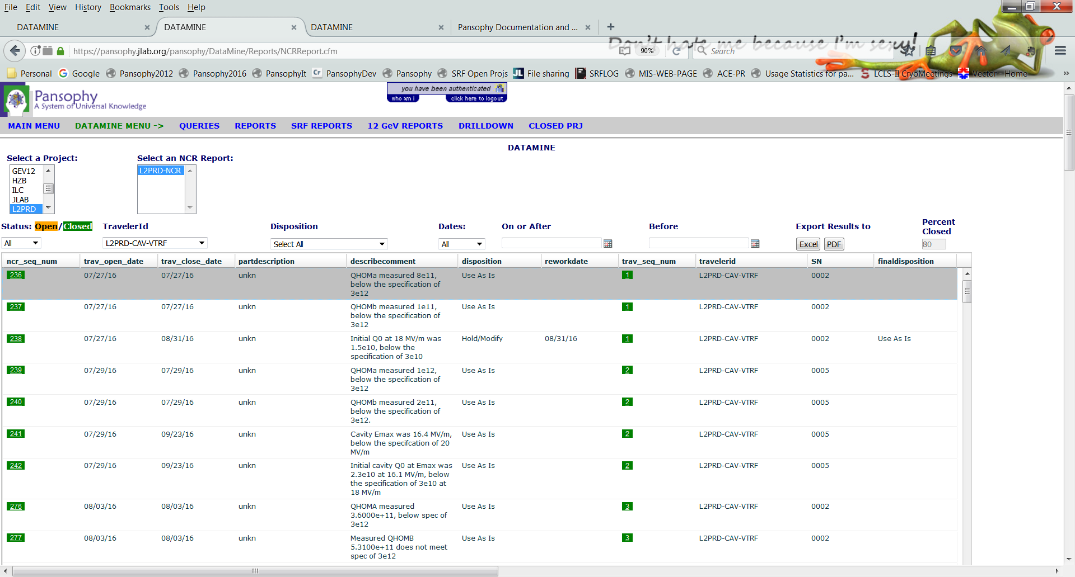
NCR Management (QA/Team Level)
Drill-down links to individual Travelers
NCRs: Non-Conformance Report
  Listing of NCRs, open/close status, related travelers
    Typically found with inspections, but any traveler can apply a NCR
  Linked to specific NCR & Traveler for “Drill Down”
Sort on Disposition, travelers, etc. to Management the NCRs

Slide 10
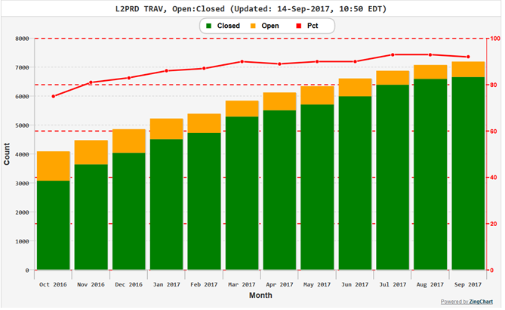
Travelers Open/Close by Month

Slide 11
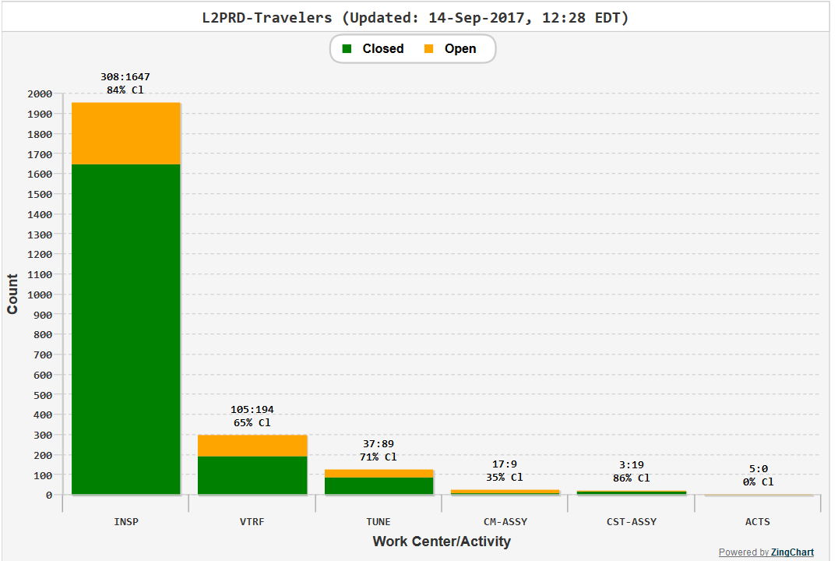
Travelers by Workcenters

Slide 12
Quality Results
Pareto on Parts & Assemblies NCR & Traveler Status for LCLS-II Cryomodule
LCLS-II QA/QC Workshop
Anne McEwen
19-Sep-2017

Slide 13
Significant NCRs – Reported to SLAC
LCLS-II 1.3 GHz Cryomodule Significant Non-Conformance Dashboard
G | On track, moving to closure
Y | Issues identified, solution being worked
R | Problematic, Project Management attention required - Insufficient Data
Laboratory: Jefferson Lab |  |  |  |  |  |  |  |  |  | Condensed from report of August2017
NCR# | Color Code Status | Component/ System Name | Serial # | Name of Supplier/ Vendor | Problem or Discrepancy | Responsible Technical Lead | Date of Detection | Location of NCR Detection (Vendor, Lab Shops, etc.) | Expected Date of Closure | Comments | Close Date | Name of Closer | Prototype or Production
566 589 | R | Dressed Cavity | 0202 0280 | Zanon | E max below spec of 19 MV/m | Palczewski/ Daly | 10/27/2016 11/22/2016 | JLab Vertical Test Area | TBD | Project Mgmt Attention Required. |  |  | Production
603 | R | Dressed Cavity | 0208 | Zanon | Low Qo 2e10 | Palczewski/ Daly | 7/10/17 |  | TBD |  |  |  | Production
823 | Y | Dressed Cavity | 0024 | RI | FE onset at 6.5MV/m, lower than spec which is >17.5MV/m. | Palczewski/ Daly | 4/17/17 |  | TBD | A scratch was found on the iris. Cavity is being returned to vendor. |  |  | Production
893 916 | R | Dressed Cavity (NX-B) | 0063 0083 | RI | Q0(16MV) below the spec of 2.5e10 | Palczewski/ Daly | 5/18/2017 5/31/2017 |  | TBD | Project Mgmt Attention Required. |  |  | Production
930 950 | R | Dressed Cavity (NX-A) | 0104 0109 | RI | Q0(16MV) below the spec of 2.5e10 | Palczewski/ Daly | 6/16/17 |  | TBD |  |  |  | Production
1002 | R | Dressed Cavity (NX-B950) | 0099 | RI | Emax below spec of 19 MV/m (18.8) | Palczewski/ Daly | 8/10/17 |  | TBD |  |  |  | Production
841 | Y | CM Final Assembly | CM02 | VAT | Leaky gate valve found during final assembly of CM2 | K. Wilson | 4/28/17 | Work Station 5 | TBD | Technical discussions have begun with Fermilab and VAT. |  |  | Production
331 | R | pCM | J1.3-01 | JLab | Cavities 1, 5, 6 & 7 HOM A < 5E11 Cavities 5, 7 & 8 HOM B < 5E11. Cavity 6 FE Onset @ 12MV/m. Cavity 2, 6, 7 & 8 couplers could not be adjusted to proper setting 4.0E7. | Drury | 8/25/17 | CMTF | TBD | Project Mgmt Attention Required. |  |  | Prototype
Condensed for Presentation purposes from the list sent August 31 to SLAC & FERMI
NCR 1085 for CM-6 Venting NCR to be added to next report

Slide 14
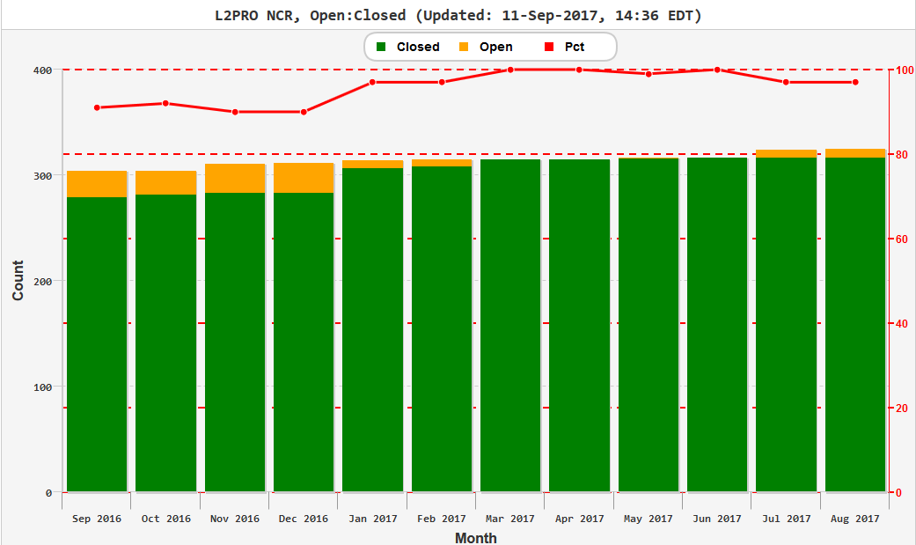
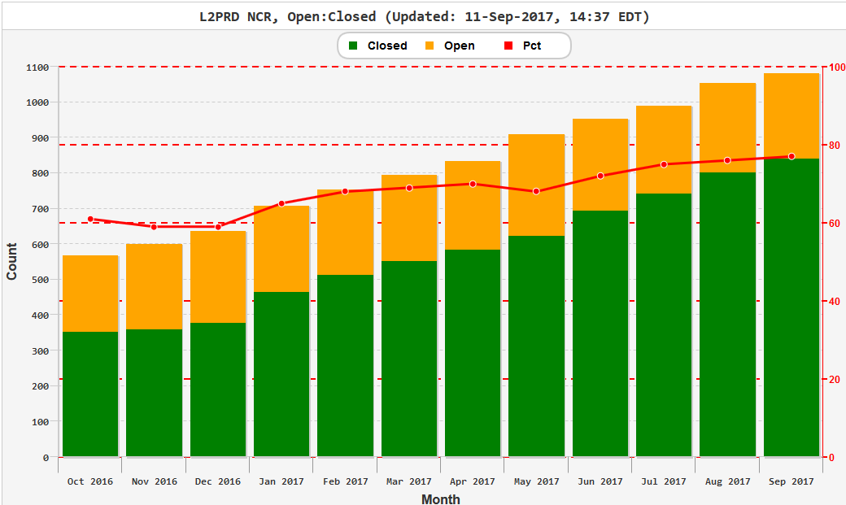
NCR Status by month
pCM (CM-1) NCRs are almost all closed
Production NCRs
% NCRs closed continues to increase

Slide 15
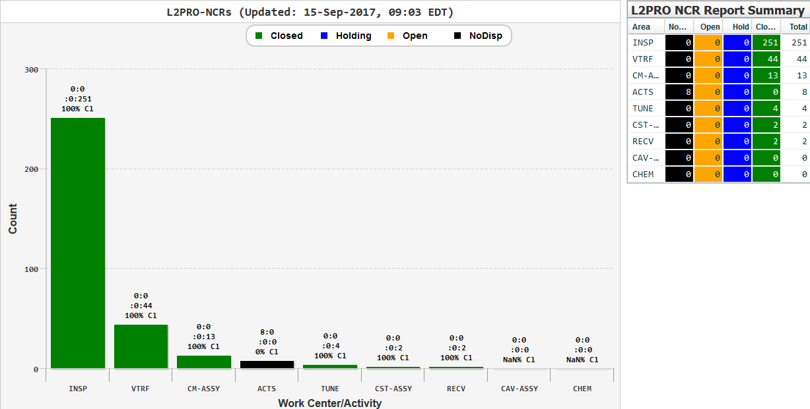
L2PROTOTYPE Open/Closed by Work center
(8) Open NCRs for pCM
Cavities 1, 5, 6 & 7 HOM A lower than 5E11
Cavities 5, 7 & 8 HOM B lower than 5E11
Cavity 8 coupler not 4.0E7
Cavity 7 coupler not 4.0E7
Cavity 6 coupler not 4.0E7
Cavity 2 coupler not 4.0E7
Cavity 6 FEOnset 12MV/m
L2PRO-CM-ACTS
Reported monthly
SRF-QB Management

Slide 16
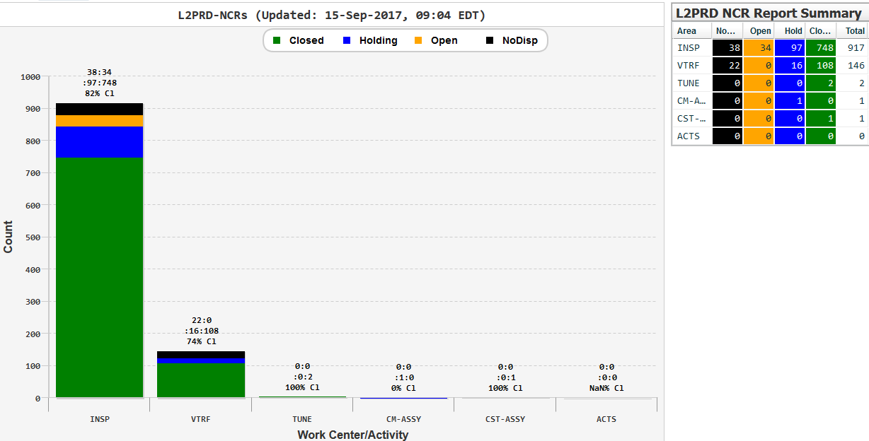
L2PRODUCTION Open/Closed by Work center
80 NCRs Closed in Last Month
9 CAV-INSP-CAV closed
14 FPC closed
6 FeedThrus closed (FPFT & BPMFT)
1 RFIN closed
11 VTRF closed
11 CM closed
15 BLBP closed
3 BLBU closed
10 BLXD closed
Reported monthly
SRF-QB Management

Slide 17
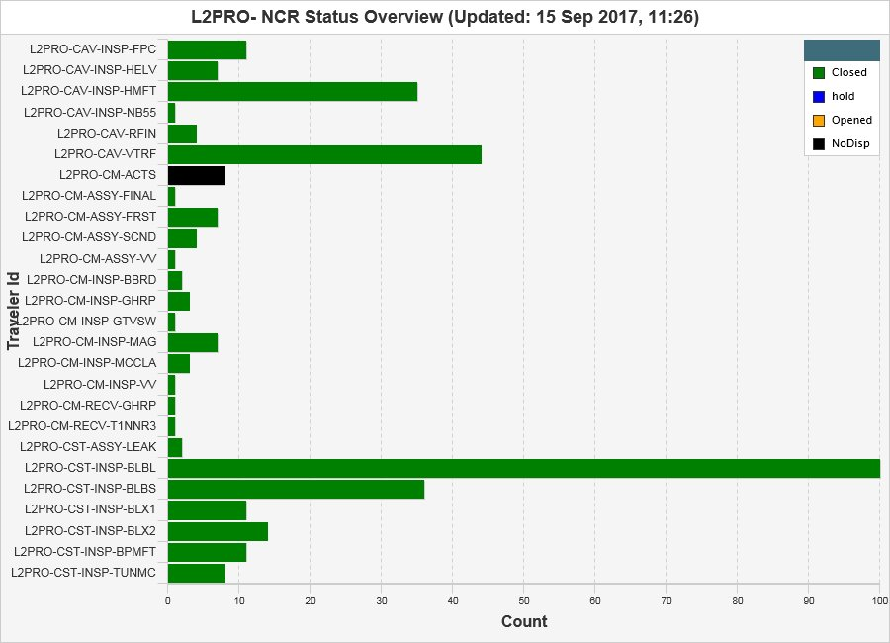
“Prototype” Cryomodule – CM-1 : NCR View

Slide 18
Production Cryomodule NCR Project View

Slide 19
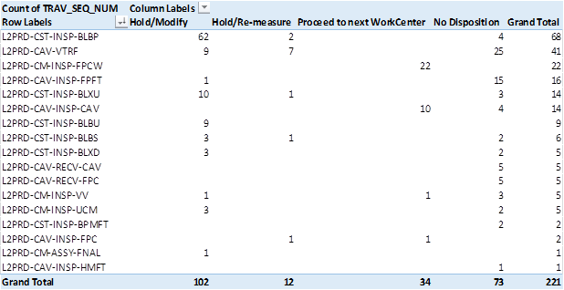
Open “Production” NCRs – Blue are “on Hold”
Parts “on Hold” (Blue) are typically often waiting until needed for re-work

Slide 20
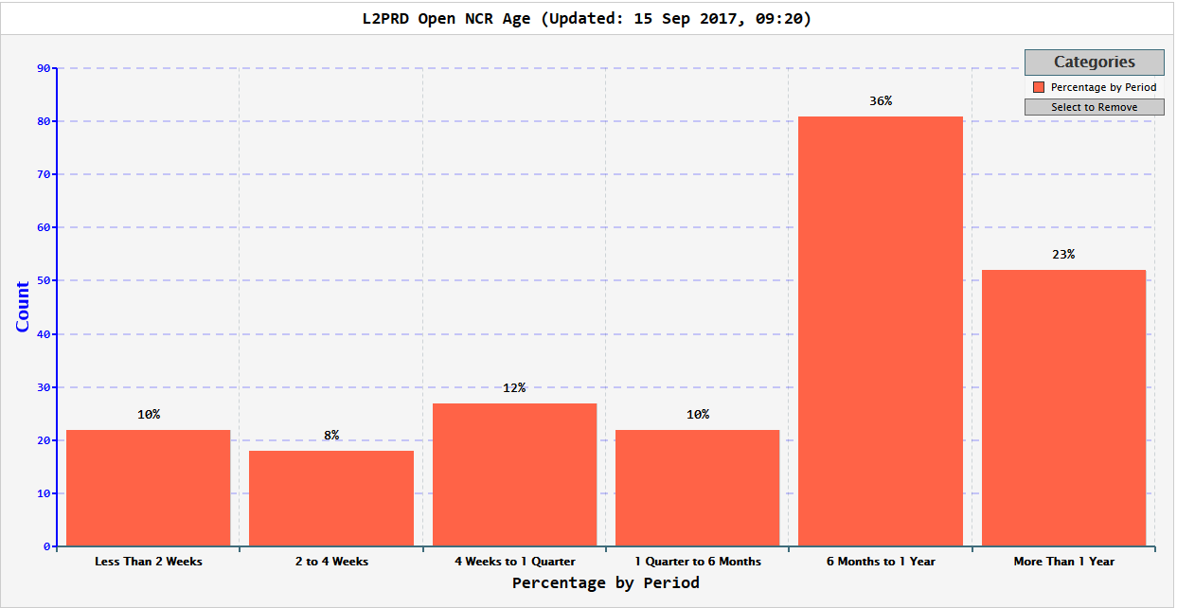
L2PRODUCTION Open NCR Age
Many NCRs 6 m-1 year are “on Hold” until needed

Slide 21
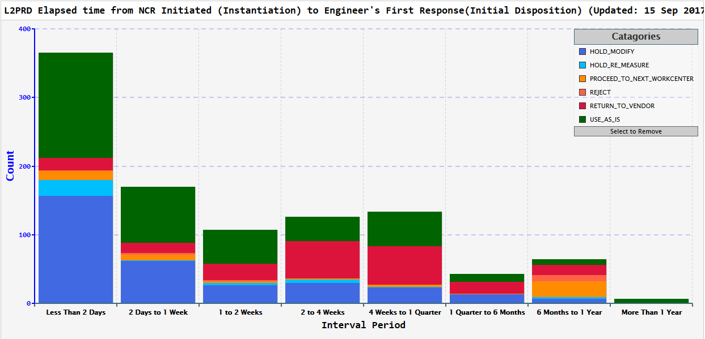
NCRs Initiated to First Response
Reported monthly
SRF-QB Management

Slide 22
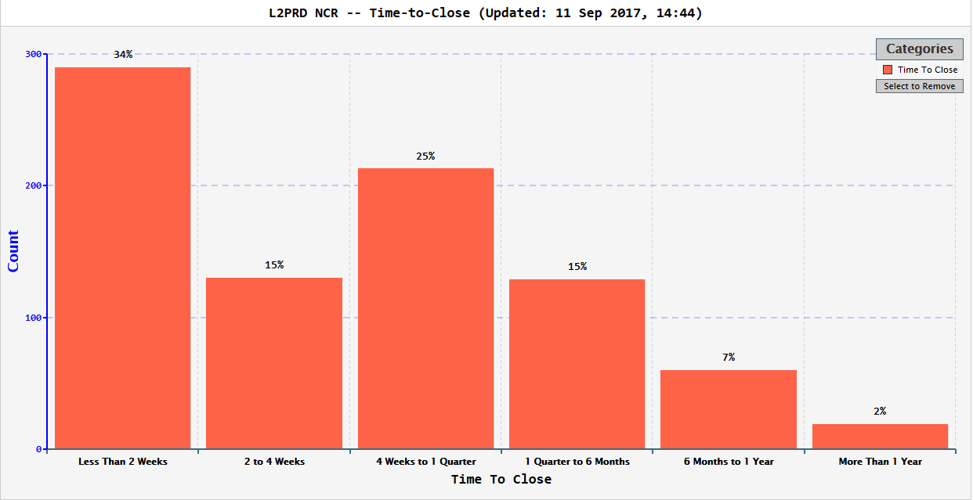
Production NCRs Time to Closure
pCM NCRs are almost all closed, Production chart below (CM-2 on)
35 15 26 16 7 2
Last week

Slide 23
JLAB Traveler Status

Slide 24
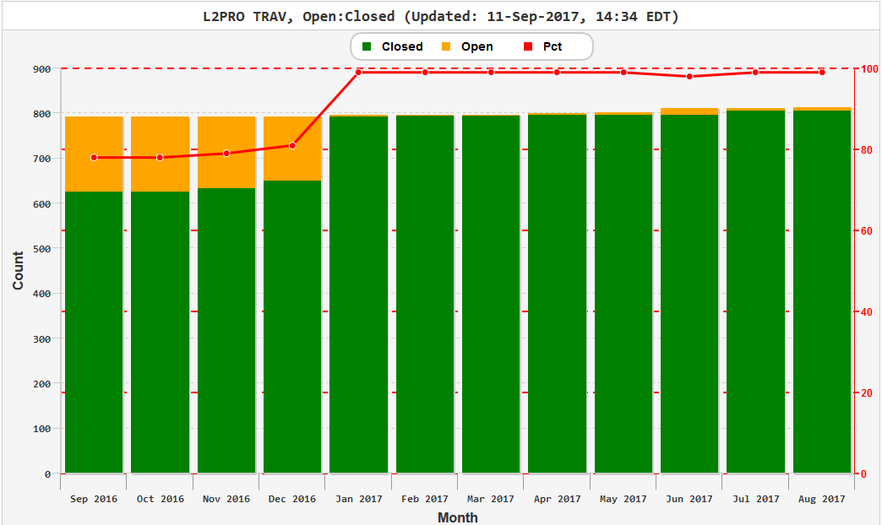
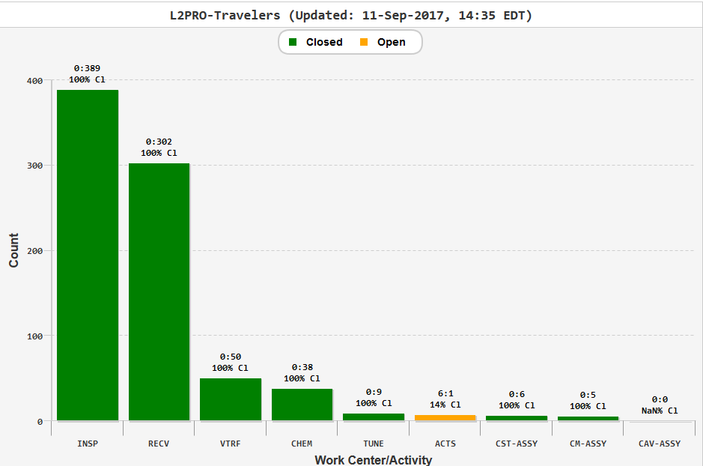
pCM Travelers - by Month &work Center
pCM Travelers closed except
ACTS = Acceptance Test (CMTF)

Slide 25
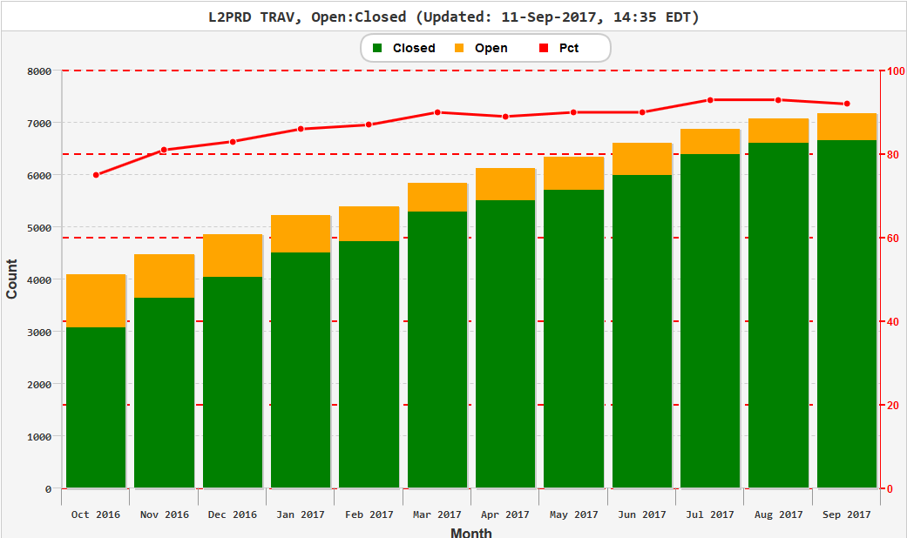
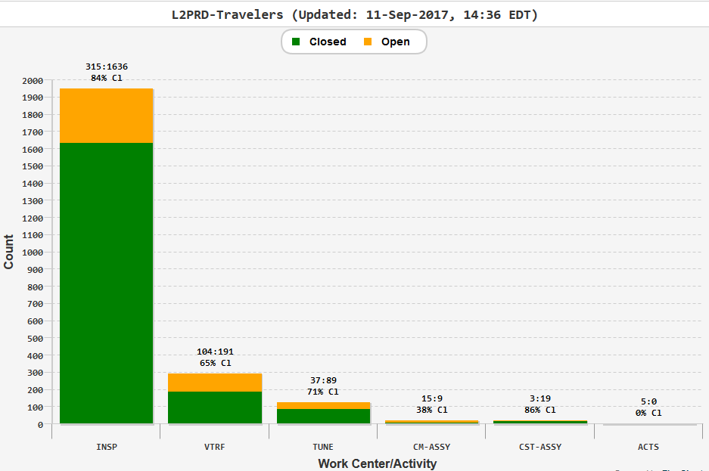
Production Travelers by month& work center
Travelers being closed as work is completed

Slide 26
Summary

Slide 27
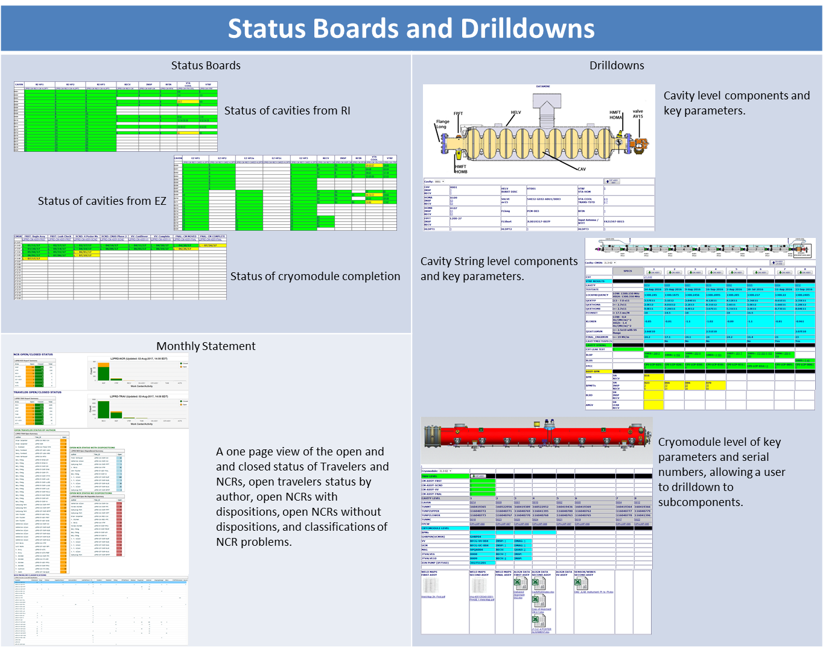
Samples of LCLS II Status Boards & Drilldowns

Slide 28
Summary
Quality Tools are supporting the Project
  Continuously improving the Reporting functions
QC Results
  NCRs are being address and closed
  Significant NCRs are reported monthly to both SLAC & Fermi Lab

Slide 29
BACK Up Slides
LCLS-II QA/QC Workshop
19-Sep-2017

Slide 30
L2PRD Traveler Names & Titles *
Traveler Name | Author | Traveler Title | Traveler Abstract
L2PRD-CST-INSP-BLBP | Katherine Wilson | LCLS-II Cavity String Weldment Bellows PrCM Inspection Traveler | Traveler defines inspection process for cavity string PrCM bellows
L2PRD-CST-INSP-BLBS | Katherine Wilson | LCLS-II Cavity String Weldment Bellows Short Inspection Traveler | Traveler defines inspection process for cavity string short bellows
L2PRD-CST-INSP-BLBU | Katherine Wilson | LCLS-II Cavity String Weldment Upstream Bellows Inspection Traveler | Traveler defines inspection process for cavity string upstream bellows
L2PRD-CST-INSP-BLXD | Katherine Wilson | LCLS-II Cavity String Weldment Extension-DS Inspection Traveler | Traveler defines inspection process for cavity string bellows/spool pieces
L2PRD-CST-INSP-BLXU | Katherine Wilson | LCLS-II Cavity String Weldment Extension-US Inspection Traveler | Traveler defines inspection process for cavity string bellows/spool pieces
L2PRD-CST-INSP-BPMFT | HyeKyoung Park | BPM Feedthrough Incoming Inspection Traveler | Incoming inspection traveler for LCLS-II production BPM feedthrough
L2PRD-CAV-INSP-CAV | Katherine Wilson | L2PRD LCLS-II Cavity Receiving Inspection | Incoming Inspection of Dressed LCLS-II Production Cavities.
L2PRD-CAV-RECV-CAV |  | L2PRD Dressed Cavity Inventory Traveler | Inventory receipt traveler for the L2PRD Dressed Cavity
L2PRD-CAV-VTRF | Kirk Davis | LCLSII (Production Cryomodule) Vertical cavity Testing | Cryogenic RF testing of 1300MHz 9-cell cavities for LCLSII Production Cryomodules
L2PRD-CM-ASSY-FNAL | John Fischer | LCLS2 Production Cryomodule Final Assembly Traveler | This traveler details the assembly and in-process quality control inspections of the LCLS2 Final Assembly. All work will be completed in the Cryomodule Assembly areas. The scope of work begins with a completed Vacuum Vessel Assembly on the cantilevered tooling and ending with a Cryomodule ready to enter the CMTF.
L2PRD-CAV-INSP-FPFT | HyeKyoung Park | LCLS-II Field Probe Feedthru Receiving Inspection | LCLS-II Field Probe feedthru receiving inspection traveler, visual inspection, dimensional checks, cold shock/cycle test, and leak test
L2PRD-CAV-INSP-HMFT | HyeKyoung Park | LCLS-II HOM Feedthru Receiving Inspection | LCLS-II HOM feed thru receiving inspection traveler, visual inspection, dimensional checks, cold shock/cycle test, and leak test
L2PRD-CAV-INSP-FPC | HyeKyoung Park | Inspection FPC- Fundamental Power Coupler | Covers FPCs incoming inspection and acceptance tests at JLAB
L2PRD-CAV-RECV-FPC | M. Stirbet | L2PRD FPC receiving (Fundamental Power Coupler ) | Covers LCLSII FPC receiving traveler
L2PRD-CM-INSP-FPCW | M. Stirbet | LCLS-II warm FPC incoming Inspection | Covers FPCs incoming inspection and acceptance tests at JLAB
L2PRD-CM-INSP-UCM | Gary Cheng | LCLS-II Upper Cold Mass Incoming Inspection | This traveler is to be used for the incoming inspection for the LCLS-II production cryomodule Upper Cold Mass (UCM).
L2PRD-CM-INSP-VV | Gary Cheng | Receiving Inspection of LCLS-II Production Cryomodule Vacuum Vessel | This traveler is for inspection of LCLS-II Production Cryomodule Vacuum Vessel
* Limited to Travelers with open NCRs as of 18Sep2017

Slide 31
Significant NCRs – Reported to SLAC (August 2017)
LCLS-II 1.3 GHz Cryomodule Significant Non-Conformance Dashboard
G | On track, moving to closure
Y | Issues identified, solution being worked
R | Problematic, Project Management attention required - Insufficent Data
Laboratory: Jefferson Lab |  |  |  |  |  |  |  |  |  | Data Month of: August 2017
NCR# | Color Code Status | Component/ System Name | Serial # | Name of Supplier/ Vendor | Problem or Discrepancy | Responsible Technical Lead | Date of Detection | Location of NCR Detection (Vendor, Lab Shops, etc.) | Expected Date of Closure | Comments | Close Date | Name of Closer | Prototype or Production
566 | R | Dressed Cavity | 0202 | Zanon | At 2K Emax is 14.9 MV/m, lower than spec which is 19 MV/m. No Q0 measurement available at 16 MV/m either. | Palczewski/ Daly | 10/27/16 | JLab Vertical Test Area | TBD | Project Mgmt Attention Required. |  |  | Production
589 | R | Dressed Cavity | 0201 | Zanon | Final 2K run, Emax 16.6MV/m, lower than spec (19MV/m). | Palczewski/ Daly | 11/22/16
603 | R | Dressed Cavity | 0208 | Zanon | Low Qo 2e10 | Palczewski/ Daly | 7/10/17
823 | Y | Dressed Cavity | 0024 | RI | FE onset at 6.5MV/m, lower than spec which is >17.5MV/m. | Palczewski/ Daly | 4/17/17 |  |  | A scratch was found on the iris. Cavity is being returned to vendor.
841 | Y | CM Final Assembly | CM02 | VAT | Leaky gate valve found during final assembly of CM2 | K. Wilson | 4/28/17 | Work Station 5 |  | Technical discussions have begun with Fermilab and VAT.
893 | R | Dressed Cavity (NX-B) | 0063 | RI | Q0(16MV) was 2.1e10, below the specification of 2.5e10 | Palczewski/ Daly | 5/18/17 | JLab Vertical Test Area |  | Project Mgmt Attention Required.
916 | R | Dressed Cavity (NX-B) | 0083 | RI | Initial Q0(16) measured 1.87e+10, below the specification of 2.5e10 | Palczewski/ Daly | 5/31/17
930 | R | Dressed Cavity (NX-A) | 0104 | RI | Q0(16)Measured 2.20e+10, below spec 2.5e10 | Palczewski/ Daly | 6/16/17
950 | R | Dressed Cavity (NX-A) | 0109 | RI | Q0 at 16MV/m was 2.38e10, lower than spec which is 2.5e10. | Palczewski/ Daly | 6/28/17
1002 | R | Dressed Cavity (NX-B950) | 0099 | RI | Cavity did not make it to 19 MV/m. It only made it to 18.8 +/- 1 MV/m | Palczewski/ Daly | 8/10/17
331 | R | pCM | J1.3-01 | JLab | Cavities 1, 5, 6 & 7 HOM A lower than 5E11. Cavities 5, 7 & 8 HOM B lower than 5E11. Cavity 6 FE Onset @ 12MV/m. Cavity 2, 6, 7 & 8 couplers could not be adjusted to proper setting 4.0E7. | Drury | 8/25/17 | CMTF |  |  |  |  | Prototype

Slide 32
NCRs - Pareto of issues for Production
Bellows & Spools - includes Scratches, Pits, Dings, Roughness (Profilometer ) , Plating, Stains , Oxidization , Residues (Not checked dimensionally)
Probes (Field HOM, BPM) : Scratches , Dimensional
Cavities & Helium Vessels : some Dimensional issues, mainly VTRF Performance (VTA Test) occasional RF Failure (test not started), Cavity Shock Sensors (shipping)
Vacuum Vessels : Scratches and paint on flanges
Mag Shield – Dents, scratches, incomplete welds

Slide 33
Back Up Slides
LCLS II Quality Reports & Documents
LCLS-II QA/QC Workshop
19-Sep-2017

Slide 34
LCLS II Status Boards and Drilldowns

Slide 35
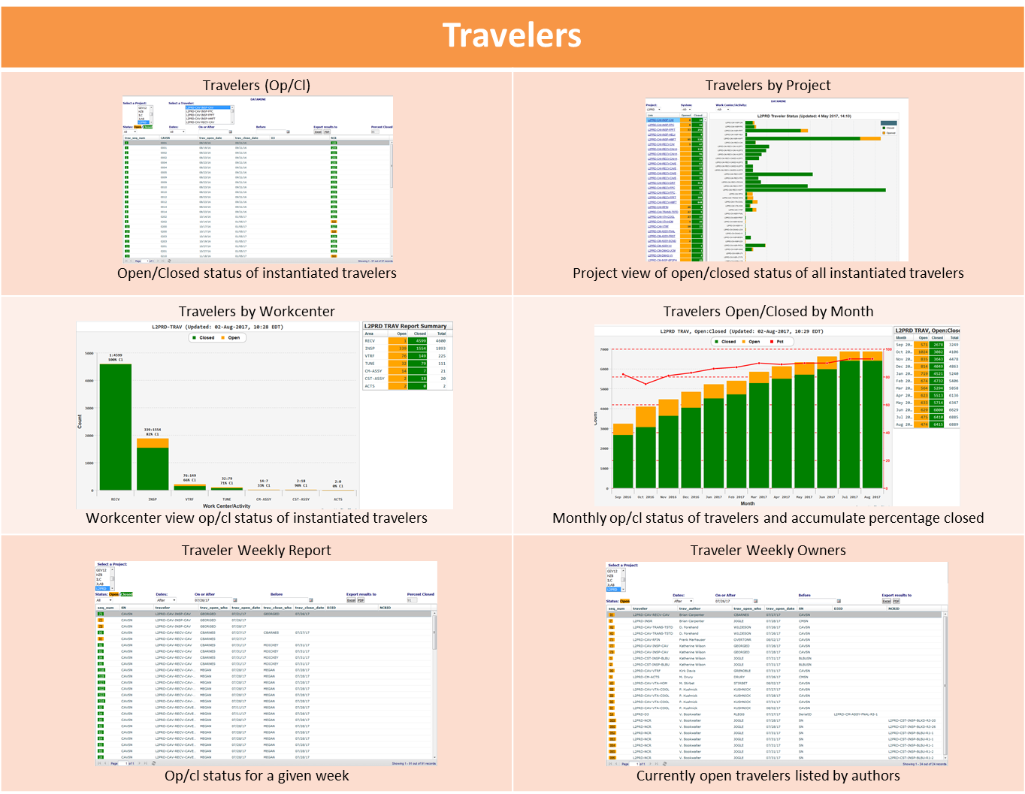
LCLS II Traveler Reports

Slide 36
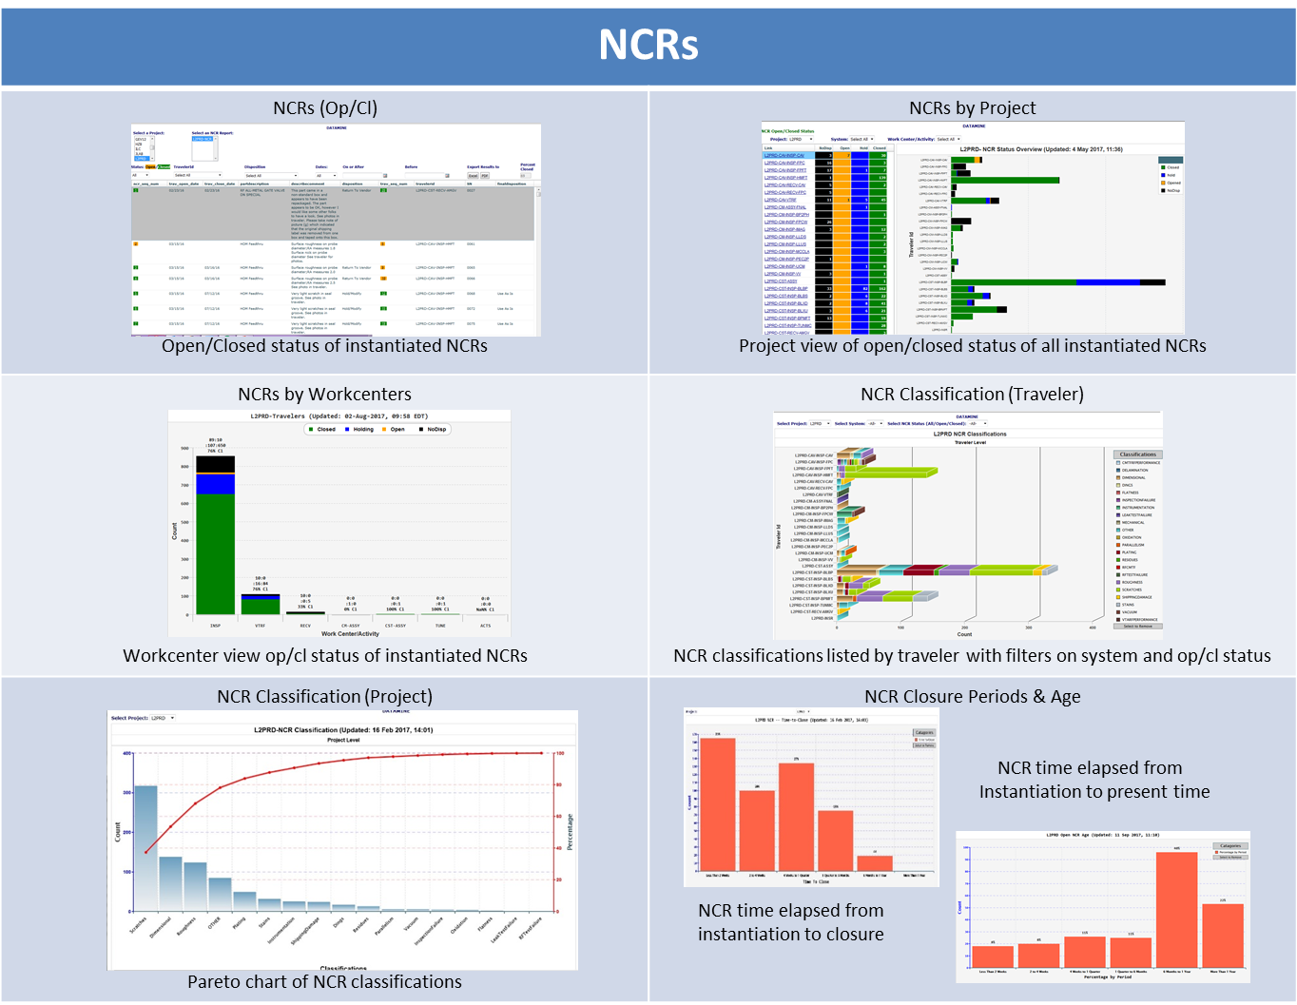
LCLS II NCR Reports

