Slide 1
JLab CM Re-Work Plans
19-September-2017

Slide 2
J1.3-01 through 06 Required Retrofits
 | -01 | -02 | -03 | -04 | -05 | -06*
Replace JT & CD with Gasguard valves | X | X | X | X | X | -
Gate Valve Flex joint on Cavity 1 | X | X | X | X | X | -
HOMs re-tuned | X | X | X | X
Valve Stems w/ wipers | X | X | X | X
Baffle in 2 phase line (?) | X
Reverse JT & CD valve plumbing | X
Replace HOM cables |  | X
Re-tune cavity 1 |  |  | X
Dis-Assemble J1.3-06 |  |  |  |  |  | X
* J1.3-06 will require complete disassembly and reprocessing
˚ J1.3-07 final assembly will coincide with Gas Guard valve delivery in November and has no known rework planned

Slide 3
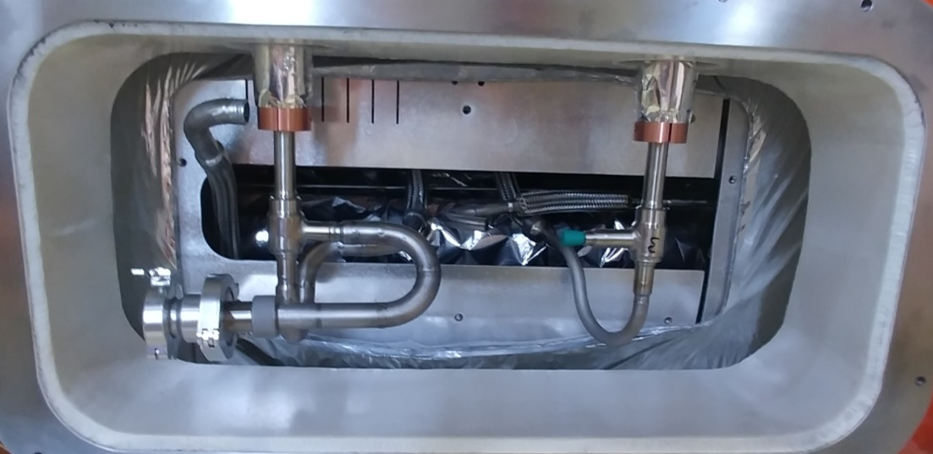
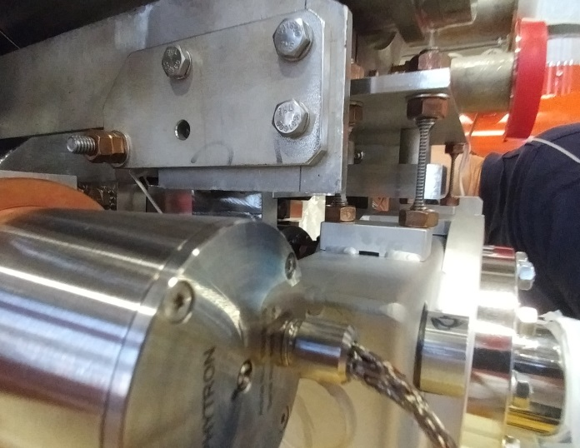
Microphonic mitigations
Reverse JT & CD valve plumbing (pCM)
Baffle in 2 phase line (pCM) Proposal
Gate Valve Flex joint on Cavity 1 (all)
Valve Stems w/ wipers (all)
Replace JT & CD with Gasguard valves (all)

Slide 4
Cost / time estimates in P6 for Plumbing & GasGuards
For pCM, about 127 hours and $4k in consumables total for retrofit.
For J1.3-02 through 05, about 141 hours and $4k in consumables each. Total is 564 hours and $16K in consumables.
New valve stems with wipers provided by FNAL.
Would be done at end of current production run.

Slide 5
Cost / time estimates in P6 for Flex Support for Gate valve
Cost is about 80 hours per cryomodule for the work with parts supplied from FNAL.
Total time is about 400 hours to retrofit 5 cryomodules.
Work would be done at end of current production run.

Slide 6
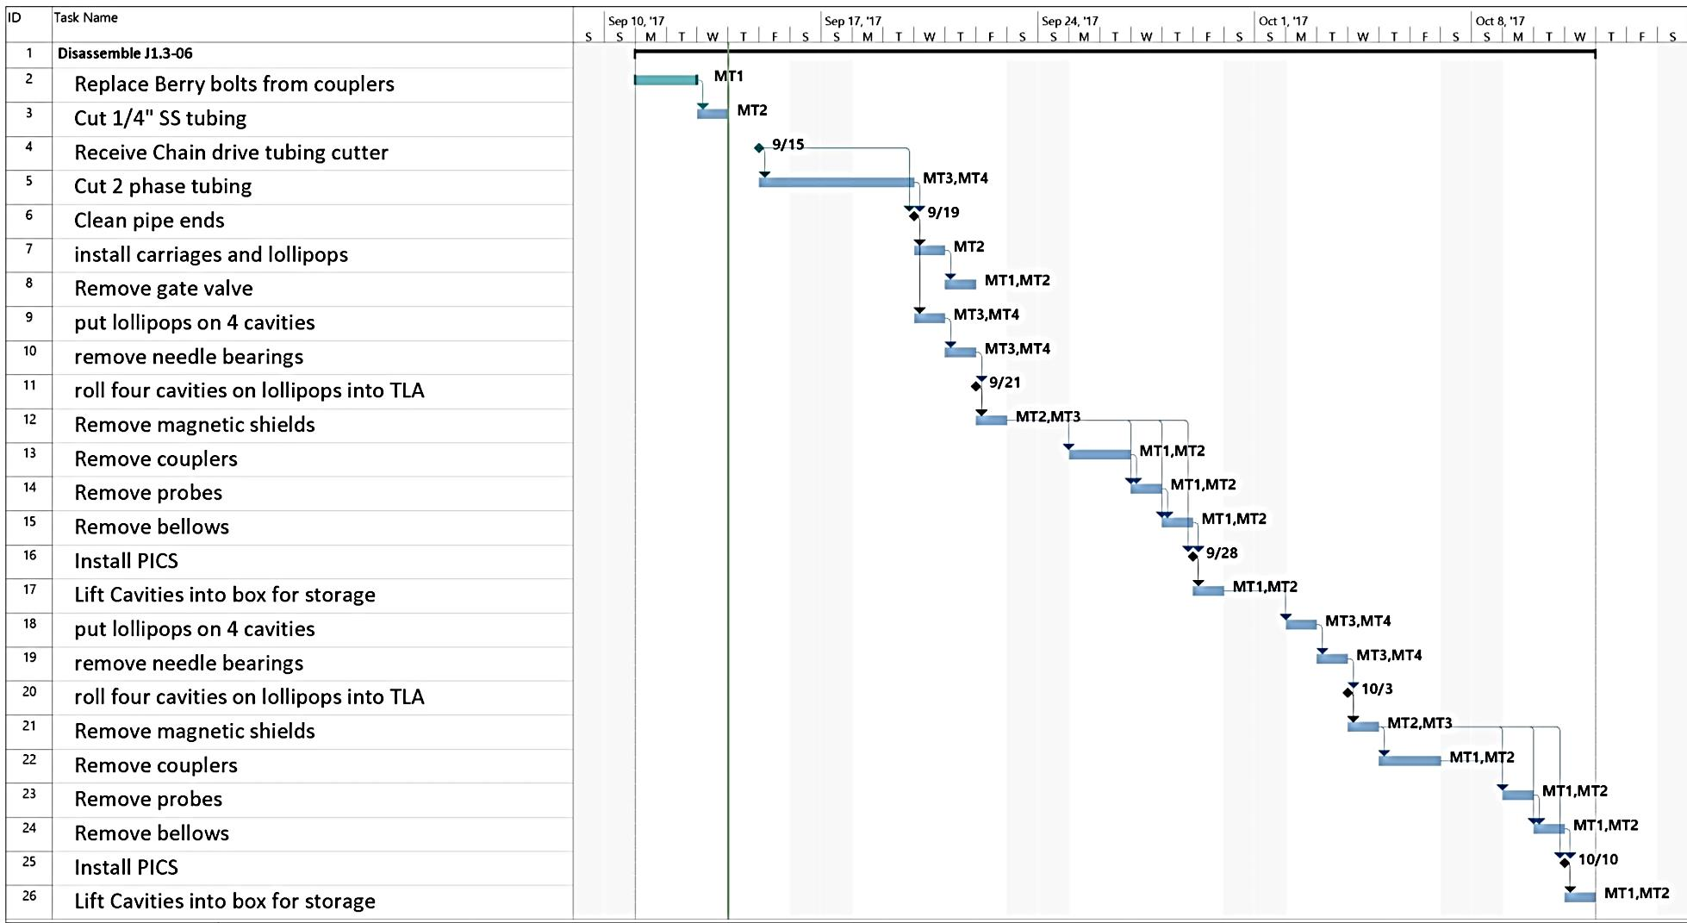
Cost / time estimates in P6 for Disassembly of J1.3-06
Proposed dis-assembly time is about 330 hours;
Reprocessing cavities and couplers is separate, non-trivial expense

Slide 7
Summary
Several major retrofits in progress, but waiting on parts
Gas guarded valves
Flex support of cavity 1 gate valves
Work to be done at end of current run or when dictated by Project
Space on floor is an issue
We need to disassemble CM06 to get the cavities and couplers back into the system for use on later strings (proposal attached)

