Slide 1
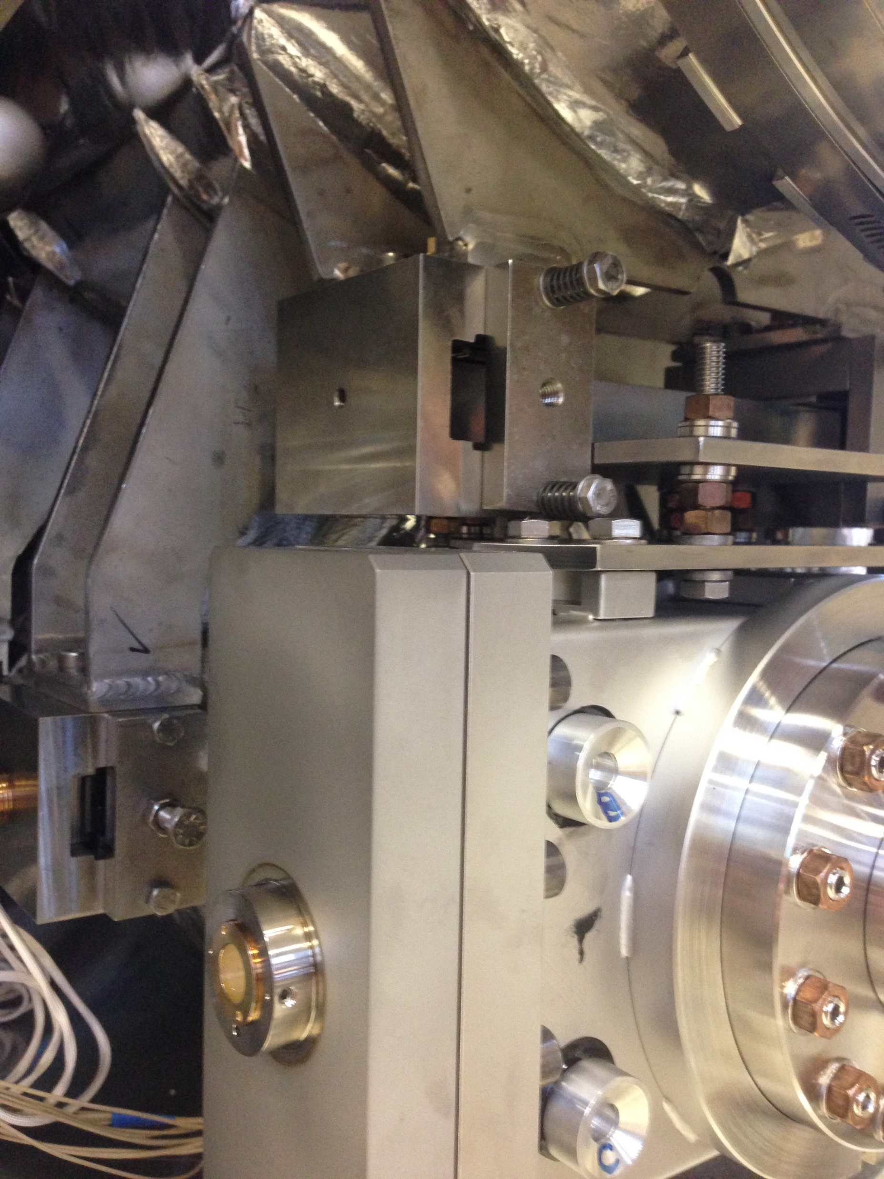
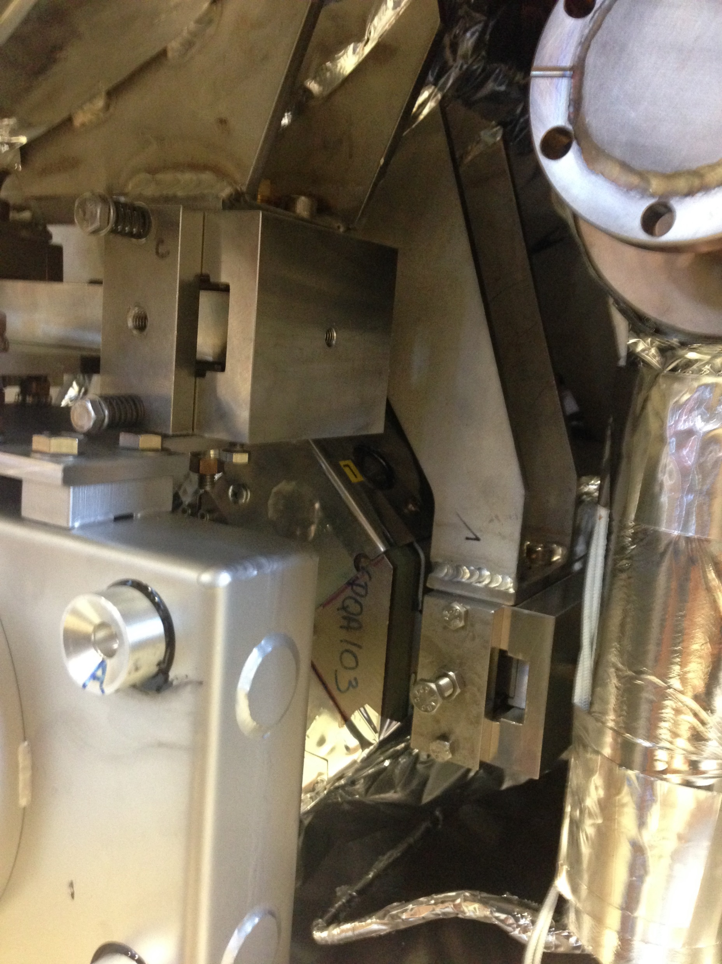
These remain in place during testing to prevent the possibility of bearings sliding out
Must be fully removed after moving into test cave
Must be fully removed after moving into test cave
CM04 Bearing Locks For Shipping and Operation

