Slide 1
Presentation Title — one line or two lines
Presenter’s Name
Meeting Title
Day Month Year

Slide 2
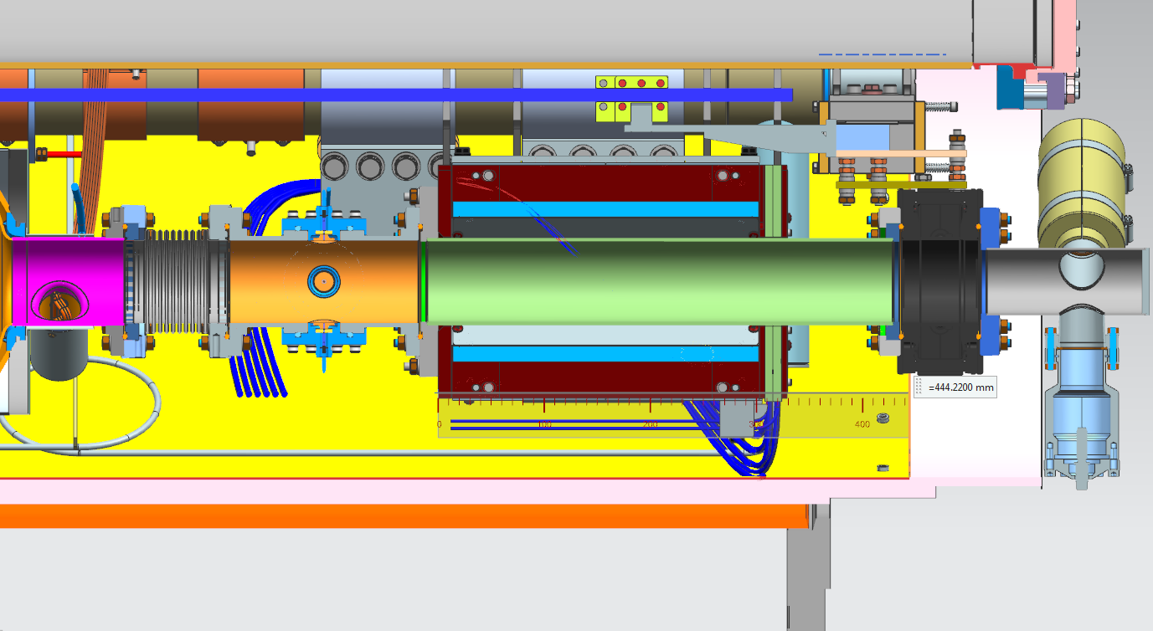
F1.3-03 Beam Pipe leak region
BP Bellow+BPM+Magnet Flange

Slide 3
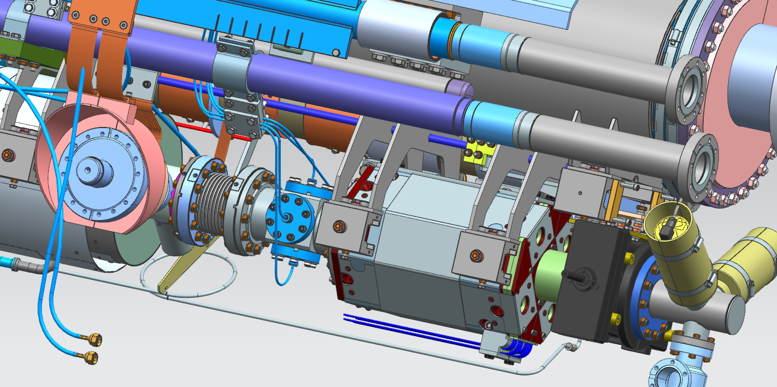
F1.3-03 Magnet-GV bearing support

Slide 4
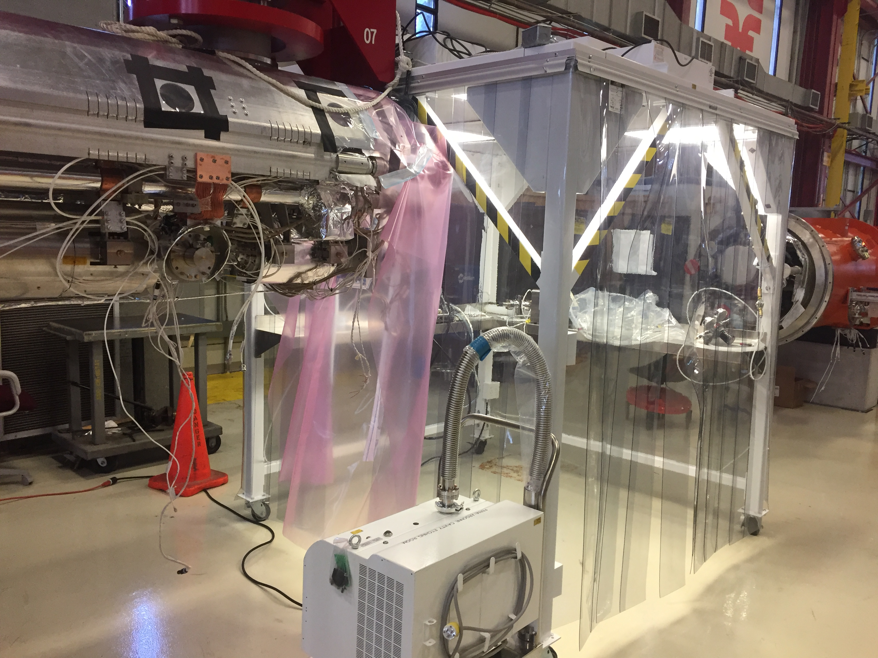
F1.3-03 preparation for BP Leak test

