Slide 1
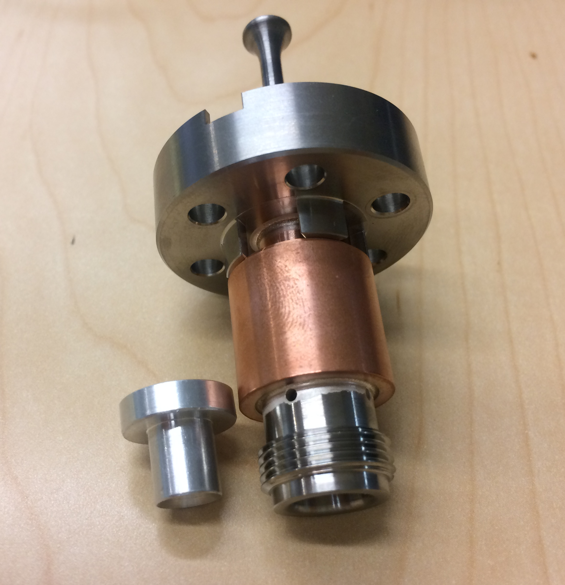
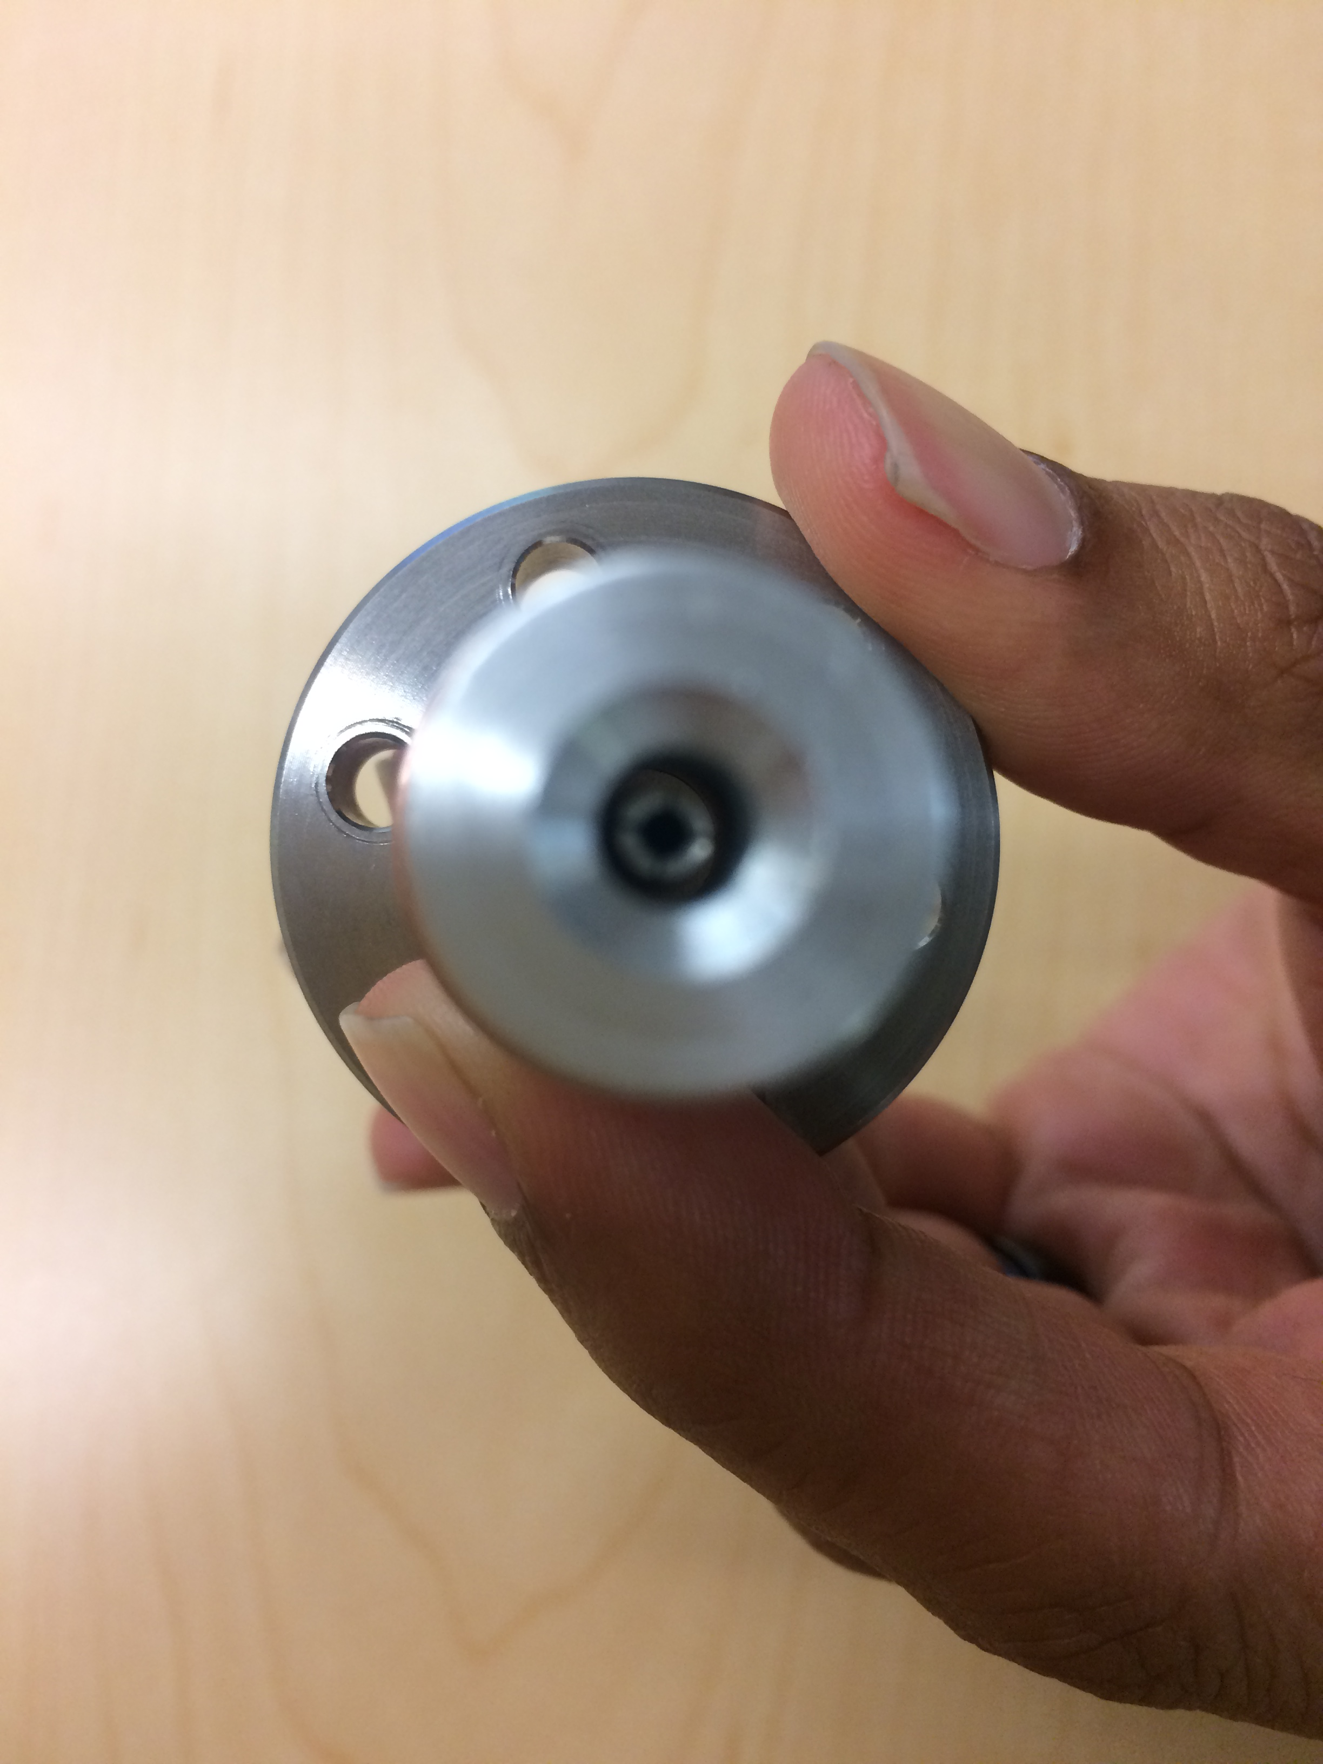
Feedthru Inspection
Incoming inspection includes pin check and results recorded in traveler. Both connector and gage are used to check.

