Slide 1
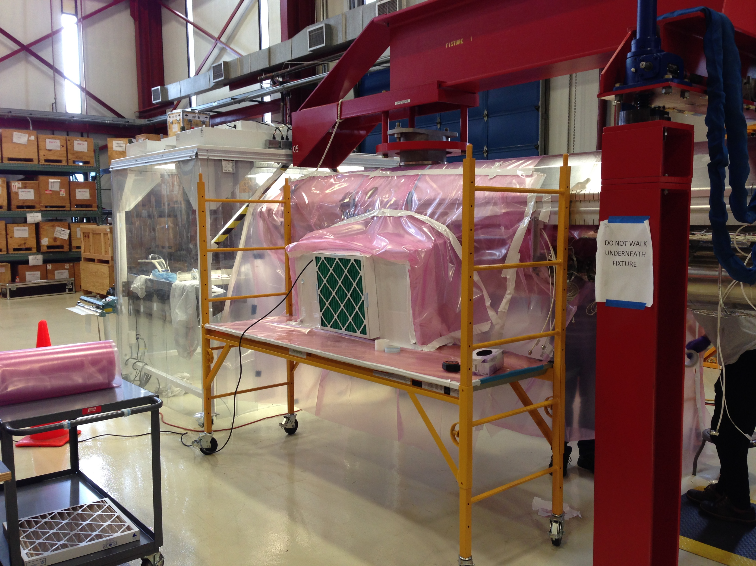
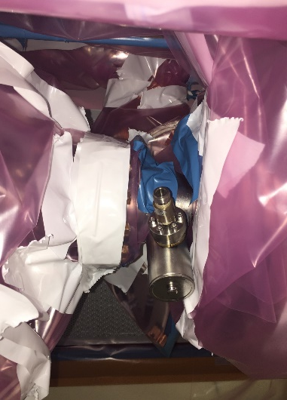
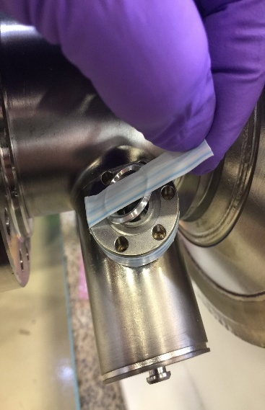
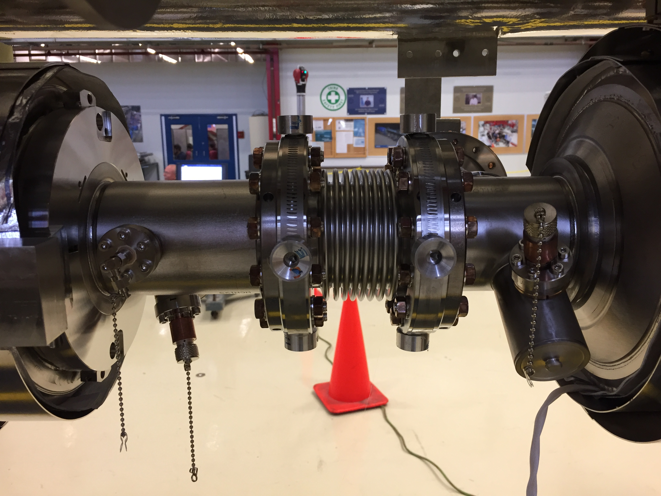
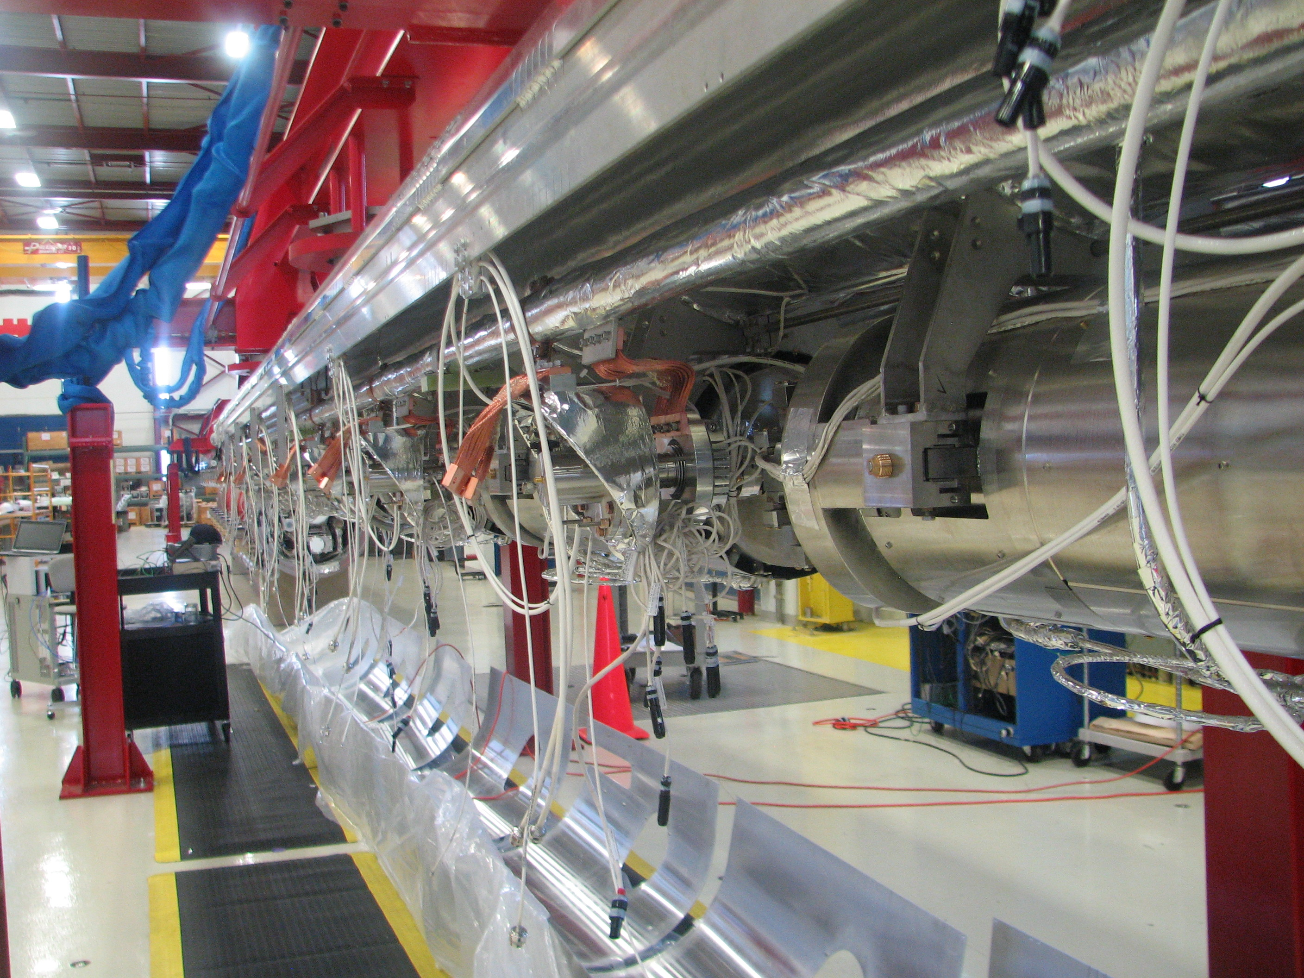
F1.3-5 Cav#2 HOM connector replacement
During final HOM notch frequency tuning at WS3, when the RF cable was removed, RF engineer noticed that Cav#2 HOM1 pin is broken
Local cleanroom tent was built. Nitrogen fogger was used to optimize the location and rotation speed of the fan filter unit
Procedures are developed, tested on a the bench with a spare cavity
HOM connector with broken pin was replaced and leak checked successfully
This is a one time incident. Official root cause analysis is not done
Mitigation Strategy: ensure that protection caps are installed throughout the cold mass assembly. RF group changed the procedure for HOM notch frequency tuning: Keep the RF cable connected during tuning
CM05 is being assembled at WS5, it will be tested after F1.3-6

