Slide 1
Charge readout components
Dario Autiero (IPNL Lyon)
September 21, 2017

Slide 2
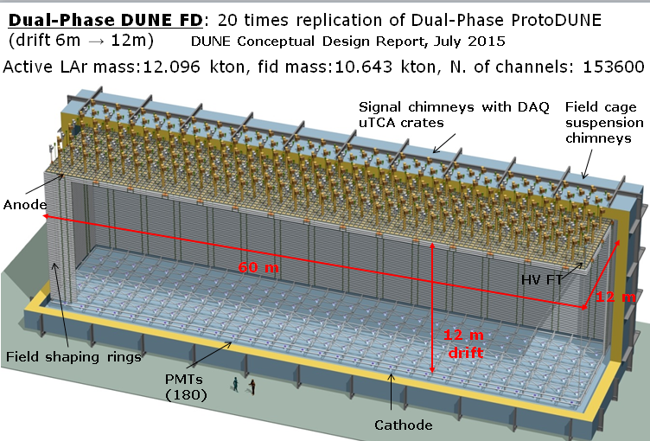
Dual-phase 10 kton FD module
80 CRP units
60 field shaping rings
240 signal FT chimneys
240 suspension chimneys
180 PMTs
153600 readout channels
Advantages of double-phase design:
Anode with 2 collection (X, Y) views (no induction views), no ambiguities
Strips pitch 3.125 mm, 3 m length
Tunable gain in gas phase (20-100), high S/N ratio for m.i.p. > 100, <100 KeV threshold, min. purity requirement 3ms → operative margins vs purity, noise
Long drift projective geometry: reduced number of readout channels
No materials in the active volume
Accessible and replaceable cryogenic FE electronics, high bandwidth low cost external uTCA digital electronics

Slide 3
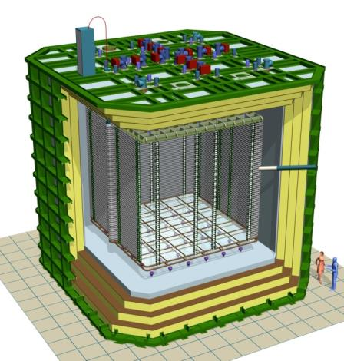
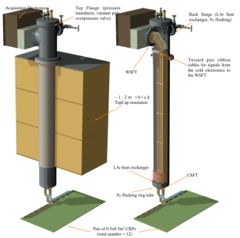
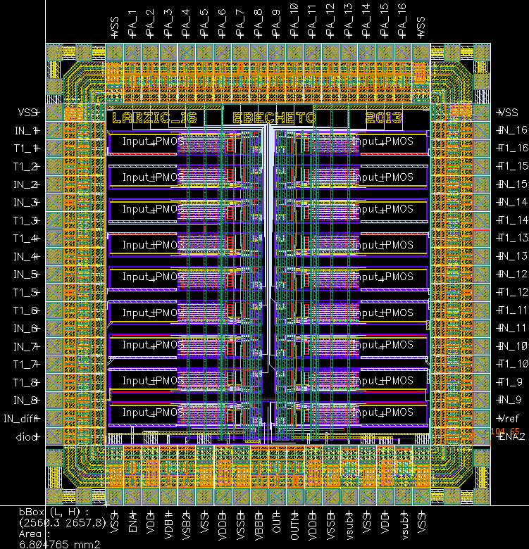
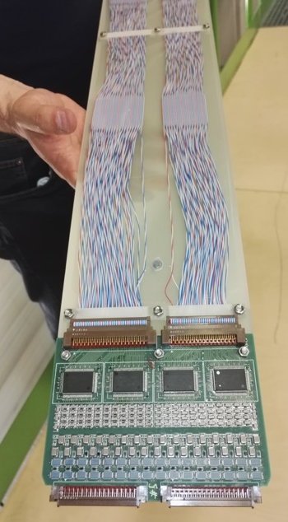
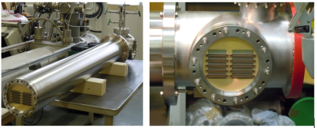
ProtoDUNE-DP accessible cold front-end electronics and uTCA DAQ system 7680 ch
Full accessibility provided by the double-phase charge readout at the top of the detector
Digital electronics at warm on the tank deck:
Architecture based on uTCA standard
1 crate/signal chimney, 640 channels/crate
→ 12 uTCA crates, 10 AMC cards/crate, 64 ch/card
Cryogenic ASIC amplifiers (CMOS 0.35um) 16ch externally accessible:
Working at 110K at the bottom of the signal chimneys
Cards fixed to a plug accessible from outside
→Short cables capacitance, low noise at low T
Warm
FE cards mounted on insertion blades
ASICs 16 ch.
(CMOS 0.35 um)
uTCA crate
Cold
CRP
Signal chimney
3

Slide 4
Dual phase liquid argon TPC
6x6x6 m³ active volume
ProtoDUNE-DP at CERN
Event size: drift window of
7680 channels x 10000 samples ⇒ 146.8 MB
X and Y charge collection strips
3.125 mm pitch, 3 m long →7680 readout channels
Segmented anode
in gas phase with
dual phase amplification
3 m
E=0.5-1.0 kV/cm
Drift coordinate
6 m = 4 ms
sampling 2.5 MHz
(400 ns), 12 bits
10000 samples
per drift window
LAr volume
Drift
dE/dx → ionization
Prompt UV
light
6 m
6 m
Cathode
Photomultipliers
4

Slide 5
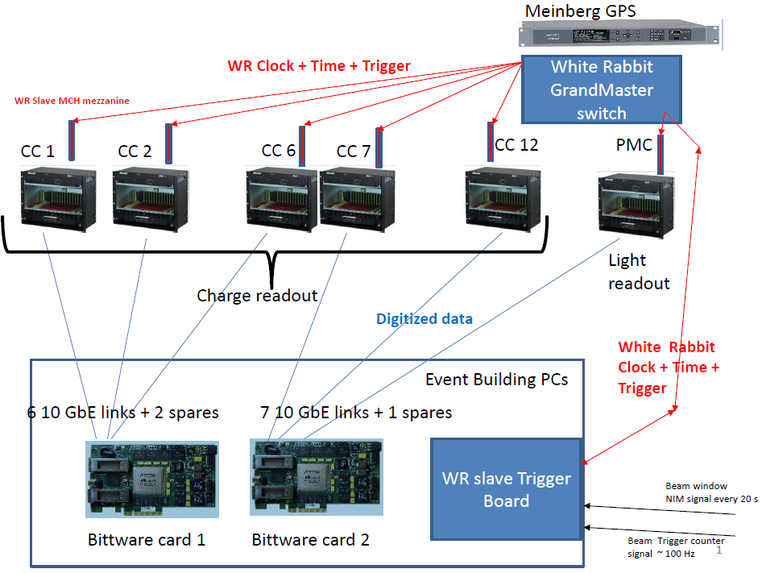
Global uTCA DAQ architecture for ProtoDUNE-DP
integrated with « White Rabbit » (WR) Time and Trigger distribution network
+ White Rabbit slaves nodes in uTCA crates +
WR system (time source, GM, trigger system, slaves)

Slide 6
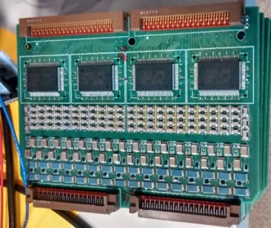
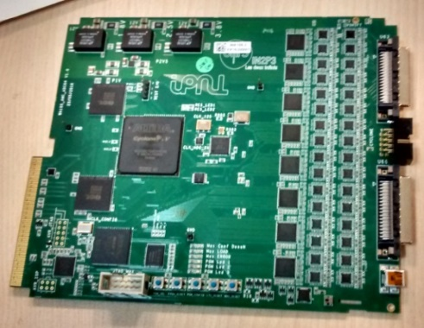
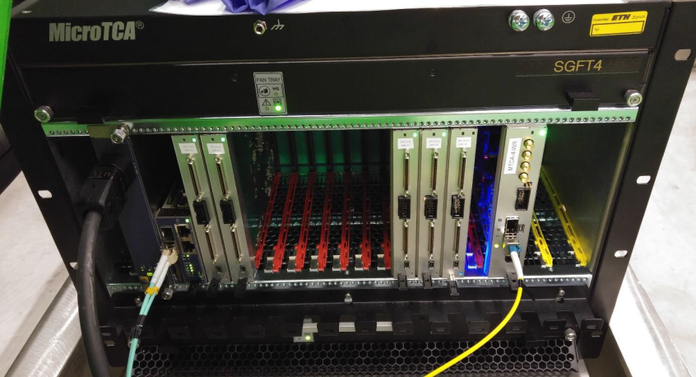
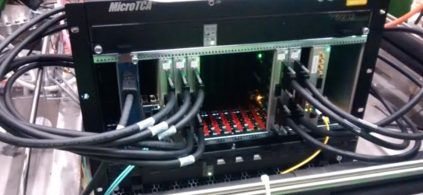
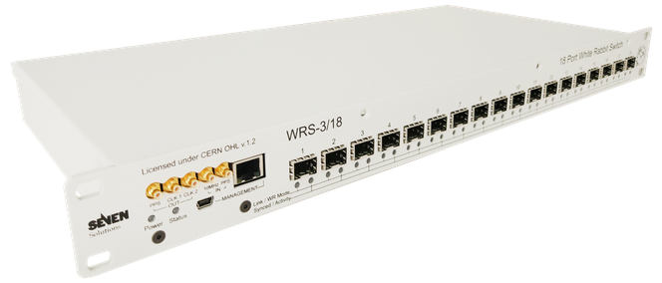
Components for a 10 kton dual-phase module, DUNE baseline: two DP modules
(list based on current 6x6x6 design prior to further optimization and channels density increase)
(see also attached excel file on INDICO)
Total number of charge readout channels: 153600
Cryogenic ASICs (16 ch): 9600
Cryogenic FE cards (64 ch): 2400
AMC cards (64 ch): 2400
uTCA White Rabbit cards: 240
uTCA crates (including MCH,PU,FU): 240
10 Gbe optical links to backend: 240
VHDCI cables (32 ch) 4800
White Rabbit switches (18 ports): 16

Slide 7
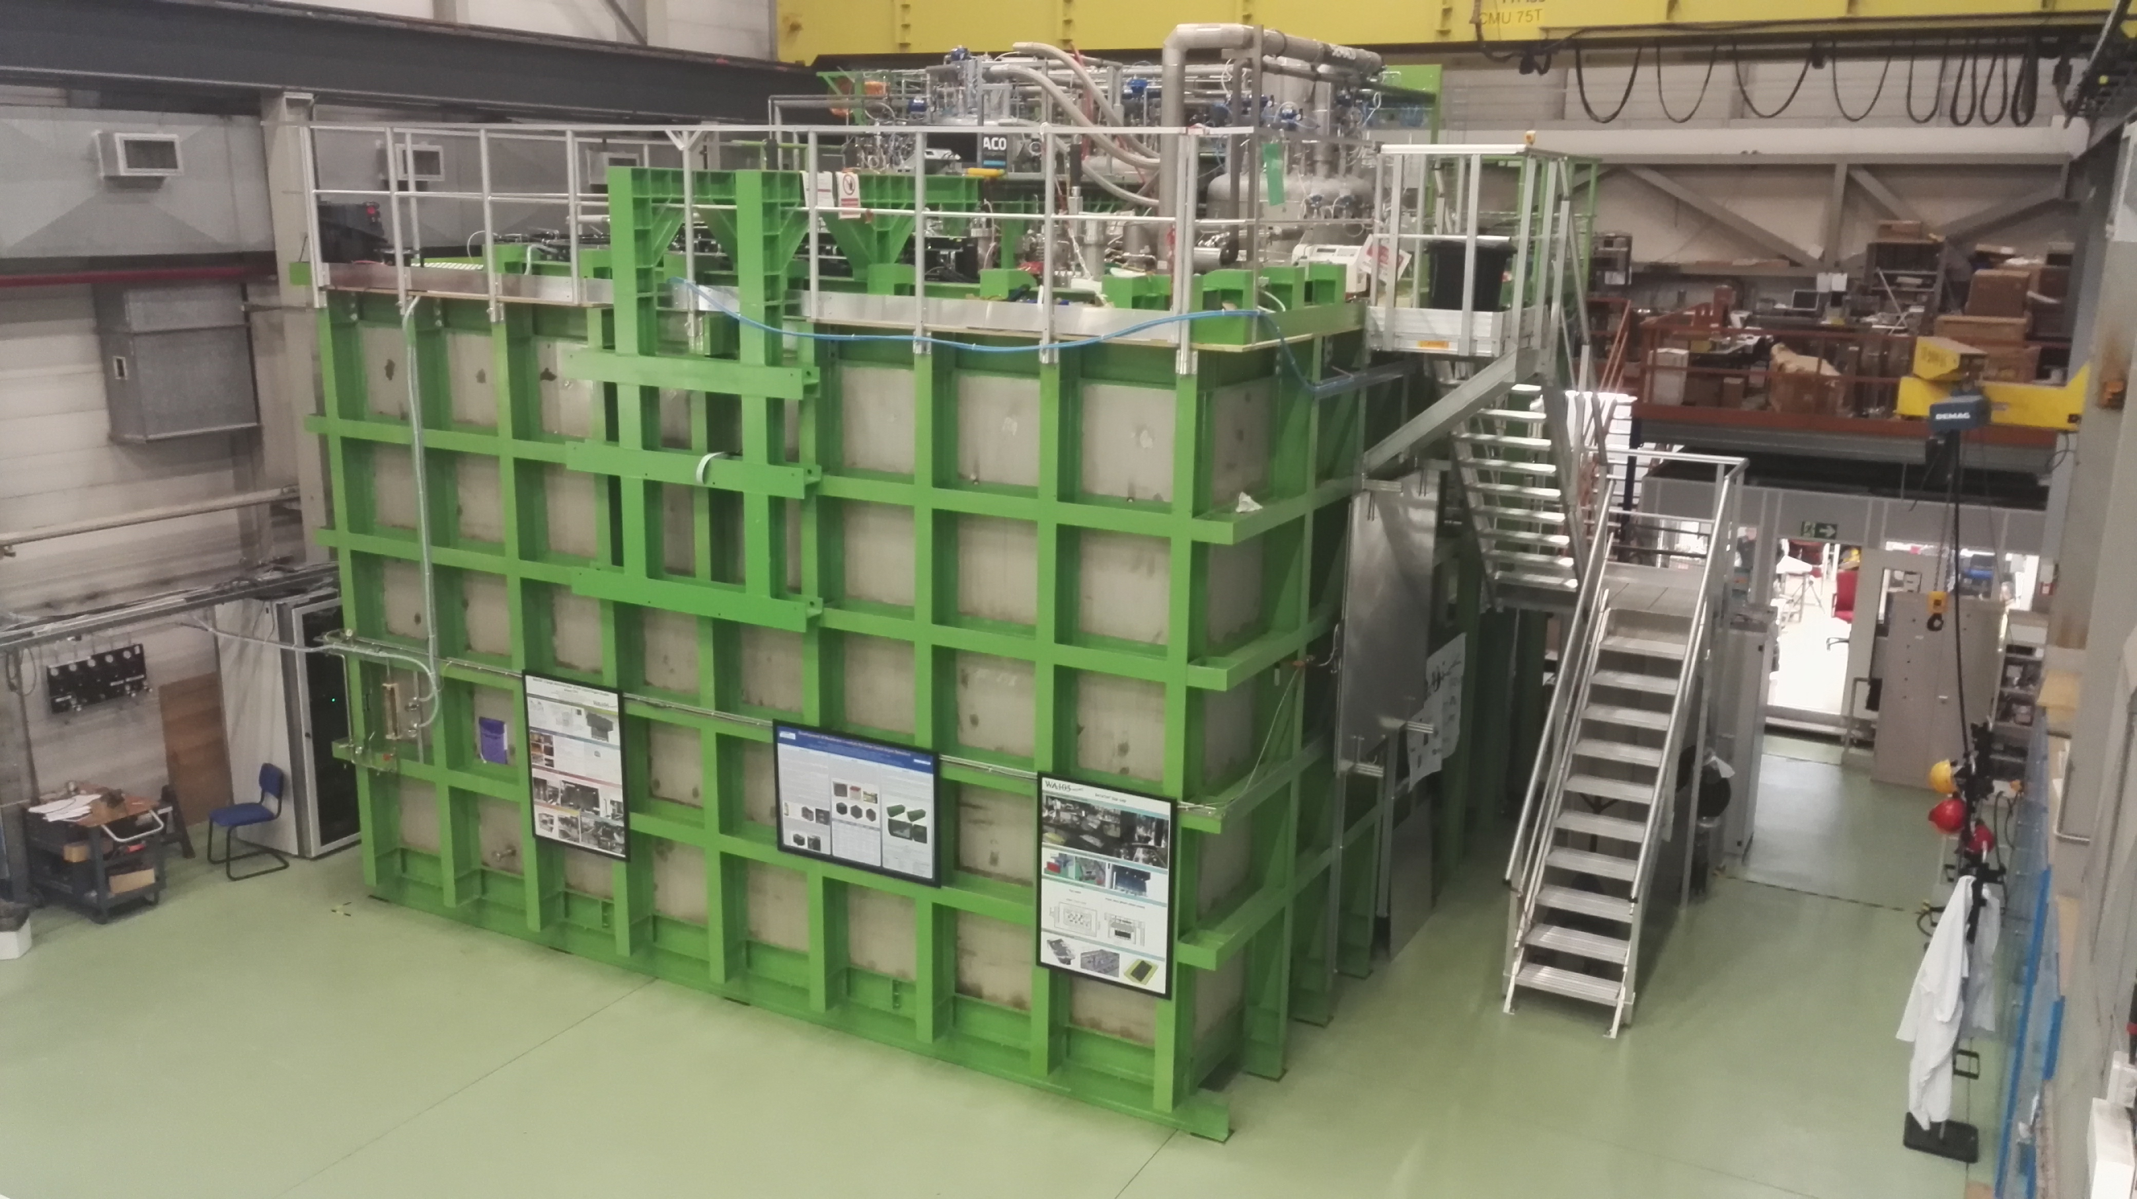
6x6x6: 12 uTCA crates (120 AMCs, 7680 readout channels)
3x1x1: 4 uTCA crates (20 AMCs, 1280 readout channels) Operational since fall 2016
Event builder, network, GPS/White Rabbit GM,
WR Trigger PC
Signal Chimneys and uTCA crates

Slide 8
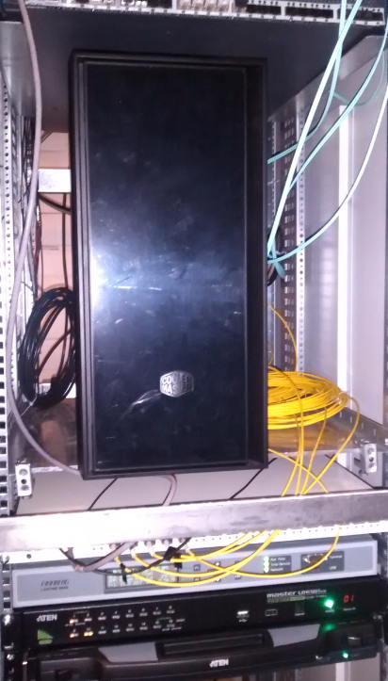
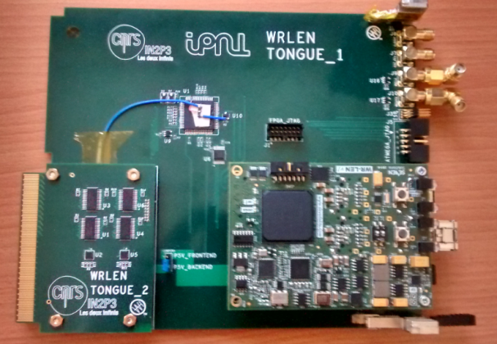
White Rabbit trigger time-stamping PC (SPEC + FMC-DIO)
White Rabbit Grand-Master
GPS unit
White Rabbit uTCA slave node based on WRLEN developed and produced for entire 6x6x6
Other components of the chain (GPS receiver, WR grandmaster, SPEC+ FMC-DIO + 13 WRLEN ) available commercially

Slide 9
How a crates was looking like before VHDCI signals cabling to the warm flange
WR uTCA slave
card node with WRLEN mezzanine
MCH
AMC 64 channels
digitization cards
10 Gbit/s data link
White Rabbit optical link

Slide 10
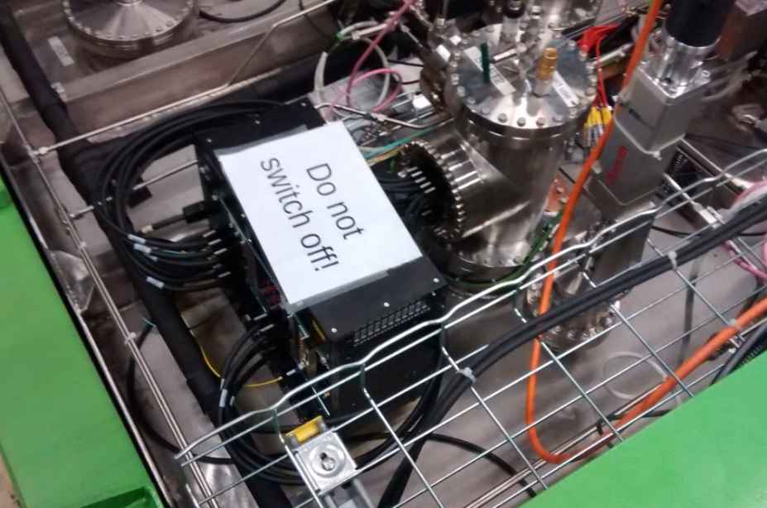
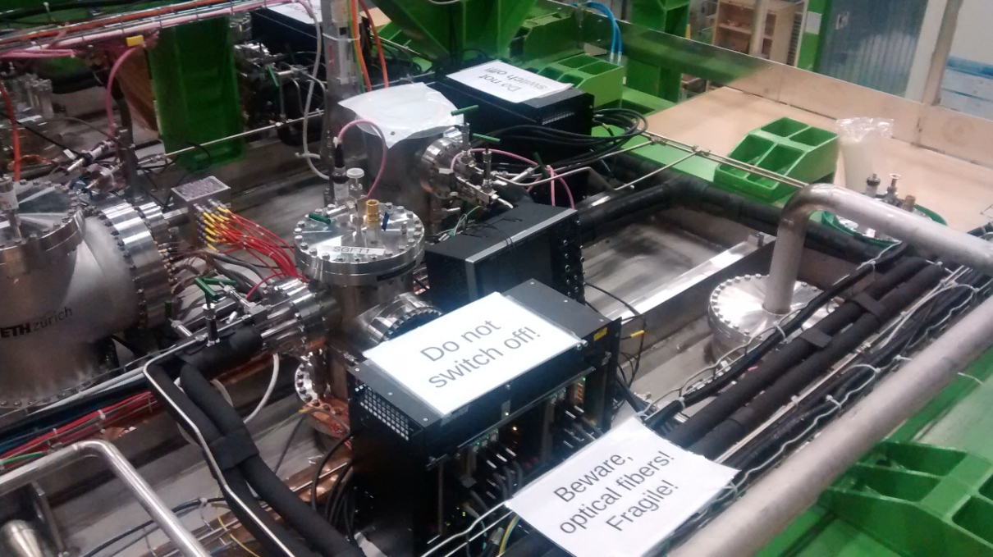
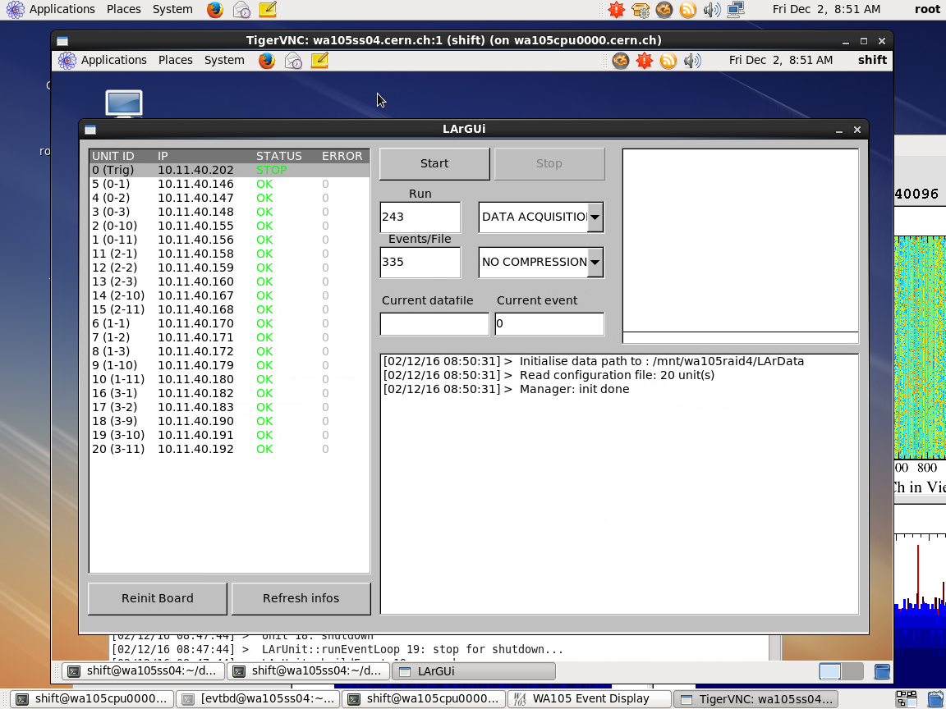
Top cap picture with uTCA crates cabled to signal chimneys
Run control with 20 AMCs
Automatic data processing on online storage/processing farm for purity and gain analysis + data transfer on EOS
Stable system, noise conditions 1.5-1.7 ADC counts RMS

Slide 11
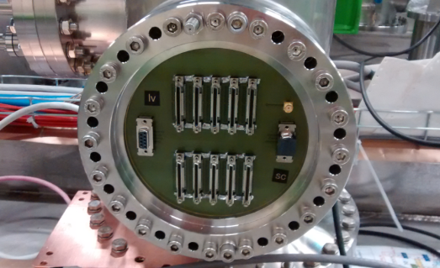
Analog cryogenic FE:
Full production 700 chips of cryogenic ASIC amplifiers procured at the beginning of 2016
64 channels FE cards with 4 cryogenic ASIC amplifiers designed and tested in the spring 2016
First batch of 20 cards (1280 channels) produced for the 3x1x1 operation, operational
Production of remaining 100 cards for 6x6x6 on 2017 budget
Digitization cards:
uTCA 64 channels AMC digitization cards (2.5 MHz, 12 bits output, 10 GbE connectivity)
20 cards produced by September 2016 to equip the 3x1x1, operational
Production of remaining 100 cards for the 6x6x6 launched in May with the 2017 budget
(main card components ADCs, FPGAs, IDT memories, already purchased in 2015 for the entire 6x6x6 production)
White Rabbit timing/trigger distribution system:
Components produced in 2016 for the entire 6x6x6, system operational on the 3x1x1

Slide 12
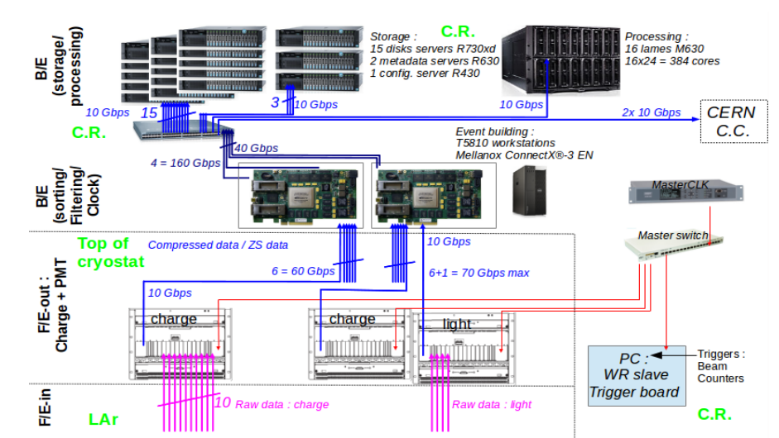
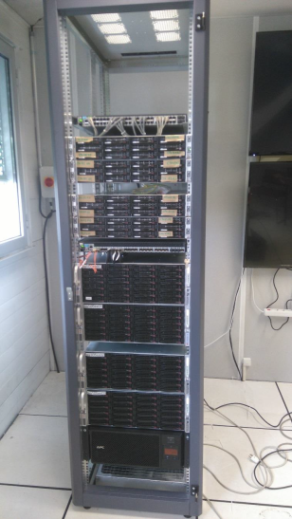
Online processing and storage facility: internal bandwidth 20 GB/s, 1 PB storage, 384 cores: key element for online analysis (removal of cosmics, purity, gain, events filtering)
Smaller test scale system of online storage/processing already installed and operative for 3x1x1 since last fall
→ Useful to perform tests to finalize the architecture of final online storage/processing facility.
C.R. stands for Counting Room

Slide 13
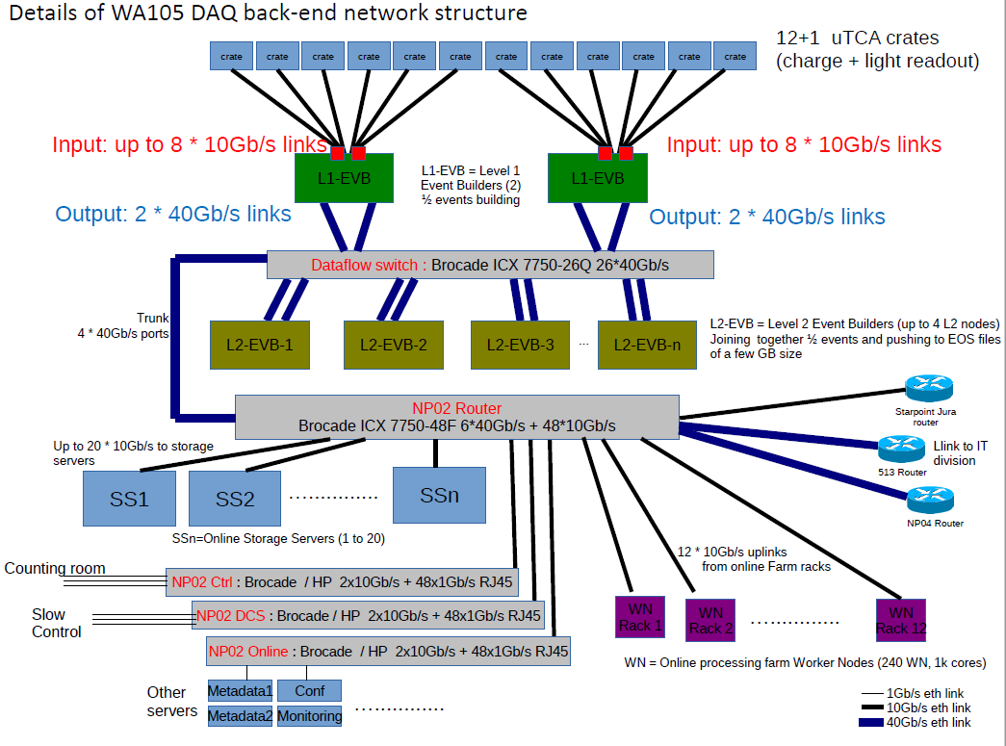

Slide 14
