Slide 1
Latest Jet Measurements with the ALICE Experiment
Eliane Epple
for the ALICE collaboration
Tue, 30.1.2018

Slide 2
Jet Physics in the Medium
Jet in Vacuum
created in a hard scattering event
back-to-back with parton/γ/Z-Boson
highly virtual parton fragmenting
and then hadronizing into measurable particles

Slide 3
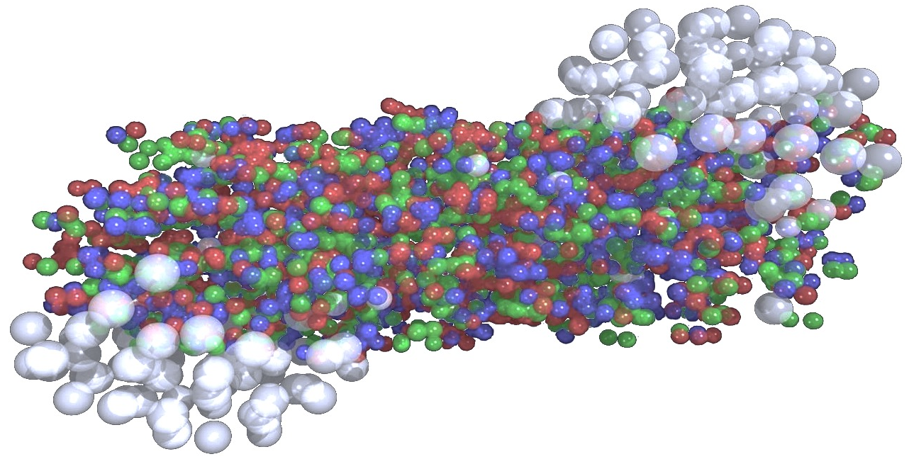

Jet Physics in the Medium
Jet in Vacuum
created in a hard scattering event
back-to-back with parton/γ/Z-Boson
highly virtual parton fragmenting
and then hadronizing into measurable particles
Jet in Medium
modification of recoil angle
modification of energy profile of the jet. Softening/broadening?
collisional/radiative jet energy loss

Slide 4
Jet Physics in the Medium
Jet in Vacuum
created in a hard scattering event
back-to-back with parton/γ/Z-Boson
highly virtual parton fragmenting
and then hadronizing into measurable particles
Jet in Medium
modification of recoil angle
modification of energy profile of the jet. Softening/broadening?
collisional/radiative jet energy loss

Slide 5
Jet Physics in the Medium
Jet in Vacuum
created in a hard scattering event
back-to-back with parton/γ/Z-Boson
highly virtual parton fragmenting
and then hadronizing into measurable particles
Jet in Medium
modification of recoil angle
modification of energy profile of the jet. Softening/broadening?
collisional/radiative jet energy loss

Slide 6
Jet Physics in the Medium
Jet in Vacuum
created in a hard scattering event
back-to-back with parton/γ/Z-Boson
highly virtual parton fragmenting
and then hadronizing into measurable particles
Jet in Medium
modification of recoil angle
modification of energy profile of the jet. Softening/broadening?
collisional/radiative jet energy loss

Slide 7
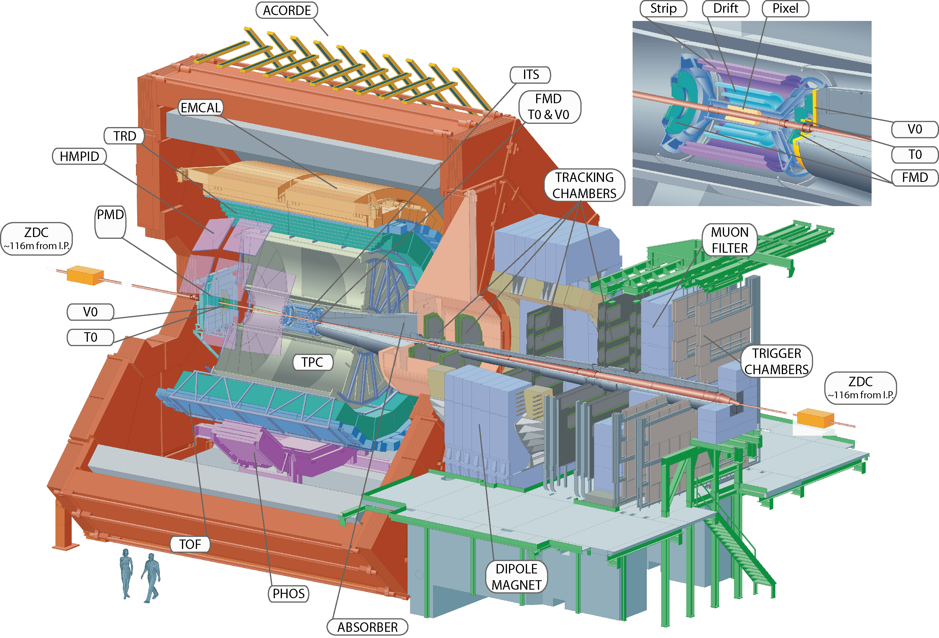
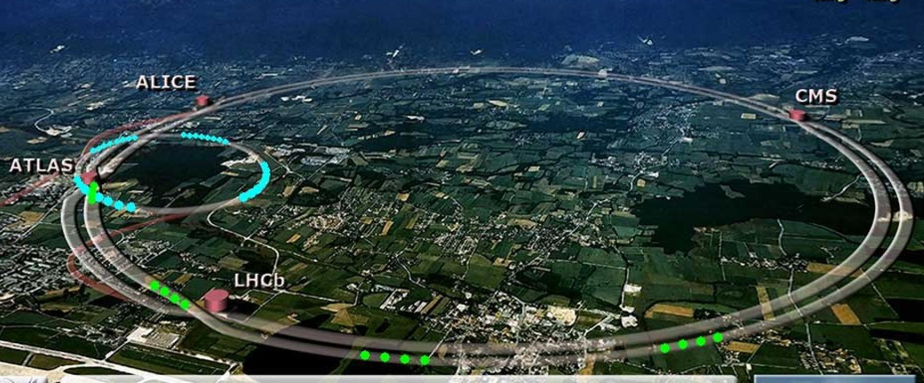
Experiment
ALICE
TPC (Time projection chamber)
3D gas drift chamber
ITS (Inner Tracking System)
Si pixel, drift, and strip detectors
ZDC (Zero Degree Calorimeter)
four calorimeters ZNA, ZNC, ZPA, ZPC
V0
forward plastic scintillator array V0A, V0C
Measured Systems
p-Pb at 5.02 TeV
pp at 0.9, 2.76, 5.02, 7, 8, 13 TeV
Pb-Pb 2.76, 5.02 TeV

Slide 8
Experiment
ALICE
TPC (Time projection chamber)
3D gas drift chamber
ITS (Inner Tracking System)
Si pixel, drift, and strip detectors
ZDC (Zero Degree Calorimeter)
four calorimeters ZNA, ZNC, ZPA, ZPC
V0
forward plastic scintillator array V0A, V0C
Measured Systems
p-Pb at 5.02 TeV
pp at 0.9, 2.76, 5.02, 7, 8, 13 TeV
Pb-Pb 2.76, 5.02 TeV

Slide 9
Results I Will Focus on
Hadron-Jet distributions in pPb
Is there a hint for jet quenching at different event activities in small systems?
Jet Mass measurements in pPb and PbPb
Is there a shift of measured jet masses due to hot QCD medium effects?
Jet shape measurement in pp and PbPb
How are the cores of jets modified in the medium?

Slide 10
Inter-jet Distributions
Hadron-Jet distributions in pPb
ALICE Collaboration, S. Acharya et al.,
arXiv:1712.05603

Slide 11
Hadron-jet Distributions
Semi-inclusive measurement of
per trigger jet yield
Δφ>π -0.6
=
Trigger Track (TT)
We measure:
p-Pb 5.02
Anti-k_{T} jet algorithm,
resolution param. R = 0.4, 0.2
|η_{jet}| < 0.5, 0.7,
p_{T} = 15 - 50 GeV/c

Slide 12
Hadron-jet Distributions
Semi-inclusive measurement of
per trigger jet yield
Δφ>π -0.6
=
Trigger Track (TT)
We measure:
p-Pb 5.02
Anti-k_{T} jet algorithm,
resolution param. R = 0.4, 0.2
|η_{jet}| < 0.5, 0.7,
p_{T} = 15 - 50 GeV/c

Slide 13
Hadron-jet Distributions
Semi-inclusive measurement of
per trigger jet yield
Δφ>π -0.6
=
Trigger Track (TT)
No knowledge about the collision geometry needed.
Ideal to measure N_{jet} in different event activity classes
We measure:
p-Pb 5.02
Anti-k_{T} jet algorithm,
resolution param. R = 0.4, 0.2
|η_{jet}| < 0.5, 0.7,
p_{T} = 15 - 50 GeV/c

Slide 14
Hadron-jet Distributions
Semi-inclusive measurement of
per trigger jet yield
Δφ>π -0.6
=
Trigger Track (TT)
No knowledge about the collision geometry needed.
Ideal to measure N_{jet} in different event activity classes
To remove contribution of combinatorial fake jets and multi parton interactions
we build a Δ_{recoil} distribution

Slide 15
Hadron-jet Distributions
ALICE Collaboration, S. Acharya et al.,
arXiv:1712.05603
TT_{Sig} and TT_{Ref} refer to Signal and Reference (mostly dominated by fake jets)
Trigger Track intervals. They correspond to TT{12,50} (GeV) and TT{6,7} (GeV) respectively.
Event activity in forward (Pb-going) direction
charged multiplicity (V0A) and zero-degree neutral energy (ZNA)

Slide 16
Δ_{recoil} in Different Event Activities
ALICE Collaboration, S. Acharya et al.
arXiv:1712.05603
This observable provides a new probe of jet quenching in small systems, whose interpretation does not require the assumption that event activity is correlated with collision geometry

Slide 17
Ratios in Different Event Activities
ALICE Collaboration, S. Acharya et al.,
arXiv:1712.05603
Measurement of jet suppression in a more controlled way.
If there is a transport of jet energy out of cone in events with larger evt. activity the ratios here should be below one.
Out of cone radiation (R=0.4) upper limit at 90%CL:
-0.4 GeV/c for high-EA compared to low-EA

Slide 18
Ratios in Different Event Activities
ALICE Collaboration, S. Acharya et al.,
arXiv:1712.05603
Measurement of jet suppression in a more controlled way.
If there is a transport of jet energy out of cone in events with larger evt. activity the ratios here should be below one.
Out of cone radiation (R=0.4) upper limit at 90%CL:
-0.4 GeV/c for high-EA compared to low-EA

Slide 19
Intra-jet Distributions I
Jet Mass
ALICE Collaboration, S. Acharya et al.,
Phys. Lett., B 776, (2018) 249

Slide 20

Jet Mass
Jet mass is a measure of the spread of the jet and is
linked to the virtuality of the initial parton
Measure jet mass in a given cone R
In Medium
If the profile broadens due to soft gluon radiation measured mass will increase
In Medium
If the profile broadens so much that large fraction of radiation is outside the cone, mass as well as p_{T} will decrease

Slide 21
Jet Mass
Jet mass is a measure of the spread of the jet and is
linked to the virtuality of the initial parton
Measure jet mass in a given cone R
In Medium
If the profile broadens due to soft gluon radiation measured mass will increase
In Medium
If the profile broadens so much that large fraction of radiation is outside the cone, mass as well as p_{T} will decrease
We measure:
p-Pb 5.02, Pb-Pb 2.76 TeV
Anti-k_{T} jet algorithm,
resolution parameter R = 0.4,
|η_{jet}| < 0.5,
p_{T} = 60 - 120 GeV/c

Slide 22
Jet Mass Results
pPb, 5.02 TeV
ALICE Collaboration, S. Acharya et al.,
Phys. Lett., B 776, (2018) 249

Slide 23
Jet Mass Results
pPb, 5.02 TeV
ALICE Collaboration, S. Acharya et al.,
Phys. Lett., B 776, (2018) 249
pPb, 5.02 TeV and PbPb 2.76 TeV
Jet mass in PbPb seems shifted to slighty lower values compared to pPb

Slide 24
Jet Mass Interpretation
ALICE Collaboration, S. Acharya et al.,
Phys. Lett., B 776, (2018) 249
To see effects of:
different q/g ratio at different collision energies
effect of different shapes of the underlying jet p_{T} spectrum
The PYTHIA ratio is compared to the Pb-Pb/p-Pb ratio
Observed effect is compatible with PYTHIA, no significant shift observed due to medium.
The soft radiation outside the cone doesn’t alter the relation between p_{T} and mass of the parton

Slide 25
Jet Mass Interpretation
ALICE Collaboration, S. Acharya et al.,
Phys. Lett., B 776, (2018) 249
Pb-Pb results compared to models
How well do they describe the in medium shower shape evolution?
PYTHIA result without jet quenching
Q-PYTHIA modifies the splitting functions of PYTHIA resulting in medium-induced gluon radiation following the multiple soft scattering approximation
JEWEL computation of scattering of leading parton with medium constituents. Gives a microscopic description of the transport coefficient .
“Recoil on” keeps additional track of momenta of recoiling scattering centers
Quenching models do not describe measured jet mass

Slide 26
Intra-jet distributions II
Jet Shapes of Small Jets

Slide 27
Jet Shapes of Small Jets
difference between leading and sub-leading track momentum
momentum dispersion
first radial moment or angularity
LeSub
p_{T}D
g
use momentum and distance to jet axis of each constituent
A measure for the radial energy profile of the jet
A measure for the hardness of the fragmentation.
Small value for many constituents. Large value for fewer constituents
p_{T}D~0
p_{T}D~1
small g
large g

Slide 28
Jet Shapes of Small Jets
difference between leading and sub-leading track momentum
momentum dispersion
first radial moment or angularity
LeSub
p_{T}D
g
use momentum and distance to jet axis of each constituent
A measure for the radial energy profile of the jet
A measure for the hardness of the fragmentation.
Small value for many constituents. Large value for fewer constituents
We measure:
pp 7 TeV, Pb-Pb 2.76 TeV
Anti-k_{T} jet algorithm,
resolution param. R = 0.2
|η_{jet}| < 0.7,
p_{T} = 40 - 60 GeV/c
p_{T}D~0
p_{T}D~1
small g
large g

Slide 29
Jet Shapes of Small Jets
pp collisions
PYTHIA in agreement with data within 20%

Slide 30
Jet Shapes of Small Jets
Pb-Pb collisions
no significant modification
momentum dispersion is shifted to higher values
radial moment is shifted
to lower values

Slide 31
Jet Shapes of Small Jets
Pb-Pb collisions
harder
no significant modification
momentum dispersion is shifted to higher values
radial moment is shifted
to lower values

Slide 32
Jet Shapes of Small Jets
Pb-Pb collisions
collimated
no significant modification
momentum dispersion is shifted to higher values
radial moment is shifted
to lower values

Slide 33
Jet Shapes of Small Jets
Pb-Pb collisions
no significant modification
momentum dispersion is shifted to higher values
radial moment is shifted
to lower values
The results of R=0.2 jet shapes indicate that jet cores in Pb–Pb are more collimated and harder than those in PYTHIA at the same energy.
Soft particles emitted outside R=0.2

Slide 34
Summary
Hadron-Jet distribution in pPb
Is there a hint for jet quenching at different event activities in small systems?
Ratios at different event activities of Δ_{recoil} do not show any sign of medium induced modification of jets in p-Pb. UL on energy transport out of cone is ~ 0.4 GeV (R=0.4)
Jet Mass measurement in pPb and PbPb
Is there a shift of measured jet masses due to hot QCD medium effects?
No significant mass shift observed due to medium. It seem the soft radiation outside the cone doesn’t alter the relation between p_{T} and mass of the parton. Quenching models can not describe measured jet mass.
Jet shape measurement in pp and PbPb
How are the cores of jets modified in the medium?
The results of R=0.2 jet shapes indicate that jet cores in Pb–Pb are more collimated and harder than those in PYTHIA at the same energy.

Slide 35
Outlook - Results to Come
Jet substructure
using Soft Drop (removal of soft subjets) to determine momentum distribution of hard subjets
shared momentum fraction
Measured z_{g} in p-Pb consistent with PYTHIA.
Previously observed modifications in z_{g} not due to cold nuclear matter effects.
We measure:
p-Pb 5.02 TeV
Anti-k_{T} jet algorithm,
resolution parameter R = 0.4,
|η_{jet}| < 0.5,
p_{T} = 60 - 120 GeV/c

Slide 36
Outlook - Results to Come
Nsubjetiness of jets in Pb-Pb collisions
Ratio of 2-Subjettiness to 1-Subjettiness (τ₂/τ₁)
measures two-prongness of the jet
Interpretation
τ_{N} ~0, N or fewer cores
τ_{N} ~1, N+1 or more cores
Thus:
τ₂/τ₁ tells us about 2-cores
If (τ₂/τ₁ ~0) parton has split into two resolvable subjets
We measure:
Pb-Pb 2.76 TeV
Anti-k_{T} jet algorithm,
resolution parameter R = 0.4,
|η_{jet}| < 0.5,
p_{T} = 40 - 60 GeV/c
consistent with PYTHIA

Slide 37
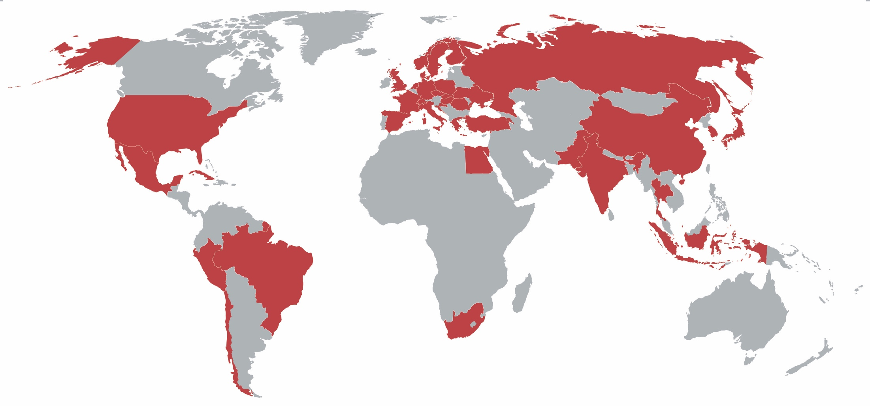
Thanks to the ALICE Collaboration
37 Countries, 154 Institutes and over 1500 members
Special thanks to the Jet working group with about 30 members
led by Leticia Cunqueiro Mendez and Tatsuya Chujo

