Slide 1
NuMI Shutdown Activities – Week 11
Marty Murphy
AD 09:00 Scheduling Meeting
22 September 2017

Slide 2
Week-11 Jobs
Completed pipe fitting of Multistack Chiller HX. Preliminary pressure testing is good. Insulation will be installed on Monday.
All cable terminations are complete and devices successfully tested.
R-Blocks dry-set over Horn-1 and Target Sections.
Stripline fastener inspection and torqueing is 90% complete.
Found two broken Bellville washers on joint between penetration section and TH section. Replacing those today.
Horn-2 RAW skid tripped on Thursday for no obvious reason; all the water was recovered, so there does NOT appear to be a leak.

Slide 3
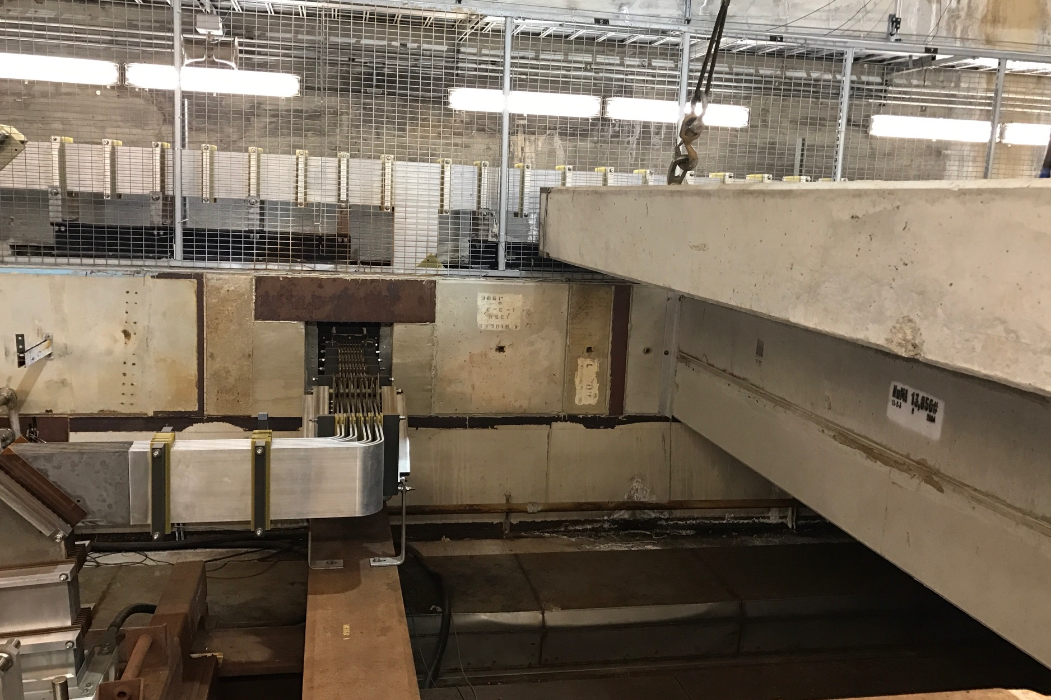
R-Block Installation & Stripline View

Slide 4
Week-12 Jobs:
Week-12
MI-65:
Install insolation on new HX piping for Multistack Chiller system.
PM Multistack chiller – Prism techs.
Target hall
Install cooling coil in Target Pile fan system – fitters (2-3 days)
Clean enclosure, remove remaining rad. waste, etc.
Pretarget Area:
Start drain cleaning.

Slide 5
To-do List:
Get PBTC & Hydrogen Peroxide systems operational
Replace TH chiller coil (fitters; 2-3 days)
PM of multistack chiller (Prism techs; one week)
Continue construction of C0 storage facility
pH test of Decay Pipe under drains
Clean drains in Pre-target; TH; & Decay Pipe (two weeks)
Goal is to “close*” TH by middle of Week-11 (Sept. 20) Week-12 (Sept. 28)
*“close” means – finish big jobs and await cleaning…

