Slide 1
Proton Source Week 11
Todd Sullivan
9am Meeting
9/22/2017

Slide 2
RIL
RIL
Integrated the flow switch status for the water skid into ACNET
General maintenance continues

Slide 3
Linac
LRF2 Marx powering the 7835, going well
LRF3 pre-installation activities in preparation to receive P1 Marx
LRF5 Marx powering the dummy load, setting up for extending running today.
LE general maintenance

Slide 4
Booster
RF group Hi-potted cables for BRF21 & BRF22
Tests were successful
Next week, increase water flow to continue checking RF stations
CHG0 tunnel electronics and tunnel work continues
Looking into issues with GMPS transformers
Bus wrapping loosening
Bus flag bent
Sump pump maintenance continues
General maintenance

Slide 5
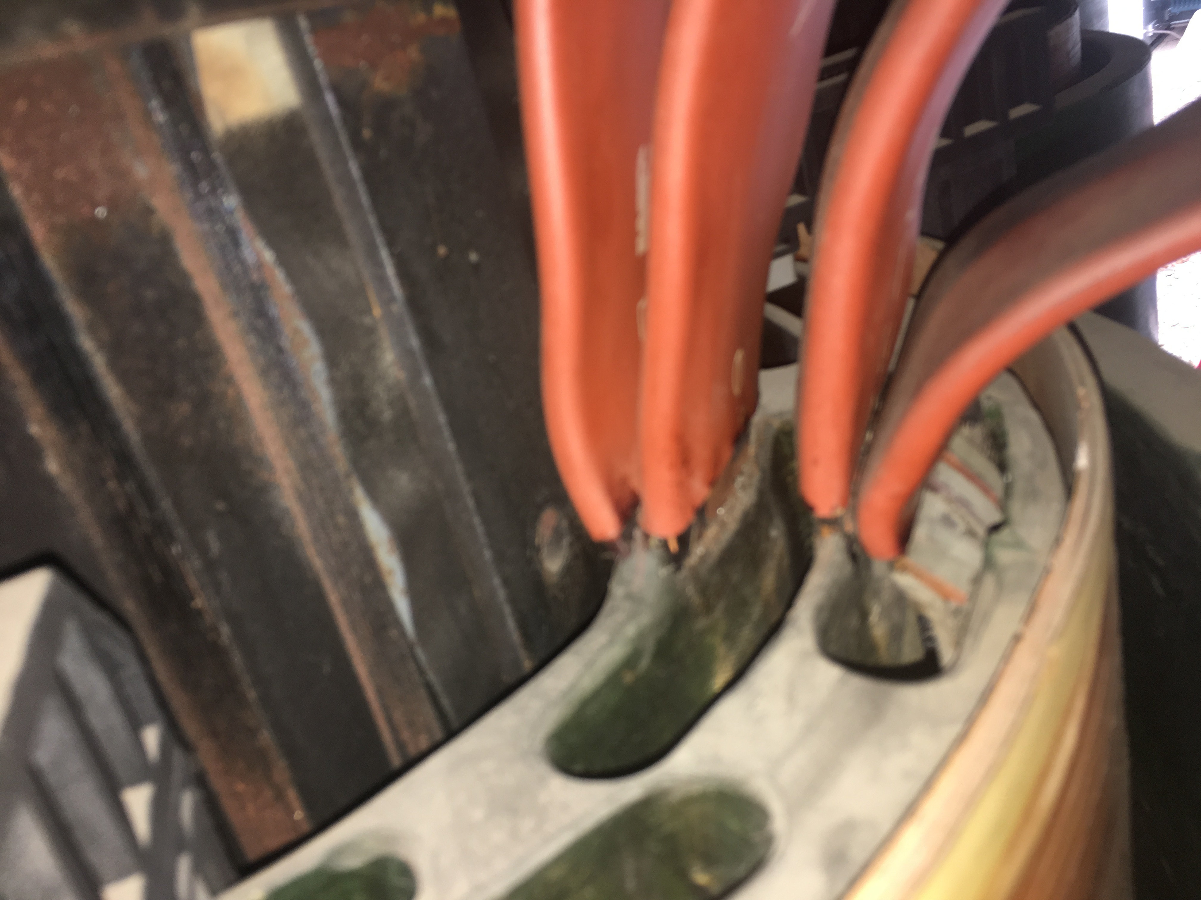
GMPS
Loose Wrapping
Bent Flag

