Slide 1
ComPASS Update
James Amundson
All Experimenters’ Meeting/Lab Status Meeting
September 25, 2017

Slide 2
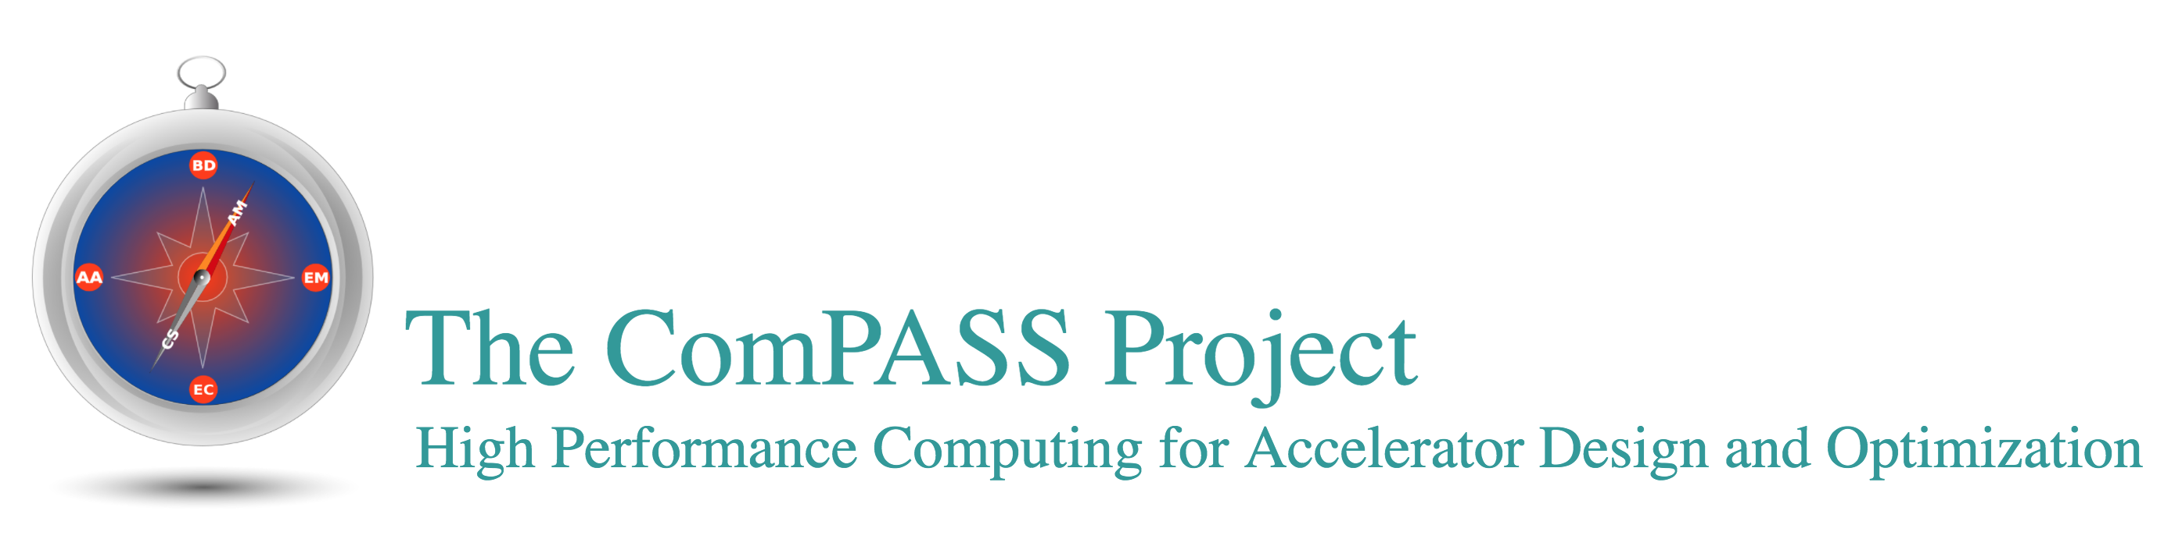
ComPASS
Community Project for Accelerator Science and Simulation
Collaboration of accelerator physicists, applied mathematicians and computer scientists
Beam dynamics with collective effects and advanced accelerators
  through high performance computing
At Fermilab since ca. 2000
  Significant simulation efforts in Booster, Muon Delivery Ring, Main Injector, Recycler
    and even Tevatron

Slide 3




SciDAC
ComPASS is (and has been) funded by DOE SciDAC, http://www.scidac.gov/
  Scientific Discovery through Advanced Computing
SciDAC4 call went out Spring 2017
  Joint HEP/ASCR funding
    ASCR: Advanced Scientific Computing Research
ComPASS4 collaboration and proposal led by Fermilab
  Collaboration between Fermilab, UCLA, ANL and UCLA
  I am project coordinator
  Beam Dynamics: Fermilab
  Plasma-based Acceleration: UCLA
  Parameter Optimization: ANL
  Solvers: LBL

Slide 4
Proposal Process and Results
ComPASS4 was awarded $8M over 5 years
  Fermilab leads 3 SciDAC4 projects, including the two largest, and participates in a fourth
Official notification on September 13
From Barbara Helland’s 04/2017 presentation to the Advanced Scientific Computing Advisory Committee

Slide 5
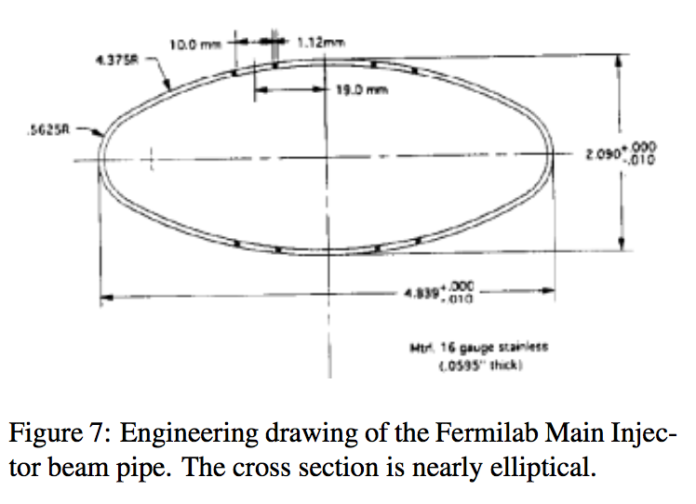
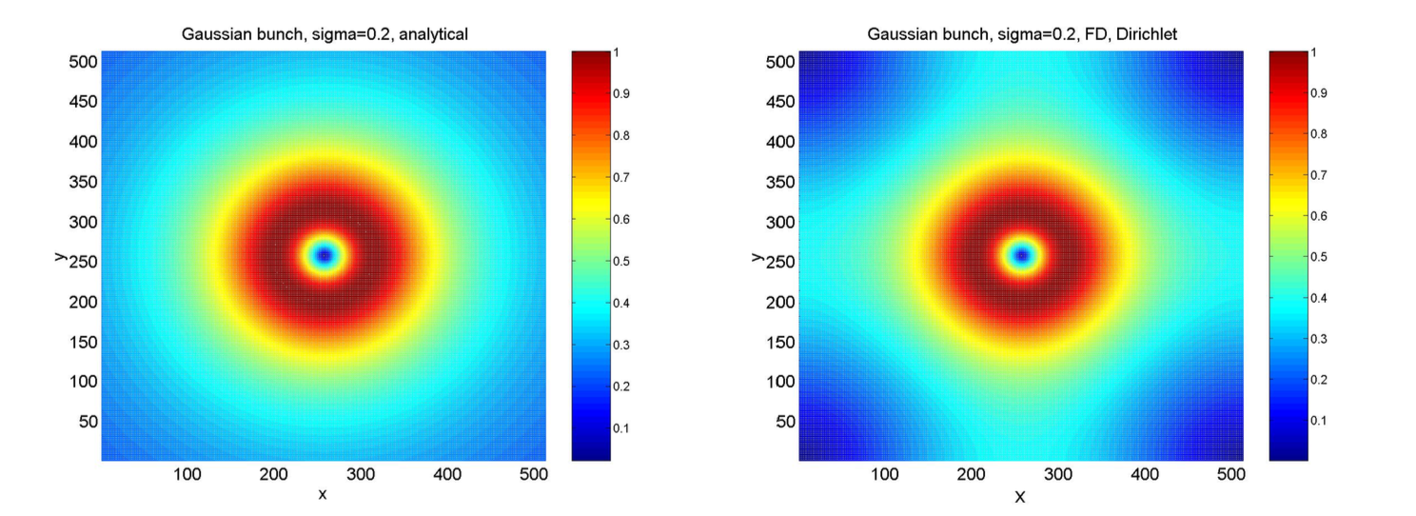
ComPASS4 Objectives
Physics
  Beam dynamics (Synergia)
    Simulation support for PIP-II
      including all relevant portions of the Fermilab complex
    Simulation support for IOTA
  Plasma-based acceleration (QuickPIC and Osiris)
    Simulation support for FACET-II
Enabling tools
  Synergia combined with MARS
    Accelerator simulations including losses and radiation transport
  Advanced Solvers
    More advanced boundary conditions
    Higher accuracy
  Parameter optimization system
    Take advantage of both high-performance computing and high-performance computer science/(applied math)
  Full plasma-based accelerator simulation (QuickPIC + Synergia)

