Slide 1
Multi-year Analytics of NOAA’s High Resolution Rapid Refresh Model
Brian Blaylock and Dr. John Horel
Department of Atmospheric Sciences
University of Utah
March 21, 2018
Salt Lake City, Utah
Open Science Grid All-hands Meeting
Notes:
My name is Brian Blaylock
I am a PhD student here at the University of Utah in the Department of Atmospheric Sciences.
I want to recognize my advisor, Dr. John Horel, who is here and has contributed to this work.
On the screen is a picture of a lenticular cloud over Mount Timpanogos, spotted by my nephew last month.
I’m showing you this picture because I want you to prepare yourself for a presentation about the weather.
Specifically, I am going to talk about using the Open Science Grid to analyze output from a weather forecast system known as the High Resolution Rapid Refresh Model.

Slide 2
What is the High Resolution Rapid Refresh Model?
Notes:
I am expecting you haven’t ever heard of the High Resolution Rapid Refresh Model before. So, what is it?
We call it the “HRRR” model, for short.
The HRRR is…
an operational short-range weather forecast system for the lower 48 states.
This visual example shows HRRR data of hourly changes in sea level pressure and precipitation for an event one year ago.
Pay attention to New England and you will notice the deepening of the low pressure system and increased precipitation.
If you are from New England, you may remember this storm, known as the “Pi-day” storm, dumped feet of snow in New York and Boston area.

Slide 3
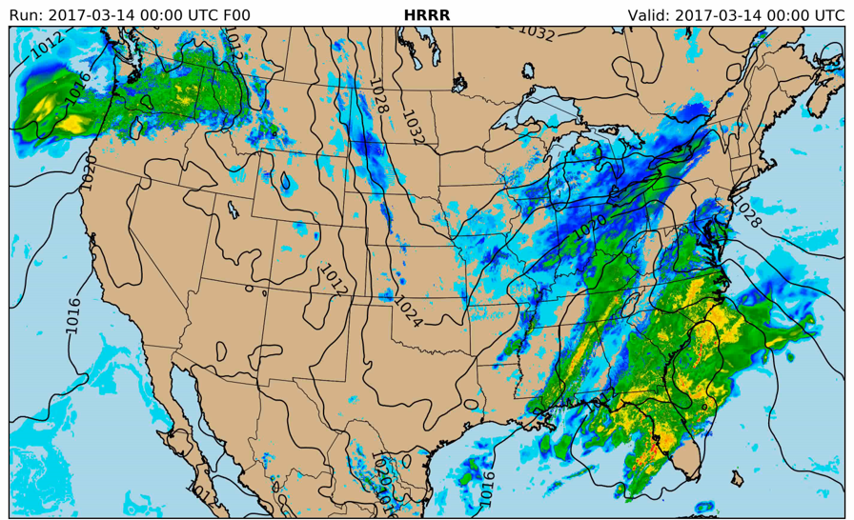
What is the High Resolution Rapid Refresh Model?
3 km grid spacing (1.9 million points)
Updated every hour
Produces 18 hour forecasts
Advanced data assimilation
Notes:
There are a few things you should know about this model:
first
The HRRR model is run with 3 km grid spacing, describing the weather in the United States at over 1.9 million grid points
The HRRR model is updated hourly. That is 3-6 times more frequently than most other operational weather models.
With each update, the HRRR produces an analysis for that hour and an 18-hour forecast. That is why this model is used for “short-term” weather forecasting.
For example, you can’t use this model to check the weather this weekend,
but instead it helps us know what weather the weather will be like when we are going to dinner tonight.
Also, this model uses advanced data assimilation techniques, but I’m not discussing the inner workings of the model today.

Slide 4
What is the High Resolution Rapid Refresh Model?
3 km grid spacing (1.9 million points)
Updated every hour
Produces 18 hour forecasts
Advanced data assimilation
The highest resolution weather model
run operationally by NOAA’s
National Centers for Environmental Prediction
Notes:
I just want you to know that the HRRR weather forecast system is the highest resolution weather model run operationally by NOAA at this time

Slide 5
What is the High Resolution Rapid Refresh Model?
Applications:
Aviation
Fighting Wildfires
Water management
Solar and wind energy
Agriculture
Severe weather
Notes:
Some of the direct applications of this model are:
Aviation
Fighting wildfires
Managing water resources
Renewable energy
Agriculture
And Severe weather outlooks and warnings
Now, that you are acquainted with the HRRR model, I will tell you how we are analyzing its output using the Open Science Grid…

Slide 6
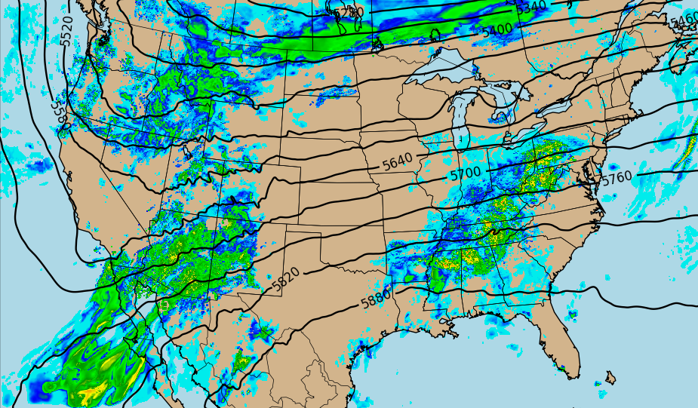
We archive raw HRRR output
HRRR data is in GRIB2 format (Gridded Binary Version 2)
Highly compressed data
Data Size: ~20 TB/year
Data Source: NOAA Operational Model Archive and Distribution System
Pando Archive at CHPC
Object storage like Amazon S3
Access: http://hrrr.chpc.utah.edu
Pando
Archive
CHPC
Notes:
As you can imagine, the HRRR model produces a lot of data; so much that no one archives it.
NOAA, who runs the model, makes the data freely available, but only for the last two days.
We started to archived the raw HRRR data since 2015 for various research projects.
HRRR output files are stored in a highly compressed data format, known as gridded binary—GRIB2.
We store about 20 TB of analyses and forecasts every year.
We download the data several times a day from NOAA and store it on the Pando archive system at Utah’s Center for High Performance Computing.
This archive system is very similar to Amazon’s Object Storage.
We have made the archive accessible to the public, and there are over 200 users of the archive.
These users typically look at a few days of data at once, but we wanted to perform analytics on the full dataset.
To do that, we needed a computing solution that would help us efficiently mine the archive.
That is why we turned to High Throughput Computing with the Open Science Grid

Slide 7
OSG Acknowledgments
Wim Cardon
Introduced me to OSG at CHPC workshop
Bala Desinghu
Got me started and rapidly replied to my questions
Mats Rynge
Prepared a Singularity image for me with pygrib and other dependencies
Benedikt Riedel
Wrote my first DAGMan file for me
Sam Liston
Helped me with Globus transfers at CHPC
Notes:
This was my first experience using the Open Science Grid.
I have a lot of fun watching thousands of jobs run through the queue.
I had a lot of help setting up the environment I work in,
and I want to acknowledge all those who have helped me get started.
……
You guys are very easy to work with and you got me started real fast.
I could not have done any work on OSG without your help

Slide 8
Science Question
Structured our science question to be answered with parallel computing
What is the range of weather conditions
at every grid point
for every hour of the year
in the last three years?
Model “climatology”
Notes:
First, to utilize the capabilities of the Open Science Grid,
I quickly learned that I needed to structure our science question in a way that we could divide the task into many embarrassingly parallel jobs.
Here is our question…
What is the range of weather conditions…
At every grid point…
For every hour of the year…
In the last three years.
Essentially, I want to calculating a model climatology.
We can answer this question by calculating various percentiles of weather variables in the HRRR model output for each hour across the three years.

Slide 9
Hourly Percentiles from 3 years of Data
For each hour in a year:
Retrieve model analysis grid from 2015, 2016, 2017
Compute statistics for each grid point
Samples:
3
June 15th
00:00 UTC
2015
2016
2017
Notes:
We are going to retrieve the model analysis for a variable, like air temperature, from the three years of archived data.
For example, here are the three years of data for 00:00 UTC on June 15th
But three samples are not adequate to compute percentiles.

Slide 10
Hourly Percentiles from 3 years of Data
For each hour in a year:
Retrieve model analysis grid from 2015, 2016, 2017
Compute statistics for each grid point
Increase sample size by including +/- 15 days
June 1st-14th
00:00 UTC
2015
2016
2015
2016
2017
2015
2016
2017
2015
2016
2017
2015
2016
2017
2017
Samples:
90
June 15th
00:00 UTC
2015
2016
2017
2015
2016
2015
2016
2017
June 16th-30th
00:00 UTC
2015
2016
2017
2015
2016
2017
2015
2016
2017
2017
Notes:
Instead, we increase the sample size by including the 15 days before and 15 days after each hour.
We use all the 00:00 UTC hours between June 1st and June 30th from the 3 years.
Now we have 90 HRRR output samples to compute our statistics.

Slide 11
Hourly Percentiles from 3 years of Data
Download 90 Grids
Calculate Statistics
Output
2017
numpy.
percentile()
2016
HDF5
Percentiles Calculated
2015
00
01
02
03
04
05
10
25
33
50
66
75
90
95
96
97
98
99
100
mean
Notes:
From those 90 grids we can download from our HRRR archive on Pando,
We simple use Python’s percentile function to calculate 19 different percentiles as well as the mean.
And we write the results to a file.
We want to do this same work for every hour of the year—an extremely parallel task that does not take long.
That is where OSG fits into this…

Slide 12
1 unique OSG job for every hour of the year
8,784 unique jobs
366 days x 24 hours
For a single variable, this work takes 2-3 hours on OSG
This same work takes ~7 days on our local node
Sacrifice data download efficiency for high-throughput computing
Each HRRR file is downloaded 30 times in 30 different jobs, but downloads are quick!
Notes:
With 1 unique job for every hour of the year, this requires 8,784 jobs. Easy work for the OSG.
To calculate the percentiles for one variable in the HRRR model, like temperature, these 8 thousand jobs completes in 2-3 hours.
If we were to do this same work on one of our groups dedicated compute node with 16 processors, this would have taken about seven days.
Thanks to the OSG, we saved a lot time, and were able to use our computer for other tasks.
I do realize that with this method I sacrifice data download efficiency for high-throughput computing
What I mean is that each HRRR file is downloaded 30 different times as part of 30 different jobs, but downloads are quick so this doesn’t matter to us.

Slide 13
1 unique OSG job for every hour of the year
8,784
hours
8
Variables
70,272 jobs
2 m Temperature
2 m Dew Point
10 m Wind Speed
Max 10 m Wind Speed
80 m Wind Speed
Surface Gusts
Simulated Composite Reflectivity
500 mb Height
Notes:
The HRRR model includes many different weather variables at different levels in the atmosphere,
but for now, I am only interested in a few near-surface weather values like
Temperature, Dew Point, and Wind speed.
I have calculated these statistics on the OSG for 8 different variables, for a grand total of over 70,000 jobs.
I don’t know how that compares with other people’s jobs, but I think that is a lot. Using the OSG has literally saved us 2 months of compute time.

Slide 14
Tools and Workflow
Singularity Container – Needed pygrib module
Python/2.7 – Main program
DAGMan – Manage jobs
Globus – Transfer files to CHPC
Notes:
I do all this work using just a few tools.
That script runs in a Singularity container, because one of our special needs was to have pygrib installed in order to read the GRIB2 files
Python is our workhorse: it retrieves the data from our public HRRR archive, calculates the statistics, and writes the output file.
The jobs are managed by a DAGMan
Finally, Globus moves the output back to our computer system here for post processing and data visualization. (data transfer also takes a few hours)

Slide 15
New Data Created
Input
Output
OSG
90 Grids
HRRR Data
20 Grids
New Percentile Data
20 statistics calculated for each variable at each model grid point
Output in HDF5 format → more bloated than GRIB2, but easier to work with
Notes:
To summarize what I am doing,
I am taking 90 grids from the HRRR weather model, cranking it through the OSG, to turn it into 20 new data fields of percentile information at every grid point in the HRRR model domain.

Slide 16
Science
Wind and temperature climatology
Full year
By month/season
Single hour
Percentiles at point or an area
Notes:
Now I can show you what the data we generate looks like and the science we can do with it.
I am going to show you some wind and temperature climatologists that span a full year, or divided by month and season, or for a single hour.
First, I am going to show you the data for a single point

Slide 17
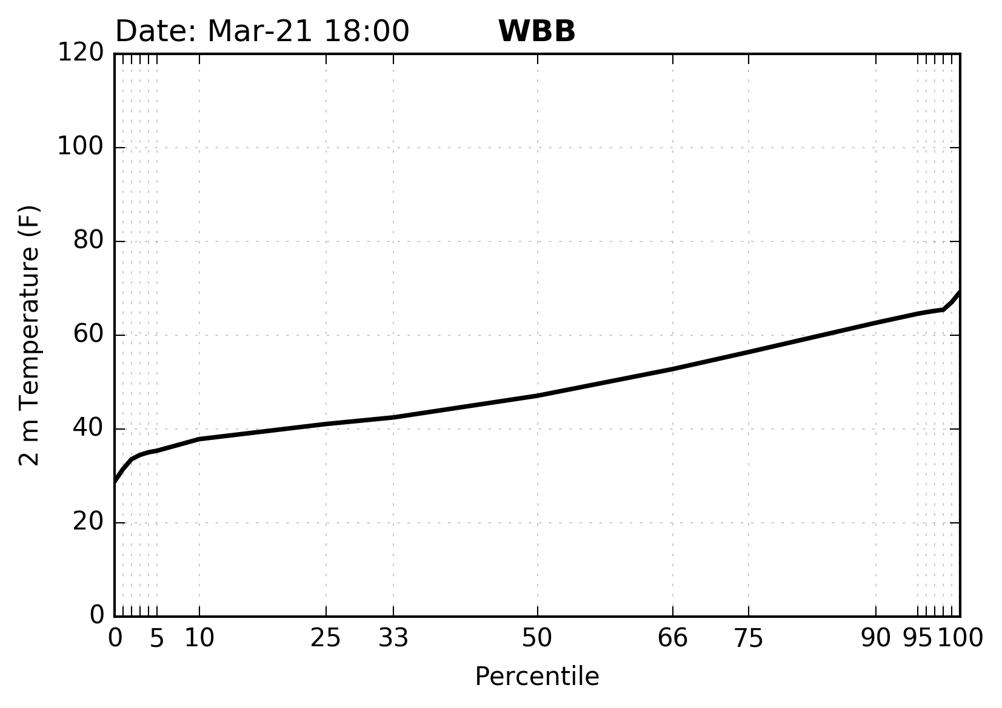
Temperature Percentiles at a Point
Single Hour
Notes:
In this figure, I have plucked out a single grid point in model domain, nearest to where we are now. (WBB is the name of a building on campus.)
This shows the 2 m air temperature (y-axis) for each of the 19 computed percentiles (x-axis) for March 21 at 18:00 UTC (approximately right now).
So you are looking at a probability distribution function of air temperature here on campus generated from three years of HRRR model data.
In the last three years for the 30 days that sandwich today,
the minimum temperature modeled by the HRRR has been 25 F
The warmest it has been is 70 F
with a median of 48 F.

Slide 18
Temperature Percentiles at a Point
Single Hour
Today’s Forecasted Temperature
58°
Notes:
Today’s forecasted temperature is about 58 F, which corresponds with the 75th percentile temperature for this time of year.
This is a warm day, but not too unusual.
This graph of the data from a single point is pretty simple, but remember, we have calculated these percentiles for every hour of the year…
…I could overlay 8,000 black lines, but that would look messy.

Slide 19
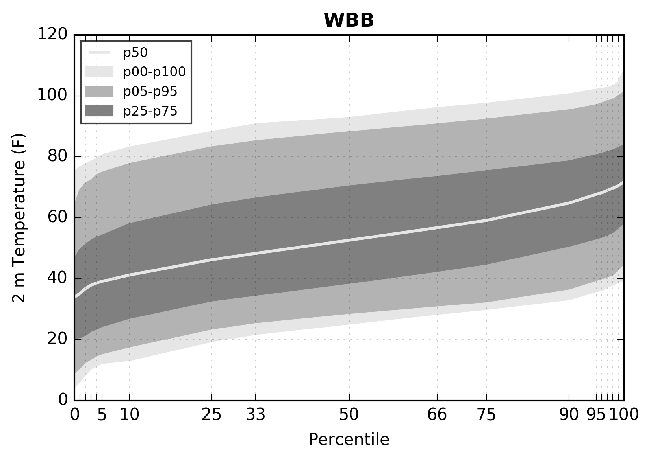
Temperature Percentiles at a Point
8,784 Hours
Notes:
Instead, I have summarized all the percentiles for this single point
with a kind of box and whisker plot that shows the percentiles of all the percentiles for every hour of the year.
The dark grey shading is the 25th-75th percentiles of each percentiles.
I’ll let you stare at that for a second

Slide 20
Temperature Percentiles at a Point
8,784 Hours
Hottest Summer Temperatures
warmest of the warmest days
Coldest Winter Temperatures
coldest of the coldest days
Notes:
The simplest way to interpret this is that
the coldest winter temperatures (the coldest of the coldest days) are in the bottom left of the figure,
and the warmest of the summer days are represented in the top right of the figure.
This figure summaries the model climatology for the University of Utah nicely, but
It is not too useful because we have removed the time dimensions.

Slide 21
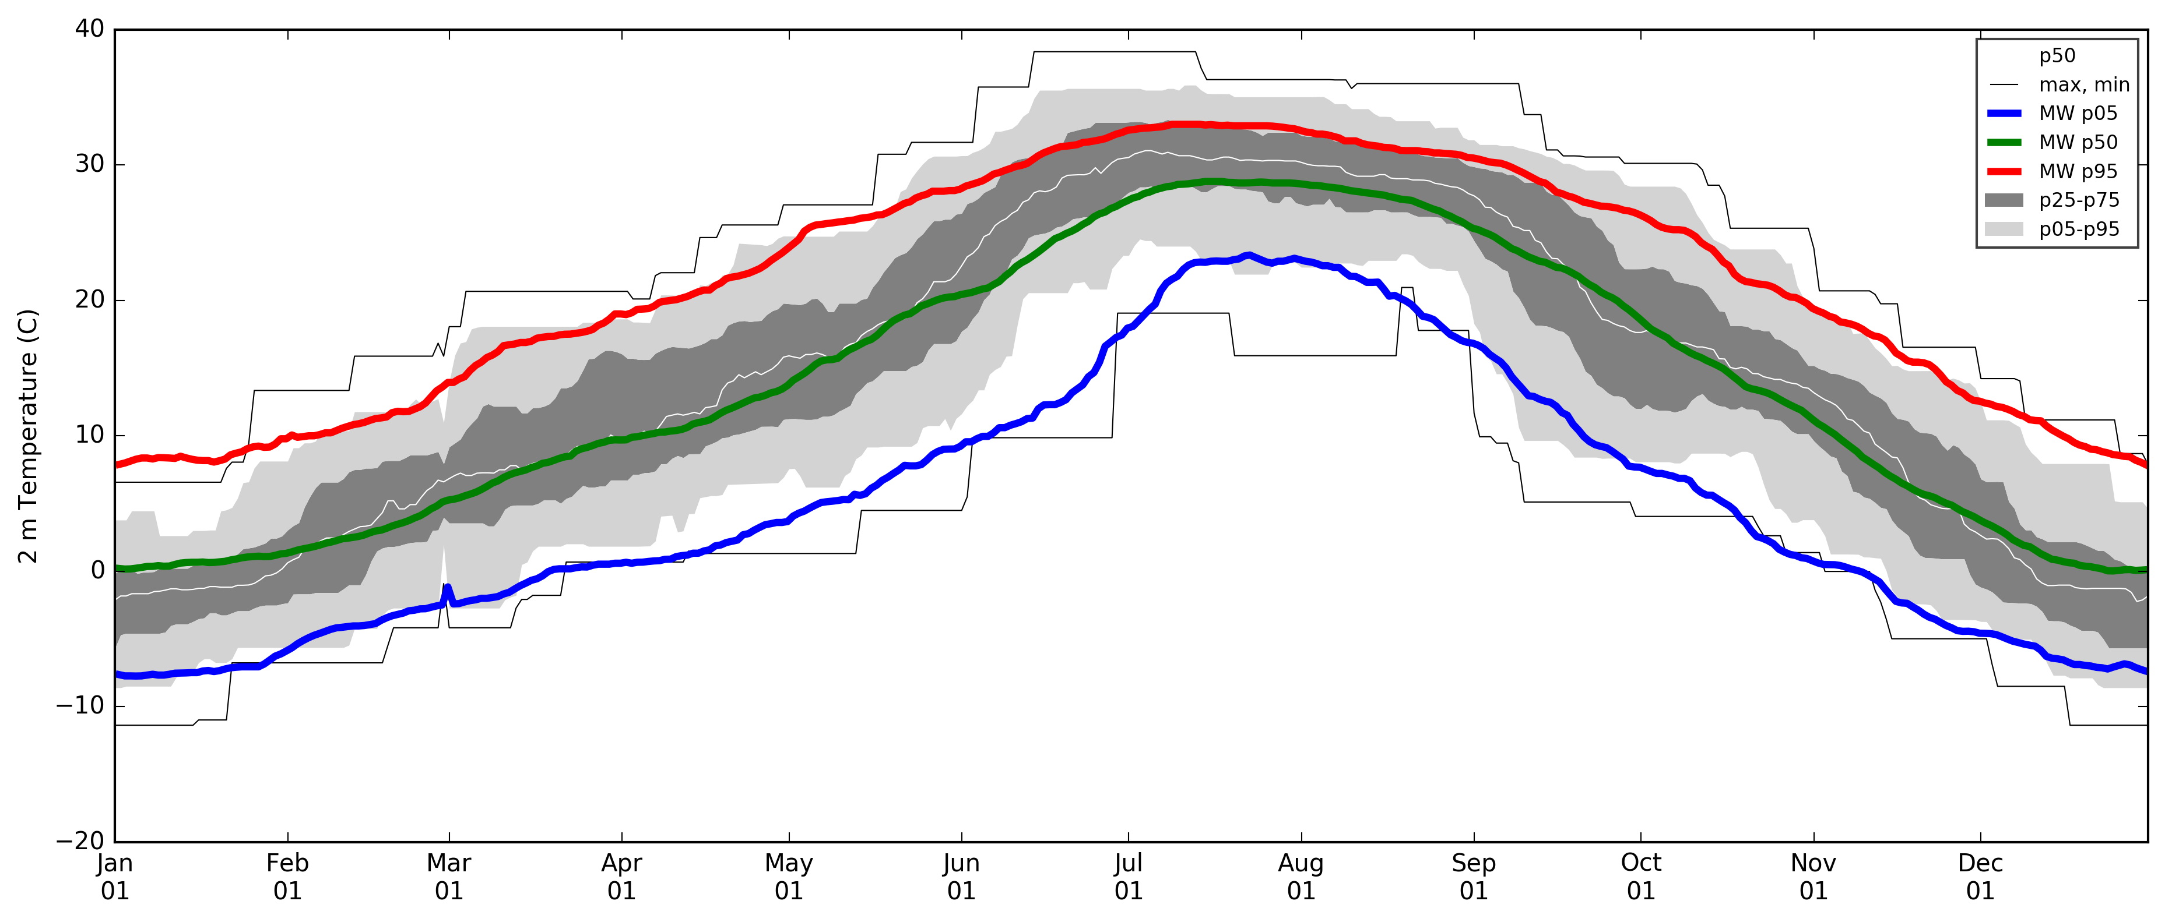
Percentiles at a Point
Temperature at University of Utah (WBB) at 1800 UTC
Notes:
Another way to look at this is by looking at the annual temperature range at all 18:00 UTC hours for the year. (again this is for a single location, here on campus)
The light grey lines show the temperature’s 5th-95th percentile,
the dark grey is the 25th -75th percentile,
and the light grey in the middle is the median.
Ignore the thin black lines for now
The colored lines represent data from a weather station on campus. We have a 20 year record that we have computed the observed temperature percentiles for this point.
Red is the 95th percentile of observed temperature
Green is the median
and Blue is the 5th percentile…of the observed temperature.
Grey is the 3-year model climatology, and color is the 20-year observed climatology
If the HRRR model were perfect, and we had more than three years, the light grey shading would match up perfectly with the colored lines.
For the most part, our model climatology agrees fairly well with the observed temperature climatology.

Slide 22
Percentiles at a Point
Wind Speed at University of Utah at 1800 UTC
Notes:
This next figure shows the same as before, but is for wind speed here on campus.
You will nice that the 95th percentile for the HRRR wind speed (light grey) is underestimated in the spring months and overestimated in the summer months.
Same with the median wind. The model is overestimating wind speeds here at the University of Utah.
That is largely an artifact of
being near mountains, which the model struggles with,
our short record of HRRR data
and some model bias.

Slide 23
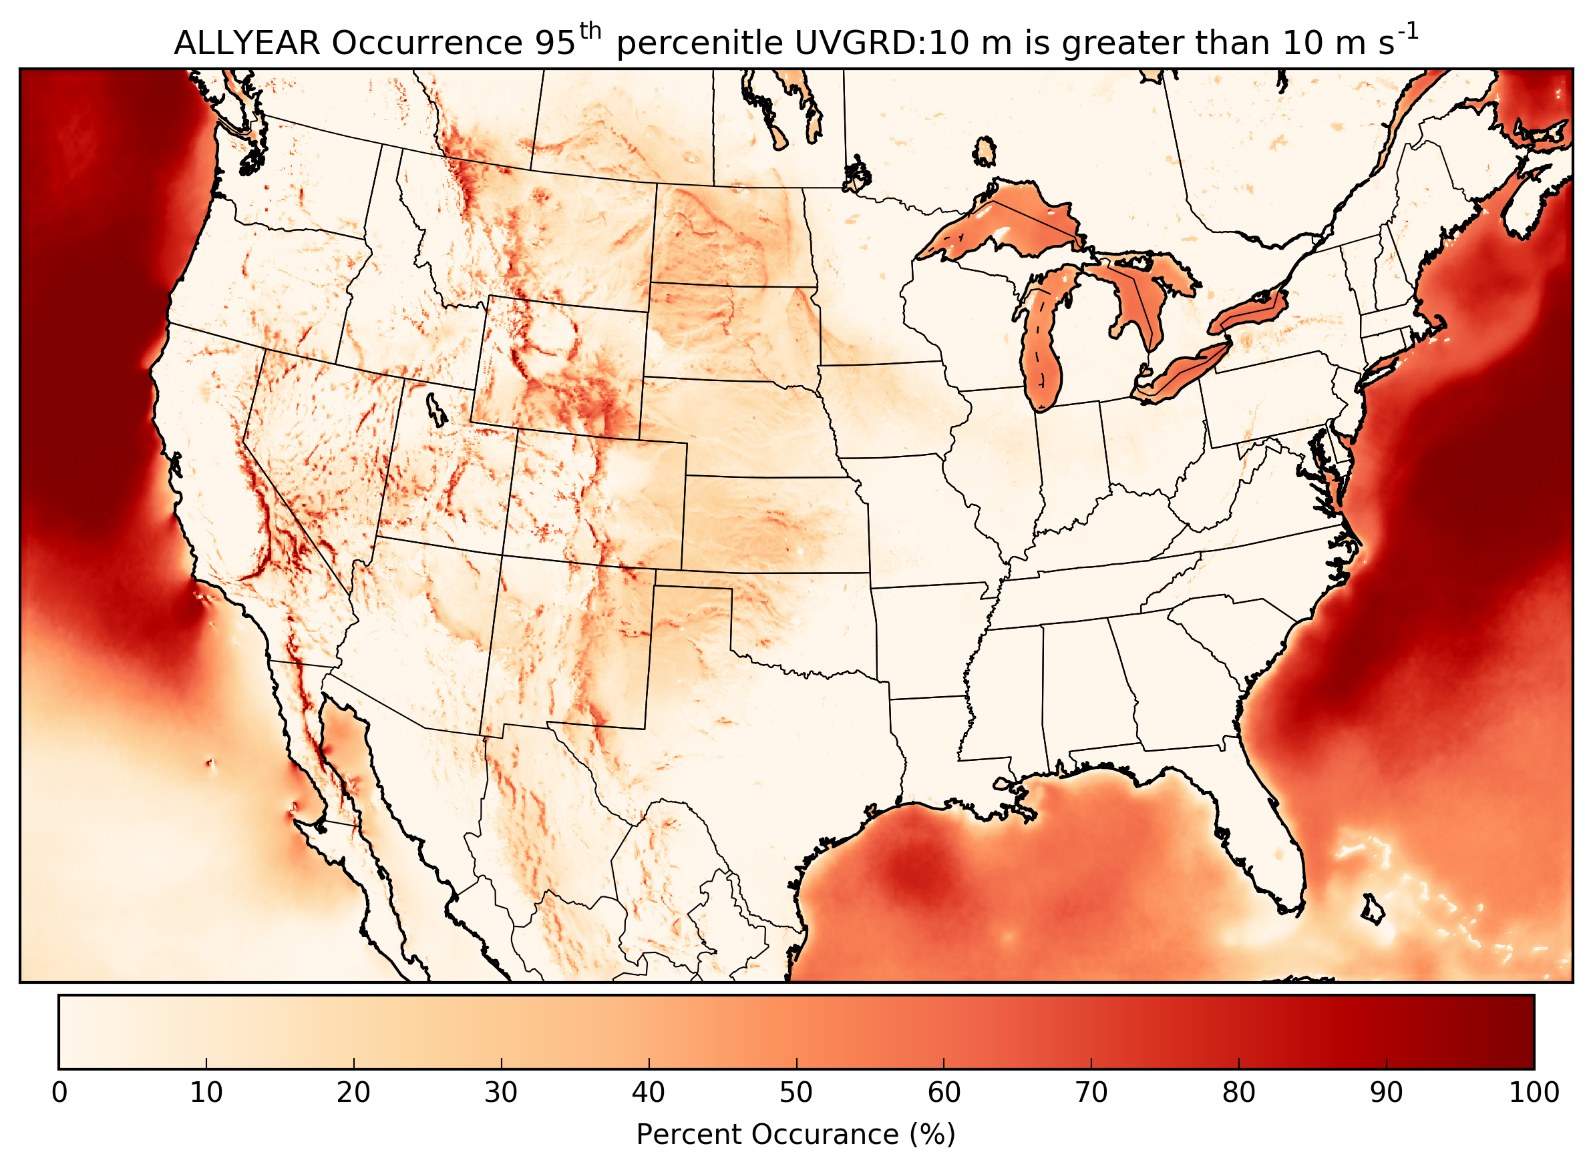
Wind Climatology
Percent Occurrence (%)
Notes:
These next figures show percentiles for the entire HRRR model domain.
This wind climatology shows how often the 95th percentile wind is greater than 10 m/s for the entire year.
In other words “how often the fastest winds are fast”
You can see that strong winds most often occur…
off the cost in the storm tracks
the top of mountain peaks
over the Great Lakes,
and in the Dakota’s

Slide 24
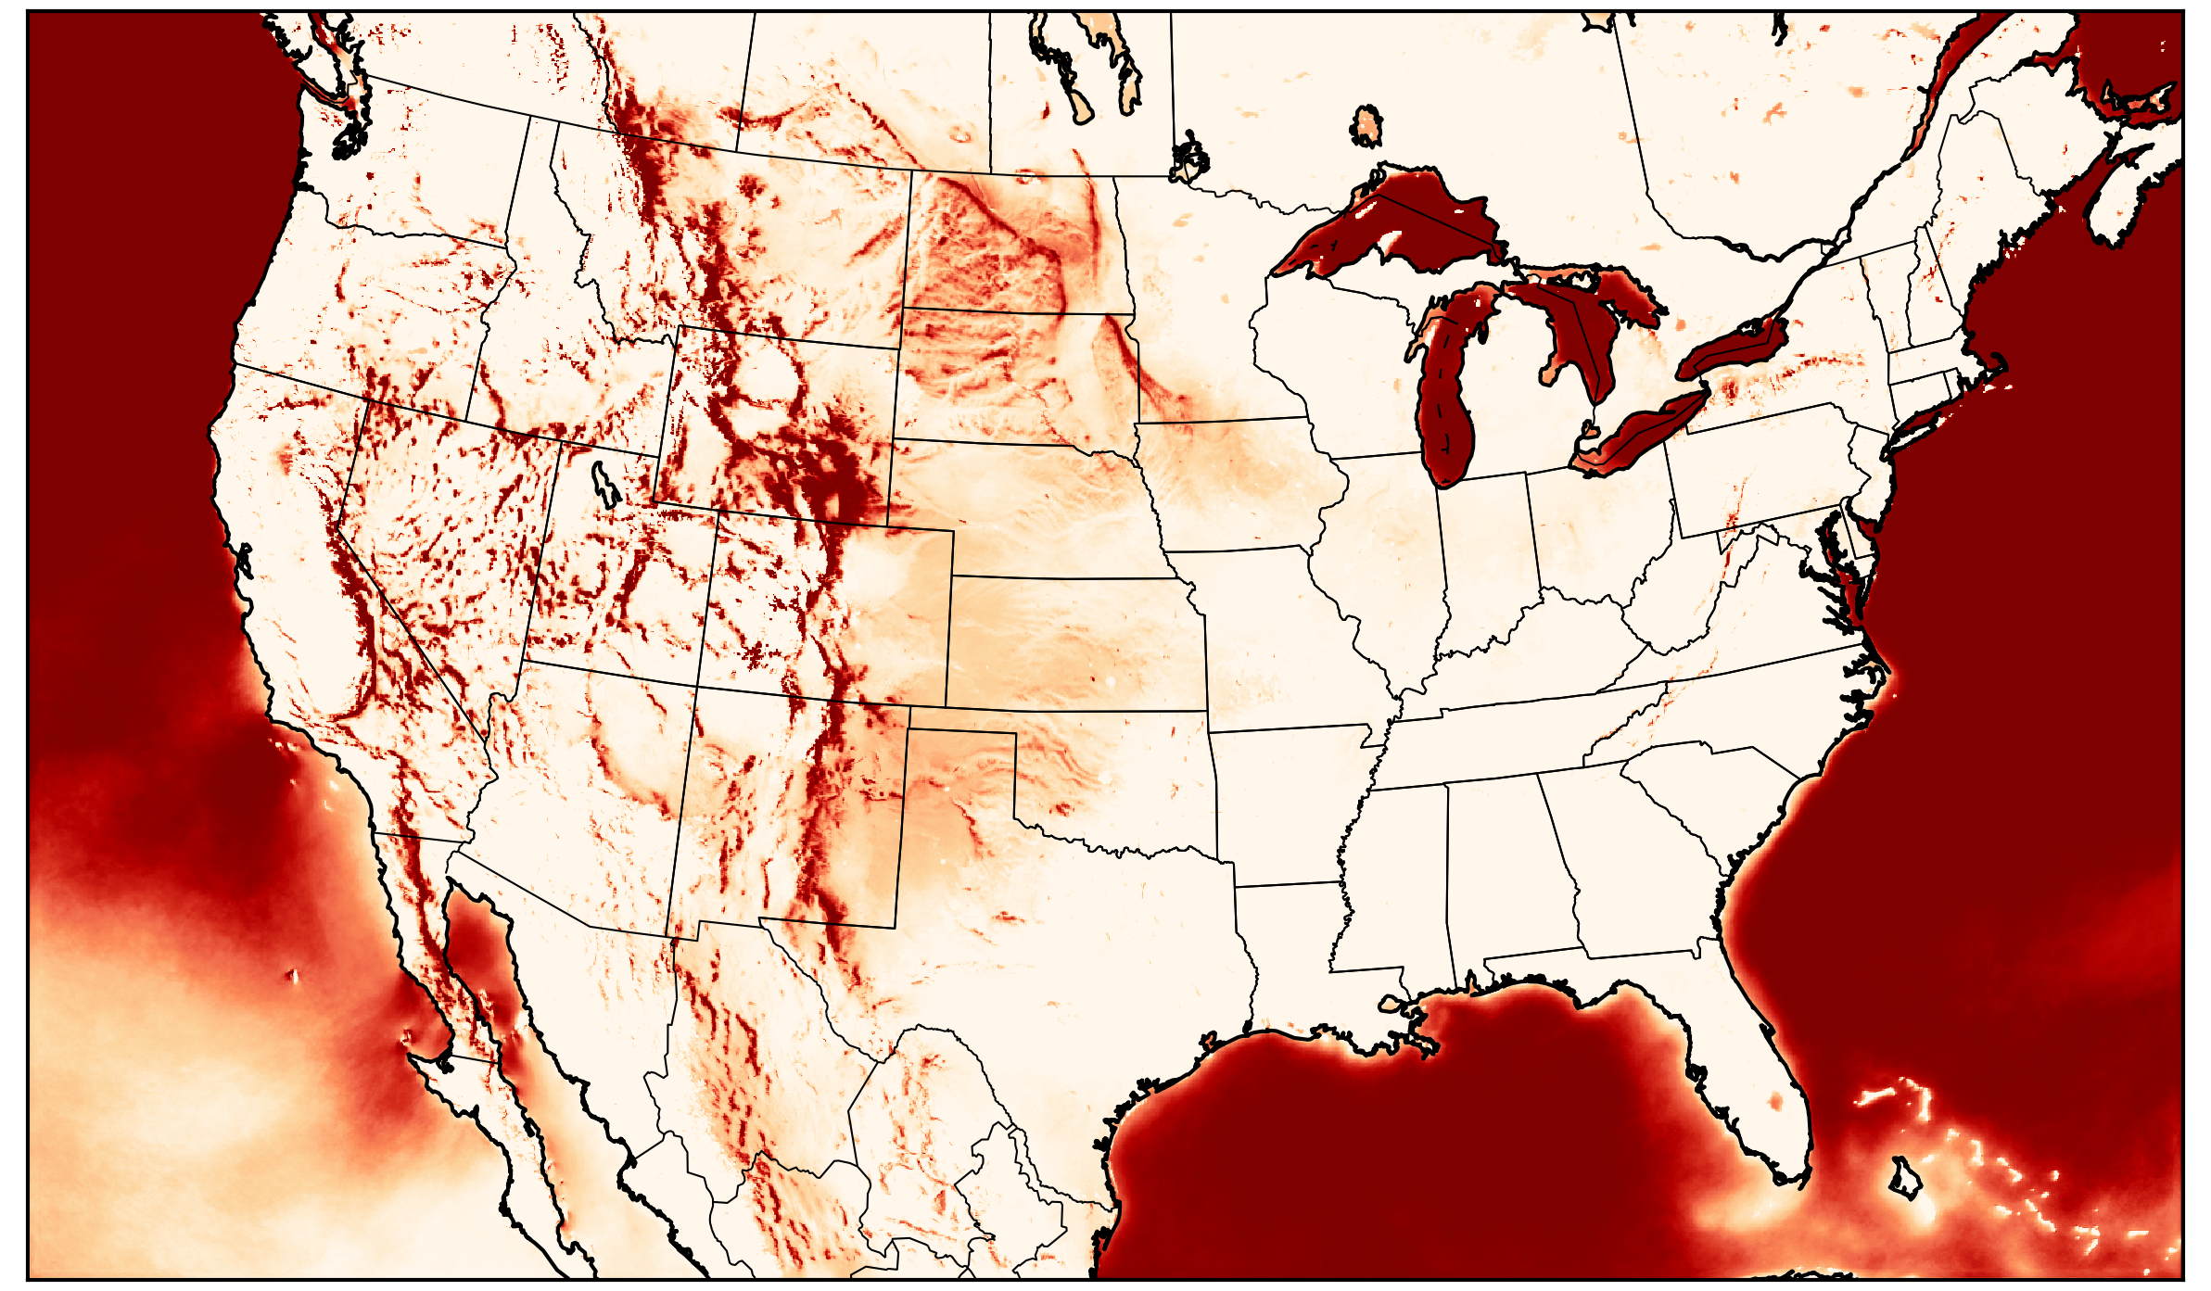
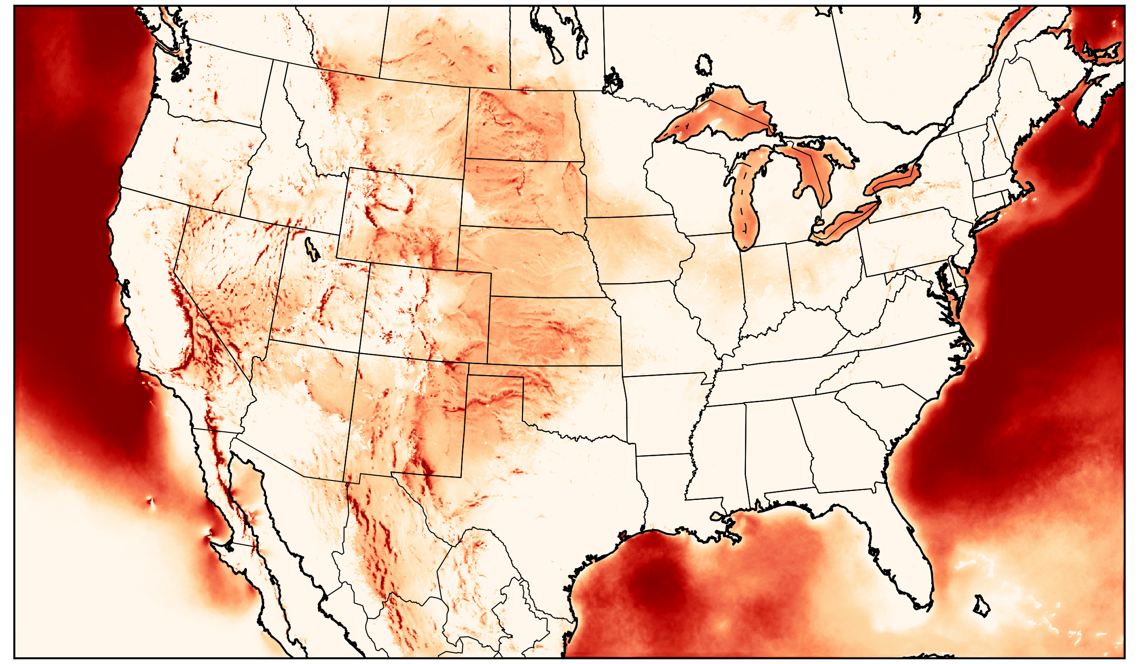
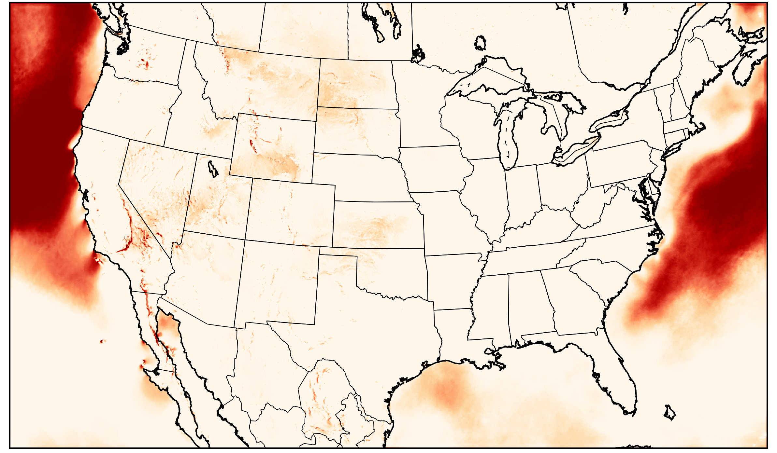
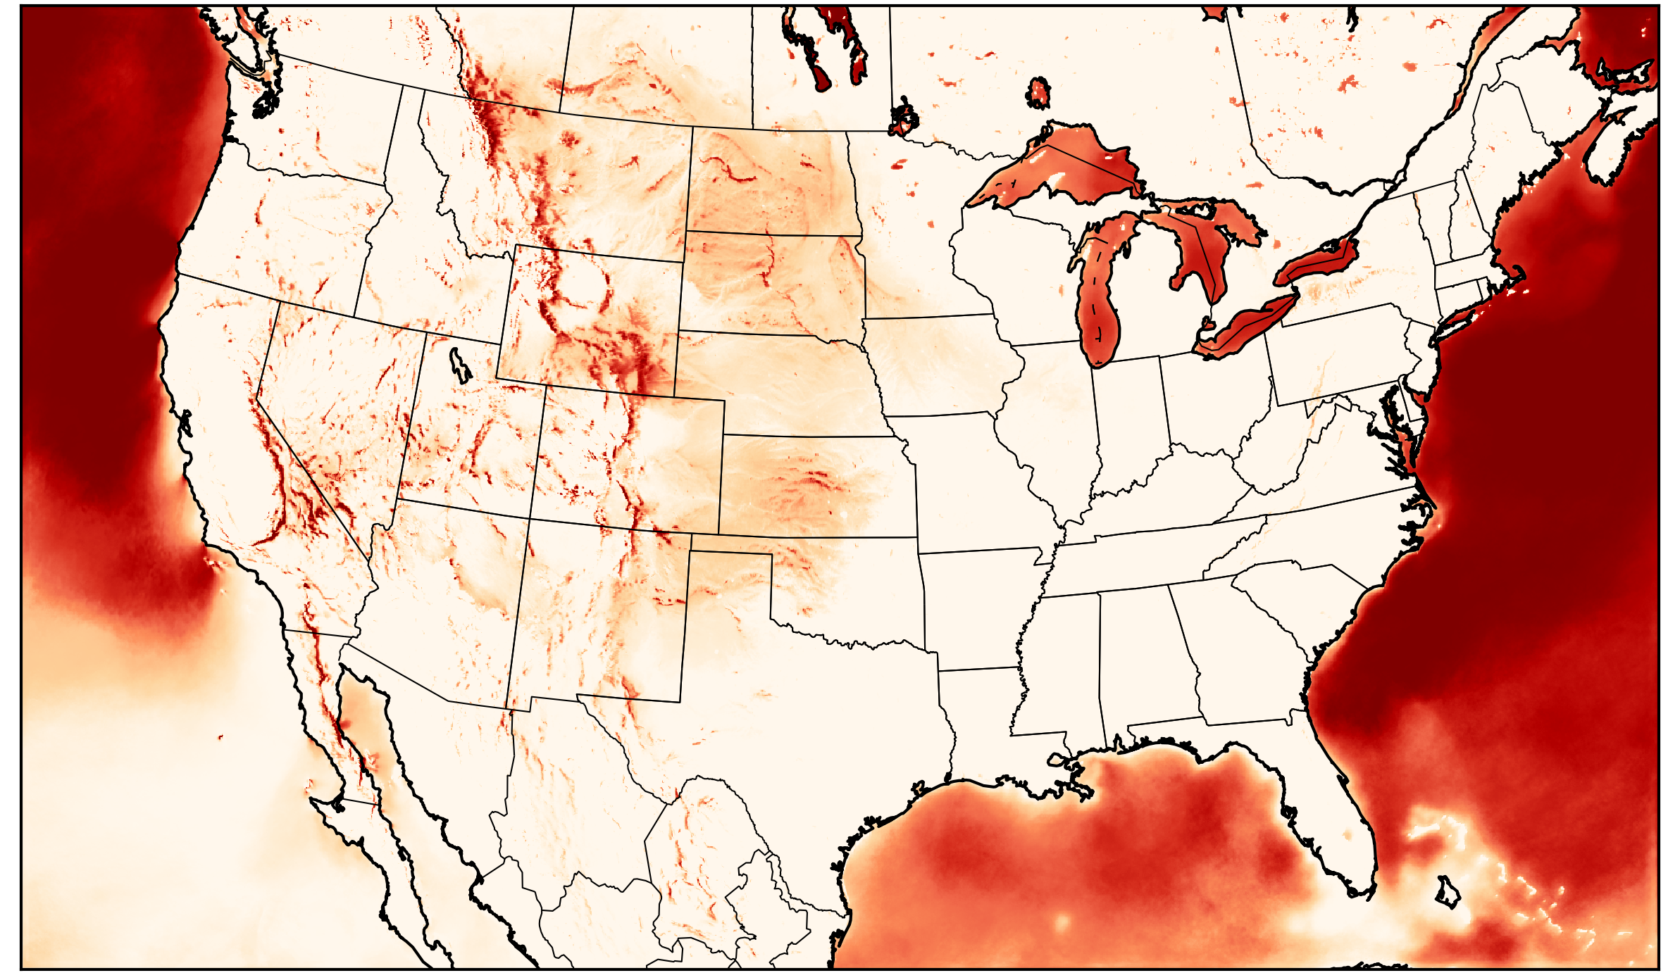
Wind Climatology
December
January
February
March
April
May
June
July
August
September
October
November
Percent Occurrence (%)
Notes:
We can break this down to show the fast wind occurrence by season
You can see that strong winds occur less often in the summer months.
Valuable information if you want to produce wind energy.

Slide 25
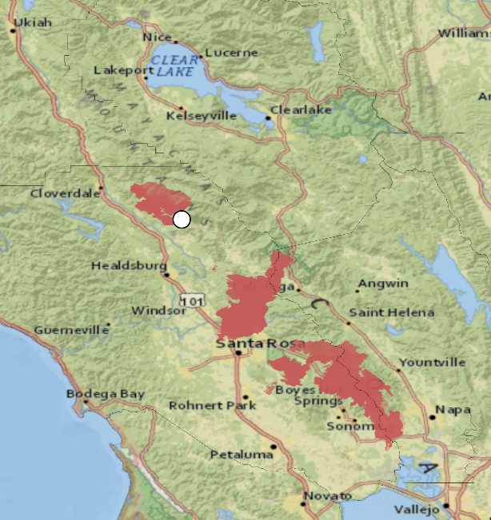
Pocket, Tubbs, and Nuns Fires
California, October 2017
HWCK1
Fire Perimeters
HRRR 10 m wind
09 Oct 2017 0700 UTC
Notes:
There are many other potential uses of model climatology.
We are funded by the Joint Fire Science Program to better understand HRRR forecast near wild fires.
So how might this data we created be used?
Well, imagine that you are a meteorologist assigned to make forecasts for a new wildfire,
out in the middle of nowhere and a place you have never forecasted before.
The data we have created could help you understand what the typical wind speeds are for that area, and help you identify when conditions are unusual.
As an example, Last October the Pocket fire in California grew rapidly due to strong winds.
The right panel shows the winds in the HRRR model for October 9th, at 07:00 UTC.
The left panel shows the location of wild fires, as well as the location of a weather station called “Hawkeye”
With our OSG statistics, we can see how unusual these winds speeds where for this area at this time…

Slide 26
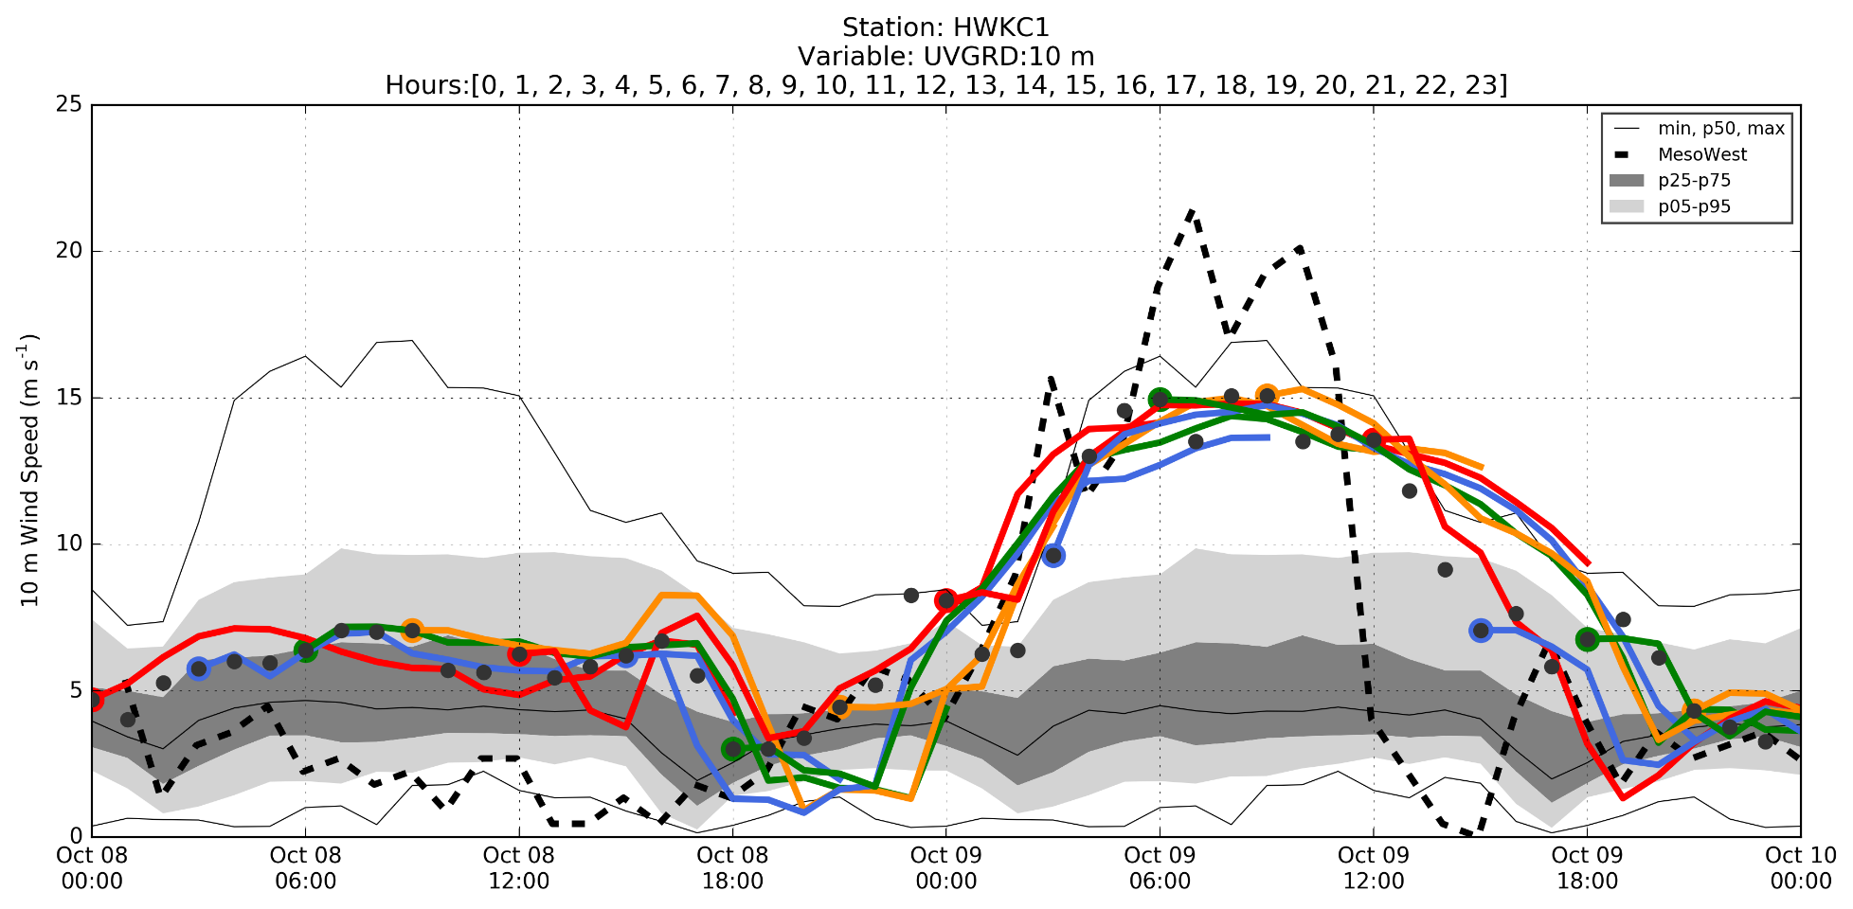
HRRR wind forecasts and observations at HWKC1
10 m wind speed (m s⁻¹)
Notes:
This time series of winds speeds at the location of the Pocket fire, is shown for October 8th-10th.
Like before, the grey colored shading is the percentile data we generated on OSG.
The thin black line represents the maximum wind speed modeled by the HRRR in three years for this time of year.
The colored lines this time are individual wind speed forecasts from the HRRR model, initialized at the dots.
The dashed line is the observed wind speed at the “Hawkeye” weather station.
On October 8th, the observed and modeled wind conditions were typical for this time of year, (HRRR was a little bullish on the wind speeds.)
But on October 9th, the forecasted and observed winds increased well above the 95th percentile, telling us that these winds were unusual for this location and time of year.
We also see that the HRRR model did not forecast winds as strong as were actual observed.
While the station observed winds in excess of 20 m/s, none of the HRRR forecasts predicted winds greater than 15 m/s.

Slide 27
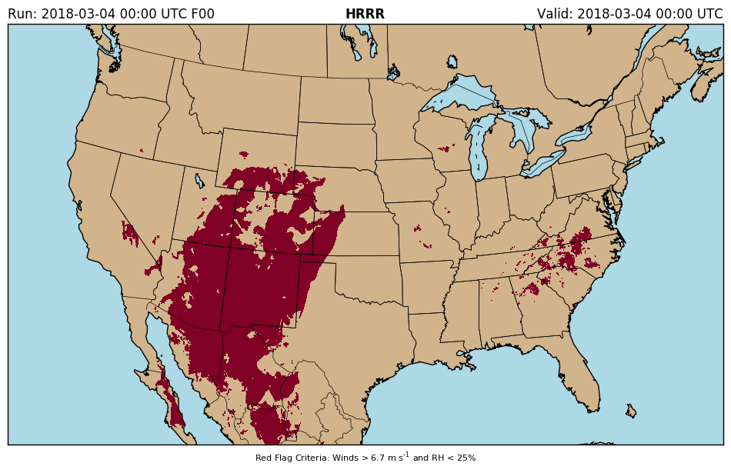
Future Work
Multivariate Percentiles
Occurrence of strong wind and low relative humidity
Red flag conditions for wildfire forecasting
Identify Model Bias
Compute percentiles for forecast hours and comparing with analyses and observations. Identify bias by variable, location, time of day and year, etc.
Notes:
There are a lot of directions we could go with this work,
With our current project, we would like to calculate a multivariate climatology for when there are strong winds and low relative humidity because dry and windy conditions are important to rapid fire spread. (The right shown and example of areas where winds are fast and humidity is low)
I also think we can identify model biases for different areas and times by running these percentiles for each of the 18 different forecast hour.

Slide 28
Why the OSG was good for this work?
Small, dedicated node—lengthy run time
HPC with interconnected nodes—not necessary
Open Science Grid high-throughput computing— just right!
Notes:
In conclusion, why was the Open Science Grid good for this work? Well, we had a Goldilocks experience…
We had the option to…
Us our own single dedicated, multiprocessor nodes – would have required lengthy run times
High Performance Computing with many interconnected nodes – this was just not necessary.
But the Open Science Grid, built for high throughput, was just right.
I wish to thank everyone again who helped me get going on the OSG. None of this work would have been possible without your help.
I am happy to answer question or hear feedback you have.

Slide 30
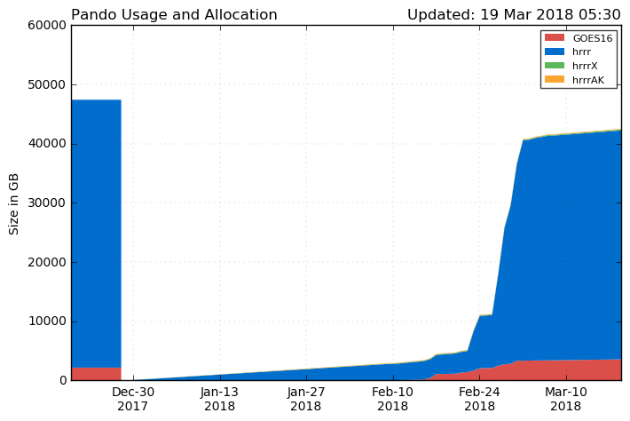
Future Work (Ugh…Technology)
The Pando archive system failed and we lost all the data.
We were able to recover data after July 2016
After July this year, we can recompute percentiles for 2 years of HRRR data.
Notes:
We would have done this already, but we experienced a little hiccup at the beginning of the year…
The Pando archive system failed, and we lost all raw HRRR data.
The archive was rebuilt and we recently had some help from the Climate Corporation to restore almost two years of the lost data.

Slide 31
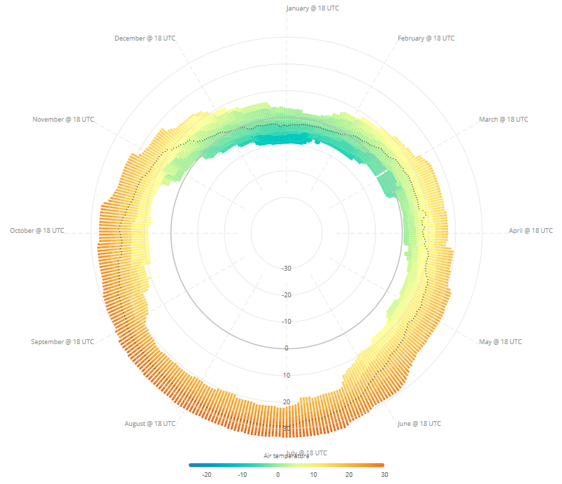
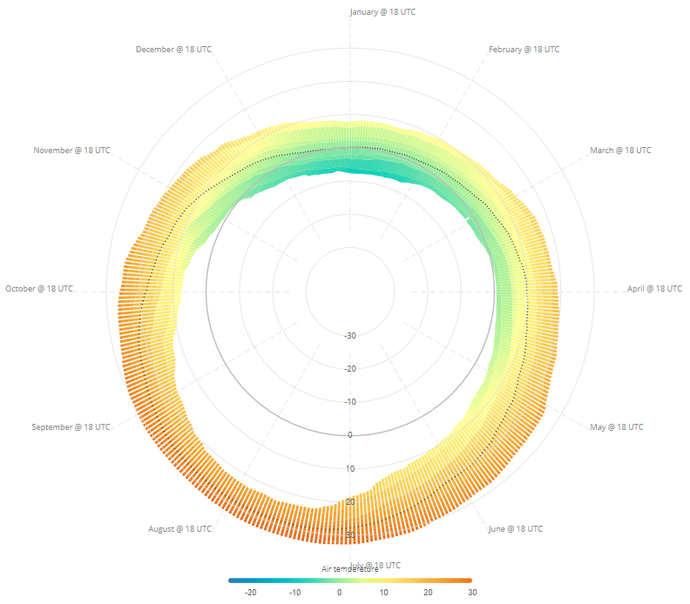
Percentiles at a Point
Credit: Chris Galli
3-year HRRR 5th-95th Percentiles
20-year Observed 5th-95th Percentiles
Notes:
Alternatively, we can plot the same data on radial plots. These were created by Chris Galli in our group. They are fun to look at too.

Slide 32
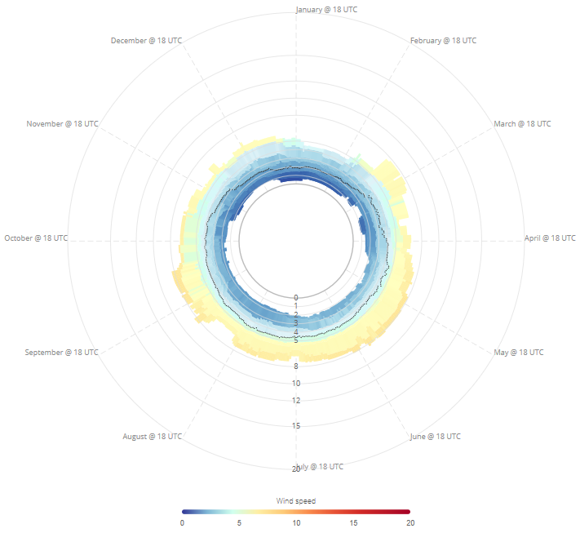
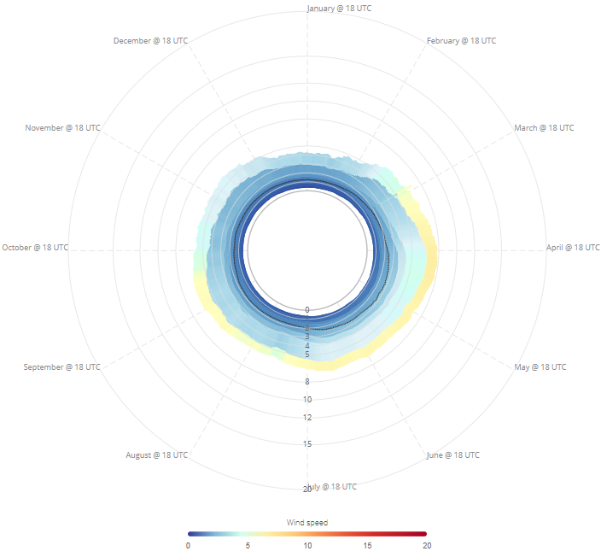
Percentiles at a Point
Credit: Chris Galli
3-year HRRR 5th-95th Percentiles
20-year Observed 5th-95th Percentiles
Notes:
And the same radial plots for wind speed

Slide 33
January Freezing Temperature Climatology
Highest Percentile that is below freezing
Notes:
This is the same kind of figure, but for 2 m temperature.
This shows the highest percentile with freezing temperatures in the month of January at 00:00 UTC
Red areas show where freezing temperatures are rare (meaning that few or none of the percentiles are ever below freezing)
Blue shows where freezing temperatures are regular (meaning that many or all of the percentiles are below freezing)

Slide 34
October Wind Climatology
Notes:
This figure is very similar to the one before, but is specific to October at 17:00 UTC and instead tells us the lowest percentile that exceeds a 5 m/s wind speed.
Lighter colors indicate areas where 5 m/s winds occur more frequently.
Darker colors indicate areas where 5 m/s winds are more rare.
For example, a 5 m/s wind speed in parts of Alabama only occur 5% of the time in October,
Whereas a wind speed greater than 5 m/s wind speed in the middle of North Dakota occurs about 80-90% of the time in October

Slide 35
HRRR Climatology vs Single HRRR Run
Notes:
It is also useful to look at weather climatology and forecasts in surrounding pixels.
Again, the grey shading is the HRRR climatology, but instead of for the entire year, it is for the surrounding model grid points, shown on the map…
This graph shows wind speed for the area, shown in the box on the right.
The dashed black line is the percentiles for the point at the center of the box.
The grey shading represents the maximum and minimum percentiles for all the boxes. (yes, this is a percentile of a percentile)

Slide 36
HRRR Climatology vs Single HRRR Run
Notes:
Another hour on the same day,
This shows the forecasted winds at the center of the box and for the entire box exceed the 95th percentile.
This was a time right before a cold front passed.

Slide 37
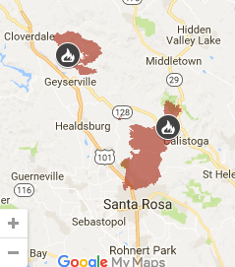
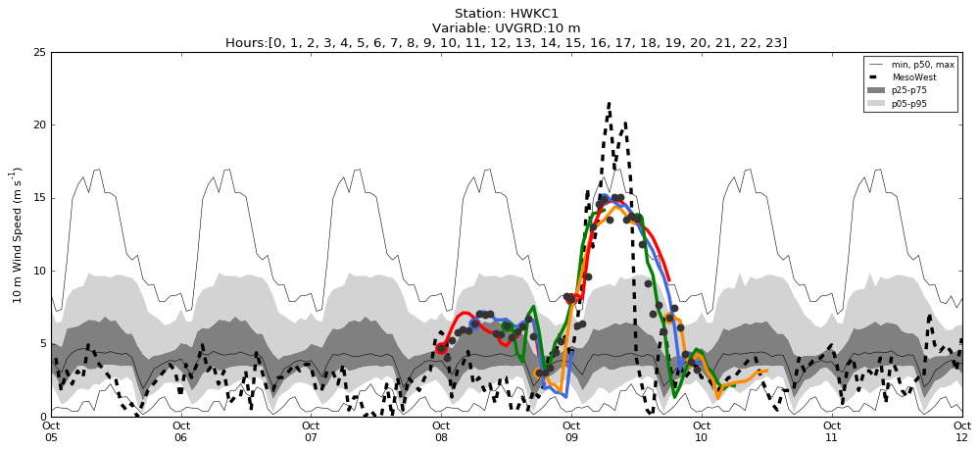
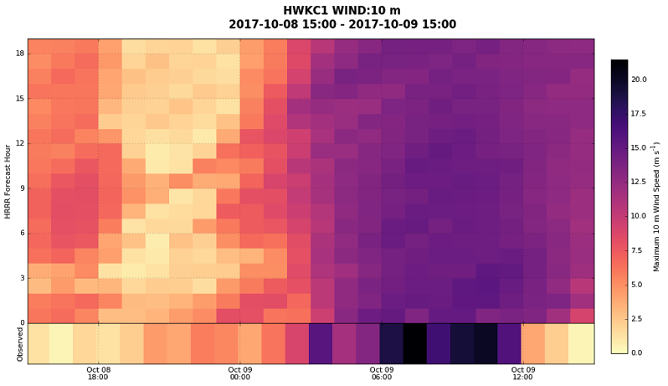
Central LNU Complex (Tubbs and Pocket Fires)

Slide 38
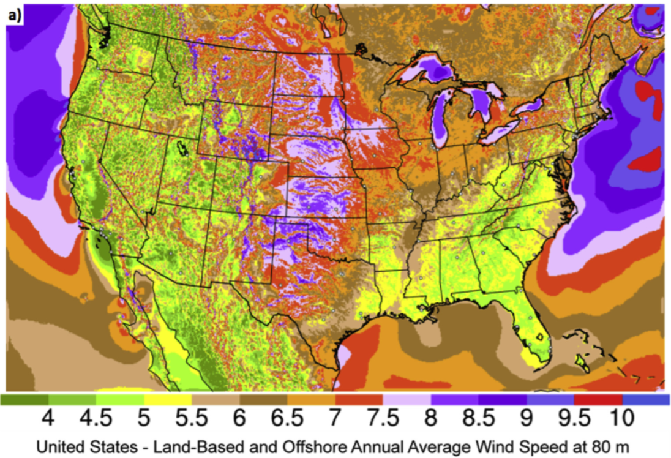
Wind Climatology
James et al. 2017
Notes:
This was encouraging, because it matches some work done by others who used the HRRR model to map out areas with high potential to create wind energy.
The red’s in our plot, match the purple locations in this work done by Eric James.

