Slide 1
Challenges in Computing for multi-disciplinary science at the FLATIRON INSTITUTE
Ian FIsk
March 21, 2018

Slide 2
Background
The Simons Foundation has existed to support science for over 20 years
  Currently Simons gives grants for over $300M annually across math and physical science, life science, large scale topic-driven science collaborations, and autism research
  5 years ago Simons decided they wanted to have an in house research group
    Started with the Simons Center for Data Analysis (SCDA), which was expected to be about 50 people

Slide 3
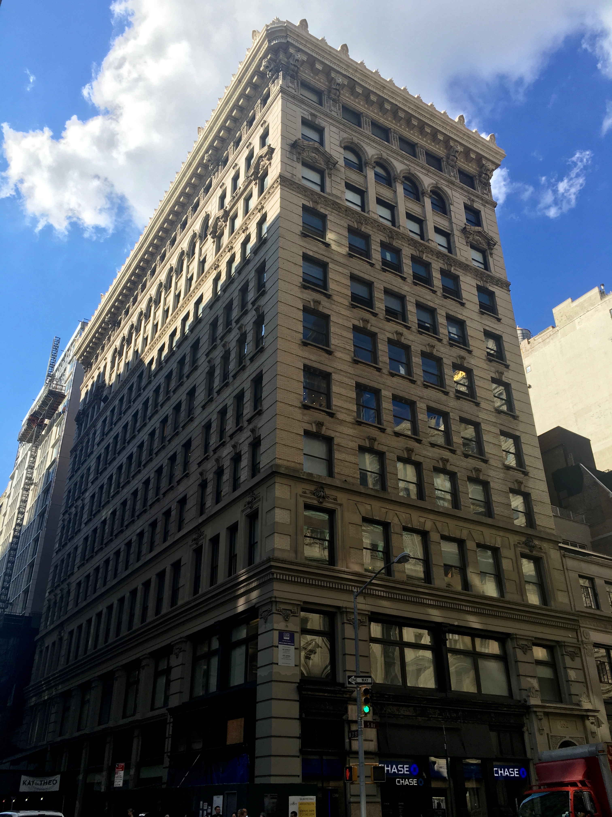
Flatiron Institute
Two and a half years ago it was decided to dramatically expand the scope
  250 scientists
  4 scientific centers
  A dedicated Facility
We moved into the building a year and a half ago
  Construction should be over by summer

Slide 4
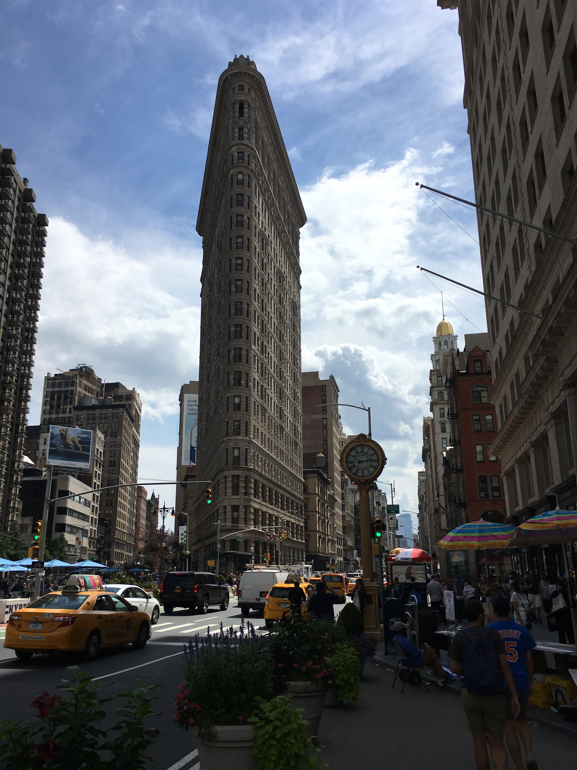
The Flatiron Institute is the research division of the Simons Foundation.
Its mission is to advance scientific research through computational methods, including data analysis, modeling and simulation.
Center for Computational Biology (CCB)
Center for Computational Astrophysics(CCA) and
Center for Computational Quantum Physics (CCQ)
CCX
Scientific Computing Core (SCC)

Slide 5
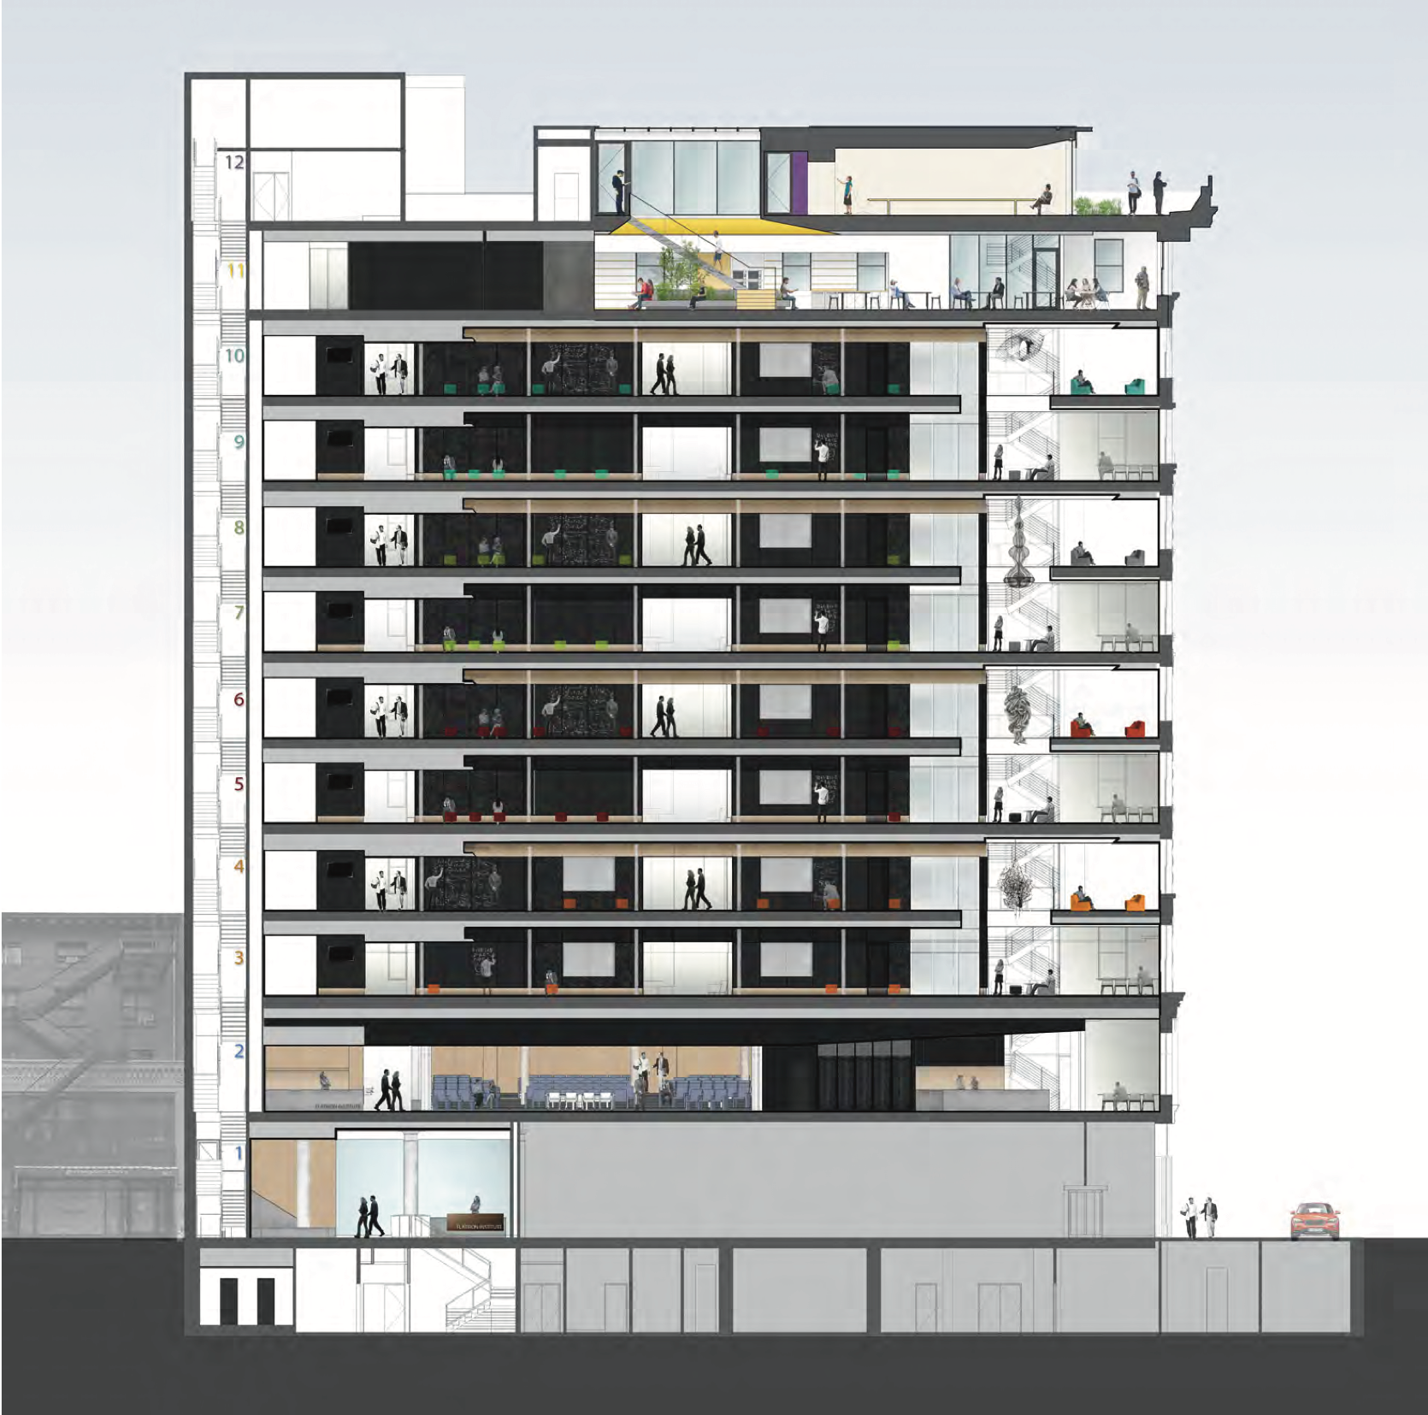
Challenges
We are in Manhattan
  Space is at a premium
    Space used for computers and computing support is space not used for scientists
      Data Center is in the basement
      Currently Scientific Computing Core is 9 people (7 + 2 directors)
        Roughly balanced between hardware and software experts
SCC
Cluster

Slide 6
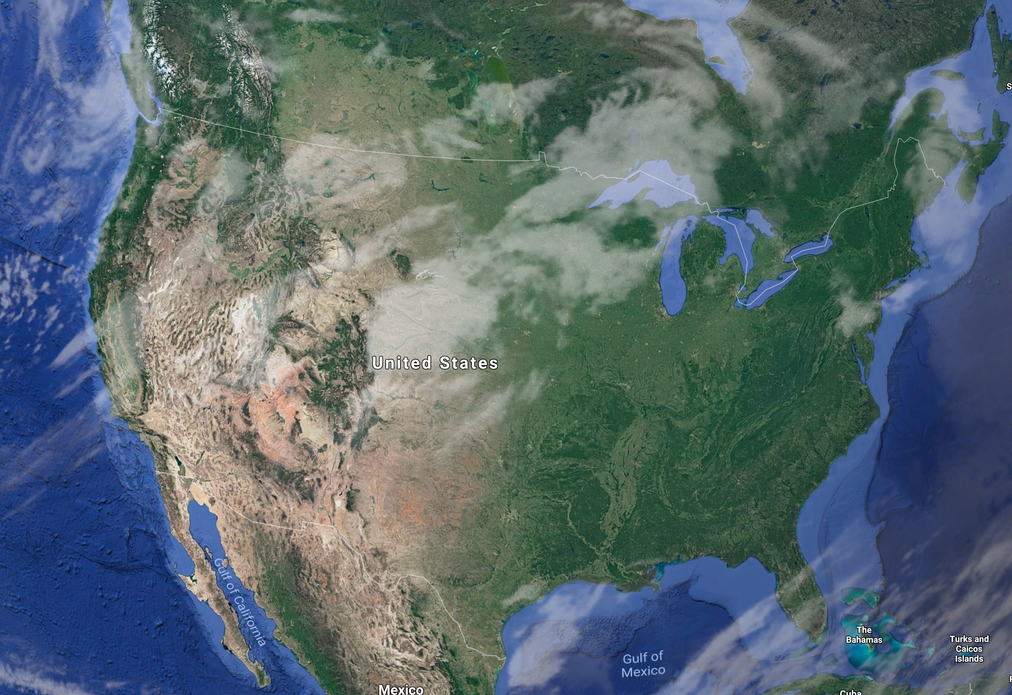
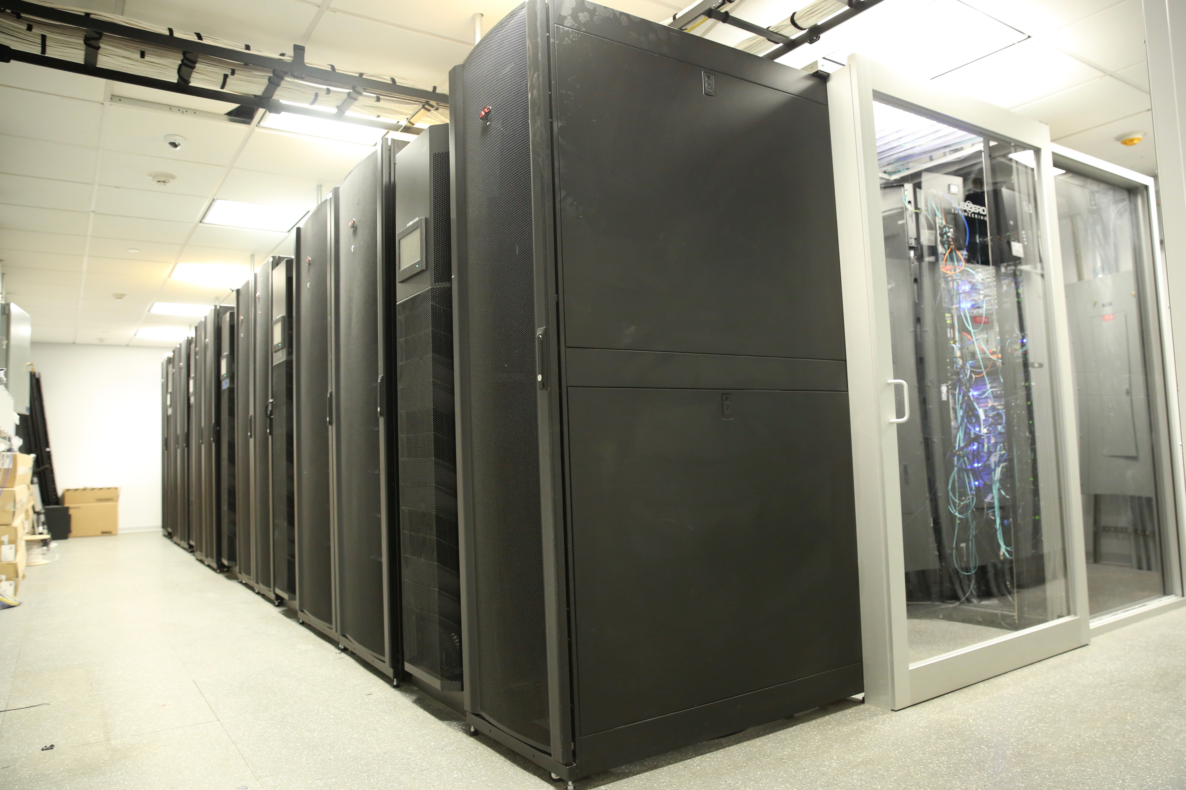
LOCATIONS
Flatiron has a data center in the basement
A co-location facility at BNL
  From the user perspective the two NY facilities are integrated
A tape archival facility at Fermilab
A leased super computer at the San Diego Computer Center
  Gordon
In addition there are opportunities in Massachusetts and Wyoming

Slide 7
Technical Challenges
Diversity of requirements
    HPC/HTC
    Finite vs. Infinite Computing
    GPU and specialized hardware
Dealing with Data
    Quantity
    Archiving
Sharing
  Exporting Data

Slide 8
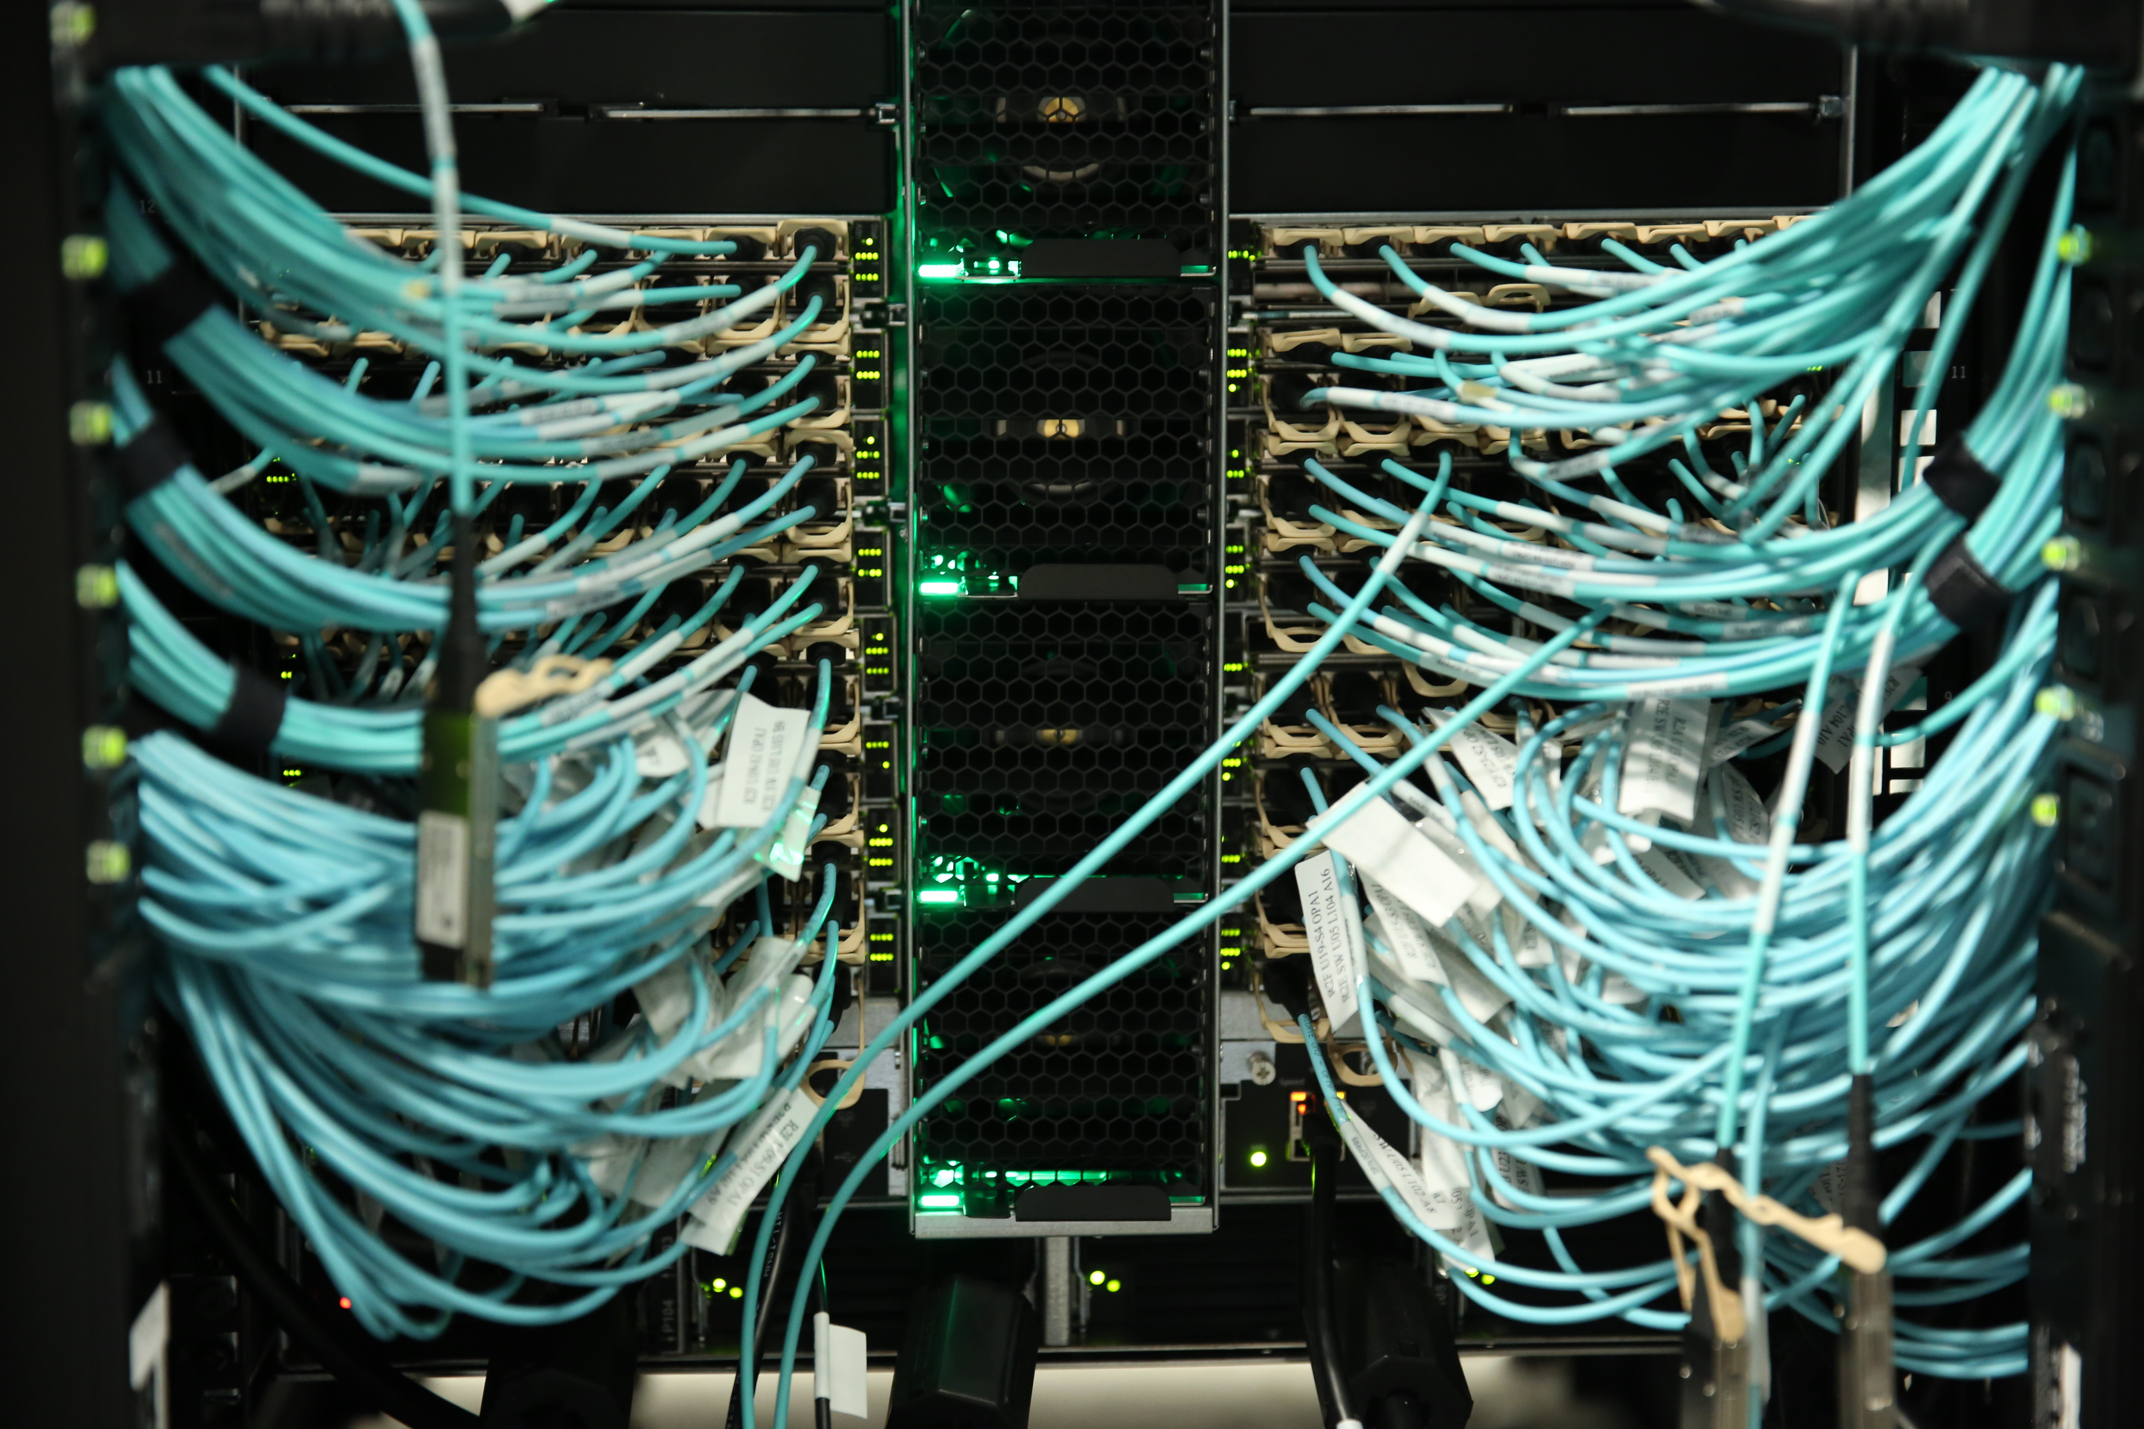
Diversity of Requirements
Astronomy simulation is primarily HPC using a few hundred cores in a tightly coupled configuration
Some portion of the Quantum systems work is also HPC
Low latency interconnects like Omnipath are needed

Slide 9
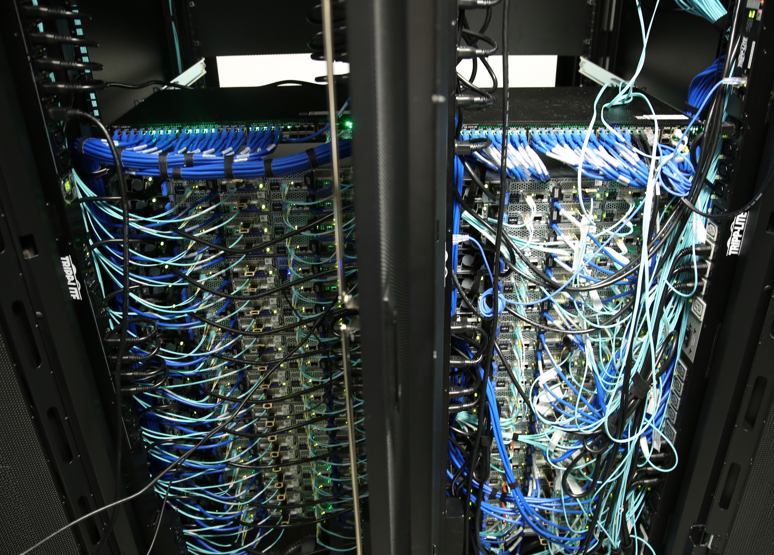
High Throughput Computing
Biology and half of Quantum systems are HTC
  Processing data and validating code in the highly parallelizable infrastructure
    Easier to support
    Easier to schedule
Nodes are common
  20GB RAM per core

Slide 10
Infinite >> Finite
Science that is done by comparing physics driven simulation to observation has no end point
  One can always adjust a parameter add a second order effect etc.
Science that processes data and tries to draw a conclusion tends to have an end of the iterations

Slide 11
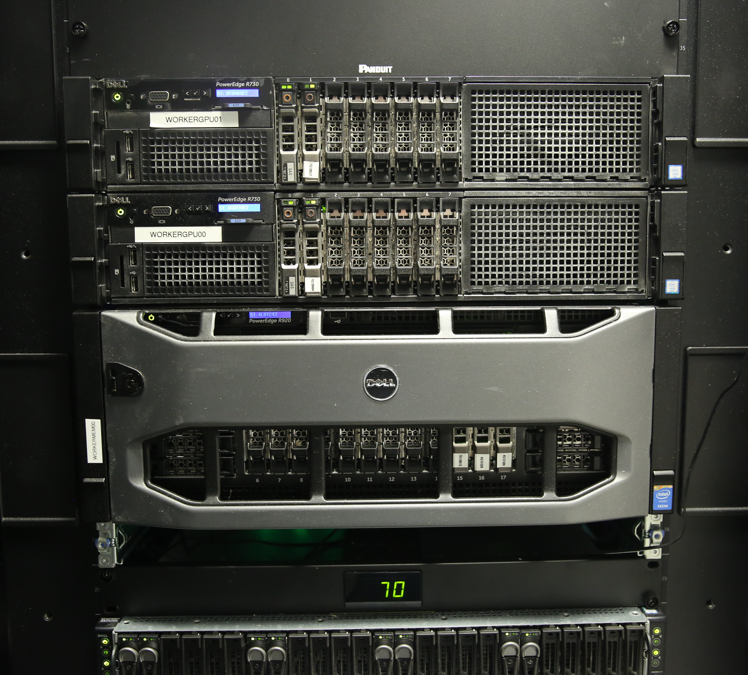
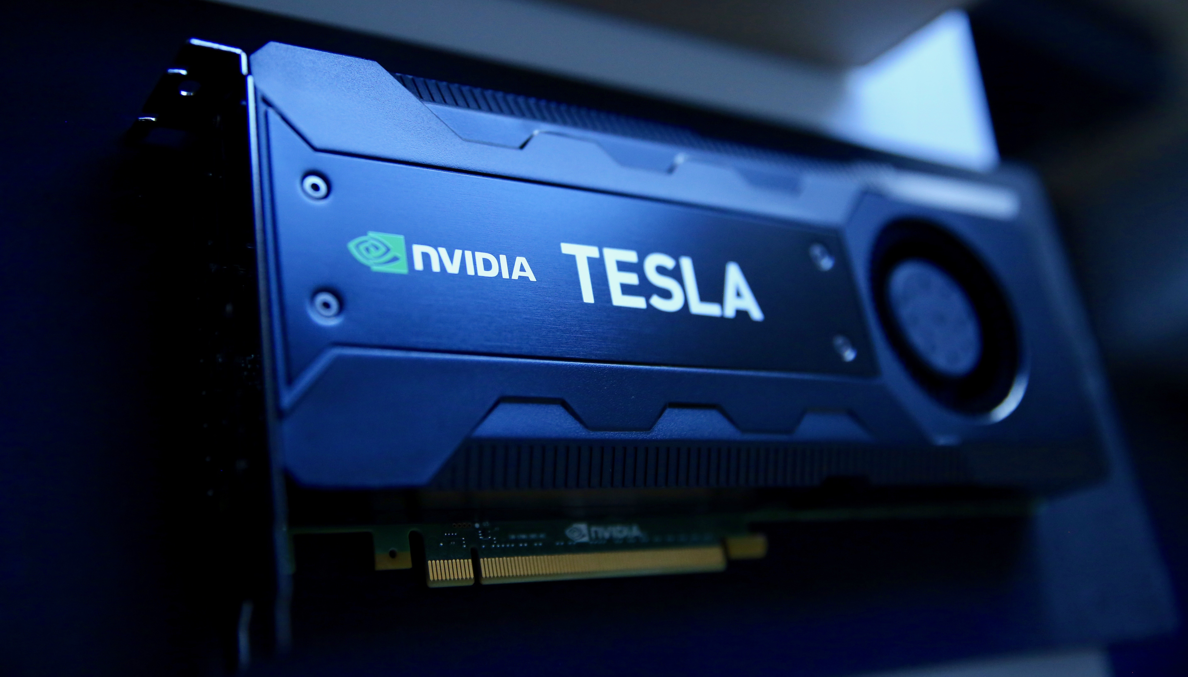
Specialized Hardware
We have seen some GPU requests
  Mostly for canned machine learning applications
The quantum system group has been hiring people who can actually program GPUs so we are watching if the requests go up

Slide 12
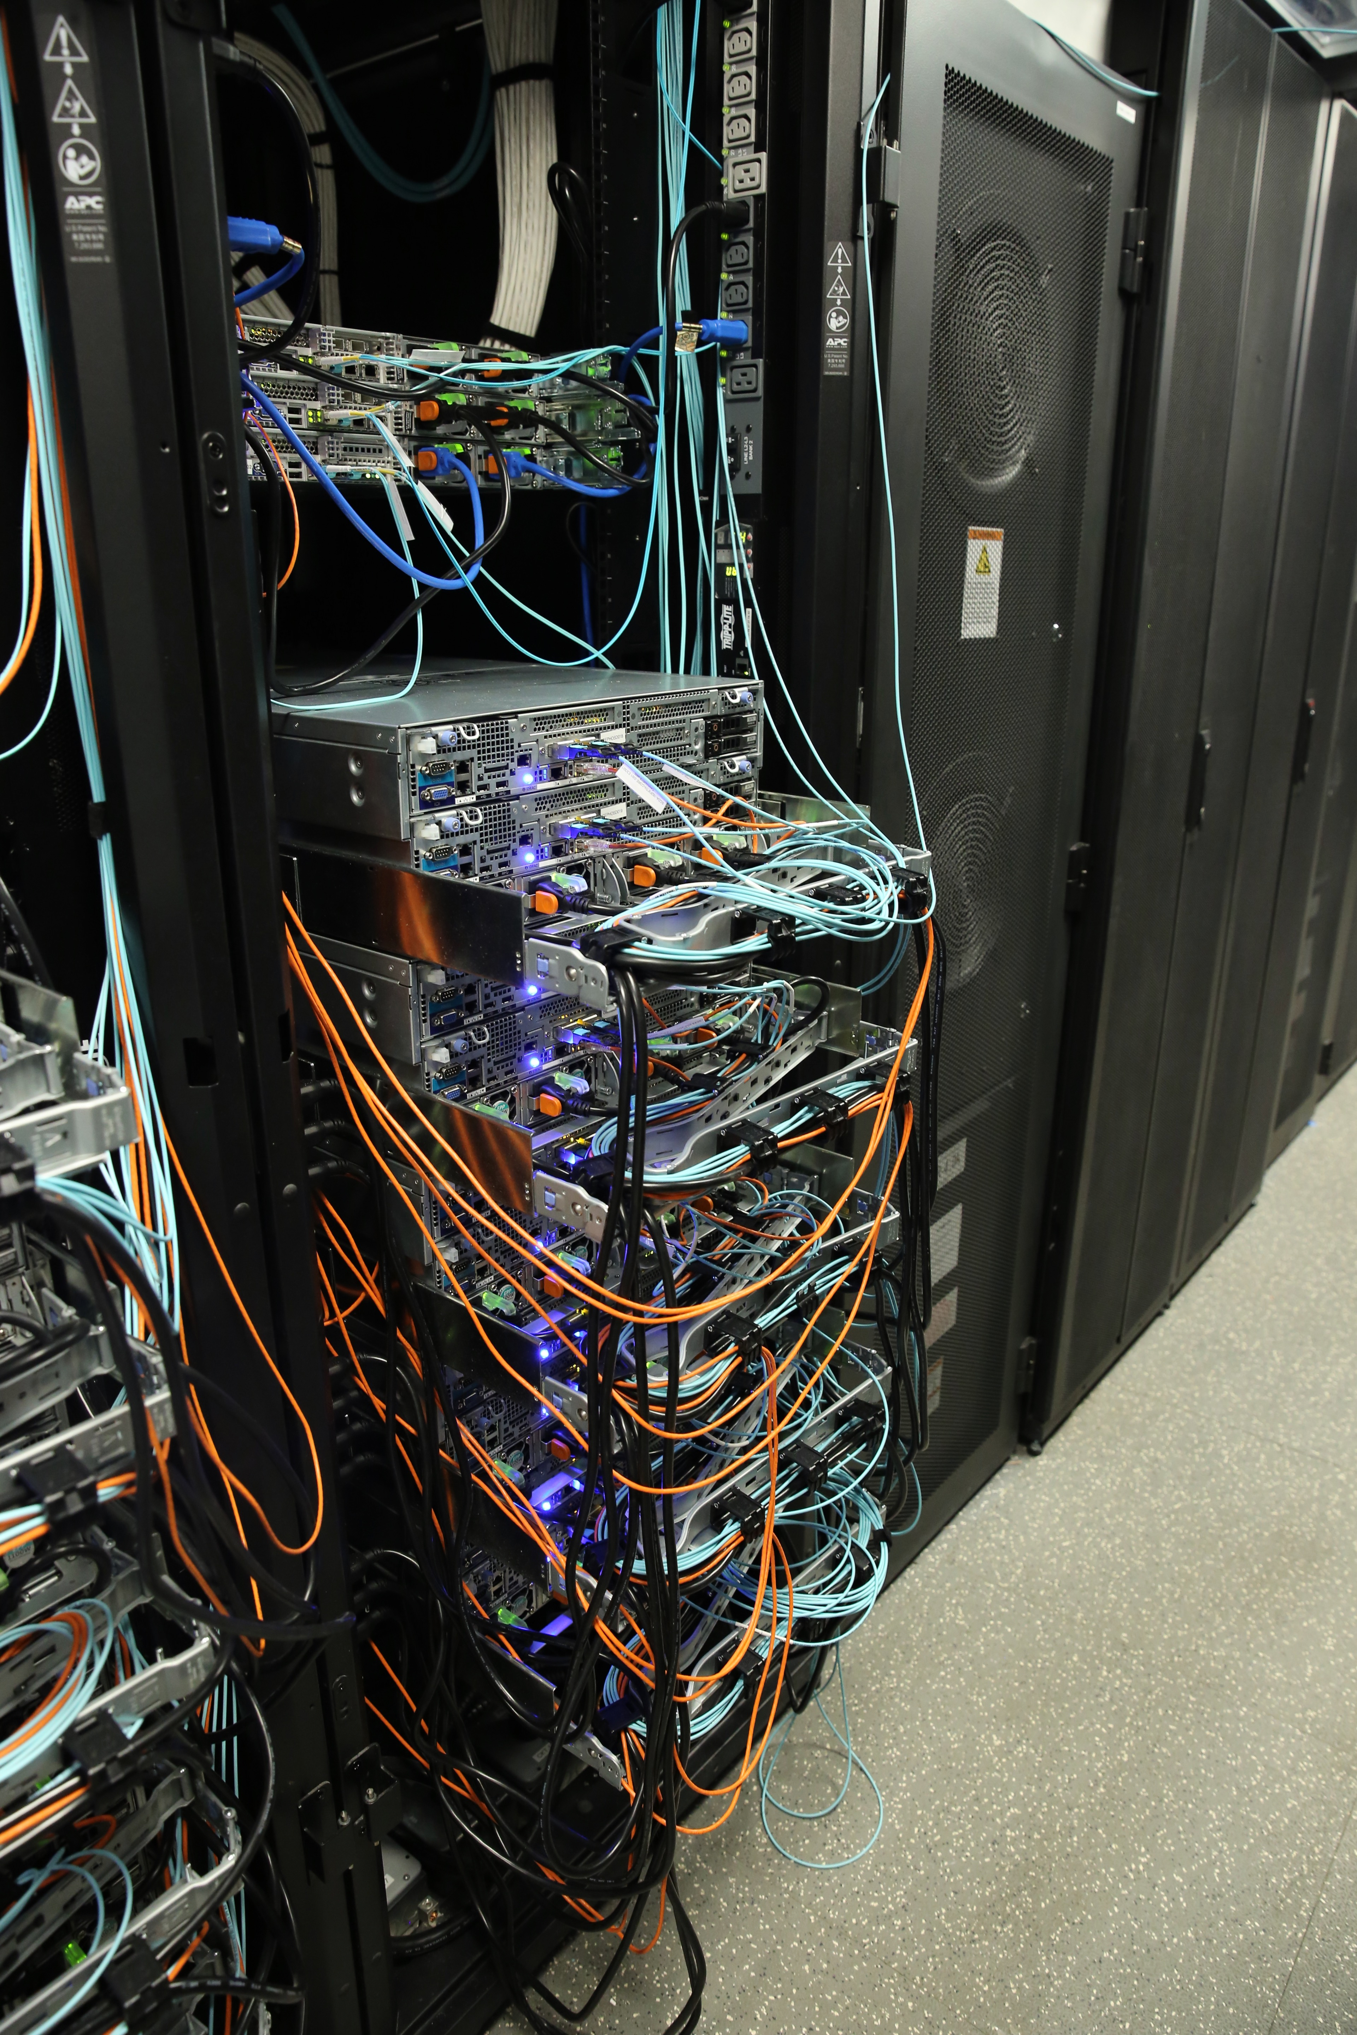
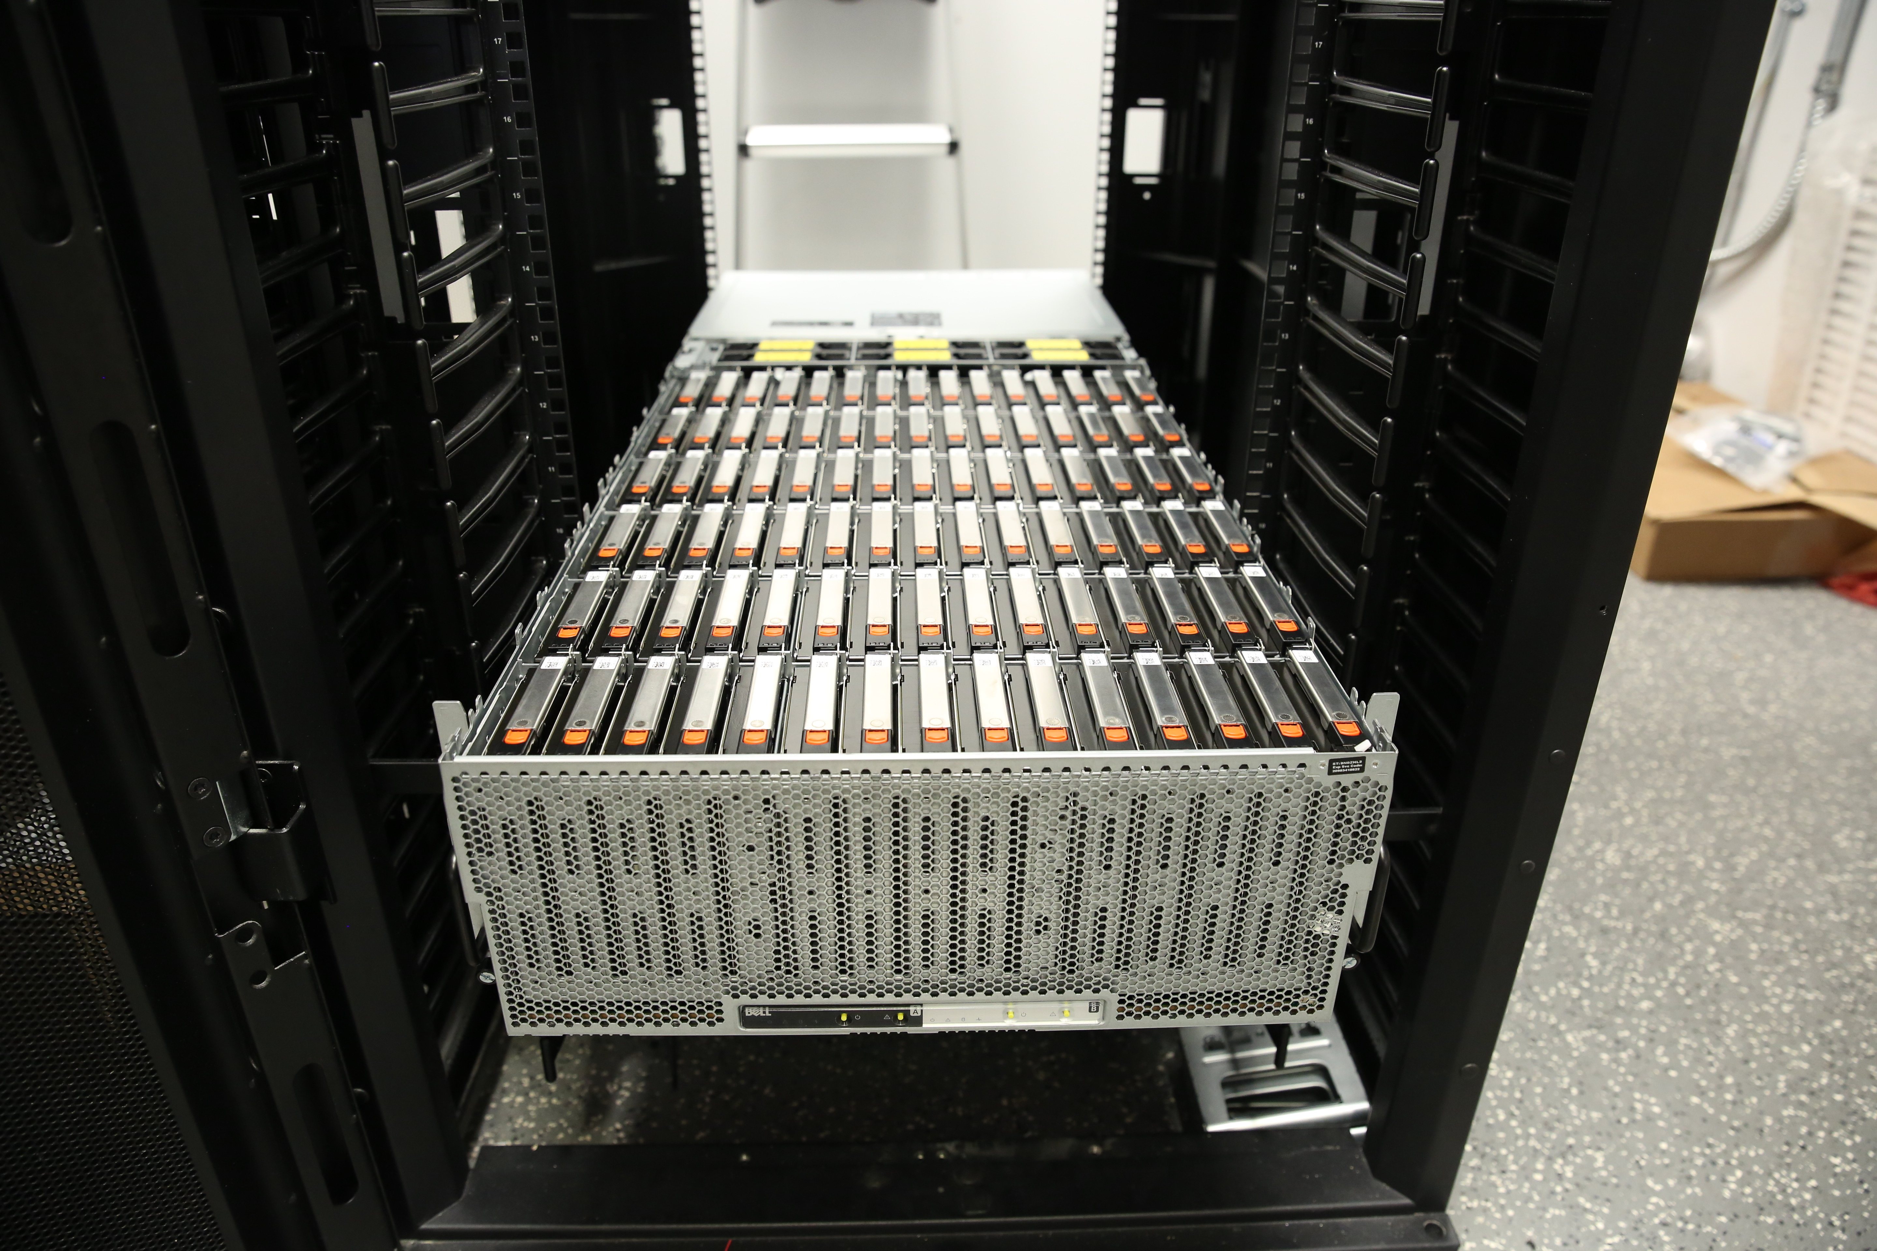
Dealing with Data
We have been using cephfs
  Currently we have almost 20PB of raw disk space
    Mostly triple replicated in ceph
    It’s run with about 0.75FTE

Slide 13
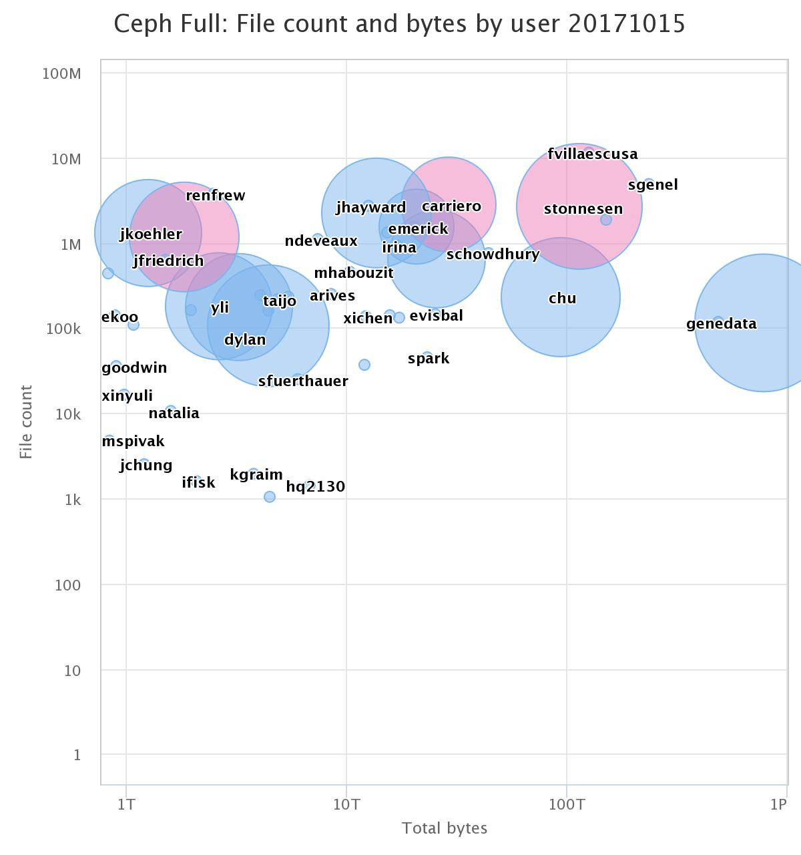
Dealing with Data
About 50% of our space is used genomic sequencing data
  200GB per person in one file
The astronomy simulation uses about 30%
  Many millions of small files

Slide 14
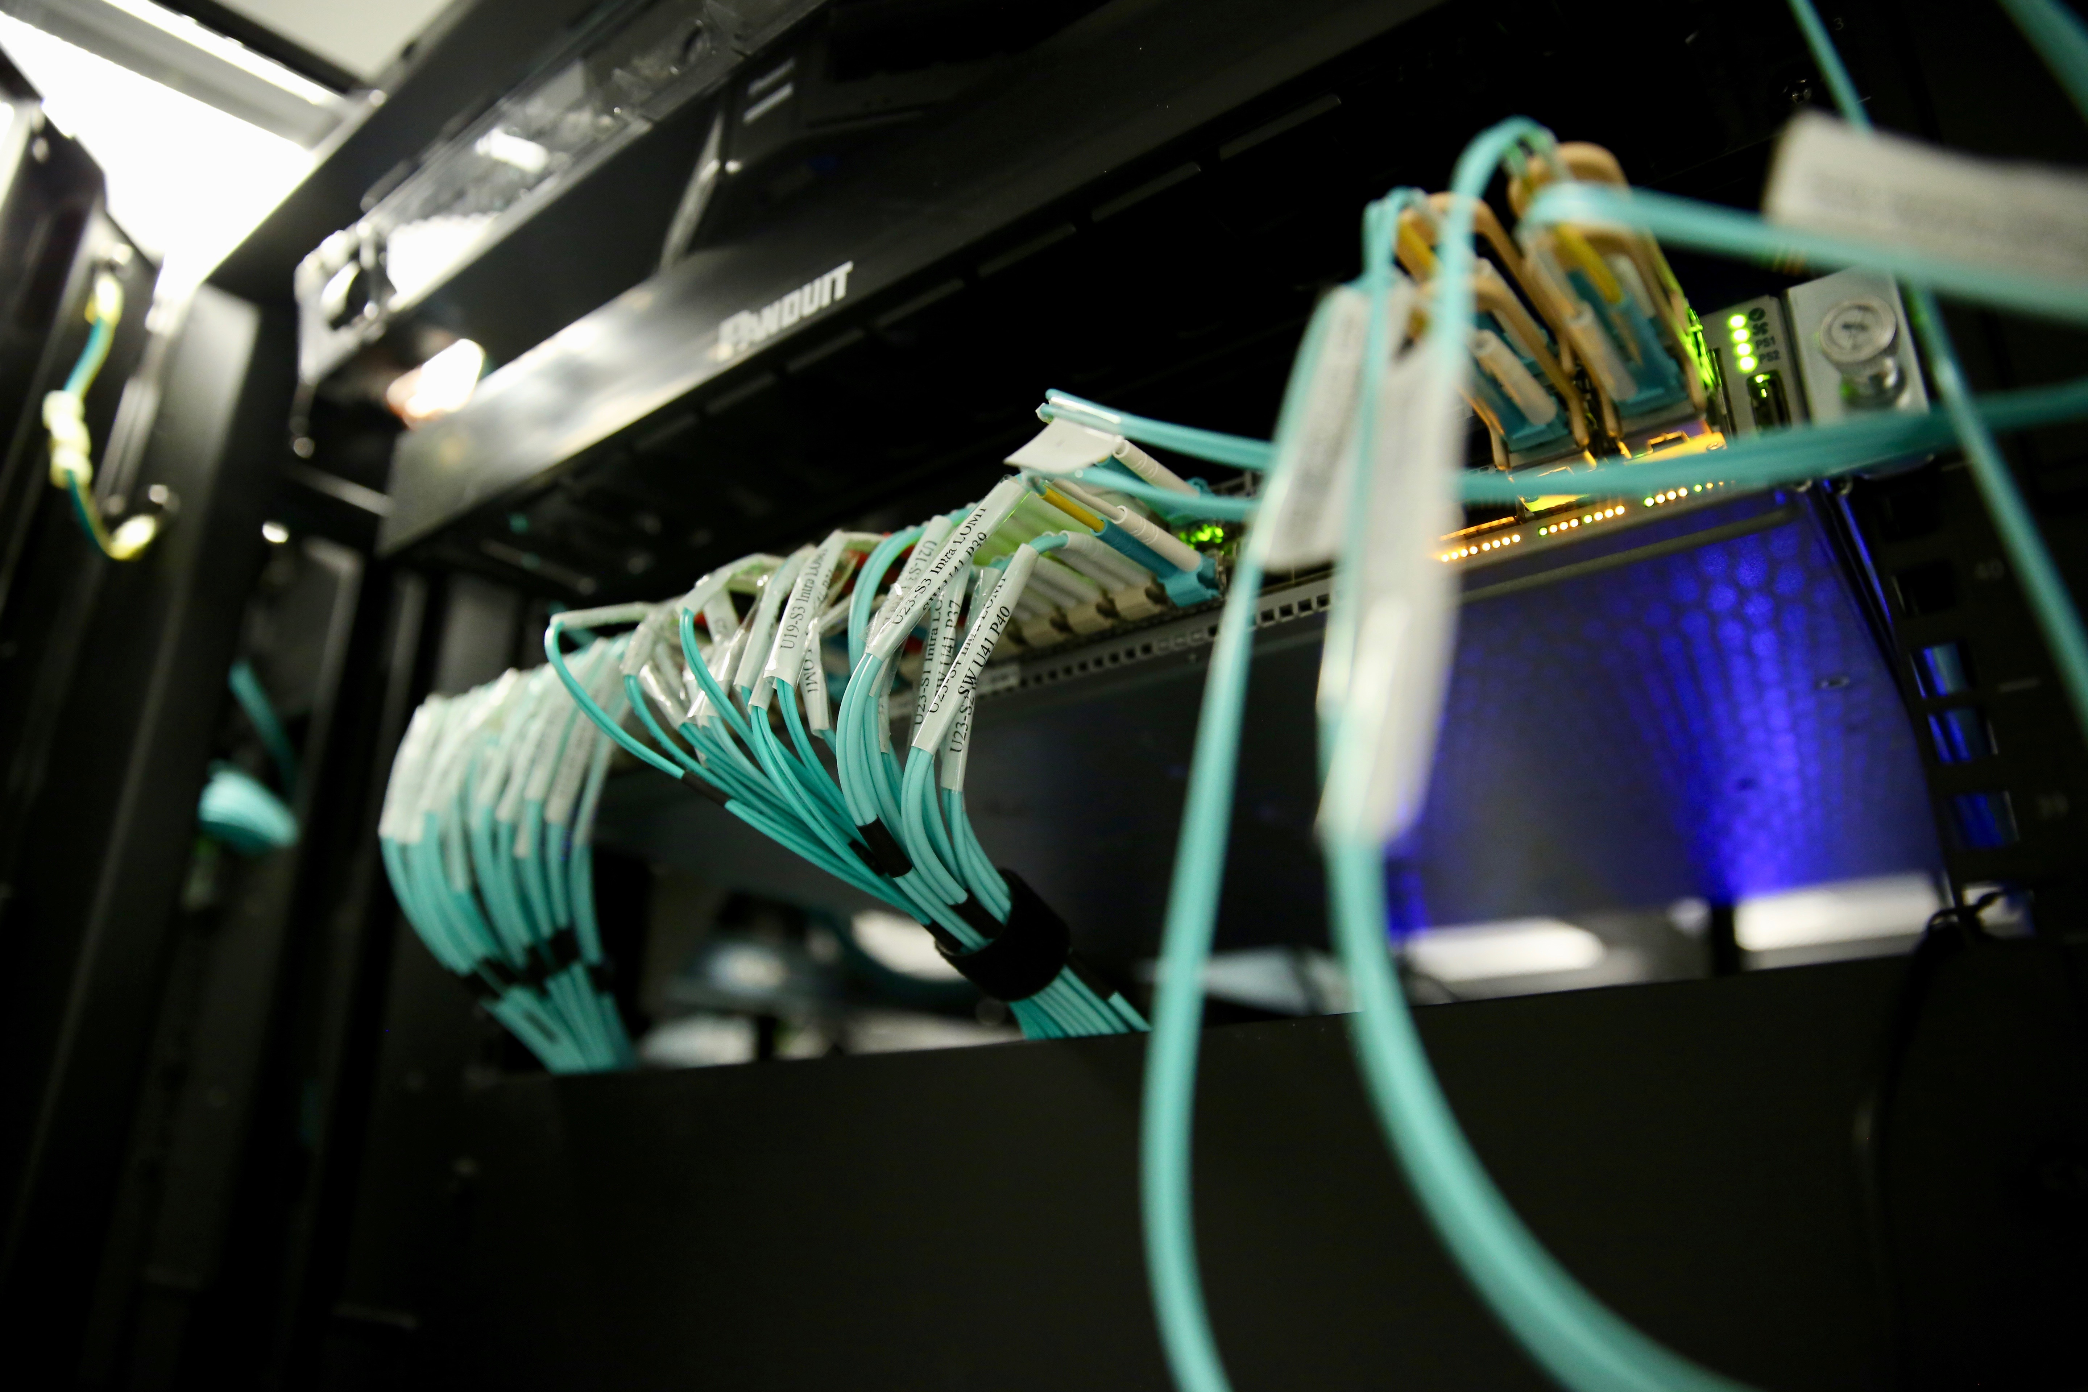
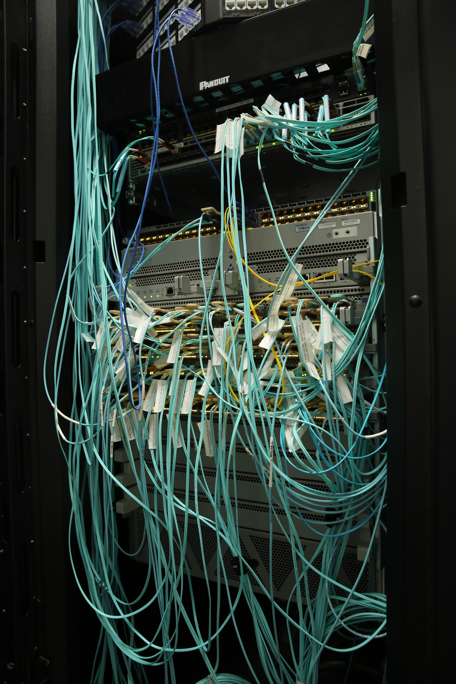
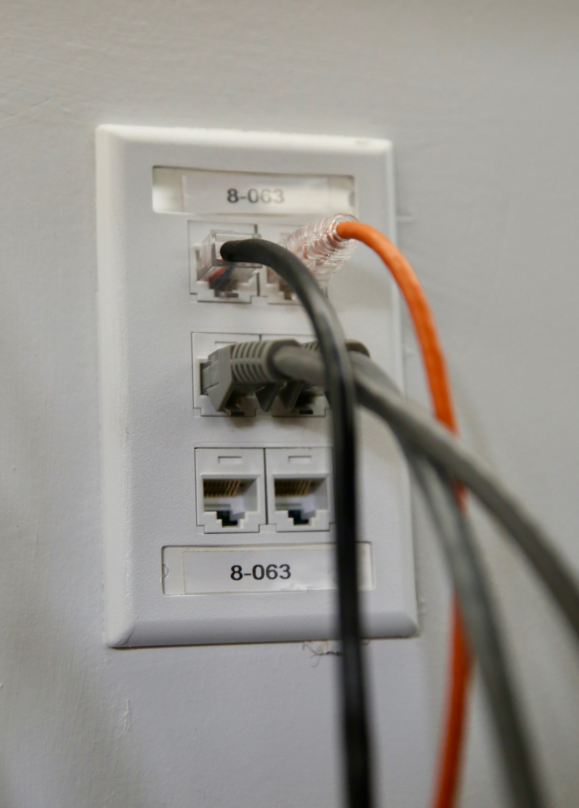
Delivering Data
Flatiron is a purpose built facility
  All office floors and offices are optimized for data access

Slide 15
Archive
If we had implemented our storage system on a non-rewritable media, we would not notice a difference in usage
  Almost nothing is ever removed
  We were ingesting data at 400TB a month during the Fall
The mix of files ranges from millions of tiny files to thousands of 100GB files
  Makes traditional tape solutions for HEP sub-optimal
    We are looking for something that would slower and cheaper than our ceph system to check data into

Slide 16
Sharing
A problem that has come up in all the centers is the desire to share and collaborate on big data samples
  100TB to 3PB sized
We have seen a variety of tools, which generally fall into two camps
  Tools designed to move groups of files around, which are good for replicating entire datasets but little knowledge of the contents
  Tools that are so tightly coupled to the contents that they can select a subset of data, but couldn’t be used for anything than the sample they were designed to handle

Slide 17
Tools
We exposed people to bare globus-url-copy tools
  Data was exported from the FNAL archive directly
    Biggest hassle was handling grid certs
We moved people to globus-online
  Globus sharing tools delegate a lot of authorization to globus so fewer cert issues
    People like it because it’s easy and the performance has been OK
      Has enough functionality to get people into trouble

Slide 18
Challenges of Sharing
The biology community has PBs of datasets that they want to share with 40 labs
  Chunks of data run into the hundreds of TB
    Data samples went up by a factor of 20 in a couple of years
  Most of the destinations are behind firewalls
  Few of the places have any experience with moving large quantities of data
    Transition to trusting the network hasn’t happened yet

Slide 19
Challenges of Sharing
The Astronomers have PBs of simulation that they want to share widely
  It’s some collection of files and often a database for the meta-data
  Each simulation is it’s own ecosysyem
    Every project essentially gets it’s own portal
    Many of the portals are designed to process locally and give distributions
      Rather than export data to process locally
    Even in those that can export the information is chopped into new files

Slide 20
COLLABORATION
Data access and management is an area we would like to get involved in with the the OSG
  Data into stash cache, wide area access to samples, data federation for distribution
    If we had this then expanded into OSG opportunistically would be interesting
  Cross community discussion on data management
    How to think about datasets, trade-offs of immutable files, moving samples around, peer serving of data

Slide 21
OUTLOOK
Supporting multiple sciences is hard
Nearly any amount of computing can be used
I think there are a number of interesting areas for activity thinking about data distribution and access

